Slide 1
Notes:
Figure XXX-1. Identification of a somatic mutation resulting in a motif gain in the Ret promoter by FUN-Seq. Luciferase reporter assays demonstrating transcriptional activity of the wild-type Ret promoter (-440 to +65) as compared to the same promoter containing the A291C mutation in DU145 cells. Results shown are the average of three independent experiments ± SD, and statistical significance was determined by t-test.

Slide 2
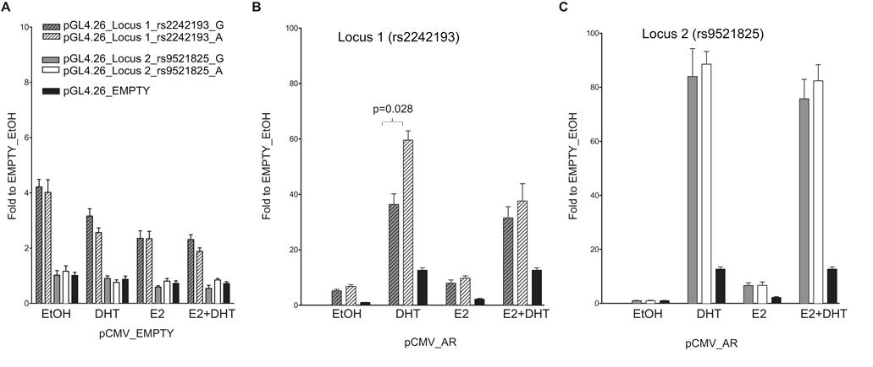
Notes:
Figure XXX-2. The selected locus 1 and locus 2 regulatory regions act as AR-dependent enhancers in the MCF7 cell line. MCF7 cells were co-transfected with pCMV AR vector along with pGL4.26_locus 1 or _locus 2 reporter. Twenty-four hour post-transfection cells were treated for 16 hours with E2, DHT or the combination of the two compounds to stimulate respectively ER- or AR-dependent transcription. Wild-type (dashed- or plain-grey bars) and SNPs rs2242193 or rs9521825 (dashed- or plain-white bars) containing constructs were tested. Indicated is the percentage value of statistical relevant differences (Student's t-test).

Slide 3
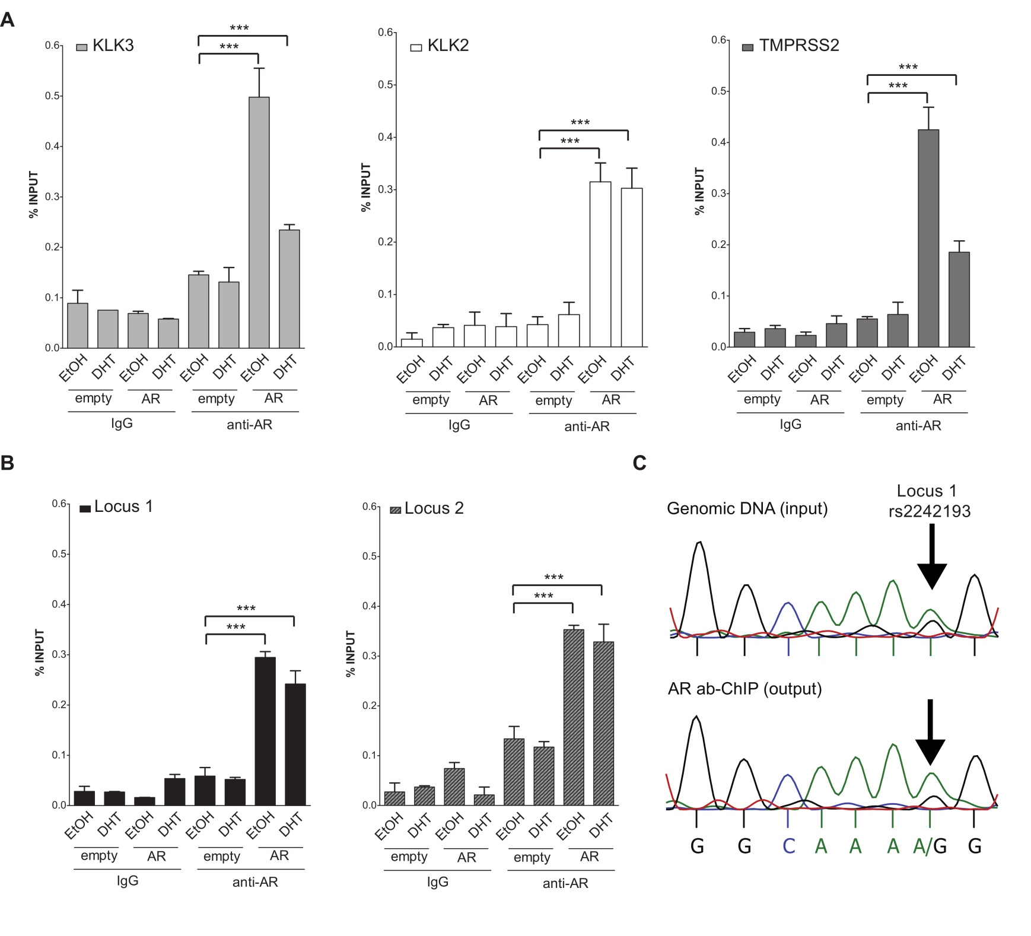
Notes:
Figure XXX-3. Both locus 1 and locus 2 are directly bound by AR. ChIP-qPCRs were performed in MCF7 cells (heterozygous for SNP rs2242193 within locus 2) to determine AR chromatin binding at locus 1 and locus 2 regions (presented respectively as black and grey-patterned bars, respectively). Mean ± s.d. of three technical replicates were plotted. *p<0.05, .**p<0.01, ***p<0.005, Student's t-test.

Slide 4
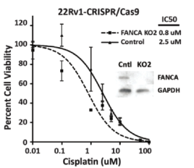
Notes:
Figure XXX-4. Cisplatin sensitivity in 22Rv1 cells following genome editing of FANCA (KO1) or a control sequence by CRISPR Inset:Western blot of FANCA and GAPDH expression in indicated cell lines.

Slide 5
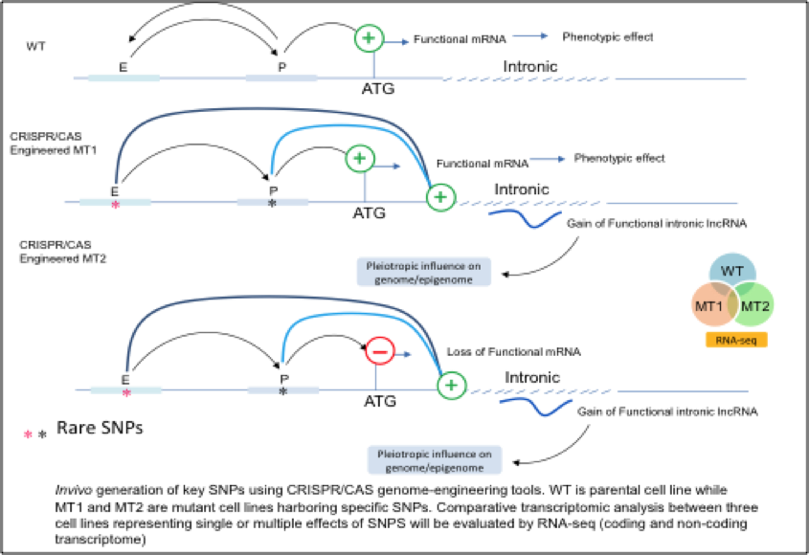
Notes:
Fig XXX-5

