Slide 1
ExAC TPRs

Slide 2
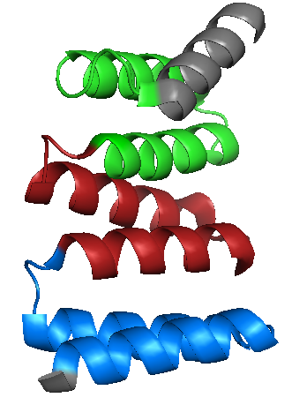
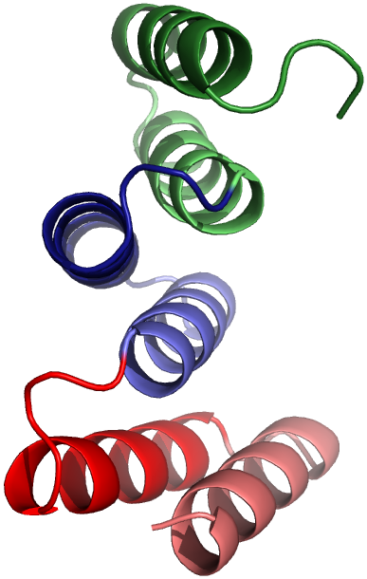
Hypervariability and conservation in human TPRs
Protein 1
TPR
TPR
TPR
Humans
Protein 2
TPR
TPR
TPR
Protein 3
TPR
TPR
TPR
Align
TPR
TPR
TPR
TPR
TPR
TPR
TPR
TPR
TPR
A1
B1
Notes:
Motif alignment across all TPRs from all species

Slide 3
Hypervariability and conservation in human TPRs
Protein 1
TPR
TPR
TPR
Humans
Protein 2
TPR
TPR
TPR
Protein 3
TPR
TPR
TPR
Align
TPR
TPR
TPR
TPR
TPR
TPR
TPR
TPR
TPR
34aa x 3 (positions 1-102)
In tandem (0 gaps btw TPR)
Notes:
Motif alignment across all TPRs from all species

Slide 4
AC/FLY at pos58 (pos24) in a 3TPR
PDB: 3SZ7, SGT2 protein from Aspergillus fumigatus
No structures solved with FLY58 and N74
Sawyer*, Chen*, Regan. J Mol Biol. (2013)
Notes:
Take only the 3TPRs
--split AC
--split FLY (pos58 instead of pos24)

Slide 5
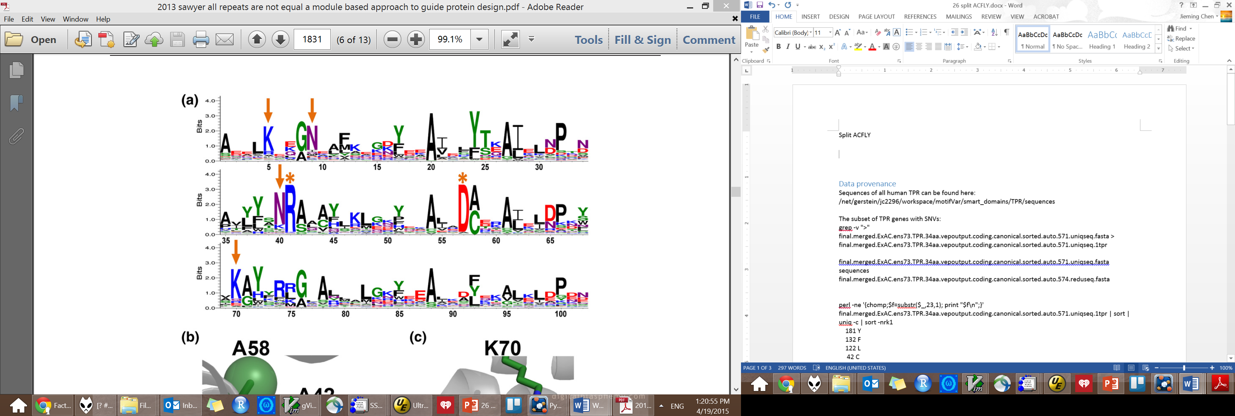
AC/FLY at pos58 (pos24) in a 3TPR
AC58
FLY58
Sawyer*, Chen*, Regan. J Mol Biol. (2013)
Notes:
Take only the 3TPRs
--split AC
--split FLY (pos58 instead of pos24)

Slide 6
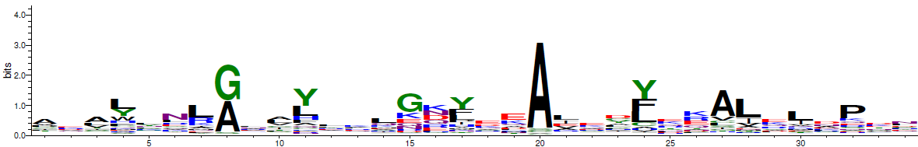
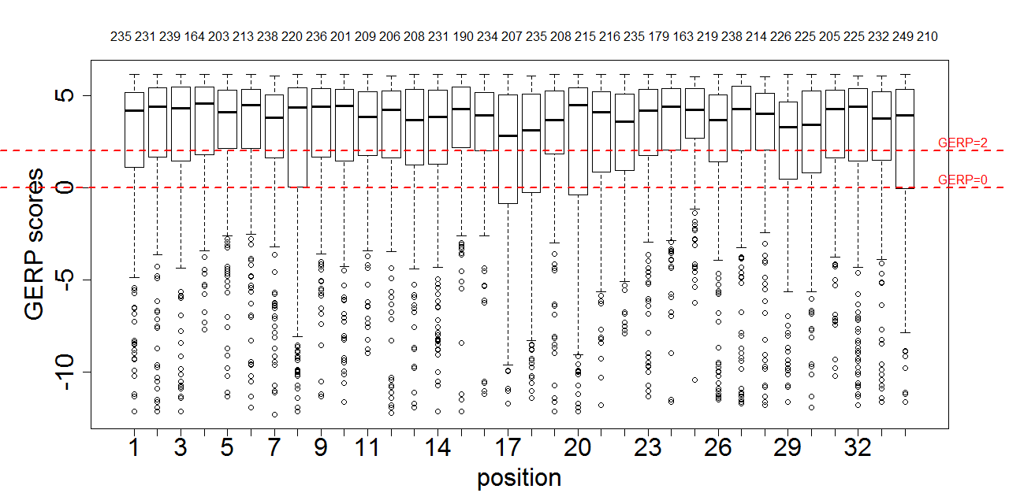
181 Y
132 F
122 L
42 C
19 H
18 A
16 V
15 I
7 G
3 W
3 S
3 Q
3 M
3 E
1 T
1 R
1 P
1 N
435 1TPR sequences
5670 SNVs

Slide 7
181 Y
132 F
122 L
42 C
19 H
18 A
16 V
15 I
7 G
3 W
3 S
3 Q
3 M
3 E
1 T
1 R
1 P
1 N
435 1TPR sequences
5670 SNVs
136 1TPR sequence 1659 SNVs

Slide 8
671 1TPR sequences
181 Y
132 F
122 L
42 C
19 H
18 A
16 V
15 I
7 G
3 W
3 S
3 Q
3 M
3 E
1 T
1 R
1 P
1 N
435 1TPR sequences
5670 SNVs; 166₃₄|83_{ns,s}
136 1TPR sequence 1659 SNVs; 48₃₄|24_{ns,s}
60 1TPR sequence
748 SNVs; 22₃₄|11_{ns,s}

Slide 9
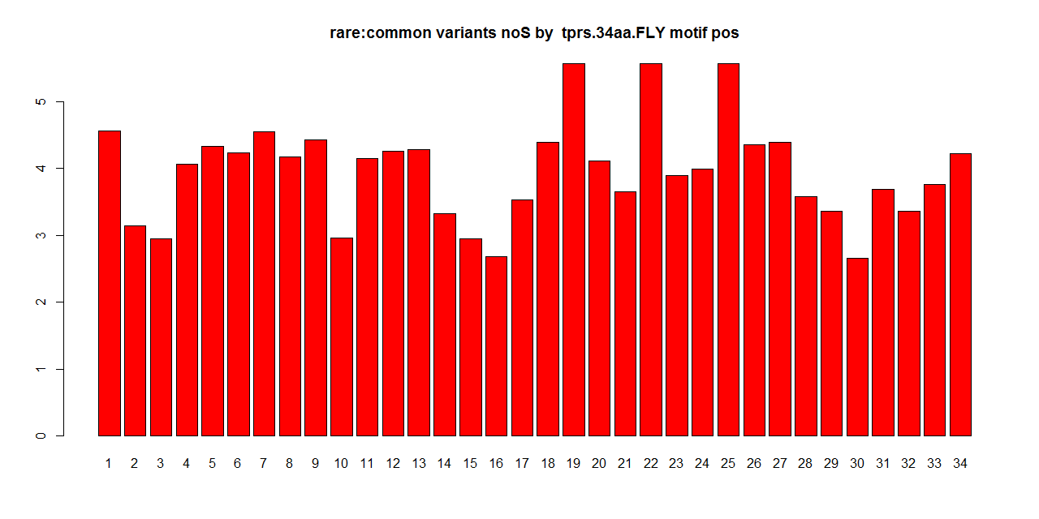
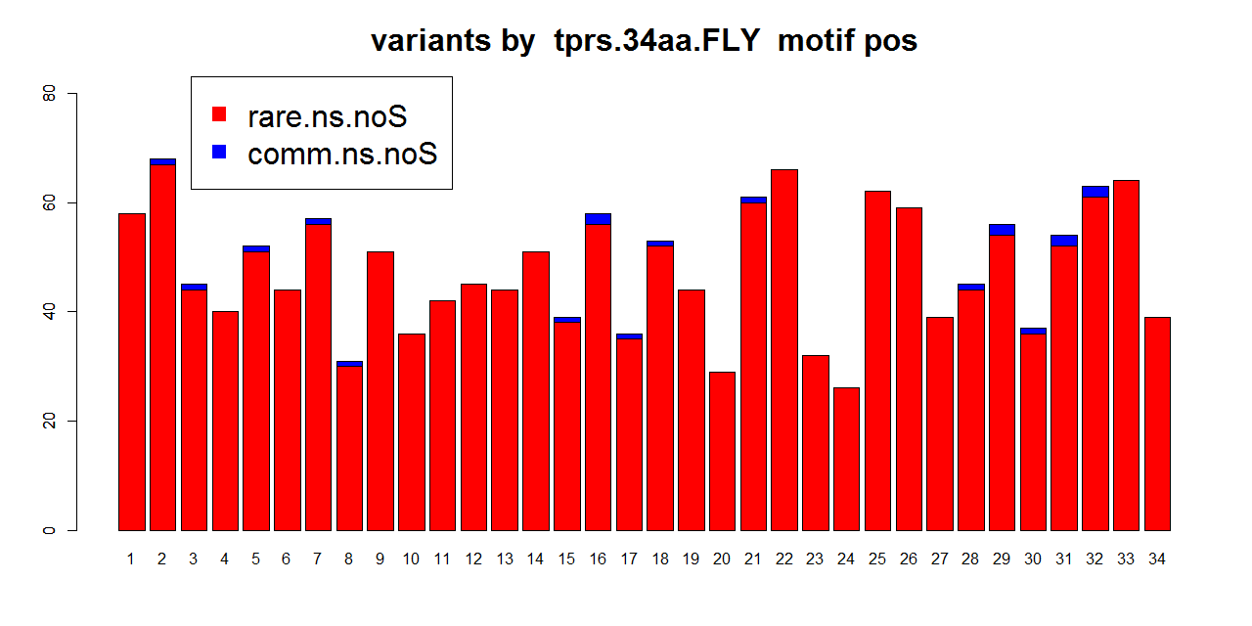
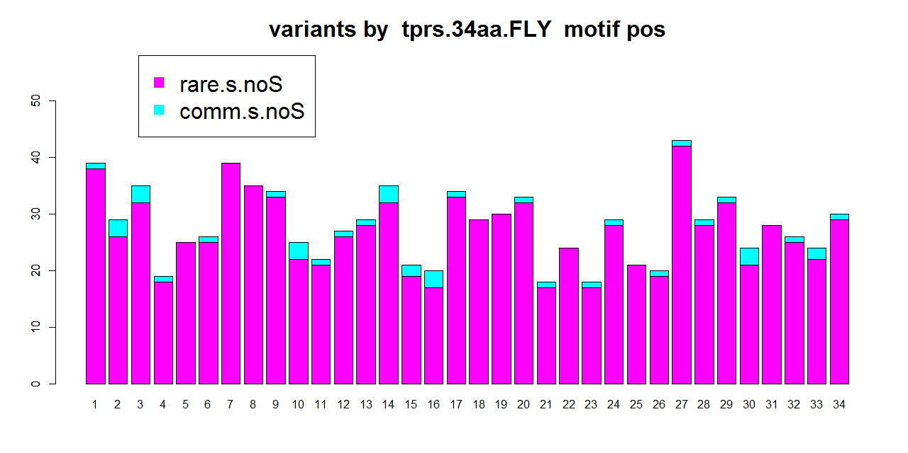
FLY
R:C
435 1TPR sequences
5670 SNVs; 166₃₄|83_{ns,s}

Slide 10
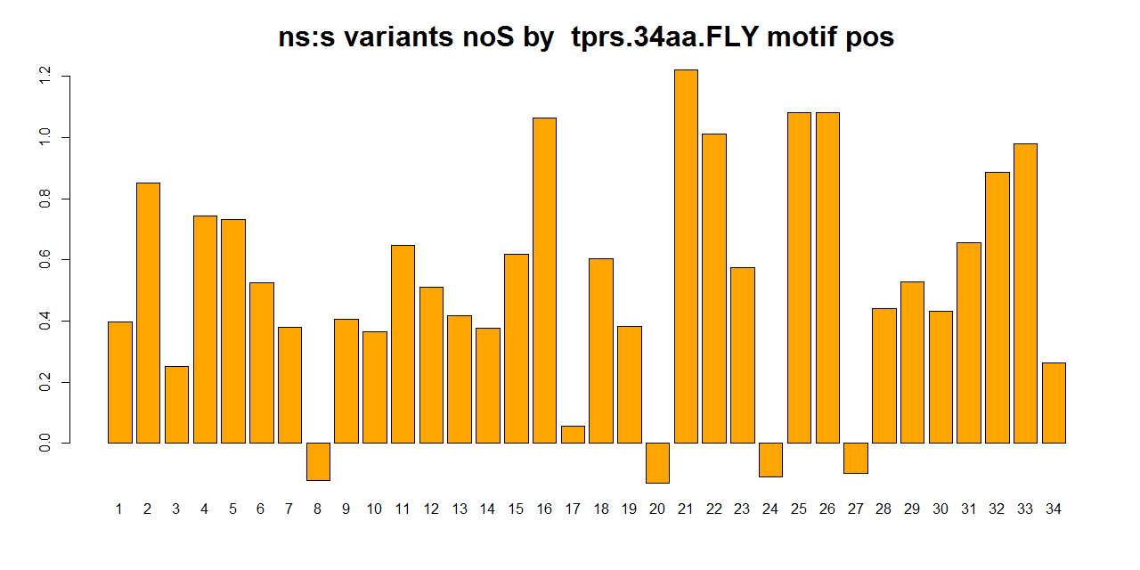
FLY
NS:S

Slide 11
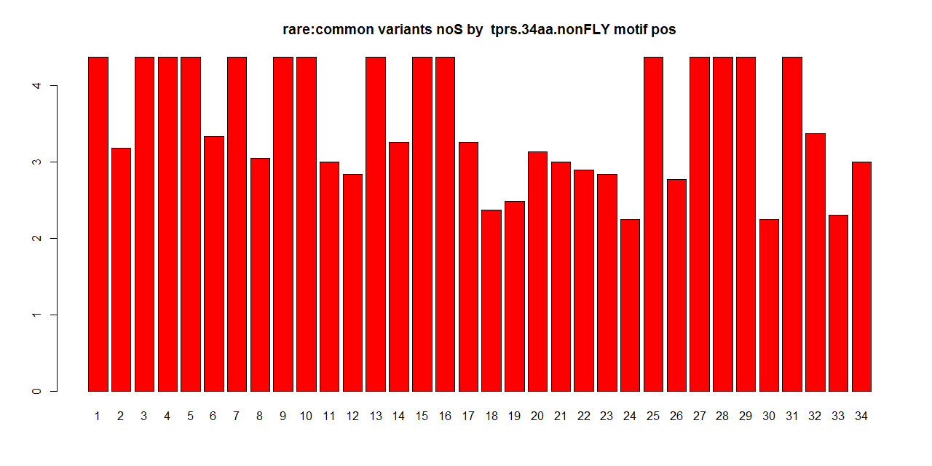
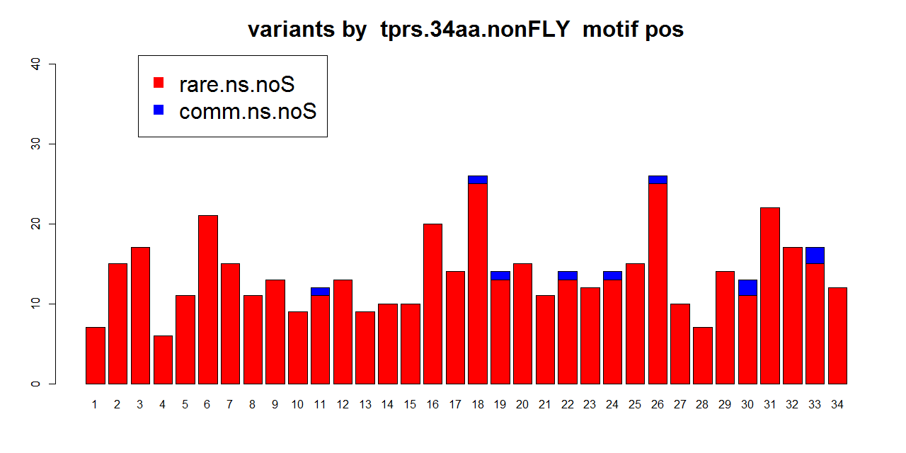
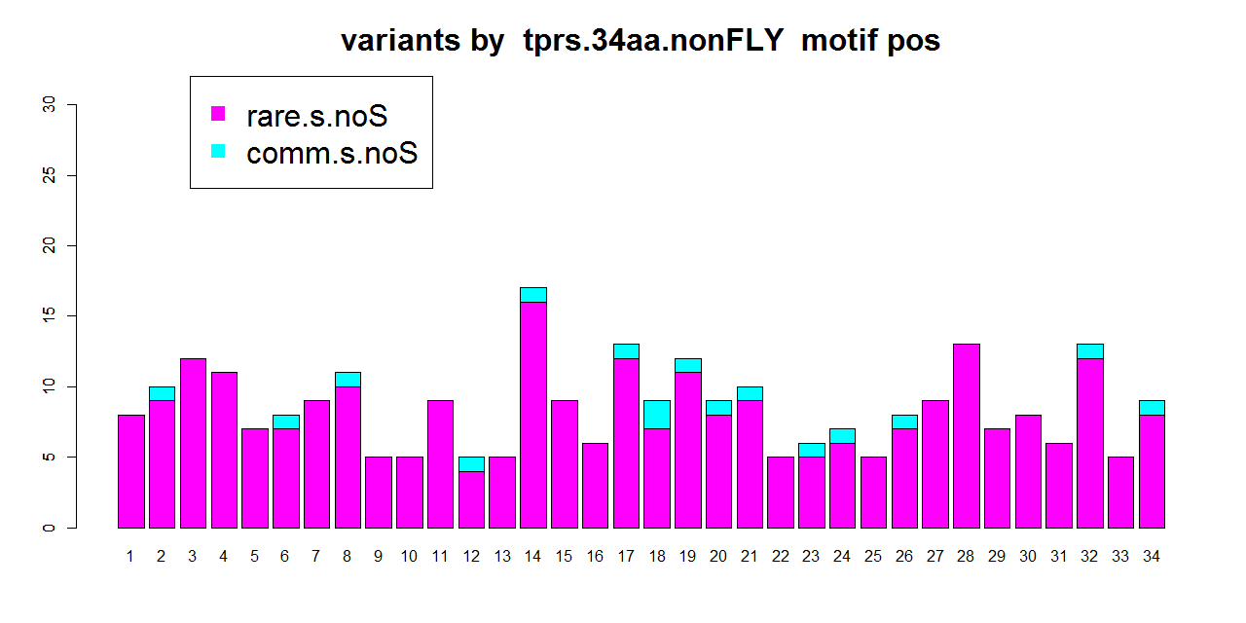
nonFLY
R:C
136 1TPR sequence 1659 SNVs; 48₃₄|24_{ns,s}

Slide 12
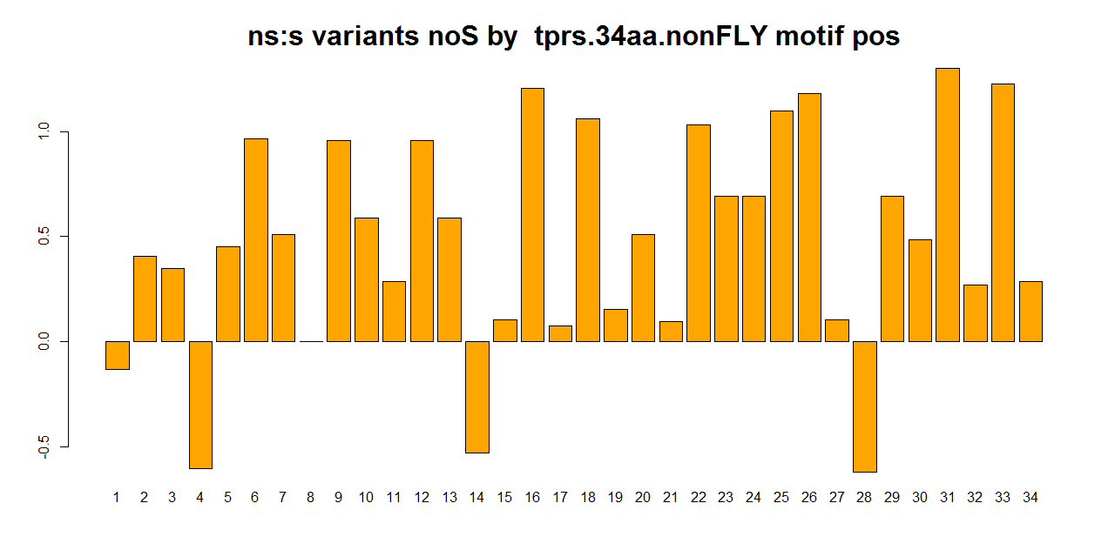
nonFLY
NS:S
136 1TPR sequence 1659 SNVs; 48₃₄|24_{ns,s}

Slide 13
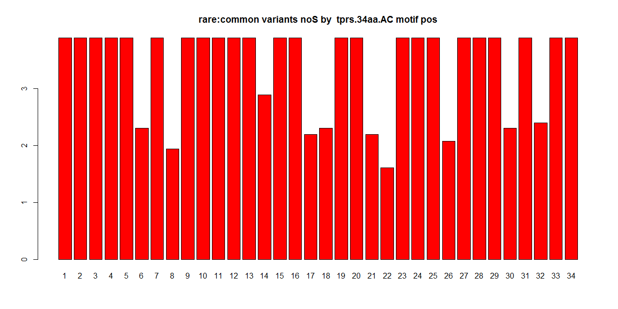
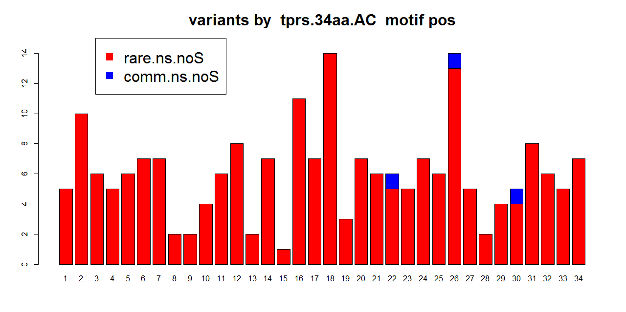
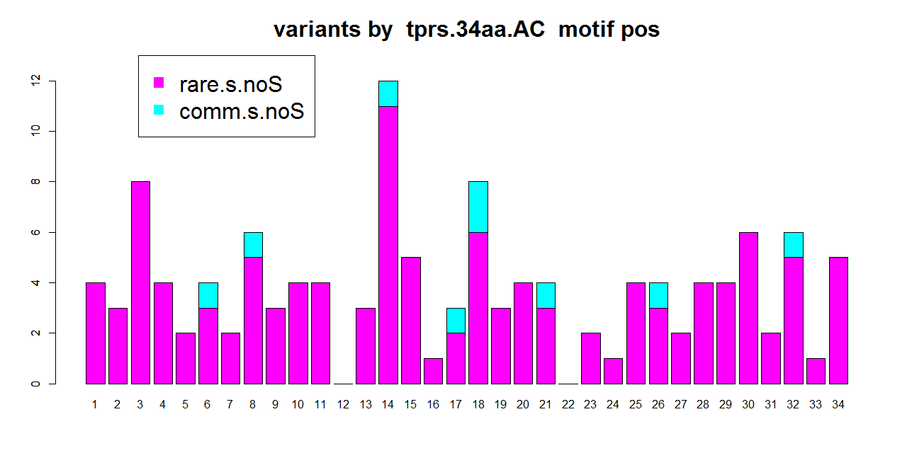
AC
R:C
60 1TPR sequence
748 SNVs; 22₃₄|11_{ns,s}
Notes:
Small Numbers…

Slide 14
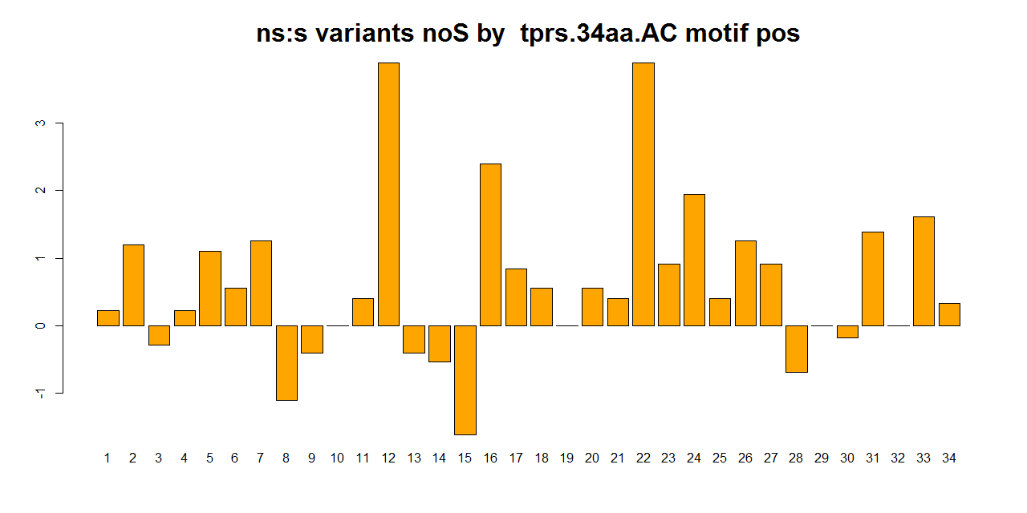
AC
NS:S
60 1TPR sequence
748 SNVs; 22₃₄|11_{ns,s}
Notes:
Small Numbers…

