Slide 1
PrivaSeq Figure Pack
May 5, 2015

Slide 2

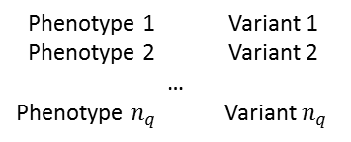




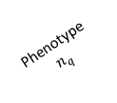

Fig 1a: Linking Attack Scenario
Phenotype Dataset
Phenotype-Genotype
Correlation Dataset
Genotype Dataset
Disease Status
(HIV+/-)
Identity
(Name)
Variant Genotypes
Phenotype
$$n_{q}$$
$$ρ_{1}$$
Phenotype 1
Phenotype 1 Variant 1
Phenotype 2 Variant 2
…
Phenotype $n_{q}$ Variant $n_{q}$
Phenotype 1
$$ρ_{2}$$
Variant 1
Variant 2
Variant
$$n_{q}$$
HIV+
…
JR
…
HIV-
…
$$ρ_{q}$$
AH
…
…
…
…
HIV-
…
MG
Genotype
Prediction
Genotype Comparison and Matching
Disease Status
(HIV+/-)
Predicted Variant
Genotypes
Identity
(Name)
Disease Status
(HIV+/-)
Predicted/Matched Genotypes
Variant 1
Variant 2
Variant
$$n_{q}$$
Variant 1
Variant 2
Variant
$$n_{q}$$
…
MG
HIV+
…
HIV+
HIV-
JR
HIV-
…
…
…
…
HIV-
AH
HIV-
Notes:
Link expression+phenotype database to genotype+identity database to reveal phenotypes of
Link the phenotype + Identity.

Slide 3





















Fig 1b: Datasets
Genotype Matrix
Expression Matrix
$$n_{v}$$
$$n_{e}$$
$$v$$
$$e$$
$$j$$
$$j$$
$$l$$
$$n_{q}$$
$$n_{q}$$
$$k$$
$$v_{k,j }^{}$$
$$k$$
$$e_{k,j }^{}$$
$$j$$
$$v_{k,j }^{}$$
$$E_{k}$$
$$\sim V_{k}$$
$ρ(E_{k},V_{k})$
eQTL Dataset
$$e_{k,j }^{}$$
$${\sim E}_{k}$$
1
2
$$V_{k}$$
0

Slide 4




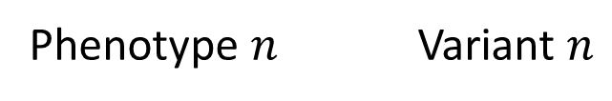

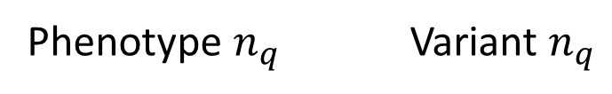

Fig 2a
Phenotype
Measurements for Individual j
Sort P-G correlations in decreasing order
Select the top variants to predict
Predict the Genotypes for
Individual j
$$ρ_{1}$$
Phenotype 1 Variant 1
Joint Predictability of Genotypes:
$$ρ_{2}$$
$$π\left(V_{1},V_{1},…,V_{n} | Phenotypes\right)$$
Phenotype 2 Variant 2
…
Characterizing Information:
Decreasing Correlation
$$ρ_{k}$$
$$\text{ICI}\left(V_{1},V_{1},…,V_{n}\right)$$
Phenotype $n$ Variant $n$
…
$$ρ_{q}$$
Phenotype $n_{q}$ Variant $n_{q}$

Slide 5




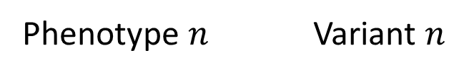


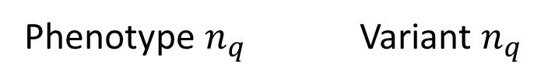

Fig 2a
$$ρ_{1}$$
Phenotype 1 Variant 1
Decreasing Joint Predictability
of Genotypes
$$ρ_{2}$$
$$π\left(V_{1},V_{1},…,V_{n} | Phenotypes\right)$$
Phenotype 2 Variant 2
…
Decreasing Correlation
$$ρ_{k}$$
Phenotype $n$ Variant $n$
…
Increasing Individual
Characterizing Information
$$ρ_{q}$$
Phenotype $n_{q}$ Variant $n_{q}$
$$\text{ICI}\left(V_{1},V_{1},…,V_{n}\right)$$
$${|ρ}_{1}\left|>{|ρ}_{2}\right|>…>{|ρ}_{q}|$$

Slide 6
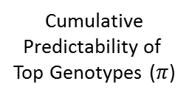




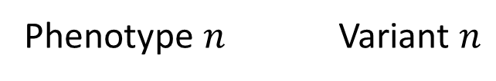



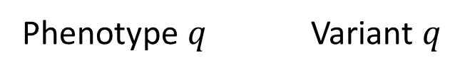
Fig 2a
Individual
Characterizing
Information in Top
Genotypes (ICI)
$$ρ_{1}$$
Cumulative
Predictability of
Top Genotypes ($π$)
Phenotype 1 Variant 1
$$ρ_{2}$$
Phenotype 2 Variant 2
…
$$ρ_{k}$$
Phenotype $n$ Variant $n$
Increasing
$$\text{ICI}\left(V_{1},V_{1},…,V_{n}\right)$$
Decreasing
$$π\left(V_{1},V_{1},…,V_{n} | Phenotypes\right)$$
…
$$ρ_{q}$$
Phenotype $q$ Variant $q$
$${|ρ}_{1}\left|>{|ρ}_{2}\right|>…>{|ρ}_{q}|$$

Slide 7
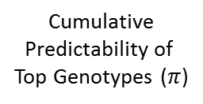
Fig 2a
Individual
Characterizing
Information in Top
Genotypes (ICI)
$$ρ_{1}$$
Cumulative
Predictability of
Top Genotypes ($π$)
Phenotype 1 Variant 1
$$ρ_{2}$$
Phenotype 2 Variant 2
…
$$ρ_{k}$$
Phenotype $n$ Variant $n$
Increasing
$$\text{ICI}\left(V_{1},V_{1},…,V_{n}\right)$$
Decreasing
$$π\left(V_{1},V_{1},…,V_{n} | Phenotypes\right)$$
…
$$ρ_{q}$$
Phenotype $q$ Variant $q$
$${|ρ}_{1}\left|>{|ρ}_{2}\right|>…>{|ρ}_{q}|$$

Slide 8
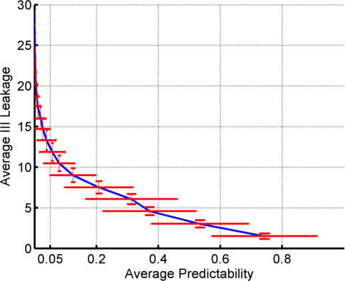
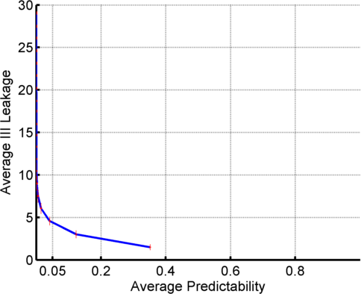
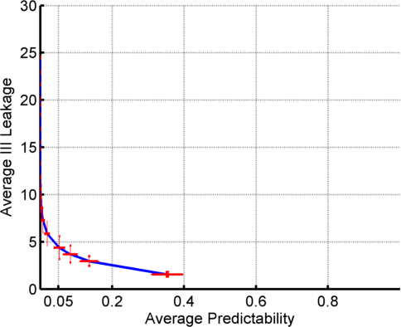
Fig 2bcd: Predictability vs Information leakage

Slide 9
Fig 3: 3 Steps of Linking Attack
Gender, Population, Age
eQTL
Dataset
Auxiliary Information
Phenotype Selection
Genotype Prediction
Linking
Absolute Value of Correlation
Maximum a Posteriori Genotype
Individual whose genotypes have the closest match to predicted genotypes

Slide 10
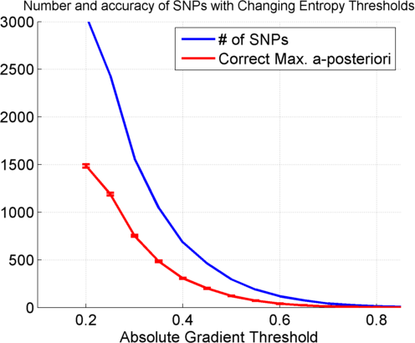
Figure 4a: MAP Genotype Prediction Accuracy

Slide 11
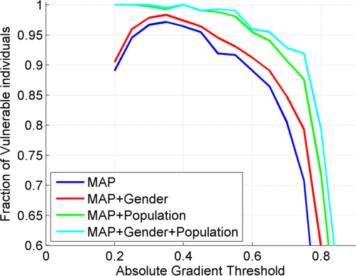
Fig 4b: Fraction of Vulnerable Individuals

Slide 12
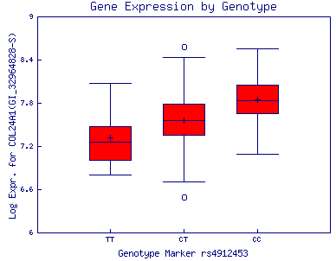
Fig 5a: Extremity based genotype prediction
Frequency
Expression
Lower expression:
Most likely TT
Higher expression:
Most likely CC

Slide 13
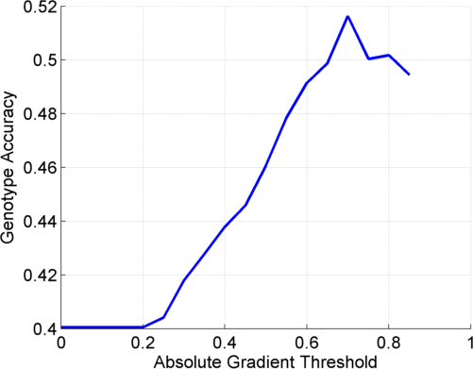
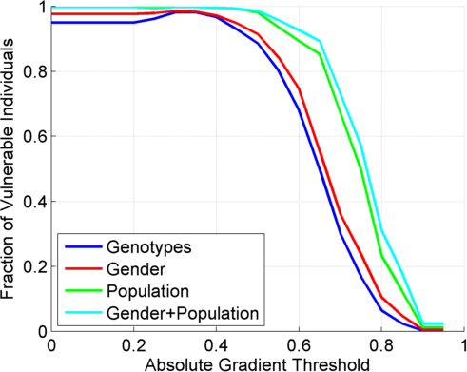
Fig 5bc
Notes:
Per SNP accuracy. TBA: Add the population panels and show how the accuracy increases.

Slide 14
Supplementary Figures

Slide 15
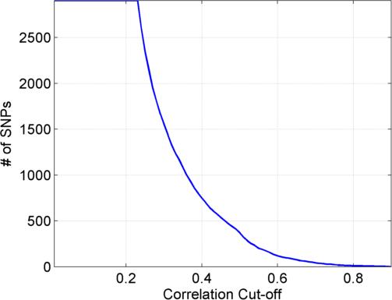
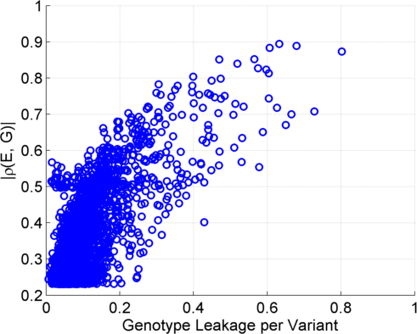
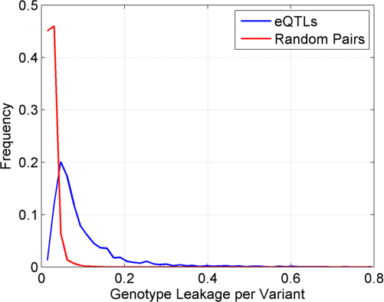
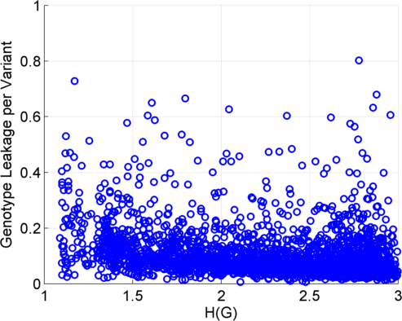
Fig S1: eQTL properties
Notes:
Total Information Content: Predictability vs Discriminability. TBA: Gender information, more datasets,
[[Add gender and race information, and finally accuracy of extremity attack with changing thresholds]]

Slide 16
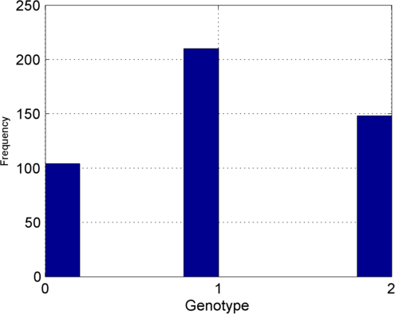
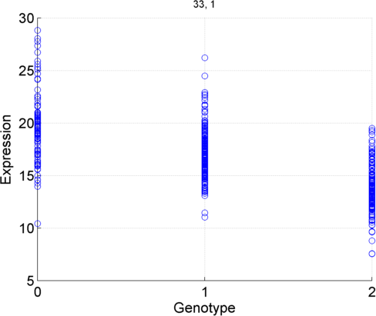
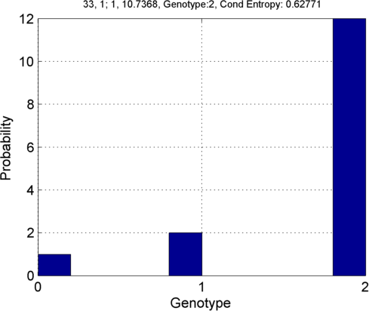




Fig SXX: Illustration of a priori, a posteriori distributions
Posterior:
  Prior: $p\left(V_{k} \right)$
  Joint: $p\left(V_{k}, E_{k}\right)$
  $$p\left(V_{k} | E_{k}=10\right)$$
$${v′}_{k,j}^{}=2$$

Slide 17





Figure SXX: Genotype Prediction
Conditional (Posterior):
  Prior: $p\left(V_{k} \right)$
  Joint: $p\left(V_{k}, E_{k}\right)$
  $$p\left(V_{k} | E_{k}=e_{k}=10\right)$$
$${v′}_{k,j}^{}=1$$
$${v′}_{k,j}^{}=2$$

Slide 18
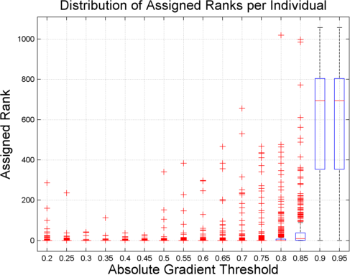
Figure SXX

Slide 19
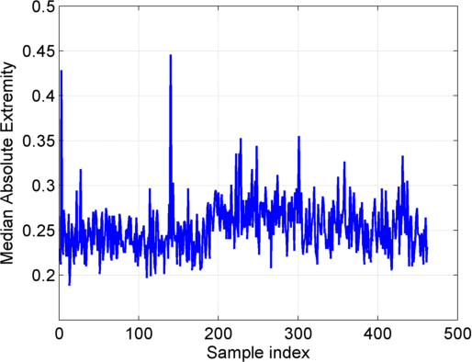
Fig SXX
Notes:
Extremity statistics of the per samples.
TBA: Replace with box plots?
TBA: Similarly, add the extremity of the genotypes, i.e., what is the frequency of each multi-snp genotype?
[[How extreme each sample is among all the eQTLs that we have, this relates better to individual identification]]

