Slide 1
ExAC in TPRs

Slide 2
Recap
SNVs found in binding sites in protein-protein interactions (PPI) are important
Since many protein motifs mediate PPI, we focus on finding binding sites in PPI domains -- an example is protein repeat domain: tetratricopeptide repeat (TPR)
Strategy
Obtain list of repeat (e.g. TPR) and non-repeat domains (e.g. PDZ)
Do a multiple sequence alignment
Identify hypervariable positions and highly conserved positions
Do these positions fall into binding pockets in available PDB structures?
SNVs falling onto these positions are assessed whether they are non-synonymous and deleterious (using SIFT and BLOSUM score)

Slide 3
Hypervariability and conservation in human TPRs
Protein 1
TPR
TPR
TPR
Humans
Protein 2
TPR
TPR
Protein 3
TPR
TPR
TPR
TPR
Align
TPR
TPR
B1
A1
B1
A1
Notes:
Motif alignment across all TPRs from all species

Slide 4
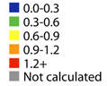
Mapping onto known PDB structures
Magliery & Regan, BMC Bioinformatics, 2005
Hypervariable
Conserved sites
B1
A1
B1
A1

Slide 5
Previous data was 1KG.ESP6500
 | 1KG.ESP6500
Num of individuals (chrs) | 7,592 (15,184)
# auto SNVs (incl. singletons) | 2,159
# auto SNVs (excl. singletons) | 889 (1,270;59%)
#chrs: Rare 0.5% | 76
Notes:
for i in combined-1KG.ESP6500.snps.nonmono.smartDomain2gPos.TPR.34aa.bed*; do echo $i ; awk '{OFS="\t"}{FS="\t"}{print $1"-"$2"-"$3}' $i | sort | uniq | egrep -v "chrX|chrY" | wc -l ; done
OR
awk '{OFS="\t"}{FS="\t"}{if($1 != "chrX" && $1 != "chrY"){print $1"-"$2"-"$3}}' ExAC.r0.3.sites.snps.pass.mod.ens73.TPR.34aa.bed | sort | uniq | wc –l

Slide 6
Compare ExAC with 1KG.ESP6500
 | 1KG.ESP6500 | ExAC | Fold change
Num of individuals (chrs) | 7,592 (15,184) | 60,706 (121,412) | 8
# auto SNVs (incl. singletons) | 2,159 | 7,359 | 3.4
# auto SNVs (excl. singletons) | 889 (1,270;59%) | 3,342 (4,017;55%) | 3.8
#chrs: Rare 0.5% | 76 | 607
Notes:
for i in combined-1KG.ESP6500.snps.nonmono.smartDomain2gPos.TPR.34aa.bed*; do echo $i ; awk '{OFS="\t"}{FS="\t"}{print $1"-"$2"-"$3}' $i | sort | uniq | egrep -v "chrX|chrY" | wc -l ; done
OR
awk '{OFS="\t"}{FS="\t"}{if($1 != "chrX" && $1 != "chrY"){print $1"-"$2"-"$3}}' ExAC.r0.3.sites.snps.pass.mod.ens73.TPR.34aa.bed | sort | uniq | wc –l

Slide 7
NS and AF
Selection within a single human species population

Slide 8
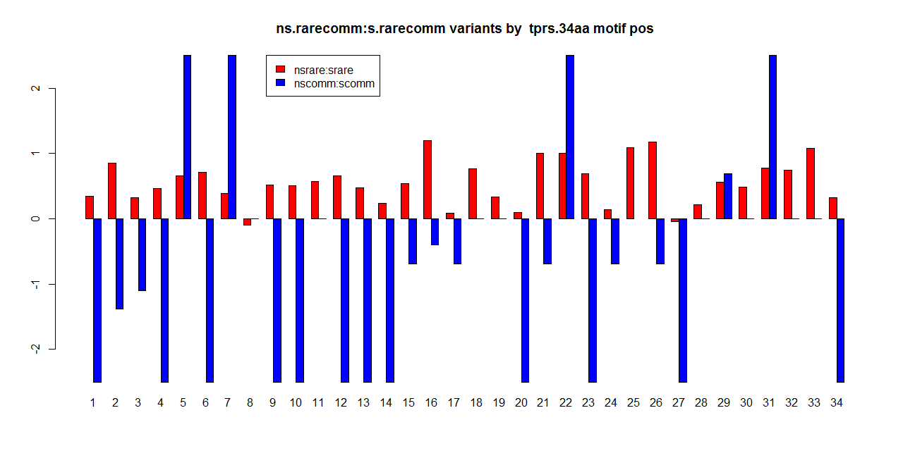
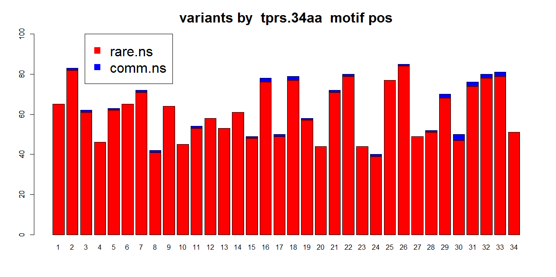
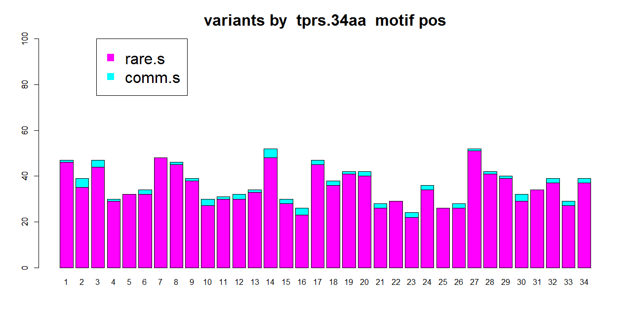

Slide 9
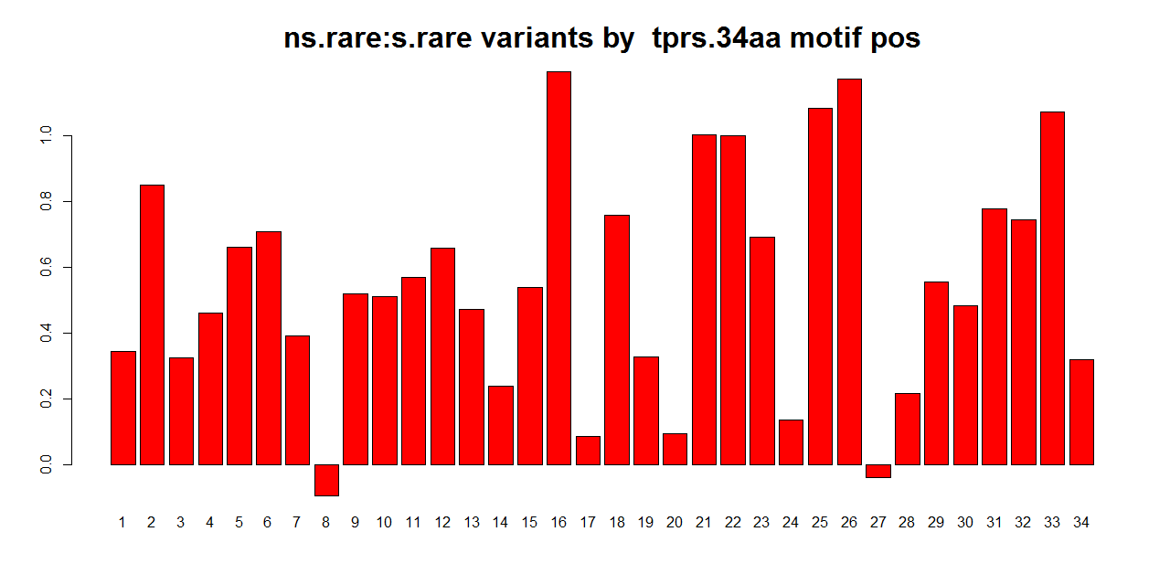

Slide 10
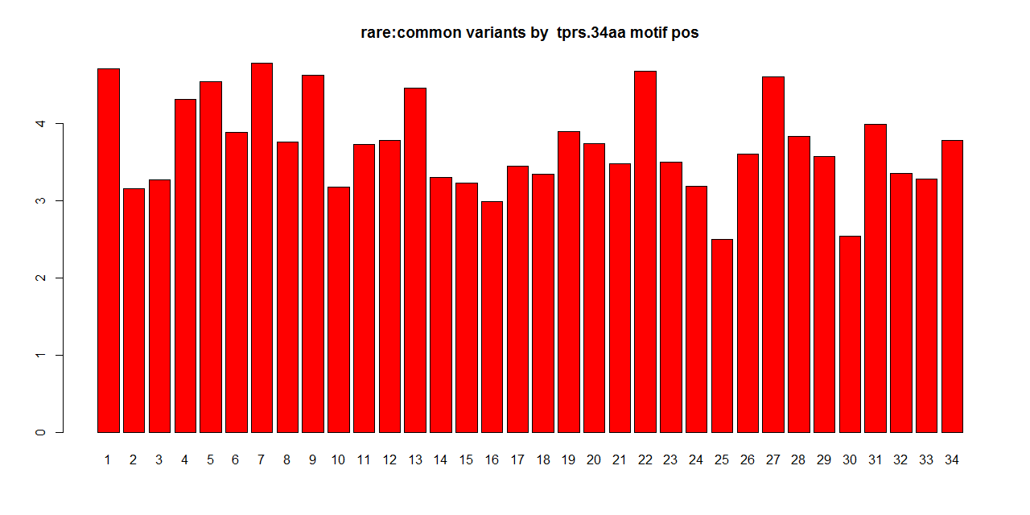
Rare2comm ratio

Slide 11
Rare.NS 2 comm.NS

Slide 12
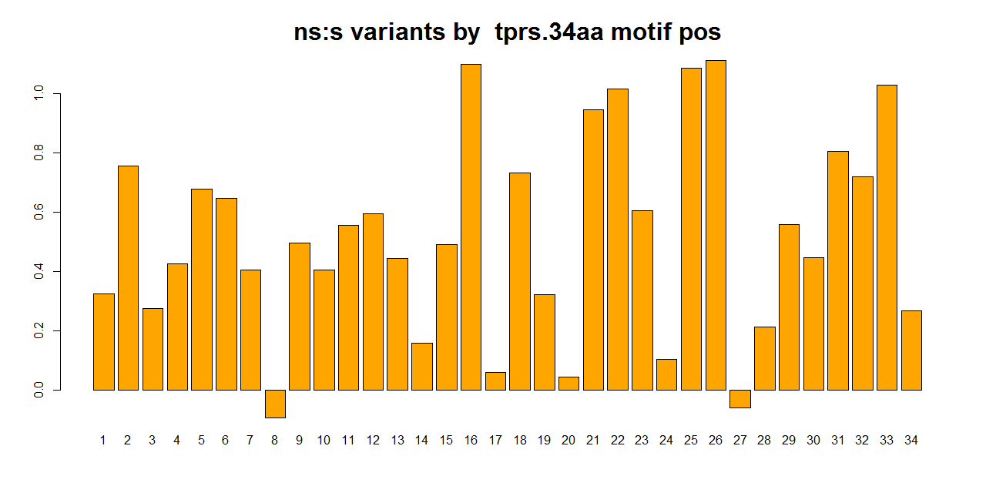
Ns2s ratio

Slide 13
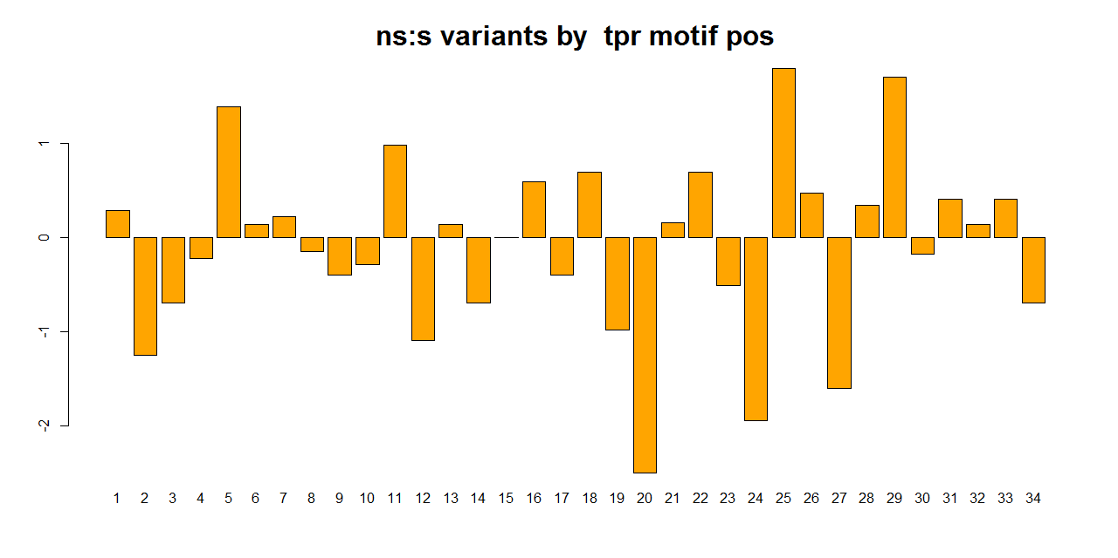
Log ratio of NS:S
Notes:
Depletion of ns?

Slide 14
Ns2s ratio: Rank sequence by conservation
20 8 24 11 27 15 17 4 28 16 7 32 26 30 19 6 21 23 10 3 14 29 1 25 18 34 31 5 33 22 12 13 9 2

Slide 15
Decide conserved and hypervariable positions
concave
convex
PDB:1ELW
20 8 24 11 27 15 17 4 28 16 7 32 26 30 19 6 21 23 10 3 14 29 1 25 18 34 31 5 33 22 12 13 9 2

Slide 16
Ns2s ratio
20 8 24 11 27 15 17 4 28 16 7 32 26 30 19 6 21 23 10 3 14 29 1 25 18 34 31 5 33 22 12 13 9 2

Slide 17
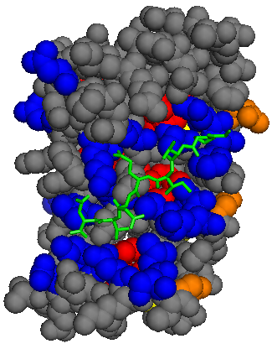
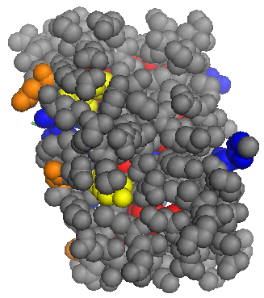
Ns2s ratio
20 8 24 11 27 15 17 4 28 16 7 32 26 30 19 6 21 23 10 3 14 29 1 25 18 34 31 5 33 22 12 13 9 2
Notes:
NS2S rato > check NS mutations : all hets? > BLOSUM score
Almost all, except 2
AC_Adj AC_Het
183 179 L>M
3479 2989 R>Q

Slide 18
Sequence identities and BLOSUMs
Impact of aa change in local alignments across multiple species

Slide 19
BLOSUM62

Slide 20
Sequence identity among human TPR sequences

Slide 21
Notes:
All BLOSUM matrices seem similar
Between BLOSUM 30 to BLOSUM 62 from sequentially divergent to sequentially more conserved
Conserved positions concentrated with BLOSUM scores of 0s (more neutral) and 4/5s (probably dominated by synonymous changes)
Nothing much in the hypervariable positions
Pos 24 and 34 seem to be able to accommodate a large spread of aa changes; weird on pos24
Pos 28 has high number of positive aa changes accommodated (high S?)

Slide 22
Notes:
Between BLOSUM 30, BLOSUM 62
What if we take away S?
NS changes concentrate around neutral or <neutral/deleterious changes in general in both matrices
Pos20 in BLOSUM 62 concentrates on neutral aa changes, while BLOSUM 30 has positive aa changes → why?
But it seems that physicochemical changes do not show as much information as conservation
What are these changes? Heatmaps….

Slide 23
Condel, PolyPhen and SIFT
Deleteriousness of aa change using protein orthology and impact of change

Slide 24
1-SIFT
Notes:
1-SIFT

Slide 25
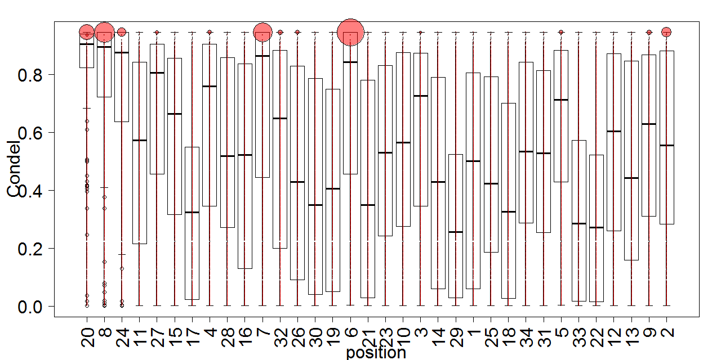
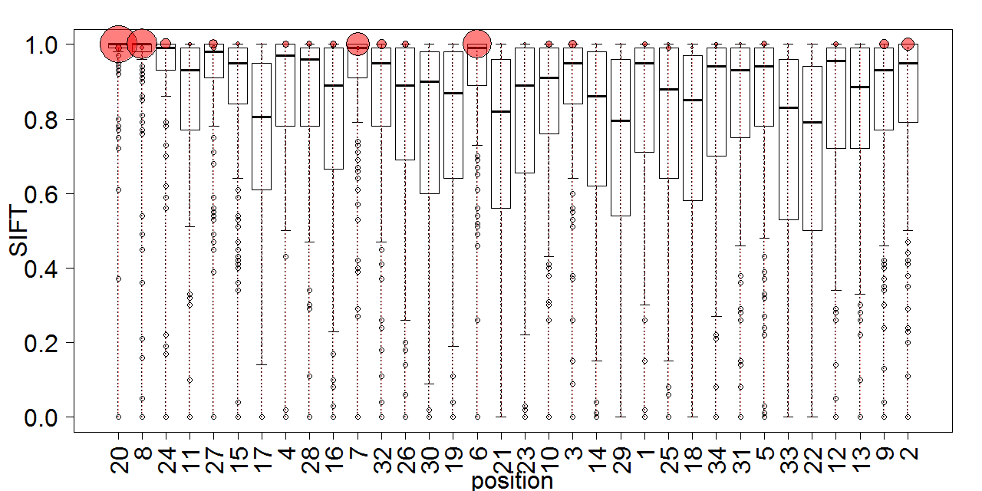
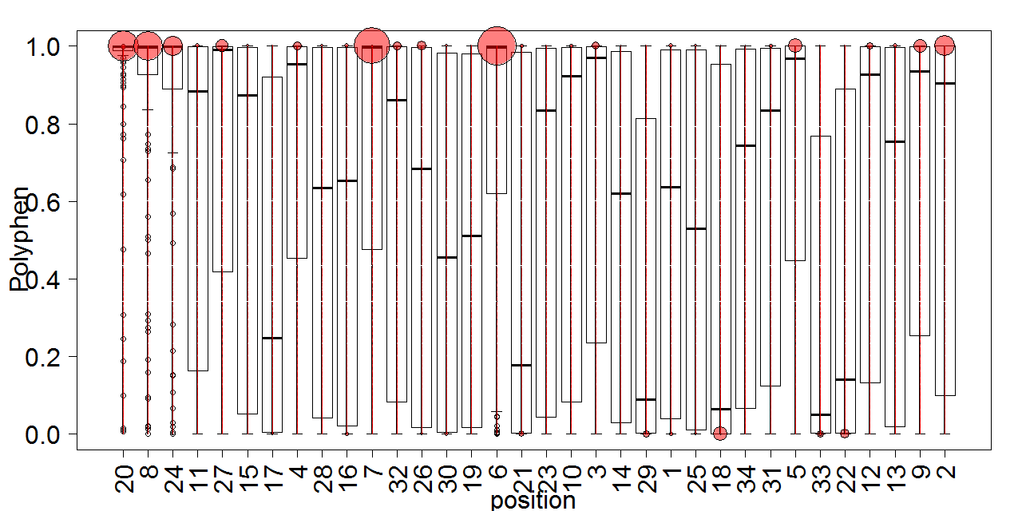
Functional impact
20 8 24 11 27 15 17 4 28 16 7 32 26 30 19 6 21 23 10 3 14 29 1 25 18 34 31 5 33 22 12 13 9 2

Slide 26
Functional impact
20 8 24 11 27 15 17 4 28 16 7 32 26 30 19 6 21 23 10 3 14 29 1 25 18 34 31 5 33 22 12 13 9 2

Slide 27
Functional impact
20 8 24 11 27 15 17 4 28 16 7 32 26 30 19 6 21 23 10 3 14 29 1 25 18 34 31 5 33 22 12 13 9 2
Notes:
Pos 6 –magenta
Pos 7 – olive (pairs with 23 as an ion bridge) → 3TPR – TPR2 AC subset

Slide 28
Functional impact
20 8 24 11 27 15 17 4 28 16 7 32 26 30 19 6 21 23 10 3 14 29 1 25 18 34 31 5 33 22 12 13 9 2
Notes:
Pos 5 – black
Pos 9 – white
Pos 2 - brown

Slide 29
GERP
Conservation of DNA nucleotides across multiple species

Slide 30
GERP

Slide 31
GERP

Slide 32
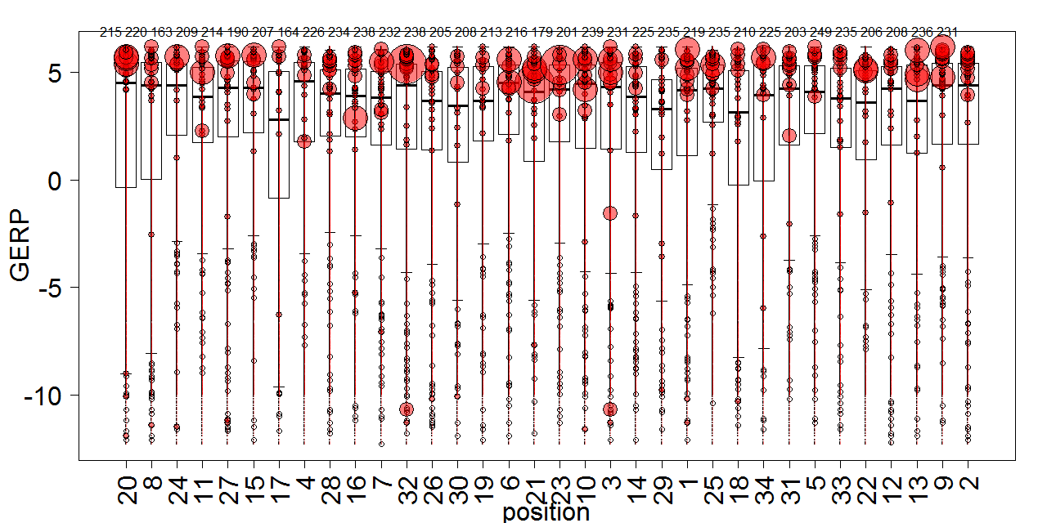
GERP
NS only
Notes:
Blobs completely goes away → caused by S

Slide 33
Putting metrics for speciation in TPRs side by side/correlations (remove NS)
Add in AF and NS within population??

Slide 34
DNA conservation does not limit aa mutations -- how can aa change without DNA change? Is it because of context or aa change without much impact?
Notes:
Nucleotide Conservation versus aa accommodation based on homology across species (BLOSUM with GERP)
--high conservation of DNA sequence across species
--but even when the DNA sequence is highly conserved, the mutations that occur at those positions still allow a large range of biochemical changes across species

Slide 35
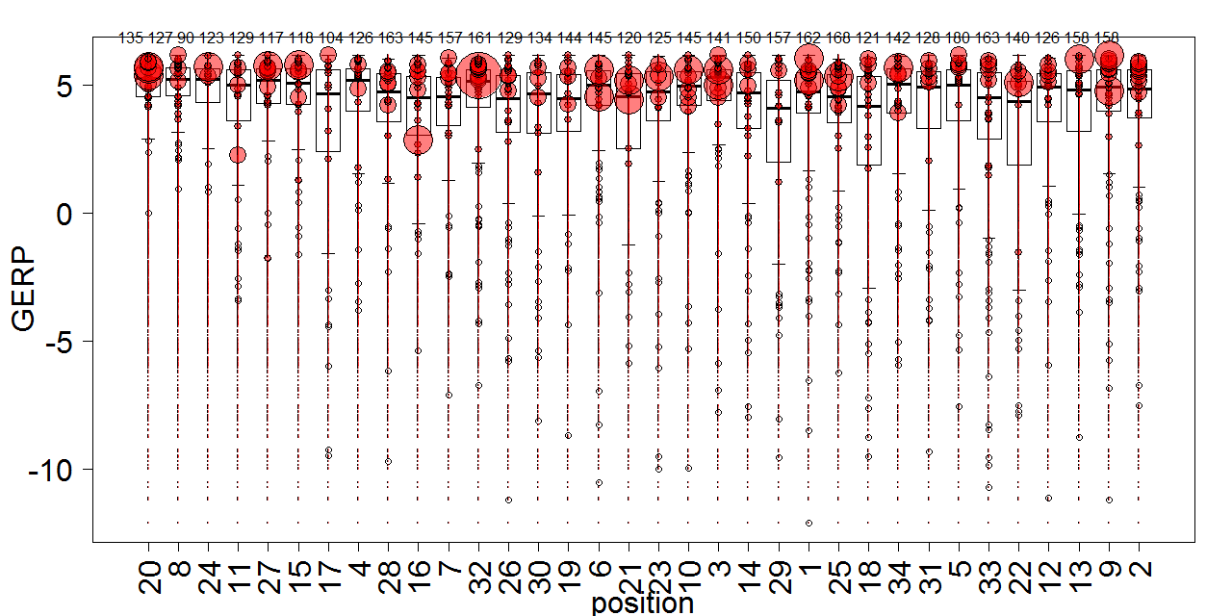
NS only
20 8 24 11 27 15 17 4 28 16 7 32 26 30 19 6 21 23 10 3 14 29 1 25 18 34 31 5 33 22 12 13 9 2
Notes:
Contextualize to positions of TPRs
Mutations are mostly accommodated in nature as seen in BLOSUM30, e.g. the most conserved by positions 20 – mostly ‘1’s
But there are still quite a number of aa changes that does not occur freq than expected in nature 30% protein homology

Slide 36
DNA conservation does not limit aa mutations -- given nucleotide conservation, how can aa change without causing high functional impact – due to physicochemical similarity?
Notes:
Nucleotide Conservation versus aa accommodation based on homology across species (BLOSUM with GERP)
--high conservation of DNA sequence across species
--but even when the DNA sequence is highly conserved, the mutations that occur at those positions still allow a large range of biochemical changes across species

Slide 37
DNA conservation does not limit aa mutations -- given nucleotide conservation, how can aa change without causing high functional impact – due to physicochemical similarity?
Notes:
Nucleotide Conservation versus aa accommodation based on homology across species (BLOSUM with GERP)
--high conservation of DNA sequence across species
--but even when the DNA sequence is highly conserved, the mutations that occur at those positions still allow a large range of biochemical changes across species

Slide 38
DNA conservation does not limit aa mutations -- given nucleotide conservation, how can aa change without causing high functional impact – due to physicochemical similarity?
Notes:
Nucleotide Conservation versus aa accommodation based on homology across species (BLOSUM with GERP)
--high conservation of DNA sequence across species
--but even when the DNA sequence is highly conserved, the mutations that occur at those positions still allow a large range of biochemical changes across species

Slide 39
NS only
20 8 24 11 27 15 17 4 28 16 7 32 26 30 19 6 21 23 10 3 14 29 1 25 18 34 31 5 33 22 12 13 9 2
Notes:
Nucleotide Conservation versus functional impact based on orthology across species (Condel with GERP)
--high conservation of DNA sequence across species
--aa changes that occur are high impact in some positions but are more accomdated at other positions
--high DNA conservation does not limit diversity of aa changes → wobble?
Within the TPR family
--within the family highly conserved aa positions --> structural are not as conserved in amino acid and nucleotide as it seems

Slide 40
DNA conservation does not limit aa mutations -- given nucleotide conservation, how can aa change without causing high functional impact – due to physicochemical similarity? Not really…
Notes:
Nucleotide Conservation versus aa accommodation based on homology across species (BLOSUM with GERP)
--high conservation of DNA sequence across species
--but even when the DNA sequence is highly conserved, the mutations that occur at those positions still allow a large range of biochemical changes across species

Slide 41
NS only
20 8 24 11 27 15 17 4 28 16 7 32 26 30 19 6 21 23 10 3 14 29 1 25 18 34 31 5 33 22 12 13 9 2

Slide 42
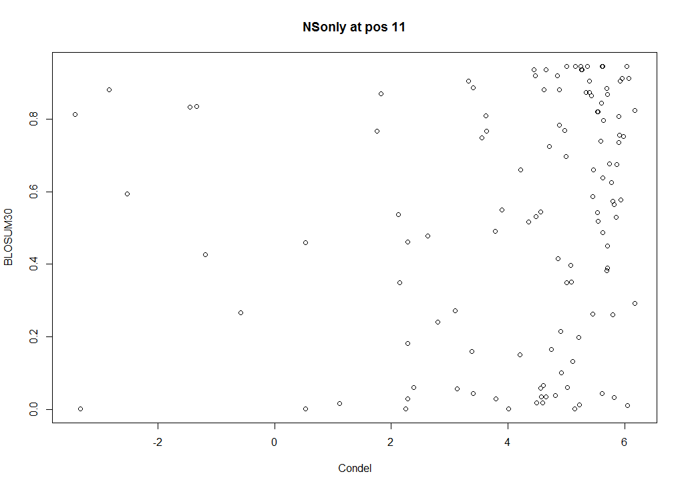
20 8 24 11 27 15 17 4 28 16 7 32 26 30 19 6 21 23 10 3 14 29 1 25 18 34 31 5 33 22 12 13 9 2

Slide 43
Future
Any ideas??
To do:
Split into known TPR functional subsets
Put on TPR domains on one single protein across species to compare distributions with current average TPR alignments within the human species
Try on ankyrins (repeat) and PDZ (non-repeat) domains

