Slide 1
Evaluation of Gene expression profiles with regards to somatic evolution
(In Cancer)
Leonidas Salichos LM
5/6/2015

Slide 2

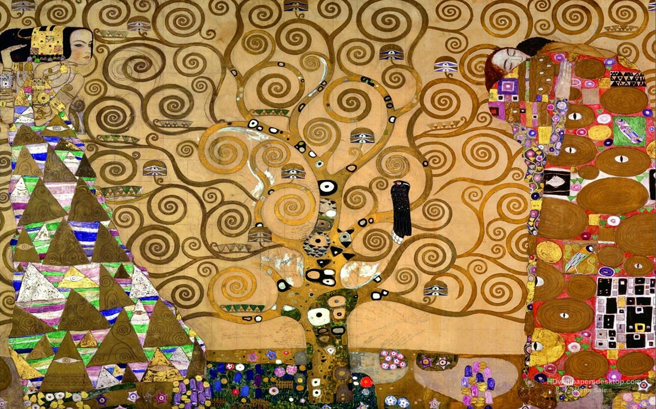
Quantifying phylogenetic incongruence
Notes:
Hi all, today I am gonna talk about revising the Tree of life. To heaven and back

Slide 3



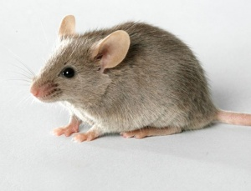
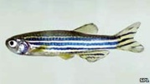



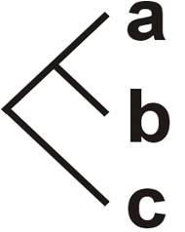
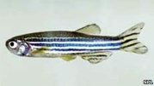
From Gene tree to Species Tree
Gene X
Species tree
Notes:
Well, in general, for a long time, from the sequence matrix of a gene, we would infer the topology for that gene and we speculate that the species tree have the same topology.

Slide 4

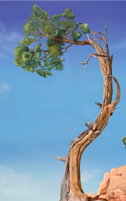
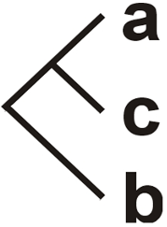

The problem of Gene Incongruence
Gene X
Gene Y
Species tree
Notes:
However, what happens when we have a second gene that may give us a different topology? In this case, which one is the species tree?

Slide 5
Creating A Supermatrix:
Concatenation of genes
Gene X
SuperGene XY
Gene Y
Species tree
Notes:
So in the 21st century we decided, what if we concatenate these two genes or more genes in one supermatrix or supergene, and then we infer the species tree.

Slide 6
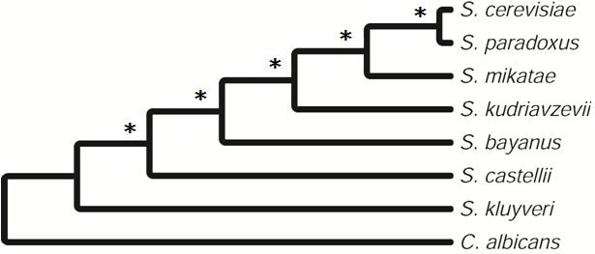
Creating A Supermatrix:
Concatenation of genes
SuperGene XY
Species tree
- Rokas et al. (2003) Nature: Concatenation of 106 Genes Yields a Single Yeast Phylogeny
More Genes, more Support
Notes:
By inferring the gene tree from this orthogroup we often make assumptions concerning the species tree

Slide 7
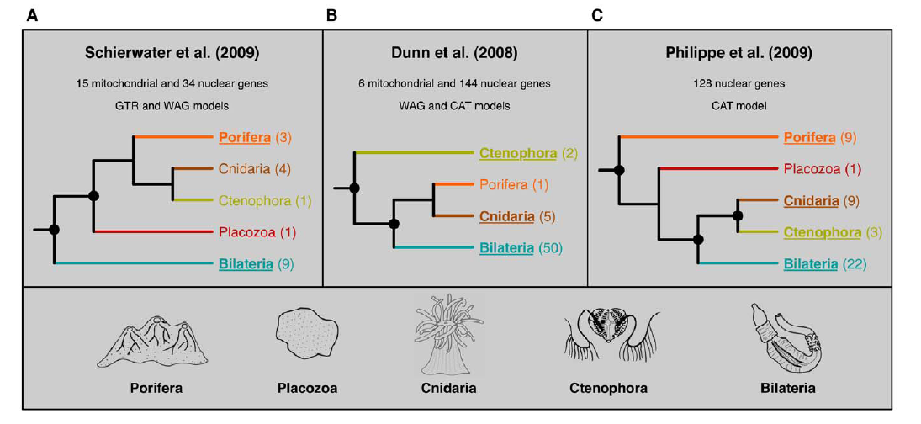
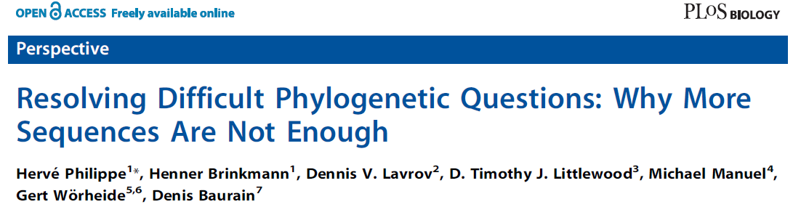
Phylogenomic Incongruence in early Metazoan
Schierwater et al. (2009). Plos Biology
Dunn et al. (2008). Nature
Philippe et al. (2009). Curr. Biol.
Notes:
So much resolving, that in 2009, within one year, Schierwater, Dunn and Philippe suggested three distinct evolutionary scenarios on the evolution of early animals using the concatenation approach of hundreds of genes. Every time a different outgroup and different evolutionary relationships

Slide 8
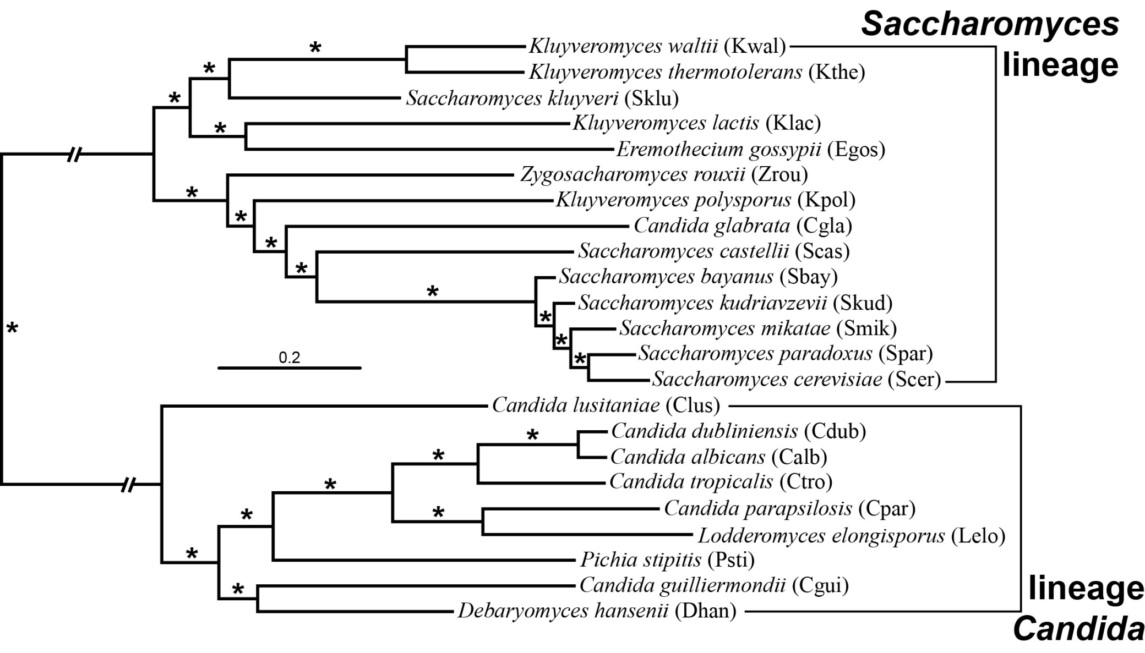
Concatenation Yields an Absolutely Supported Phylogeny
Which is at least partly wrong
(Scannell et al. 2006)
Notes:
As expected, the concatenation tree we got from the pipeline depicting the evolutionary scenario of yeast, had absolute support for every branch. However, we know that it is at least partly wrong, in the Glabrata-Castellii case that I previously explained. Imagine that the use of more than a thousand genes, was not enough to identify the correct topology.

Slide 9
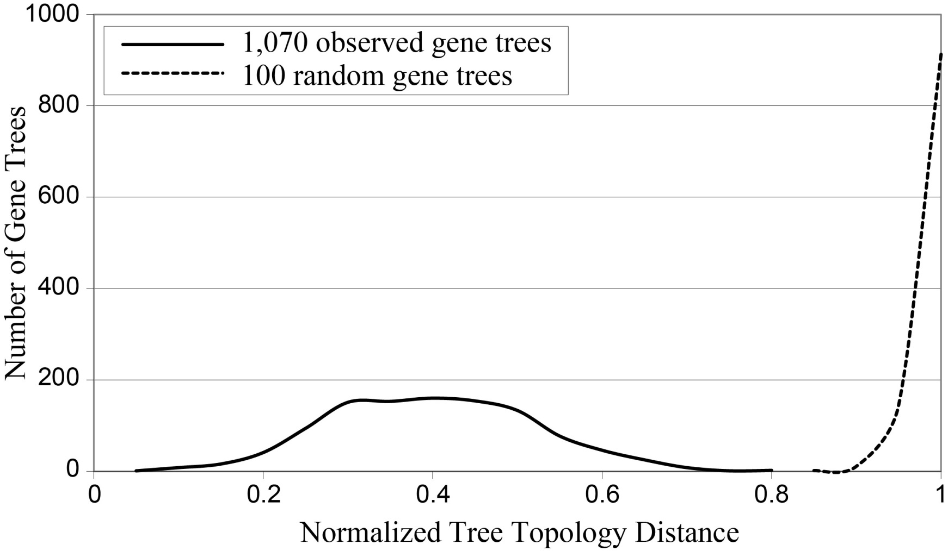
All 1070 Gene-Trees Disagree With the Concatenation Species Tree!!
Gene X
Gene Y
Species tree
Notes:
By inferring the gene tree from this orthogroup we often make assumptions concerning the species tree

Slide 10
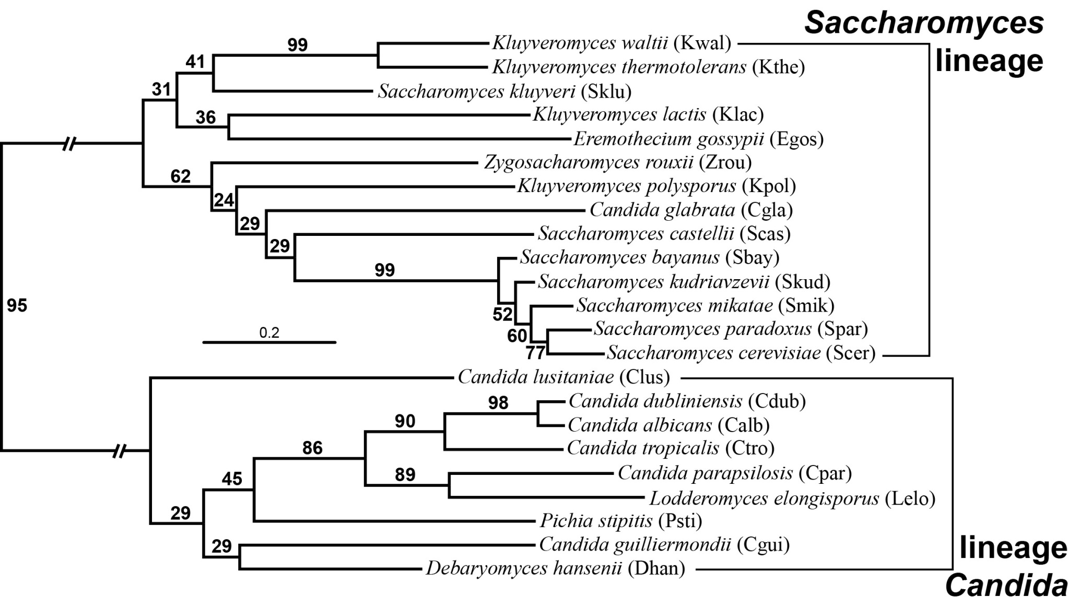
Gene Consensus Tree Yields Clades With Low “Gene Support Frequency” (GSF)
Gene Support Frequency: The percent of genes that support a particular internode
Notes:
For this reason, I decided to see what is going on in gene level. I therefore constructed a consensus tree where each number represents the percentage of gene that agree with the specific internode. This measurement is also called Gene support Frequency, or GSF.

Slide 11
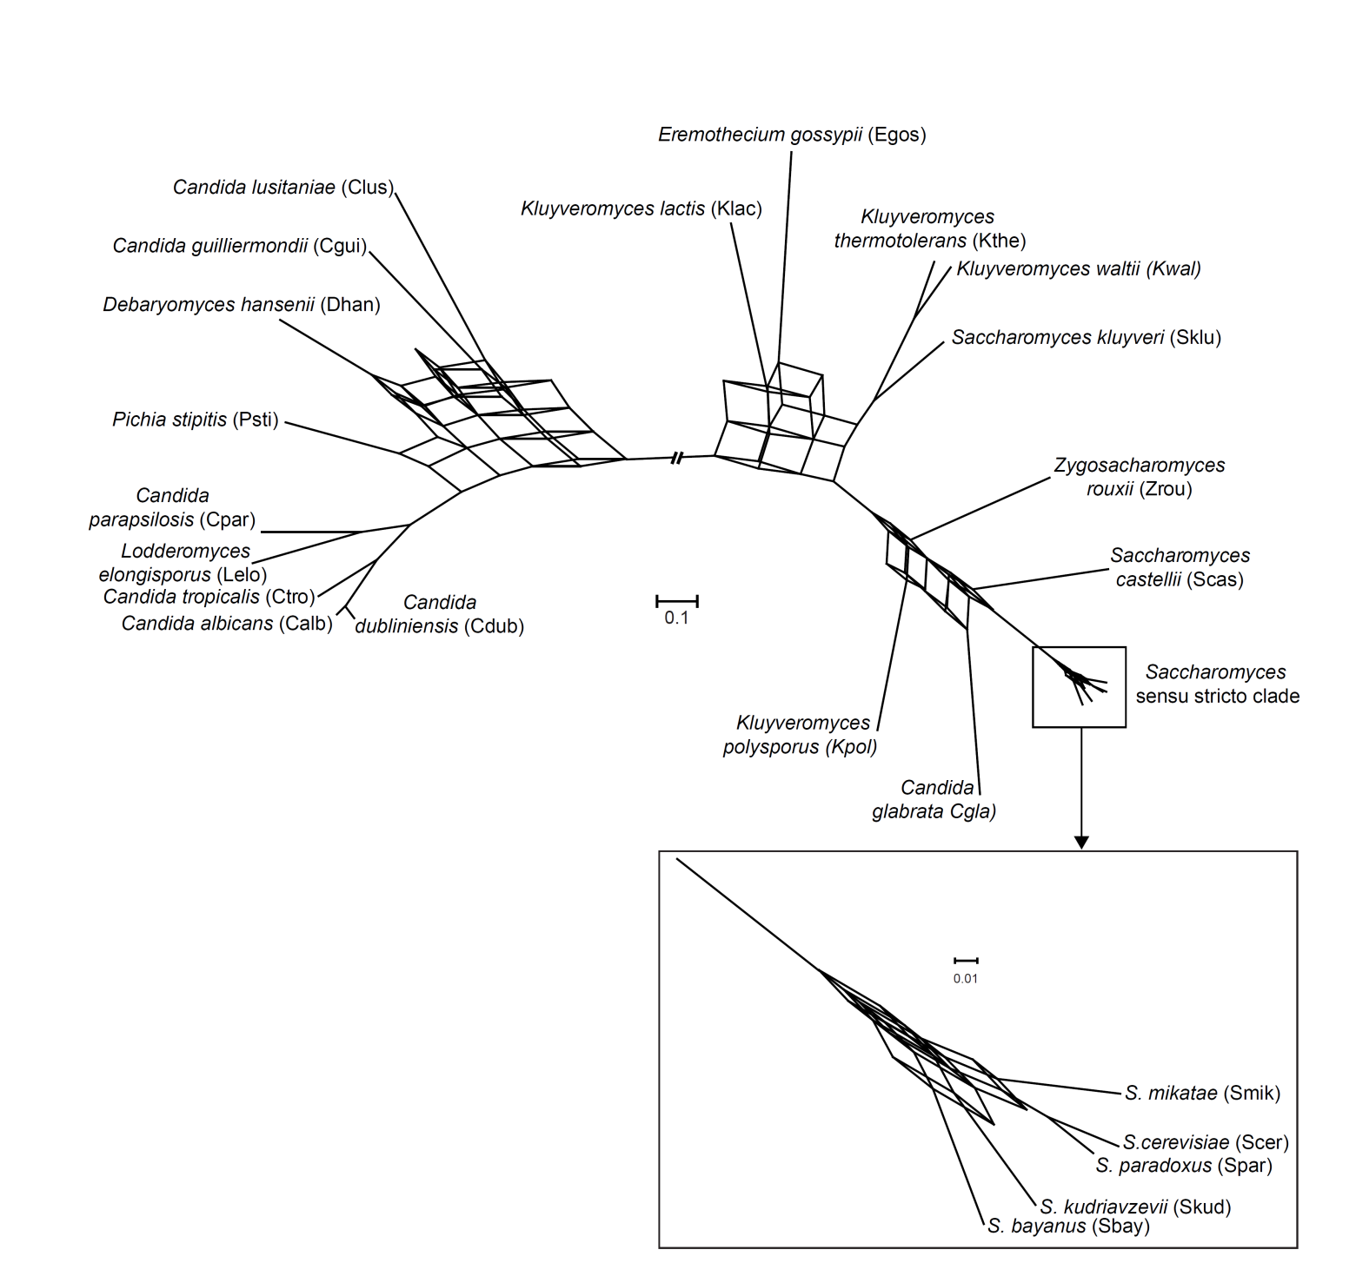
The Species Tree Looks Kind of Messy

Slide 12
Reasons That Genes May Provide Different Trees
Analytical reasons (There is a problem with our model)
    Sampling: Genes are not representative of whole population
    Systematic: Misspecification of the evolutionary model
Notes:
First, we have analytical reasons

Slide 13
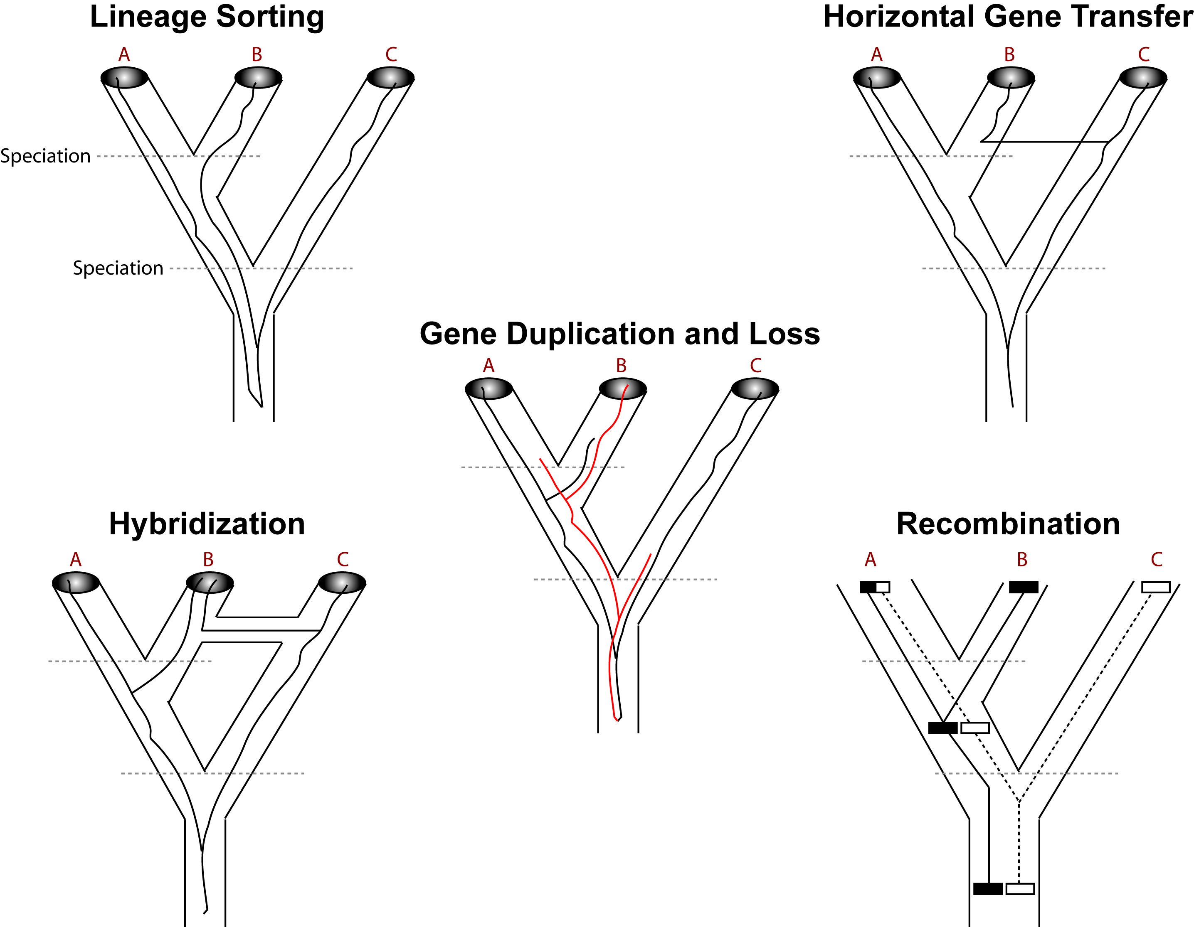
Reasons That Genes May Provide Different Trees
Analytical reasons (There is a problem with our model)
    Sampling: Genes are not representative of whole population
    Systematic: Misspecification of the evolutionary model
Biological reasons (Genes have different history than species)

Slide 14
Reasons That Genes May Provide Different Trees
Analytical reasons
(There is a problem with our model)
    Sampling: Genes are not representative of whole population
    Systematic: Misspecification of the evolutionary model
Biological reasons
(Genes have different history than species)
X

Slide 15
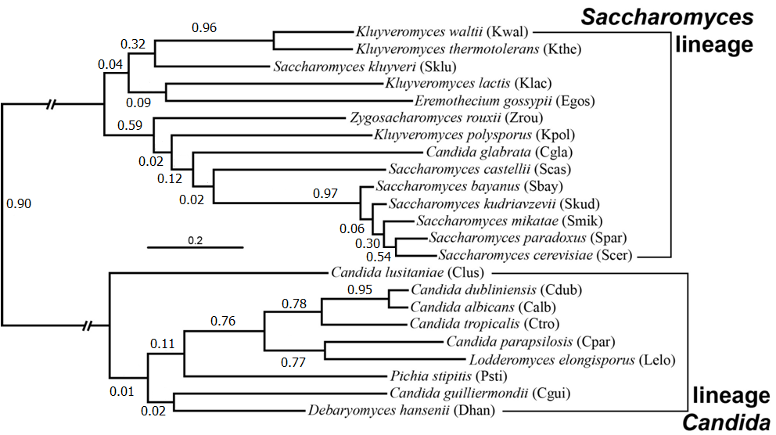
Reasons That Genes May Provide Different Trees
% Support for most prevalent conflicts:
#0: 52%
#1: 29%
#2: 14%
#3: 11%
#4: 11%
#5: 08%
IC value: 0.06
Notes:
To go back to our example with the too similar but also very different internode supports,

Slide 16
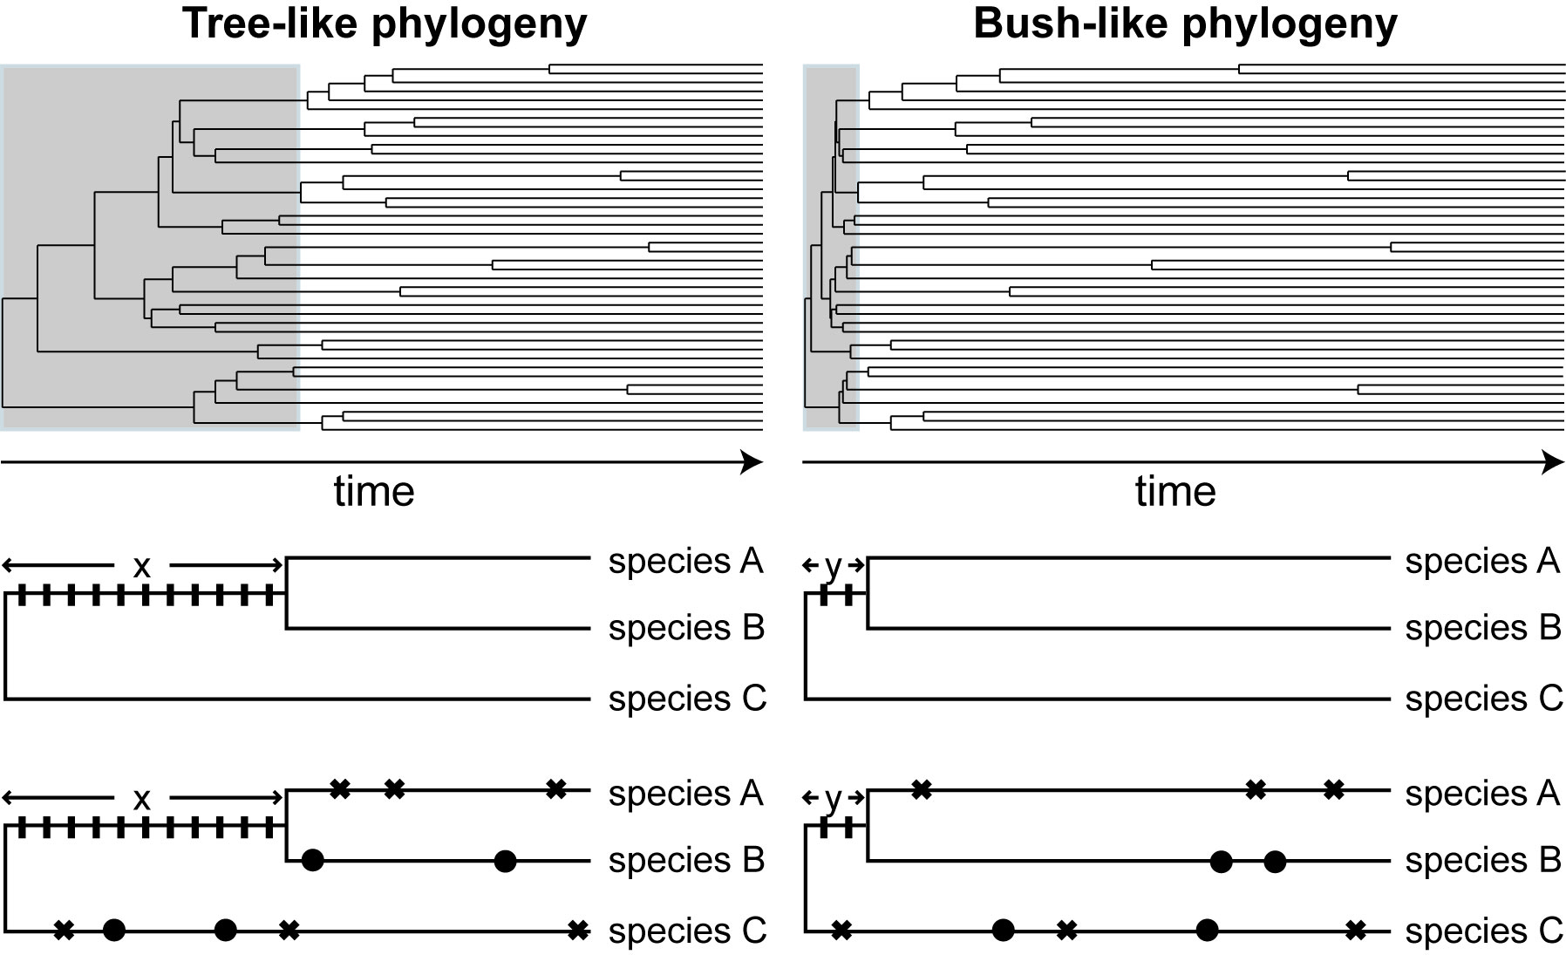
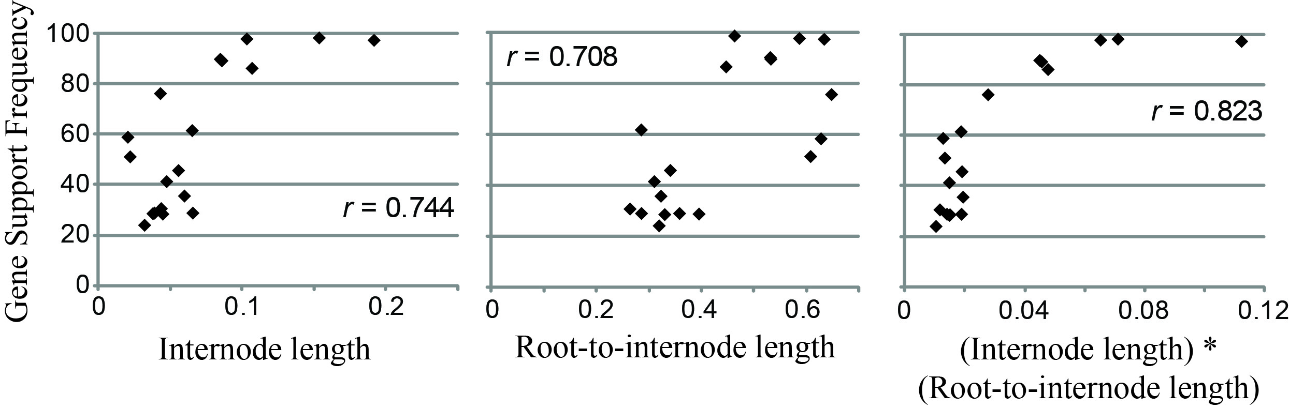
Analytical Reasons:
Internode Support depends on Internode and Length Depth
Rokas & Carroll (2006) PLOS Biol.
a)
b)
a) Homoplasy: independent evolution of identical characters
b) Internode length: influences amount of phylogenetic signal
Notes:
Indeed,
So What can we do?

Slide 17

Evaluating Factors That Influence Gene Tree Incongruence
Notes:
Well, if you look more carefully, you can see that most nodes with low certainty appear to be concentrated in deep time and small internodes

Slide 18
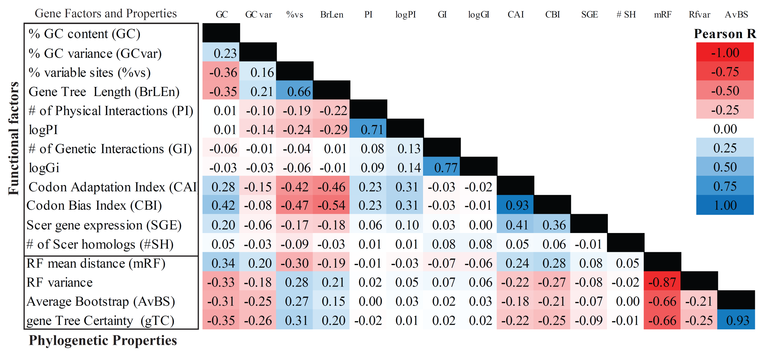
Part II. Evaluating Gene Factors That
Influence Incongruence
Evaluating Gene Factors That
Influence Incongruence
Genes Tree Space Based on RF distance
Notes:
Indeed,
So What can we do?

Slide 19
Evaluating Gene Factors That
Influence Incongruence
    All phylogenetic properties were highly correlated with each other.
    Significant correlation was also observed between functional factors
    % GC content, % of variable sites, codon bias and codon adaptation provided a significant correlation with phylogenetic properties
Notes:
Indeed,
So What can we do?

Slide 20
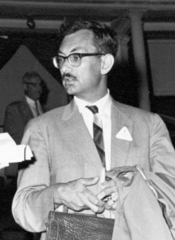
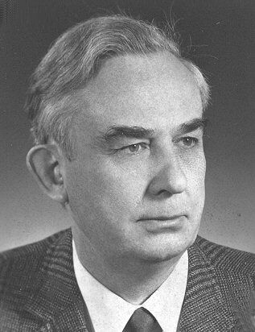
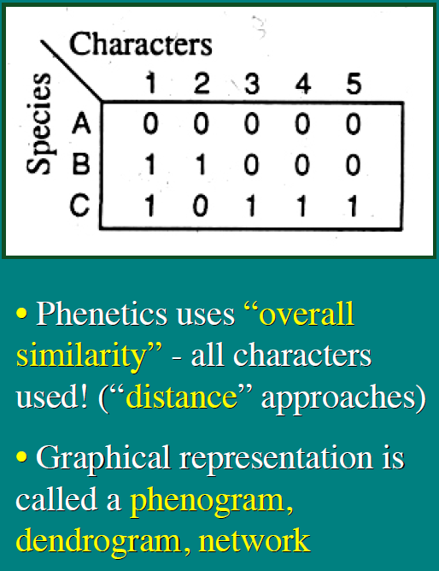
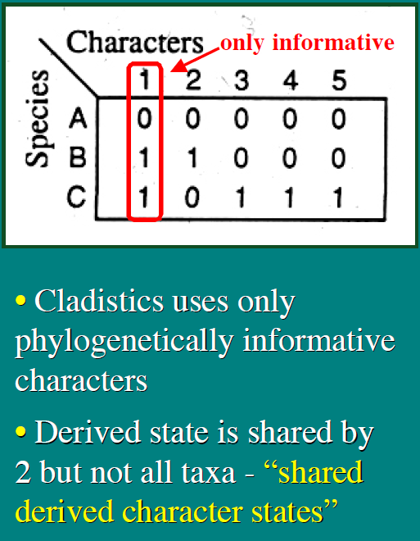

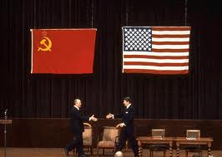
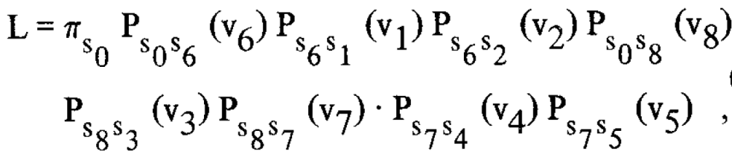
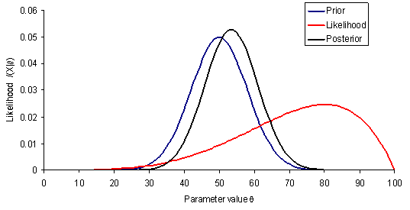

Selective Informative Genes and Clades
A combinatory Approach
Phenetics / Statistical Phylogenetics:
Principles of Numerical Taxonomy, 1963
by Peter Sneath and Robert Sokal
Cladistics:
(Phylogenetic Systematics, 1966)
By Willi Hennig

Slide 21
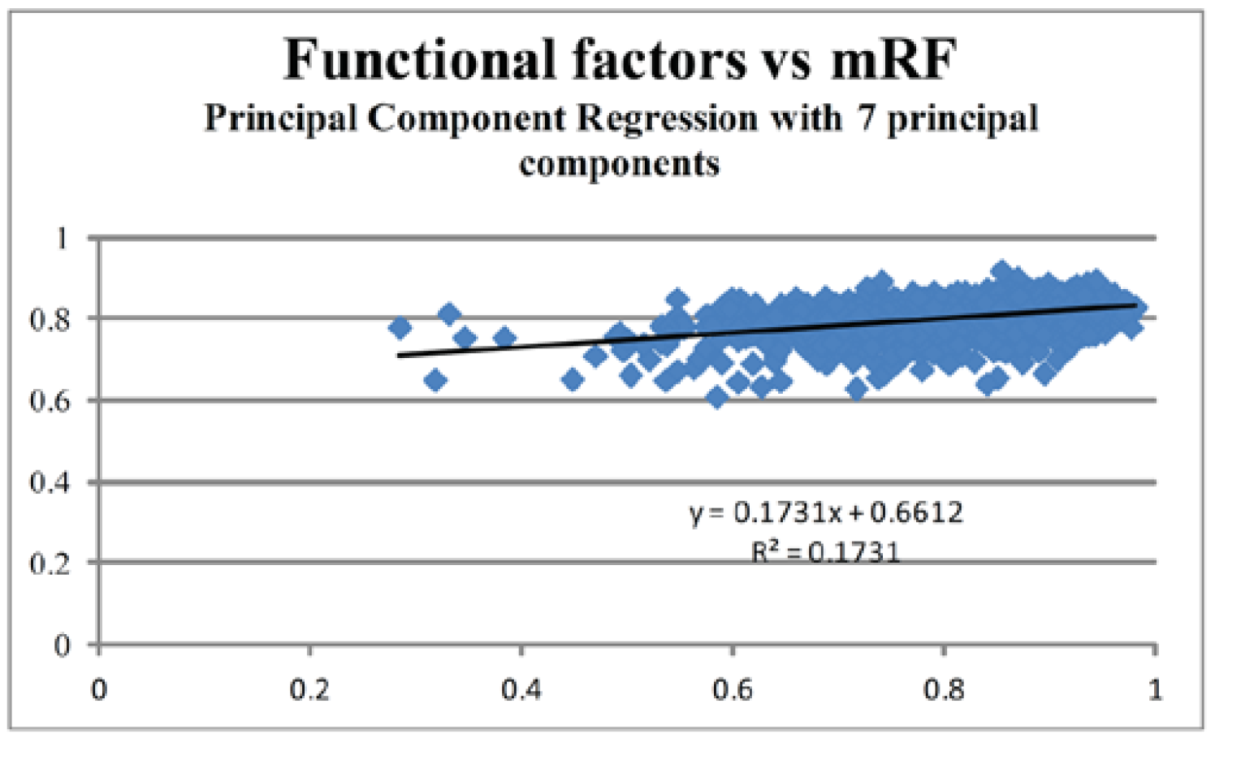
A Principal Component Regression Analysis Explains 17% of Gene Tree Incongruence
Notes:
Indeed,
So What can we do?

Slide 22
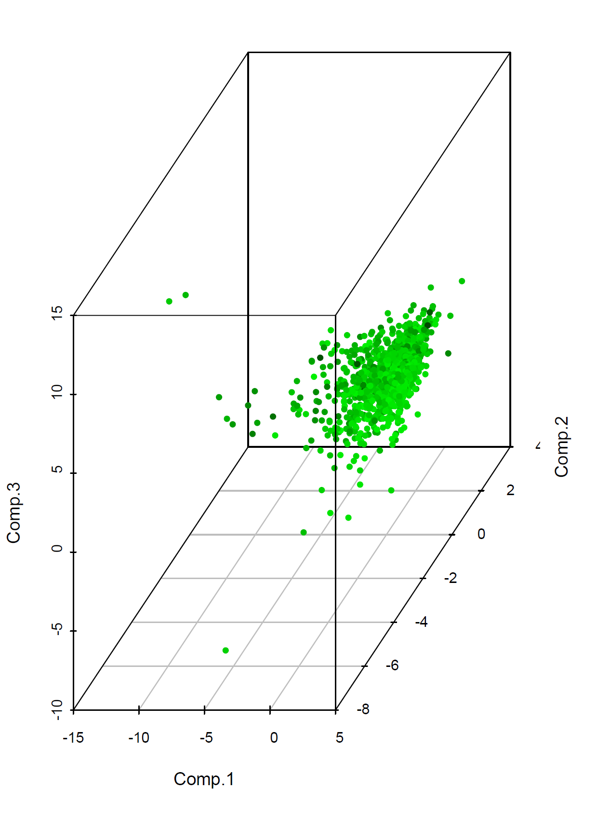
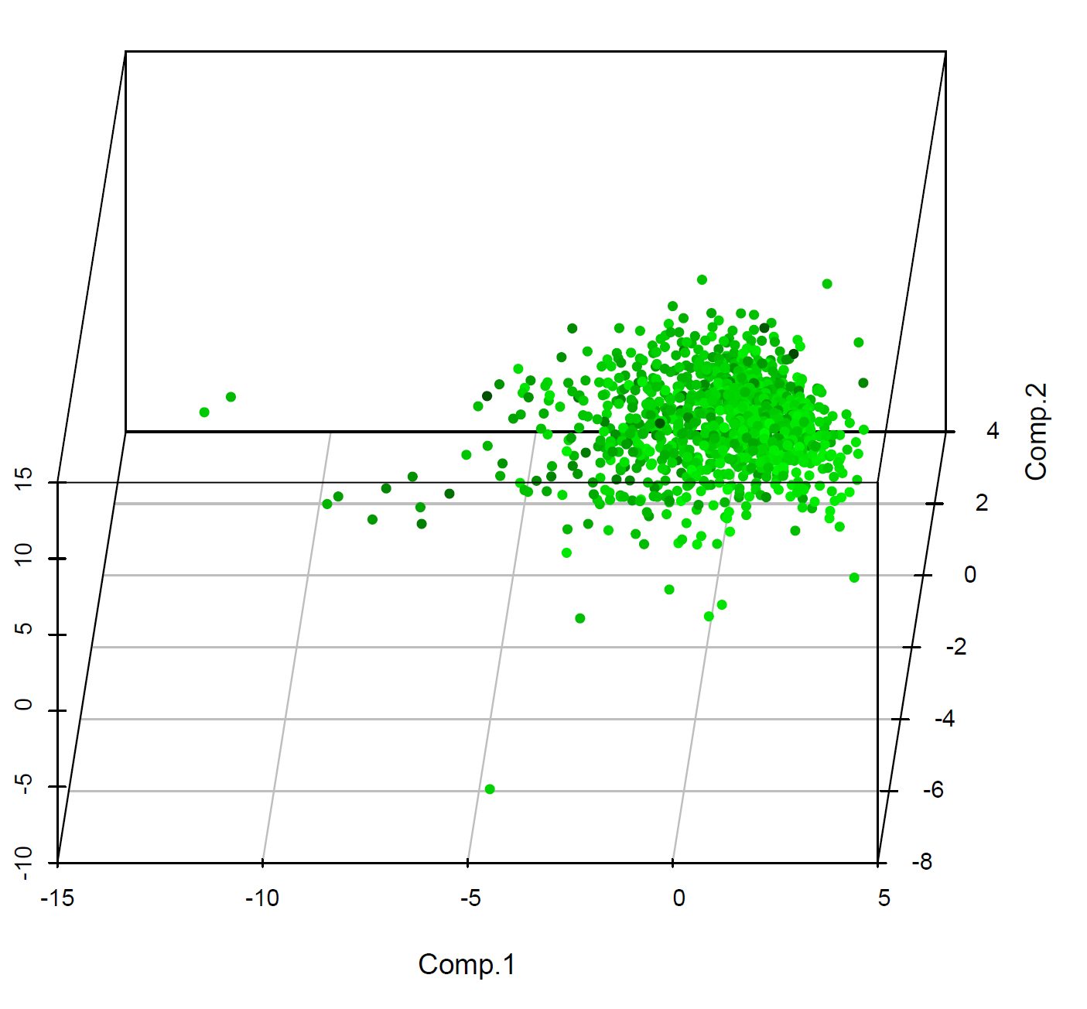
PCR analysis
3d Scatterplot using 3 Principal Components
Notes:
Indeed,
So What can we do?

Slide 23
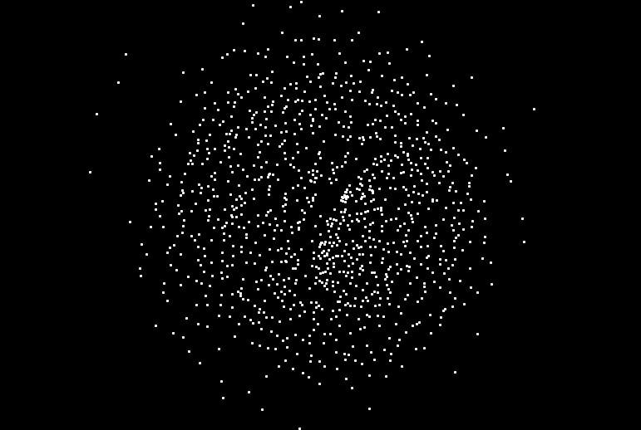
Part II. Evaluating Gene Factors That
Influence Incongruence
Evaluating Gene Factors That
Influence Incongruence
Genes Tree Space Based on RF distance
Notes:
Indeed,
So What can we do?

Slide 24
Exploration of Gene expression profiles with regards to somatic evolution in Breast Cancer
Leonidas Salichos LM
5/6/2015

Slide 25
Exploration of Gene expression profiles with regards to somatic evolution in Breast Cancer
Current
  Select genes based on clinical associations
  Automated pipeline
  Test on BRCA
Future
  Select genes based on somatic mutations and clinical data
  Associate somatic mutations with jumps in expression profiles
  Compare Expression profiles across Cancer and different Tissues

Slide 26
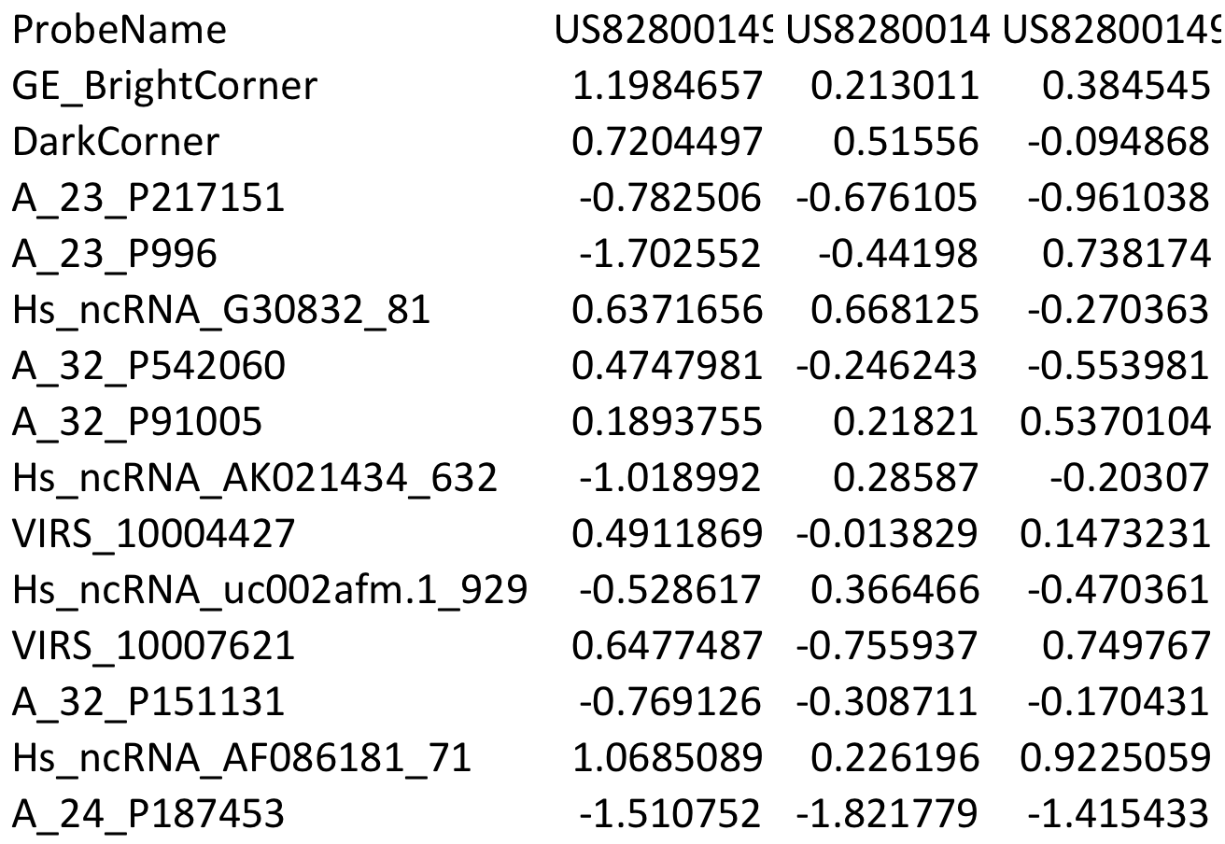
PCR using genes associated with DTD criterion

Slide 27
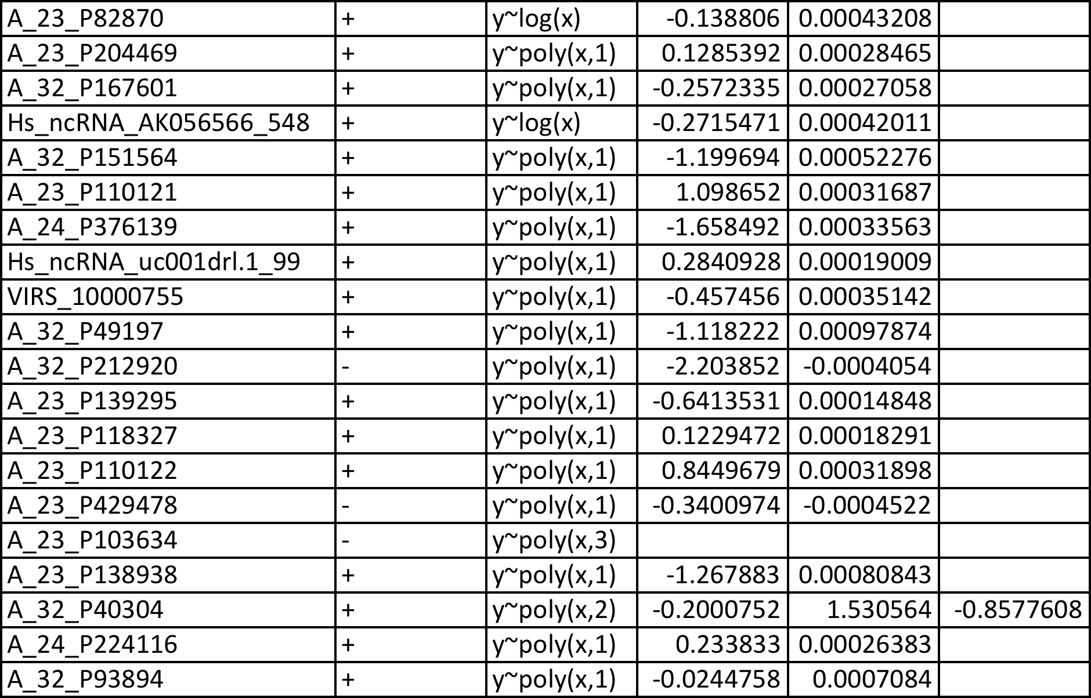
Individual Gene function

Slide 28
Principal Component Regression

Slide 29
Principal Component Regression
12 PCs ~80%
5 significant PCs
R^2~0.5
p-value:3.341e-10

Slide 30
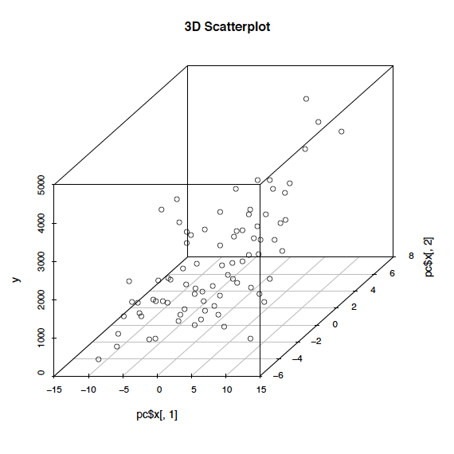
PC1 vs PC2 vs DTD

Slide 31
Expression Differences
All Patients vs all
  1 vs 2:(|GeneA₁-GeneA₂|+..+|GeneN₁-GeneN₂|)
  1 vs 3:(|GeneA₁-GeneA₃|+..+|GeneA₁-GeneA₃|)
  …
|A_{i} - A_{verageExpression}|
  1 : (|GeneA₁-GeneA_{av}|+..+|GeneN₁-GeneN_{av}|)
  2 : (|GeneA₂-GeneA_{av}|+..+|GeneN₂-GeneN_{av}|)
  …
Σ|A_{i} - A_{minDTD}|
  1 : (|GeneA₁-GeneA_{min}|+..+|GeneA₁-GeneN_{min}|)
  2 : (|GeneA₂-GeneA_{min}|+..+|GeneN₂-GeneN_{min}|)
  …
Σ|A_{i} - A_{maxDTD}|
  1 : (|GeneA₁-GeneA_{max}|+..+|GeneN₁-GeneN_{max}|)
  1 : (|GeneA₂-GeneA_{max}|+..+|GeneN₂-GeneN_{max}|)
  …

Slide 32
Expression Difference:
Xpatient vs Average GenExp

Slide 33
Expression Difference:
Xpatient vs Minimum and Maximum GenExp

Slide 34
Expression Difference:
Average vs Minimum, Average vs Max
(The Cancer Exp. Universe is converging)

Slide 35
All vs All expression differences

Slide 36
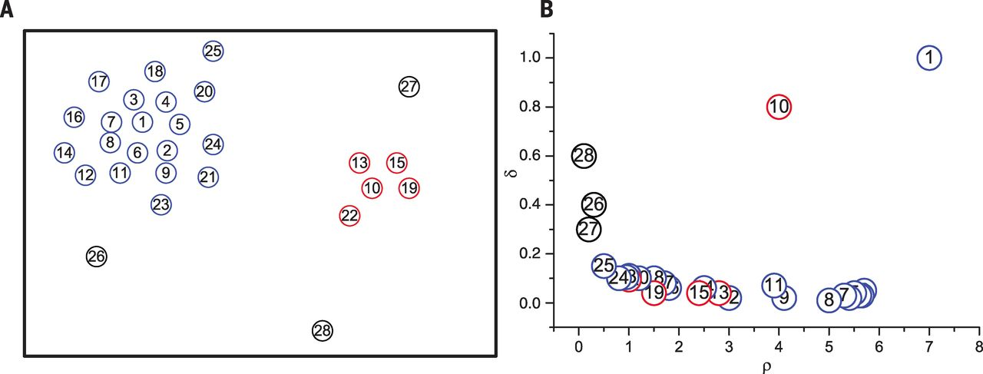
Examining density peaks with
Fast density peak algorithm
Alex Rodriguez and Alessandro Laio, Science 2014. DOI: 10.1126/science.1242072

Slide 37
Single peak for cutoff 35

Slide 38
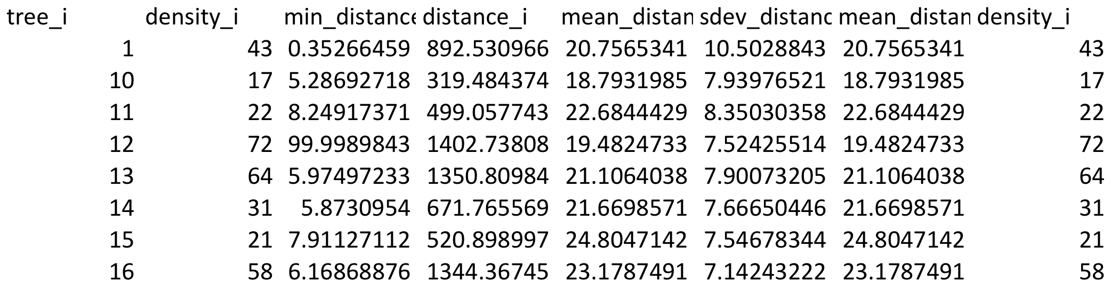
Landscape of BRCA

Slide 39
Future Additions
  Select genes based on somatic mutations and clinical data
  Associate somatic mutations with jumps in expression profiles
  Compare Expression profiles across Cancer, different Tissues, Stem Cells, same cancer tissue
Cancer types | # of Patients with DTD | % vs all
COAD | 85 | 0.16536965
GBM_vb | 378 | 0.812903226
KICH | 14 | 0.134615385
KIRC_nice | 193 | 0.317957166
KIRP | 19 | 0.073929961
LUAD_nice | 124 | 0.629441624
LUSC_nice | 330 | 0.751708428
PAAD_nice | 72 | 0.476821192
Prostate | 6 | 0.014814815
STAD | 93 | 0.252717391

Slide 40
Thank you!

