Slide 1
Allele

Slide 2
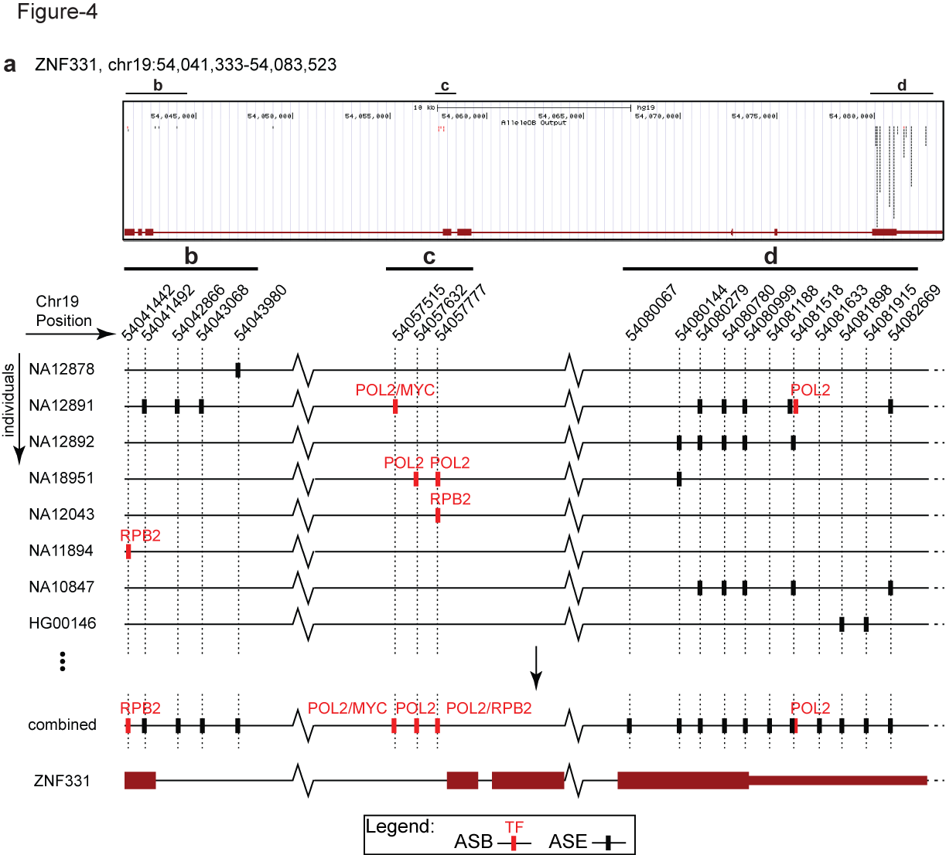
Figure 4. Visualization ASB and ASE in ZNF331 in AlleleDB

Slide 3
Figure 4. Visualization ASB and ASE in ZNF331 in AlleleDB

Slide 4
Figure 4. Visualization ASB and ASE in ZNF331 in AlleleDB

Slide 5
Supplementary Table 1 Inconsistencies in the original eight studies
Notes:
Add a row that says AlleleDB where everything is the same
Dup reads (RNA-seq/ChIP-seq)

Slide 6
Supplementary File 8 Min number of reads for accessible SNVs

Slide 7
Allele-specific activity is complex and often subtle. Our ability to confidently associate genomic variants with differential effects between alleles depends on breadth, as well as depth, of sampling. We present a strategy to comprehensively annotate variants and elements associated with allele-specific binding and expression observed in 1,263 ChIP-seq and RNA-seq datasets from 382 individuals. We show that such a large-scale analysis requires uniform processing to harmonize the heterogeneity of these functional datasets. We report groups of allele-specific variants, regions and genes enriched in allele-specific activity, including SNURF and ZNF331. Finally, we make these data available as a public resource at AlleleDB (www.alleledb.gersteinlab.org).

Slide 8
Overdispersion versus size of dataset
Notes:
1261
1141

