Slide 1
Notes:
Figure XX1. Identification of a somatic mutation resulting in a motif gain in the Ret promoter by FUN-Seq. A. Sequence chromatograms of plasmids containing the wild-type Ret promoter (Ret), or the Ret promoter containing a somatic mutation at chr10, 43572291 A>C (Ret Mut), resulting in the gain of an AP-1 motif. B. Luciferase reporter assays demonstrating transcriptional activity of the wild-type Ret promoter (-440 to +65) as compared to the same promoter containing the A291C mutation in DU145 cells. Results shown are the average of three independent experiments ± SD, and statistical significance was determined by t-test.

Slide 2
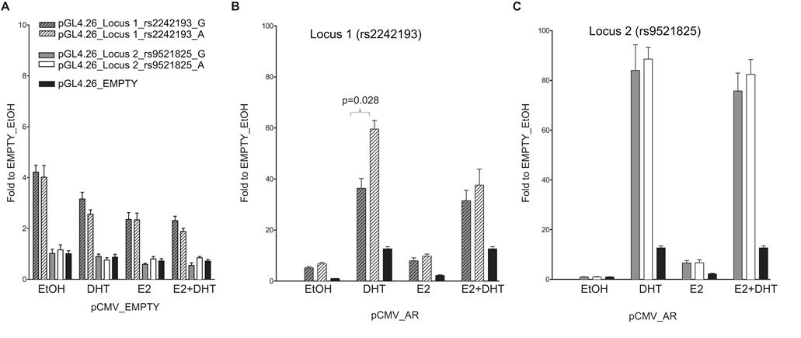
Notes:
Figure XX2. The selected locus 1 and locus 2 regulatory regions act as AR-dependent enhancers in the MCF7 cell line. A) MCF7 cells were co-transfected with pCMV_EMPTY vector along with different pGL4.26 reporter constructs containing selected regulatory regions isolated from two putative AR- or ER-target elements (indicated in the legend). Twenty-four hour post-transfection cells were treated for 16 hours with E2, DHT or the combination of the two compounds to stimulate respectively ER- or AR-dependent transcription. B - C) MCF7 cells were co-transfected with pCMV_AR vector along with pGL4.26_locus 1 or _locus 2 reporter constructs using the same experimental conditions as in panel A. Wild-type (dashed- or plain-grey bars) and SNPs rs2242193 or rs9521825 (dashed- or plain-white bars) containing constructs were tested. Indicated is the percentage value of statistical relevant differences (Student's t-test).

Slide 3
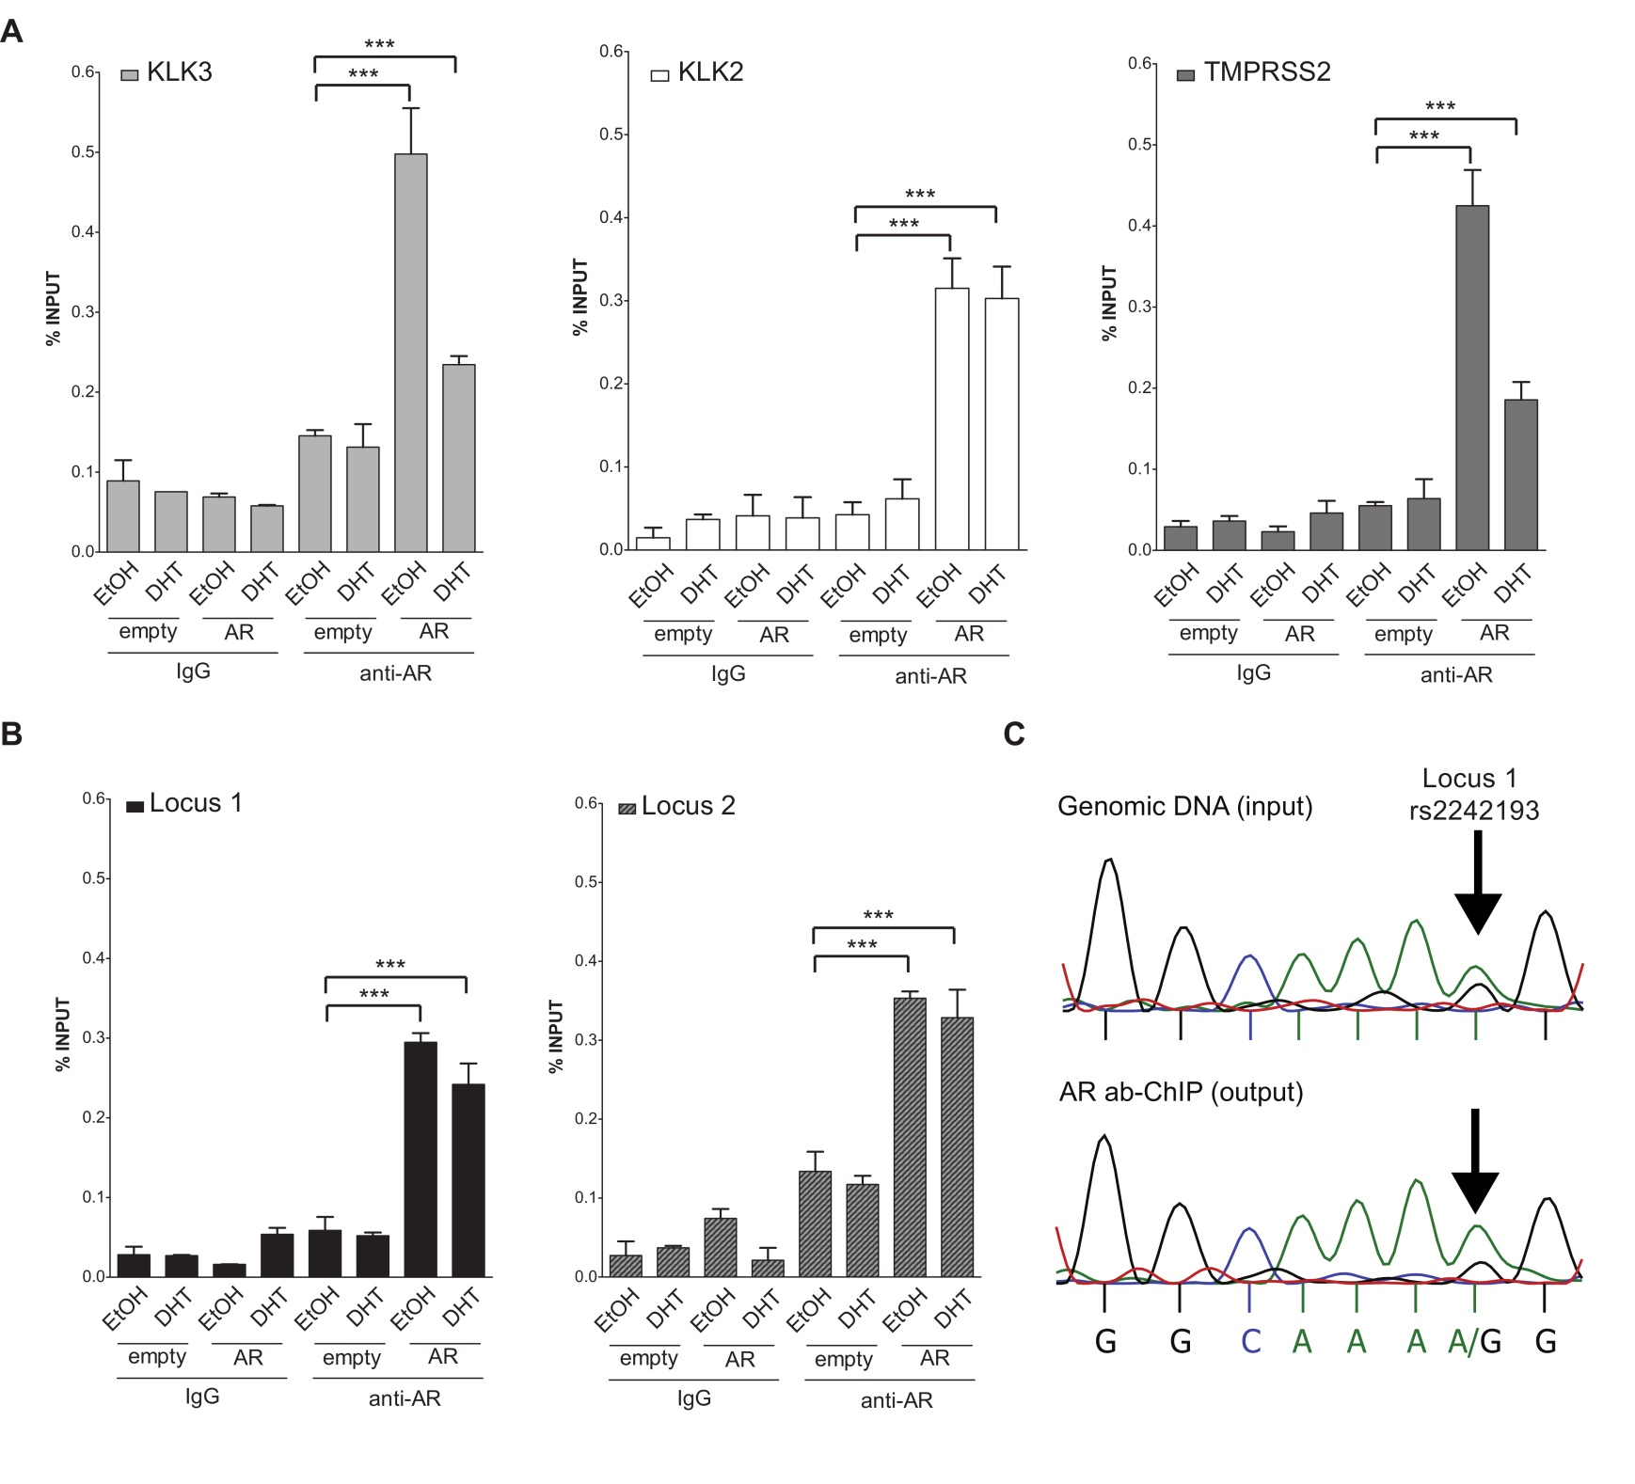
Notes:
Figure XX3. Both locus 1 and locus 2 are directly bound by AR. A) A series of ChIP-qPCRs were performed in MCF7 cells (heterozygous for SNP rs2242193 within locus 2) to determine AR chromatin binding at positive control enhancers -KLK3 (light grey bars), KLK2 (white bars) and TMPRSS2 (dark grey bars)- and B) at locus 1 and locus 2 regions (presented respectively as black and grey-patterned bars, respectively). Mean ± s.d. of three technical replicates were plotted. *p<0.05, .**p<0.01, ***p<0.005, Student's t-test. C) ChIP analysis from panel B) was followed by standard PCR to amplify locus 1 region and direct-sequencing was performed to quantify AR recruitment. The specific peaks involving the SNP rs2242193 are highlighted with arrows. Electropherograms showed that AR was preferentially recruited to the A allele of the SNP rs2242193 (p<10⁻²²). Input samples from ChIP assay were used as a control.

Slide 4
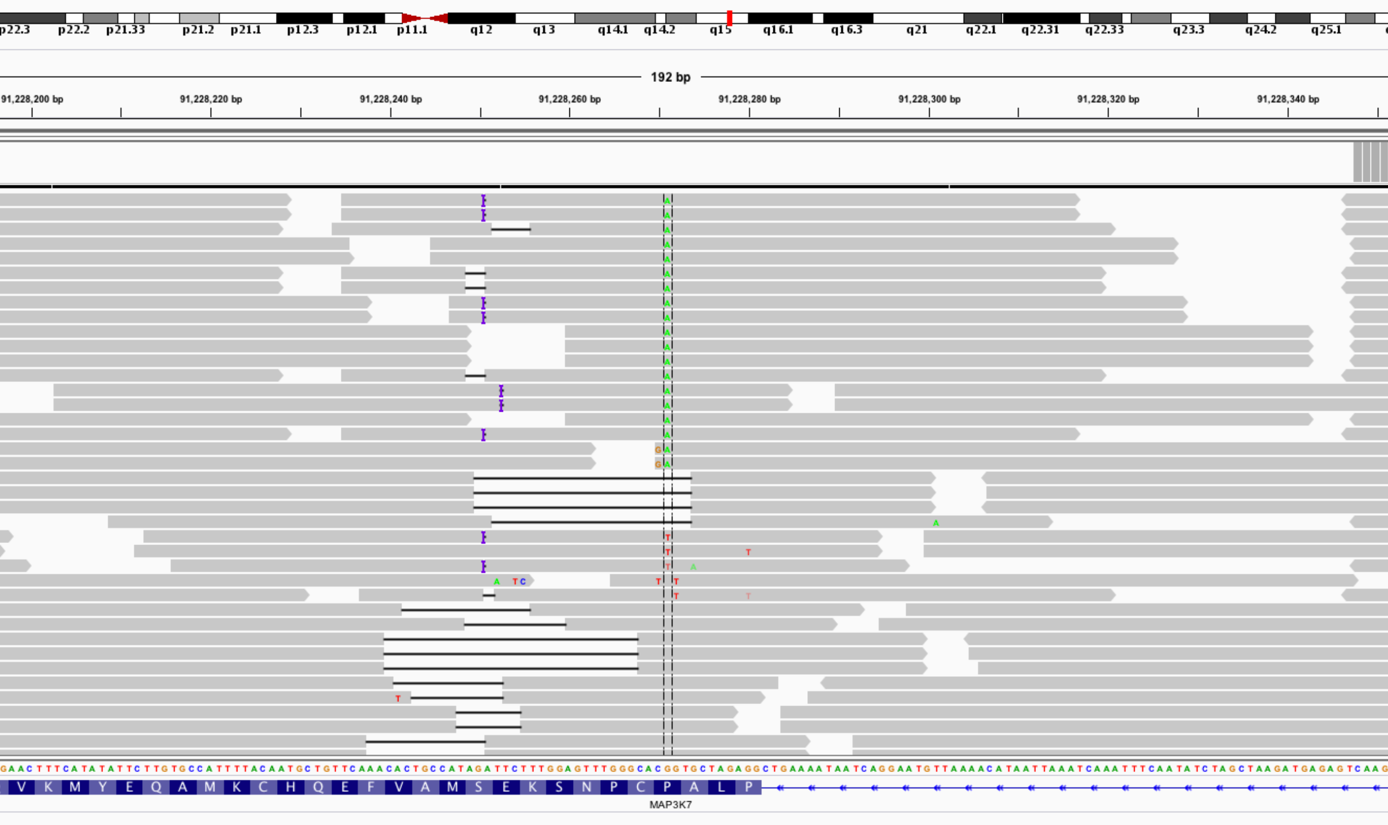
Notes:
Figure XX4. Targeted sequencing of the MAP3K7 gene in Hek 293 cells demonstrates the introduction of somatic mutation in the MAP3K7 gene

Slide 5
A
B
Notes:
Figure XX5.(A) Cisplatin sensitivity in 22Rv1 cells following genome editing of FANCA (KO1) or a control sequence by CRISPR Inset:Western blot of FANCA and GAPDH expression in indicated cell lines. (B) Immunofluorescent staining demonstrates loss of FANCD2 foci with CRISPR ko of FANCA gene

