Slide 1
What we have recently done
Breakpoints/Mechanism study
Functional enrichment
Retroduplications

Slide 2
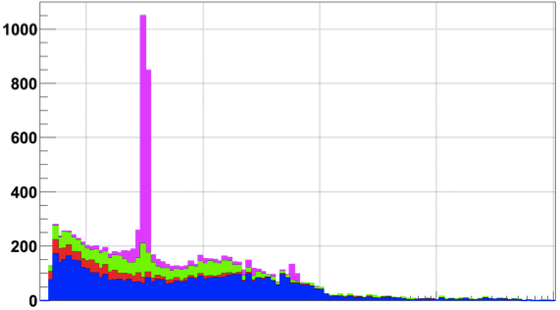
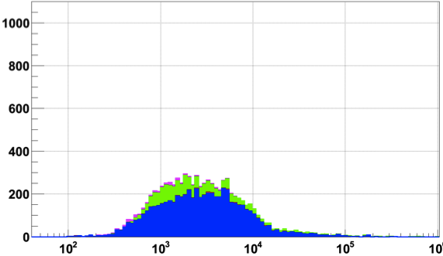
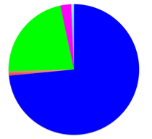
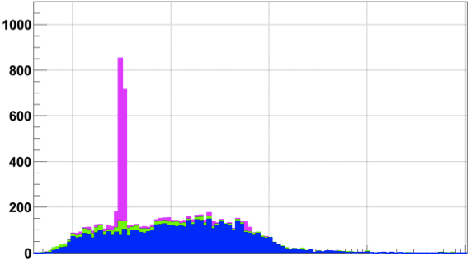
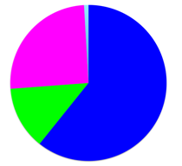
8,943 Deletion Breakpoints (Phase I)
FDR from IRS, PCR, and high-coverage trios
  ~7% for site existence
  13% for site existence + sequence precision
Pilot set
Data for 1,092 samples
Integrated set
Multiple CNV callers
TEI
NAHR
NH
VNTR
Call merging
Phase 1
Count of deletions
Breakpoint assembly
Mapping to junctions
Abyzov et al. 2015

Slide 3
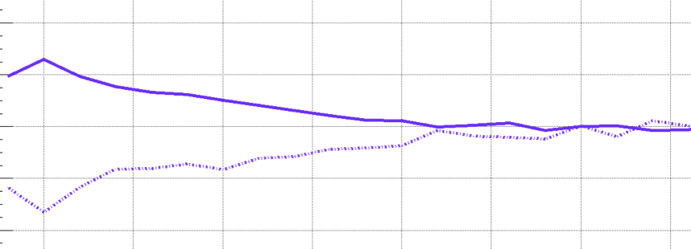
Higher SNP Density and Relaxed Selection at NH Breakpoints
+4%
NH
SNP density
-4%
Conservation score
0
700 Kbps
Abyzov et al. 2015
Notes:
SNP density at NAHR bkpts is driven by excessive C>T
A consequence of high CpG%

Slide 4
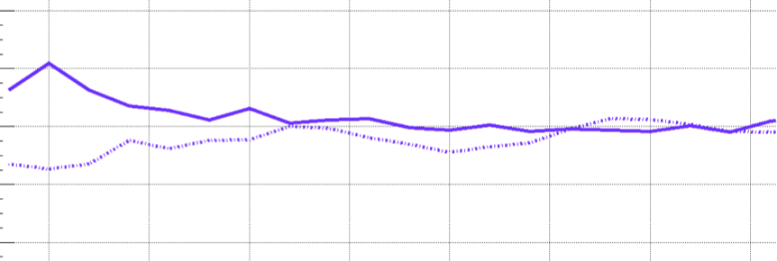
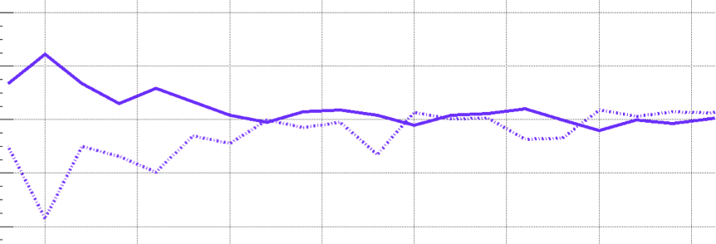
Higher SNP Density and Relaxed Selection at all Breakpoints
+4%
NH
SNP density
-4%
Conservation score
+4%
TEI
-4%
+4%
NAHR
-4%
0
700 Kbps
Abyzov et al. 2015
Notes:
SNP density at NAHR bkpts is driven by excessive C>T
A consequence of high CpG%

Slide 5
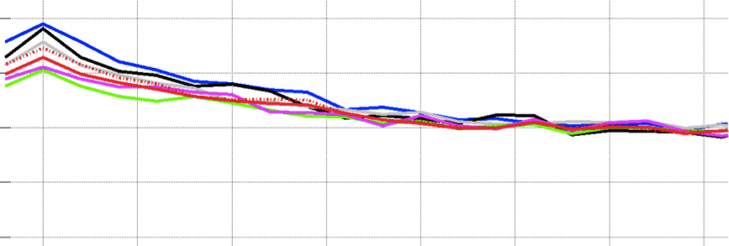
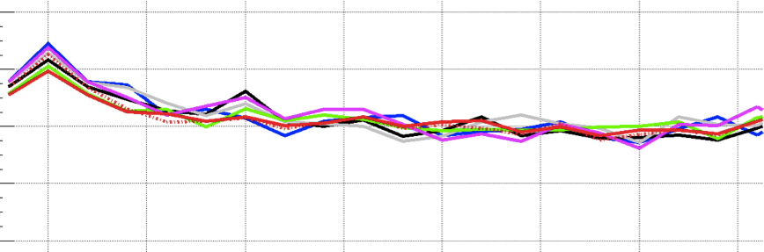
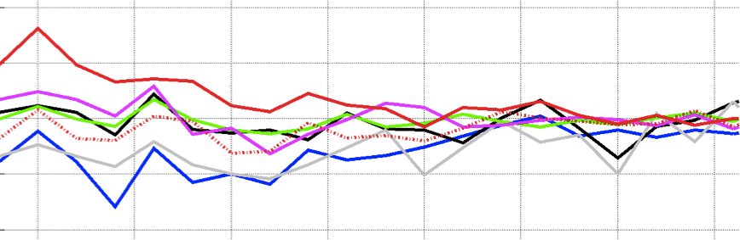
SNP Density at NAHR is Driven by High C>T
C>A C>G C>T
T>A T>C T>G
C>T outside CpG
+4%
NH
SNP density
-4%
Conservation score
+4%
TEI
-4%
+4%
NAHR
-4%
0
700 Kbps
Abyzov et al. 2015
Notes:
SNP density at NAHR bkpts is driven by excessive C>T
A consequence of high CpG%

Slide 6
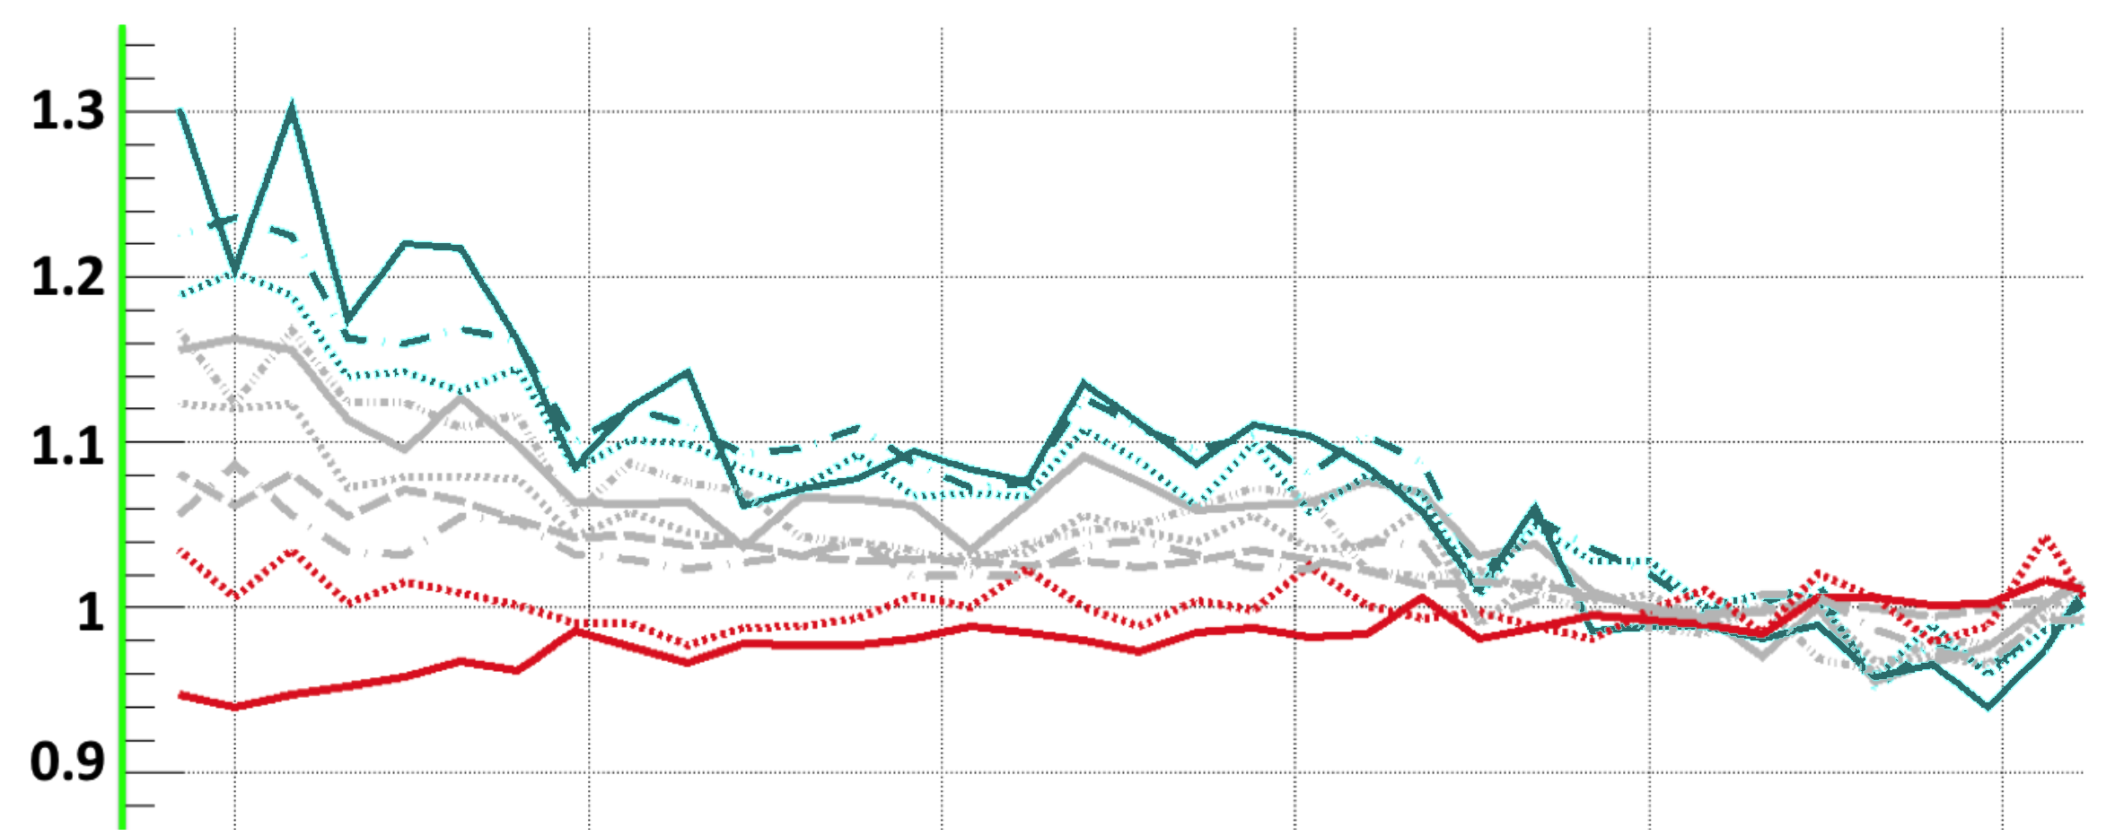

NAHR breakpoint are associated with open chromatin environment
TEI
NAHR
NH
Supported by Hi-C and
Histone modification
Hypothesis: Some NAHR
deletions occur w/o cell
replication
Closed
Open
0 ±0.5 ±1 ±1.5 ±2 ±2.5
Distance from breakpoints, Mbps
Abyzov et al. 2015

Slide 7
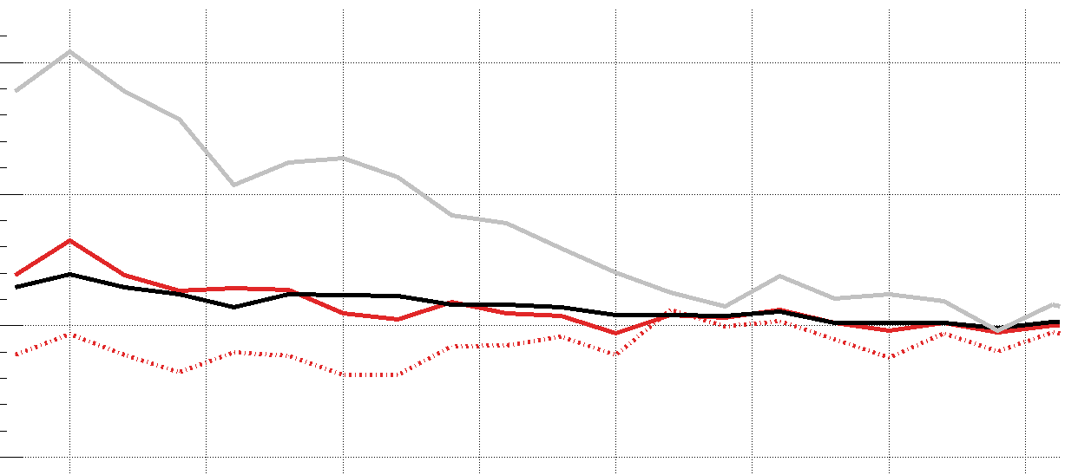
Methylation pattern associated with breakpoints mechanisms
Lower C>T in CpG around NAHR breakpoints
  indicates lower methylation level in germline & embryonic cells
Confirmed in male gamete
TEI
NAHR
NH
+10%
6
1
CpG%
NAHR
C>T(all)
Hypomethylated regions in sperm
GC%
C>T(CpG)
-5%
0
700 Kbps
-10 0 10
Distance from breakpoints, Kbps
Abyzov et al. 2015

Slide 8
Micro-homology Identified around Breakpoints
Breakpoints have micro-homologous sequences with the template sites.
Abyzov et al. 2015

Slide 9

NH deletions are often coupled with micro-insertions
Templates locate at two characteristic distance of breakpoints and replicate late
Suggesting spatial and temporal during template switching
Abyzov et al. 2015

Slide 10
More about breakpoints/mechanisms
More accurate breakpoints and detailed investigation from the trios
More mechanism assignment
  Recombination effects on SV origin
    Ectopic recombination mediated by LTR/Alu/LINE1
    Deletions close to recombination hotspots (population specific)
  BreakSeq2 - developing a more accurate mechanism pipeline taking advantage of the longer reads
Use high-res. Hi-C data to further investigate the relationship of high-order chromatin structure and mechanisms of bkpts
  Mechanisms of bkpts; Special focus on NAHR
  micro-insertion template (potential tool to automate template finding/micro-homology identification)
Functional region biased bkpts discovery

Slide 11
Others
More retroduplications - compare retroduplications in parents and child:
  Inherited retroduplications
  Newborn retroduplications in the child
  Missing heritability
  Parent-of-origin
More functional enrichment
  Detect regions with high/low variations in the child compared to the parents, and identify potential involved functions; compare the trend in multiple trios
SV-eQTL
  Limited by sample size if only look at trios
  Instead, pick out the eQTLs identified from populations, check whether they are significant in the trios, and why (might not have exactly matching populations)

Slide 12
Others
Autonomous/non-autonomous mobile elements insertion polymorphism
  Repetitive elements mapping strategies
  Transgenerational presence/absence dimorphism
Identify SVs including Deletions, inversion & intra/inter-chromosomal translocation.
Use HiC data to investigate influence of SVs on the association between the genomic elements and its target region.
  Specifically look into SV hotspot region

