Slide 1


Computational Methods for Estimating Functional Consequences of Genetic Variants and Application to Cancer Genomics
Yao Fu
Program in Computational Biology and Bioinformatics
Yale University
Advisor: Prof. Mark Gerstein
Thesis Committee: Prof. Michael Krauthammer & Prof. Hongyu Zhao

Slide 2
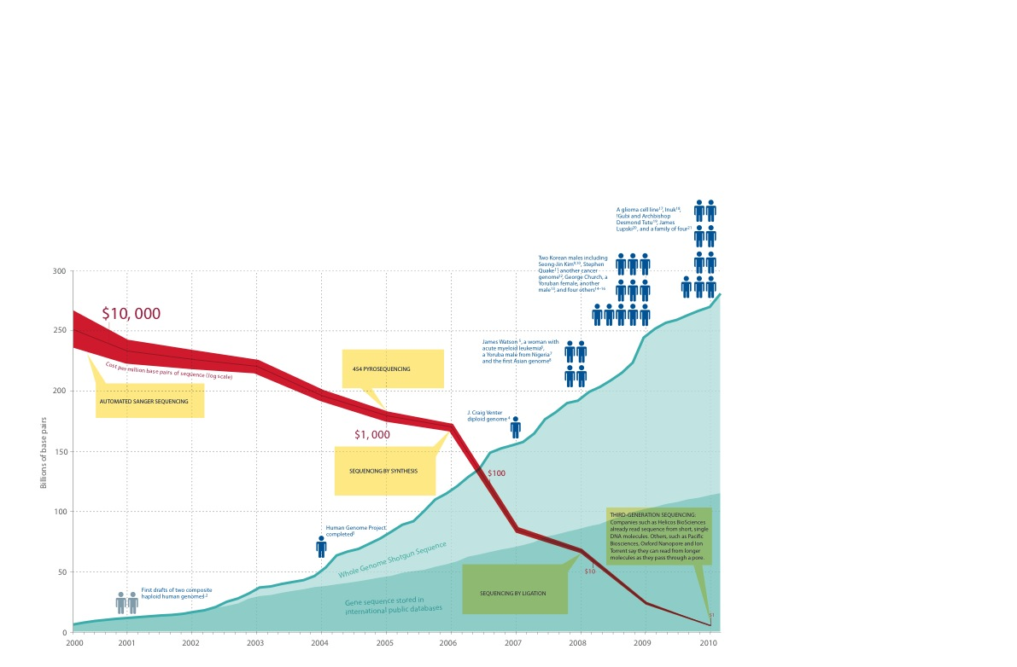
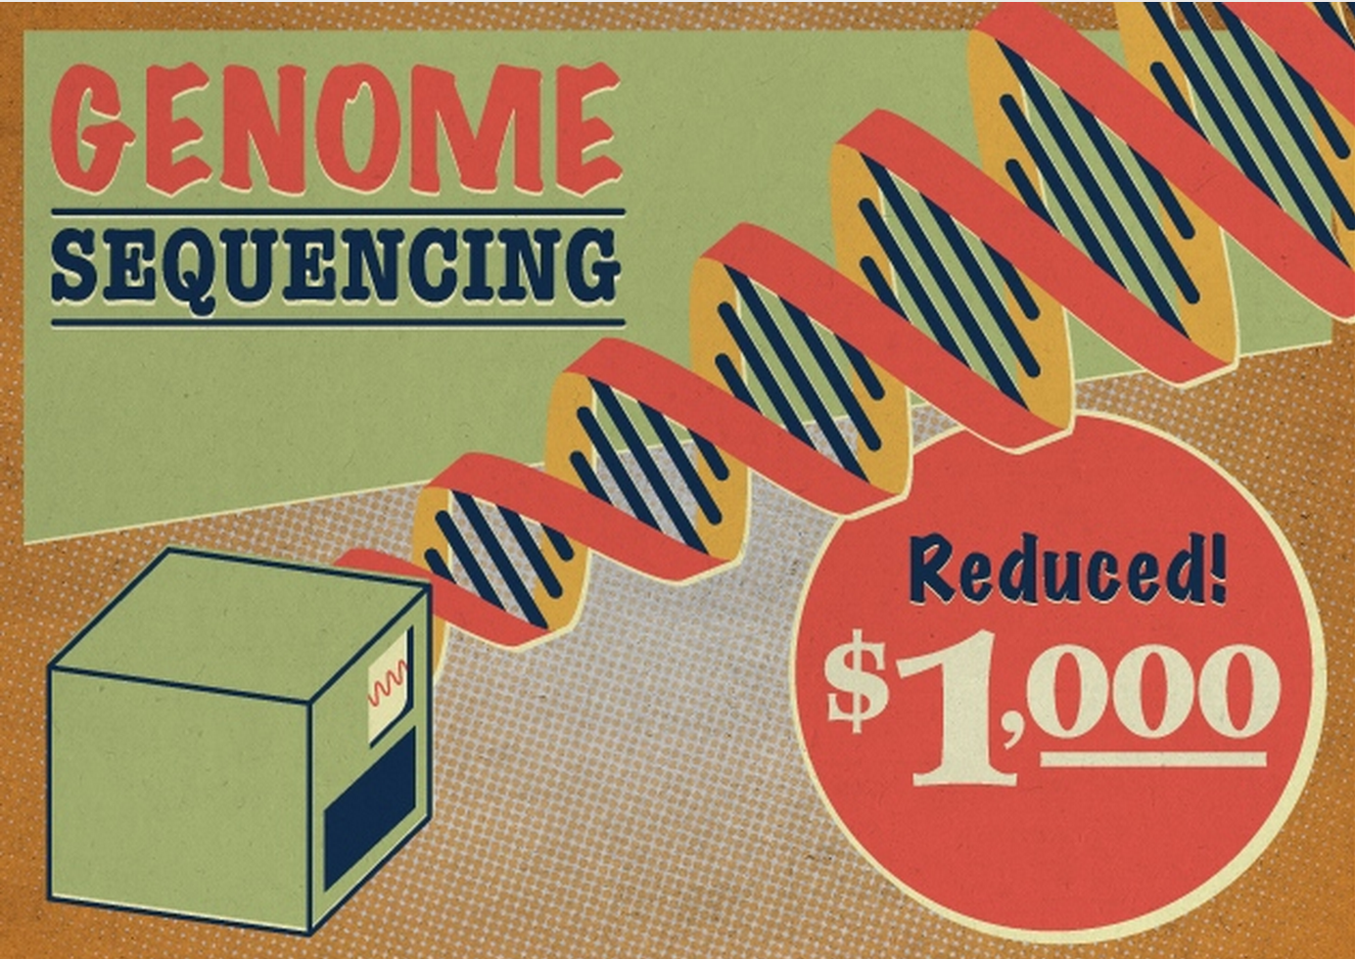
The Sequencing Explosion
’14
$1K
HiSeq
’04
’07
’08
Human Reference Genome
$300 million
Venter Genome
$70 million
Watson Genome
$1 million
Nature, 2010
Notes:
Introduction slides.
Personal/disease genome
The question of selecting disease variants
GWAS for common variants, many of them enriched in noncoding regions, how to interpret the functions of those variants….
What about rare and somatic variants
Rare variant ~3.5 M, whereas for somatic ~1000 mutations
Recurrent – gwas for exact position, recurrent for regions
See ncvarg grant introduction….

Slide 3
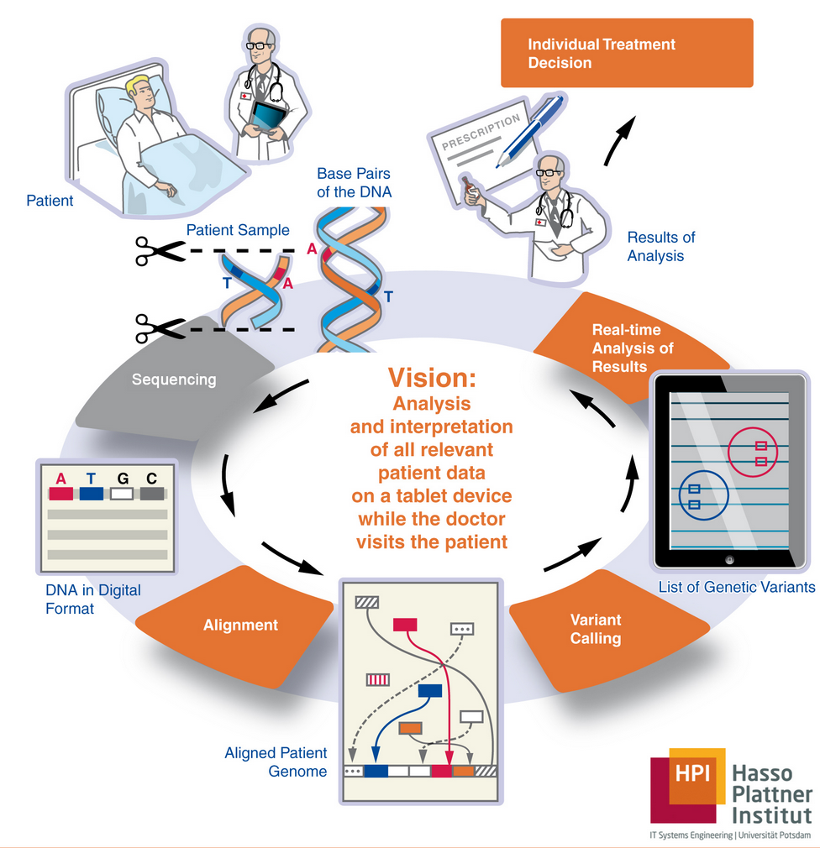
Personalized Medicine
Use an individual's genetic profile to guide decisions made in regard to the prevention, diagnosis, and treatment of disease.
Genomic variants
SNV - Single Nucleotide Variants (~ 3.5M)
Indel - Short Deletions and Insertion (~ 0.35M)
SV - Structural Variants, large deletions, duplications, inversions and translocation and etc. (~ 2.5K)
How to select disease variants?
Notes:
Introduction slides.
Personal/disease genome
The question of selecting disease variants
GWAS for common variants, many of them enriched in noncoding regions, how to interpret the functions of those variants….
What about rare and somatic variants
Rare variant ~3.5 M, whereas for somatic ~1000 mutations
Recurrent – gwas for exact position, recurrent for regions
See ncvarg grant introduction….

Slide 4
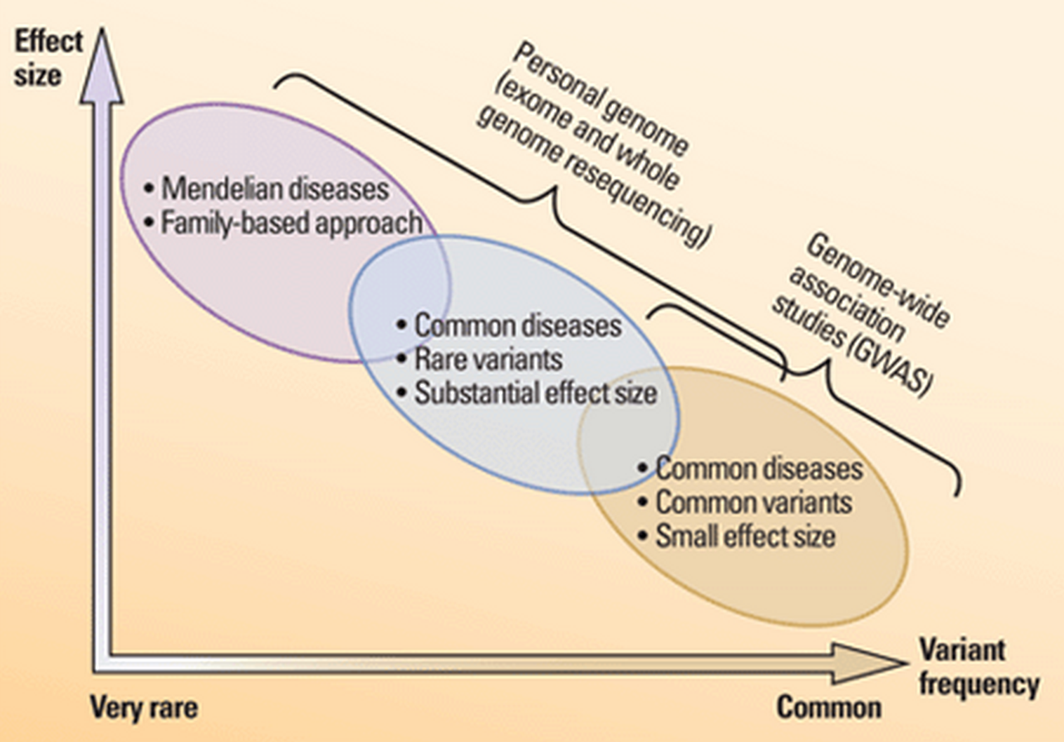
Common / Rare Variant
GWAS
SNP may not be causative allele, but this should be in a region of linkage disequilibrium (LD) around SNP
88% of identified SNPs are intergenic or intronic (Hindorff et al. 09)
How to find causal variants? How to interpret noncoding variants?
Kaiser, Science 2012
Notes:
GWAS:
Pros: far more sensitive than family studies
Cons: 1 . different rare mutations act in different families or individuals at the same locus (allelic heterogeneity)
2. Detection of rare variants
3. LD issues

Slide 5
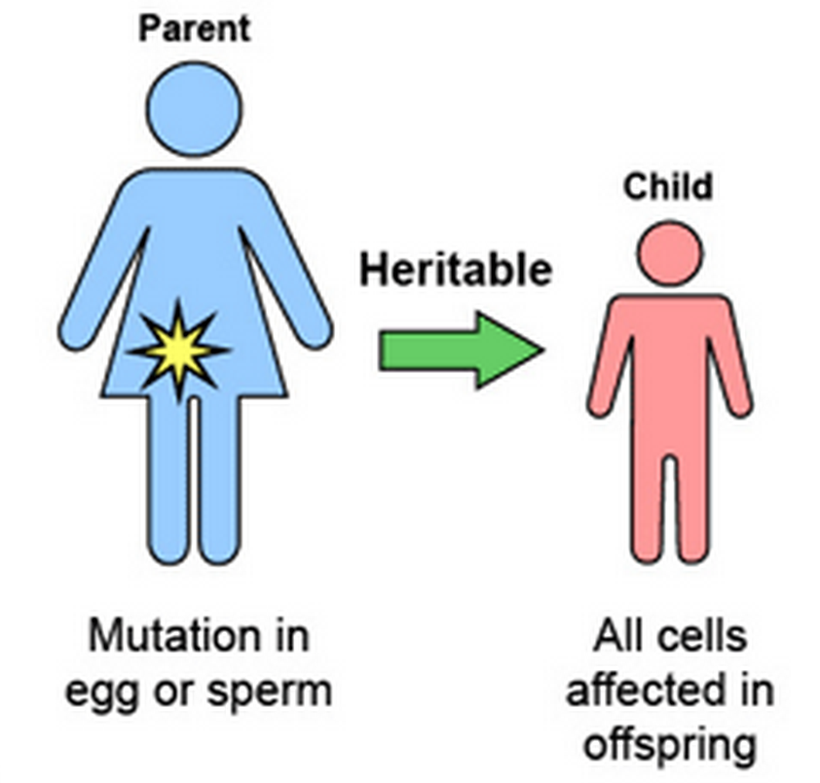
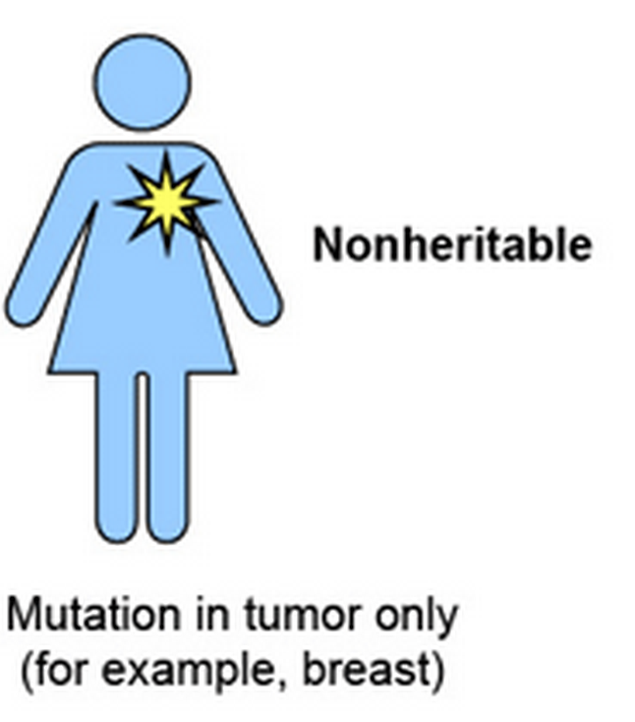
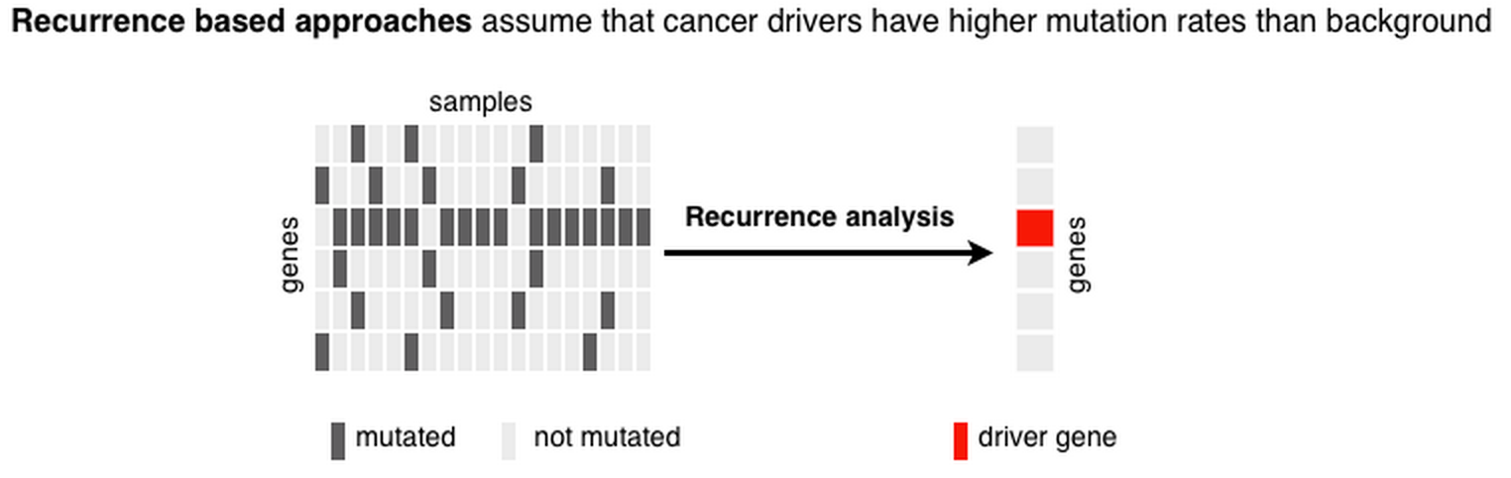
Rare Germline / Somatic Mutations
Rare germline mutation
- Inherited variants
- Purifying selection or neutral ?
Somatic mutations
- DNA mitosis
- Tumor drivers are positively selected
30~150K (0.5%)
120~680K (0.5~5%)
~ A few thousands
Notes:
Rare variant ~3.5 M, whereas for somatic ~1000 mutations
Recurrent – gwas for exact position, recurrent for regions
See ncvarg grant introduction….

Slide 6
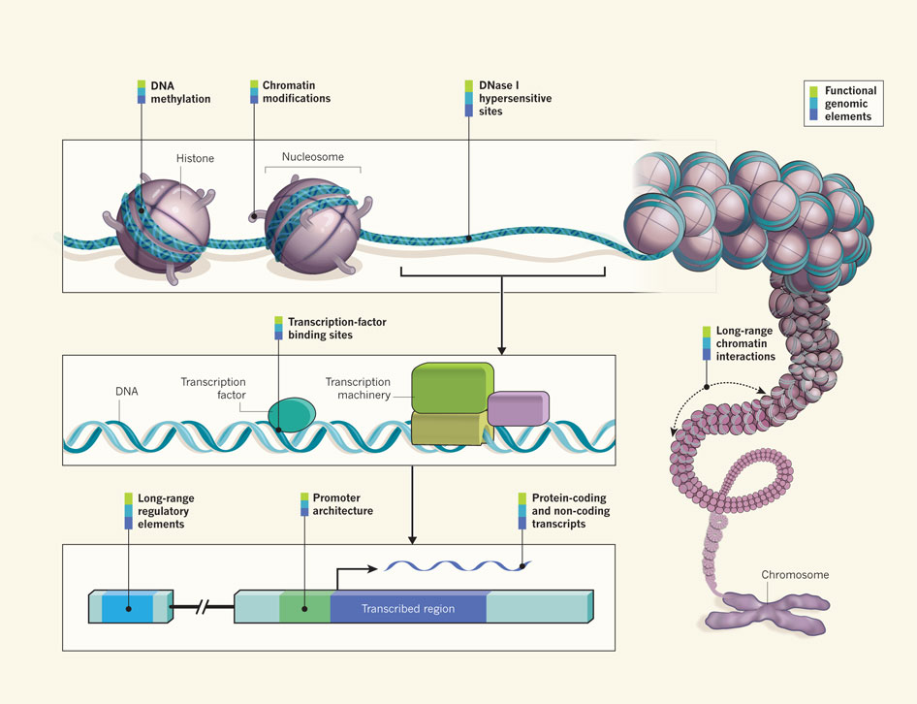
Decoding the Human Genome - coding / noncoding
ENCODE Project
How to quantify functional consequences of genetic variants ?
Ecker et al., Nature, 2012

Slide 7
Outline
Coding Variants Interpretation
  NetSNP
  ALoFT
Noncoding Variants Interpretation
  FunSEQ

Slide 8
Part One - Coding Variants
1.1 - A Unified Network Approach to Interpret Coding Variants
1.2 - ALoFT: Consequences of Loss-of-Function Mutations

Slide 9
Multinet – the ultimate hairball!
Genes participate in many networks and no single network captures the global picture of gene interactions
Combine regulatory, physical protein-protein, signaling, metabolic, phosphorylation and genetic interactions to create a unified network (Multinet)
Nodes: ~15,000 genes
Edges: ~110,000 interactions
Khurana* and Fu* et al., PLOS Comp. Bio. ’13
1.1 - A Unified Network Approach to Interpret Coding Variants
Notes:
Explain better: may be show just the hairball and then show nodes on it

Slide 10
Multi-Net
Exceptions to the rule
Hubs in metabolic network are tolerant to LoF mutations
Metabolic hubs have more duplicated copies
Perhaps ’protective’ effect of metabolic pathways leads to different architecture
1.1 - A Unified Network Approach to Interpret Coding Variants
Notes:
Introduce the pink & cyan
Goal is to predict disease
We’ll start training/testing on the extremes
Lof
Essen -
Hgmd – rarer mendelian variants
Gwas – “common” variants
Neutral

Slide 11
Overlapping 3D Structures with Protein Protein Interaction Network
Essential genes have more interacting interfaces
1.1 - A Unified Network Approach to Interpret Coding Variants
Notes:
Introduce the pink & cyan
Goal is to predict disease
We’ll start training/testing on the extremes
Lof
Essen -
Hgmd – rarer mendelian variants
Gwas – “common” variants
Neutral

Slide 12
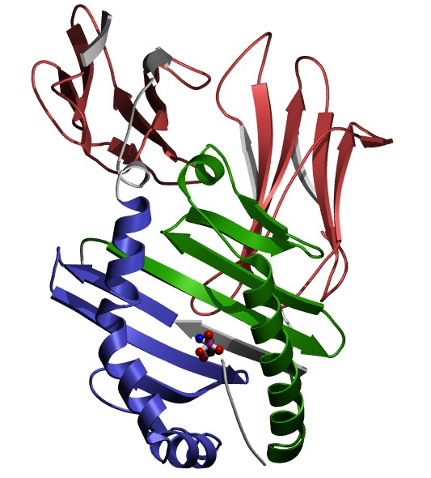
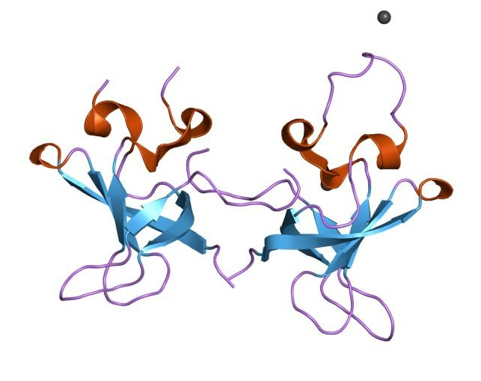
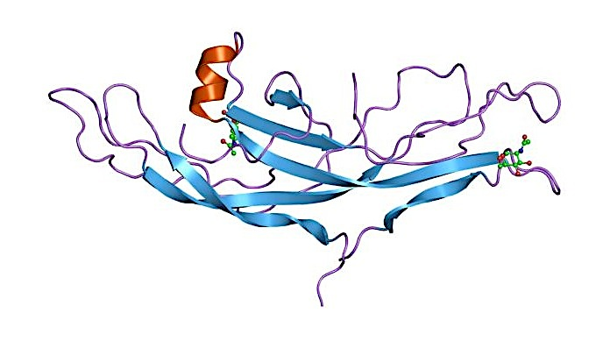
Accessible surface area of miss-sense SNPs
WASP
CDC42
PBD
WH1
TRIP10
WASP interactions tested using yeast two-hybrid experiments
Collaborated with H Yu Cornell
Khurana* and Fu* et al., PLoS Comp. Bio., 2013
Khurana* and Fu* et al, Science, 2013
Wang et al, Nature Biotech, 2012
1.1 - A Unified Network Approach to Interpret Coding Variants

Slide 13
Integration of network properties to predict systems-level effects of deleterious mutations
Train logistic regression model using network and evolutionary properties
Can distinguish between LoF-tolerant and Essential genes with high accuracy
Application of the model on all genes
AUC=0.91
True positive rate
False positive rate
1.1 - A Unified Network Approach to Interpret Coding Variants

Slide 14
Conclusions
A unified network approach to investigate gene essentiality
For Metabolic network, central genes have more duplicated copies and are more tolerant to loss-of- function mutations
Disease mutations tend to occur inside protein, and also on interacting interfaces
Built a classifier to score variant in genes
1.1 - A Unified Network Approach to Interpret Coding Variants

Slide 15
Part One - Coding Variants
1.1 - A Unified Network Approach to Interpret Coding variants
1.2 - ALoFT: Consequences of Loss-of-Function Mutations

Slide 16
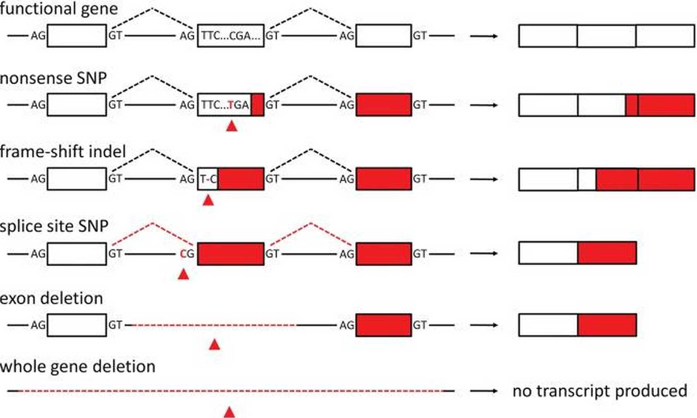
Prevalence of Loss-of-function variants in healthy individuals
Previous LoFs are considered as having high probability of being deleterious
Surprisingly, ~ 100 LoF variants per genome, 20 genes are completely inactivated
MacArthur et al., Hum Mol Genet, 2010
1.2 - ALoFT: Consequences of Loss-of-Function Mutations

Slide 17
ALoFT workflow
Annotate variant with Mismapping,
Functional, Conservation and etc.
Predict disease-causing potentials
1.2 - ALoFT: Consequences of Loss-of-Function Mutations

Slide 18
Pathogenicity prediction trained on benign, recessive and dominant LoFs
Random Forest
Training: 404 Benign LoFs; 2,560 Recessive LoFs; 2,181 Dominant LoFs
One variant per gene
Random sample balanced data for each tree
10 - fold cross-validation; repeat 40 times
AUC: 0.955
1.2 - ALoFT: Consequences of Loss-of-Function Mutations

Slide 19
Healthy people carry nonsense LoFs in known disease genes
426 Variant
LoF location
Transcript disruption
~ 27.6% on different isoforms
P-value: 8e-3
Training data are excluded
1.2 - ALoFT: Consequences of Loss-of-Function Mutations

Slide 20
Isoform-specific LoFs
NF2:
Neurofibromatosis type II
Autosome dominant inheritance pattern
1.2 - ALoFT: Consequences of Loss-of-Function Mutations
Notes:
Update this figure….

Slide 21
CMG dominant Vs. recessive mutations
CMG: Center for Mendelian Genomics
1.2 - ALoFT: Consequences of Loss-of-Function Mutations

Slide 22
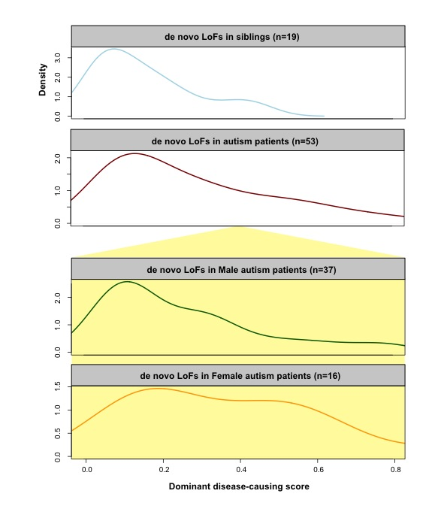
Mutation burden bias of de novo LoFs in Autism
Proband Vs. Sibling
P-value: 5e-3
Male Proband Vs. Female Proband
P-value: 0.03
1.2 - ALoFT: Consequences of Loss-of-Function Mutations
21

Slide 23
Enrichment of deleterious LoFs in tumor suppressors
Nonsense somatic LoFs from ~ 6,000 Exome-Sequencing
1.2 - ALoFT: Consequences of Loss-of-Function Mutations
22

Slide 24
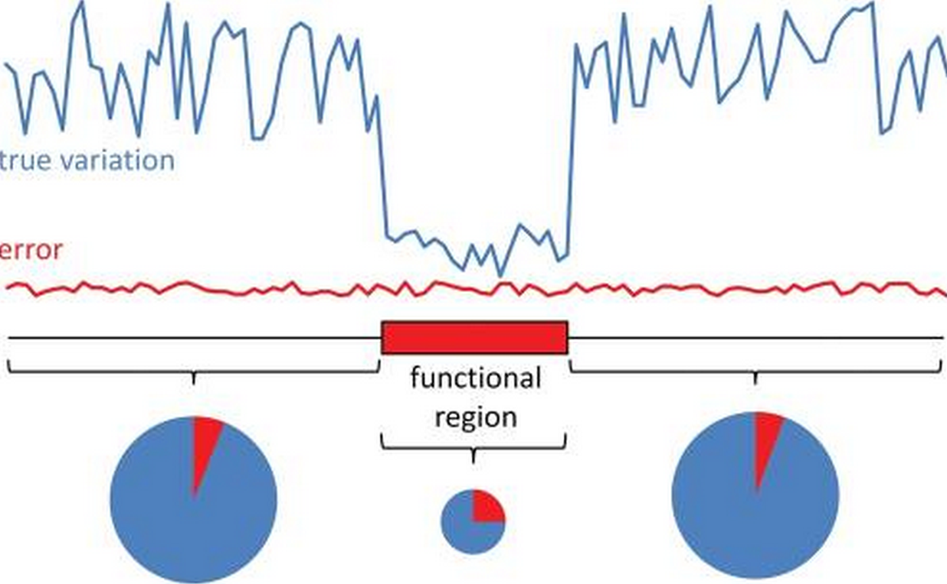
How many disease LoFs do we have ?
High error rate of LoF variants
High-confident set: Filtered out variants with >=1% allele frequency in 1KG, but absent in ESP6500
Among ~100 LoFs, we estimate 3 recessive, close to 0 dominant disease nonsense variants per healthy genome.
MacArthur et al., Hum Mol Genet, 2010
1.2 - ALoFT: Consequences of Loss-of-Function Mutations

Slide 25
Conclusions
Developed ALoFT for charactering Loss-of-function variants.
  - Discriminate dominant vs. recessive LoFs
Autism female patients demonstrate higher mutation burden than males, in terms of nonsense LoFs
On average, each individual is a carrier of 3 recessive and close to 0 dominant nonsense LoFs
1.2 - ALoFT: Consequences of Loss-of-Function Mutations

Slide 26
Part Two - Noncoding variants
FunSEQ - A Framework for Prioritizing Regulatory Variants in Cancer and Application to Gastric Tumor Genomes

Slide 27
2.1 Selection Pressure Acting on Regulatory elements
2.2 Contrasting Somatic with Germline Mutations
2.3 FunSEQ - A Framework for Prioritizing Regulatory Variants in Cancer
2.4 Application to Gastric Cancer

Slide 28
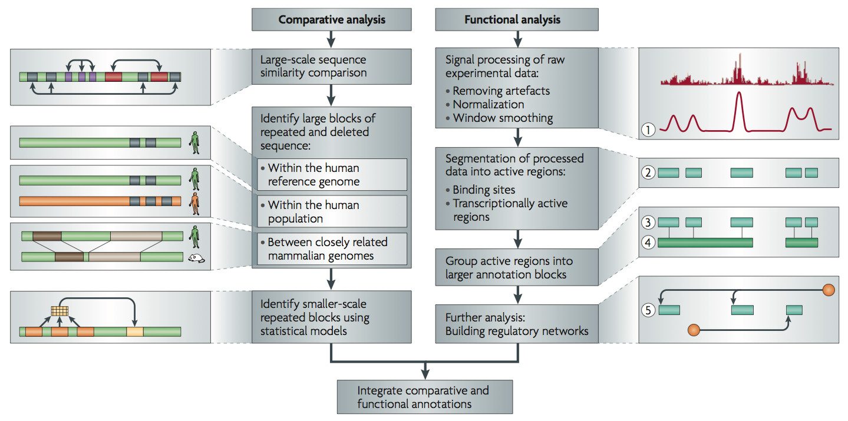
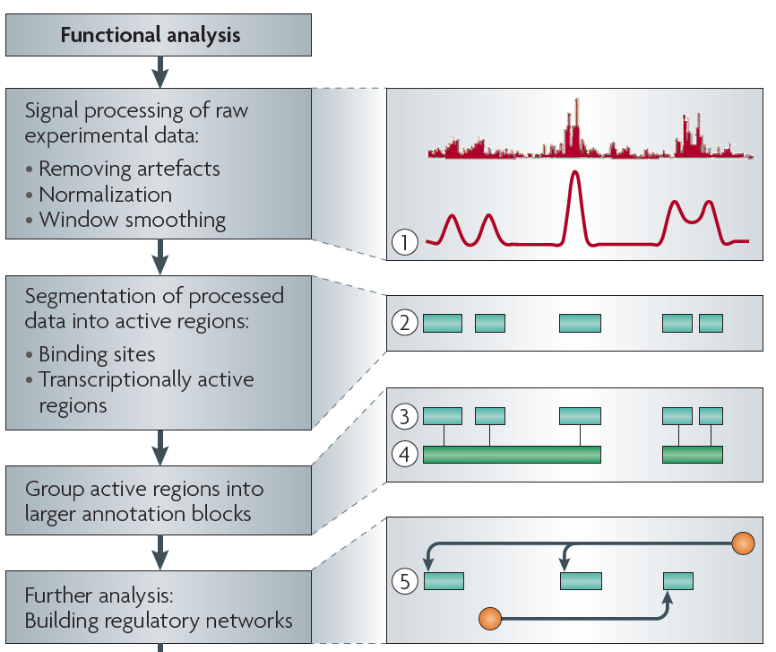
Non-coding Annotations: Overview
There are several collections of information "tracks" related to non-coding features
Sequence features, incl. Conservation
Functional Genomics
Chip-seq (Epigenome & seq. specific TF) and ncRNA & un-annotated transcription
[Nat. Rev. Genet. (2010) 11: 559]
2.1 Selection Pressure Acting on Regulatory elements

Slide 29



Metrics for selection
  Evolutionary conservation (GERP)
  SNP density
  (confounded by mutation rate)
Depletion of common polymorphisms for regions under selection
  Alternatively, negative selection restricts the allele frequency of deleterious mutations.
1
2
3
4
‘Conservation’
Typically defined by comparison across species
How do we define ‘sensitivity’ within human population?
- a depletion of common variants/an enrichment of rare variants
2.1 Selection Pressure Acting on Regulatory elements
Notes:
Baseline within human pop: 99.9% of the elements should be conserved

Slide 30
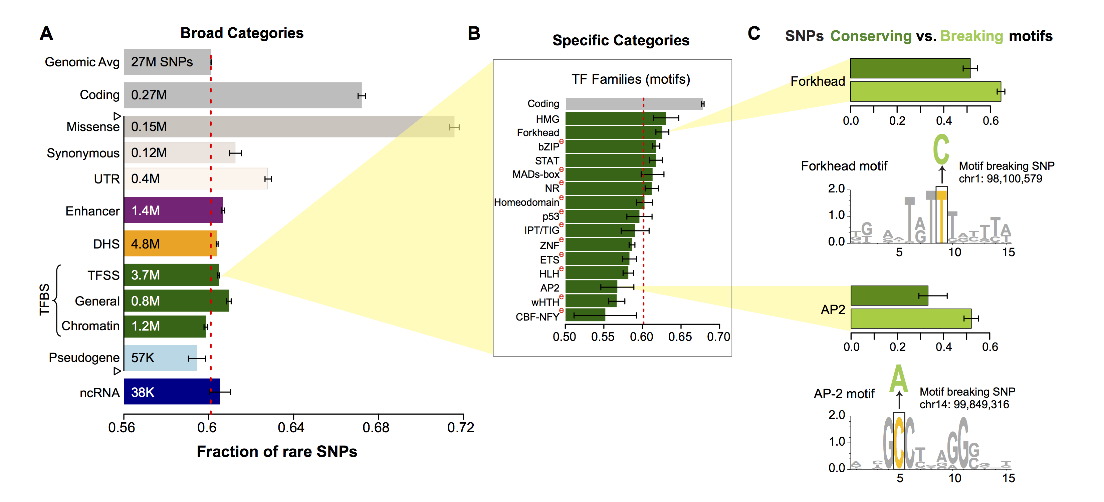
Differential selective constraints among sub-categories
2.1 Selection Pressure Acting on Regulatory elements

Slide 31
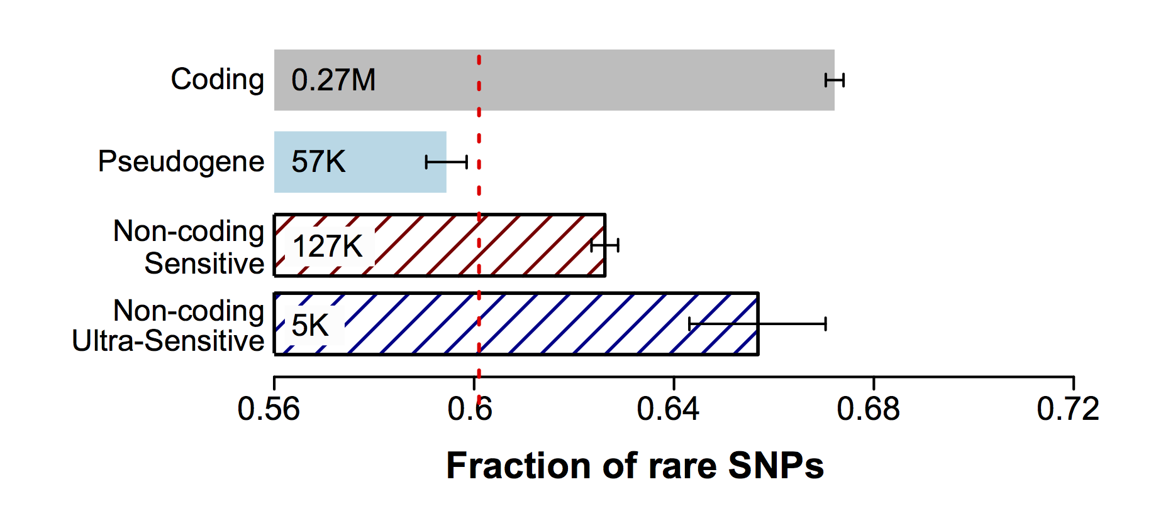
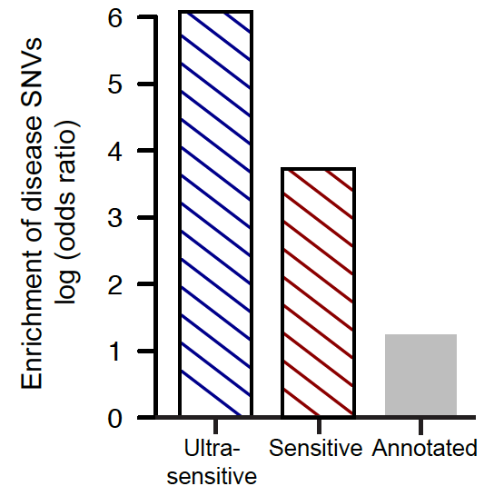
Can we identify which non-coding elements are under very strong “coding-like” selection ?
~0.4% genomic coverage (~ top 25)
~0.02% genomic coverage (top 5)
Start 677 high-resolution non-coding categories; Rank & find those under strongest selection
Binding peaks of some general TFs (eg FAM48A)
Core motifs of some TF families (eg JUN, GATA)
DHS sites in spinal cord and connective tissue
~400-fold
Enrichment of know disease-causing mutations from Human Gene Mutation database
~40-fold
2.1 Selection Pressure Acting on Regulatory elements

Slide 32
Noncoding cancer variants from whole-genome sequencing
64 prostate cancer (Berger et al, Nature, 2011; Baca et al, Cell, 2013)
  ~1,500 to 18,000 per sample
21 breast cancer (Nik-Zainal et al, Cell, 2012)
  ~2,000 to 80,000 per sample
3 medulloblastoma (Rausch et al., Cell 148, 2012)
  ~1,600 to 2,000 per sample
~ 99% of somatic SNVs occur in non-coding regions, including TFBSs, ncRNAs and pseudogenes
Cancer sequencing has been very exome focused
Publicity for TERT promoter mutation – exception proves the rule!
2.2 Contrasting Somatic with Germline Mutations

Slide 33
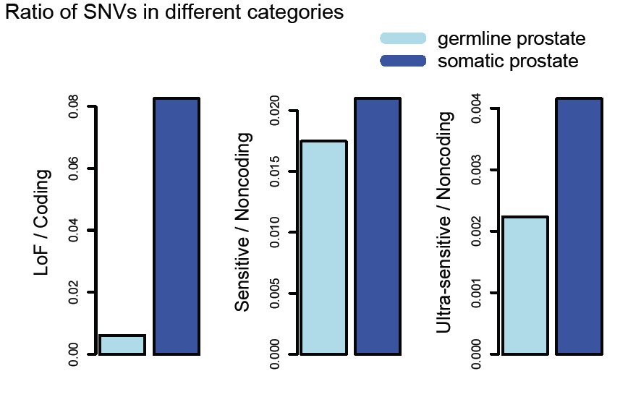
Somatic Vs. Germline Mutations
Somatic mutations do not follow patterns of natural polymorphisms
Those deviating the most from these patterns are most likely to be cancer drivers providing selective advantage to the tumor cells (confirmed for protein-coding genes)
Look for mutations in elements under strong negative selection
Khurana* and Fu* et al., Science, 2013
2.2 Contrasting Somatic with Germline Mutations
32

Slide 34
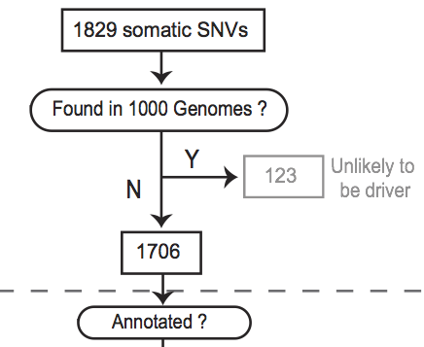
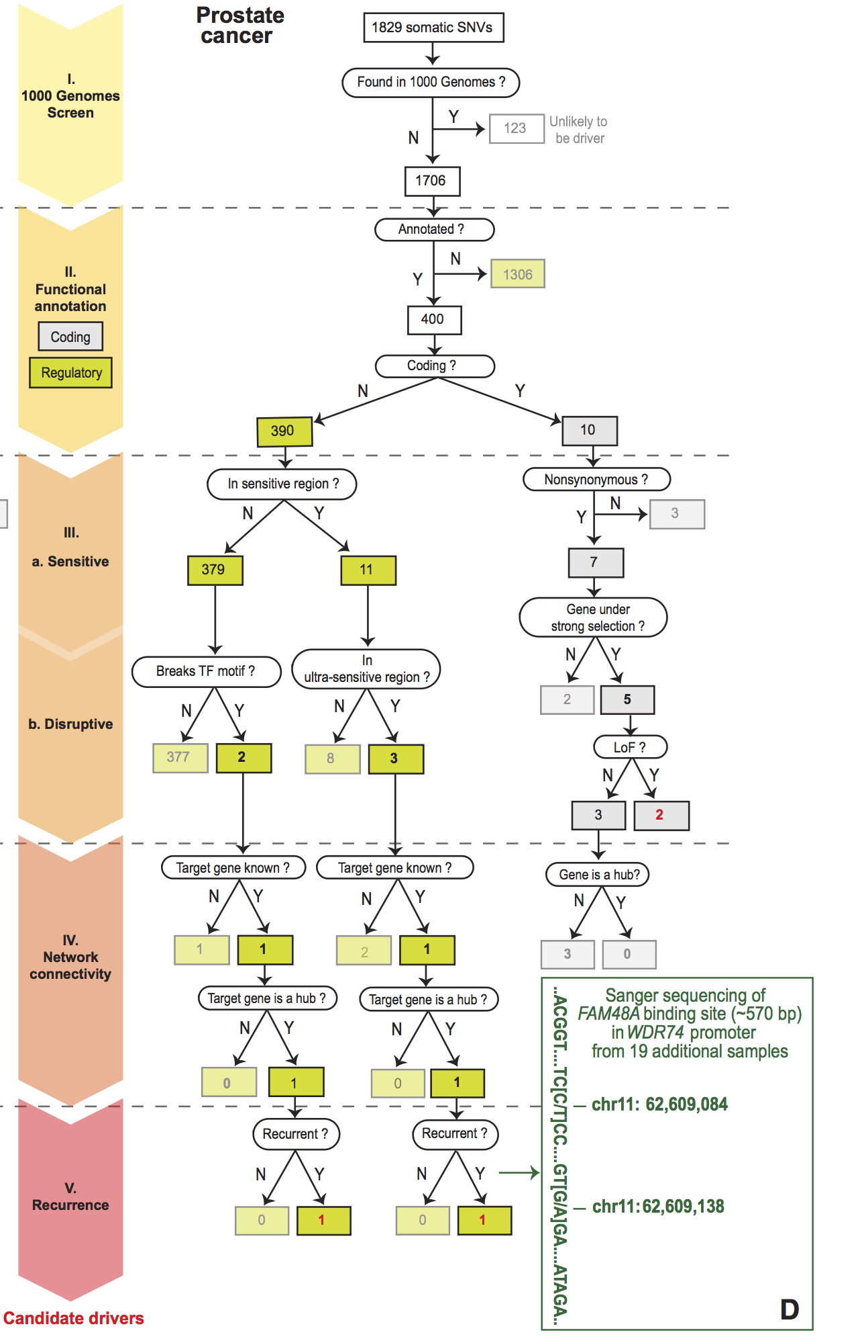
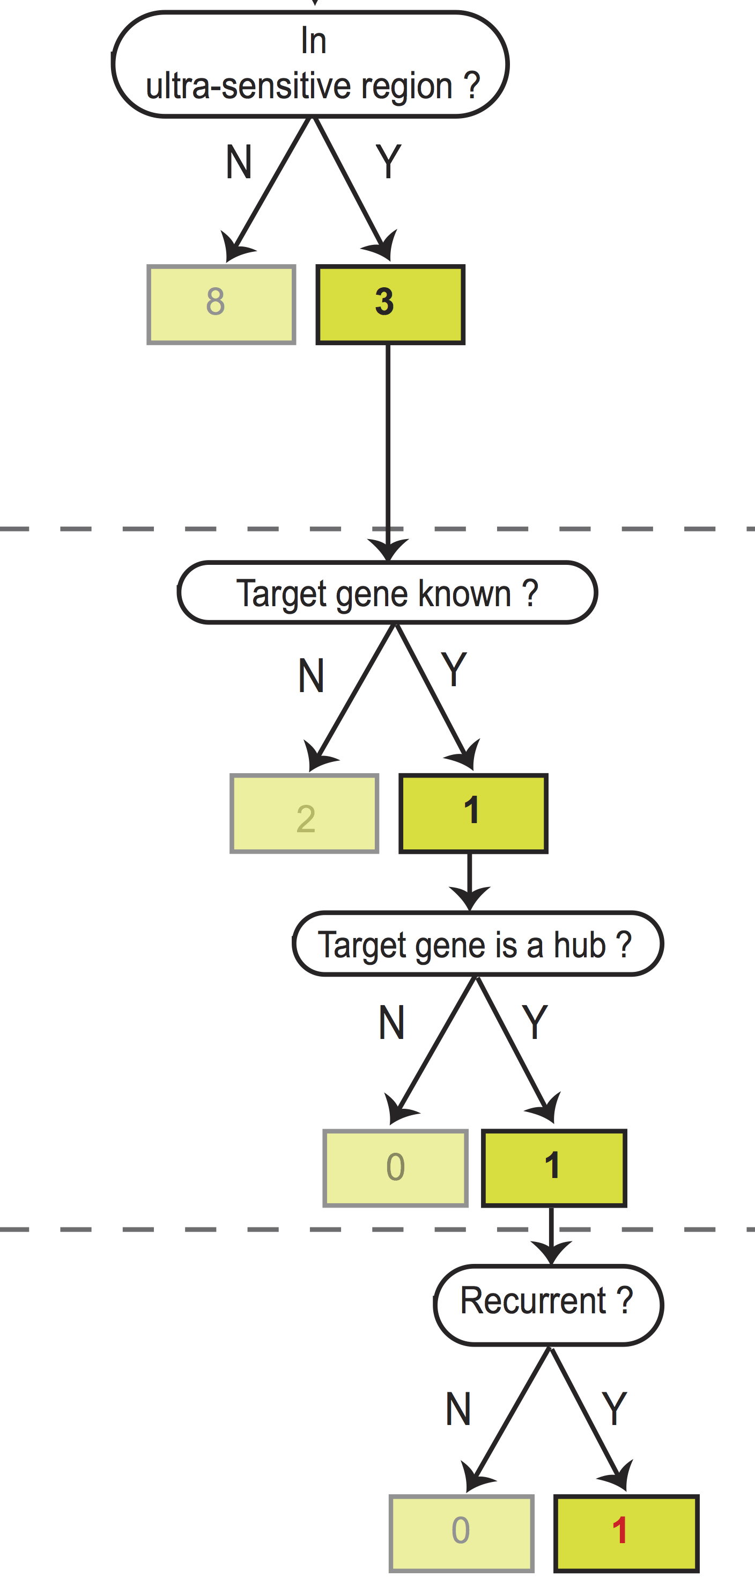
Flowchart for 1 Prostate Cancer Genome (from Berger et al. '11)
2.2 Contrasting Somatic with Germline Mutations
33
Notes:
Just have one path

Slide 35
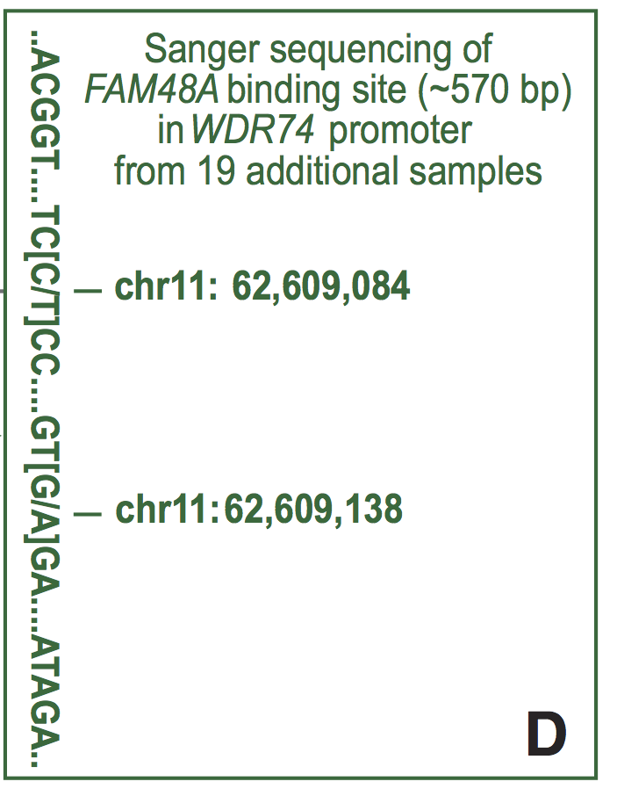
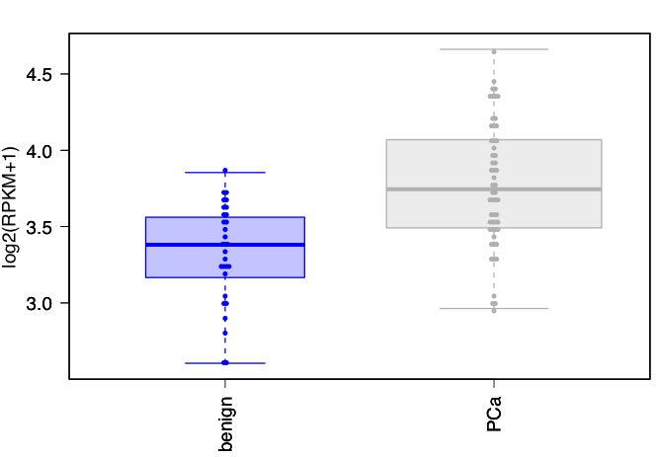
Validation of a candidate driver identified in prostate cancer sample in WDR74 gene promoter
Sanger sequencing in 19 additional samples confirms the recurrence
WDR74 shows increased expression in tumor samples
benign
PCs
Khurana* and Fu* et al., Science, 2013
2.2 Contrasting Somatic with Germline Mutations
34

Slide 36
Human Genome Analysis:
Large-scale Non-coding Annotation & Application to Cancer Genomics
Noncoding Annotation
  1st Level Linear Annotation: Regulatory Sites
    Peak calling & enhancer finding (genome segmentation)
    Sites particularly sensitive to mutations (‘sensitive regions’)
    …
  2nd Level Network Annotation
    Linking regulatory elements with genes
    More connectivity = more constraint
Prioritization of cancer mutations
  FunSEQ software tool
    Summarizing large data context
  Validating the tool
2.3 FunSEQ - A Framework for Prioritizing Regulatory Variants in Cancer
35

Slide 37
Associate regulatory elements with target genes
Idea: Histone modifications to predict gene expression
  Active marks: H3K4me1 and H3K27ac
  Repressive marks: DNA methylation
We identified ~ 703K significant associations between ~ 332K regulatory elements and ~ 17K genes
Yip et al., Genome Biology (2012)
HM signals
Expression levels
H3K4me1
H3K27ac
...
Gene 1
Gene 2
Gene 3
...
Scale
GM12878
Strong
Cell lines
H1-hESC
HeLa-S3
Hep-G2
K562
...
Weak
Find correlated enhancer-target pairs
Fu et al., Genome Biology (2014)
2.3 FunSEQ - A Framework for Prioritizing Regulatory Variants in Cancer
36

Slide 38
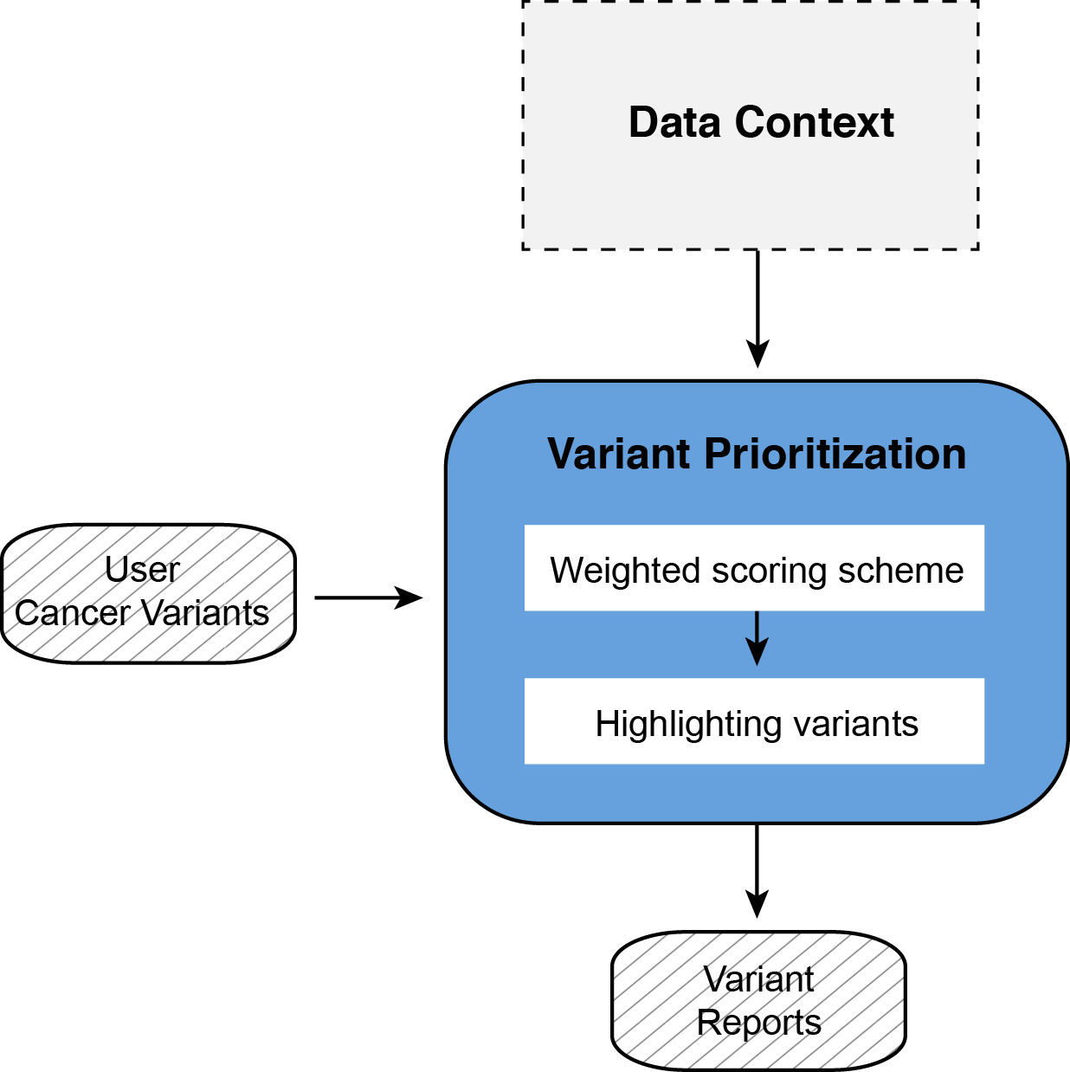
FunSEQ Structure
0. Data Context
Weighted scoring scheme
  1.1 Core score
  1.2 Recurrence module
2. Highlighting variants with
additional features
2.3 FunSEQ - A Framework for Prioritizing Regulatory Variants in Cancer
37

Slide 39
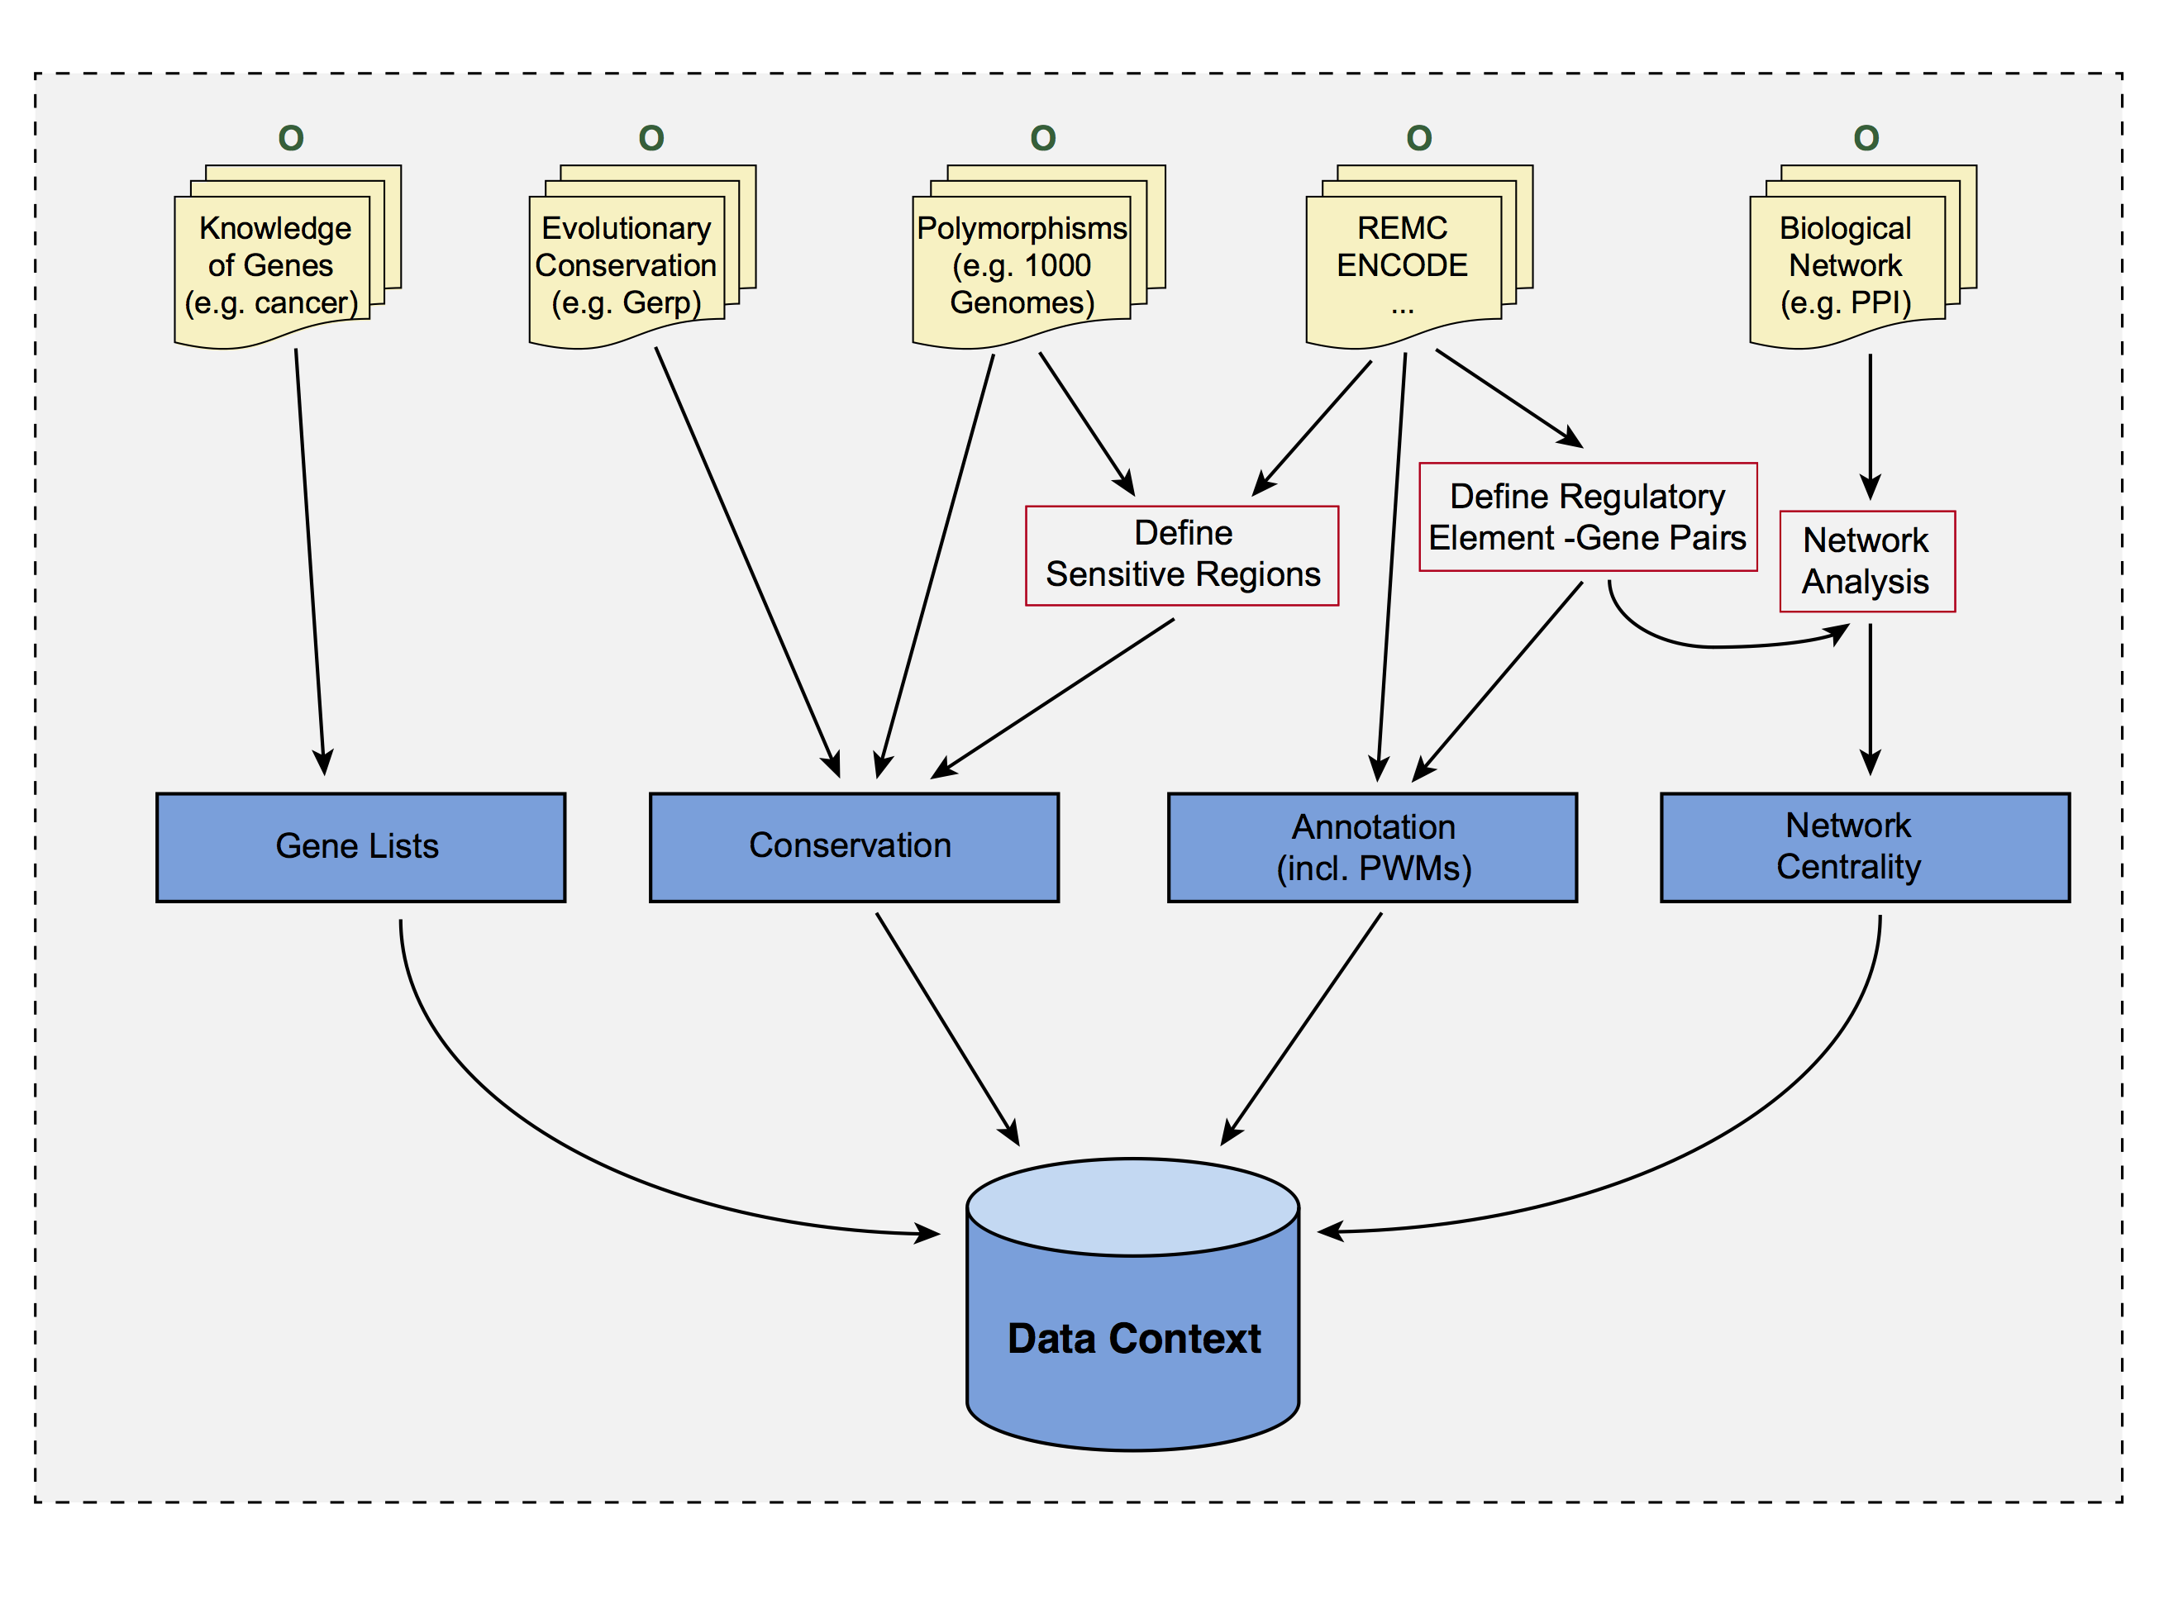
Data context
~10TB
input data
Summar-ized Data
~10 GB (public)
2.3 FunSEQ - A Framework for Prioritizing Regulatory Variants in Cancer
38
Notes:
Size of data context

Slide 40
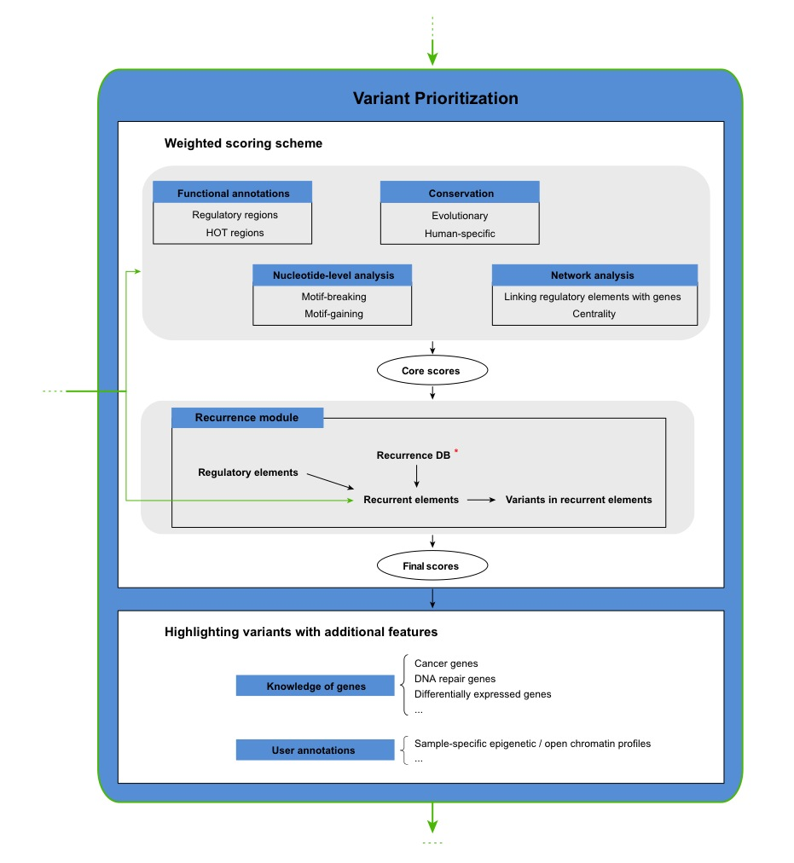
Data Context (~10Gb, public)
Compute variant prioritization for every possible substitution in the genome
(3 subs * 3 Gb).
Not specific to any study (or cancer) & not private
User Variants
(small, ~5000 & pot. private)
"Core Score File"
2.3 FunSEQ - A Framework for Prioritizing Regulatory Variants in Cancer

Slide 41
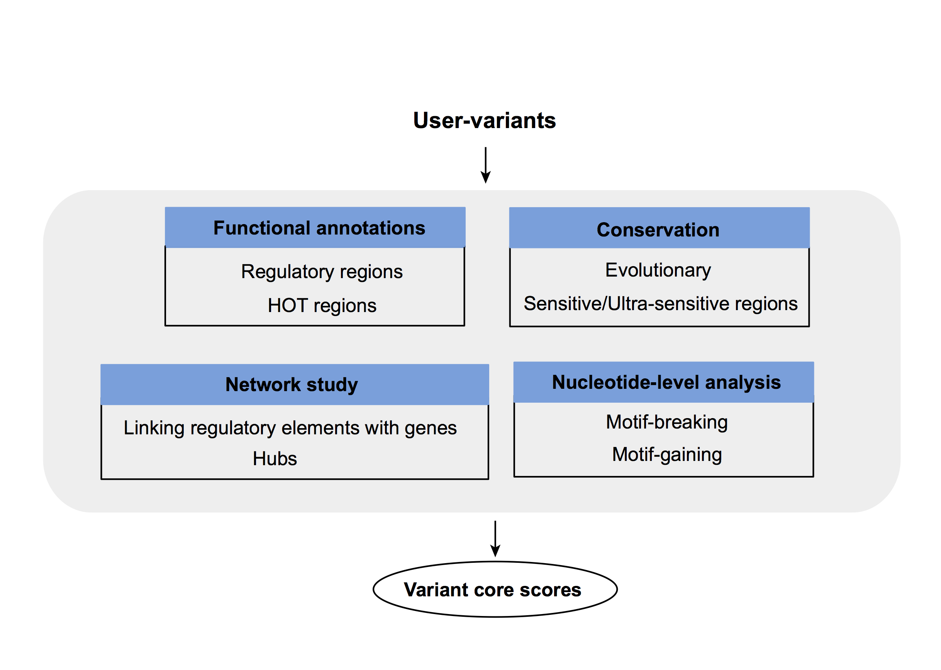
Weighted scoring scheme (1)
Core score
  Each feature gets a weight
"Core Score File"
2.3 FunSEQ - A Framework for Prioritizing Regulatory Variants in Cancer
40

Slide 42
Feature weight
- Weighted with mutation patterns in natural polymorphisms
(features frequently observed weight less)
- entropy based method
HOT region
Sensitive region
Polymorphisms
Genome
Feature weight:
p = probability of the feature overlapping natural polymorphisms
For a variant:
2.3 FunSEQ - A Framework for Prioritizing Regulatory Variants in Cancer
41
Notes:
Better schematic ….

Slide 43
Weighted scoring scheme (2)
Recurrent elements
- regulatory elements mutated in >= 2 samples
Recurrence database
- 670 whole-genome sequenced samples
- 11 cancer types
- also contains COSMIC dataset
2.3 FunSEQ - A Framework for Prioritizing Regulatory Variants in Cancer
42

Slide 44
Highlighting variants with additional features
Cancer genes, DNA-repair genes….
Differentially expressed genes - a module to detect those genes from RNA-Seq.
Other user annotations (optional), e.g. sample-specific epigenetic modifications
Sakabe et al., Genome Biology, 2012
2.3 FunSEQ - A Framework for Prioritizing Regulatory Variants in Cancer
43

Slide 45
Recurrent variants have higher core scores than non-recurrent ones
COSMIC noncoding variants
Variants from 119 breast cancer samples
2.3 FunSEQ - A Framework for Prioritizing Regulatory Variants in Cancer
44

Slide 46
Germline pathogenic variants show higher core scores than controls
3 controls with natural polymorphisms (allele frequency >= 1% )
1. Matched region: 1kb around HGMD variants
Matched TSS: matched for distance to TSS
Unmatched: randomly selected
Ritchie et al., Nature Methods, 2014
2.3 FunSEQ - A Framework for Prioritizing Regulatory Variants in Cancer
45

Slide 47
Apply to individual tumor genomes
Cancer samples with TERT promoter mutation (chr5:1295228)
2.3 FunSEQ - A Framework for Prioritizing Regulatory Variants in Cancer
46

Slide 48
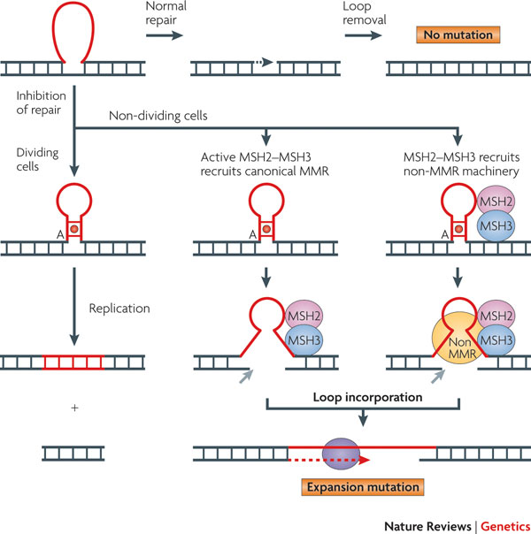
Molecular and Histological Subtypes of Gastric Cancer
Gastric Cancer Samples
(100)
EBV (Epstein-Barr Virus) Positive
(8)
MSI (Microsatellite Instable)
(10)
Impaired DNA repair system
MSS
intestinal type
(41)
mixed type
(14)
diffuse type
(29)
gland-forming adenocarcinoma
infiltrating isolated cells
McMurray, Nature Review Genetics,2010
2.4 Application to Gastric Cancer

Slide 49
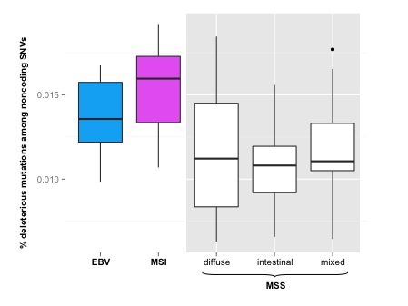
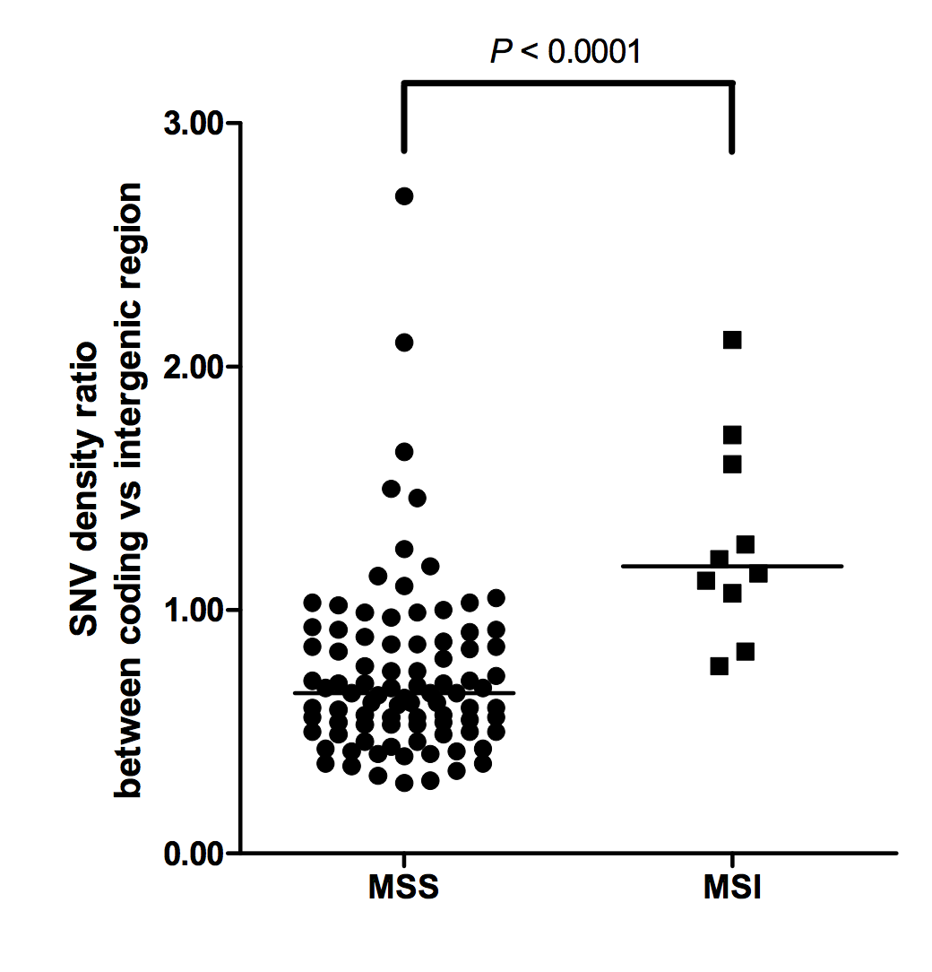
MSI (micro-satellite instable) Tumors have More Deleterious Noncoding SNVs than MSS
MSI Enriched for Coding Mutations
P-value: 1.7e-3
Wang et al., Nature Genetics, 2014
2.4 Application to Gastric Cancer

Slide 50
Passenger mutations accumulate with tumor progression
Driver events tend to occur in the early stage of tumor
2.4 Application to Gastric Cancer

Slide 51
Conclusions
Identified ‘sensitive regions’ under strong purifying selection
Somatic mutations tend to disrupt functional important elements
Developed FunSEQ to annotate and prioritize noncoding variants
Subtype differences among gastric cancer

Slide 52
Future Directions
Model updates with newly available dataset
Better recurrence model, quantify noncoding RNAs
Apply to large-scale cancer genomes - ICGC, TCGA
…

Slide 53


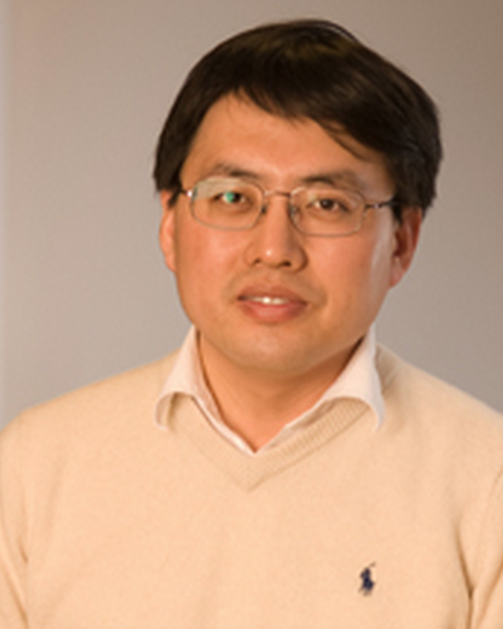
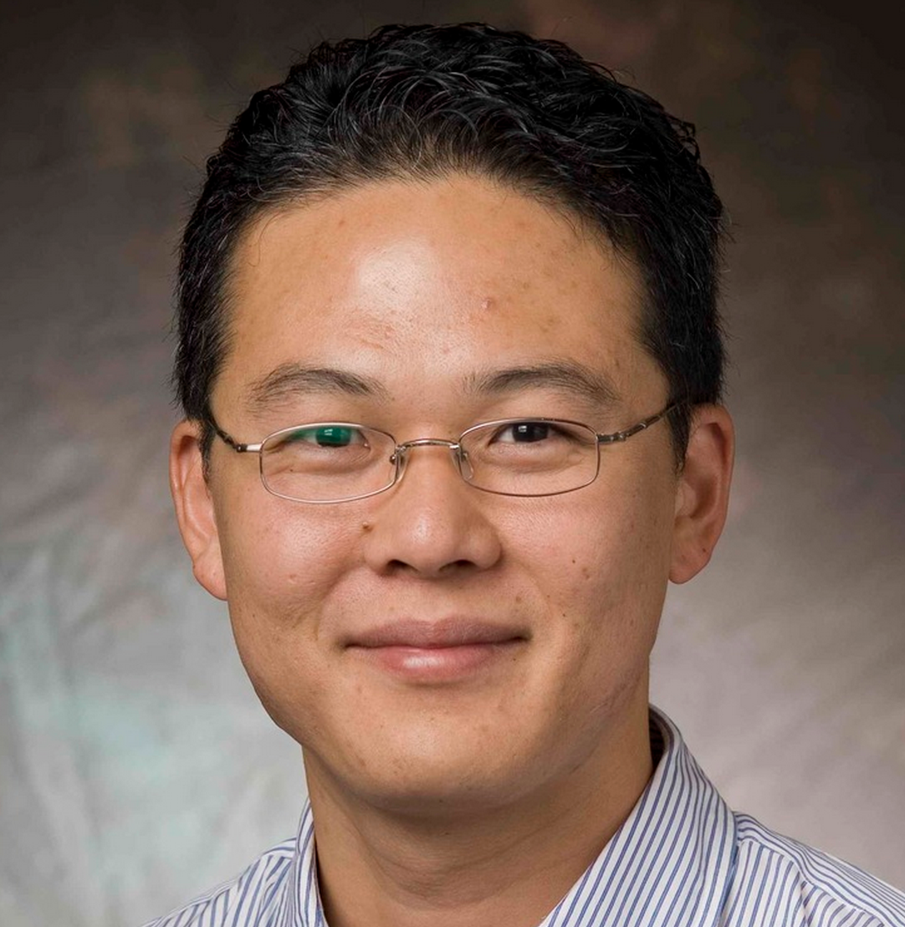
Acknowledgement
Committee Member
Mark Gerstein
Michael Krauthammer
Hongyu Zhao
Taehoon Kim

Slide 54
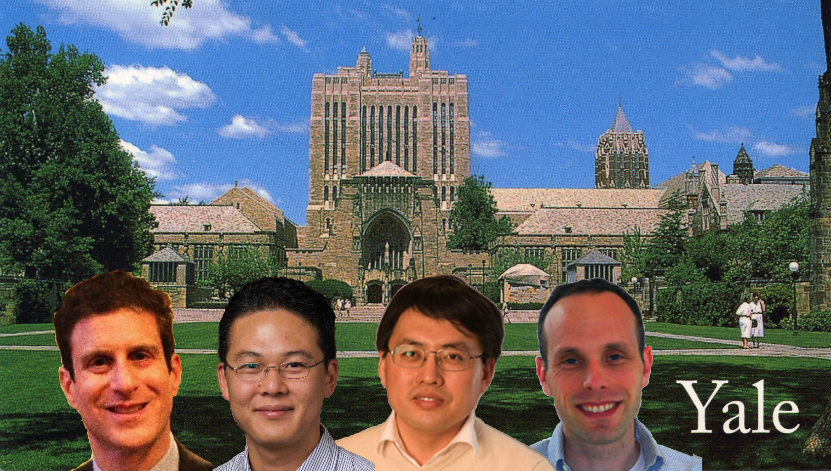
Acknowledgement

Slide 55
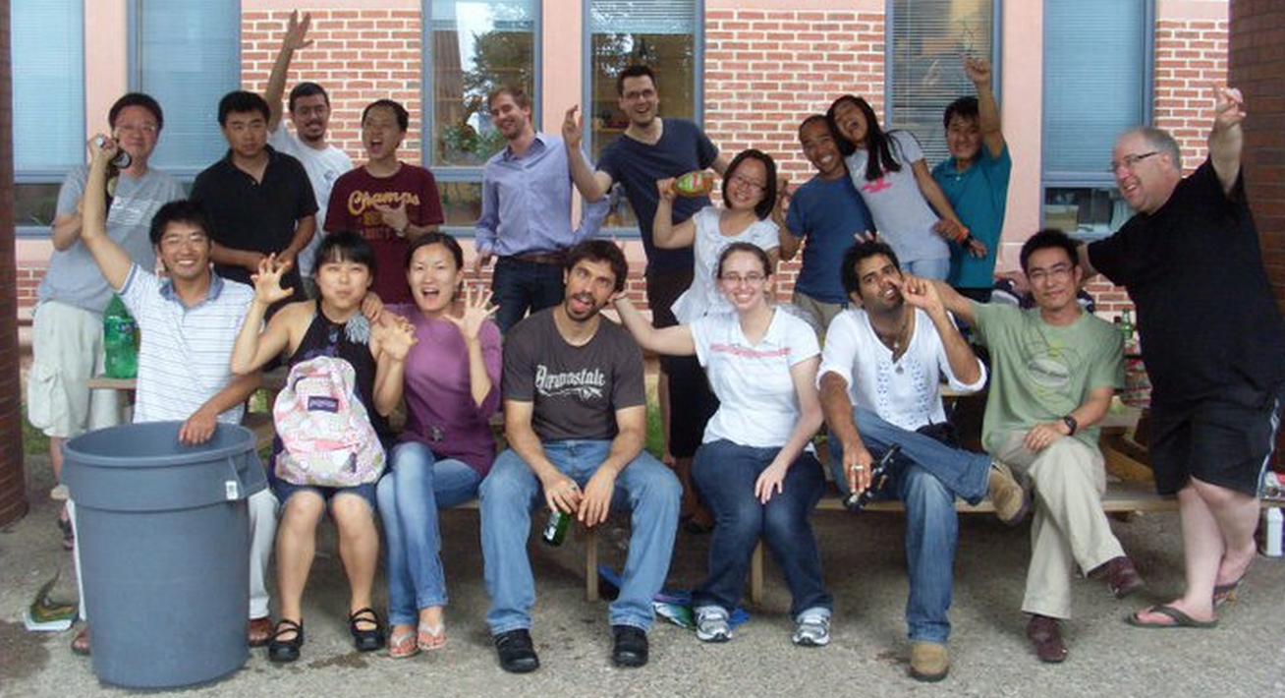
Acknowledgement
Xinmeng Jasmin Mu (Broad)
Chong Shou
Jieming Chen
Jason Bedford
Andrea Sboner (Cornell)
Alexej Abyzov (Mayo)
Lucas Lochovsky
Declan Clarke
Arif Harmanci
Joel Rozowsky
Anurag Sethi
Koon-Kiu Yan
Ekta Khurana (Cornell)
Suganthi Balasubramanian
Chao Cheng (Dartmouth)
Baikang Pei
Michael Rutenberg Schoenberg
Robert Kitchen
Cristina Sisu
Daifeng Wang
Yan Zhang
Jing Zhang
Sushant Kumar
Timur Galeev
Fabio Navarro
Leonidas Salichos
Dan Spakowicz
Shantao Li
Mengting Gu
Paul Muir
Mihali Felipe
Lori Iannicelli

Slide 56

Acknowledgement
Zhu Liu
Shaoke Lou
Kevin Y Yip
Mark Rubin
Dimple Chakravarty
Lisa Sobel
Perry Miller
All the Yale CBBer
My family and friends
Zhixiang Lin
Vincenza Colonna, Yali Xue, Chris Tyler-Smith, Hyun Min Kang, Tuuli Lappalainen, Kathryn Beal, Daniel Challis, Yuan Chen, Laura Clarke, Fiona Cunningham, Emmanouil T. Dermitzakis, Uday Evani, Paul Flicek, Erik Garrison, Javier Herrero, Yong Kong, Kasper Lage, Daniel G. MacArthur, Gabor Marth, Donna Muzny, Tune H. Pers, Graham R. S. Ritchie, Jeffrey A. Rosenfeld, Fuli Yu, Richard Gibbs, Haiyuan Yu

Slide 57

Thanks for listening!
It’s
time for Questions.

