Slide 1
Analysis of Protein Networks
Insert image from Flickr -- maybe something like the following:
Tree-Networks-beginning-to-be-revealed--DSC04343
Mark Gerstein
Yale University
June 8, 2015

Slide 2
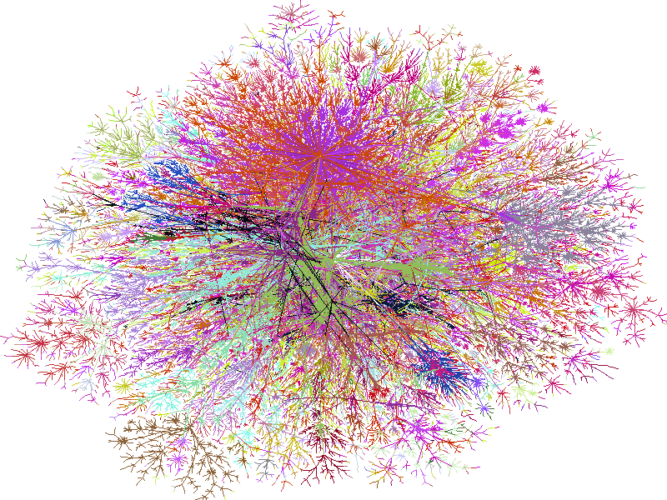
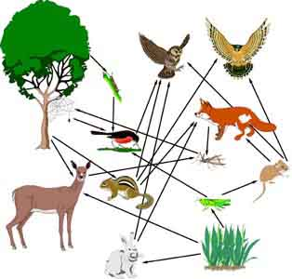
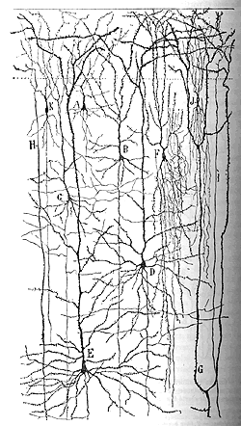
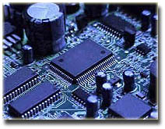
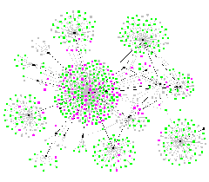
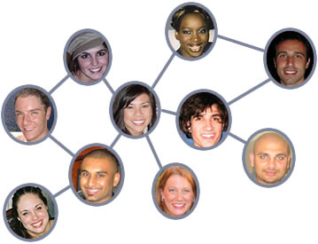
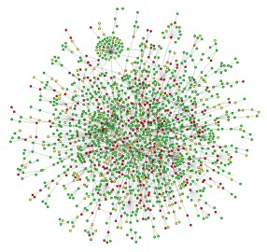
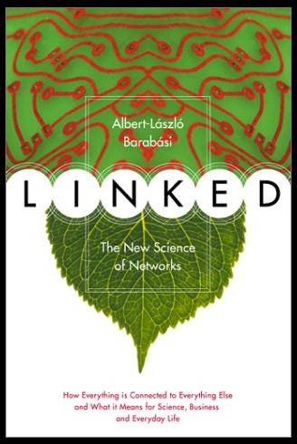
Networks as a universal language
Internet
[Burch & Cheswick]
Electronic
Circuit
Food Web
Disease Spread
[Krebs]
Neural Network
[Cajal]
Protein
Interactions
[Barabasi]
Social Network

Slide 3
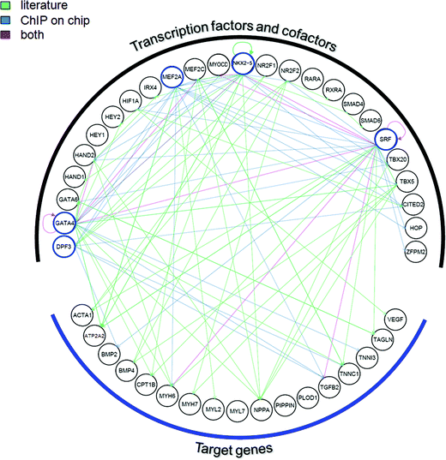
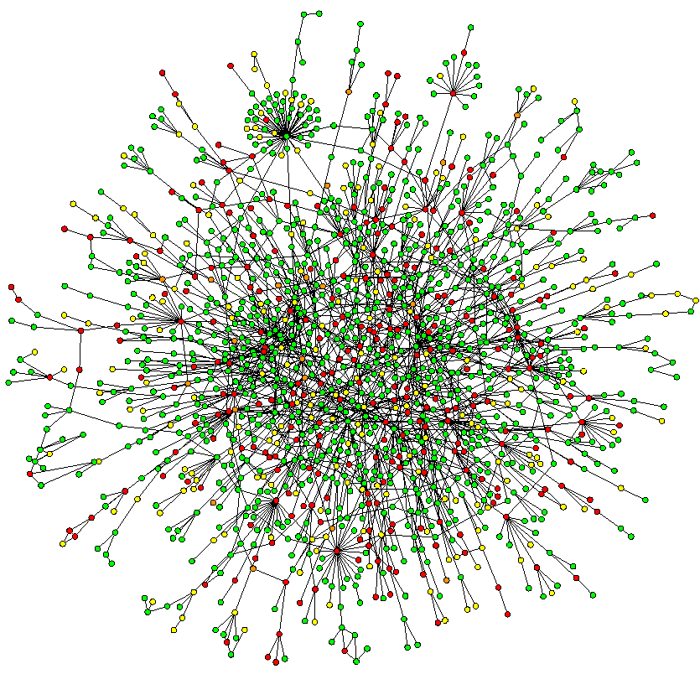
Different Interactome networks
Interaction networks
Regulatory networks
Undirected
Directed
[Toenjes, et al, Mol. BioSyst. (2008)]
[Jeong et al, Nature (2001)]

Slide 4
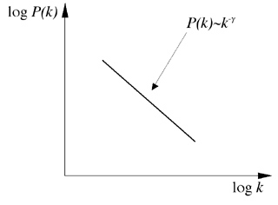
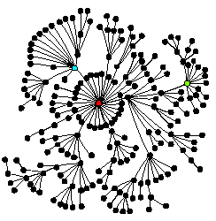
Scale-free networks
Power-law distribution
log(Frequency)
log(Degree)
Hubs dictate the structure of the network
[Barabasi]

Slide 5
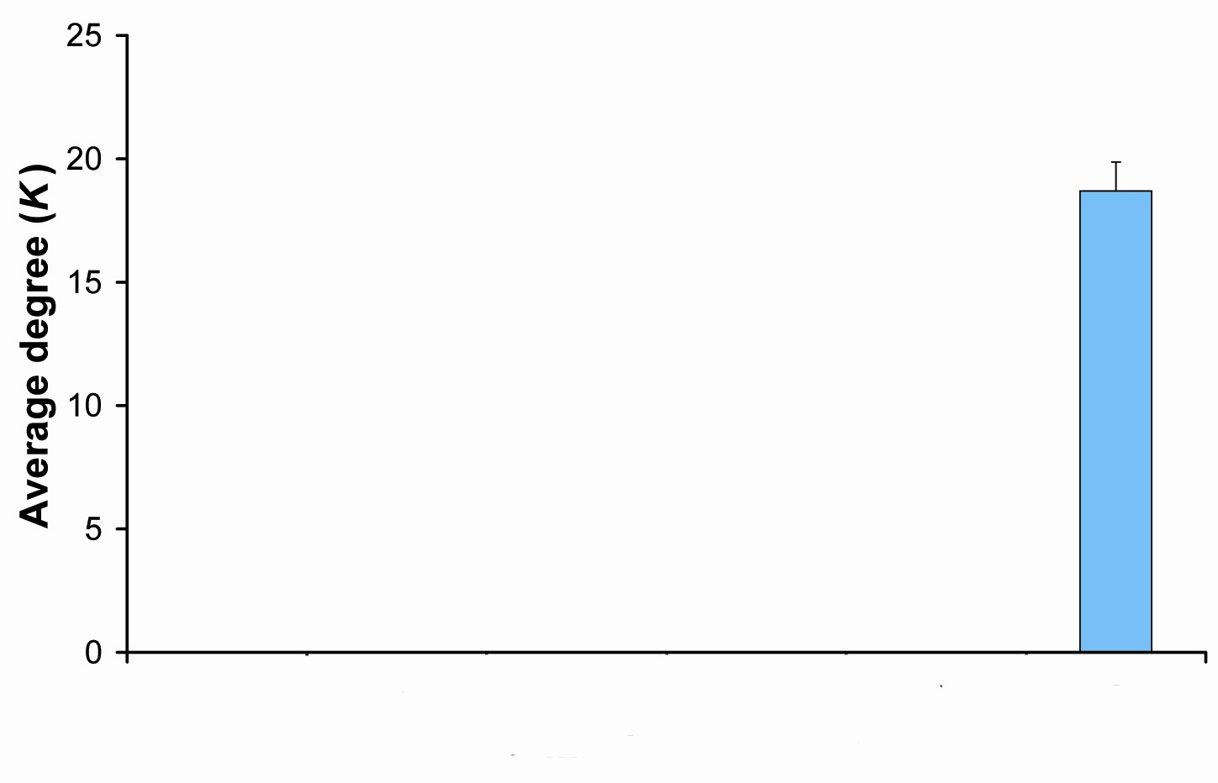
Hubs tend to be Essential
Integrate gene essentiality data with protein interaction network. Perhaps hubs represent vulnerable points?
[Lauffenburger, Barabasi]
"hubbiness"
Non- Essential
Essential

Slide 6
SIN: Integration of Structural Information with Protein-Protein Interaction Networks Reveals Distinct Classes of Hub Proteins

Slide 7
Building the Structural Interaction Network
Kim, Philip M., et al. "Relating three-dimensional structures to protein networks provides evolutionary insights." Science 314.5807 (2006): 1938-1941.

Slide 8
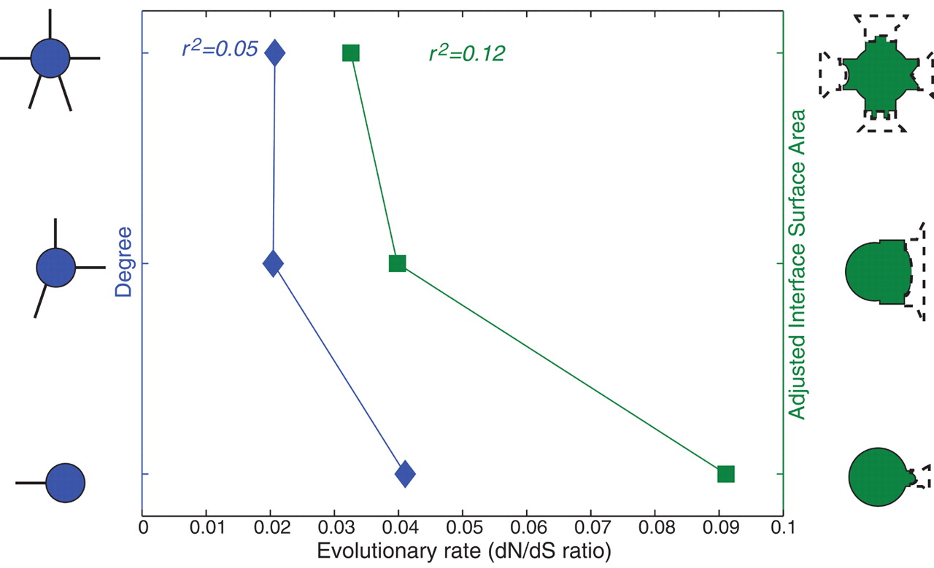
Kim, Philip M., et al. "Relating three-dimensional structures to protein networks provides evolutionary insights." Science 314.5807 (2006): 1938-1941.

Slide 9
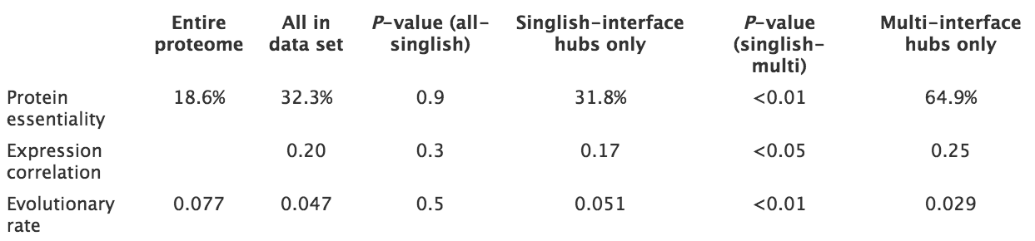
Kim, Philip M., et al. "Relating three-dimensional structures to protein networks provides evolutionary insights." Science 314.5807 (2006): 1938-1941.
Notes:
Evolutionary rates (dN/dS rates) for singlish-interface, multiinterface hubs and non-hubs and hubs.

Slide 10
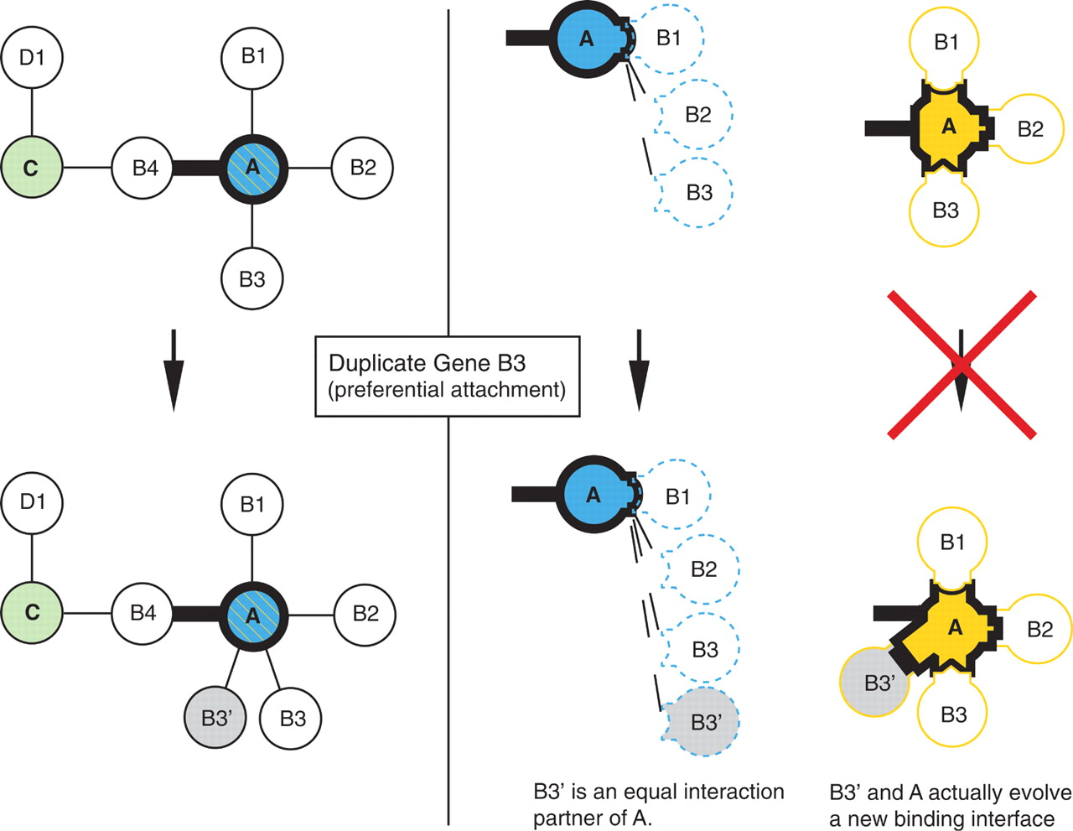
Network Growth by Gene Duplication
Multi- and Singlish-Interface Hubs
Kim, Philip M., et al. "Relating three-dimensional structures to protein networks provides evolutionary insights." Science 314.5807 (2006): 1938-1941.

Slide 11
DynaSIN: Integration of Alternative Conformations with Protein-Protein Interaction Networks

Slide 12
Bhardwaj, Nitin, et al. "Integration of protein motions with molecular networks reveals different mechanisms for permanent and transient interactions." Protein science 20.10 (2011): 1745-1754.

Slide 13
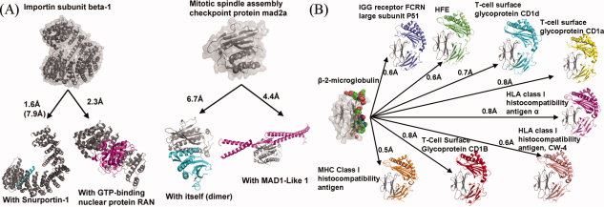
Conformational changes associated with transient interactions
Conformational changes associated with permanent interactions
Bhardwaj, Nitin, et al. "Integration of protein motions with molecular networks reveals different mechanisms for permanent and transient interactions." Protein science 20.10 (2011): 1745-1754.

Slide 14
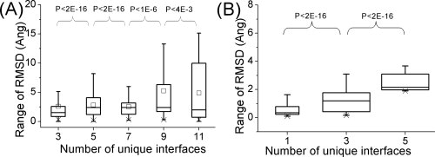
Bhardwaj, Nitin, et al. "Integration of protein motions with molecular networks reveals different mechanisms for permanent and transient interactions." Protein science 20.10 (2011): 1745-1754.

Slide 15
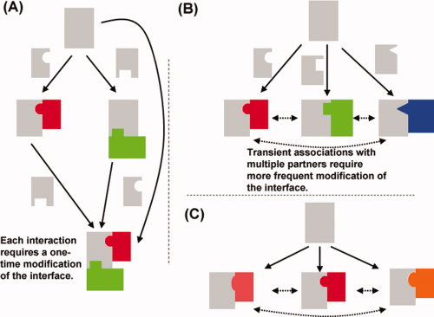
Conformational changes in the context of
permanent and transient interactions
Bhardwaj, Nitin, et al. "Integration of protein motions with molecular networks reveals different mechanisms for permanent and transient interactions." Protein science 20.10 (2011): 1745-1754.

Slide 16
Insights through the integration of variation data with structure interaction networks

Slide 17
Multinet – the ultimate hairball!
Genes participate in many networks and no single network captures the global picture of gene interactions
Combine regulatory, physical protein-protein, signaling, metabolic, phosphorylation and genetic interactions to create a unified network (Multinet)
Nodes: ~15,000 genes
Edges: ~110,000 interactions
Khurana* and Fu* et al., PLOS Comp. Bio. ’13
Notes:
Explain better: may be show just the hairball and then show nodes on it

Slide 18
Multi-Net
Exceptions to the rule
Hubs in metabolic network are tolerant to LoF mutations
Metabolic hubs have more duplicated copies
Perhaps ’protective’ effect of metabolic pathways leads to different architecture
Notes:
Introduce the pink & cyan
Goal is to predict disease
We’ll start training/testing on the extremes
Lof
Essen -
Hgmd – rarer mendelian variants
Gwas – “common” variants
Neutral

Slide 19
Overlapping 3D Structures with Protein Protein Interaction Network
Essential genes have more interacting interfaces
1.1 - A Unified Network Approach to Interpret Coding Variants
Notes:
Introduce the pink & cyan
Goal is to predict disease
We’ll start training/testing on the extremes
Lof
Essen -
Hgmd – rarer mendelian variants
Gwas – “common” variants
Neutral

Slide 20
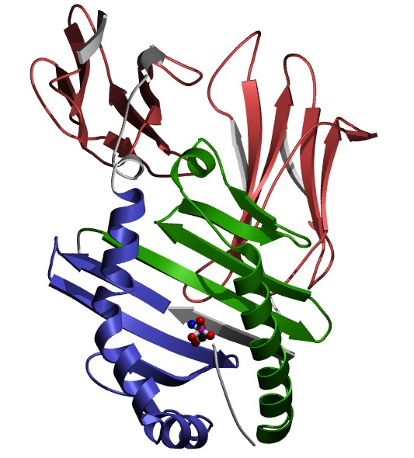
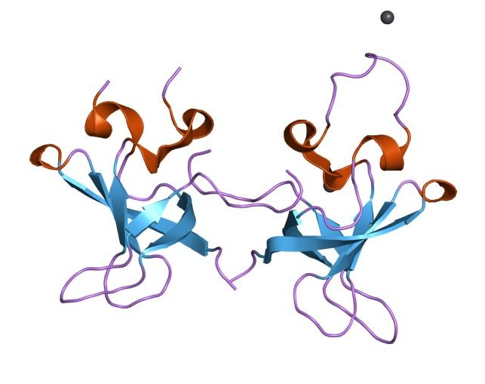
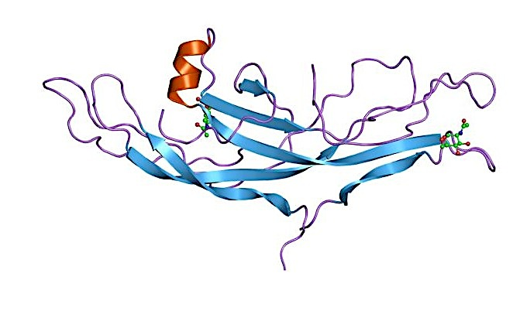
Accessible surface area of miss-sense SNPs
WASP
CDC42
PBD
WH1
TRIP10
WASP interactions tested using yeast two-hybrid experiments
Collaborated with H Yu Cornell
Khurana* and Fu* et al., PLoS Comp. Bio., 2013
Khurana* and Fu* et al, Science, 2013
Wang et al, Nature Biotech, 2012
1.1 - A Unified Network Approach to Interpret Coding Variants

Slide 21
Integration of network properties to predict systems-level effects of deleterious mutations
Train logistic regression model using network and evolutionary properties
Can distinguish between LoF-tolerant and Essential genes with high accuracy
Application of the model on all genes
AUC=0.91
True positive rate
False positive rate
1.1 - A Unified Network Approach to Interpret Coding Variants

Slide 22
Intra-Protein Networks of Interacting Residues, Conformational Change, and Allostery: Networks for the Study of Individual Structures

Slide 23
Renewed interest in allostery
  Relevance in the context of human disease
  Growing volume of available data on allosteric systems
  Allostery as a basic framework for understanding proteins in general
Motlagh, Hesam N., et al. Nature (2014)
Smock, Robert G., and Lila M. Gierasch. "Sending signals dynamically." Science 324.5924 (2009): 198-203.
23

Slide 24
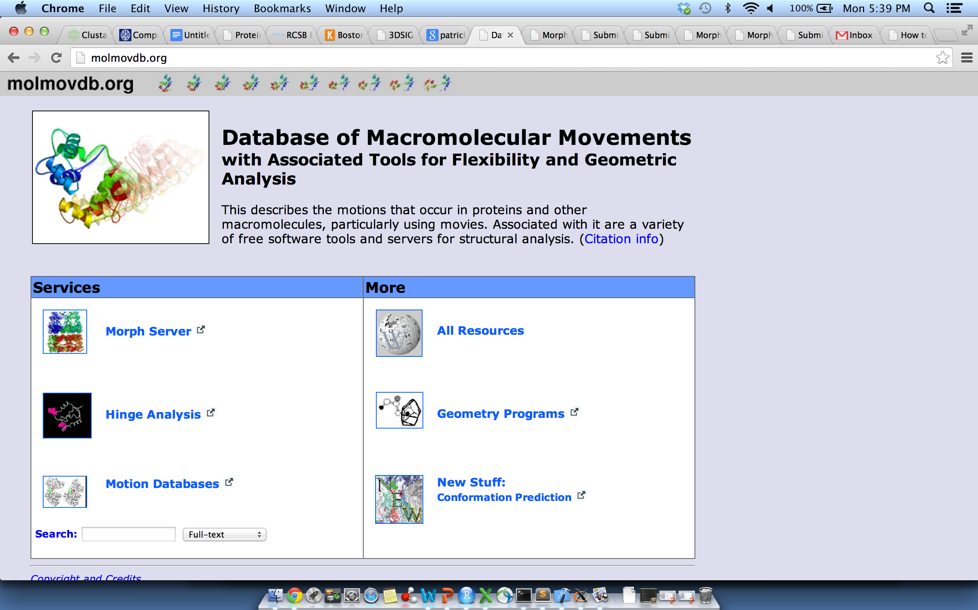
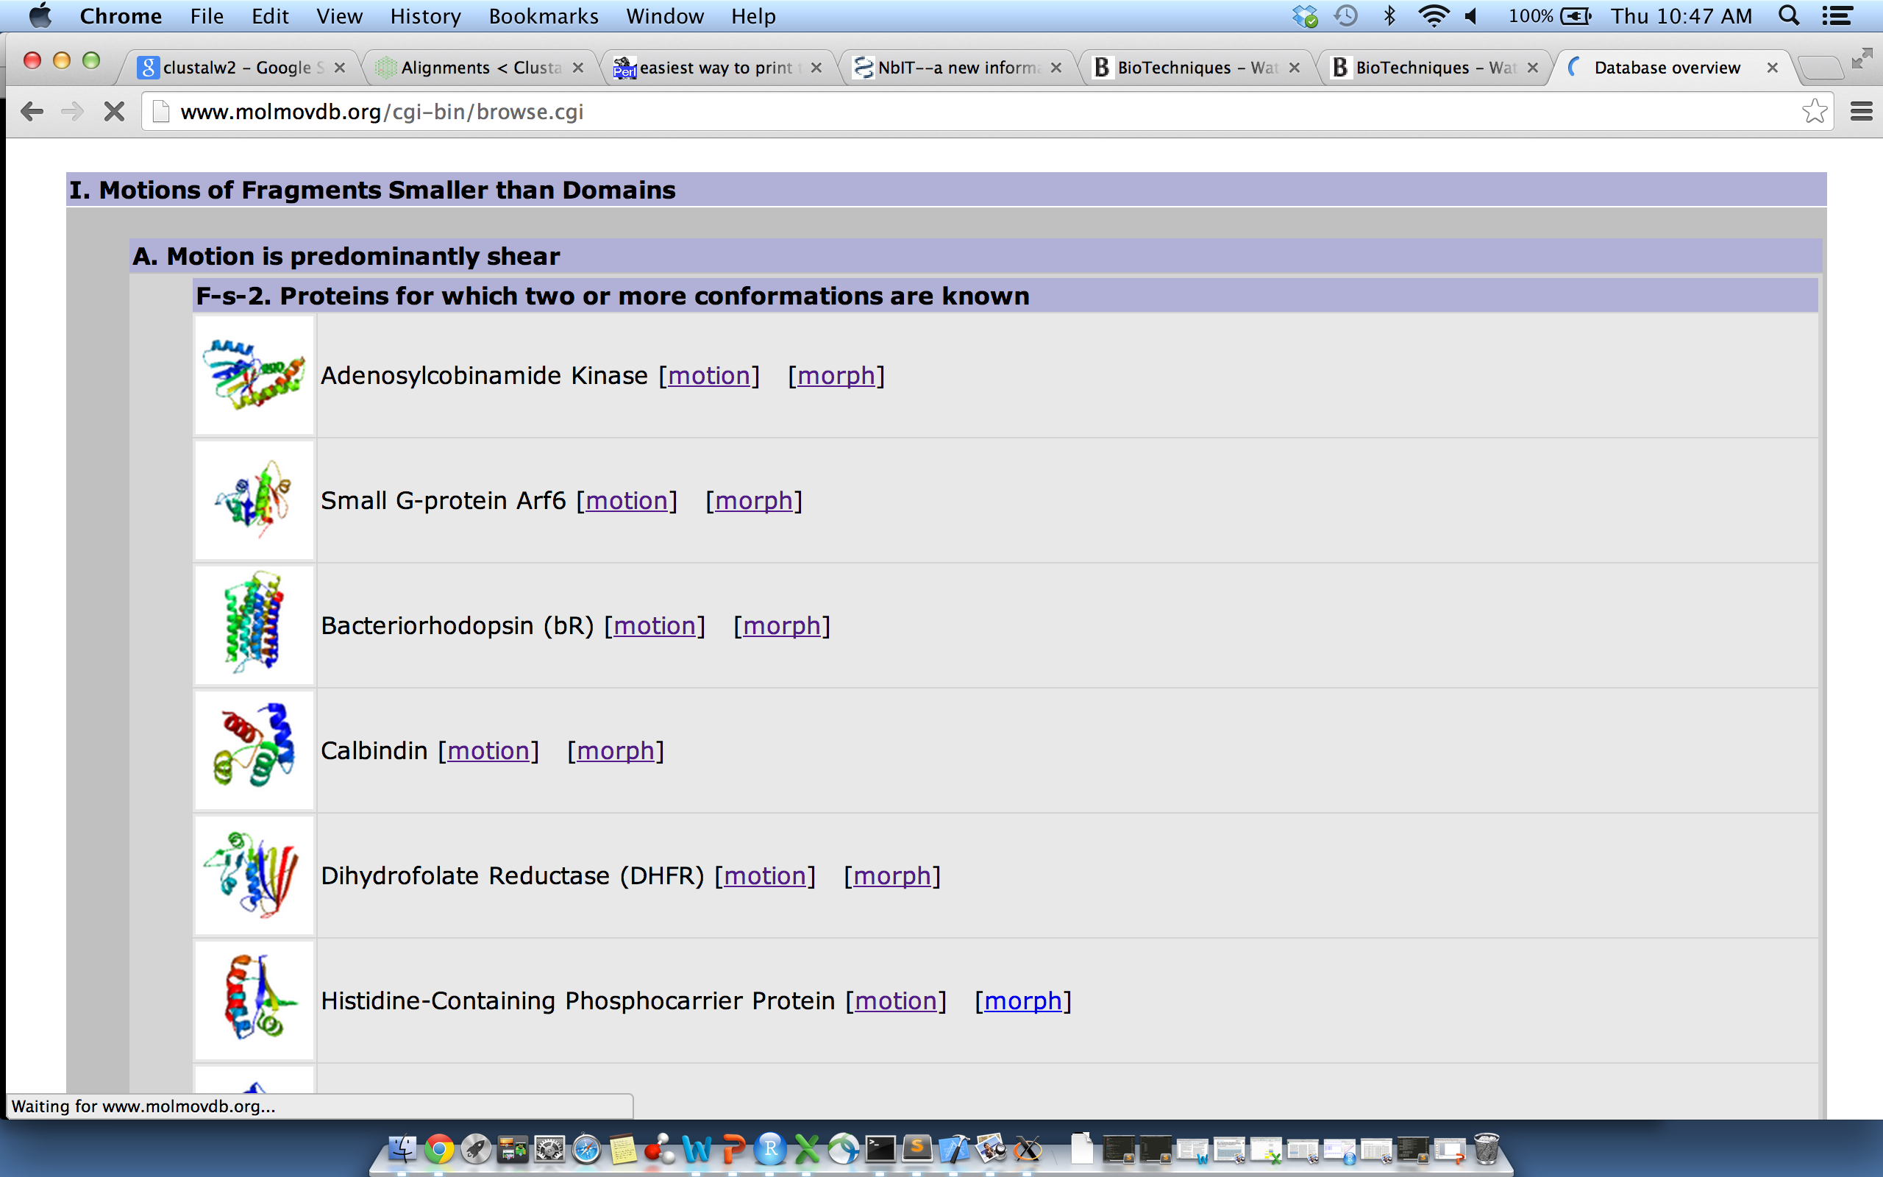

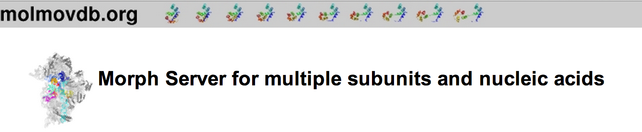

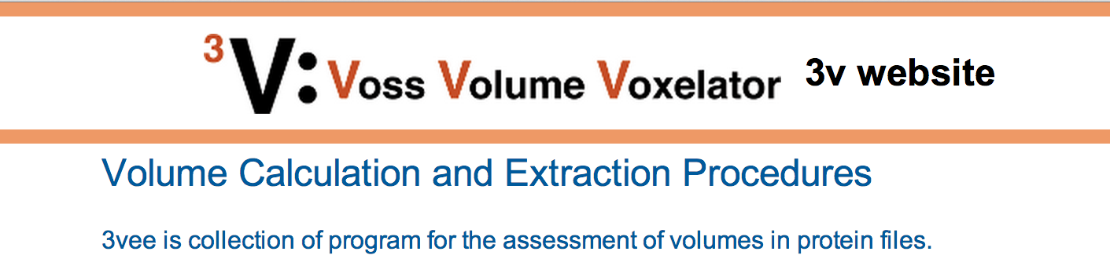
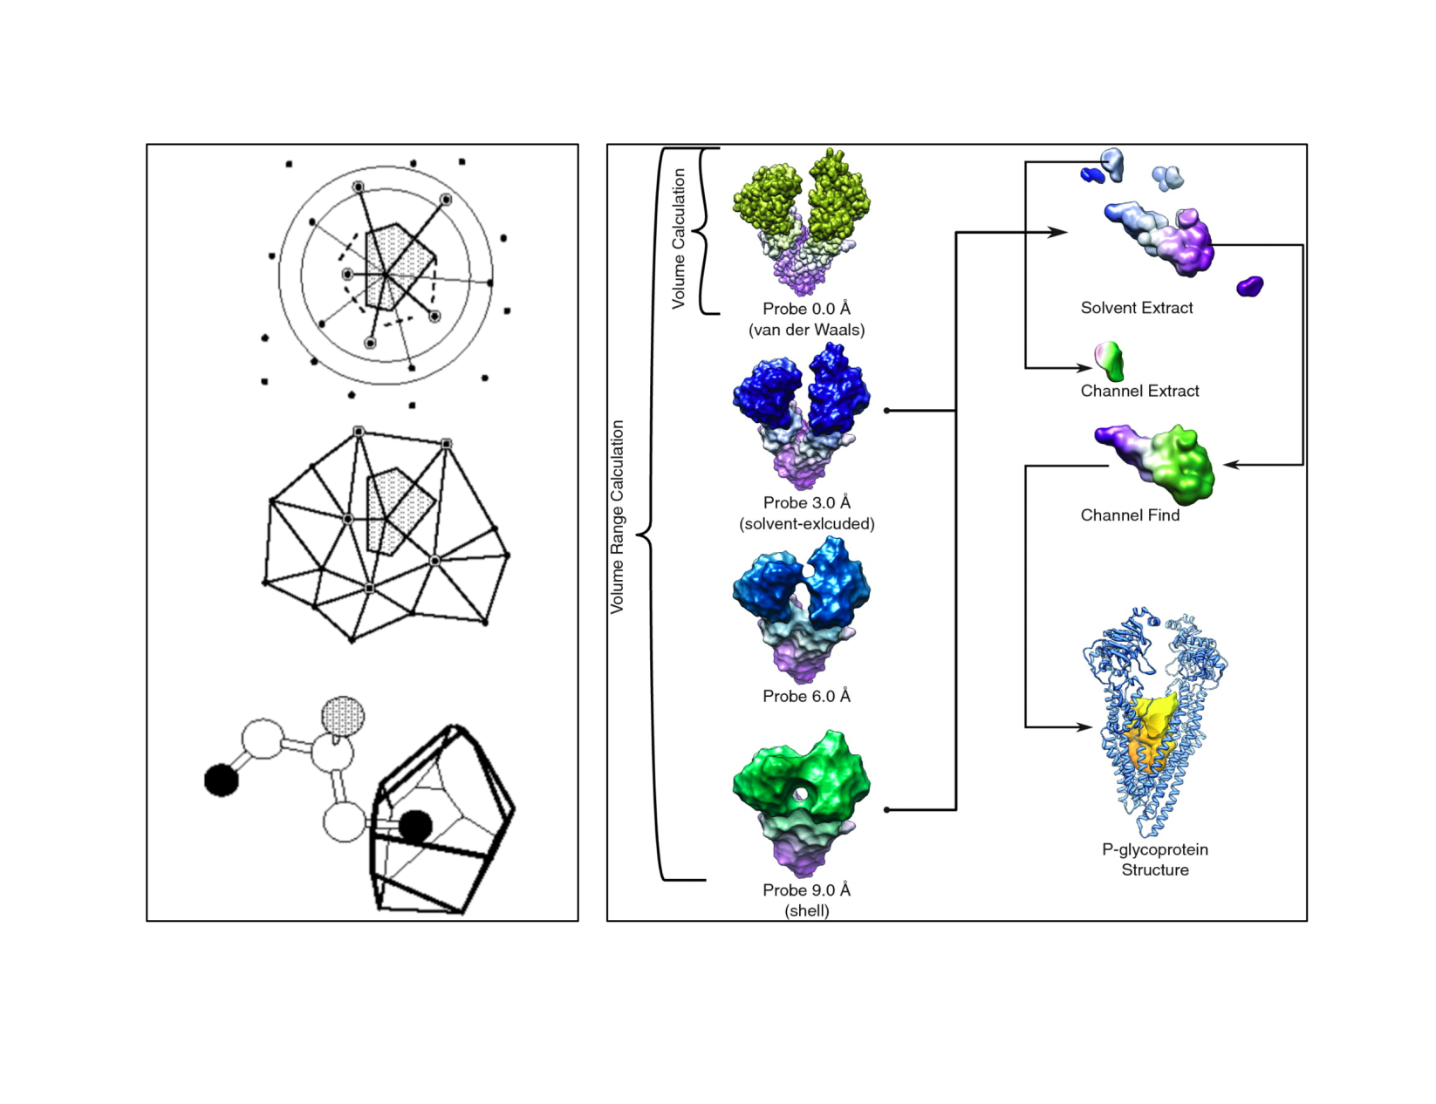
Movies of Conformational Changes
Database of Alternative Conformations
Quantifying Internal Packing of Residues
Identification of Protein Cavities

Slide 25
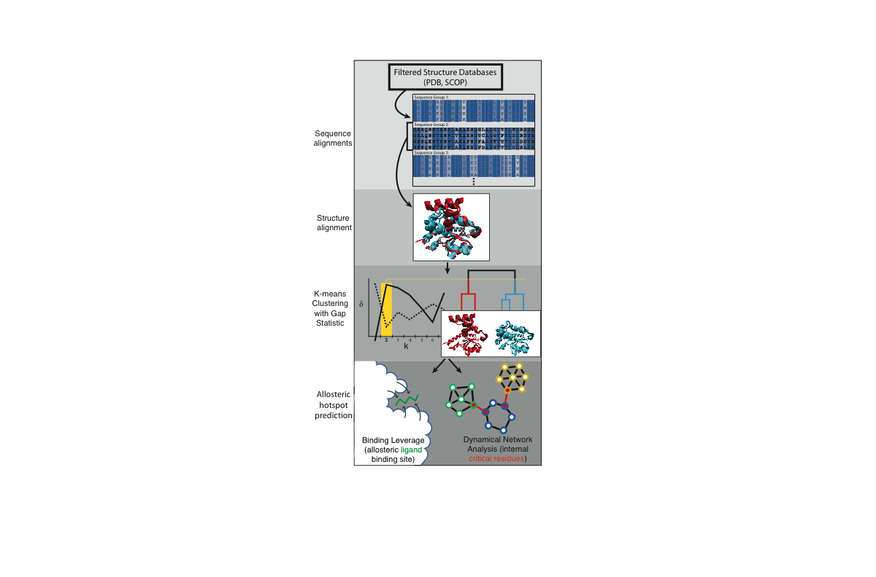

Slide 26
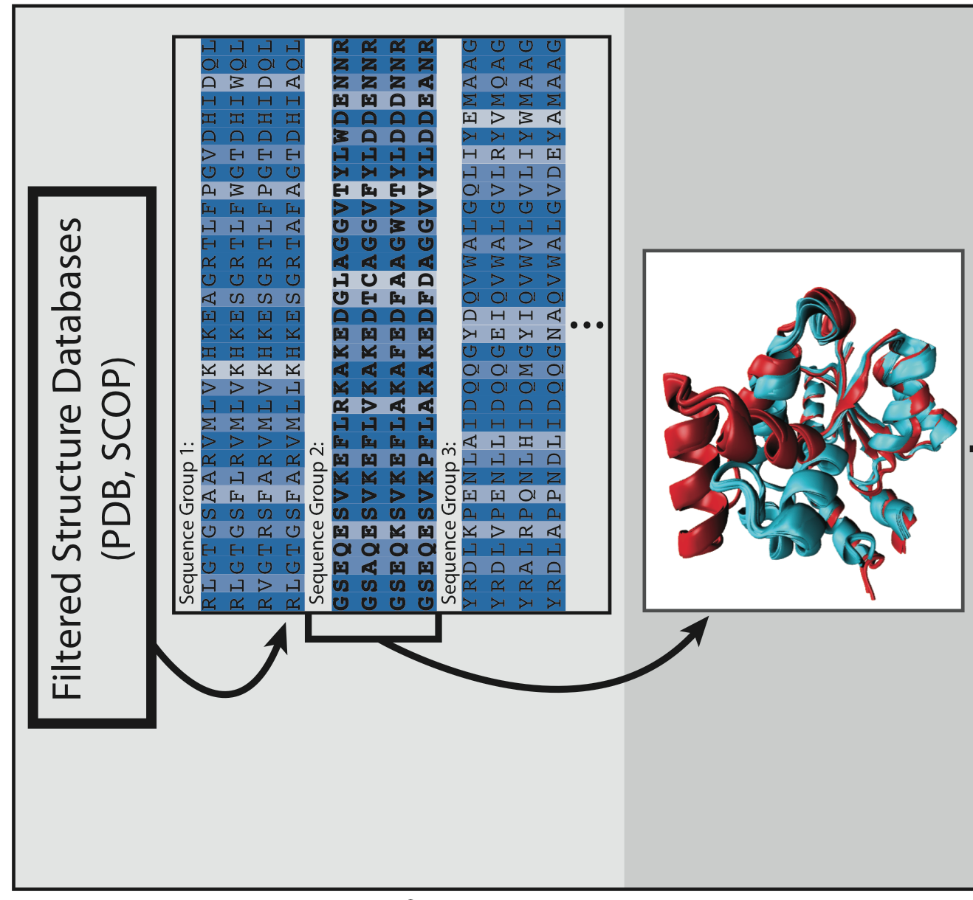
Processing Raw Data: Sequence & Structure Alignments

Slide 27
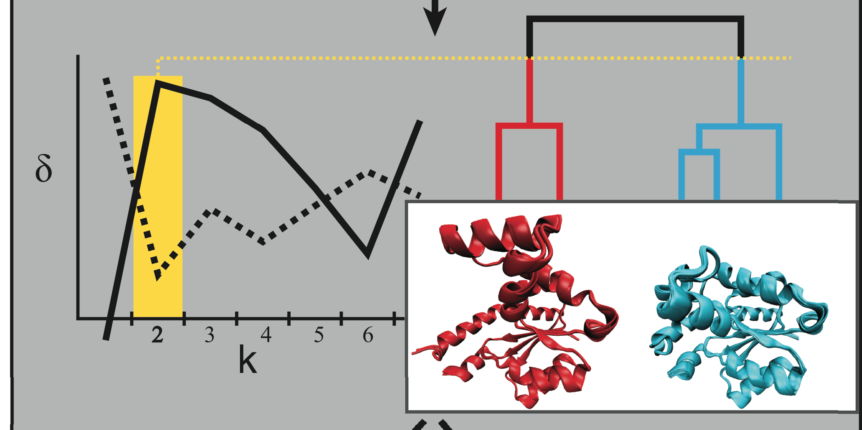
Automated Identification of Alternative Biological States

Slide 28
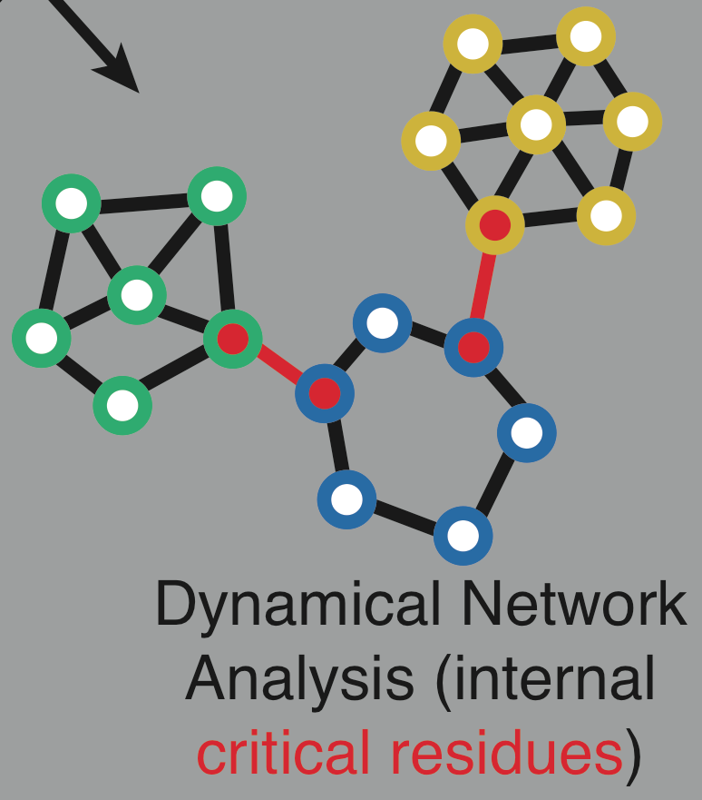
Identification of Allosteric Hotspots: Networks

Slide 29
Betweenness
Freeman LC (1977) Set of measures of centrality based on betweenness.
Sociometry 40: 35–41.
Girvan & Newman (2002) PNAS 99: 7821.

Slide 30
Bottlenecks & Hubs
[Yu et al., PLOS CB (2007)]

Slide 31
Girvan and Newman, PNAS 2002
Edge Betweenness: Number of shortest paths passing through a pair of nodes
Define essential residues as those which connect communities (identified through GN) and exhibit the greatest edge betweenness.
Sethi et al, 2009

Slide 32
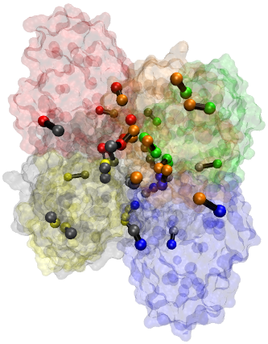
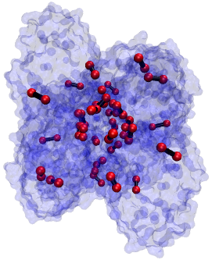
Conservation of network-identified residues implicated in allosteric signal transmission
DAF
ConSurf Score

Slide 33
Acknowledgements
Phil Kim
Nitin Bhardwaj
Ekta Khurana
Yao Fu
Jieming Chen
Anurag Sethi
Declan Clarke
Sushant Kumar
Koon-Kiu Yan

