Slide 1
ExAC

Slide 2
Compare ExAC with 1KG.ESP6500
 | ExAC | 1KG.ESP6500 | Fold change
Num of individuals | 60,706 | 7,592 | 8
#SNVs (incl. singletons) | 7,502 | 2,204 | 3.4
#SNVs (excl. singletons) | 3,431 (4,071;54%) | 900 (1,304;59%) | 3.8
#chrs: Rare 0.5% | 607 | 76

Slide 3
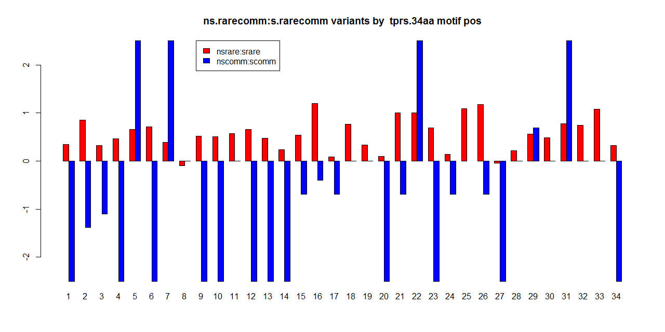
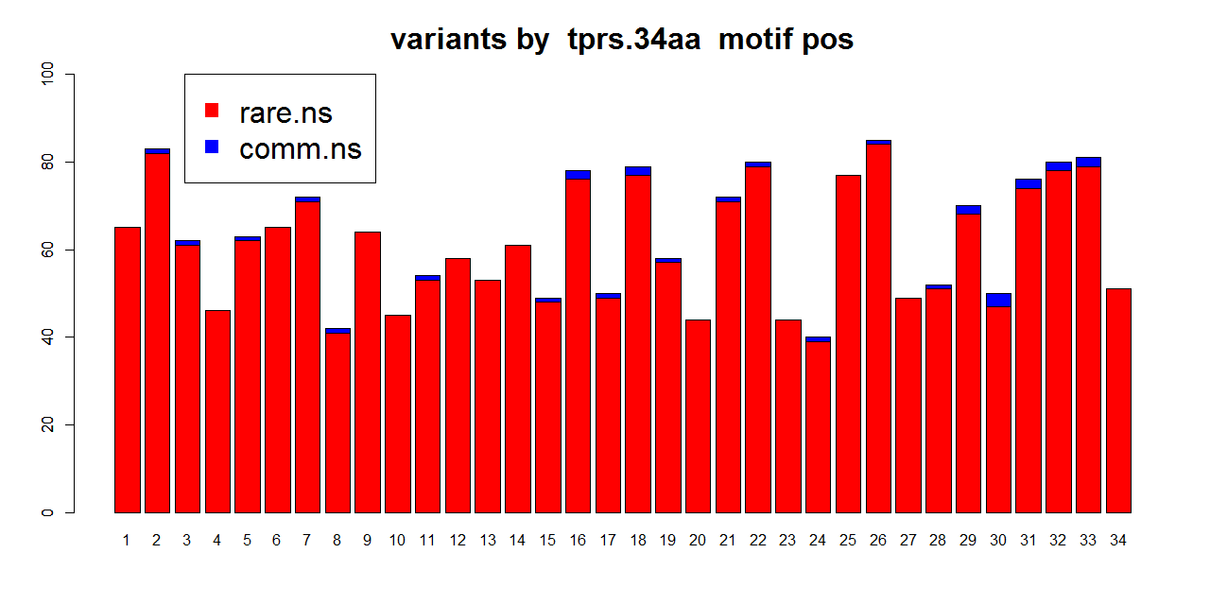
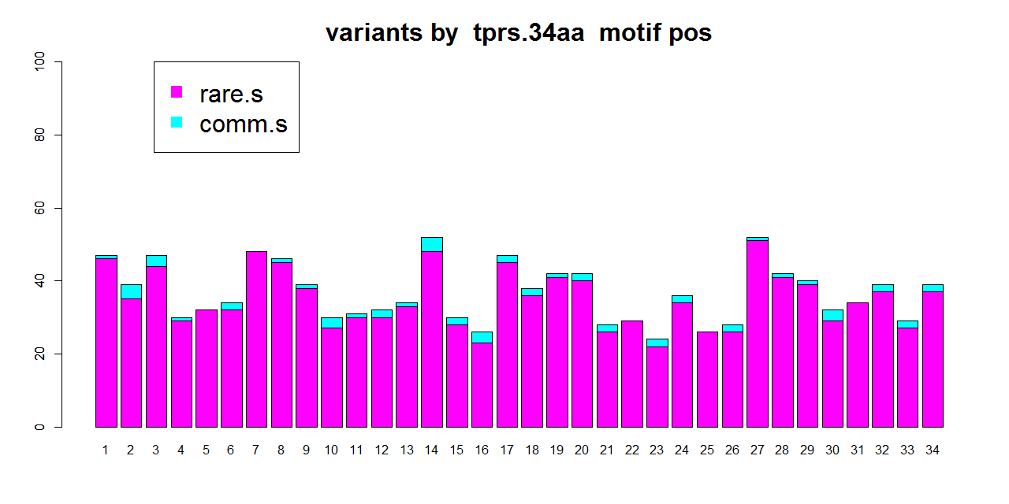
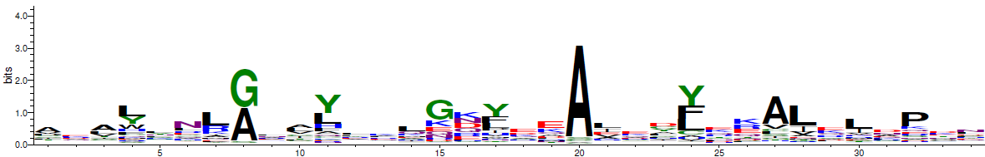

Slide 4
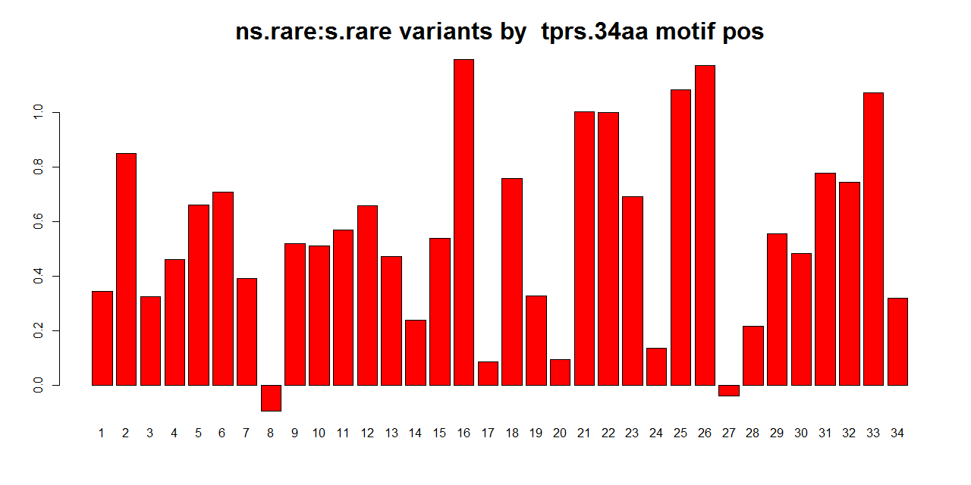

Slide 5
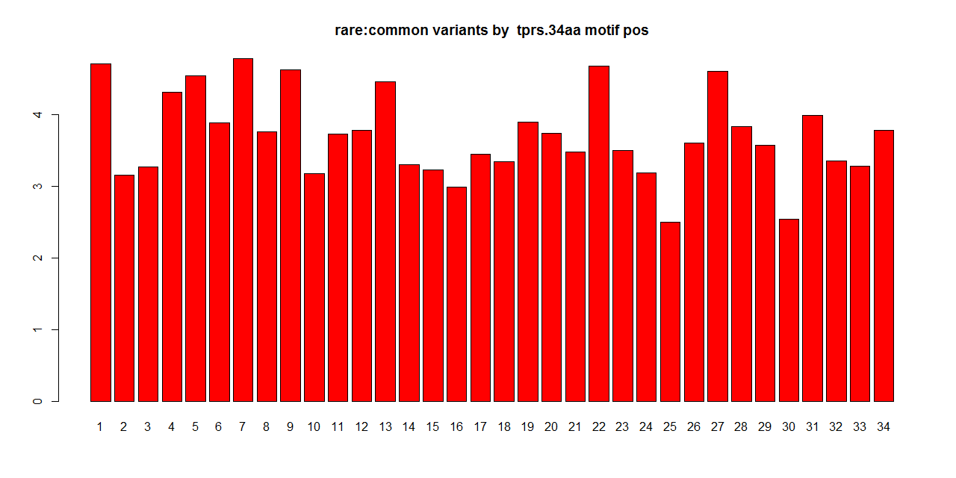
Rare2comm ratio

Slide 6
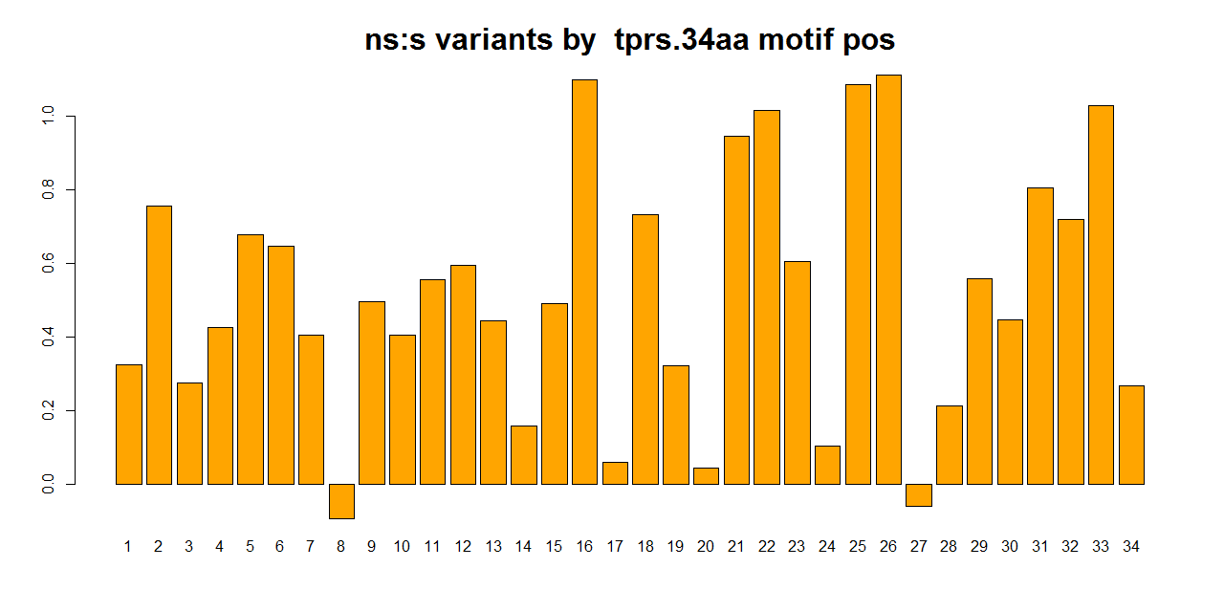
Ns2s ratio

Slide 7
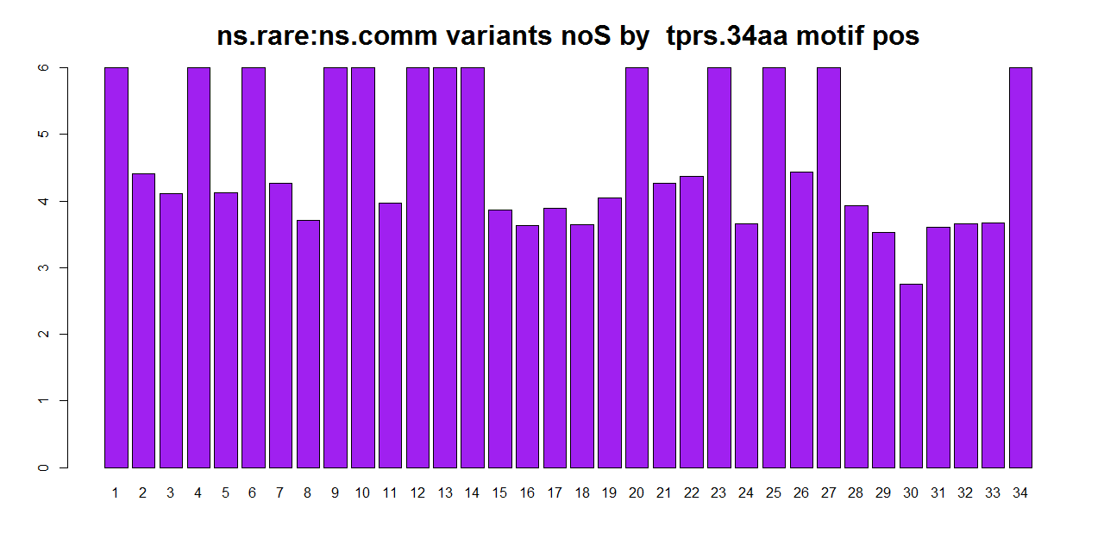
Rare.NS 2 comm.NS

Slide 8
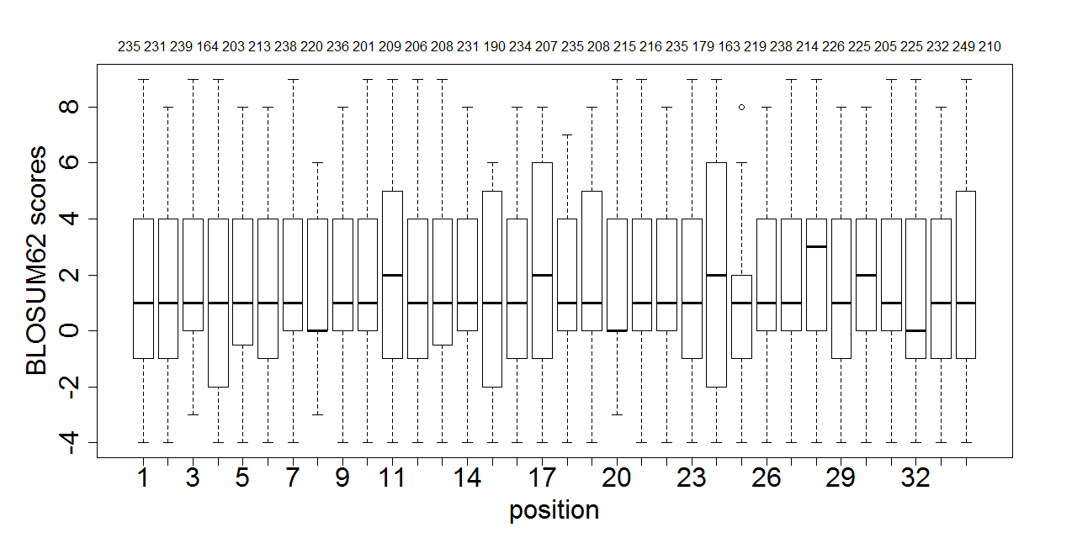
BLOSUM62

Slide 9
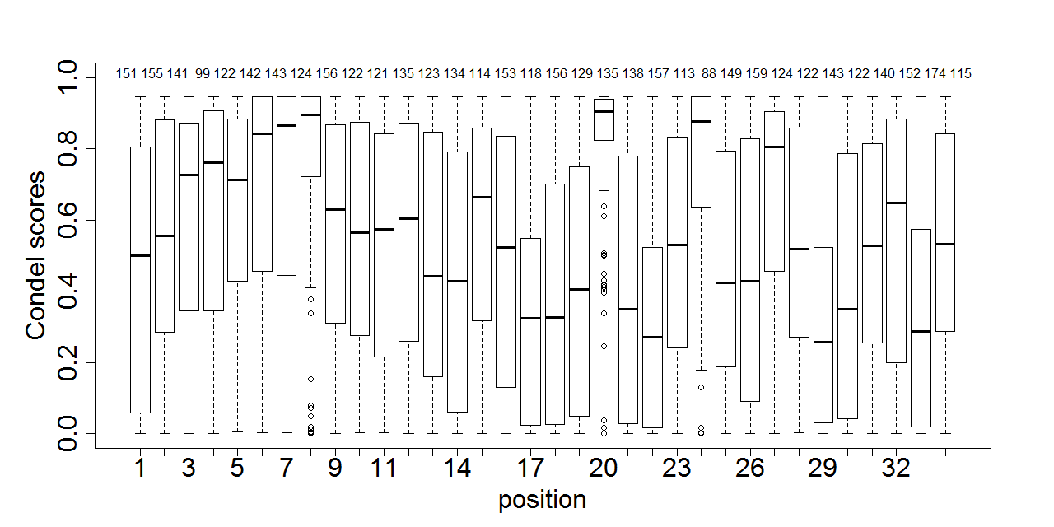
Condel

Slide 10
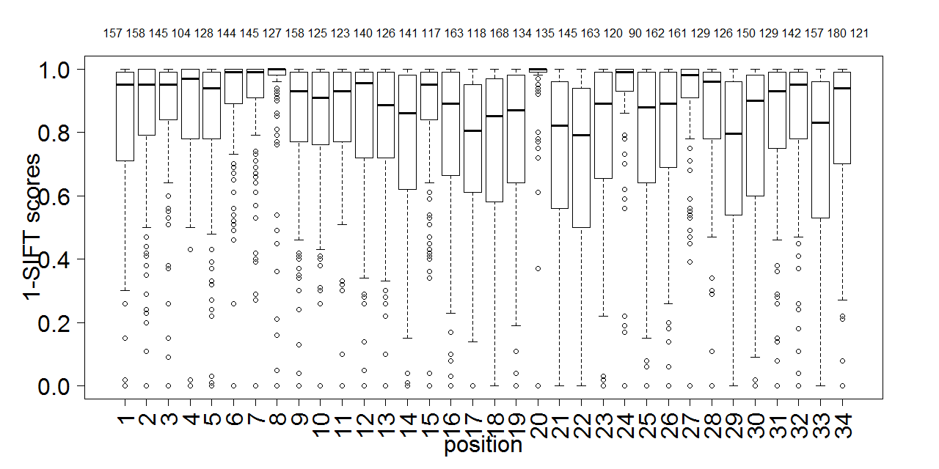
SIFT

Slide 11
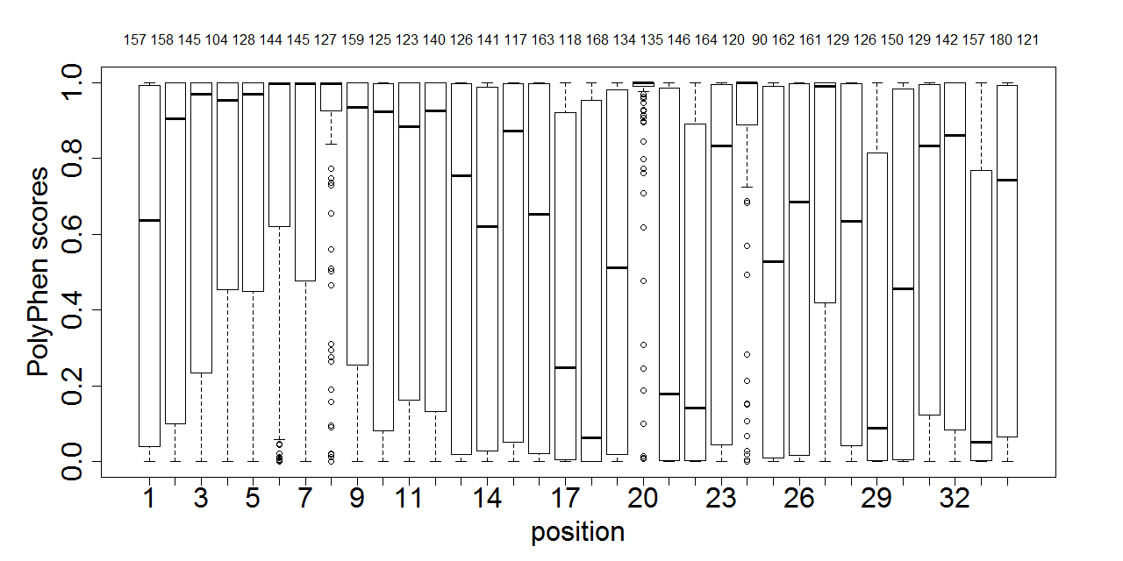
PolyPhen

Slide 12
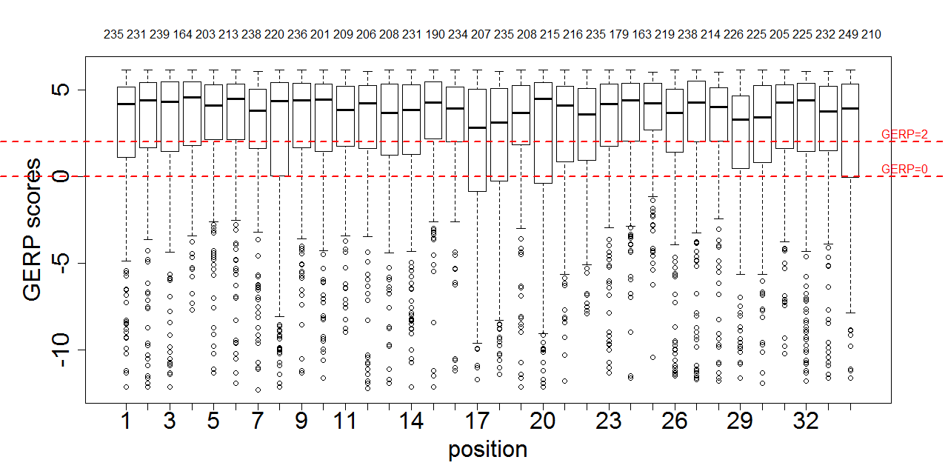
GERP

Slide 13
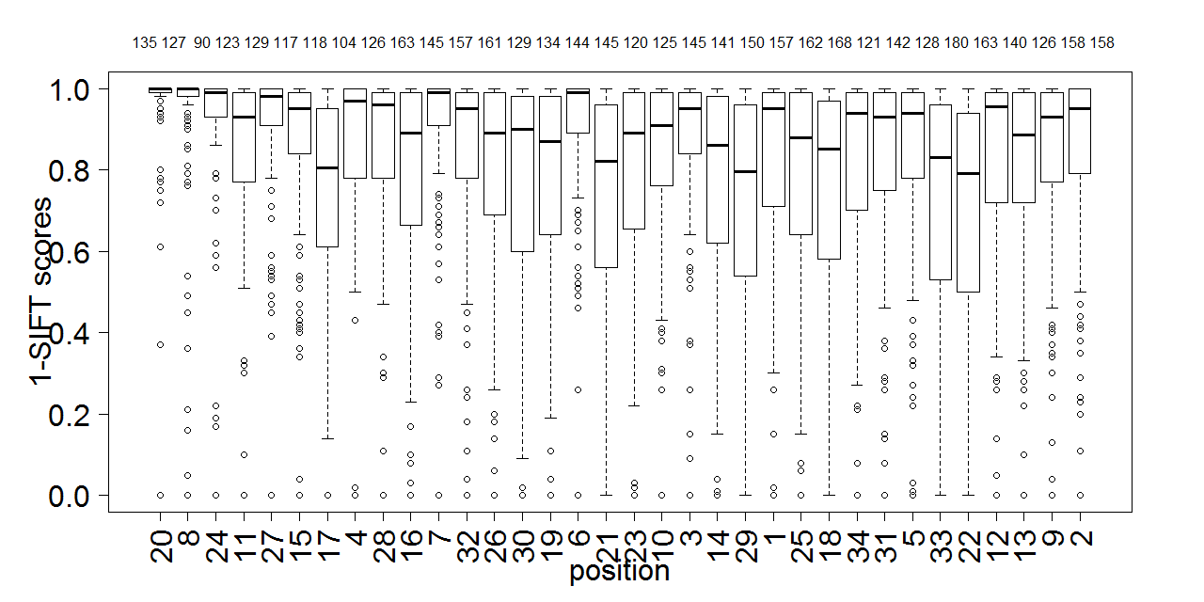
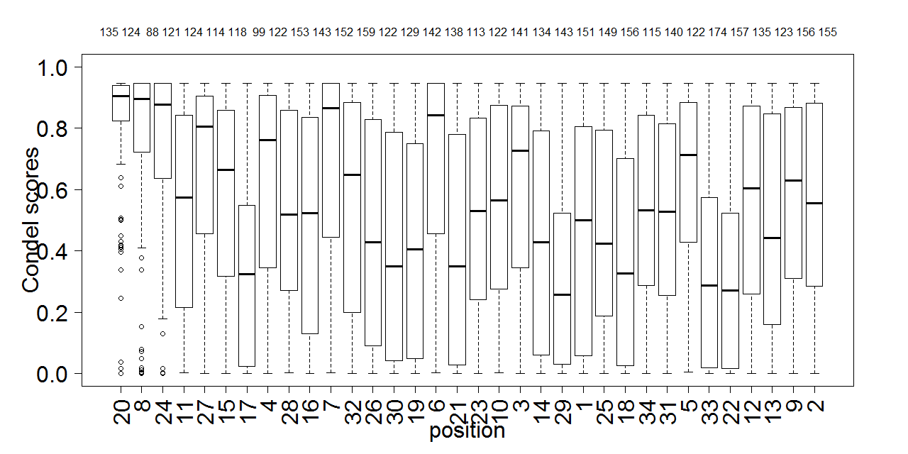
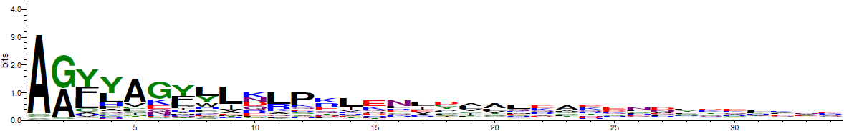
20 8 24 11 27 15 17 4 28 16 7 32 26 30 19 6 21 23 10 3 14 29 1 25 18 34 31 5 33 22 12 13 9 2

Slide 14
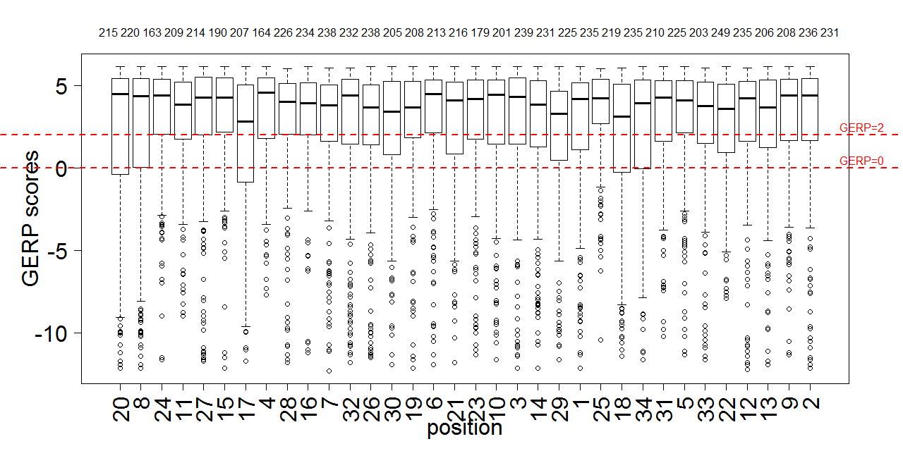
20 8 24 11 27 15 17 4 28 16 7 32 26 30 19 6 21 23 10 3 14 29 1 25 18 34 31 5 33 22 12 13 9 2

Slide 15
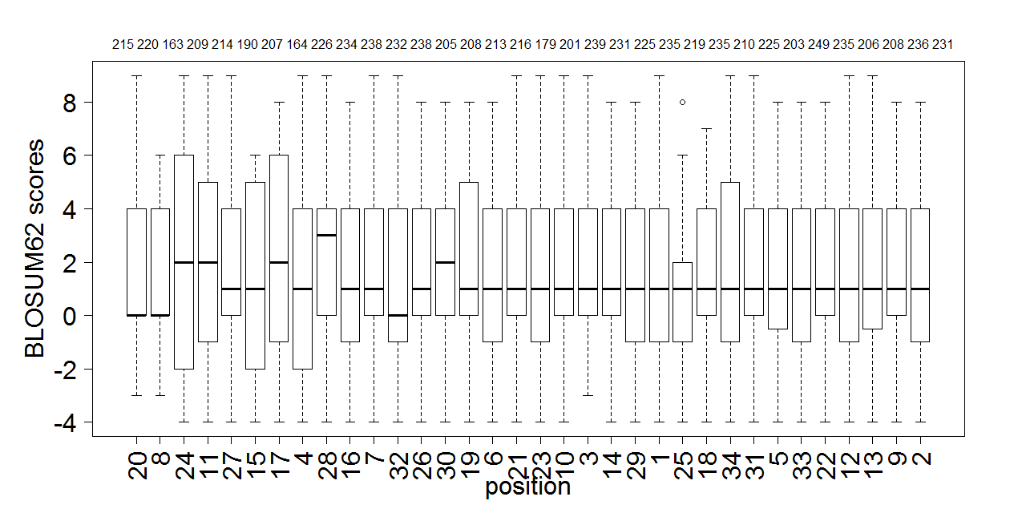
20 8 24 11 27 15 17 4 28 16 7 32 26 30 19 6 21 23 10 3 14 29 1 25 18 34 31 5 33 22 12 13 9 2

Slide 16
Possible future directions
Where do we go from here?
Fitness scores from the Siepel Lab
Compare with distribution of HGMD and known disease mutations in TPR positions
Manual literature search for possible human functional TPR positions
--> sense of what’s out there right now

Slide 17
Dissertation Progress Report
What I have done for AlleleDB and motifVariation
What remains to be done
The timeline

Slide 18
Dissertation Progress Report
Describe in detail the progress you have made this year toward the completion of your dissertation. This may include chapters or papers written, progress on experiments or field work, changes in the direction of your work, or obstacles which impeded your progress. If you have submitted or published any written work since your last report, please upload copies of this work to this site. If you have been admitted to candidacy in the last 3 months, you may submit the prospectus in lieu of completing this field. In addition to dissertation progress, you may (optionally) also include other activities in which you have engaged, such as teaching, workshop attendance, grant writing, outreach work, etc.

Slide 19
Dissertation Progress Report
Describe the work that remains to be completed on your dissertation, including a detailed schedule of your research or writing plans for the coming academic year. This might include fieldwork, experiments to be completed, and dissertation chapters or articles to be written. Please comment on known obstacles to completing your work, and your strategy for dealing with these concerns. Indicate whether you expect to submit your dissertation within the next year. Optionally, you may also indicate your plans for other activities, such as teaching, workshop attendance, grant writing, outreach work, etc.

Slide 20
Dissertation Progress Report
Describe the nature and frequency of your meetings with your advisor and/or the members of your dissertation committee during the last year. Based upon your plan of study, do you foresee changes in this/these relationship(s) in the coming year? What was the date of your last committee meeting and who attended?

