Slide 1
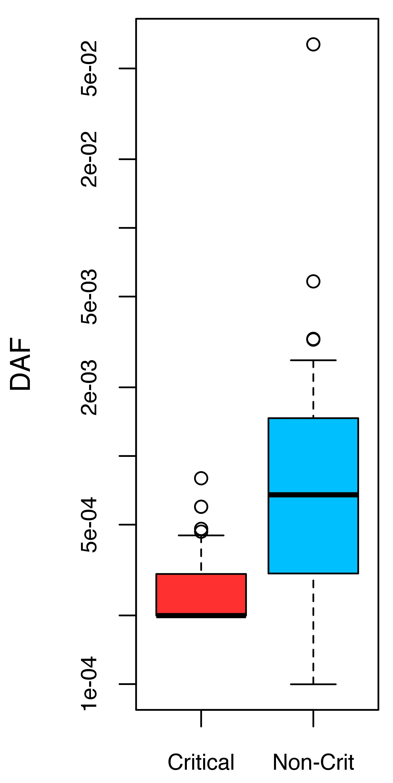
pdb | Fract rare SNPs (crit) | Fract rare SNPs (NON crit)
2WP3 | 1 | 0.666666667
1LD7 | 1 | 0.742857143
2F0Y | 1 | 0.742857143
3GLS | 1 | 0.777777778
3C10 | 1 | 0.785714286
1JDX | 1 | 0.833333333
2R1V | 1 | 0.920792079
1S1P | 1 | 0.924882629
1T0L | 1 | 0.951612903
1DE4 | 1 | 0.961538462
1GG3 | 1 | 1
1H6G | 1 | 1
1IIL | 1 | 1
1MMK | 1 | 1
1RKB | 1 | 1
1W24 | 1 | 1
1ZVM | 1 | 1
2AH9 | 1 | 1
2OO1 | 1 | 1
3EVX | 1 | 1
3FVX | 1 | 1
3HPH | 1 | 1
3I7G | 1 | 1
3KEJ | 1 | 1
3KMW | 1 | 1
3LJZ | 1 | 1
3O5M | 1 | 1
3RPN | 1 | 1
3RPP | 1 | 1
4F45 | 1 | 1
4HW3 | 1 | 1
PDB | Fract rare in CRIT | Fract rare SNPs in NON-CRIT
2WP3 | 1 | 0.666666667
3O5M | 1 | 0.73015873
1LD7 | 1 | 0.742857143
2F0Y | 1 | 0.742857143
3LJZ | 1 | 0.75
1ZVM | 1 | 0.771929825
3GLS | 1 | 0.777777778
1S1P | 1 | 0.784037559
3C10 | 1 | 0.785714286
3I7G | 1 | 0.797385621
3KEJ | 1 | 0.798701299
2R1V | 1 | 0.811881188
1GG3 | 1 | 0.818181818
1JDX | 1 | 0.833333333
1DE4 | 1 | 0.846153846
4HW3 | 1 | 0.846153846
3RPP | 1 | 0.923076923
3RPN | 1 | 0.9375
1T0L | 1 | 0.951612903
3FVX | 1 | 0.966292135
1H6G | 1 | 1
1IIL | 1 | 1
1MMK | 1 | 1
1RKB | 1 | 1
1W24 | 1 | 1
2AH9 | 1 | 1
2OO1 | 1 | 1
3EVX | 1 | 1
3HPH | 1 | 1
3KMW | 1 | 1
4F45 | 0.821918 | 1
p-value = 1.798e-05
Notes:
GN -- DAF = 0.005, DAF = 0.001

Slide 2
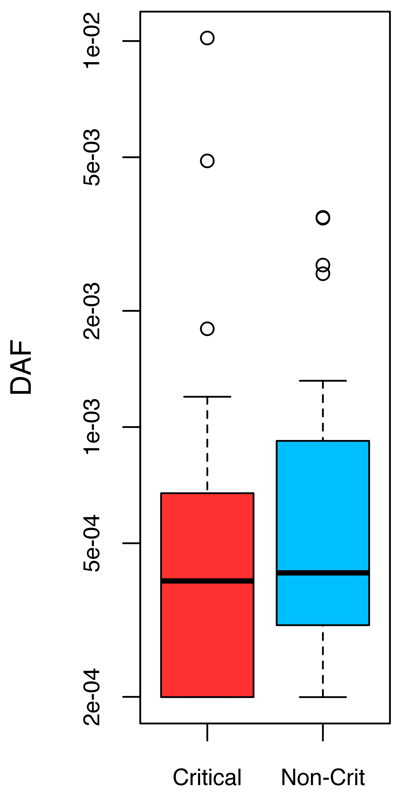
pdb | Fract rare SNPs in CRIT | Fract rare SNPs in NON crit
2F0Y | 1 | 0.470588235
3GLS | 0.5 | 0.875
1I3L | 1 | 0.9
1T09 | 1 | 0.912234043
1GG3 | 1 | 0.9375
1T0L | 1 | 0.951612903
1DE4 | 1 | 0.958333333
1BX4 | 1 | 1
1H6G | 1 | 1
1HZD | 1 | 1
1IIL | 1 | 1
1MMK | 1 | 1
1XRJ | 1 | 1
1ZNQ | 1 | 1
1ZVM | 1 | 1
2AH9 | 1 | 1
2FY7 | 1 | 1
2O3T | 1 | 1
2ONM | 1 | 1
2ZQQ | 1 | 1
3B6R | 1 | 1
3BL7 | 1 | 1
3DRB | 1 | 1
3FVX | 1 | 1
3I7G | 1 | 1
3KEJ | 1 | 1
3KMW | 1 | 1
3RPN | 1 | 1
3RPP | 1 | 1
3ZNS | 0 | 1
4F45 | 1 | 1
4H9S | 1 | 1
PDB | Fract rare SNPs in CRIT | Fract rare SNPs in NON-CRIT
2F0Y | 1 | 0.470588235
2O3T | 1 | 0.535714286
4F45 | 1 | 0.694117647
1I3L | 1 | 0.8
1ZVM | 1 | 0.820689655
1HZD | 1 | 0.833333333
1ZNQ | 1 | 0.833333333
2ZQQ | 1 | 0.833333333
3B6R | 1 | 0.857142857
4H9S | 1 | 0.857142857
1GG3 | 0.75 | 0.875
3GLS | 0.5 | 0.875
3I7G | 0.516129032 | 0.884057971
3DRB | 1 | 0.888888889
3KEJ | 0 | 0.896103896
1T09 | 0.806451613 | 0.912234043
1DE4 | 1 | 0.916666667
3RPP | 1 | 0.916666667
3RPN | 1 | 0.939393939
3BL7 | 1 | 0.944444444
1T0L | 1 | 0.951612903
1BX4 | 1 | 1
1H6G | 1 | 1
1IIL | 1 | 1
1MMK | 1 | 1
1XRJ | 1 | 1
2AH9 | 1 | 1
2FY7 | 1 | 1
2ONM | 0 | 1
3FVX | 0.959459459 | 1
3KMW | 1 | 1
3ZNS | 0 | 1
p-value = 0.3085
Notes:
BL – DAF = 0.005, DAF = 0.001

Slide 3
Notes & Caveats
Only PDBs for which at least 1 critical residue AND at least 1 NON-critical residue is hit by a 1000G SNP are considered – the requirement that at least 1 NON-critical residue be hit by a 1000G non-synonymous SNP is enforced to allow comparisons.
Better to concatenate ALL proteins together (rather than on a protein-by-protein basis)?
Rare DAF threshold of 0.005
Unlike the analysis performed for cross-species analyses (ie, ConSurf, shown previously), the null model used here for NON-critical residues does not take into account the degree of burial or any other physical properties (data otherwise becomes very sparse).

