Slide 1
AlleleDB Figure Pack
Notes:
Allelic != allele-specific

Slide 2
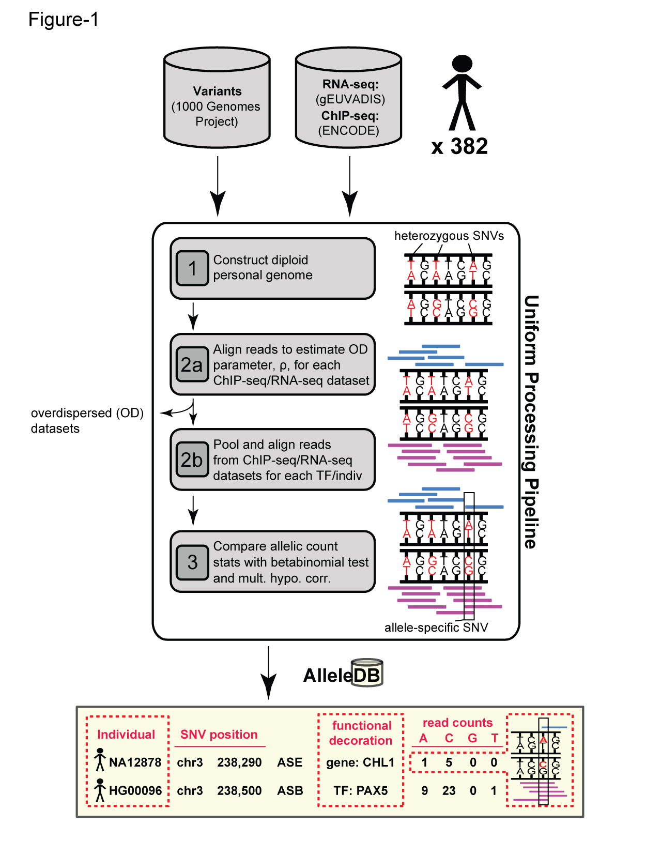
Figure 1. Workflow for uniform processing of data from 382 individuals and construction of AlleleDB.

Slide 3
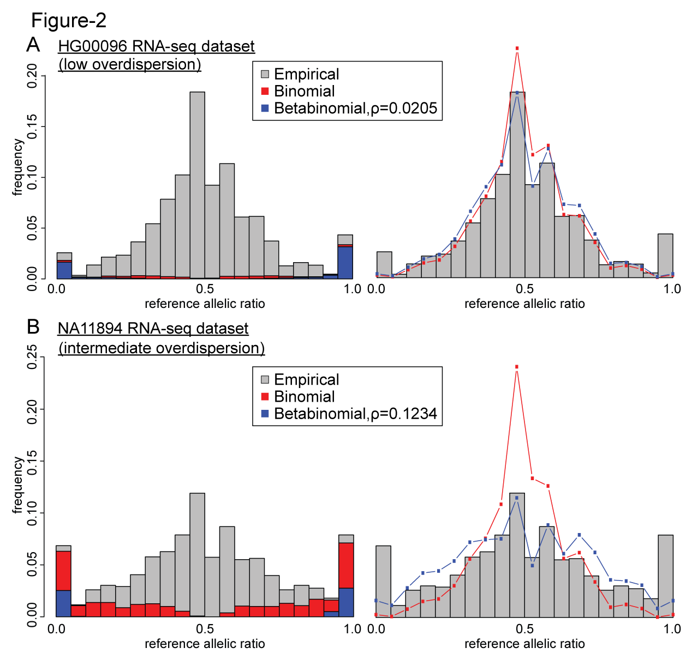
Figure 2. Comparing the effects of the binomial and beta-binomial tests in datasets with low and intermediate level of overdispersion.

Slide 4
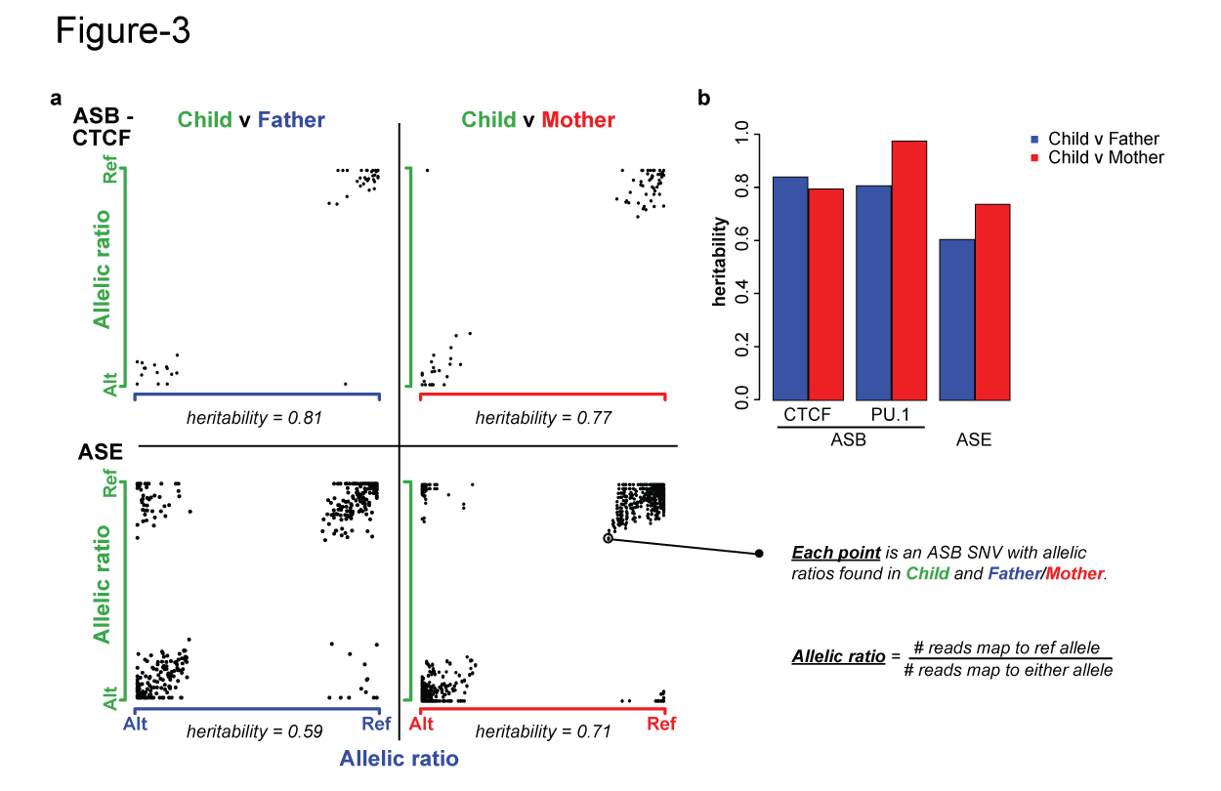
Figure 3. Inheritance of allele-specific behavior.

Slide 5
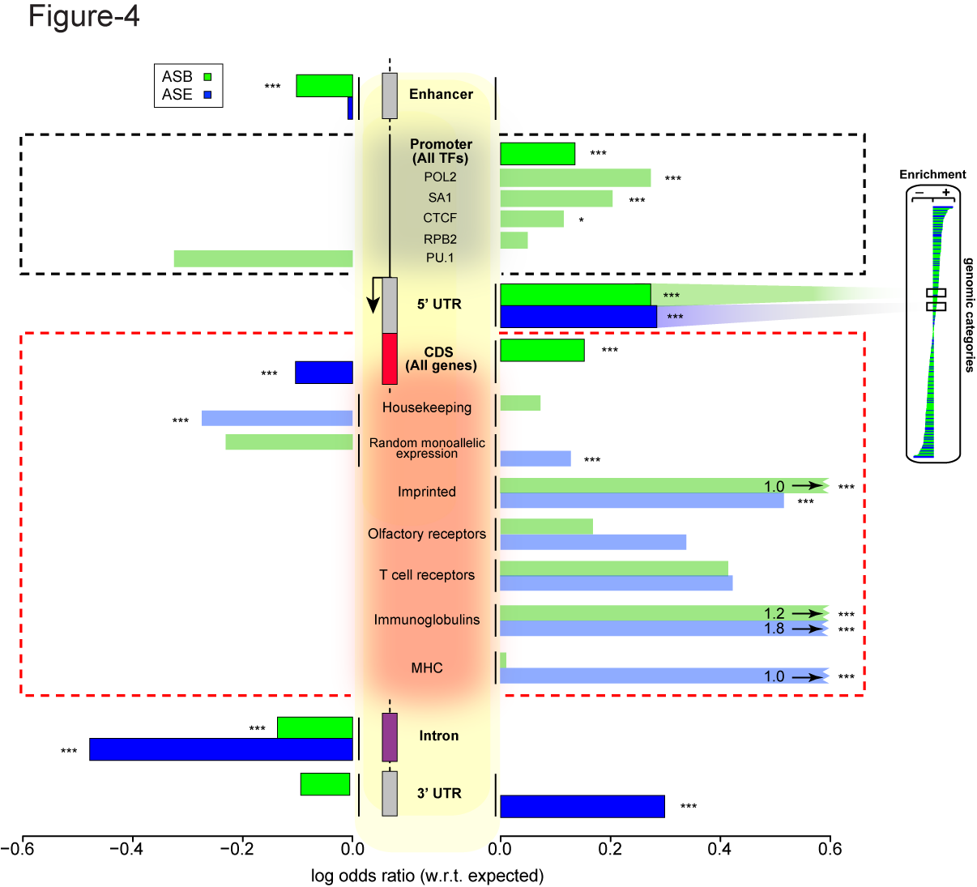
Figure 3. Some genomic regions are more susceptible to allele-specific regulation.
Notes:
Bonferonni corrected p

Slide 6
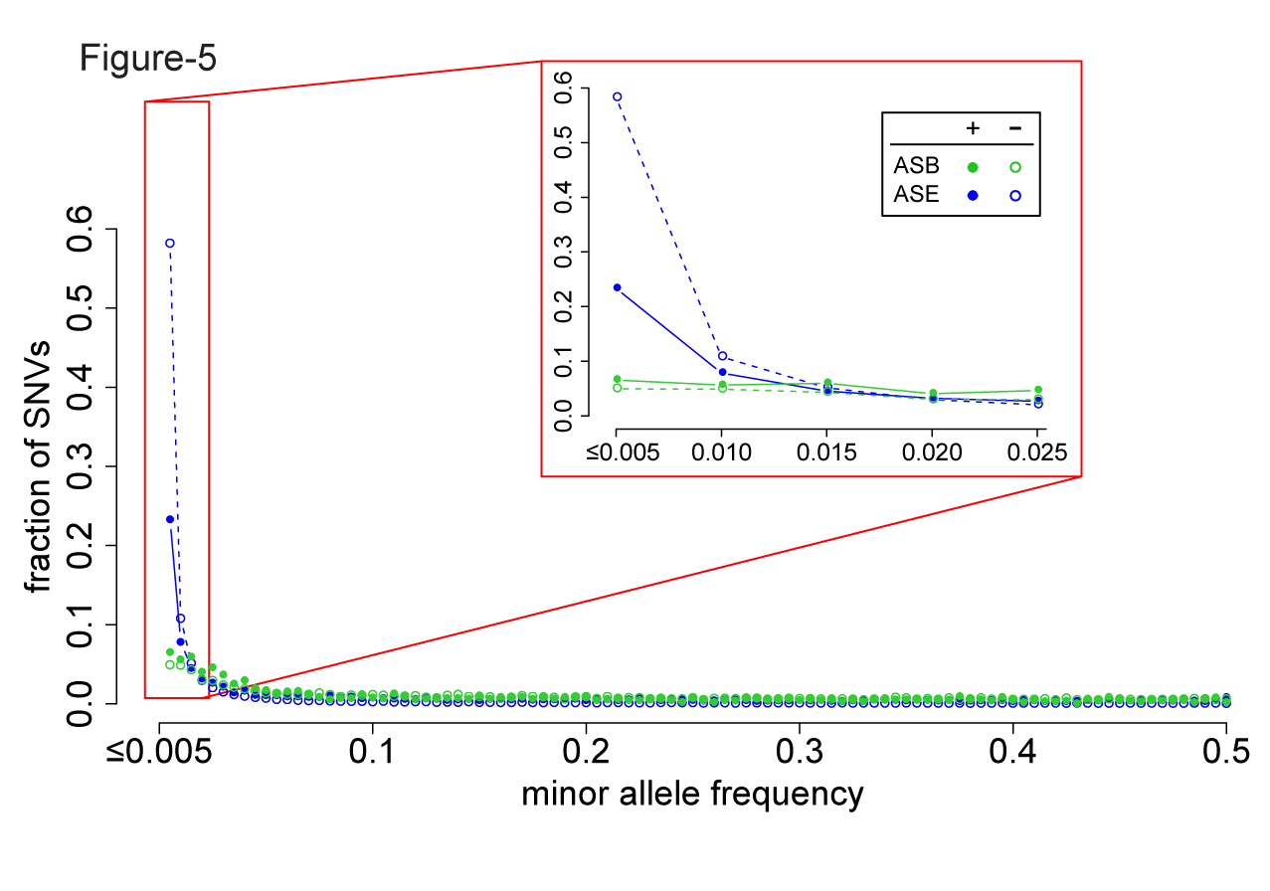
Figure 4. A considerable fraction of AS variants are rare but do not form the majority. Lesser proportion of ASE SNVs than non-ASE SNVs are rare, suggesting less selective constraints in ASE SNVs.

Slide 7
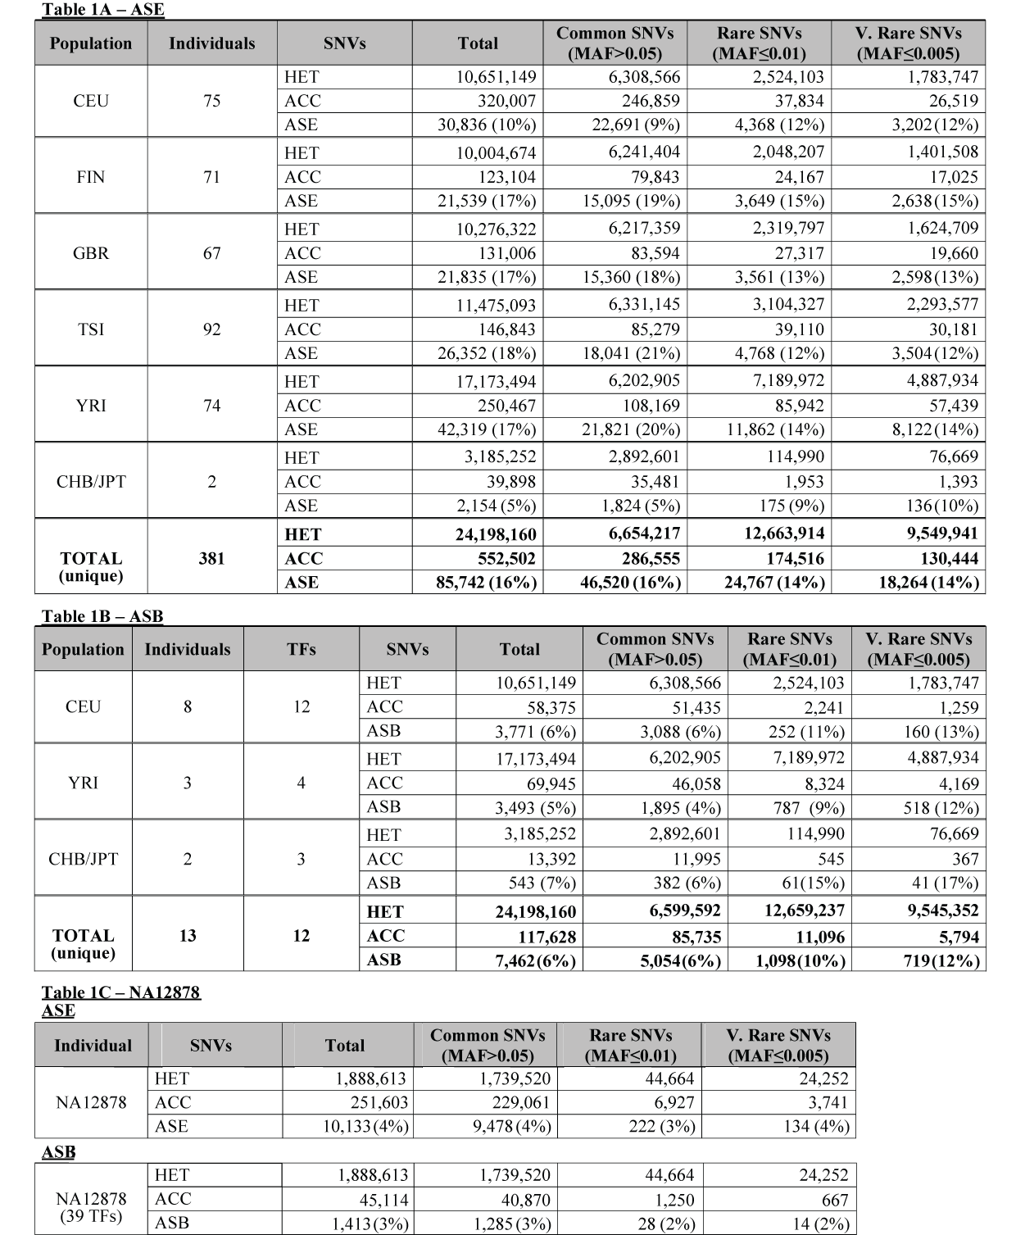
Table 1.

Slide 8
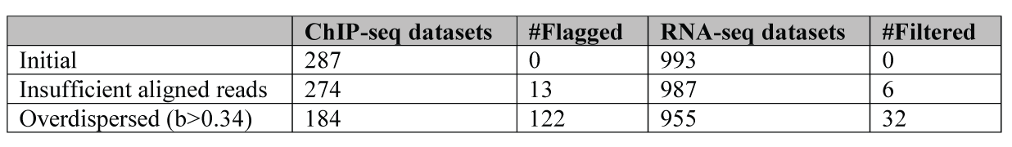
Supplementary Table 1
Flagging of individual datasets

Slide 9
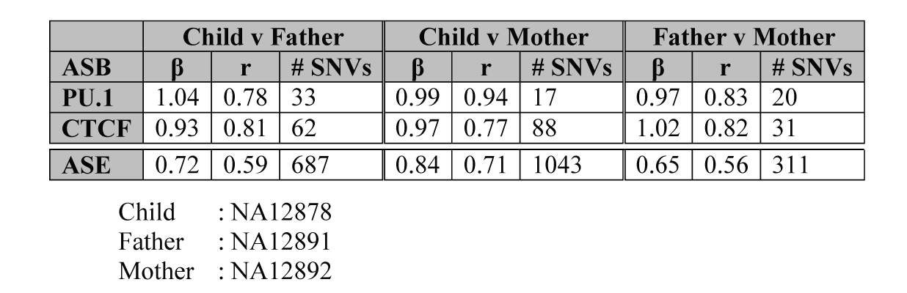
Supplementary Table 2
Allelic inheritance
Notes:
# sNVs

Slide 10
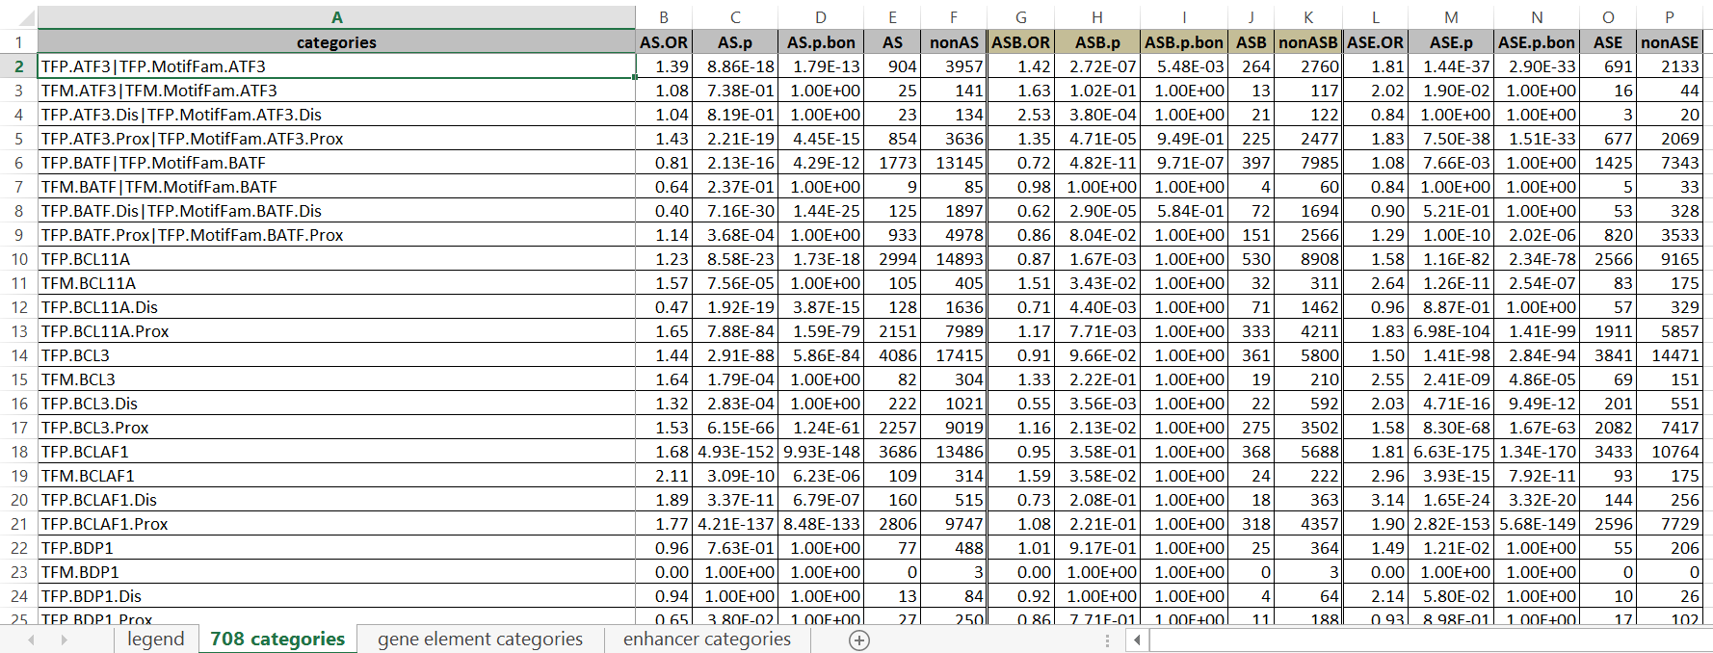
Supplementary File 1
708 unique non-coding categories, gene elements, enhancers
ASB, ASE and AS, with Bonferroni-corrected p values

Slide 11
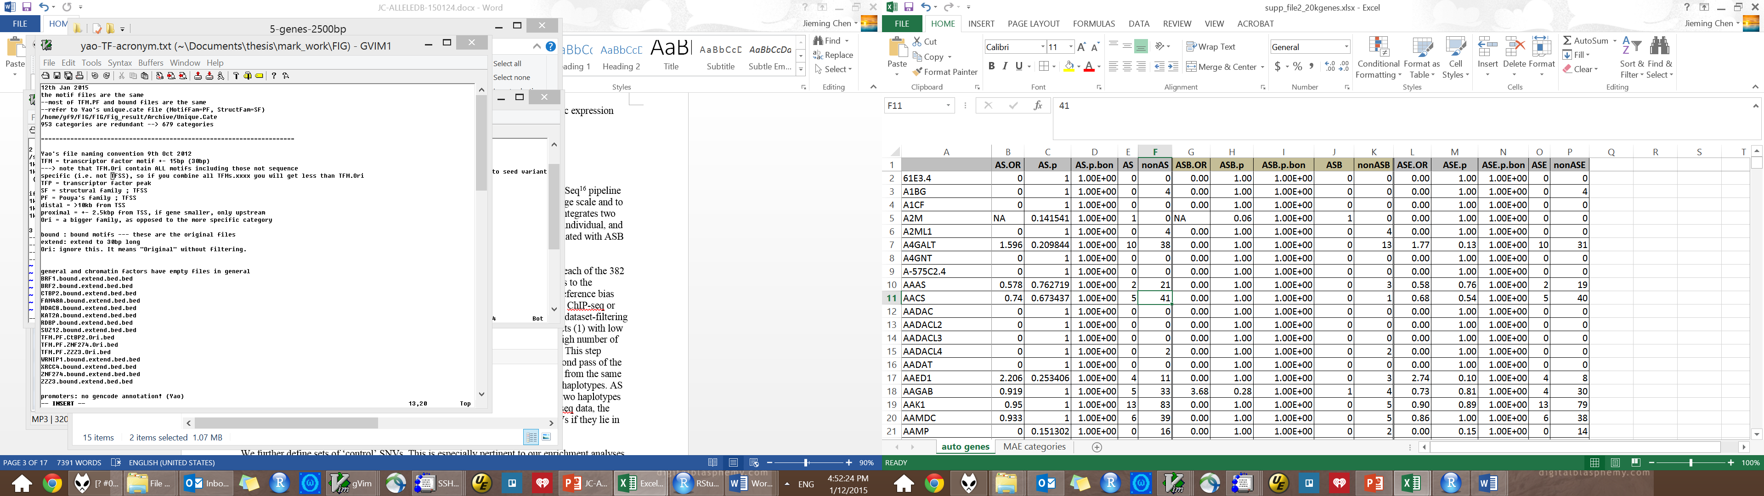
Supplementary File 2
19,257 autosomal genes, MAE categories
 | AS.OR | AS.p.bon | AS | nonAS | ASB.OR | ASB.pbon | ASB | nonASB | ASE.OR | ASE.pbon | ASE | nonASE
FHIT | 0.13884 | 6.30E-07 | 6 | 262 | 0.00 | 1.00E+00 | 0 | 23 | 0.14 | 4.74E-07 | 6 | 242
SNURF | 186.1098 | 4.62E-45 | 61 | 2 | 0.00 | 1.00E+00 | 0 | 1 | 167.96 | 9.04E-43 | 61 | 2
ASB, ASE and AS, with Bonferroni-corrected p values

Slide 12
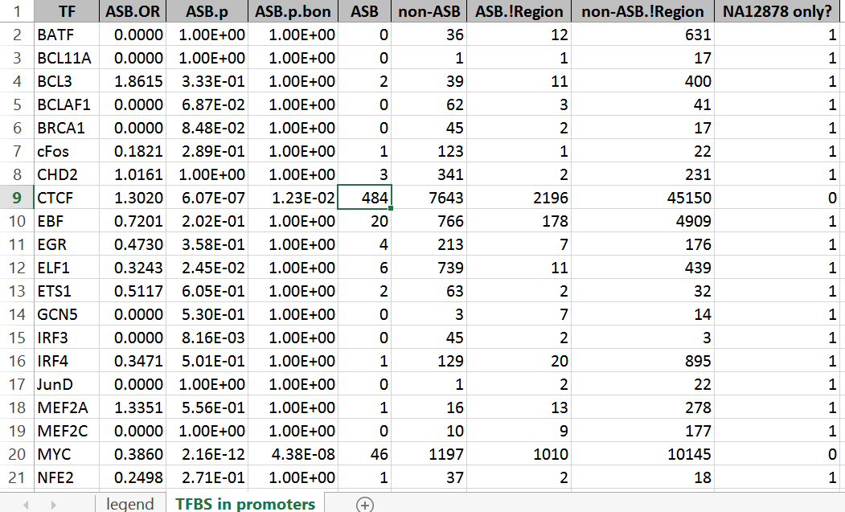
Supplementary File 3
ASB SNVs of 44 TFs in promoters
ASB, ASE and AS, with Bonferroni-corrected p values

Slide 13
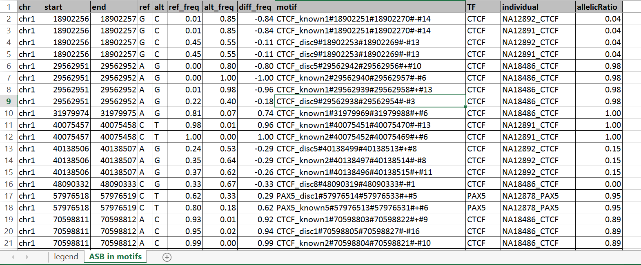
Supplementary File 4
ASB SNVs in TF motifs

Slide 14
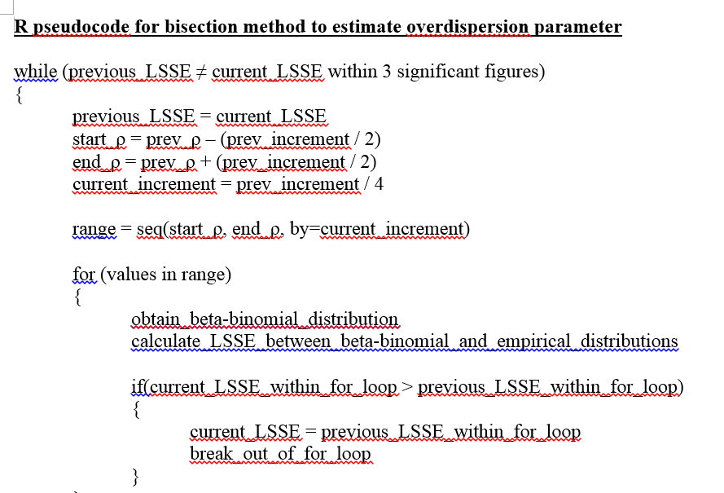
Supplementary File 5
R Pseudocode for bisection method to estimate overdispersion parameter

Slide 15
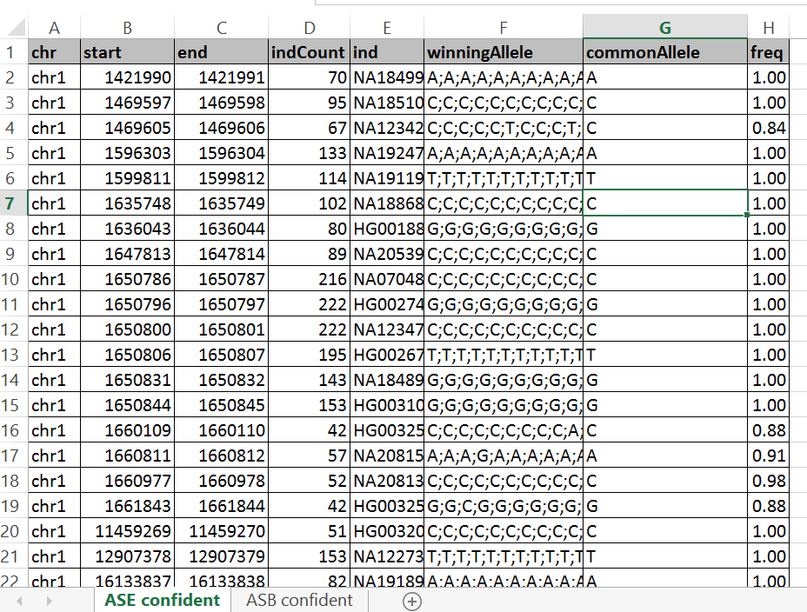
Supplementary File 6
More confident set

