Slide 1
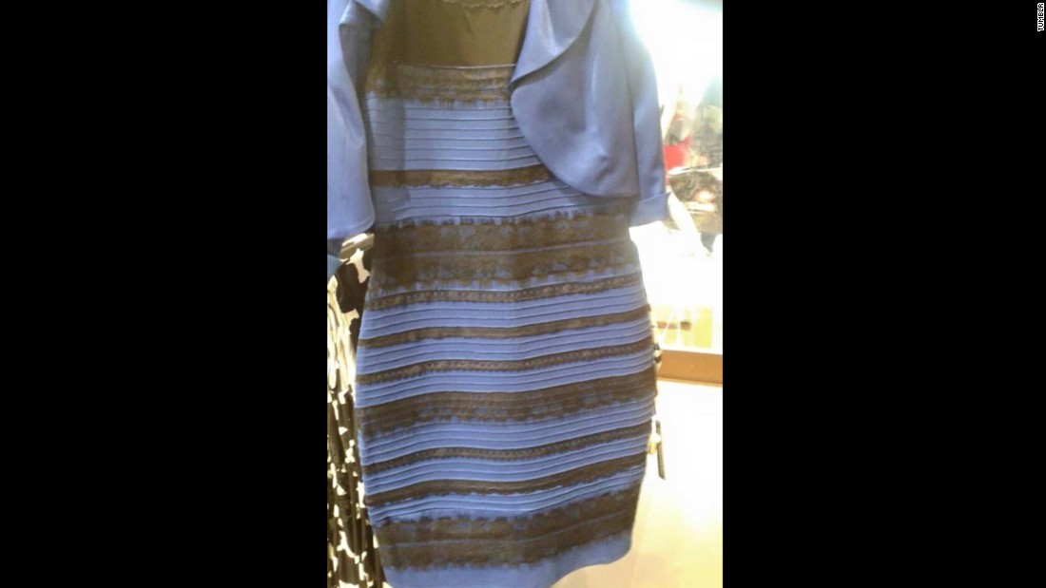
What color is this Dreiss?

Slide 2
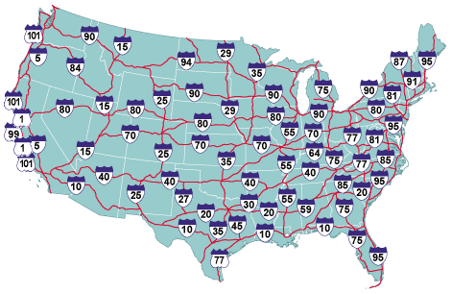
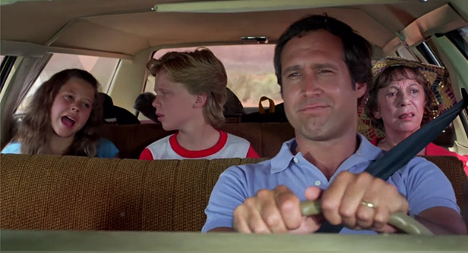
t+T
t+3
t+2
t+1
t

Slide 3
Get dreissed we are going on a trip (trippin)
Based on each car’s position across timepoints
1) Who spends more money and When?
2) what do the basic trajectories look like?

Slide 4
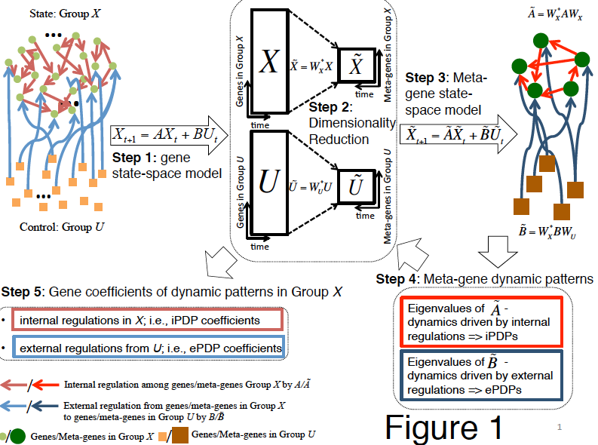
DREISS model
Model Assumptions:
Expr_{x+1} =f(Expr_{x})
# timepoints >> Nr of eigengenes
Conclusions
Very conserved genes play greater role in regulatory dynamics
Conserved genes have more similar basic expression patterns

Slide 5
Additional figures

Slide 6
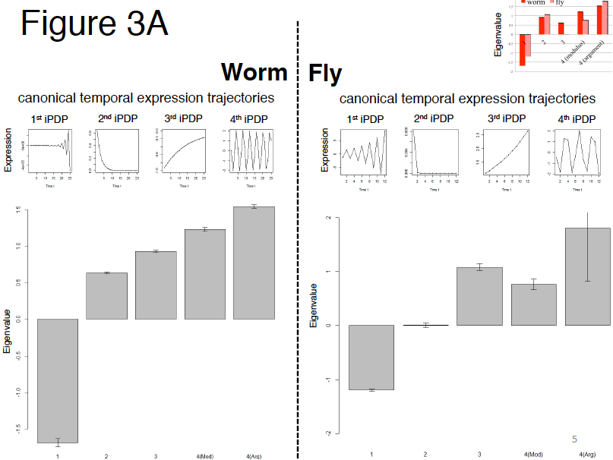

Slide 7
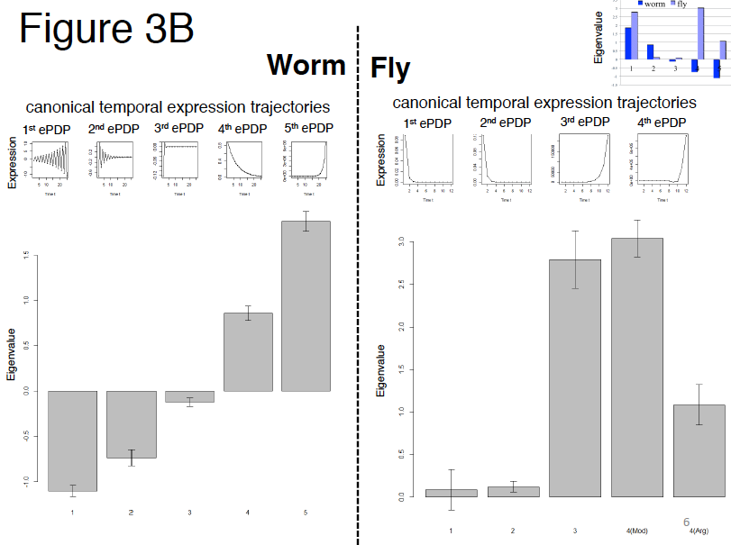

Slide 8
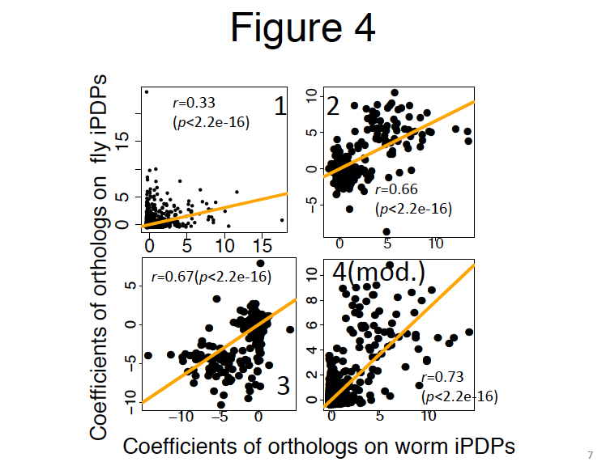

Slide 9
List of suggestions - “concerns”
Already sent to Daifeng

Slide 10
List of suggestions - “concerns”
Major two components should be highlighted.
Model’s assumption need to be presented:
Does the system needs to be complete in order for Expr_{x+1} =f(Expr_{x})? If yes, is second example correct?
Do ‘U’ genes need to not interact with each other?
Conclusions are expected and should be treated as confirmatory
Correlation in figure 4 is more depended on on/off pattern rather than “expression pattern”
So many ‘0’ values in figure 4 may drive correlation anyway
What happens if you calculate PDP eigenvalues to all iPDP vs all ePDP? Do you find both (worm AND FLY) “1st” iPDPs and both 1st ePDP?
Do different genes fit different PDPs? In Principal components, you would get the same genes participating across different components. Do you get the same here, because if you do I am struggling to find the biological meaning.
I think it is important to show overall expressional dynamics and how the break into different PDP. For example start with one and keep adding them until they fit overall profile

