Slide 1
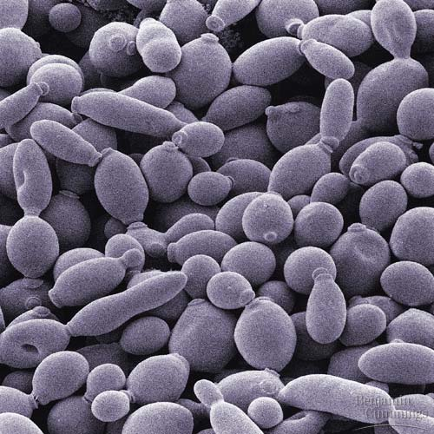
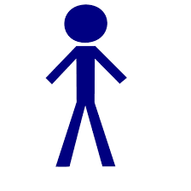
Regulatory networks: from yeast to human
 | 150 TFs, 6000 genes | 1300 TFs, 20000 genes
 | 130 kinases, 1000 targets | 500 kinases, up to 6000 targets
Transcriptional regulatory network
transcription
factor
target
transcription
regulation
Kinase network
(regulation in translational level)
kinase
target
phosphorylation

