Slide 1
Multiscale Peak Calling with MUSIC
Arif Harmanci
Gerstein Lab, Yale University
January 23, 2015

Slide 2
MUSIC
Identification of enriched regions in the data from ChIP-Seq experiments
MUSIC: MUltiScale enrIchment Calling (Harmanci et al, Genome Biology, 2014)
Code available gersteinlab github page:
https://github.com/gersteinlab/MUSIC
Easy to build and run
Two main motivations for a new peak (ER) caller
The need to process the signals at different scales
Non-uniform mappability of the genomes
Notes:
[[Broad peaks as biomarkers???]]

Slide 3
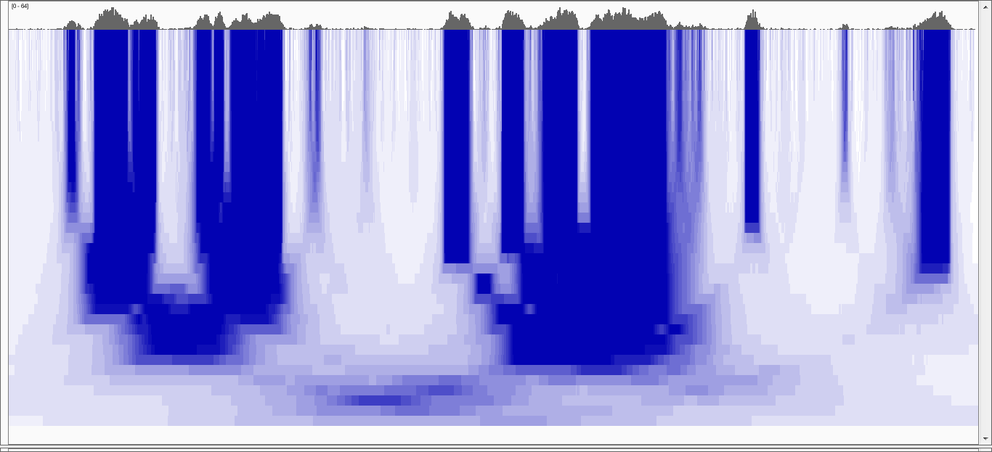
Multiscale Decomposition
20kb
100 b
Increasing Scale
100 kb
Notes:
To address the first issue, we use median based decomposition, which is median filtering the RD signal with increasing window lengths.
In order to perform median filtering with a window length, you take the signal and replace signal value at each point with the median of the values within the vicinity of that point.
In the figure, the RD signal is shown at the very top. In the bottom heatmap, each row is a filtered signal track in the decomposition.
White-> low, blue->high
Notice that the peaks in the signal get merged over the increasing scales.
Notice the “blocky” behavior of the decomposition where the edges are conserved over several scales before they die off rather quickly at a certain scale.

Slide 4
Multiscale Decomposition
Very
Punctate
ER
20kb
Broader
ER
Punctate
ER
Broad
ER
100 b
Increasing Scale
Very Broad
ER
100 kb
Notes:
In comparison with Gaussian decomp, median based decomp conserves the enriched regions upto a certain scale then removes them completely. Unlike
Gaussian, where all the signal features are transferred till the highest scale in the decomposition. This property makes median filtering a better candidate
For analysing the which scales levels are enriched in the signal

Slide 5
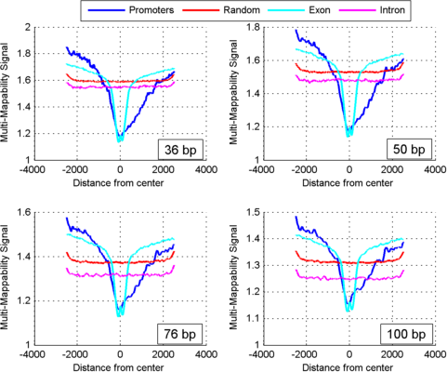
Multi-Mappability Profile
“Number of reads mapping at a position from uniformly sampled genome”
Notes:
Lets puts the MS decomposition aside.
For dealing with non-uniform mappability we generate multi-mappability profile and use it in a correction procedure.

Slide 6
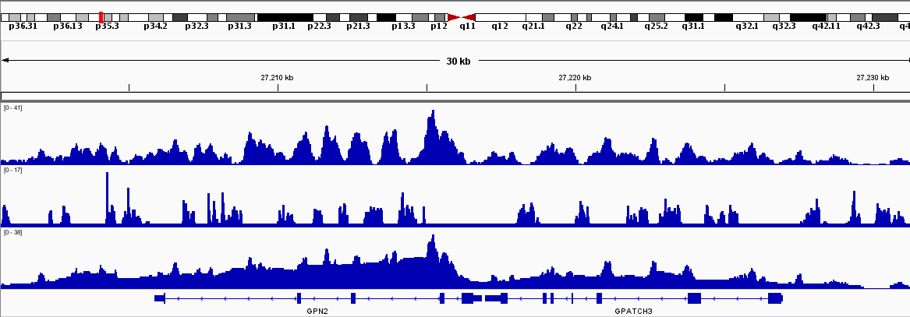
Multi-Mappability Correction
At each position, use the surrounding highly mappable positions to update and smooth the signal
H3K36me3
Multi-mappability
Corrected

Slide 7
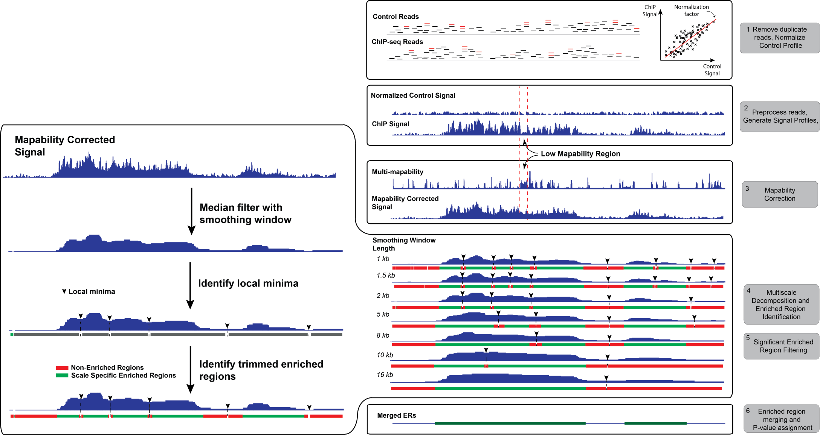
MUSIC Algorithm
Notes:
Can do broad, punctate and TF peak calling with default parameters or with user defined parameters

Slide 8
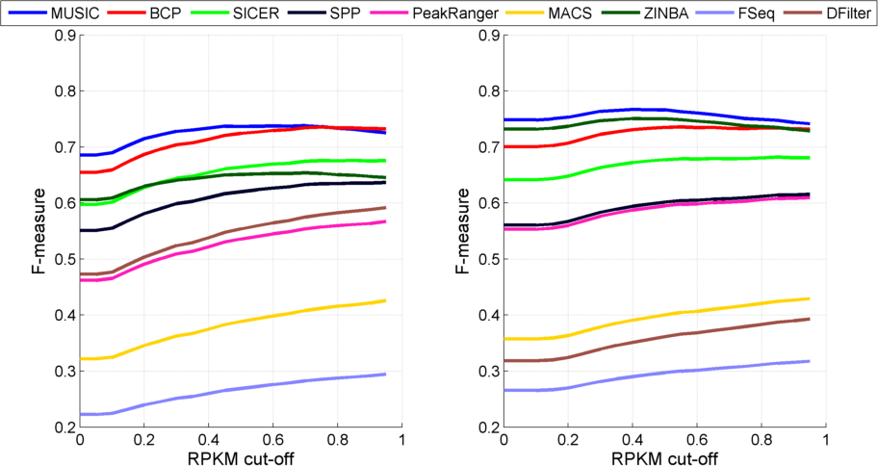
Comparison with Other Methods
H3K36me3: Active Gene Bodies
K562
GM12878
Notes:
We have a set of parameters based on gene length distributions.
We used the parameters proposed by the methods authors.

Slide 9
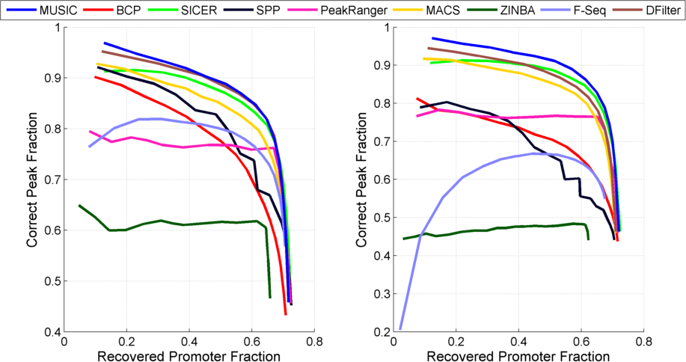
Comparison with Other Methods
H3K4me3: Active Promoters
K562
GM12878

Slide 10
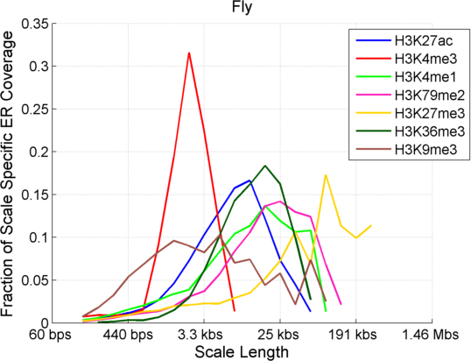
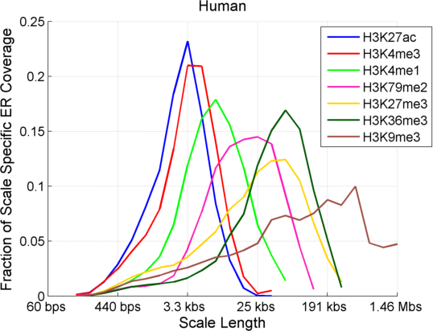
MUSIC Identifies Scale Spectrum
For each ER, what is the largest scale at which we we observe it?
Small scales: Punctate ERs
Large scales: Broad ERs
Scale Spectrum: Fraction of coverage of genome at different scales

Slide 11
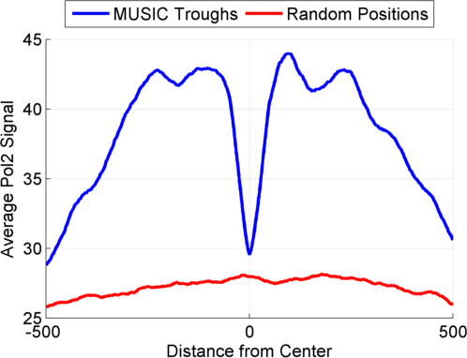
MUSIC Identifies Mappable Troughs
Reported ER
Reported Trough
For each ER, one trough with high mappability is reported
We can report more troughs
Pol2 is depleted at H3K4me3 troughs for fly
Fly
Notes:
The troughs are particularly important for algorithms that do enhancer prediction since they are the most likely spots where TFs bind.

Slide 12
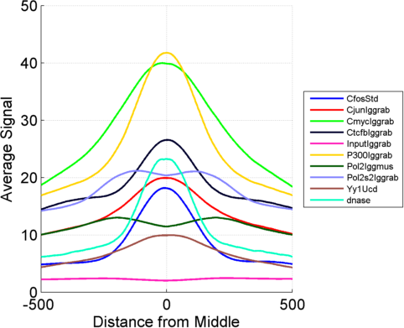
H3K27ac Mappable Troughs
Pol2 bimodal peaks

Slide 13
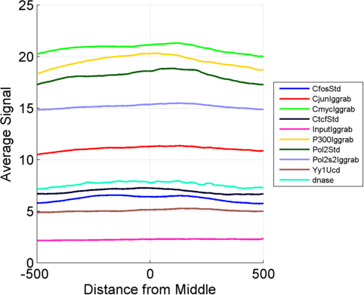
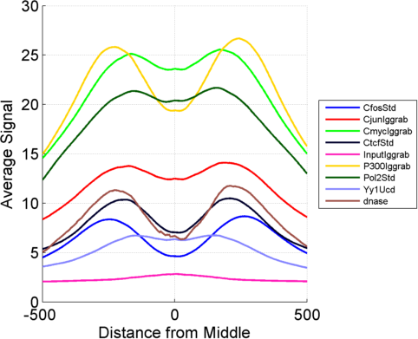
H3K27ac Summits and Random Regions
Randomly Shifted Troughs
Summits

Slide 14
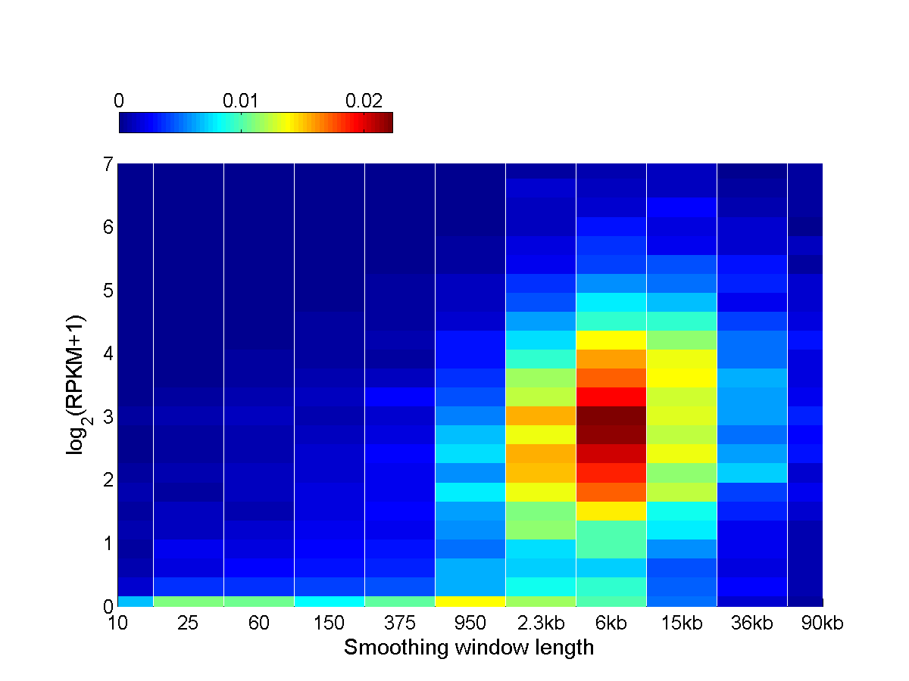
Pol2 Scale Spectrum over Protein Coding Genes Reveal Different Patterns of Gene Activity
Elongating
(Broad-High)
Stalled
(Punctate-Low)

Slide 15
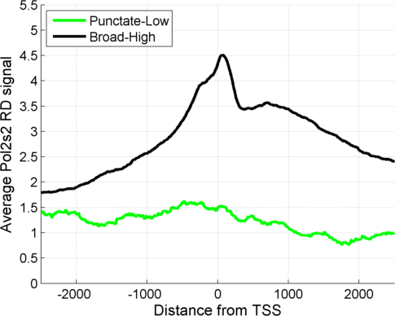
Pol2 Scale Spectrum over Protein Coding Genes Reveal Different Patterns of Gene Activity
Upstream
Gene body
Notes:
Figure 4: (b) Aggregation of elongating Pol2s2 signal around promoters of genes with low expression and punctate polymerase binding (“Punctate-Low”), genes with high expression and punctate polymerase binding (“Punctate-High”). The aggregation signal for stalled polymerase bound promoters (“Punctate-Low”) show the smallest Pol2s2 signal levels.

Slide 16
MUSIC makes music
-get_multiscale_music: Generates a .wav file using the aggregate multiscale decomposition
Listen to K562 H3K36me3 chromosome 1: http://archive.gersteinlab.org/proj/MUSIC/music/H3K36me3.mp3
Telomeres are vocal, centromeres (46:00-53:00) are silent
Listen K562 H3K4me3 chromosome 1: http://archive.gersteinlab.org/proj/MUSIC/music/H3K4me3.mp3
More “clicky” than H3K36me3 with more punctate enriched regions

Slide 17
Deliverables
Peaks at multiple scales
Final (merged) peaks
Scale spectrum for each factor/histone modification
Acknowledgements
Arif Harmanci (arif.harmanci@yale.edu), Joel Rozowsky, Mark Gerstein
Notes:
Acknowledgements

Slide 18
Extra Slides

Slide 19
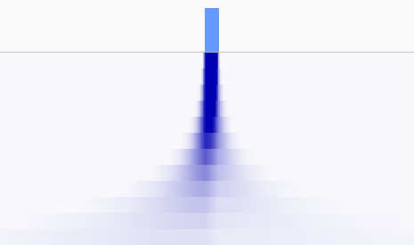
Gaussian vs Median Decomposition
Gaussian
Median
Increasing Scale

Slide 20
Gaussian vs Median Decomposition
Gaussian
Median
10kb
Increasing Scale
Signal is blurred over all the scales
5 kb long peak gets
lost at 10kb scale

Slide 21
Enrichment Feature Filtering and Trimming
$$P\left(x>t | x\sim Poiss\right)<0.05$$
Poisson
Threshold (t)
Trimmed by binomial
P-value minimization
(All counts are per l_p kb windows in the peak)
Poisson threshold
trimmed
$$p_{i}=\sum_{i=n_{chip}+1}^{n_{chip}+n_{conrol}}{\left({n_{chip}^{}+n_{control}^{} \atop i}\right)}{0.5}^{\left(n_{chip}^{}+n_{control}^{}\right)}$$
Per strand signal consistency:
$$min⁡(\frac{\sum{x_{i}^{−}}}{\sum{x_{i}^{+}}},\frac{\sum{x_{i}^{+}}}{\sum{x_{i}^{−}}})>0.5$$
Notes:
[[Binomial P-value based filtering of the features: We have way too many features, we have to get rid of some of them]]
[[Binomial P-value based trimming of the ends]]
[[Poisson thresholding based end trimming]]
[[Signal loss based filtering: When the signal is too smoothed, do not use that feature any more]]

Slide 22
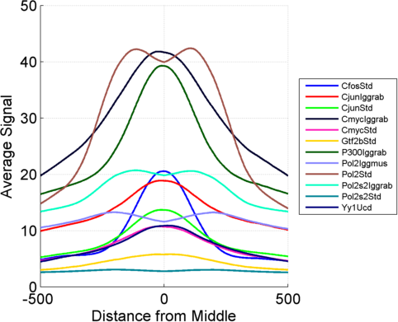
H3K4me3 Mappable Troughs

Slide 23
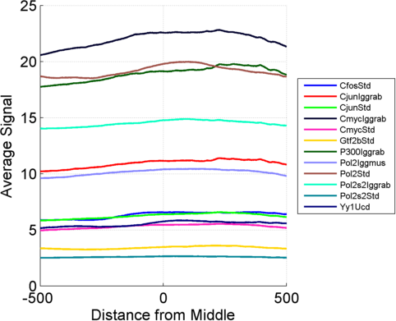
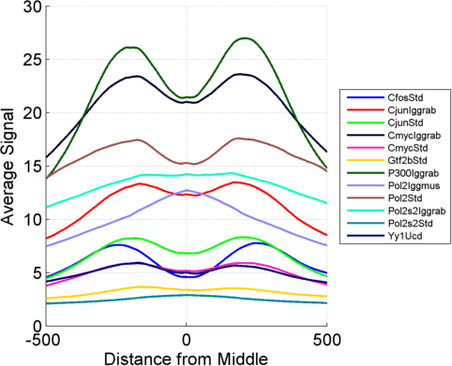
H3K4me3 Summits and Random Regions
Randomly Shifted Troughs
Summits

