Slide 1
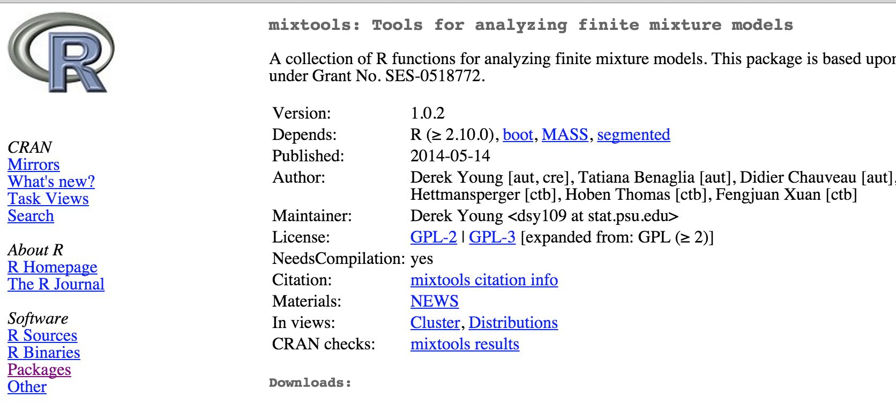
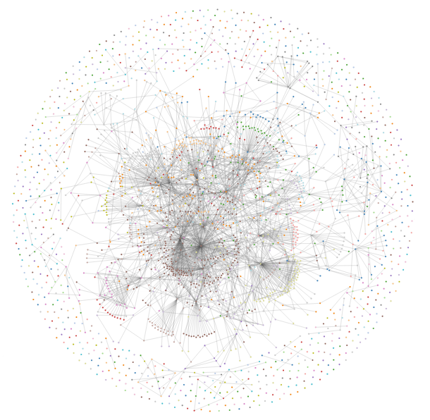
Network of R package dependencies
~5700 packages
boot
mixtools
MASS
segmented
image: tlfvincent R Bloggers

