Slide 1
MPM1 16S PROCESSING AND ANALYSIS
05 Mar 2015

Slide 2
OUTLINE
2 projects involving microbiome sampling with spatial information
JAX building sampling
Surface sampling (desks, chairs, etc)
Temporal (1/wk for 20 weeks)
Individuals
JAX colony mouse microbiome pilot
Stool samples
Different strains
Different rooms

Slide 3
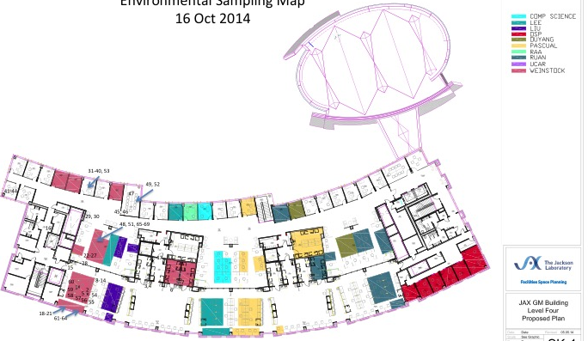
JAX BUILDING SAMPLING
20 weeks
(~ 160 samples/wk, ~3 hrs collecting time/ wk , 3 indiv = 7.5 person days of work)

Slide 4
MP14
MP15
MP13
MP23
BALB/cJ
BALV/cJ
A/J
A/J
CBA/J
BALB/cJ
A/J
CBA/J
C57BL/6J
A/J
A/J
CBA/J
AX9
CBA/J
AX1
AX28
AX4
BALB/cJ
C57BL/6J
C57BL/6J
C57BL/6J
BALB/cJ
CBA/J
C57BL/6J
AX27
AX30
NOD.Cg
NOD.Cg
NOD.Cg
NOD.Cg
NOD.Cg
1210
1230
MGL277
AMP
VFPWT3
CByB6F1
AMP
VFP_277
VFPWT3
CByB6F1
CByB6F1
CByB6F1
AMP
VFP_277

Slide 5
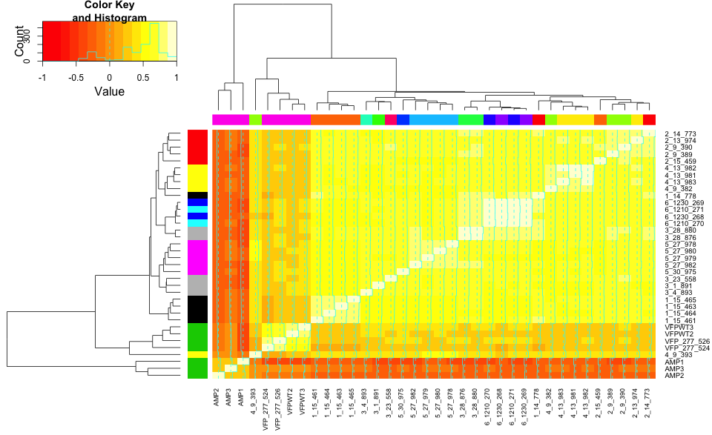
SPEARMAN
Notes:
InputLocation= "~/Box Sync/Projects/mpm1/dataProcessing/"
FileName = "otu_table_fraction.csv"
ForInput = paste(InputLocation, FileName, sep="")
OTUTable=read.csv(file=ForInput, header=TRUE, sep = ",", quote = "\"", dec = ".", stringsAsFactors=FALSE)
rownames(OTUTable) <- OTUTable$X
OTUTable$X <- NULL
OTUTable$X.1 = NULL
colnames(OTUTable) = c("1_14_778", "1_15_461", "1_15_463", "1_15_464", "1_15_465", "2_13_974", "2_14_773", "2_15_459", "2_9_389", "2_9_390", "3_1_891", "3_23_558", "3_28_876", "3_28_880", "3_4_893", "4_13_981", "4_13_982", "4_13_983", "4_9_382", "4_9_393", "5_27_978", "5_27_979", "5_27_980", "5_27_982", "5_30_975", "6_1210_270", "6_1210_271", "6_1230_268", "6_1230_269", "AMP1", "AMP2", "AMP3", "VFP_277_524", "VFP_277_526", "VFPWT2", "VFPWT3")
# tOTUTable <- as.data.frame(t(OTUTable))
# tOTUTable$Sample <- rownames(tOTUTable)
# tOTUTable$Sample <- gsub("Joe1.1.Aging.Qia.ube", "", tOTUTable$Sample)
# tOTUTable$Sample <- gsub("^\\.", "", tOTUTable$Sample)
# tOTUTable$Sample <- gsub(".ST", "", tOTUTable$Sample)
# tOTUTable$Sample <- gsub("min.*_L001", "min", tOTUTable$Sample)
# rownames(tOTUTable) <- tOTUTable$Sample
# tOTUTable$Sample <- NULL
#ObsList <- grep('*.5.min.*', tOTUTable$Sample, ignore.case = FALSE, perl = FALSE, value = FALSE,
# fixed = FALSE, useBytes = FALSE, invert = FALSE)
#tOTUTableSub <- tOTUTable[ObsList,]
#tOTUTableSub$Sample <- NULL
# OTUTableFinal <- as.data.frame(t(tOTUTable))
# var 1 is the strain information
var1 <- c(1, 1, 1, 1, 1, 2, 2, 2, 2, 2, 3, 3, 3, 3, 3, 4, 4, 4, 4, 4, 5, 5, 5, 5, 5, 6, 6, 7, 7, 8, 8, 8, 8, 8, 8, 8)
var1 <- replace(var1, which(var1 == 1), "black")
var1 <- replace(var1, which(var1 == 2), "red")
var1 <- replace(var1, which(var1 == 3), "grey")
var1 <- replace(var1, which(var1 == 4), "yellow")
var1 <- replace(var1, which(var1 == 5), "magenta")
var1 <- replace(var1, which(var1 == 6), "cyan")
var1 <- replace(var1, which(var1 == 7), "blue")
var1 <- replace(var1, which(var1 == 8), "green3")
# var 2 is the room information
var2 <- c(1, 2, 2, 2, 2, 3, 1, 2, 4, 4, 5, 6, 7, 7, 8, 3, 3, 3, 4, 4, 9, 9, 9, 9, 10, 11, 11, 12, 12, 13, 13, 13, 13, 13, 13, 13)
var2 <- replace(var2, which(var2 == 1), "#FF0000FF")
var2 <- replace(var2, which(var2 == 2), "#FF7600FF")
var2 <- replace(var2, which(var2 == 3), "#FFEB00FF")
var2 <- replace(var2, which(var2 == 4), "#9DFF00FF")
var2 <- replace(var2, which(var2 == 5), "#27FF00FF")
var2 <- replace(var2, which(var2 == 6), "#FF0076FF")
var2 <- replace(var2, which(var2 == 7), "#00FF4EFF")
var2 <- replace(var2, which(var2 == 8), "#00FFC4FF")
var2 <- replace(var2, which(var2 == 9), "#00C4FFFF")
var2 <- replace(var2, which(var2 == 10), "#004EFFFF")
var2 <- replace(var2, which(var2 == 11), "#2700FFFF")
var2 <- replace(var2, which(var2 == 12), "#9D00FFFF")
var2 <- replace(var2, which(var2 == 13), "#FF00EBFF")
#Creates a correlation variable (r=matrix of correlations, n=number of observations, p=asymptotic p-values)
CorrTable <- rcorr(as.matrix(OTUTable), type="spearman")
CorrTable.r <- CorrTable$r
CorrTable.p <- CorrTable$P
# dev.off()
heatmap.2(CorrTable.r, margin= c(6,6), dendrogram = c("both"), cexRow = 0.9,
RowSideColors = var1, ColSideColors = var2)
par(lend = 1) # square line ends for the color legend
legend("topleft", # location of the legend on the heatmap plot
legend = c("A/J", "BALB/cJ", "C57BL/6J", "CBA/J", "NOD.Cg-Prkdcscid Il2rgtm1Wjl/SzJ", "CByB6F1/J Studs", "CByB6F1/J Pseudo Moms", "Roopenian Strain"), # category labels
col = c("black", "red", "grey", "yellow", "magenta", "cyan", "blue", "green3"), # color key
lty= 1, # line style
lwd = 15 # line width
)
legend("topright",
legend = c("MP14", "MP15", "MP13", "AX9", "AX1", "MP23", "AX28", "AX4", "AX27", "AX30", "1210", "1230", "MGL 277"),
col = c("#FF0000FF", "#FF7600FF", "#FFEB00FF", "#9DFF00FF", "#27FF00FF", "#FF0076FF", "#00FF4EFF", "#00FFC4FF", "#00C4FFFF", "#004EFFFF", "#2700FFFF", "#9D00FFFF", "#FF00EBFF"),
lty= 1, # line style
lwd = 15 # line width
)

Slide 6
BRAY-CURTIS

Slide 7
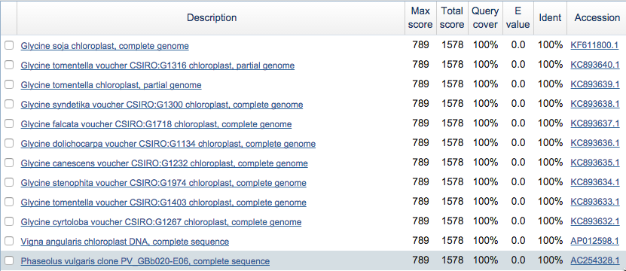
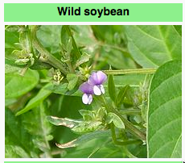
AMP DIFFERENCE DRIVEN BY OTU33
Notes:
This is the BLAST result of the OTU that caused the large amount of “Unclassified” reads at the phylum level.

Slide 8
SPEARMAN TREE
Is 2_13 more like mice of the same strain (2_9's and 2_14 and 2_15), or mice in the same room (4_13's)?

Slide 9
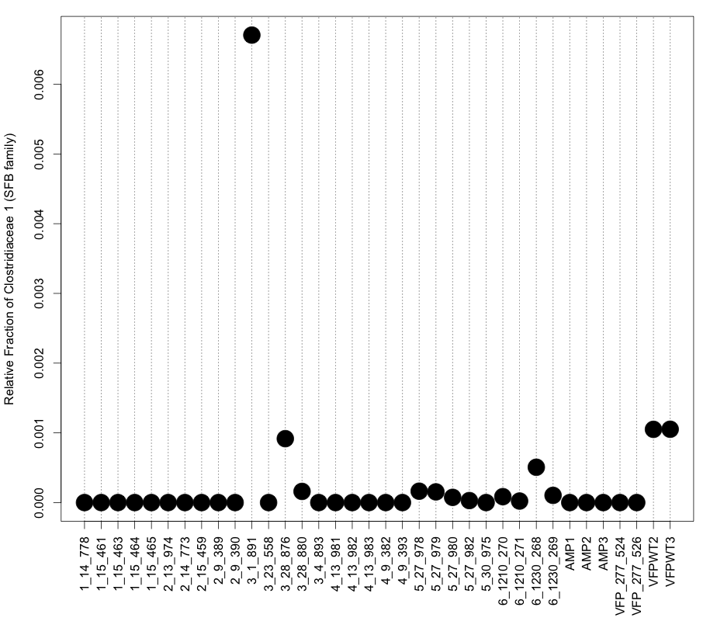
OBSERVATION OF SEGMENTED FILAMENTOUS BACTERIA
Notes:
setwd('~/Box Sync/Projects/mpm1/abundanceTables/')
phylum$X = NULL
colnames(phylum) = c("1_14_778", "1_15_461", "1_15_463", "1_15_464", "1_15_465", "2_13_974", "2_14_773", "2_15_459", "2_9_389", "2_9_390", "3_1_891", "3_23_558", "3_28_876", "3_28_880", "3_4_893", "4_13_981", "4_13_982", "4_13_983", "4_9_382", "4_9_393", "5_27_978", "5_27_979", "5_27_980", "5_27_982", "5_30_975", "6_1210_270", "6_1210_271", "6_1230_268", "6_1230_269", "AMP1", "AMP2", "AMP3", "VFP_277_524", "VFP_277_526", "VFPWT2", "VFPWT3”)
phylum = read.csv('OTURelAbunTable_Phylum.csv', row.names = 2)
par(mar=c(8, 4, 1, 1) + 0.1)
plot(x, tsfb, xaxt = "n", xlab = '', pch = 19, cex = 3, ylab = "Relative Fraction of Clostridiaceae 1 (SFB family)")
axis(1, labels = xlab, las = 2, at = 1:36)
xlab = c("1_14_778", "1_15_461", "1_15_463", "1_15_464", "1_15_465", "2_13_974", "2_14_773", "2_15_459", "2_9_389", "2_9_390", "3_1_891", "3_23_558", "3_28_876", "3_28_880", "3_4_893", "4_13_981", "4_13_982", "4_13_983", "4_9_382", "4_9_393", "5_27_978", "5_27_979", "5_27_980", "5_27_982", "5_30_975", "6_1210_270", "6_1210_271", "6_1230_268", "6_1230_269", "AMP1", "AMP2", "AMP3", "VFP_277_524", "VFP_277_526", "VFPWT2", "VFPWT3")
abline(v = c(1:36), lty = 3)

