Slide 1
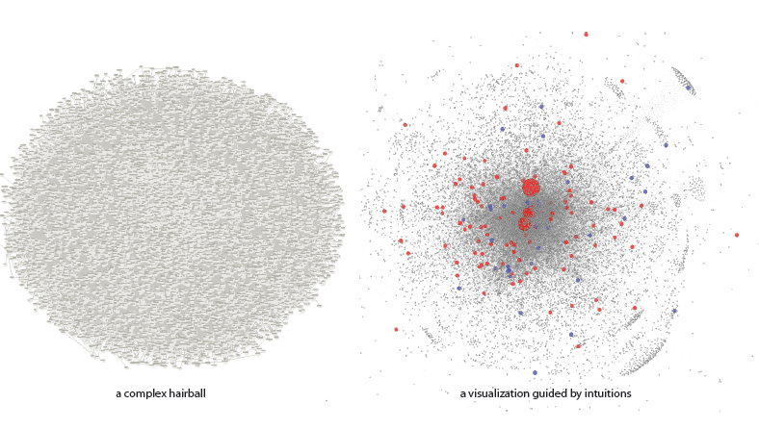

Slide 2
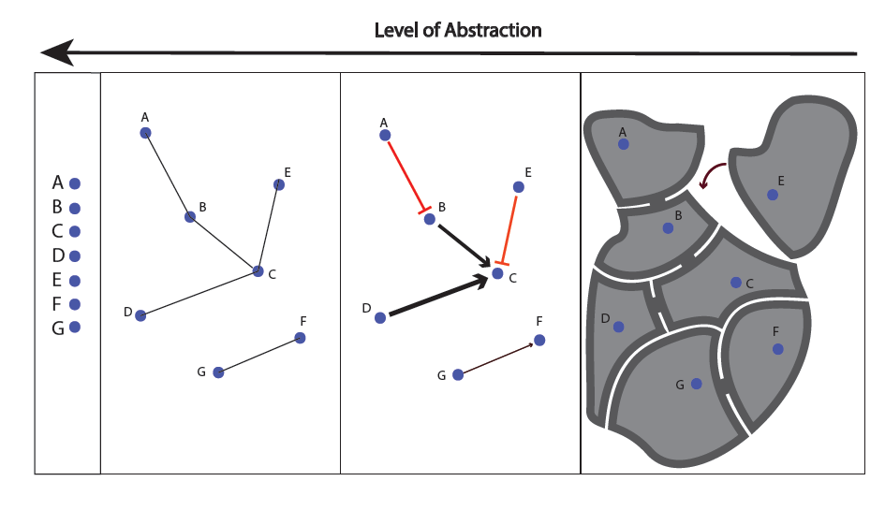

Slide 3
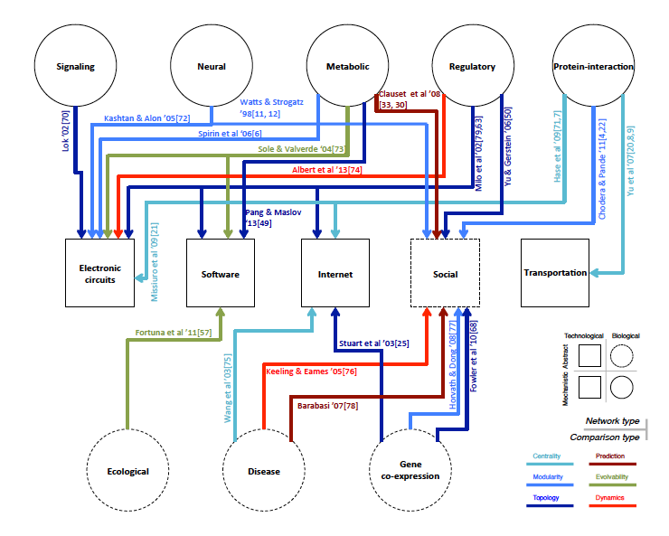

Slide 4
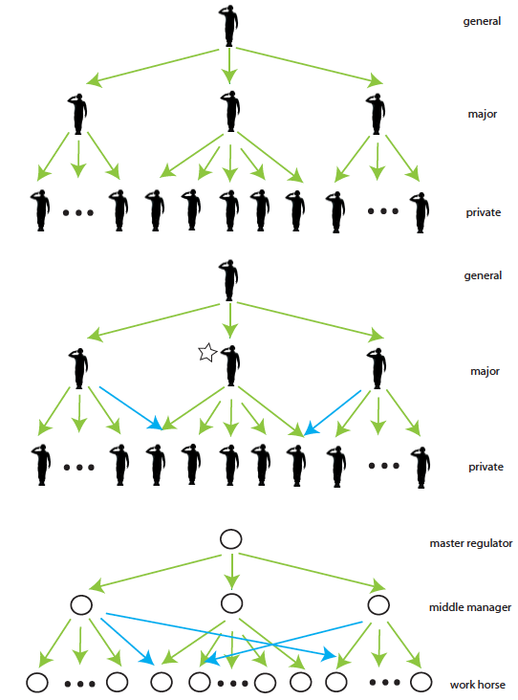

Slide 5
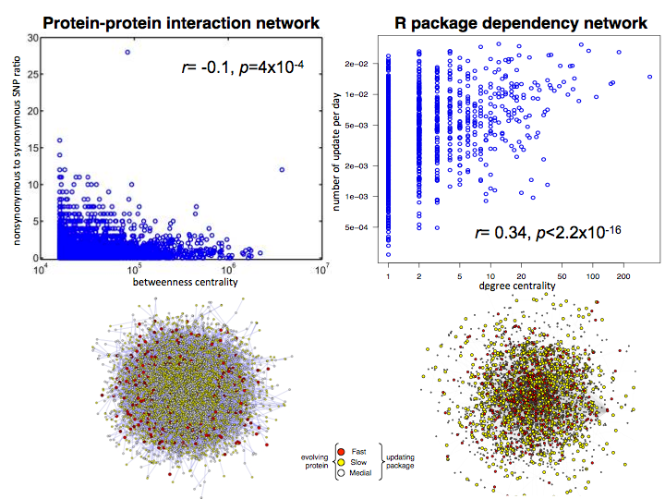
Tinkering versus Design: Connectivity and Constraint
rate of evolution
centrality
Kim et al. PNAS 2007
Yan KK et al. PLoS Biology (under review)

Slide 6
Hierarchy algorithm: from Hairball to Hierarchy

Slide 7
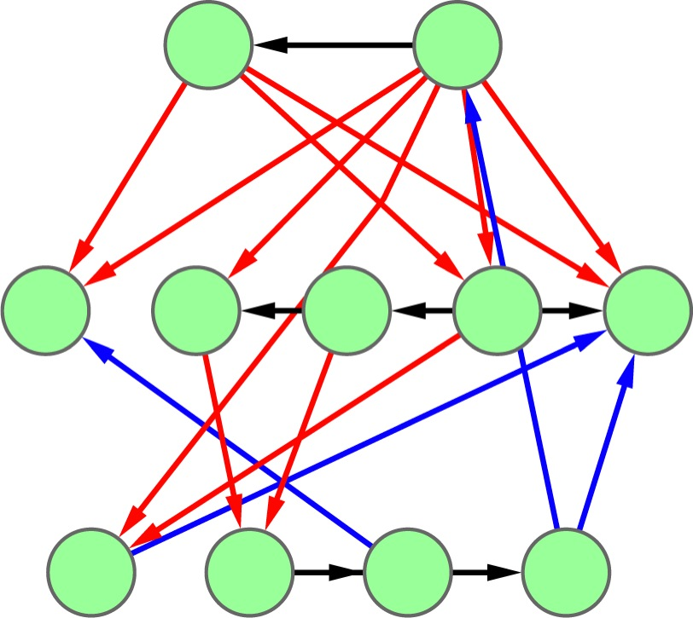
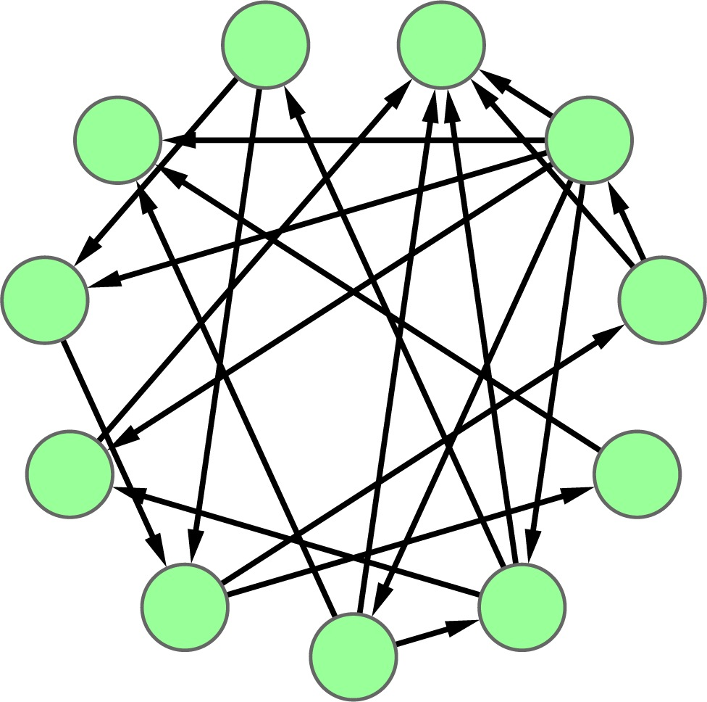
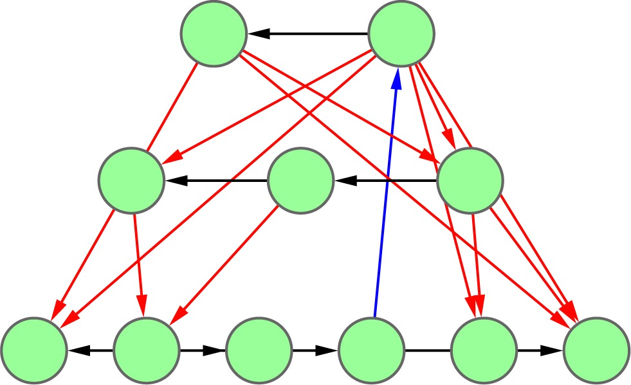
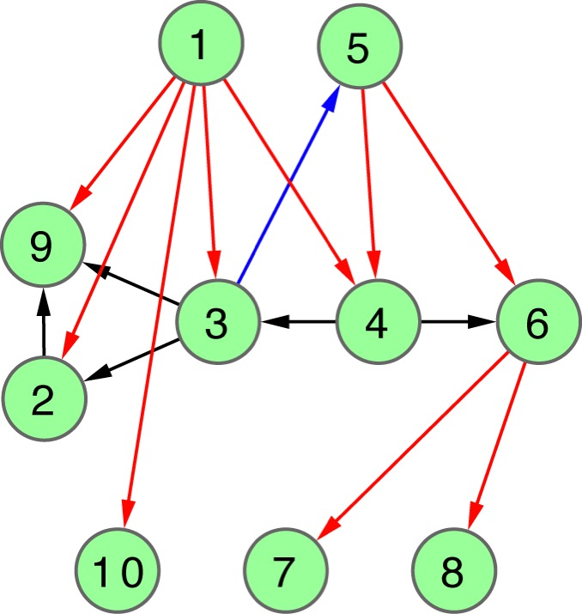
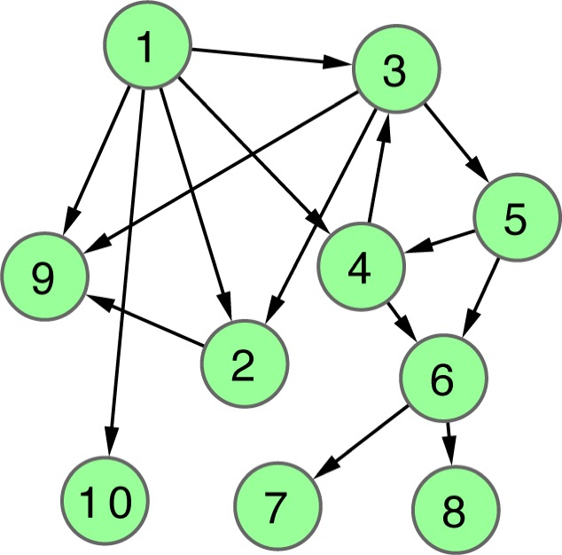
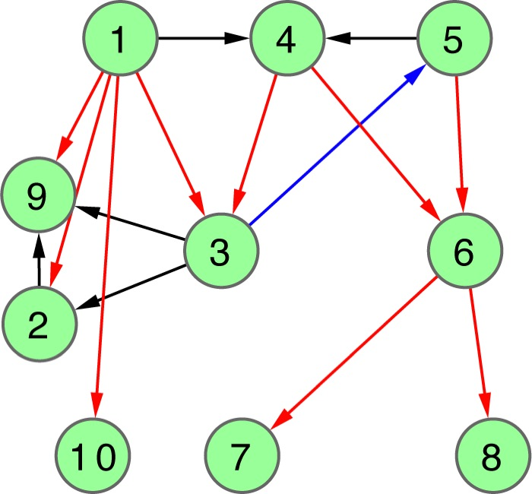
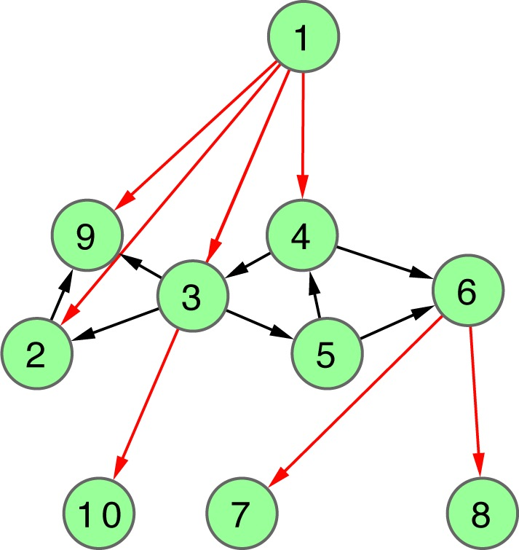
Hierarchy Score Maximization Algorithm
Definition
Simulated annealing
maximize HS
HSM algorithm
L1 L2 L3
N1
N2
N3
N4
N5
N6
N7
N8
N9
N10
L3
.
L2
.
repeat k times
.
L1
Discretized hierarchy network
Probabilistic hierarchy network

Slide 8
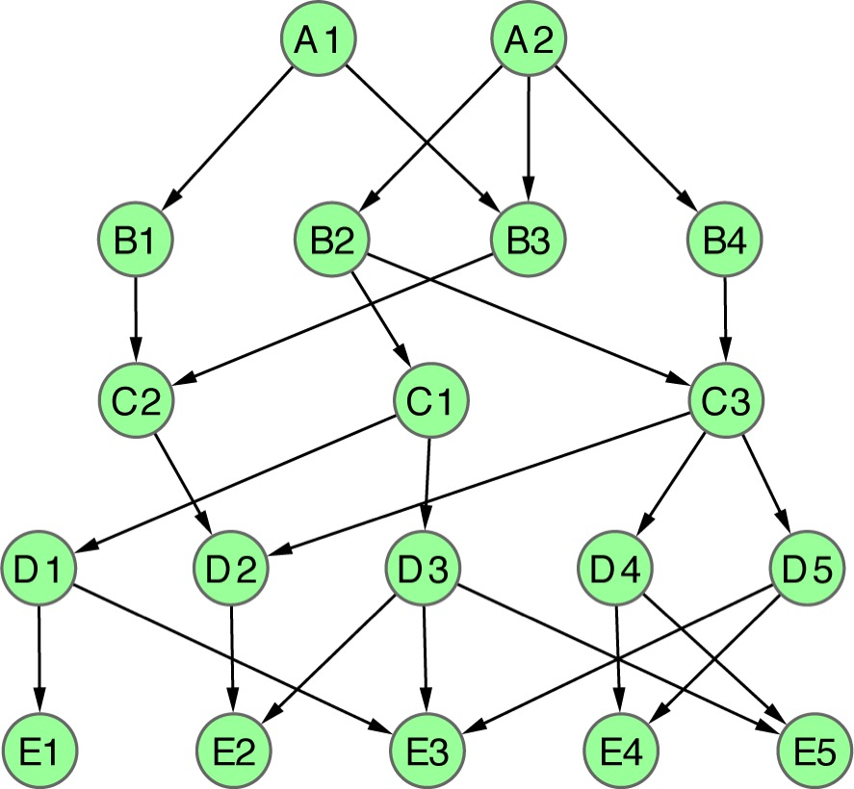
Apply HSM to a toy example
L=5
L=4
L=3
L=2
L=1
1 2
1 2 3
1 2 3 4
1 2 3 4 5
1 2 3 4 5 6
1 2 3 4 5 6 7
1 2 3 4 5 6 7 8
A1
A2
B1
B2
B3
B4
C1
C2
C3
D1
D2
D3
D4
D5
E1
E2
E3
E4
E5
|L|=2
HS=2.1
CHS=2.4
PHS=2.1
|L|=3
HS=5.5
CHS=5.5
PHS=5.5
|L|=4
HS=8.7
CHS=5.4
PHS=8.7
|L|=5
HS=∞
CHS=∞
PHS=∞
|L|=6
HS=∞
CHS=∞
PHS=16.1
|L|=7
HS=∞
CHS=∞
CHS=10.4
|L|=8
HS=∞
CHS=∞
PHS=9.4
Notes:
Fig. 2

Slide 9
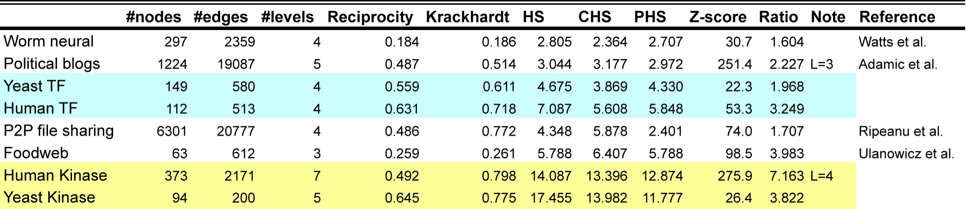
Kinase network is more hierarchical than TF network

Slide 10
Application: yeast TF regulatory network
P=0.03
T<(M+B) P=0.008
M>(T+B) P=0.04
BFS(L=4)
VS(L=3)
HSM(L=4)
VS(L=7)
HSM(L=3)
up-edge
horizontal
down-edge
HSM(L=3)
BFS(L=4)
VS(L=3)
T>(M+B) P=0.03

Slide 11
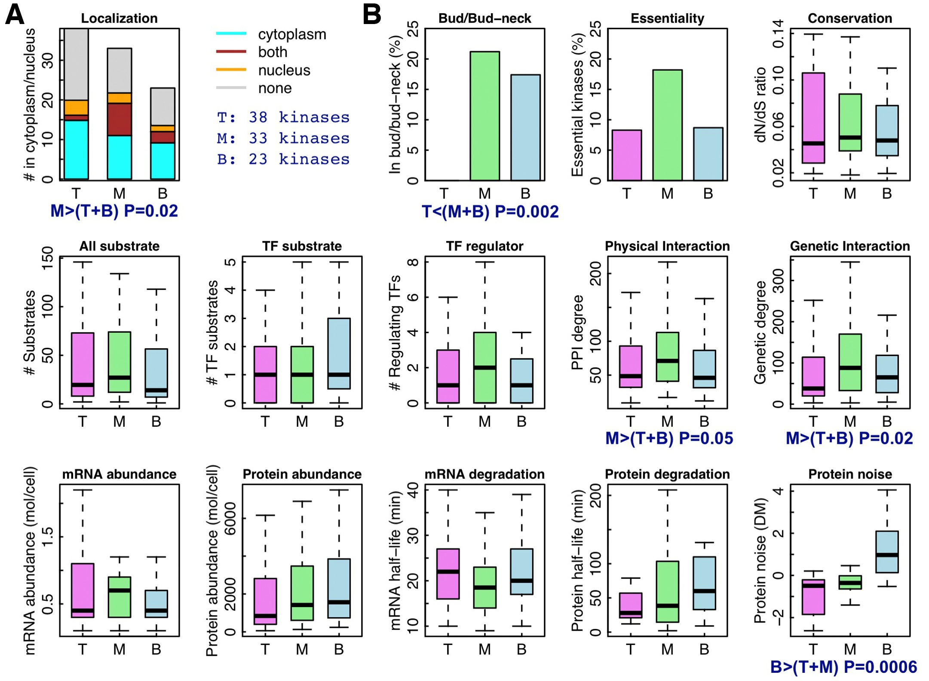
Application: yeast kinase network

