Slide 1
Jieming
Variation
17th March 2015

Slide 2
MotifVar
SNVs found in binding sites in protein-protein interactions (PPI) are important
Since many protein motifs mediate PPI, we focus on finding binding sites in PPI domains -- an example is protein repeat domain: tetratricopeptide repeat (TPR)

Slide 3
AIM1: Strategy
Obtain list of repeat (e.g. TPR) and non-repeat domains (e.g. PDZ)
Do a multiple sequence alignment
Identify hypervariable positions and highly conserved positions
Do these positions fall into binding pockets in available PDB structures?
SNVs falling onto these positions are assessed whether they are non-synonymous and deleterious (using SIFT and BLOSUM score)

Slide 4
Data
Sources of variants
PREV: 1000 Genomes Project Phase 1 (1KG) - 1092 individuals, ~500K exome variants
CURR: + Exome Sequencing Project (ESP) - 6500 individuals, ~1.2M

Slide 5
Hypervariability and high conservation e.g. TPR
Protein 1
TPR
TPR
TPR
Protein 2
TPR
TPR
Protein 3
TPR
TPR
TPR
TPR
Align
TPR
TPR
B1
A1
B1
A1
Notes:
Motif alignment across all TPRs from all species

Slide 6
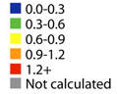
Mapping onto known PDB structures
Magliery & Regan, BMC Bioinformatics, 2005
Hypervariable: 2,5,9,12,13,33,34
Conserved sites: 8,11,15,20,24,27,32
B1
A1
B1
A1

Slide 7
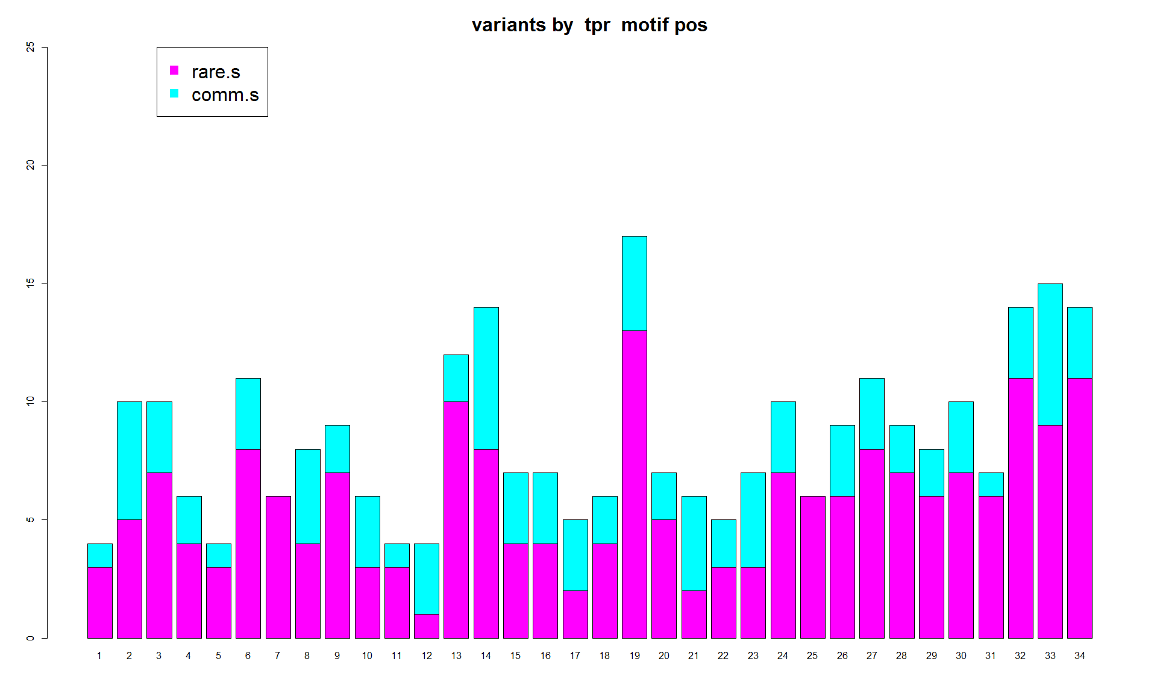
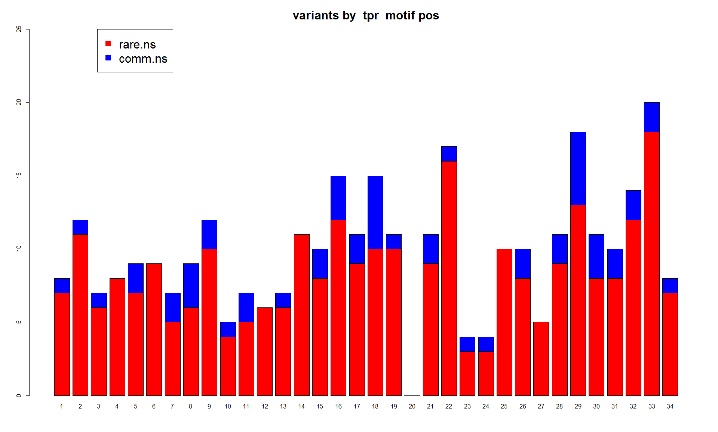
Histograms for 1KG+ESP

Slide 8
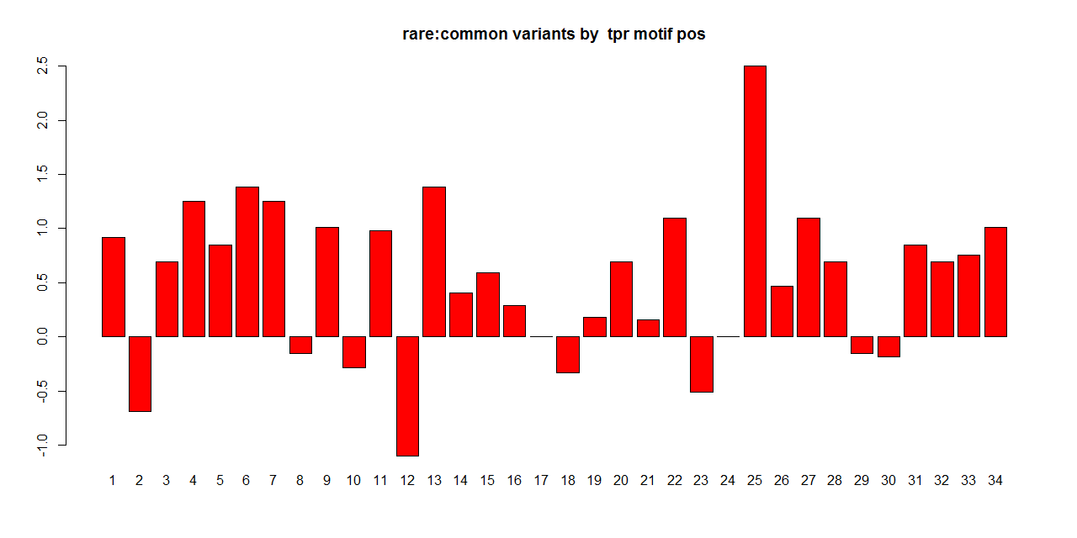
Log ratio of rare:common
Notes:
Enrichment of rare?

Slide 9
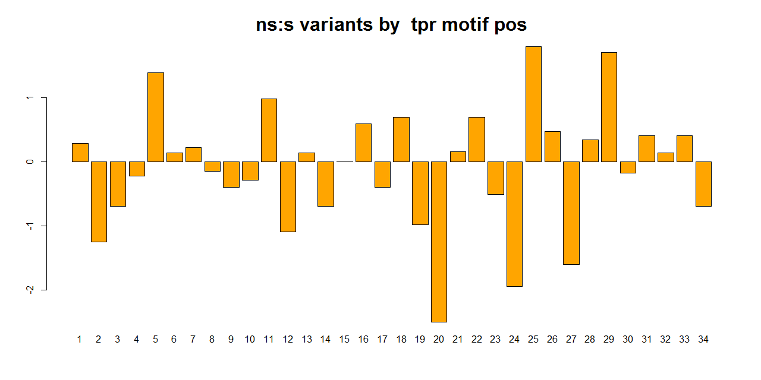
Log ratio of NS:S
Notes:
Depletion of ns?

Slide 10
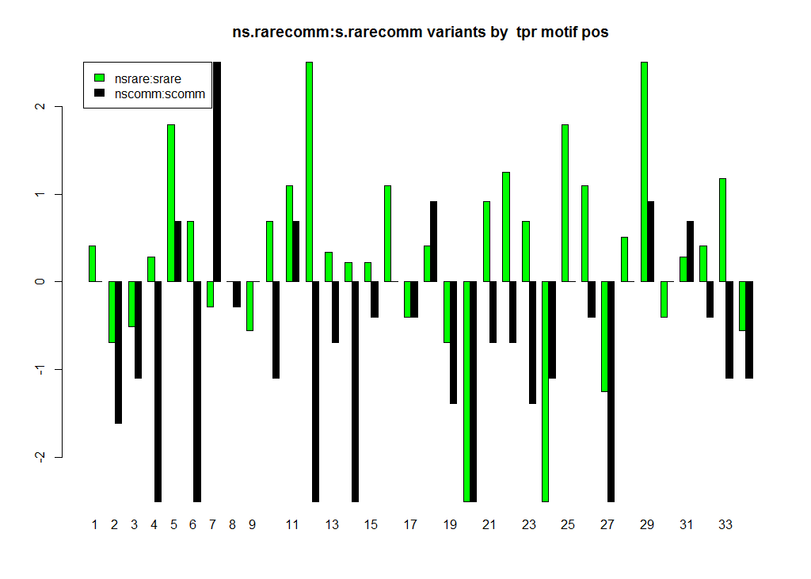
Log ratio of NS/rare:S/rare
Notes:
Depletion of ns?

Slide 11
Define “rare” by distribution shifts not by cutoffs

Slide 12
Maybe TPR is special
What about other protein motifs?
Ankyrins are similar to TPRs
Bromodomains are very specific to monoacetylated lysine residues (e.g. on N terminal histone tails) -- would be similar to aligning conserved proteins

Slide 13
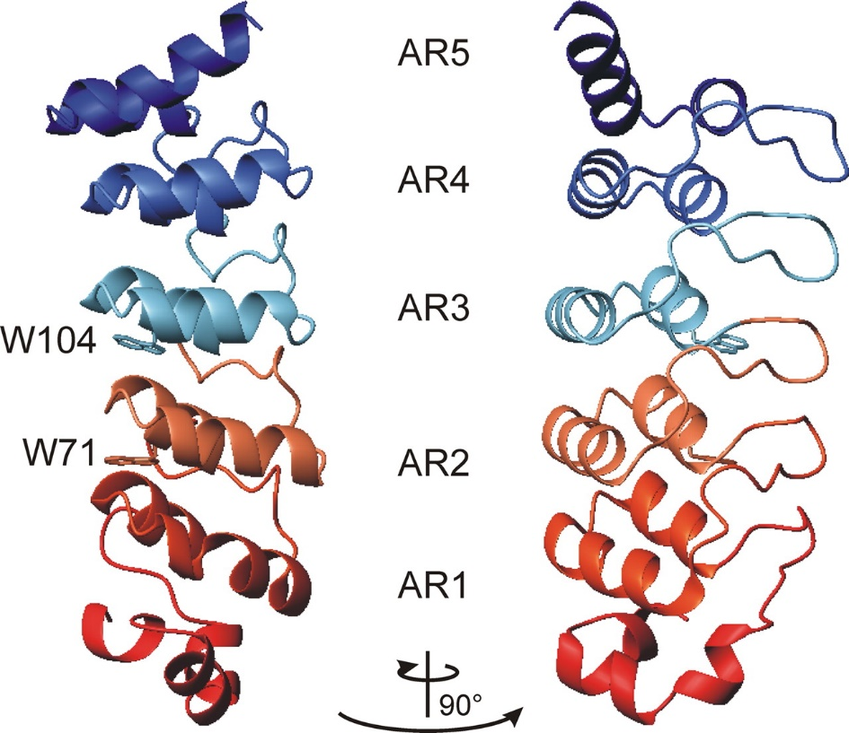
ANKS: MotifNum.30aa
Low et. al. (2008) PNAS

Slide 14
ANKS: MotifSize
Low et. al. (2008) PNAS

Slide 15
ANKS: Multiple Sequence Alignment
All species = 71473 seq
Low et. al. (2008) PNAS
Human = 1023 seq

Slide 16
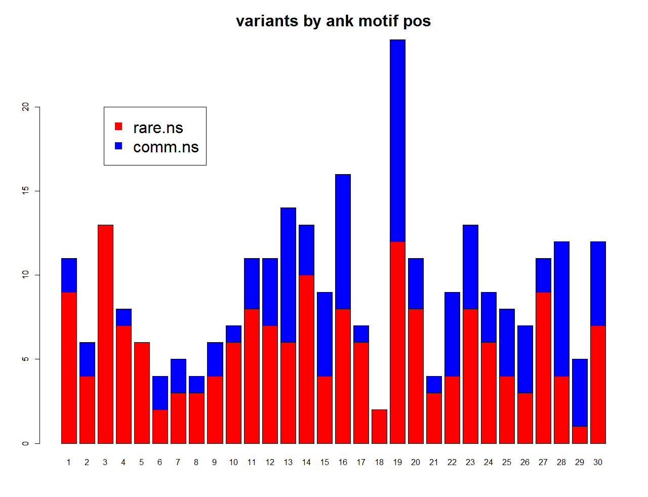
ANKS

Slide 17
Going forward
A general trend of enrichment of rare and depletion of NS variants in all coding positions -- allele frequencies do not seem to inform function/importance -- NS/S seem to (anti)correlate with entropy more
Try with new data sources -- ExAC dataset - 61,486 exomes (including ESP)
Optimize the pipeline -- currently still clunky -- Get SIFT and its databases to work in Linux -- BLOSUM
Automated mapping of SNVs onto PDB structures

