Slide 1
ENCODE & Cancer
Cancer AWG Sub-working group
3.14.15 (Pi Day)
Mark Gerstein

Slide 2
Cancer Group activities:
Outreach: Making ENCODE annotation useful to the cancer world.
Outreach: Harmonizing pipelines.
Scientific presentations: Highlighting Specific ENCODE results on cancer variants.
Inreach: learning about aspects of cancer genomics relevant to ENCODE

Slide 3
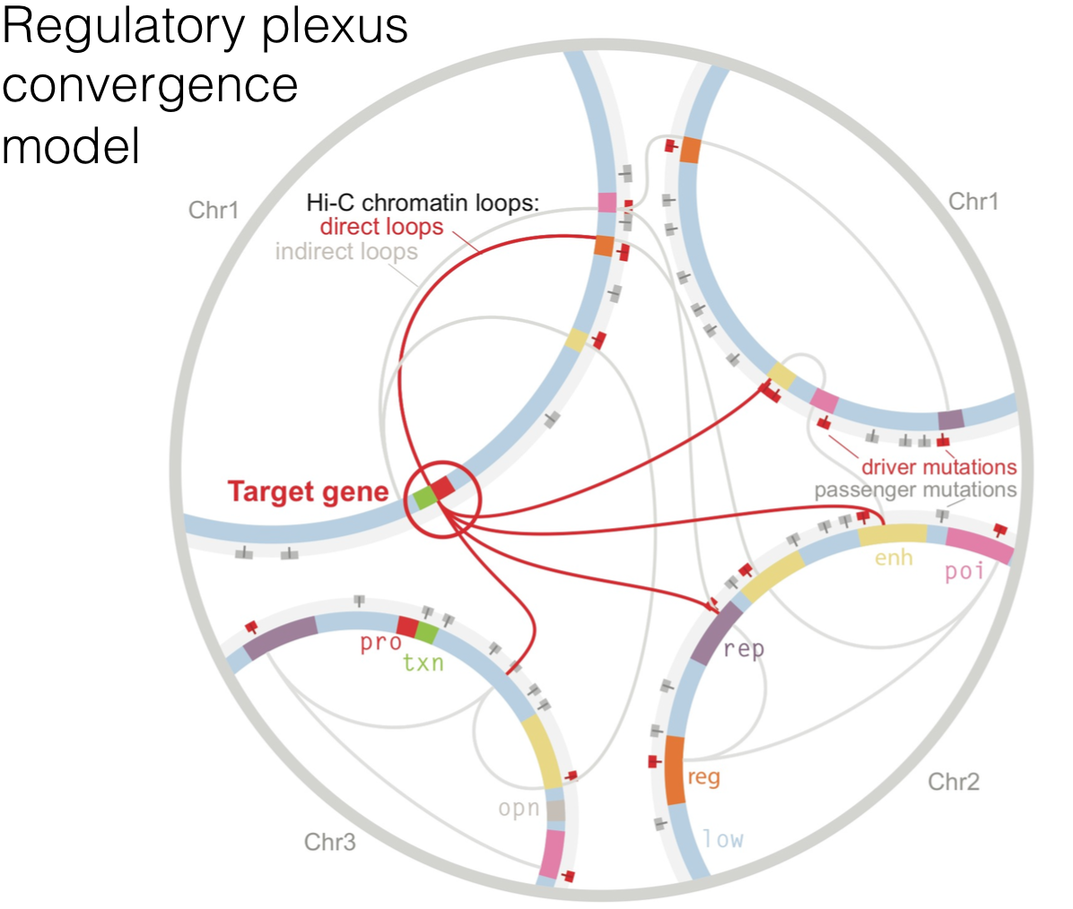
Outreach: Making ENCODE annotation useful to the cancer world: Plexus (Kellis Lab)
Plexis are used in a permutation test of the significance of mutational burden.

Slide 4
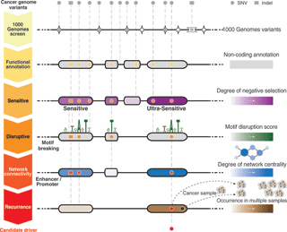
Outreach: Making ENCODE annotation useful to the cancer world: FunSeq (Gerstein Lab)
started with 677 high-resolution non-coding categories.
defined ultra sensitive regions with increased with 400x increase in disease assoc.

Slide 5
Outreach: Making ENCODE annotation useful to the cancer world: LARVA (Gerstein Lab)
SNVs from multiple samples were intersected with the ENCODE annotations.
the significance of the number of SNVs in an element can is then assessed via a permutation test.

Slide 6
Outreach: Harmonizing pipelines: Gunnar Ratsch
Through the use of standard pipelines we can better characterize transcription alteration that cause cancer.

Slide 7
Outreach: Specific results on cancer variants: RABIT (Shirley Liu Lab)
Pan-cancer assessment of differentially regulated gene expression using penalized regression.

Slide 8
Scientific presentations: Specific results on cancer variants: Leonard Lipovich
LncRNAomics has emerged as a clinically relevant field.
lncRNAs, that are functional in cell growth and cell death, in ER+ breast cancer.

Slide 9
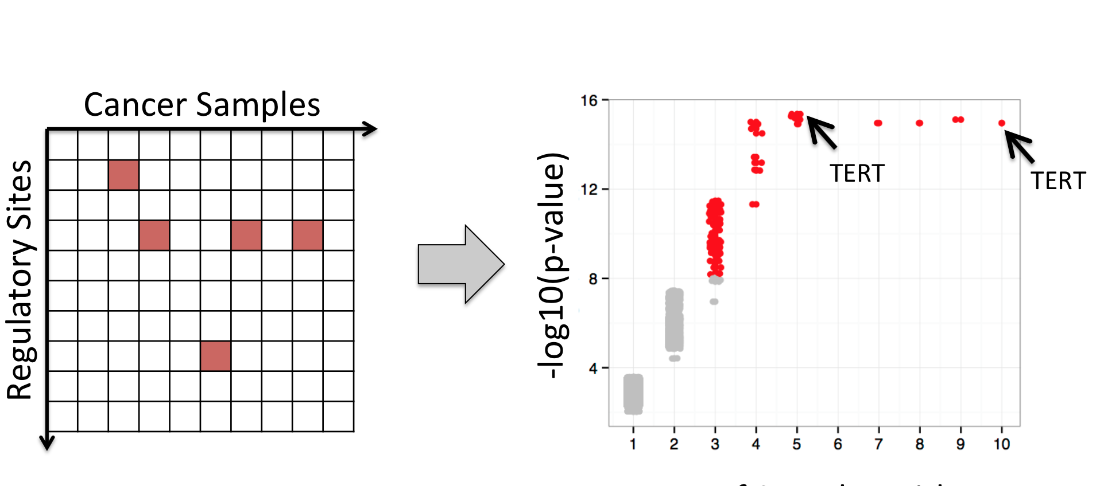
Scientific presentations: Specific results on cancer variants: TERT (Snyder Lab)
Observed repeated mutations of positions in regulatory regions selected for in cancer.

Slide 10
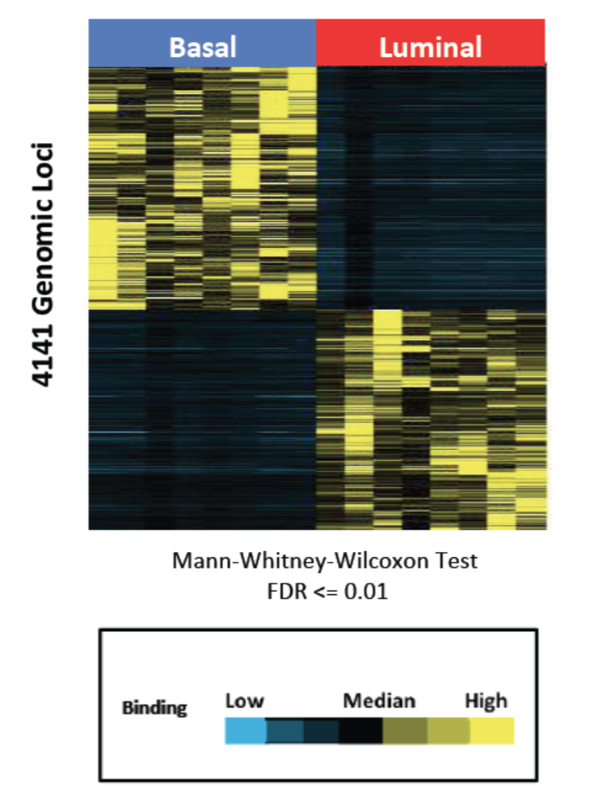
Scientific presentations: Specific results on cancer variants: Breast Cancer (R Myers Lab)
Intersect TF binding sites from ENCODE with genomic regions specifically unmethylated in TNBC (Triple negative breast cancer; basal)
GR and STAT3 binding sites are significantly enriched in unmethylated basal/TNBC loci
Further ChIP-Seq experiments showed that GR and STAT3 bind in a sub- type specific manner

Slide 11
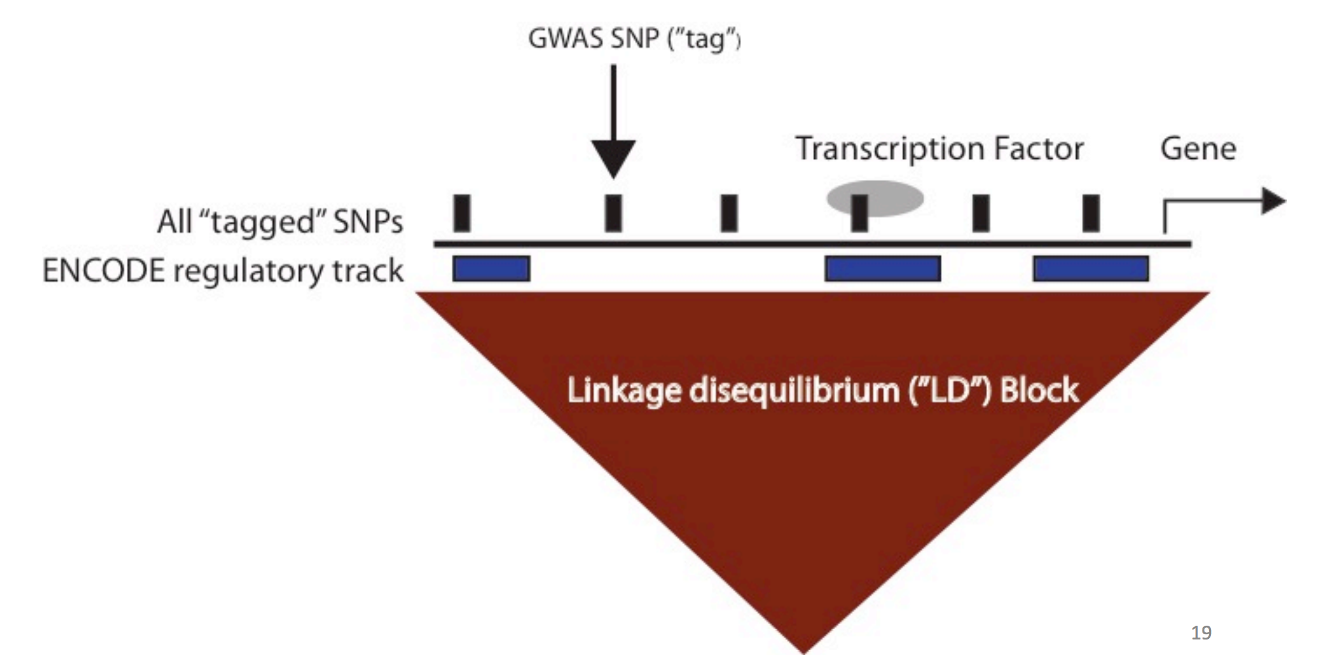
Inreach: Learning about cancer: Robert Klein (ENCODE GWAS)
Helped us to understand the significance of the pluripotent transformation
Helped us better understand the GWAS group.
Helped us understand the ENCODE cell lines as cancer models

Slide 12
Inreach: Learning about cancer: David Wheeler (from TCGA)
Helped us to better understand the errors associated with diploid SNP calling in TCGA.

Slide 13
Inreach: Learning about cancer: Zhining Wang (from TCGA program office)
Helped us better understand what TCGA data that we could use.

Slide 14
Specific Outcomes of the Last Year
Identified a group of ENCODE researchers interested in this topic and tools they've put together
Went over access to the data & identified common datasets to focus on (breast/brain, lung/liver)
Discussed a connection with PCAWG either in terms of pipeline harmonization (PCAWG-3) or contributions to analysis
Are we ready to do something more coordinated related to the analysis of cancer data using ENCODE annotation ?

