Slide 1
Identifying Essential Allosteric Residues & Pathways of Communication
First Entails Identifying Coherent Network Communities
Manley G, Rivalta I, and Loria JP. J. Phys. Chem. B (2013)

Slide 2
Given a Network Partition, How do we Define “Critical Residues”?

Slide 3
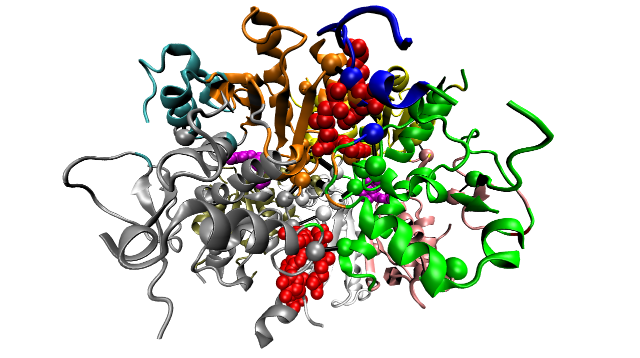
Threonine Synthase (pdb 1e5x)

Slide 4
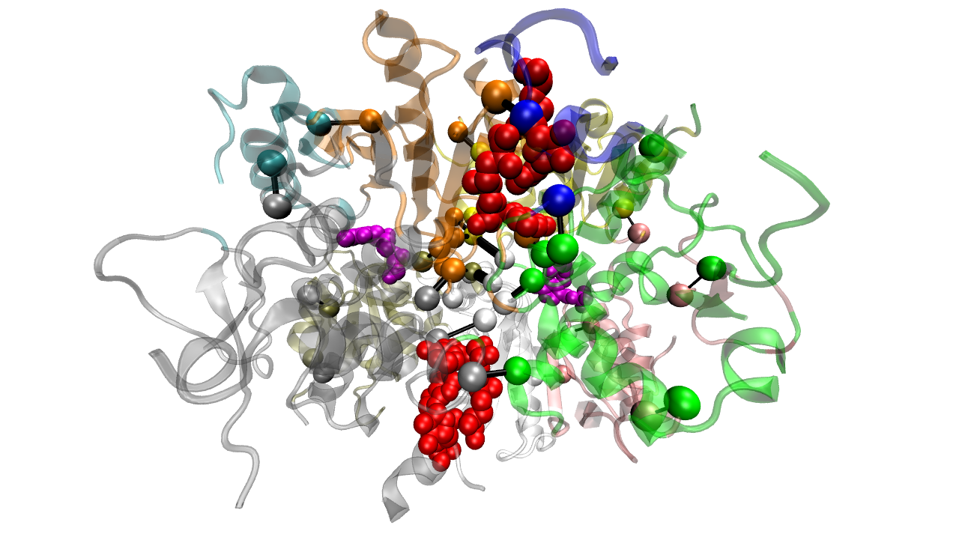
Threonine Synthase (pdb 1e5x)

Slide 8
pdb | GN_critical | avg scores for non crit w/same deg
1bks | -0.272214 | -0.0136937
1cd5 | -0.465487 | -0.0547185
1e5x | -0.417486 | -0.170565
1efk | -0.118944 | 0.00271188
1j3h | -0.0305185 | -0.183362
1nr7 | -0.450595 | -0.0459061
1xtt | -0.107278 | -0.0923966
2hnp | -0.379125 | -0.0517154
3d7s | -0.265954 | -0.187414
3ju5 | -0.166609 | -0.18769
4ake | -0.104727 | -0.13164
Avgs | -0.252630682 | -0.101489947
P-val (for avgs): 1.106e-05

Slide 12
pdb | GN_critical | rand_selected non crit w/same degr.
1bks | -0.272214 | -0.00157143
1cd5 | -0.465487 | 0.0892821
1e5x | -0.417486 | -0.143297
1efk | -0.118944 | -0.176527
1j3h | -0.0305185 | 0.0135556
1nr7 | -0.450595 | -0.0417703
1xtt | -0.107278 | -0.217056
2hnp | -0.379125 | -0.15515
3d7s | -0.265954 | -0.197
3ju5 | -0.166609 | -0.229217
4ake | -0.104727 | -0.131667
Avgs | -0.252630682 | -0.108219821
P-val (for avgs): 0.002404

Slide 13
Sequence analysis as a means of justifying stated identification of allosteric residues
  Sequence conservation analysis for GN residues across all proteins (n.b. ConSurf availability)
  Sequence conservation for residues identified in prioritized BL sites (at protein surface)
  Complementary approach 1000G integration
Calculations of solvent accessibility calculations (all proteins)
  All residues
  GN-critical residues
  Residues at prioritized BL sites
Structure conservation
  Similarity in GN & prioritized BL sites across folds, families, superfamilies, and families (ie, concordance in these sites across homologues)
  Local structure similarity of these sites across homologues

