Slide 1
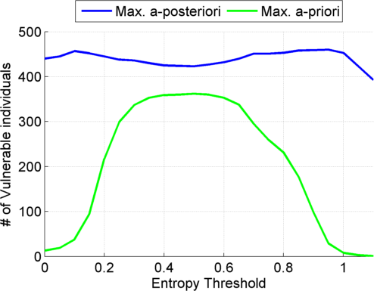
III Leakage: Step 3: Linking

Slide 2
III Leakage (linking attack): 3 Level Process
eQTL Selection
Genotype Prediction
Linking
Entropy of conditional distribution
Allele Frequency
Maximum a-posteriori genotype
Maximum a-priori genotype
Individual with exact matching of the predicted genotypes
Individual whose genotypes have the closest match to predicted genotypes

Slide 3
III Leakage (linking attack): 3 Level Process
Gender, Population, Age
Auxiliary Information
eQTL Selection
Genotype Prediction
Linking
Entropy of conditional distribution
Maximum a-posteriori genotype
Individual whose genotypes have the closest match to predicted genotypes

Slide 4
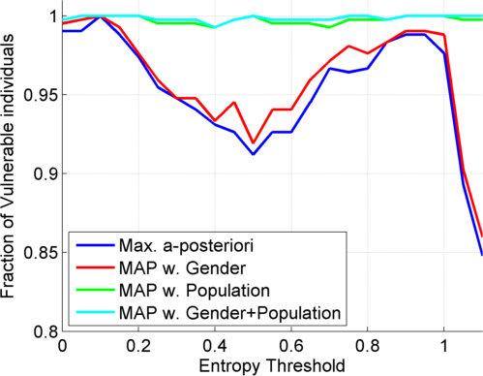
Incorporate Gender and Population Information

Slide 5
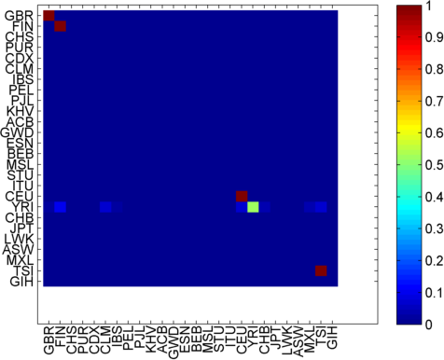
Prediction of Population

Slide 6
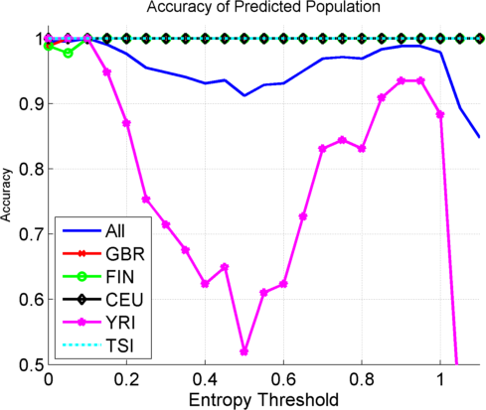
Average Population Prediction Accuracy

Slide 7
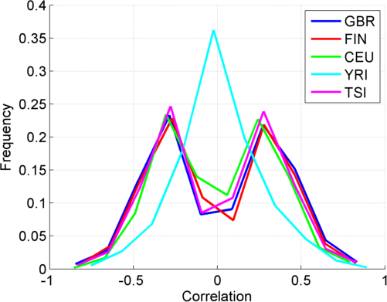
Distribution of Correlation between Expression and Genotype

