Slide 1
Sequence identification of cancer-associated antibody using RNAseq data in cancer tissue
Chang Ohk Sung, MD,PhD
02/23/2015

Slide 2
Antibody is very import source
Target agents for personalized cancer therapy
Biomarkers as cancer detection, prognostic or predictive makers
Identification of new cancer-associated antibodies (CAAs) has great values, but it is difficult.
(antibody sequence is made by new recombination of variable genes and
somatic hypermutation, resulted in different sequences with their germ-line
genome.)

Slide 3
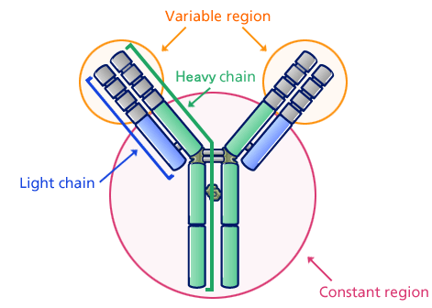
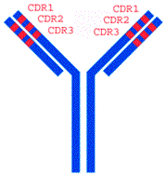
Antibody structure
* Two variable regions
heavy chain: Vs-Ds-Js genes combination
light chain (kappa or lambda chain): Vs-Js genes combination
- Antibody is produced by plasma cell (terminal form of B lymphocytes)
- Plasma cells secrete large amounts of antibodies at rates of
up to 10000 molecules per second per cell.
Image source: google
http://www.escience.ws/b572/L14/L14.htm
http://www.biology.arizona.edu/immunology/tutorials/antibody/structure.html

Slide 4
Kappa light chain rearrangement
Lecture materials
from University of Ulsan collage of medicine

Slide 5
Heavy chain rearrangement

Slide 6
N nucleotide addition at joining segments: the addition of random bases

Slide 7
Diversity calculations
Lecture materials
from University of Ulsan collage of medicine

Slide 9
H&N sqcc

Slide 10
Question was drawn by
Fact 1: In some cancer tissues, there is abundant CAPs infiltration.
Fact 2: plasma cell infiltration in cancer tissue is associated with good survival in
some cancer types.
Fact 3: Function of plasm cell is making an antibody against certain antigen.
Fact 4: Cancer cells generate many neo-antigens by somatic mutations
if then,
Question : what types of antibodies are made from CAPs and their roles in cancer
patients?

Slide 11
Concept/method
Constant region: no/little changed => start from C region as initial seed
then de novo assembly approach applied
IGKC
IGKJ
IGKV
3’-
-5’
IGK
323 bp
38-39 bp
~300 bp
IGHC
J
D
V
3’-
-5’
IGH
?
Variable region:
identification of this final recombinants
is our final goal

Slide 12
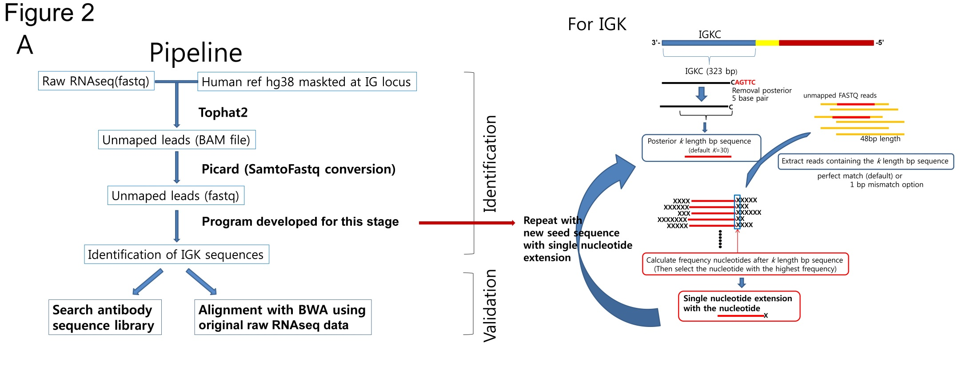
Analysis flow

Slide 13
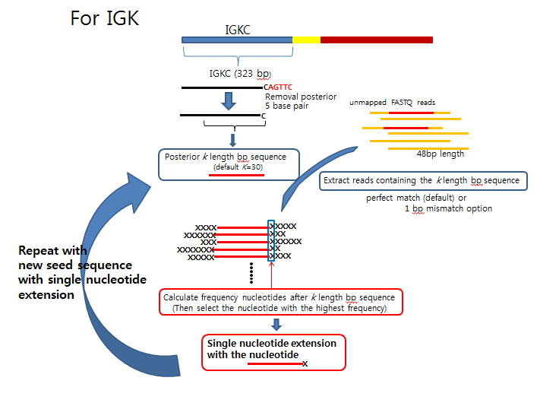
3’-
-5’
3’-
-5’

Slide 14
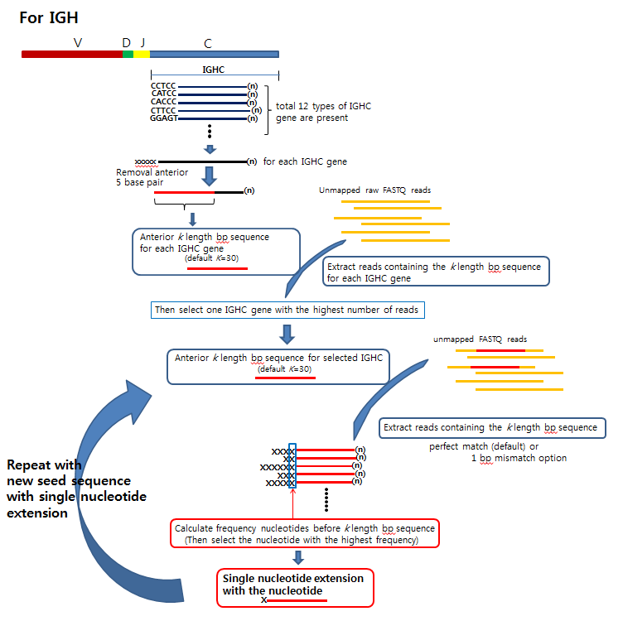
5’-
-3’

Slide 15
Results are same independent of
K-length option and mismatch option in this case

Slide 16
Result files of current version of program

Slide 17
Figure 4
diversity at nucleotide (%):
[(1-Max/100) x 100 (%)]
(Max is number of
maximally counted nucleotide)

Slide 18
Figure 5. Evaluation of identified IGK sequence using abYsis antibody database (www.bioinf.org.uk/abYsis). Identified sequence was composed of B3 or IGKV8 with best similarity for IGKV gene and JK1 for IGKJ gene and 3 hypervariable regions (red marker) were also shown.

Slide 19
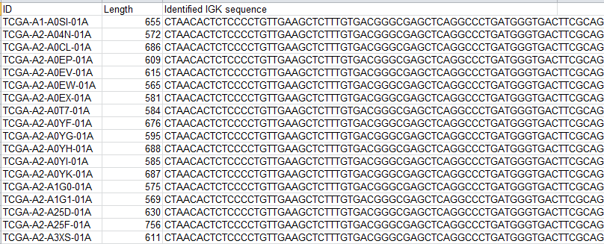
Supplementary data
Finally identified IGK sequence that is the highest mRNA expression level

Slide 20
4 versions of program
Identification of
1) One IGK sequence with the highest mRNA expression
2) All variant sequences of IGK
3) One IGH sequence with the highest mRNA expression
4) All variant sequences of IGH (under development)

Slide 21
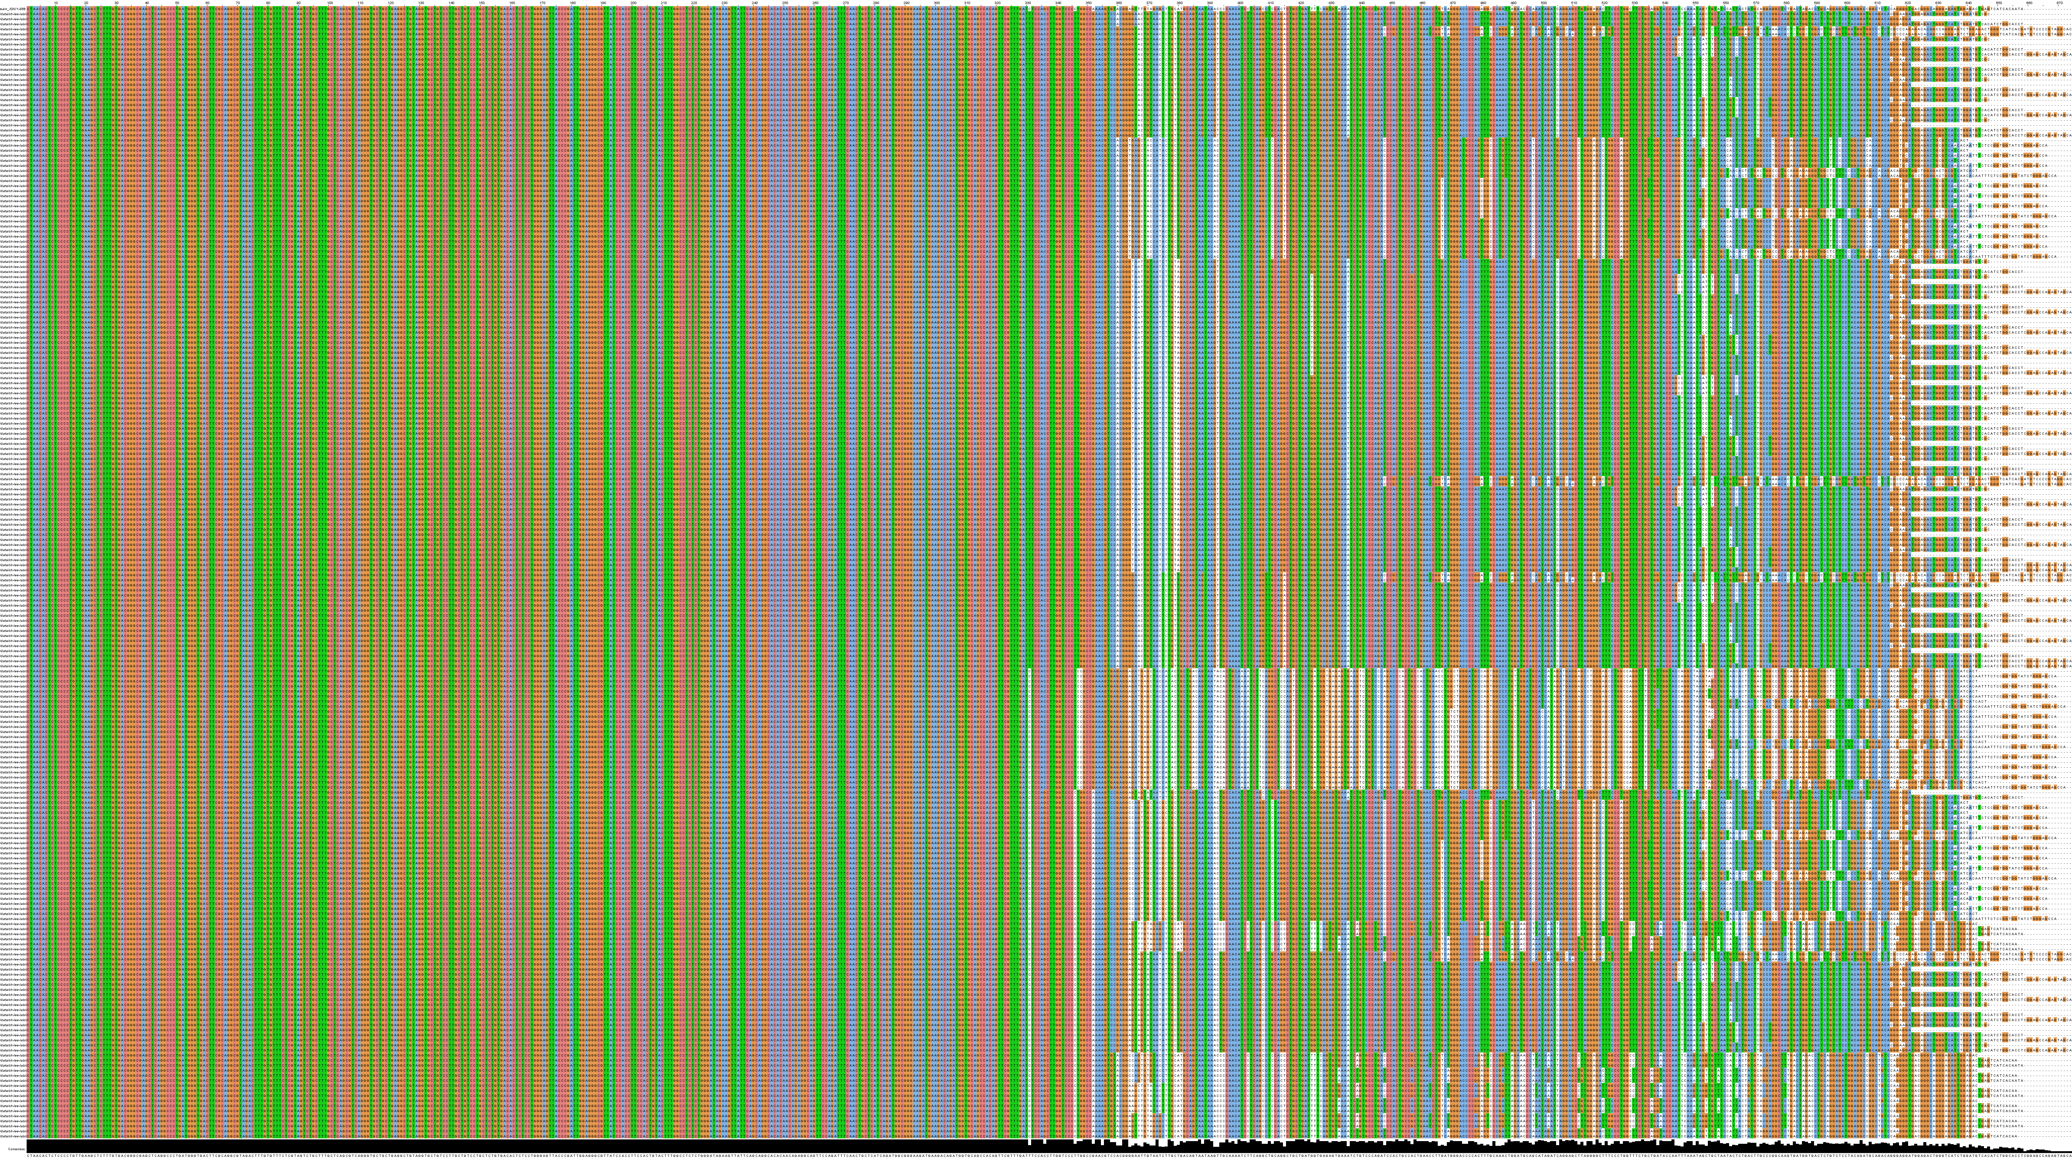
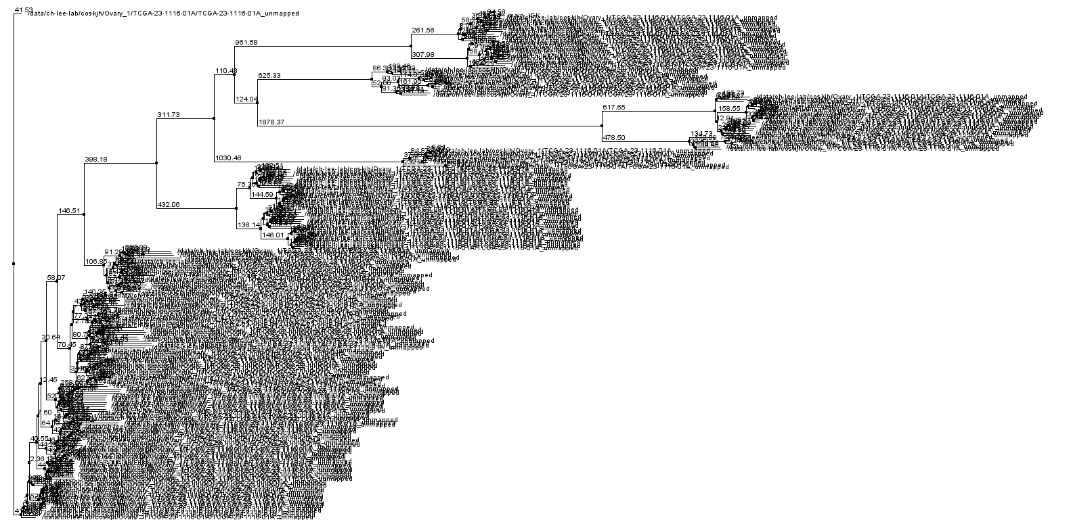
All variants of IGK using all-variant-detection version in a case
Variants
Nucleotides
PCA

Slide 22
Advantage of this program
Easy identification of antibody sequences directly from cancer tissue
Antibody recombination pattern or mechanism can be revealed using this program.
Other applications: such as identification of viral integration site in human genome, easy identification of fusion gene

Slide 23
To be improved
Independent double check for algorithm before experimental validation
Making as publication form that can be used easily for readers
Speed up for all-variants-detection version of program (currently, more than 2 months are needed using 12 processes per case)

