Slide 1
JAX mice and building sampling
Presentation to Gerstein Lab
04 Mar 2015

Slide 2
Introduction
2 projects involving microbiome sampling with spatial information
JAX building sampling
Surface sampling (desks, chairs, etc)
Temporal (1/wk for 20 weeks)
Individuals
JAX colony mouse microbiome pilot
Stool samples
Different strains
Different rooms

Slide 3
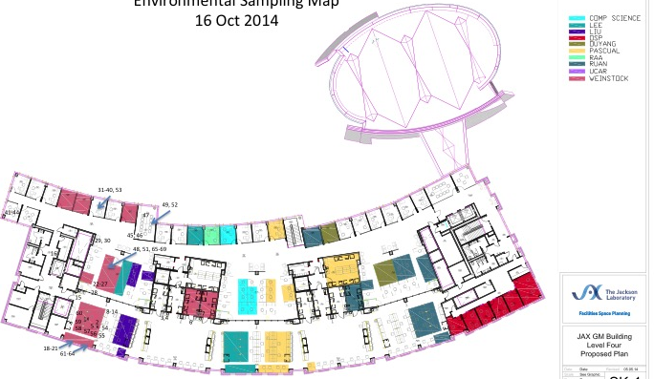
JAX building sampling
20 weeks
(~ 160 samples/wk, ~3 hrs collecting time/ wk , 3 indiv = 7.5 person days of work)

Slide 4
JAX building sampling progress
Round 3 of protocol development
Plans to start test sequencing in April
Working through IRB’s for sampling individuals
Expected to begin seeing larger amounts of data in the summer

Slide 5
JAX mouse colony sampling background
Most of JAX’s $ comes from mouse sales
Phenotypes closely followed
There are examples of genetically identical mice responding differently to experimentation
JAX is exploring storing microbiome data with their other metadata that ships with the mice
Also, some individuals keep their own colonies, found segmented filamentous bacteria - unclear if it is widespread in the colony

Slide 6
JAX mouse colony metadata and questions
How similar are the microbiomes?
Is the stool microbiome more affected by room or strain?
Are SFB widespread?

Slide 7
Method summary
Clean and assemble reads (Trimmomatic, Uchime, FLASH, RDP, convert to fasta)
Generate OTUs (Usearch)
Identify OTUs (RDP)
Generate taxa abundance tables (R)
Convert to Relative abundance tables (R)

Slide 8
Summary of the data
OTU count table
 | 1_14_778 | 1_15_461 | 1_15_463 | 1_15_464 | 1_15_465 | 2_13_974 | 2_14_773 | 2_15_459 | 2_9_389
OTU_24 | 849 | 325 | 267 | 467 | 179 | 1051 | 210 | 3 | 1102
OTU_37 | 198 | 120 | 389 | 624 | 448 | 556 | 26 | 501 | 181
OTU_10 | 1993 | 96 | 1 | 1 | 16 | 1 | 35 | 0 | 71
OTU_2 | 1992 | 763 | 661 | 970 | 2930 | 1590 | 1153 | 1311 | 509
OTU_13 | 1545 | 276 | 0 | 0 | 1703 | 1505 | 0 | 112 | 0
OTU_9 | 608 | 0 | 184 | 85 | 116 | 3 | 556 | 7 | 167
Taxa relative abundance table

Slide 9
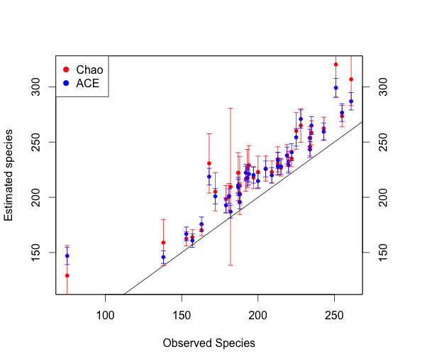
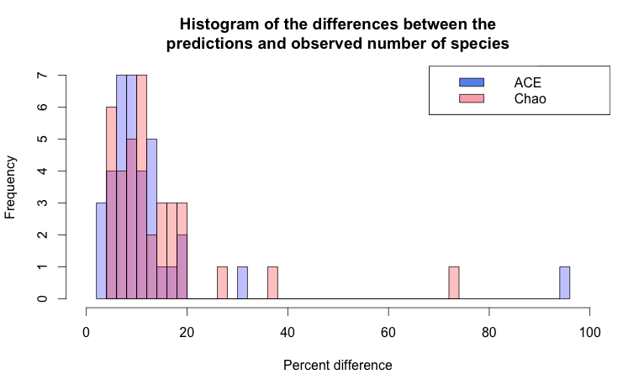
One sample may needs more sequencing depth
Notes:
tOTU_Table <- t(OTU_Table)
est.plot.t <- estimateR(tOTU_Table)
test.plot.t = t(est.plot.t)
test.plot.t = data.frame(test.plot.t)
x <- test.plot.t$S.obs
y1 <- test.plot.t$S.chao1
y2 <- test.plot.t$S.ACE
par(mar=c(5,4,4,5)+.1)
plot(x,y1,type="p",col="red", pch = 20, xlab = "Observed Species", ylim = c(120, 320), ylab = "Estimated species")
par(new=TRUE)
plot(x, y2,,type="p",col="blue",xaxt="n",yaxt="n",xlab="",ylab="", pch = 20, ylim = c(120, 320))
axis(4)
legend("topleft",col=c("red","blue"), pch = 19, legend=c("Chao","ACE"))
abline(0,1)
arrows(x, y1-test.plot.t$se.chao1, x, y1+test.plot.t$se.chao1, length=0.05, angle=90, code=3, col = "red")
arrows(x, y2-test.plot.t$se.ACE, x, y2+test.plot.t$se.ACE, length=0.05, angle=90, code=3, col = "blue")

Slide 10
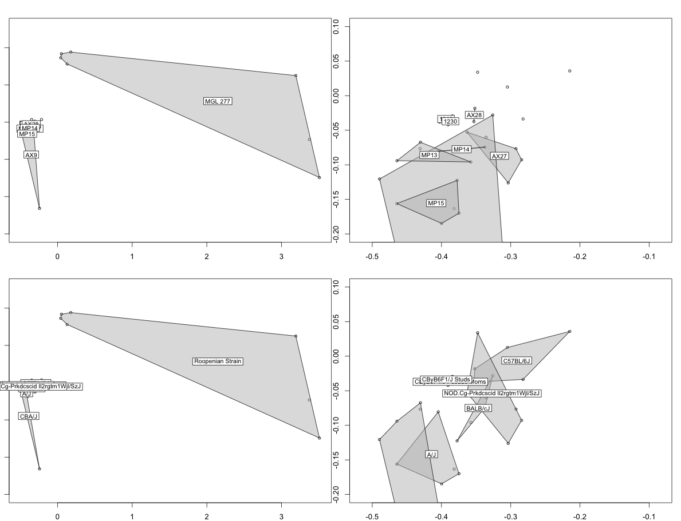
Polygons drawn by room
Polygons drawn by mouse strain
Notes:
otu = read.table("otu_table.tsv", sep = "\t", header = T, row.names = 1)
colnames(otu) = c("1_14_778", "1_15_461", "1_15_463", "1_15_464", "1_15_465", "2_13_974", "2_14_773", "2_15_459", "2_9_389", "2_9_390", "3_1_891", "3_23_558", "3_28_876", "3_28_880", "3_4_893", "4_13_981", "4_13_982", "4_13_983", "4_9_382", "4_9_393", "5_27_978", "5_27_979", "5_27_980", "5_27_982", "5_30_975", "6_1210_270", "6_1210_271", "6_1230_268", "6_1230_269", "AMP1", "AMP2", "AMP3", "VFP_277_524", "VFP_277_526", "VFPWT2", "VFPWT3")
mpm1_otu_NMDS = metaMDS(t(otu))
par(mfrow=c(2,2))
par(mar = c(2,1,2,1))
ordiplot(mpm1_otu_NMDS, display = "sites")
ordihull(mpm1_otu_NMDS, groups = samplefile$Mouse.Room, draw = "polygon", col = c("grey", 1), label = T)
ordiplot(mpm1_otu_NMDS, display = "sites", xlim = c(-0.5,-0.1), ylim = c(-0.2, 0.1))
ordihull(mpm1_otu_NMDS, groups = samplefile$Mouse.Room, draw = "polygon", col = c("grey", 1), label = T)
ordiplot(mpm1_otu_NMDS, display = "sites")
ordihull(mpm1_otu_NMDS, groups = samplefile$Strain, draw = "polygon", col = c("grey", 1), label = T)
ordiplot(mpm1_otu_NMDS, display = "sites", xlim = c(-0.5,-0.1), ylim = c(-0.2, 0.1))
ordihull(mpm1_otu_NMDS, groups = samplefile$Strain, draw = "polygon", col = c("grey", 1), label = T)

Slide 11
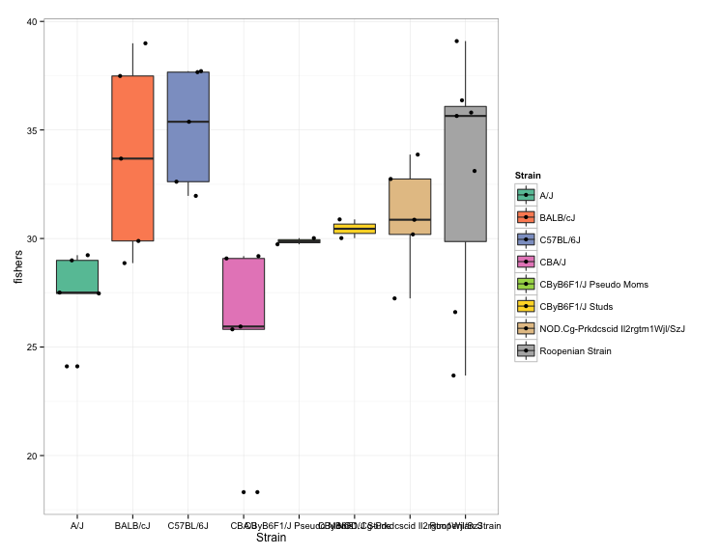
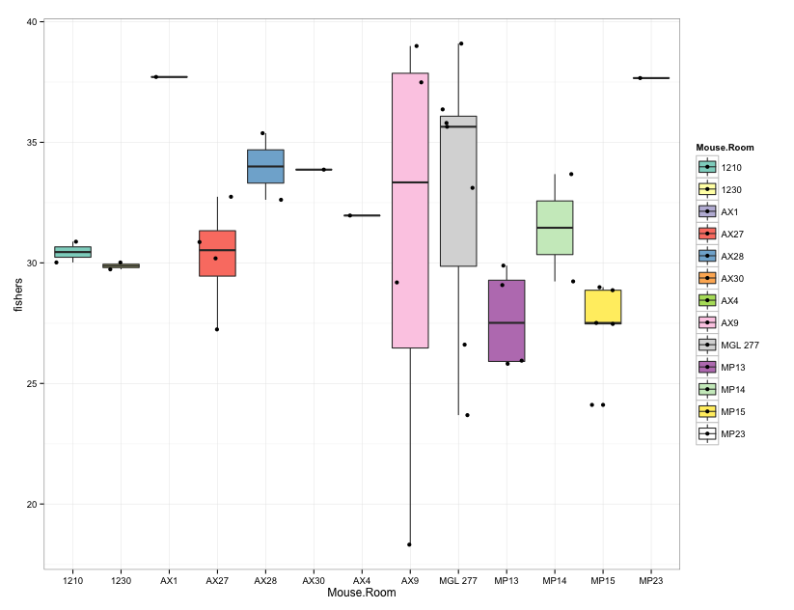
Roopenian strains are not less diverse, just different

Slide 12
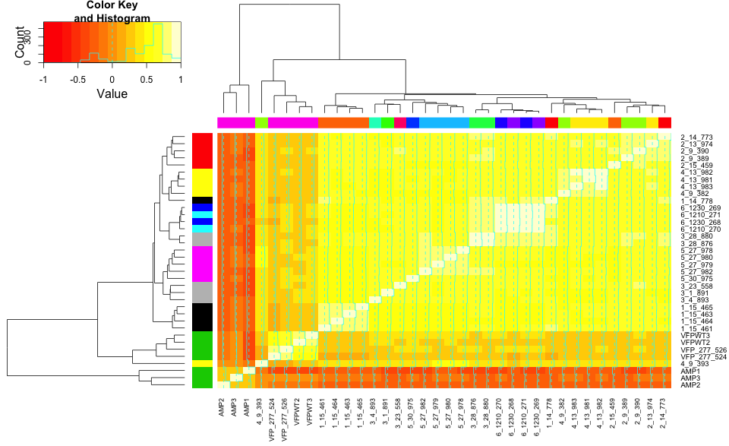

Slide 13
