Slide 1
AlleleDB Figure Pack
Notes:
Allelic != allele-specific

Slide 2
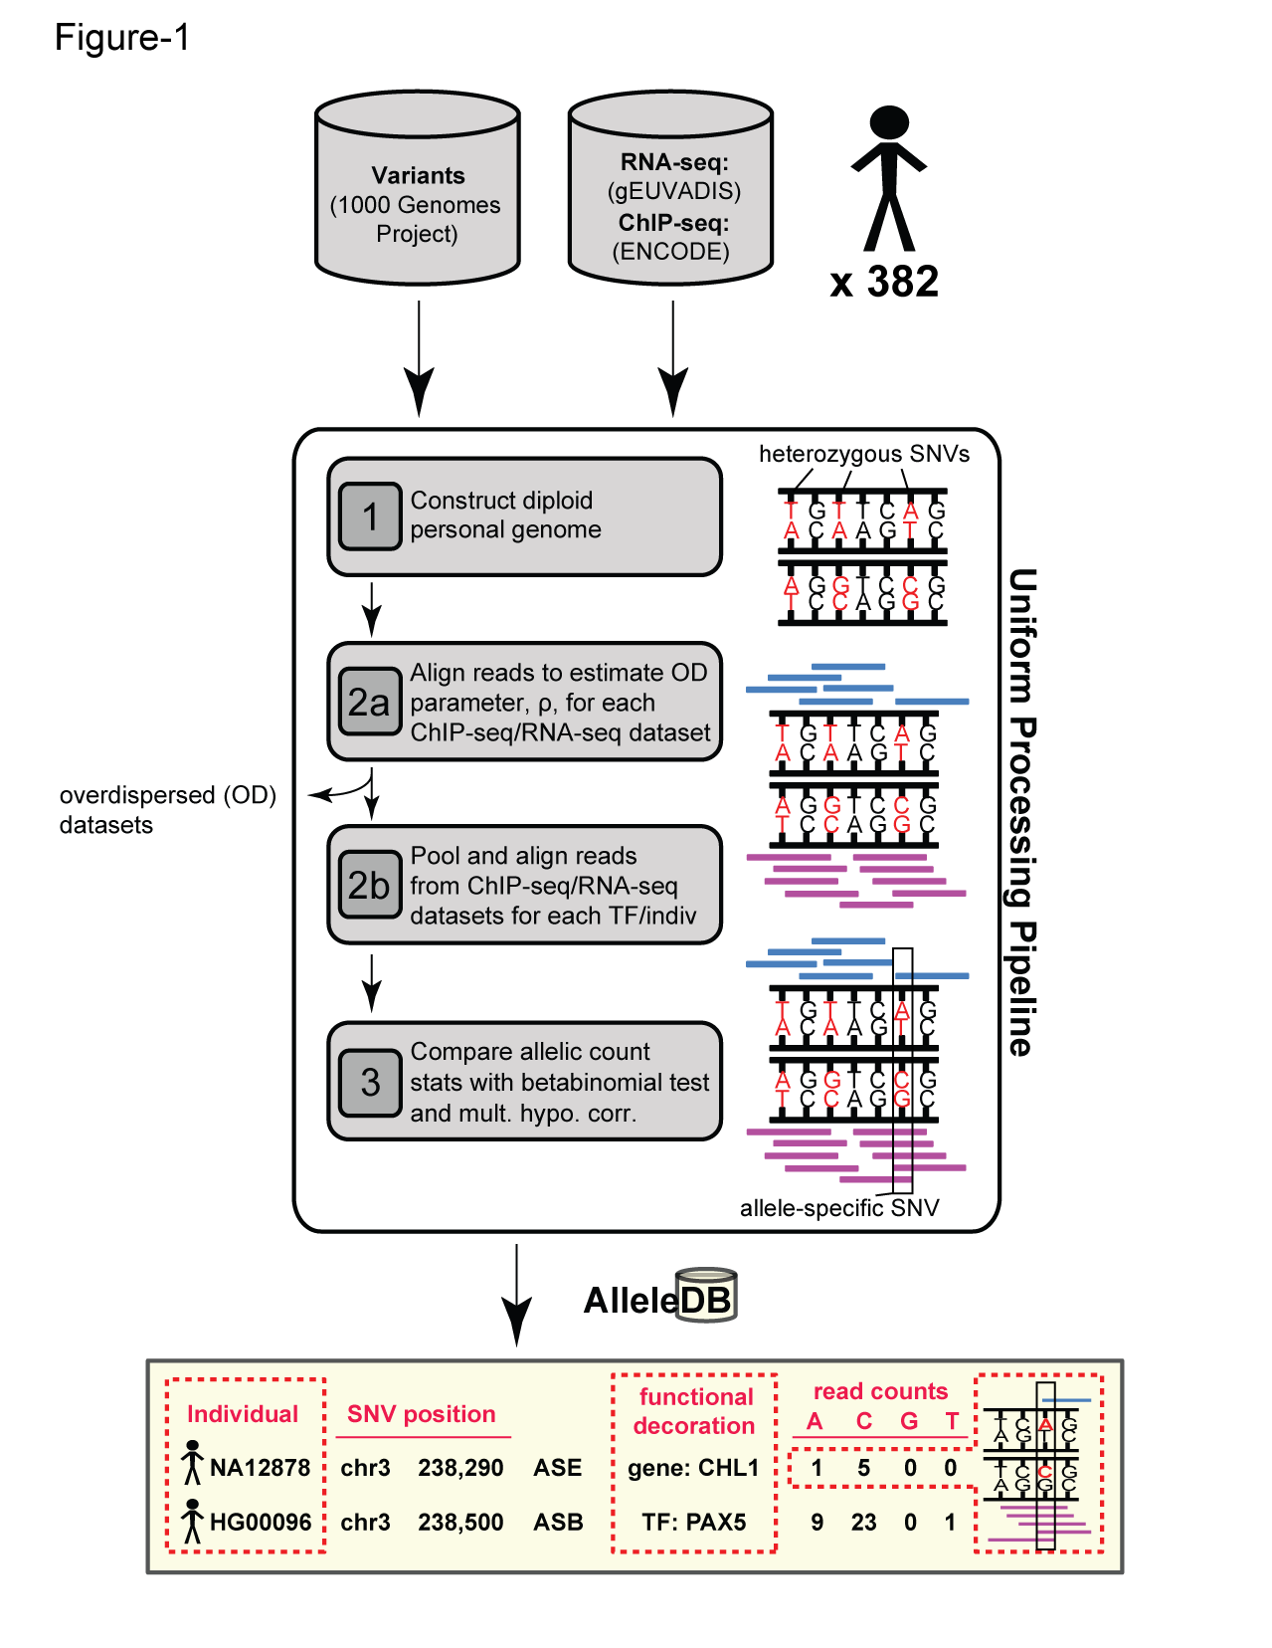
Figure 1. Workflow for uniform processing of data from 382 individuals and construction of AlleleDB.

Slide 3
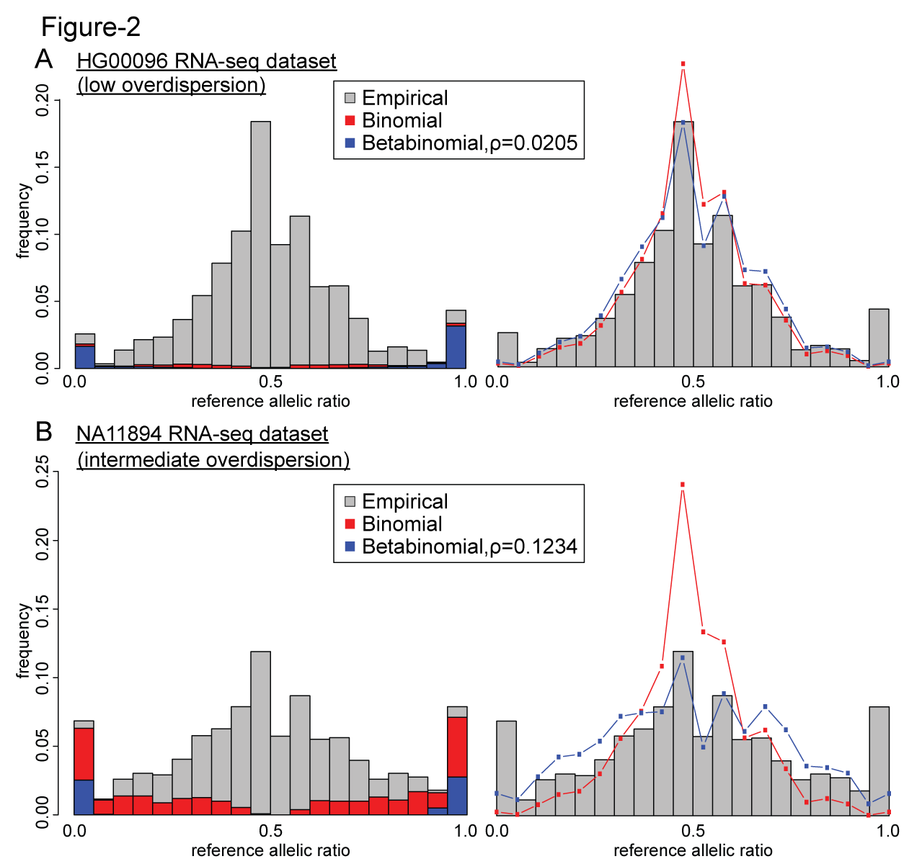
Figure 2. Comparing the effects of the binomial and beta-binomial tests in datasets with low and intermediate level of overdispersion.

Slide 4
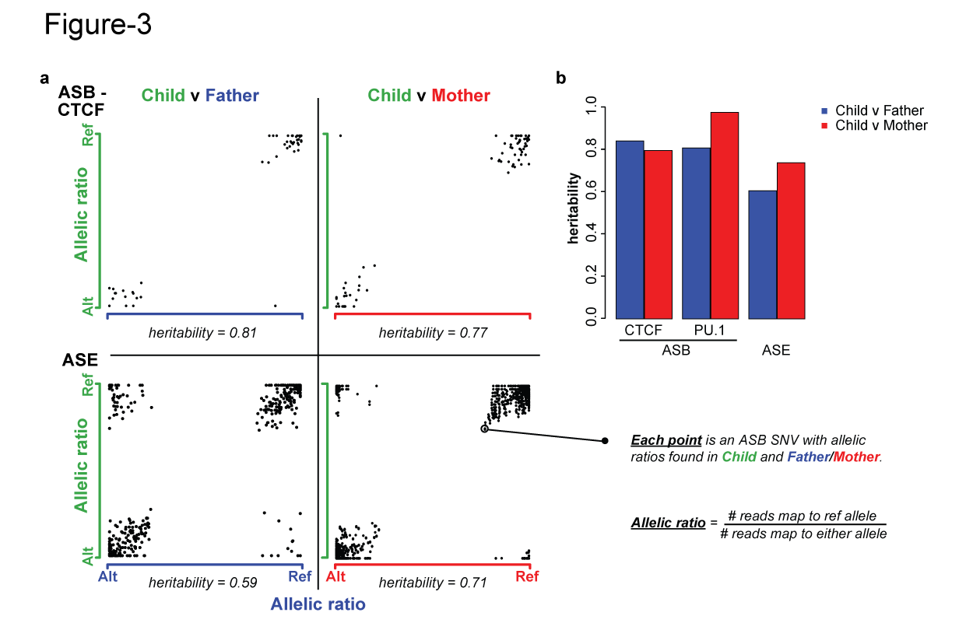
Figure 3. Inheritance of allele-specific behavior.

Slide 5
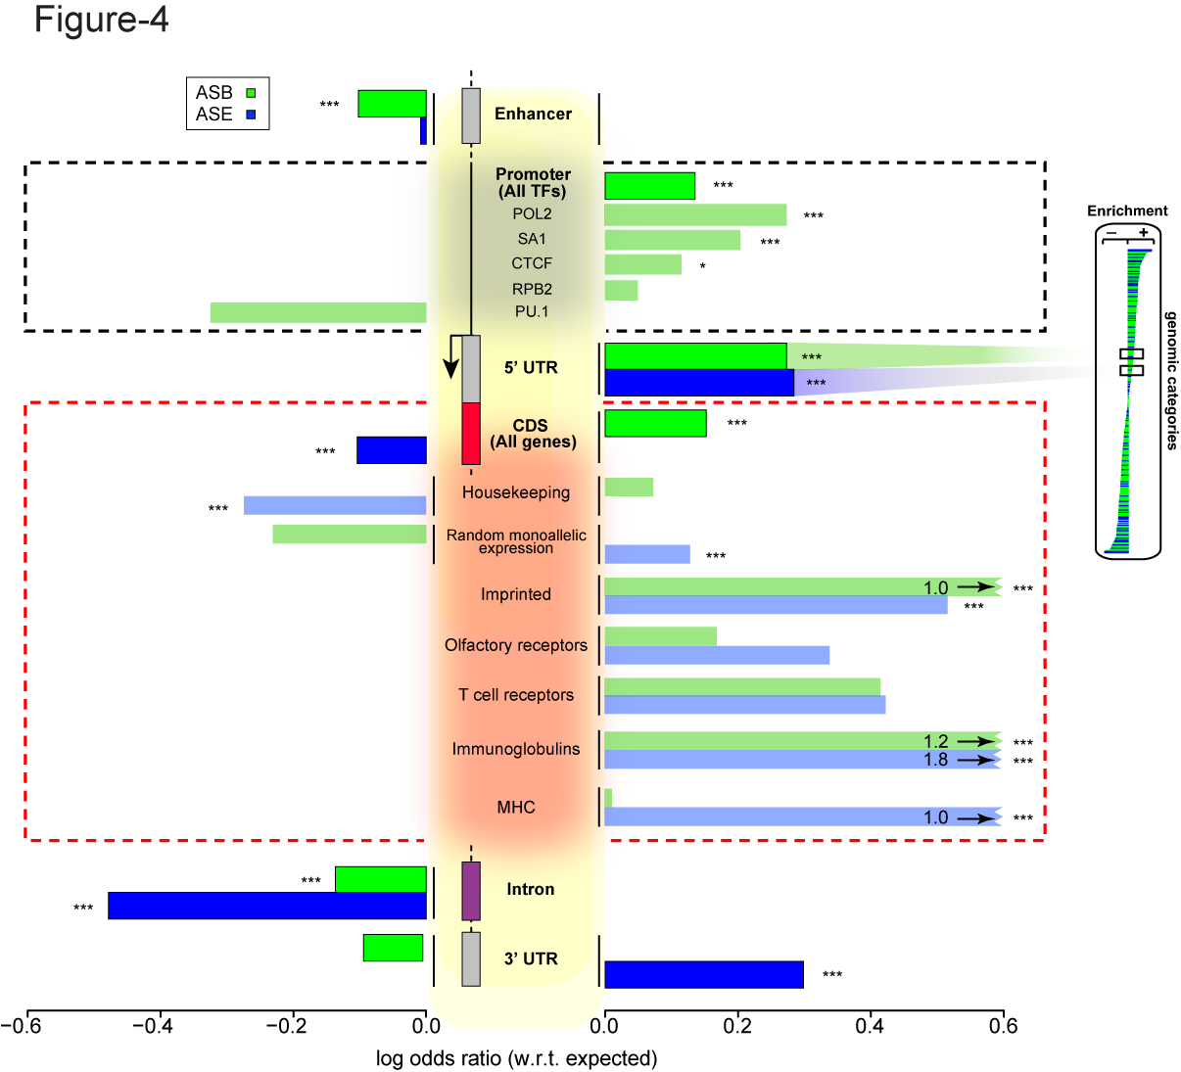
Figure 3. Some genomic regions are more susceptible to allele-specific regulation.
Notes:
Bonferonni corrected p

Slide 6
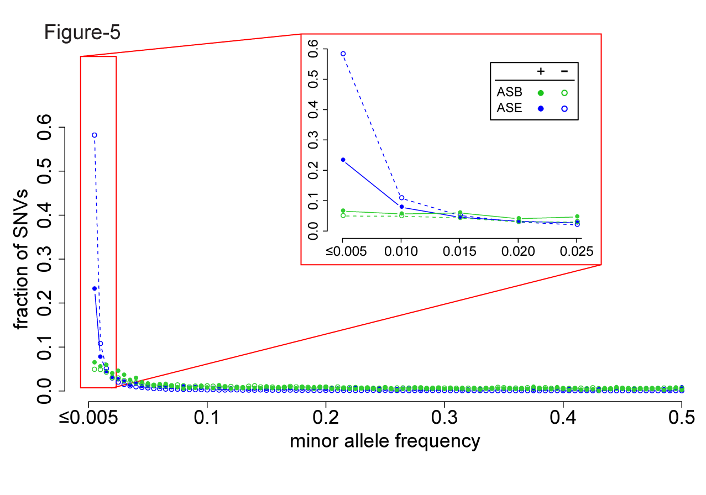
Figure 4. A considerable fraction of AS variants are rare but do not form the majority. Lesser proportion of ASE SNVs than non-ASE SNVs are rare, suggesting less selective constraints in ASE SNVs.

Slide 7
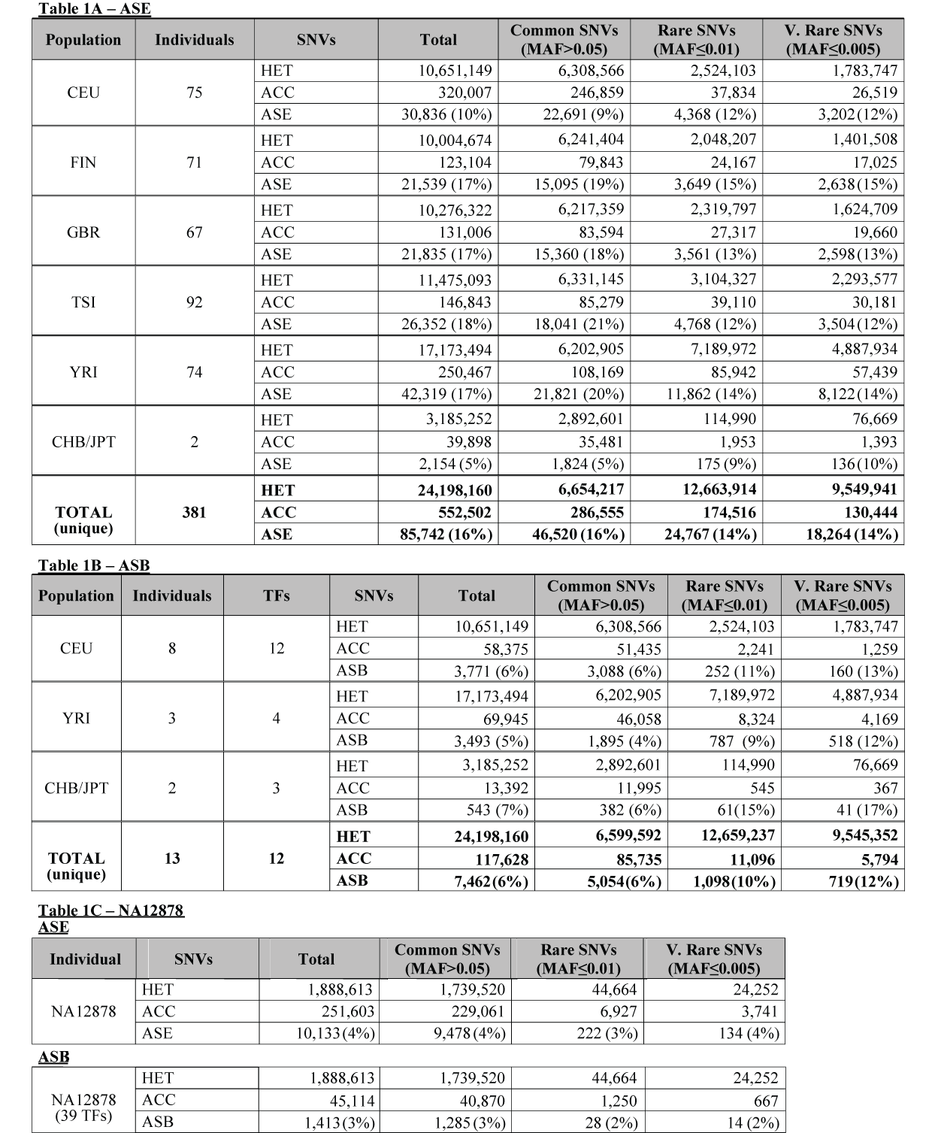
Table 1.

Slide 8
Supplementary Table 1 Flagging of individual datasets

Slide 9
Supplementary Table 2 Allelic inheritance
Notes:
# sNVs

Slide 10
Supplementary File 1 708 unique non-coding categories, gene elements, enhancers
ASB, ASE and AS, with Bonferroni-corrected p values

Slide 11
Supplementary File 2 19,257 autosomal genes, MAE categories
 | AS.OR | AS.p.bon | AS | nonAS | ASB.OR | ASB.pbon | ASB | nonASB | ASE.OR | ASE.pbon | ASE | nonASE
FHIT | 0.13884 | 6.30E-07 | 6 | 262 | 0.00 | 1.00E+00 | 0 | 23 | 0.14 | 4.74E-07 | 6 | 242
SNURF | 186.1098 | 4.62E-45 | 61 | 2 | 0.00 | 1.00E+00 | 0 | 1 | 167.96 | 9.04E-43 | 61 | 2
ASB, ASE and AS, with Bonferroni-corrected p values

Slide 12
Supplementary File 3 ASB SNVs of 44 TFs in promoters
ASB, ASE and AS, with Bonferroni-corrected p values

Slide 13
Supplementary File 4 ASB SNVs in TF motifs

Slide 14
Supplementary File 5 R Pseudocode for bisection method to estimate overdispersion parameter

Slide 15
To do
Sets of more confident AS SNVs found in multiple individuals, split by populations
Reboot AlleleDB online
Edit the manuscript

