Slide 1
AlleleDB Figure Pack
Notes:
Allelic != allele-specific

Slide 2
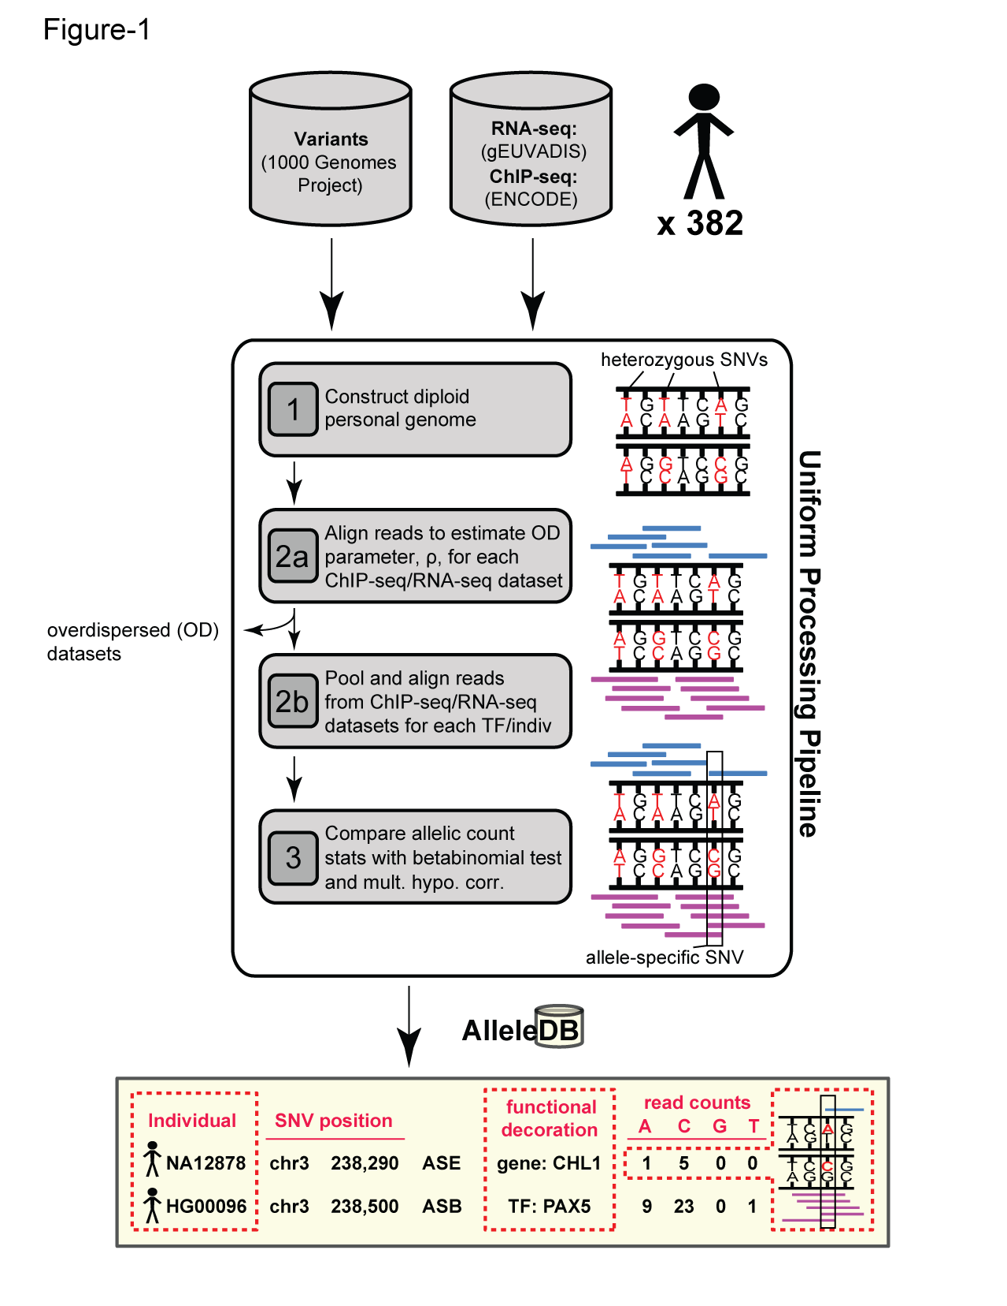
Figure 1. Uniform processing of data from 382 individuals and construction of AlleleDB.

Slide 3
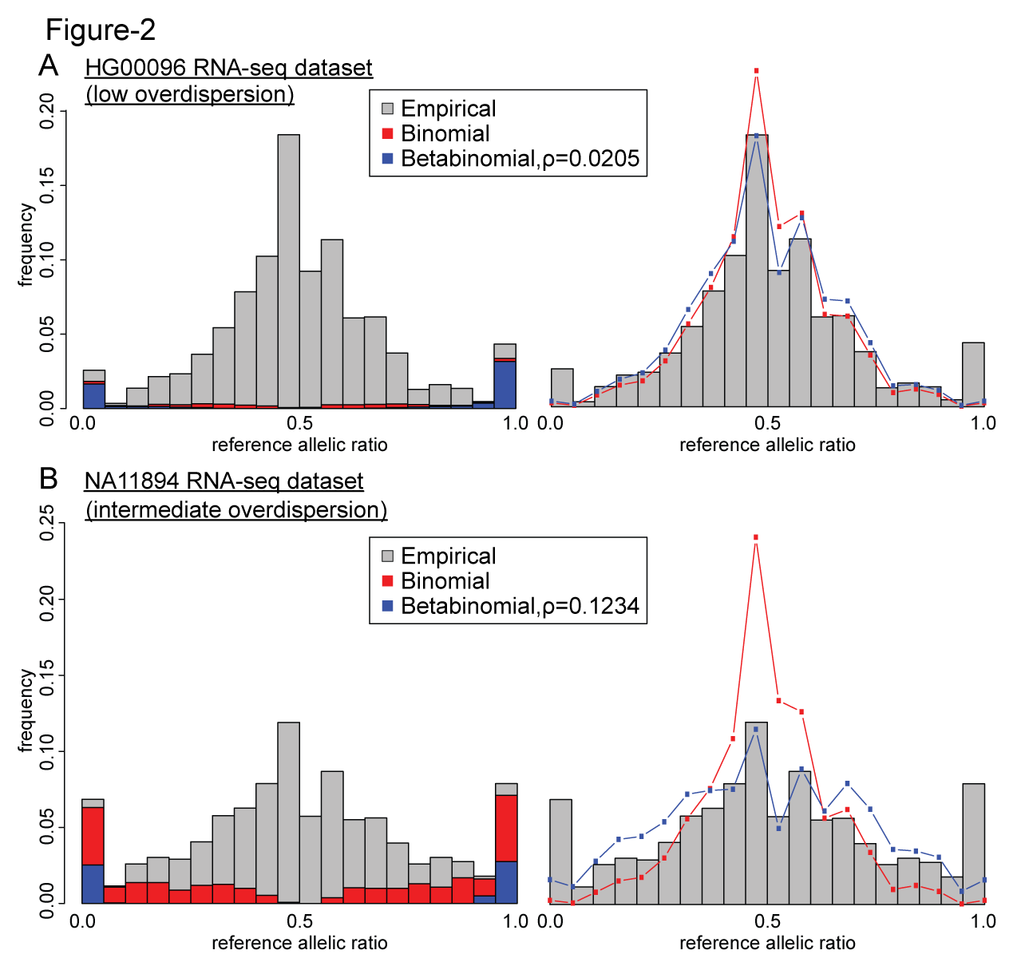
Figure 2. Effects of using a betabinomial test versus using a binomial test in allele-specific SNV detection on overdispersed datasets.

Slide 4
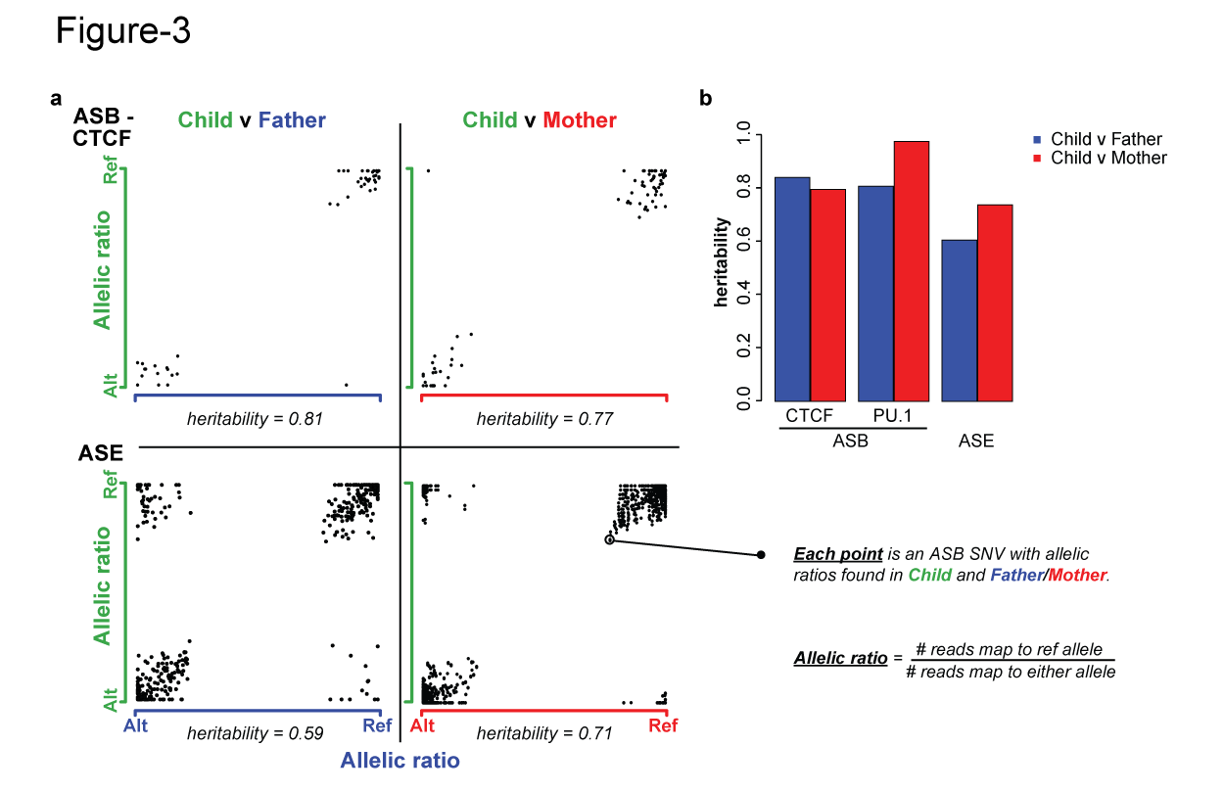
Figure 3. Inheritance of allele-specific binding events is evident in some TFs but not so apparent in others.

Slide 5
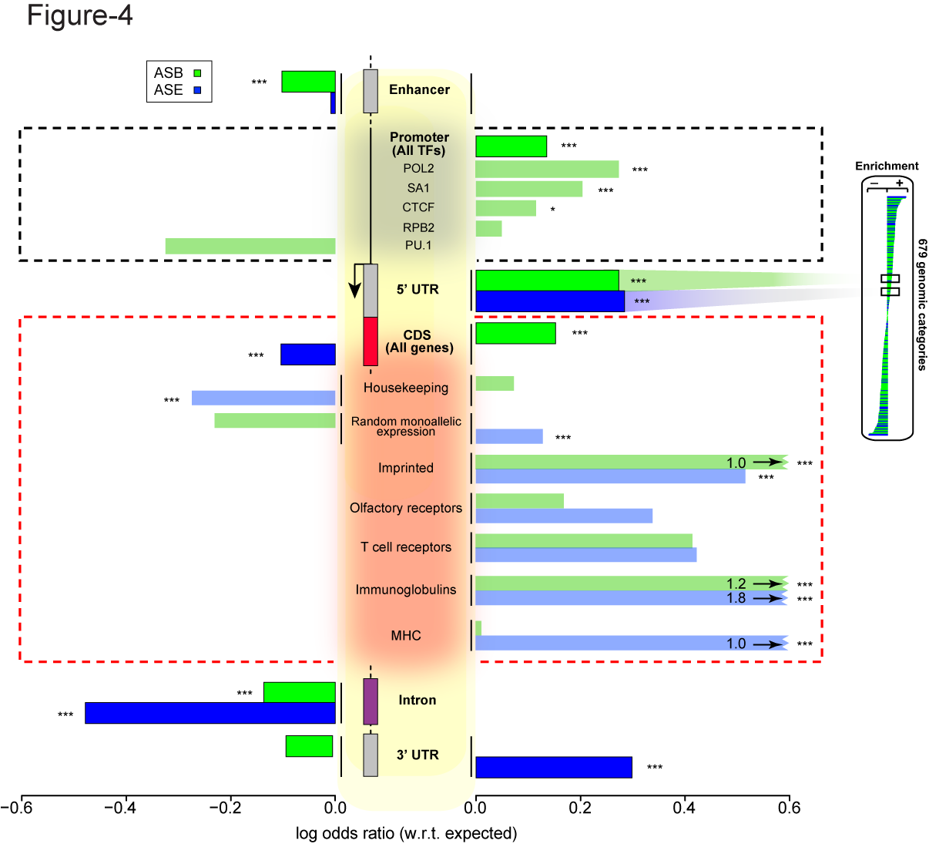
Figure 3. Some genomic regions are more susceptible to allele-specific regulation.
Notes:
Bonferonni corrected p

Slide 6
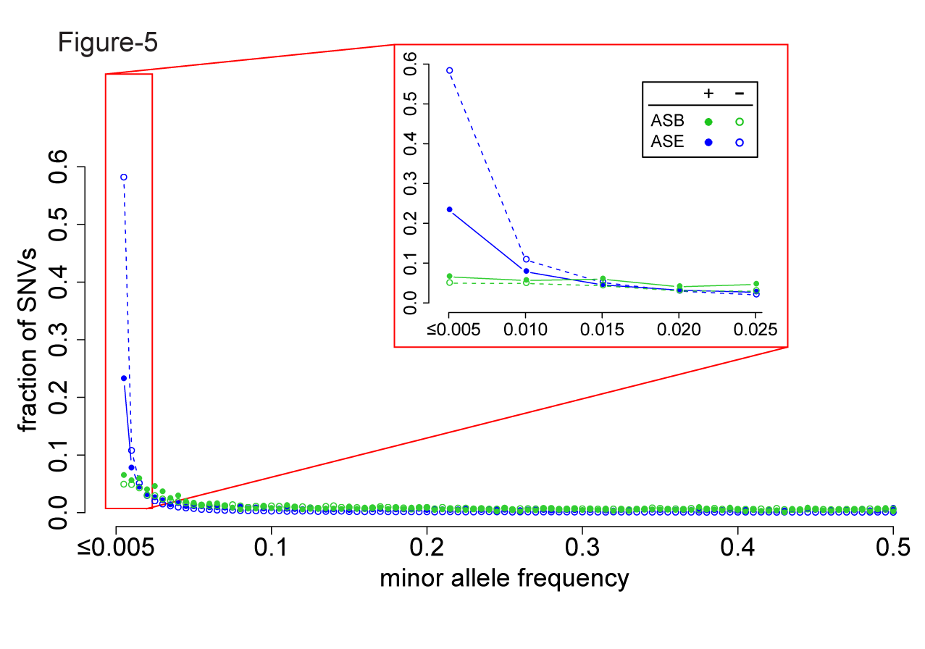
Figure 4. A considerable fraction of AS variants are rare but do not form the majority. Lesser proportion of ASE SNVs than non-ASE SNVs are rare, suggesting less selective constraints in ASE SNVs.

Slide 7
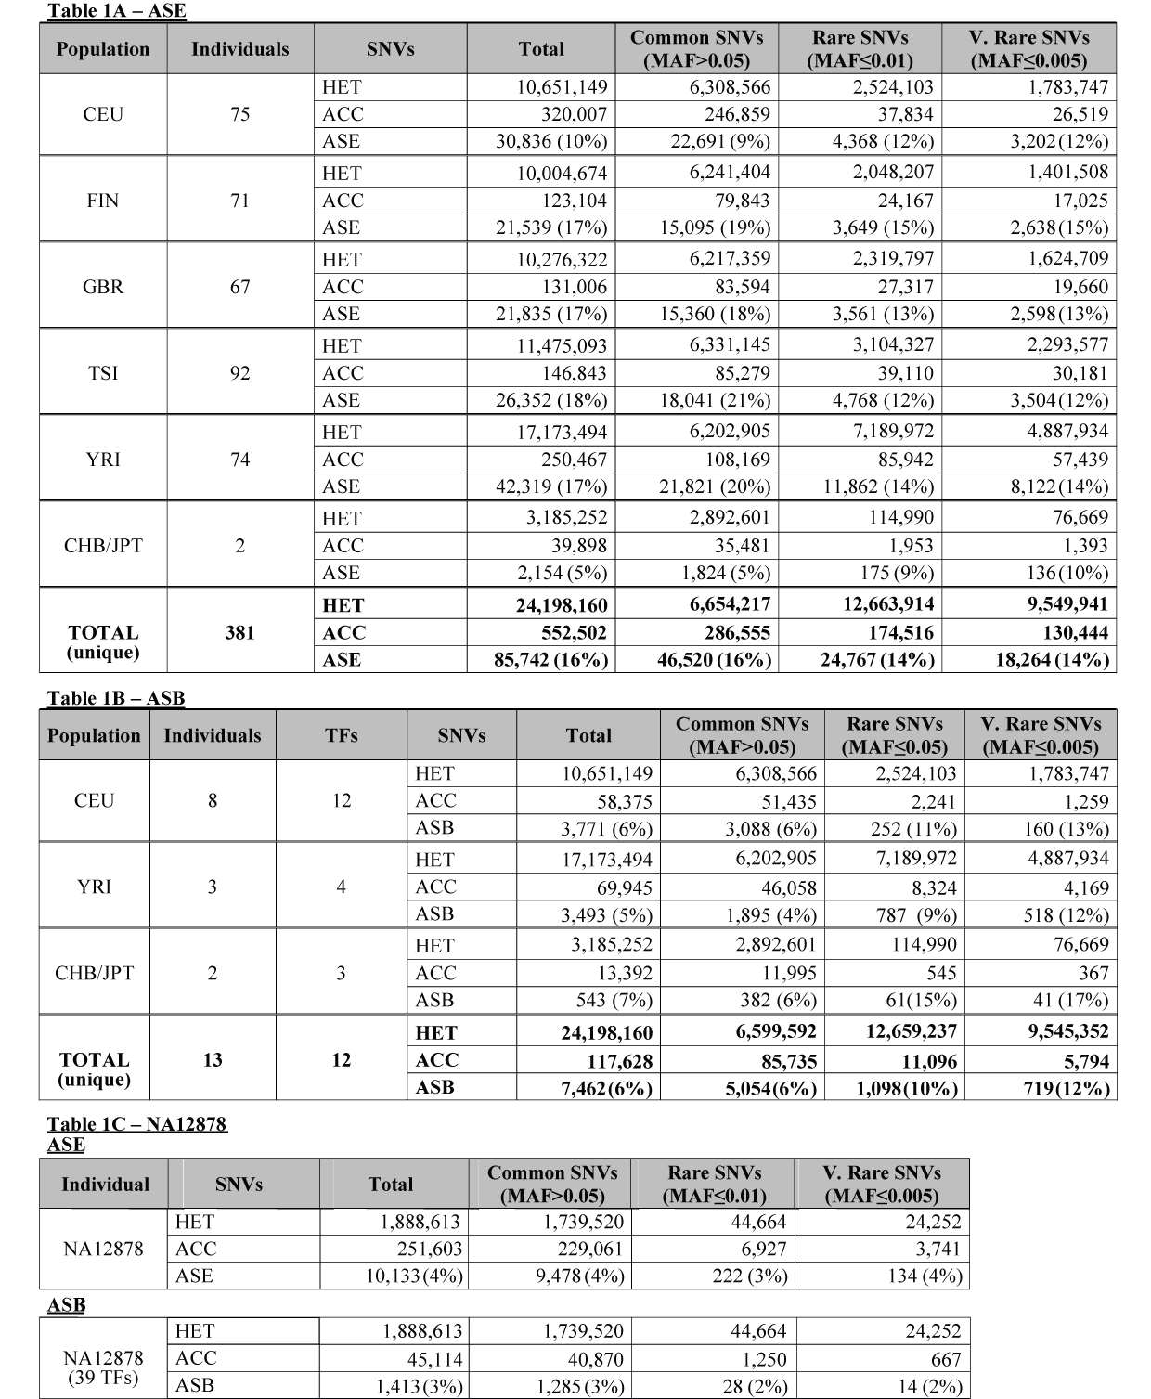
Table 1.

Slide 8
Supplementary Table 1 Filtering of individual datasets in first pass of AlleleSeq

Slide 9
Supplementary Table 2 Allelic inheritance
Notes:
# sNVs

Slide 10
Supplementary File 1 679 unique non-coding categories, gene elements, enhancers
ASB, ASE and AS, with Bonferroni-corrected p values

Slide 11
Supplementary File 2 19,257 autosomal genes, MAE categories
 | AS.OR | AS.p.bon | AS | nonAS | ASB.OR | ASB.pbon | ASB | nonASB | ASE.OR | ASE.pbon | ASE | nonASE
FHIT | 0.13884 | 6.30E-07 | 6 | 262 | 0.00 | 1.00E+00 | 0 | 23 | 0.14 | 4.74E-07 | 6 | 242
SNURF | 186.1098 | 4.62E-45 | 61 | 2 | 0.00 | 1.00E+00 | 0 | 1 | 167.96 | 9.04E-43 | 61 | 2
ASB, ASE and AS, with Bonferroni-corrected p values

Slide 12
Supplementary File 3 ASB SNVs of TFs in promoters
ASB, ASE and AS, with Bonferroni-corrected p values

Slide 13
To do
AS SNVs found in TF motifs
Sets of more confident AS SNVs found in multiple individuals, split by populations
Reboot AlleleDB online
Edit the manuscript

