Slide 1
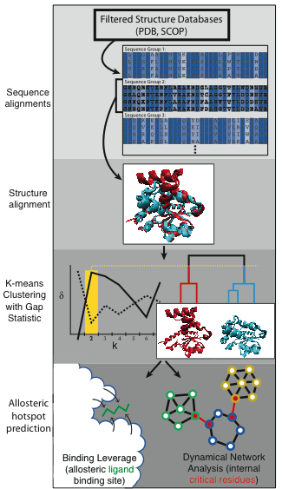
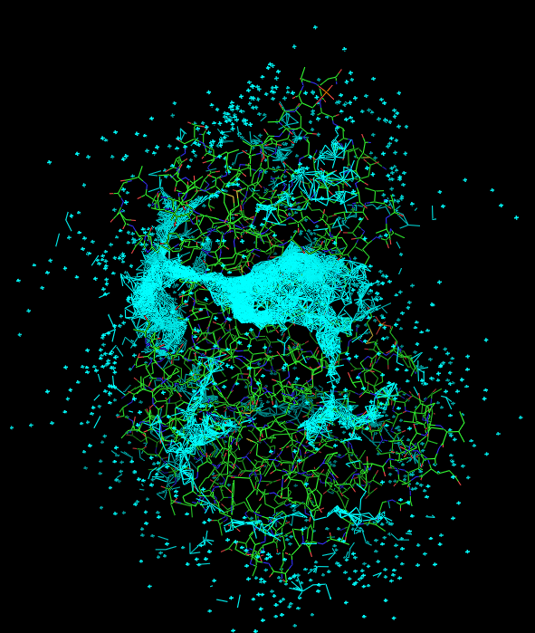

Slide 2
In reality, each protein is likely to have only a small number of surface patches that can truly function as allosteric leverage points by modulating large-scale conformational changes (whether these sites are used biologically or simply constitute ‘latent’ allosteric sites).
Objective (for end user and for downstream analyses): For each protein, provide these surface-exposed “allosteric hotspots” in the form of lists of residues.
Site 1 residues: 61_B 57_A 227_A 225_B 229_A 235_A 228_A 230_A 223_B 261_B
Site 2 residues: 219_A 220_A 61_A 225_A 400_A 229_C 228_C 268_A 223_A 401_A
Site 3 residues: 191_C 132_B 133_B 197_C 194_C 135_B 193_C 195_C 196_C 215_C

Slide 3
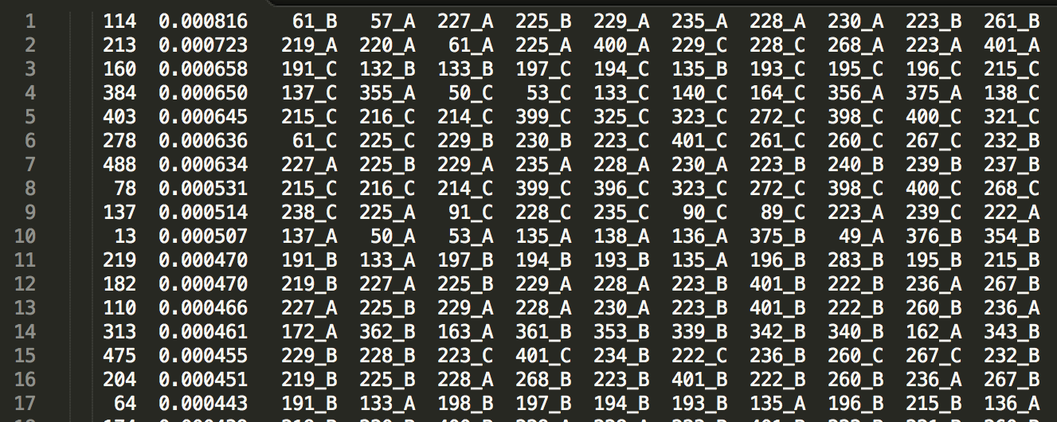
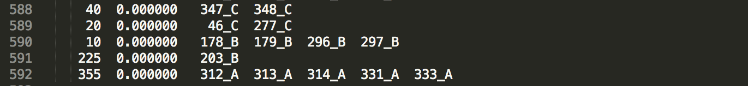
.
.
.

Slide 4
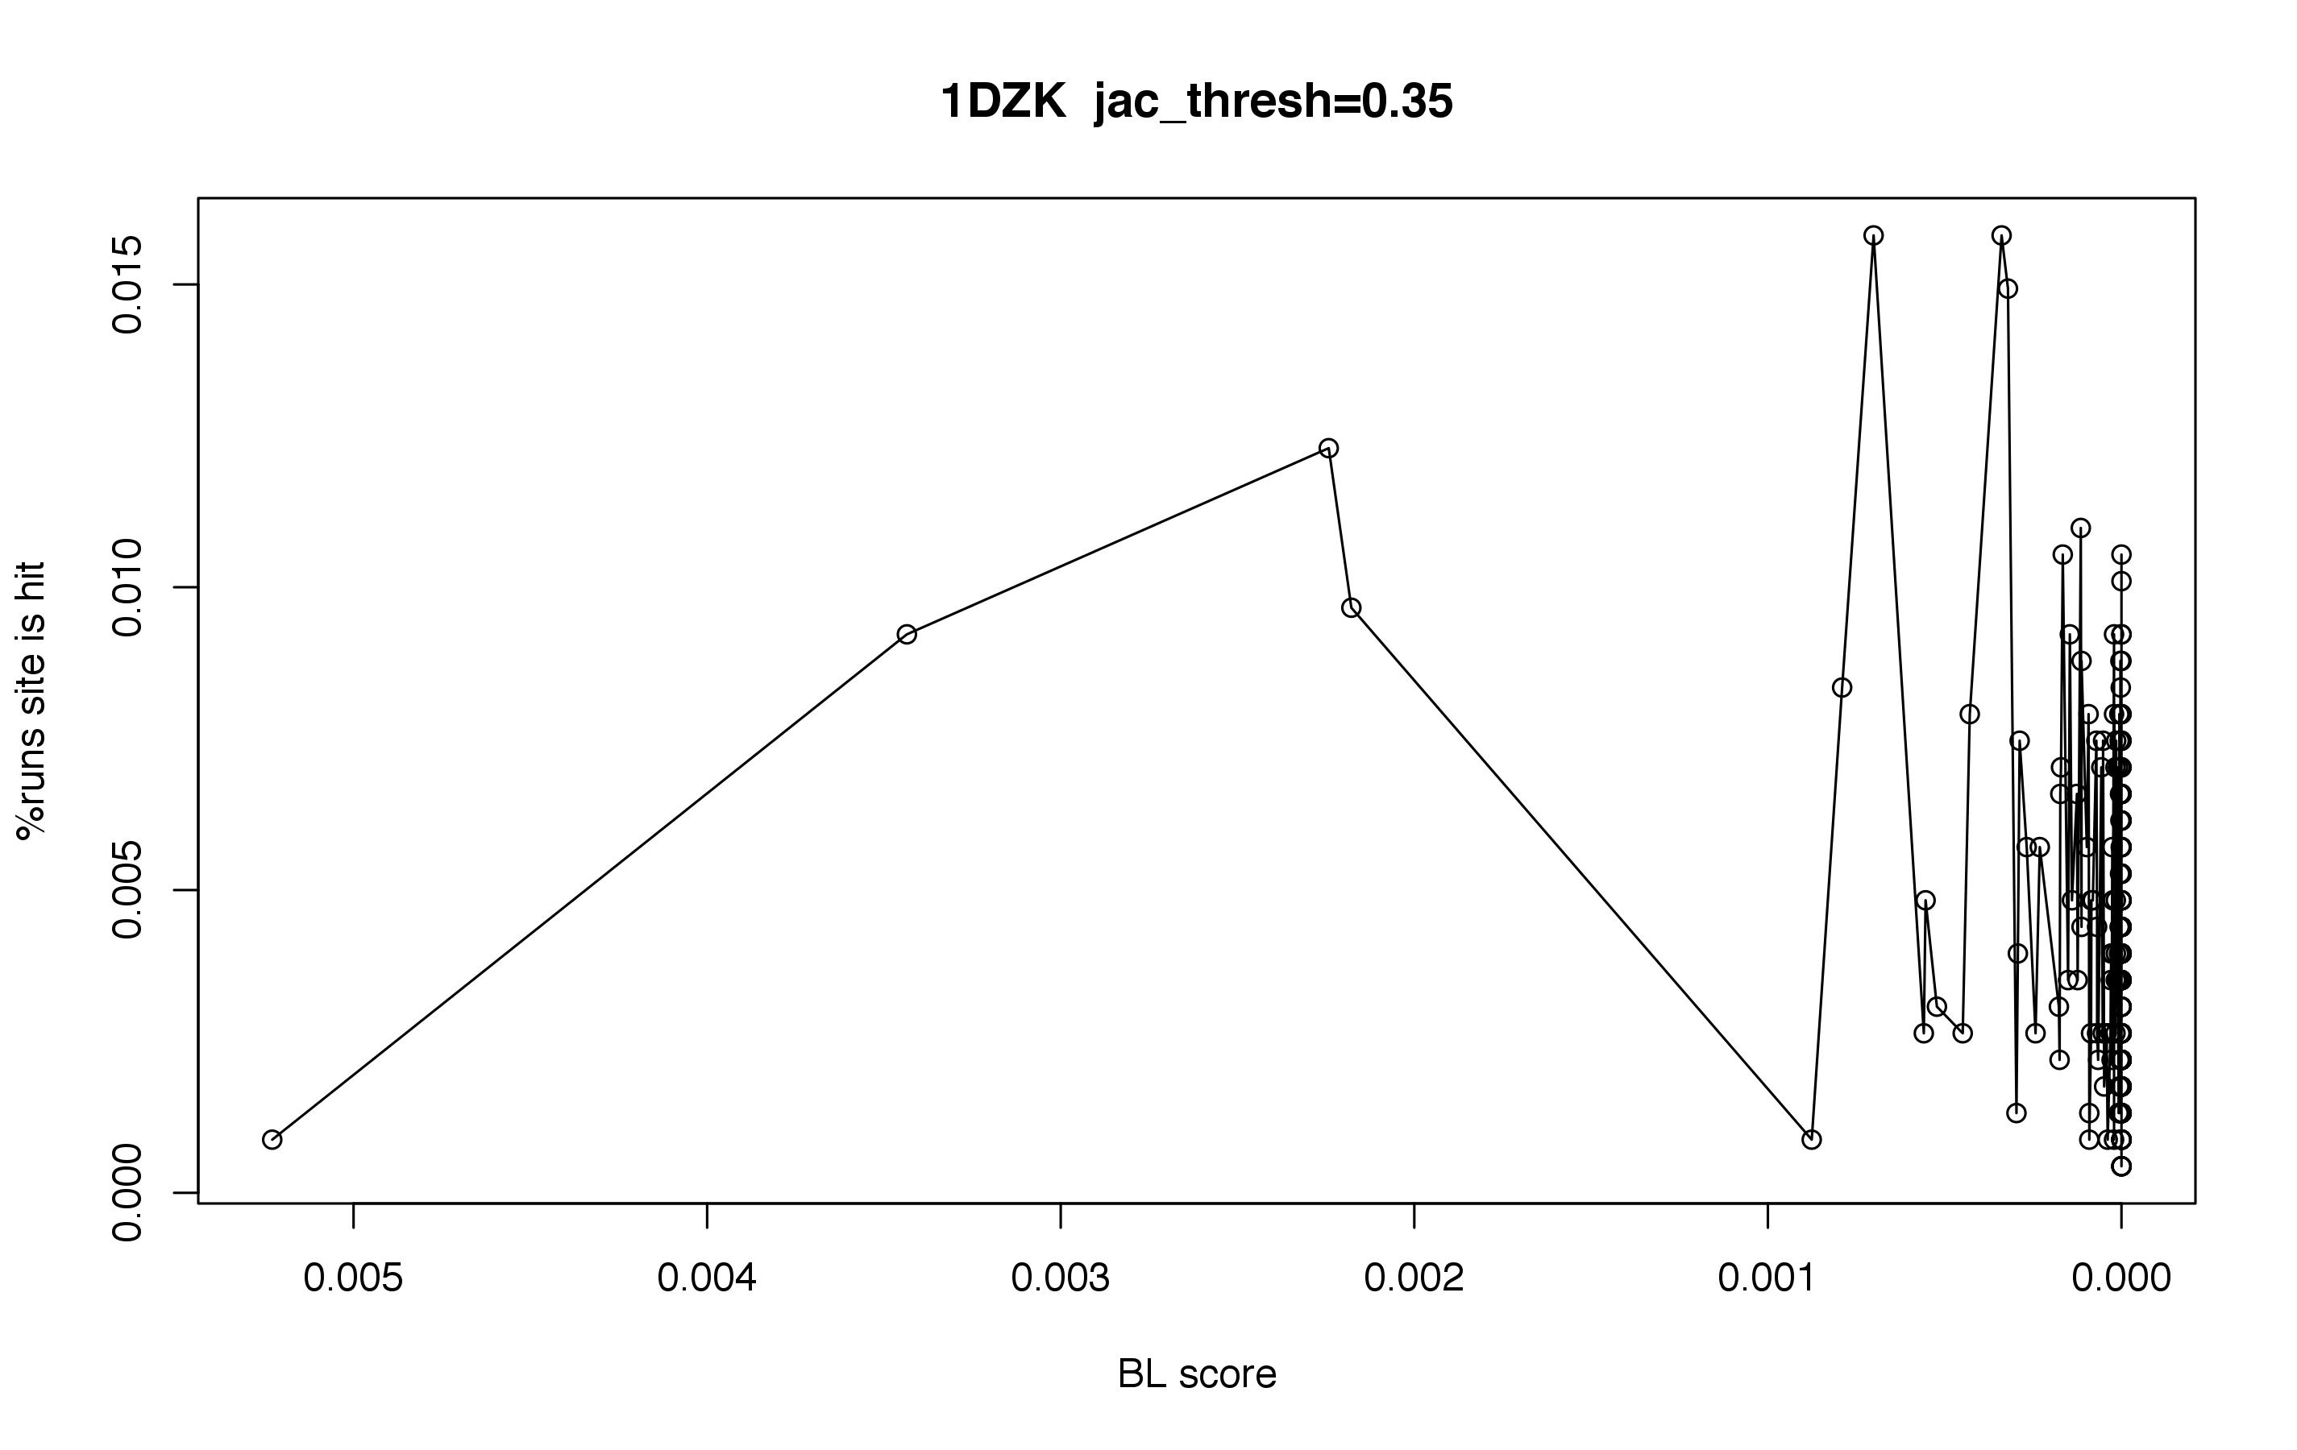
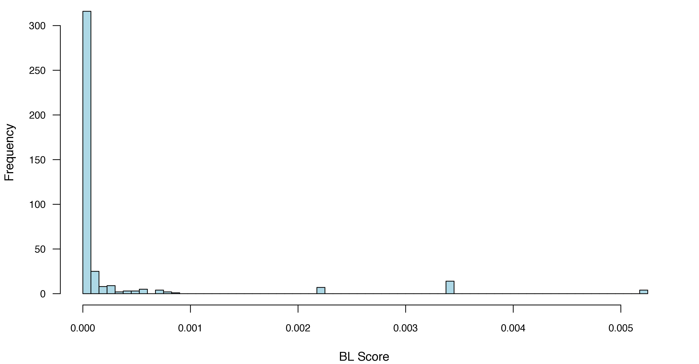

Slide 5
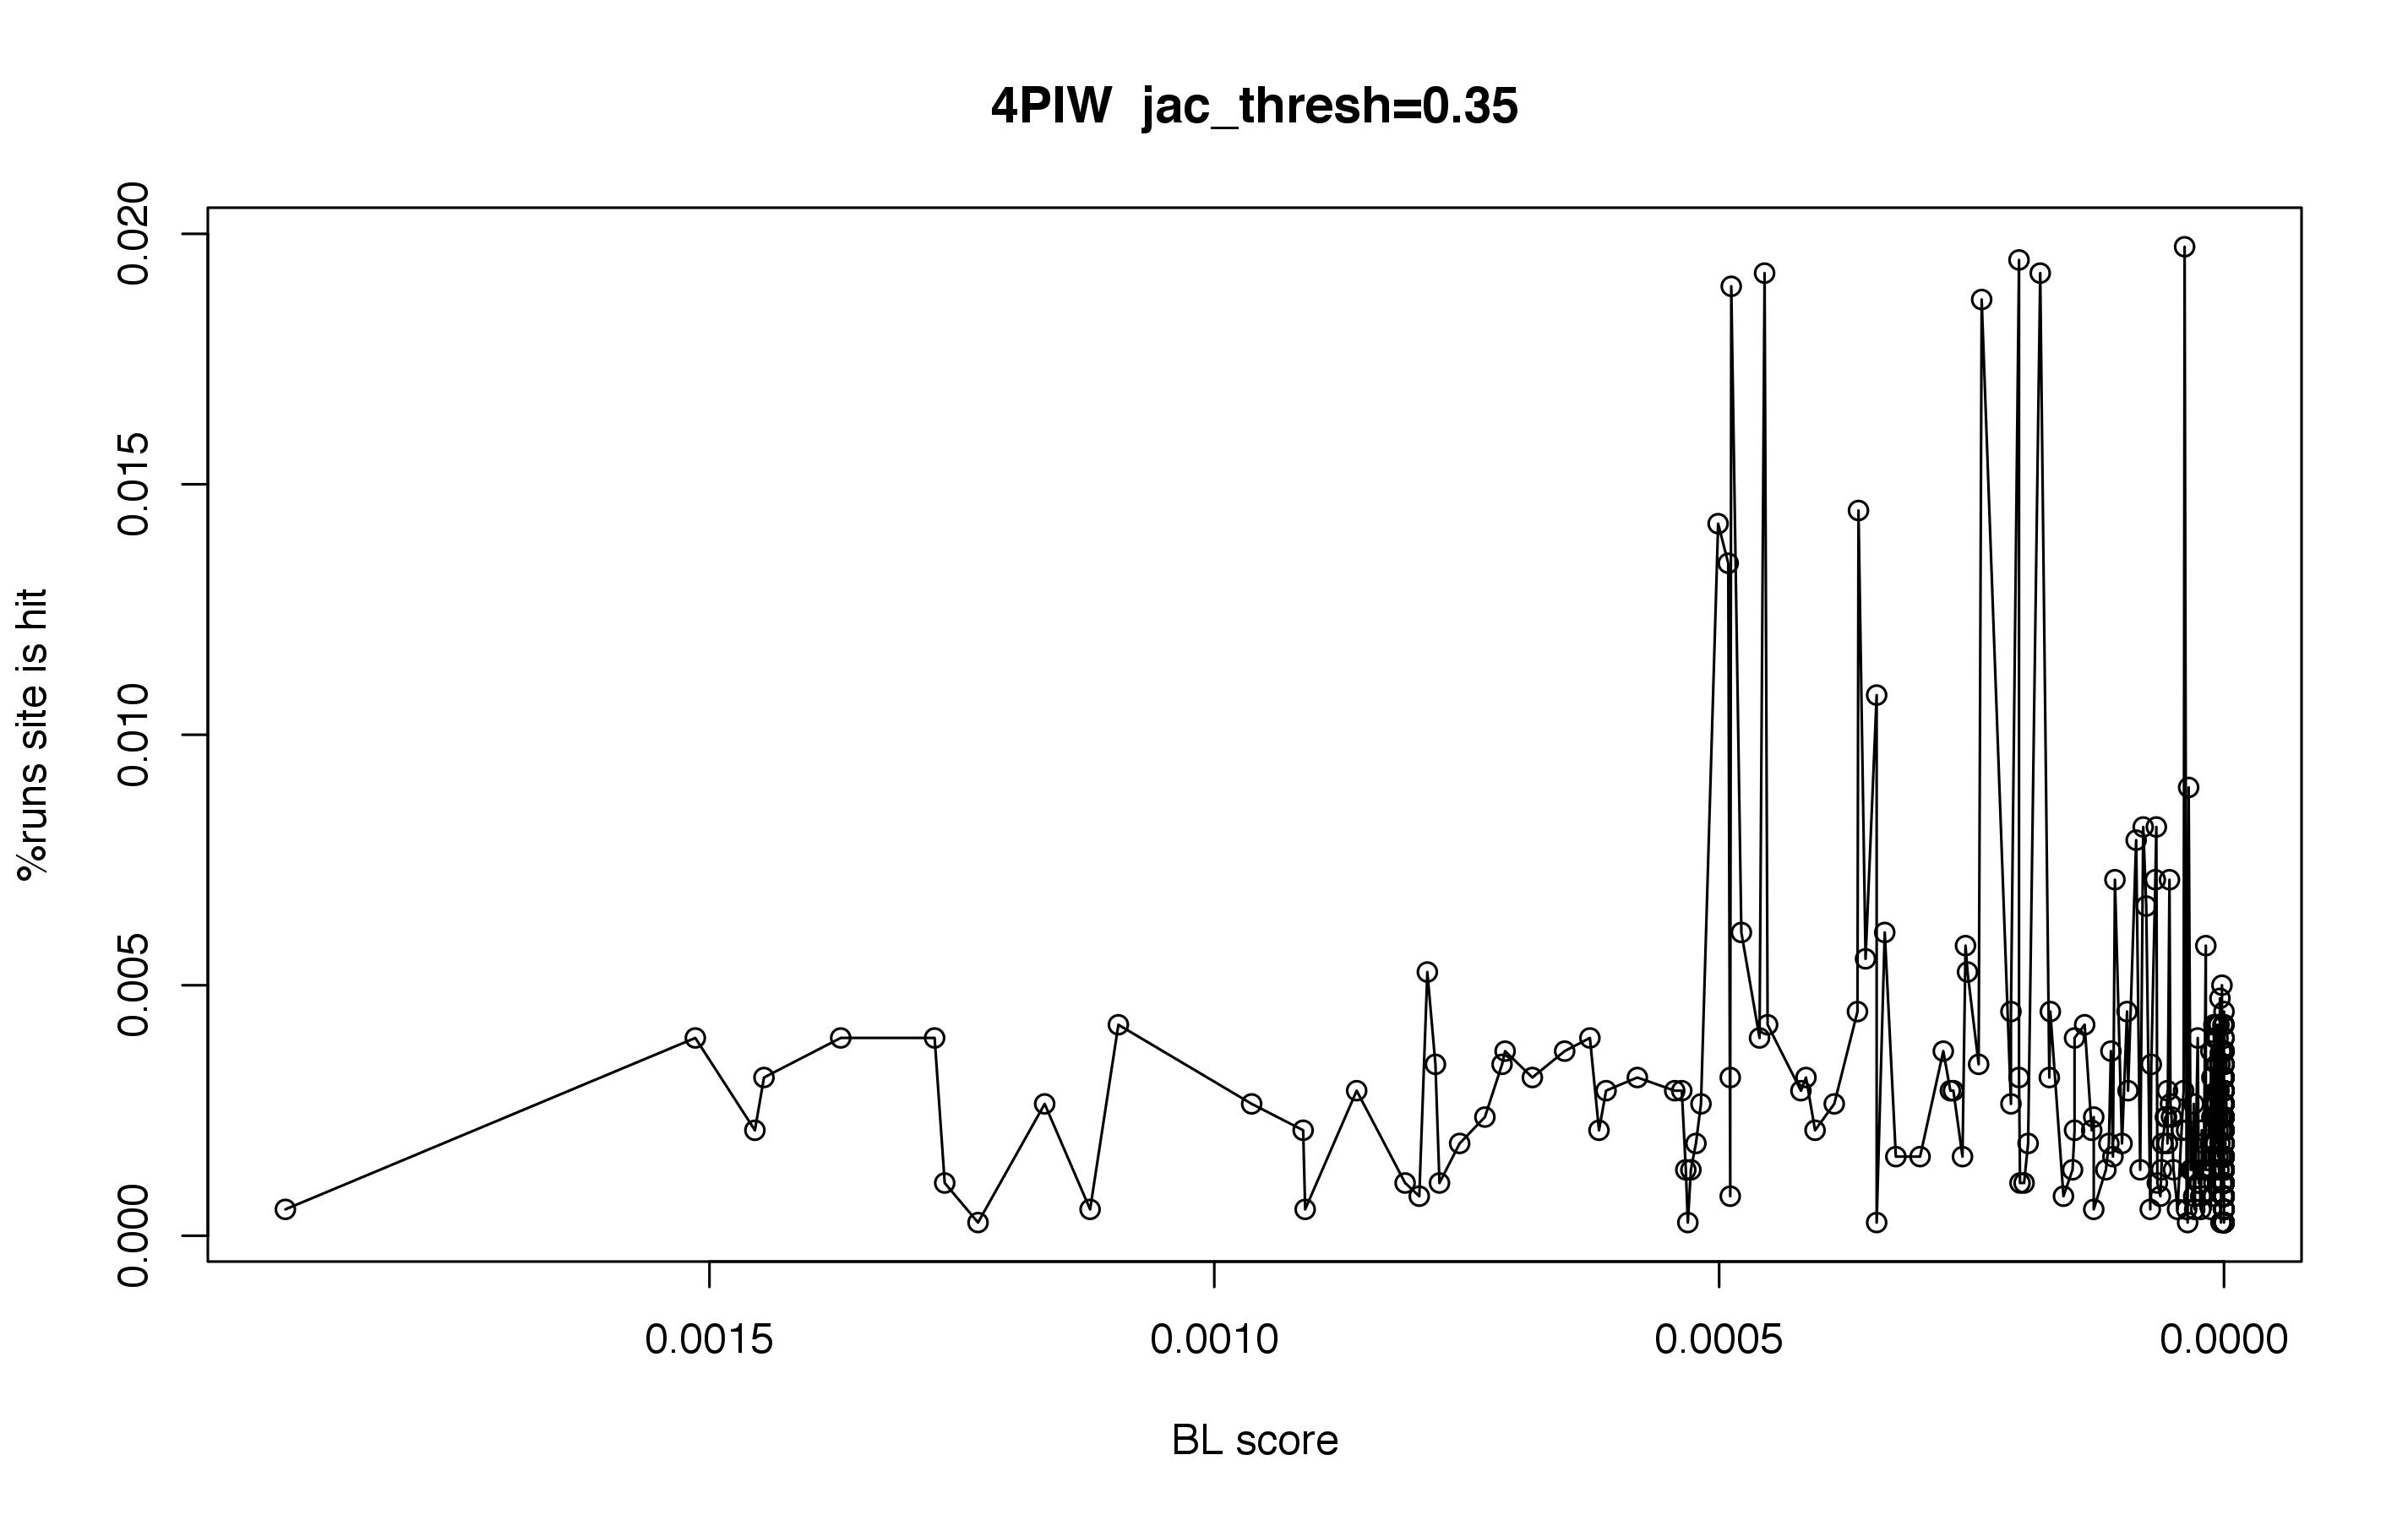
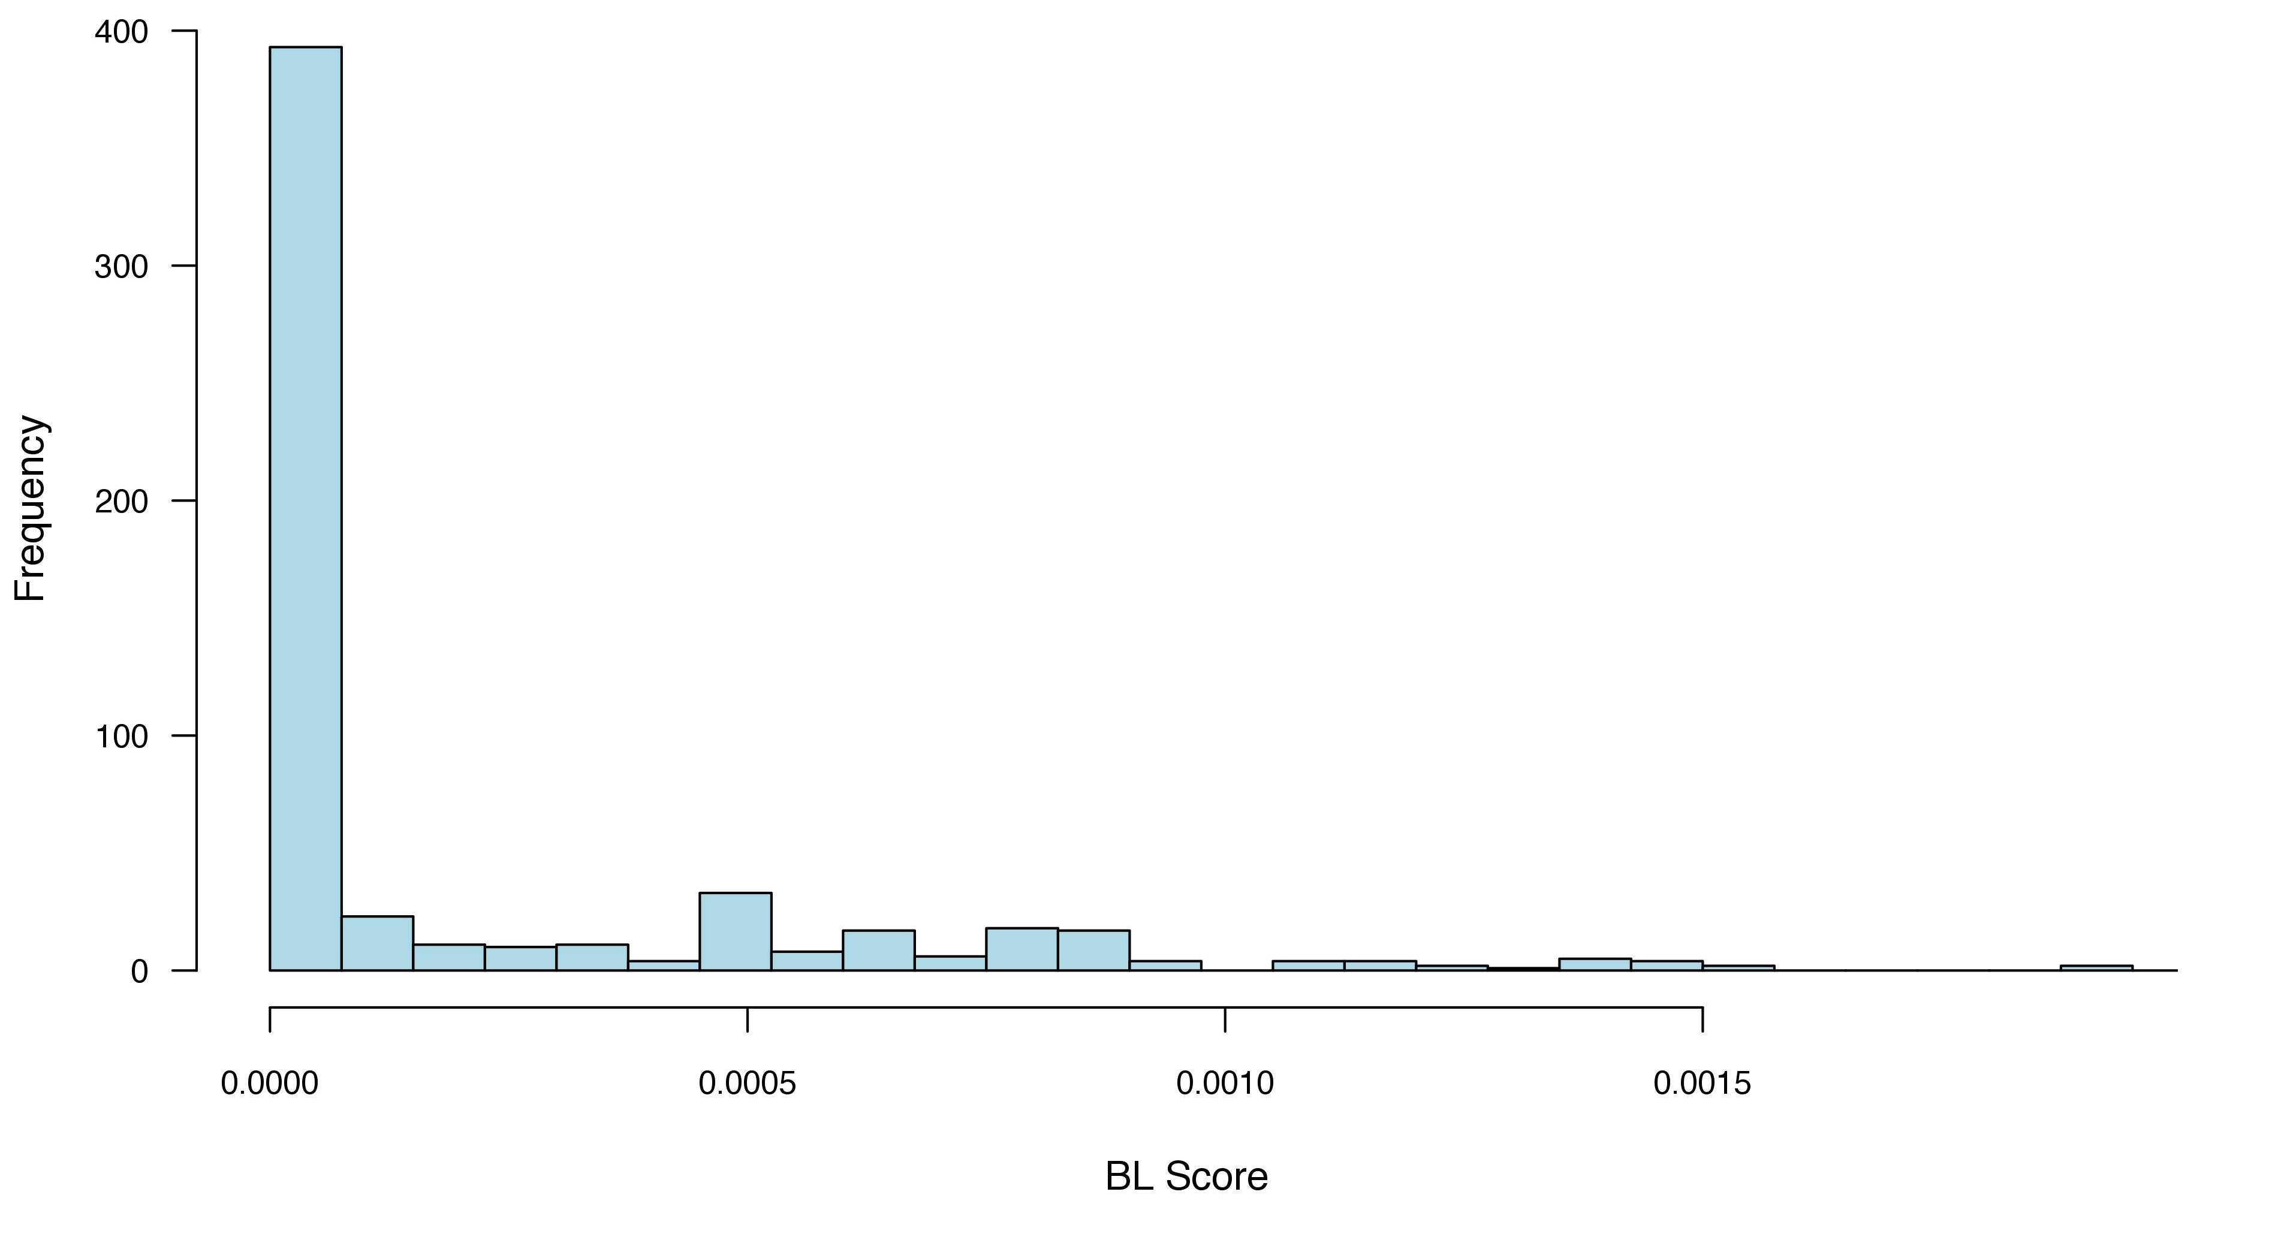

Slide 6
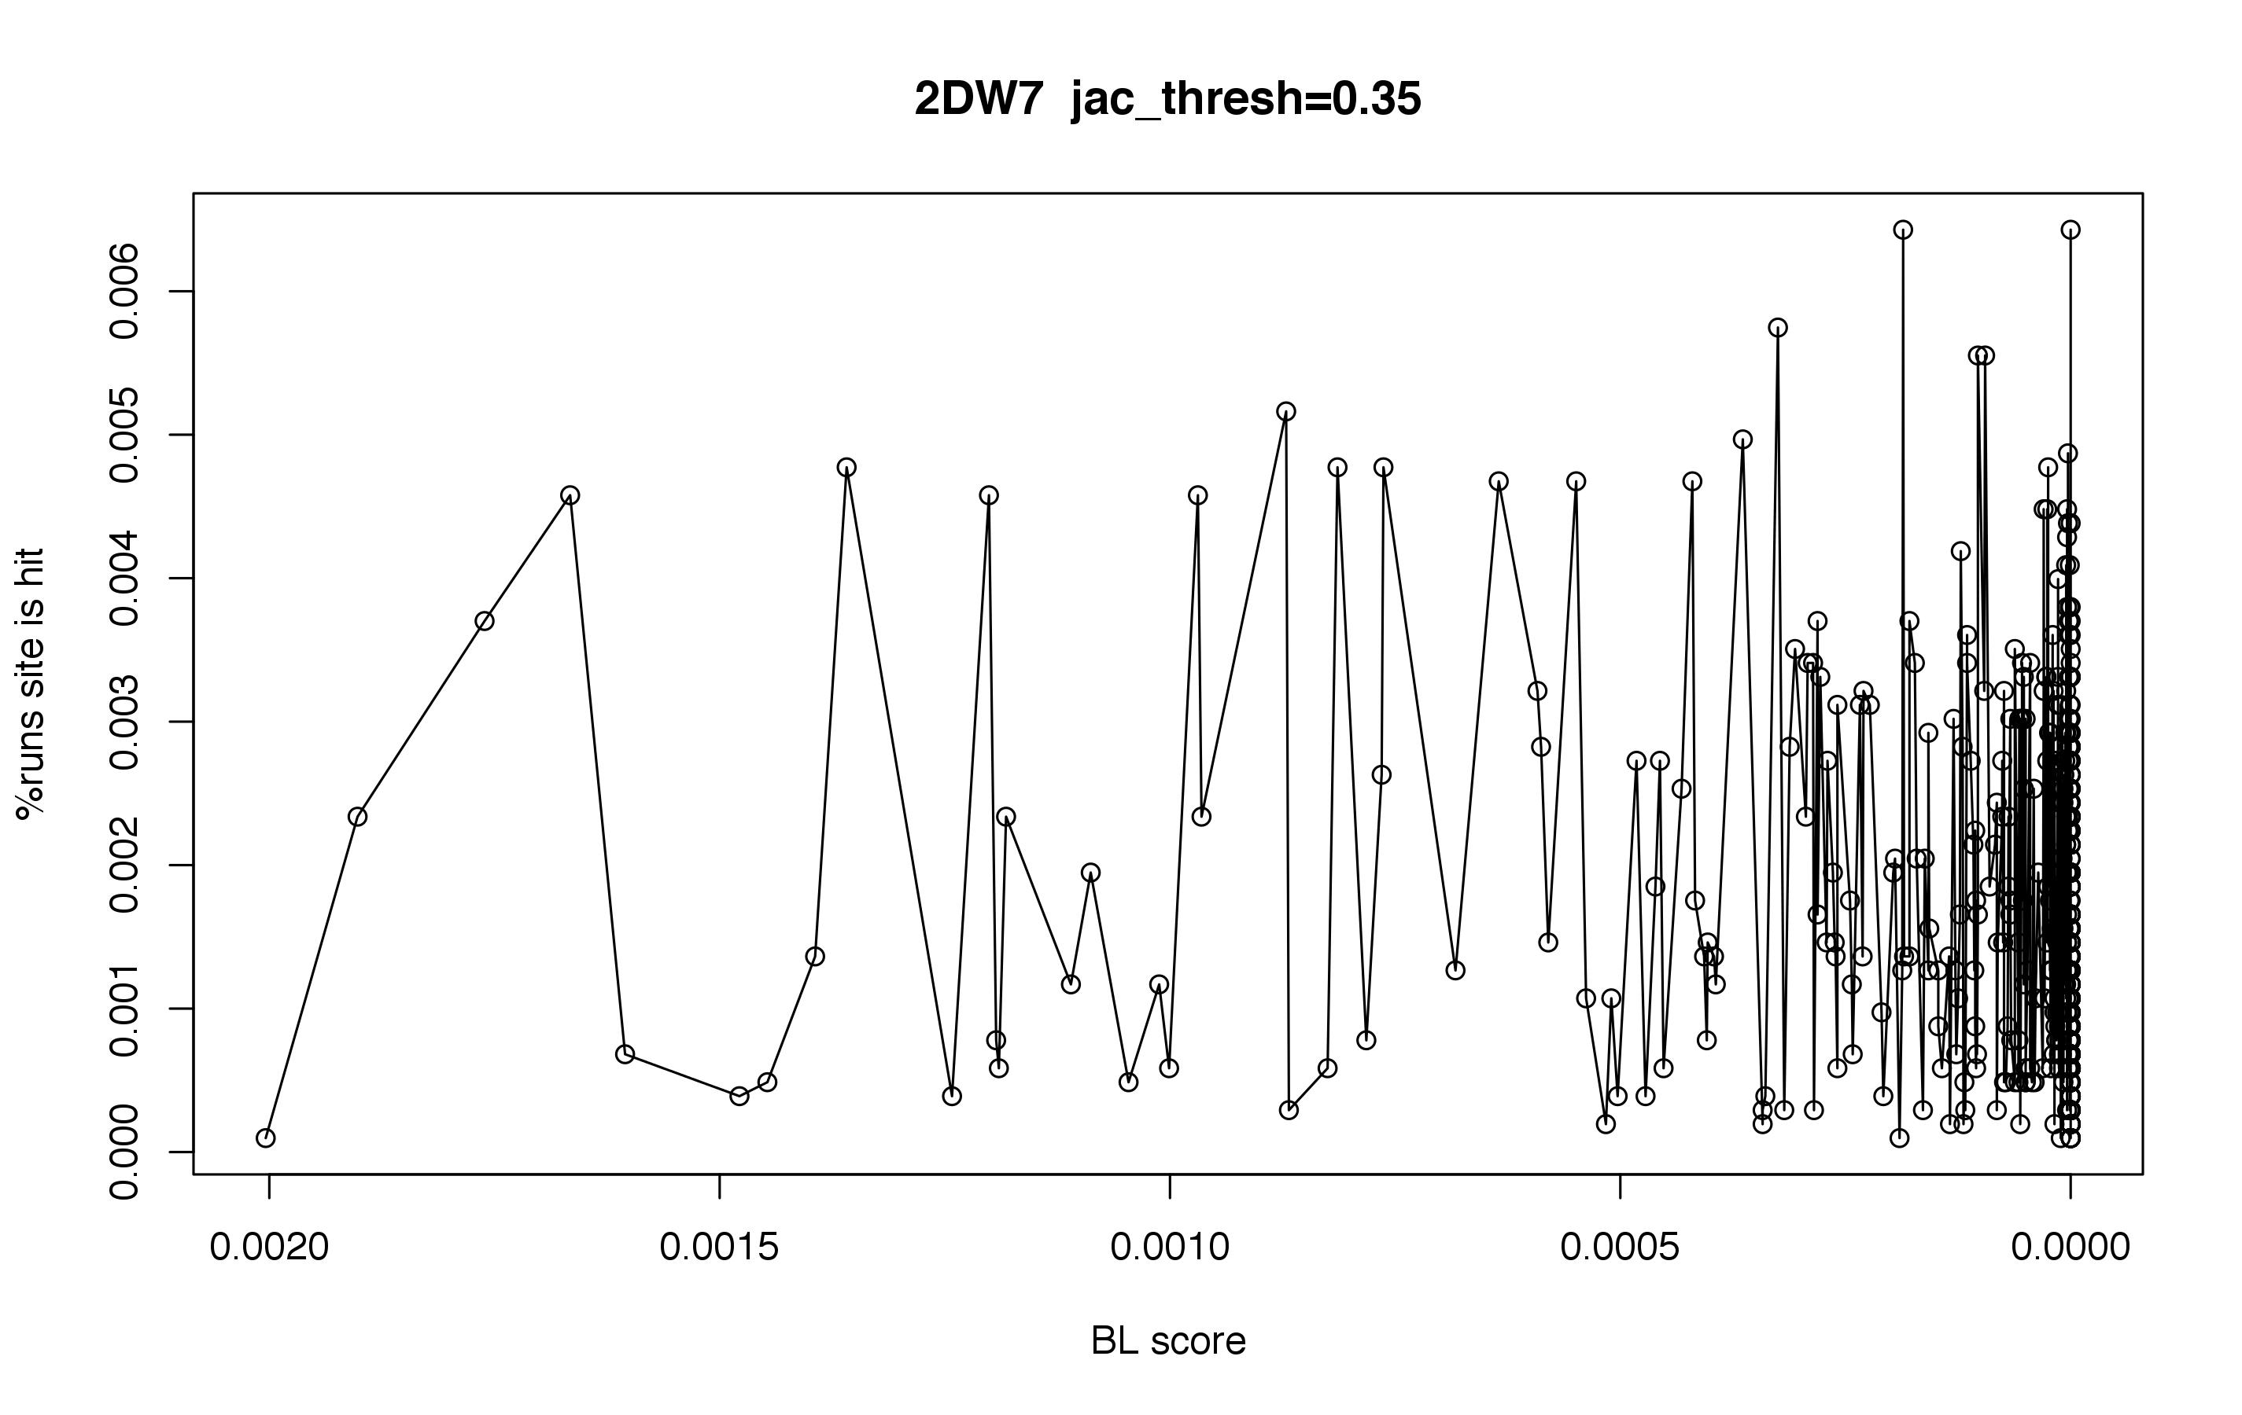
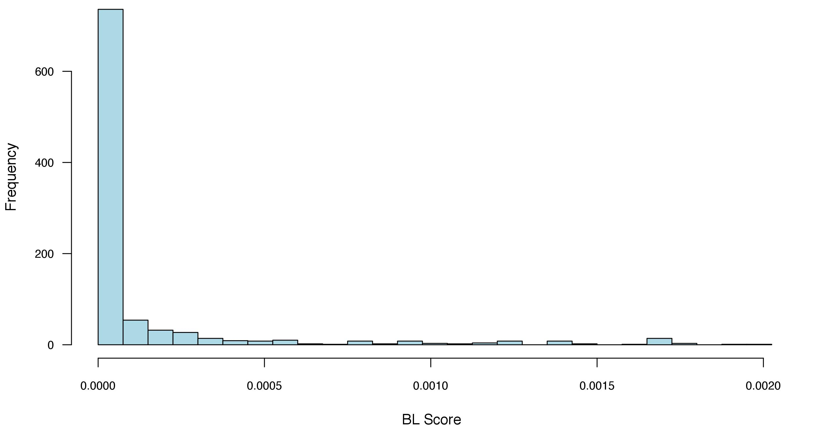

Slide 7
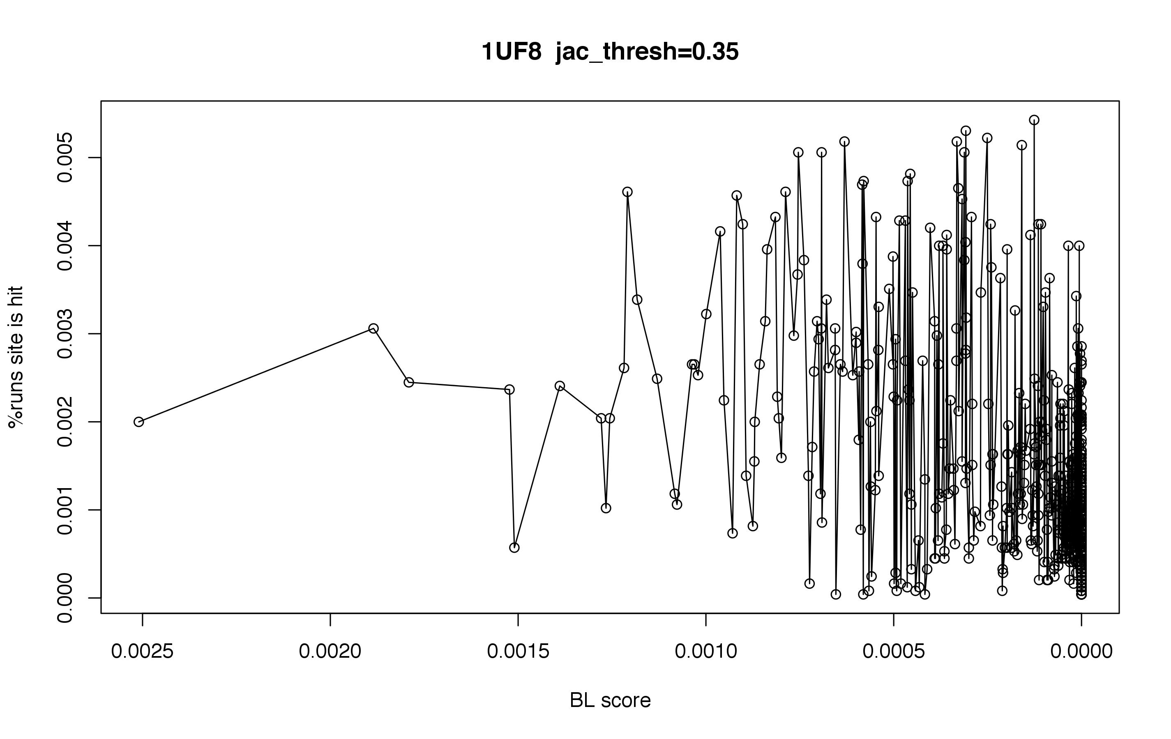
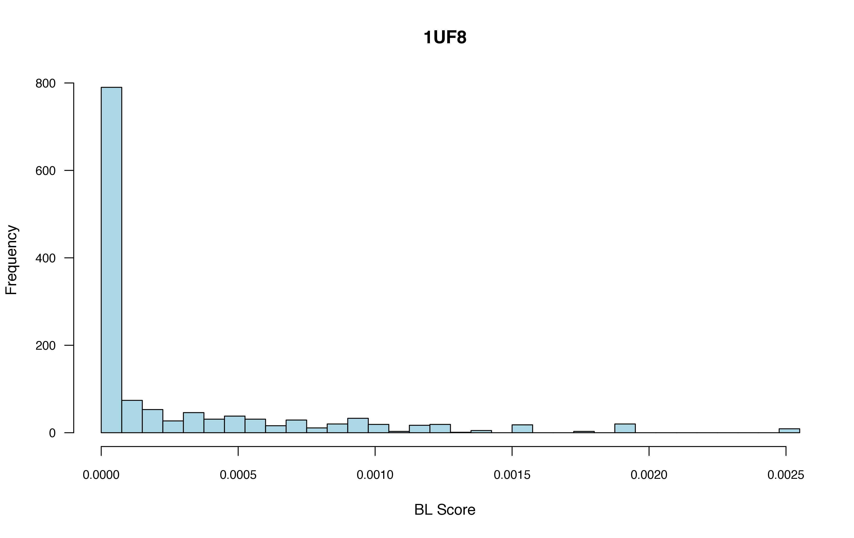

Slide 8
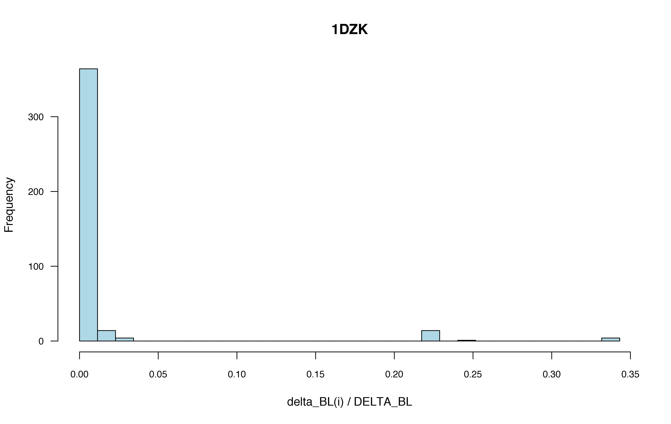

Slide 9
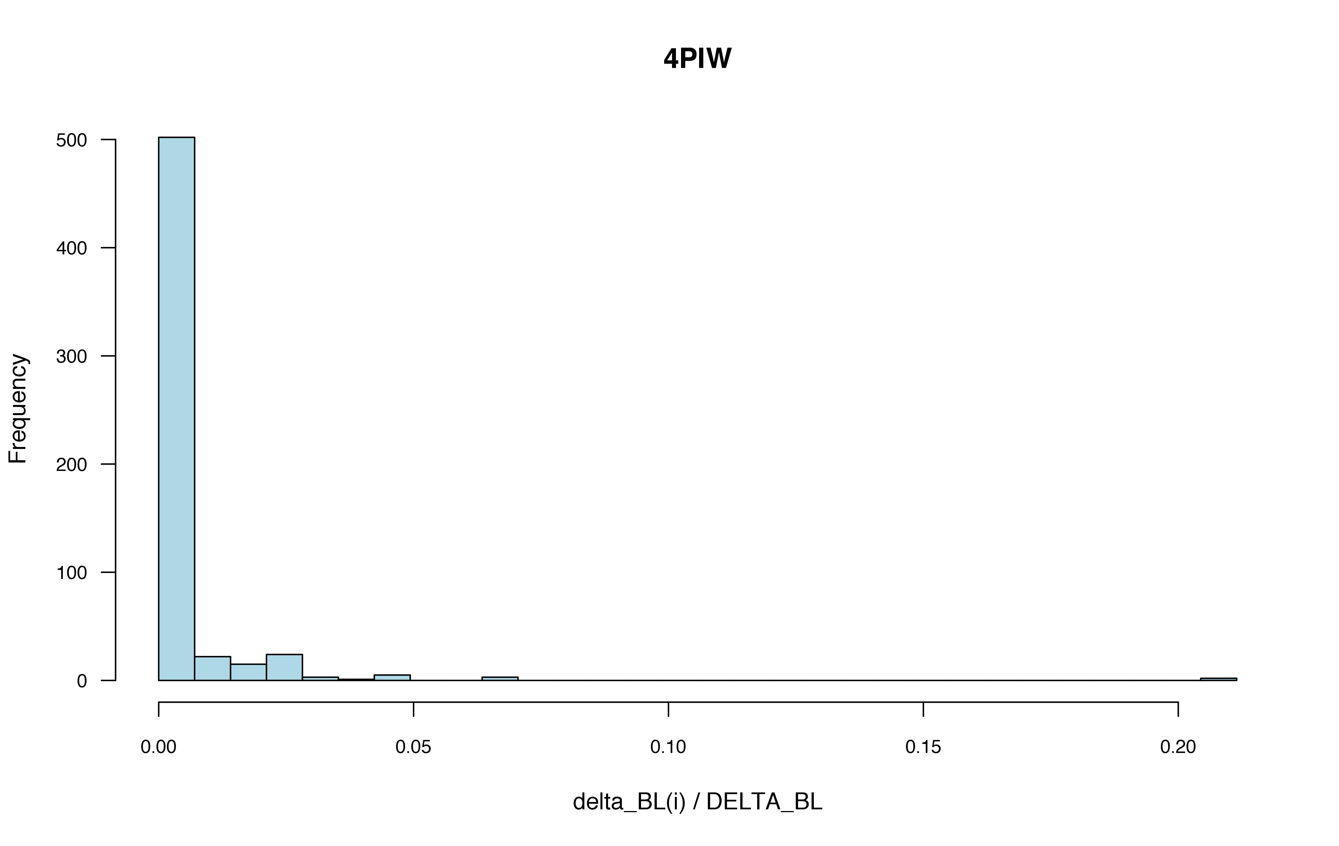

Slide 10
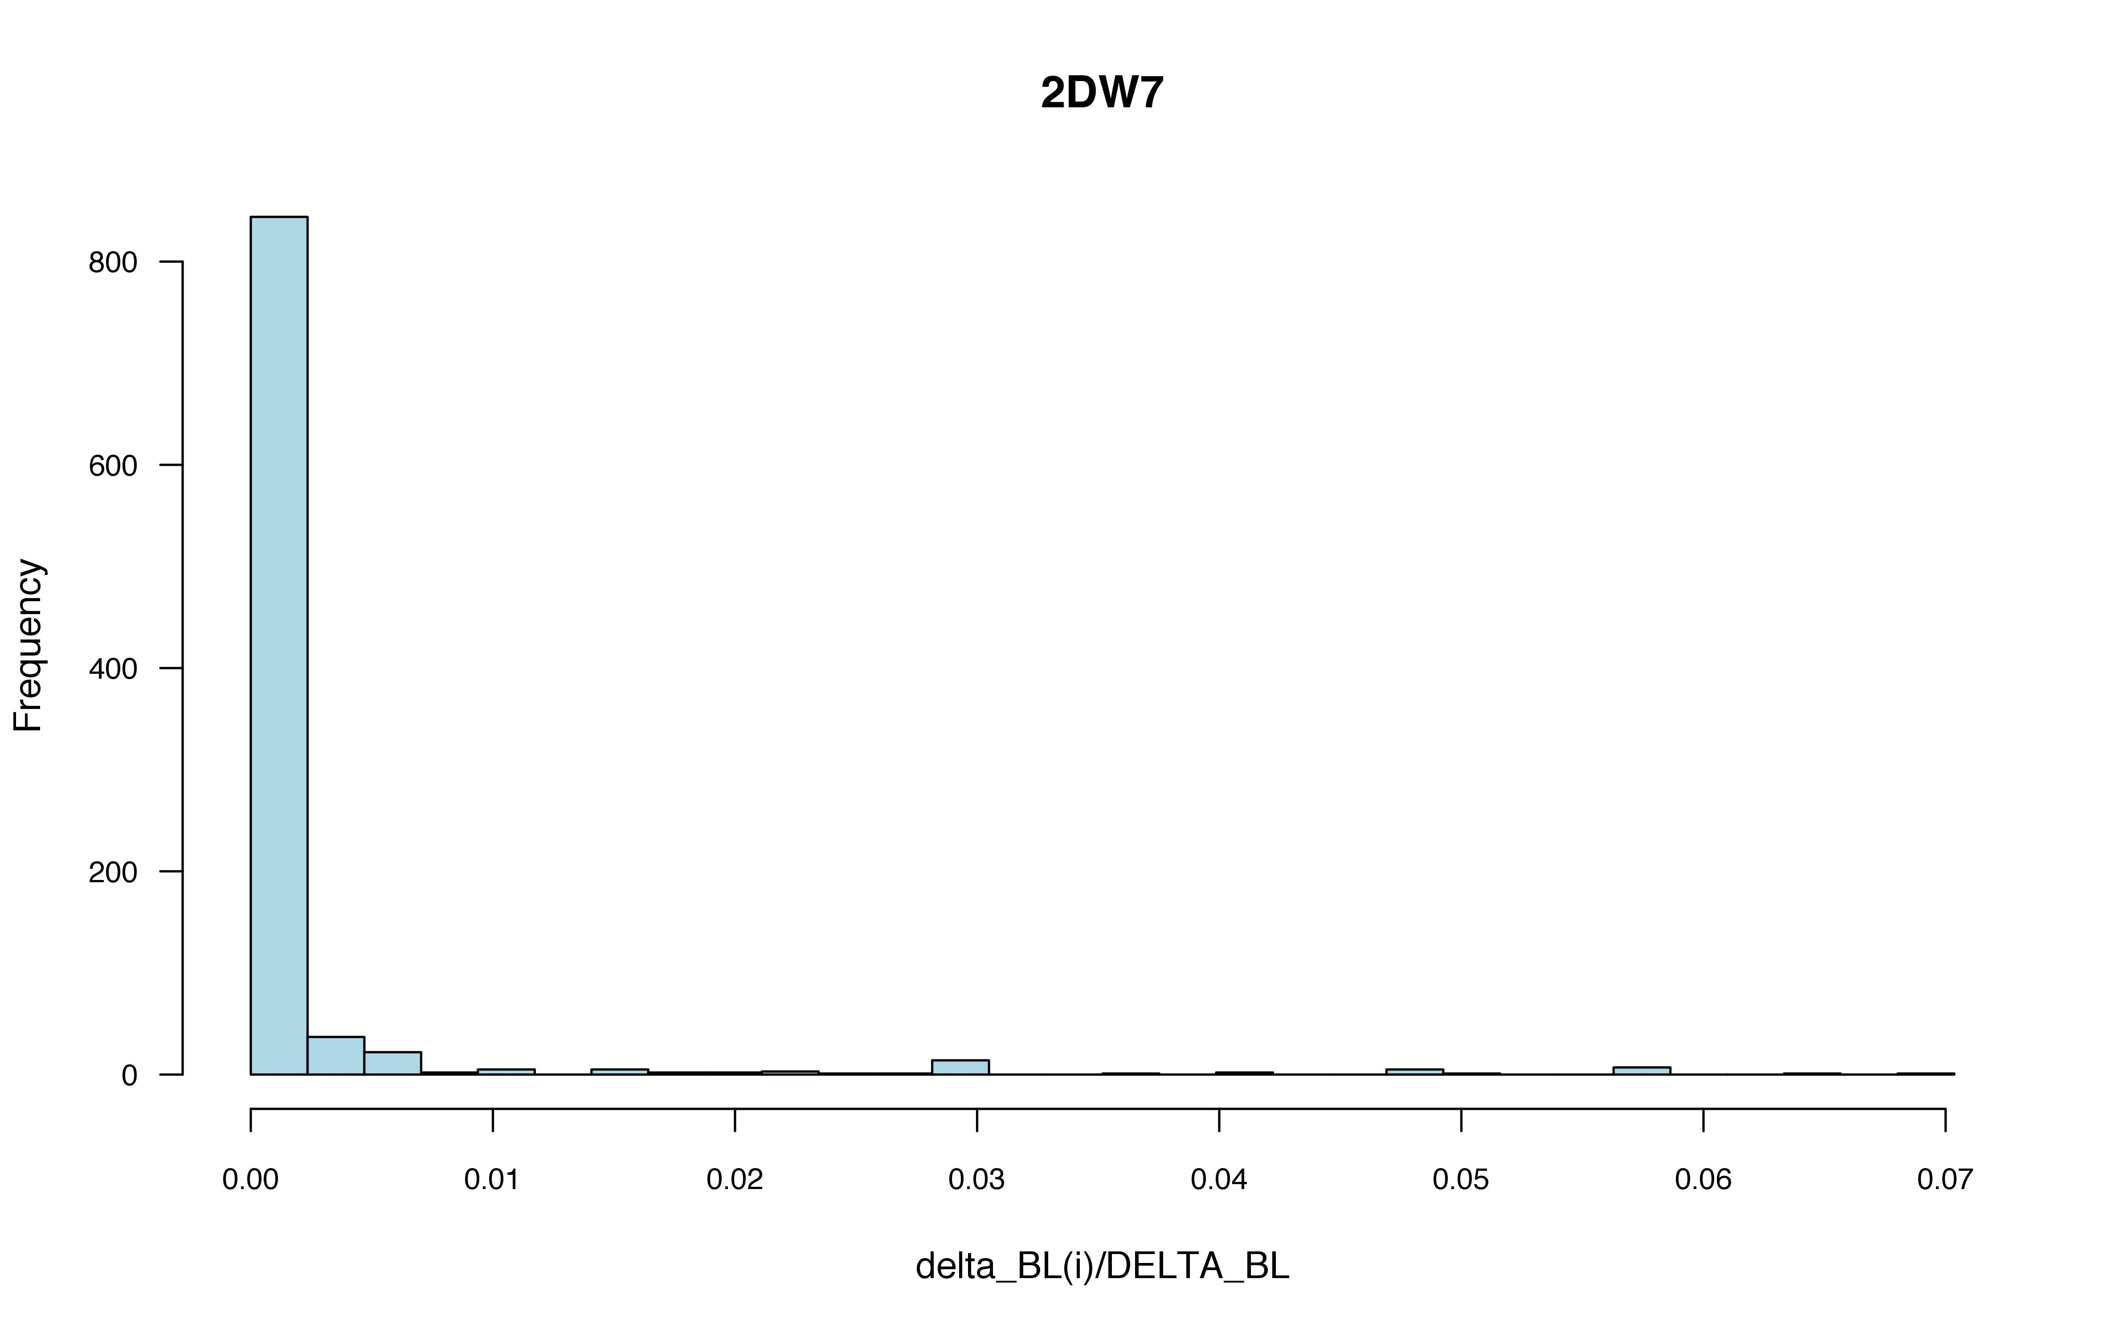

Slide 11
