Slide 1
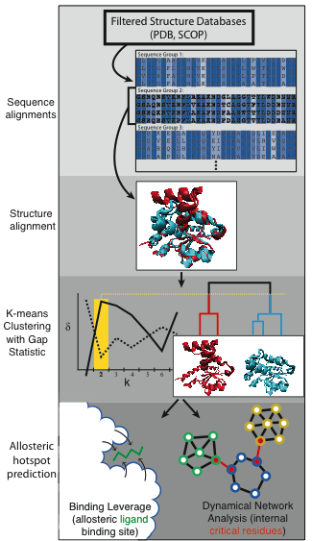
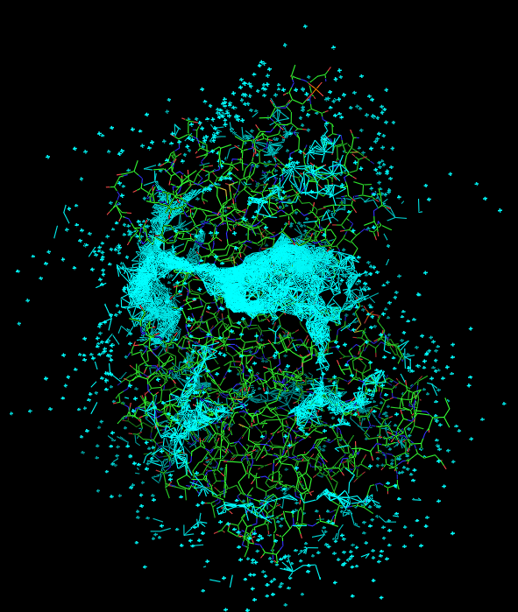

Slide 2
In reality, each protein is likely to have only a small number of surface patches that can truly function as allosteric leverage points by modulating large-scale conformational changes (whether these sites are used biologically or simply constitute ‘latent’ allosteric sites).
Objective (for end user and for downstream analyses): For each protein, provide these surface-exposed “allosteric hotspots” in the form of lists of residues.
Site 1 residues: 61_B 57_A 227_A 225_B 229_A 235_A 228_A 230_A 223_B 261_B
Site 2 residues: 219_A 220_A 61_A 225_A 400_A 229_C 228_C 268_A 223_A 401_A
Site 3 residues: 191_C 132_B 133_B 197_C 194_C 135_B 193_C 195_C 196_C 215_C

Slide 3
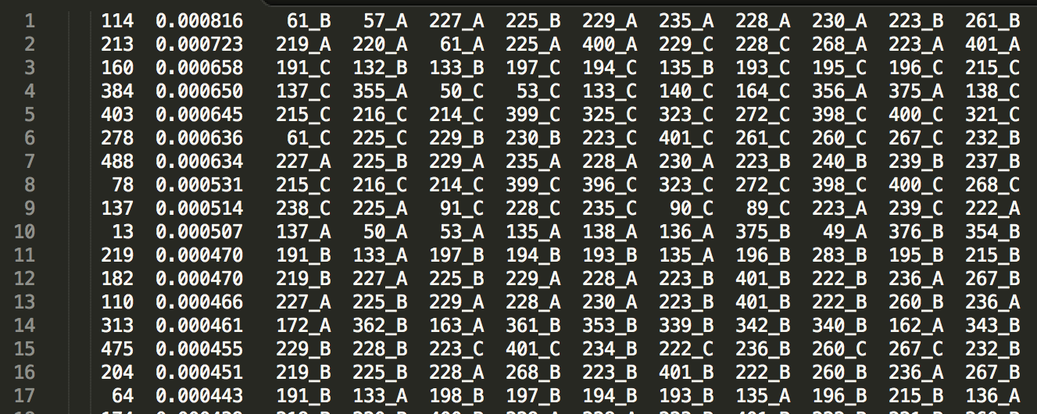
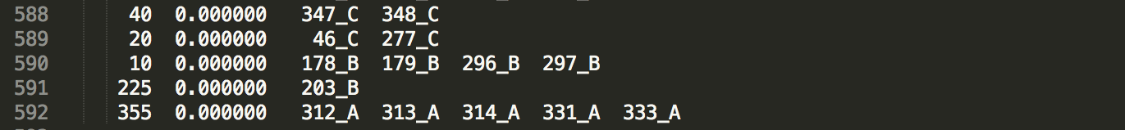
.
.
.

Slide 4
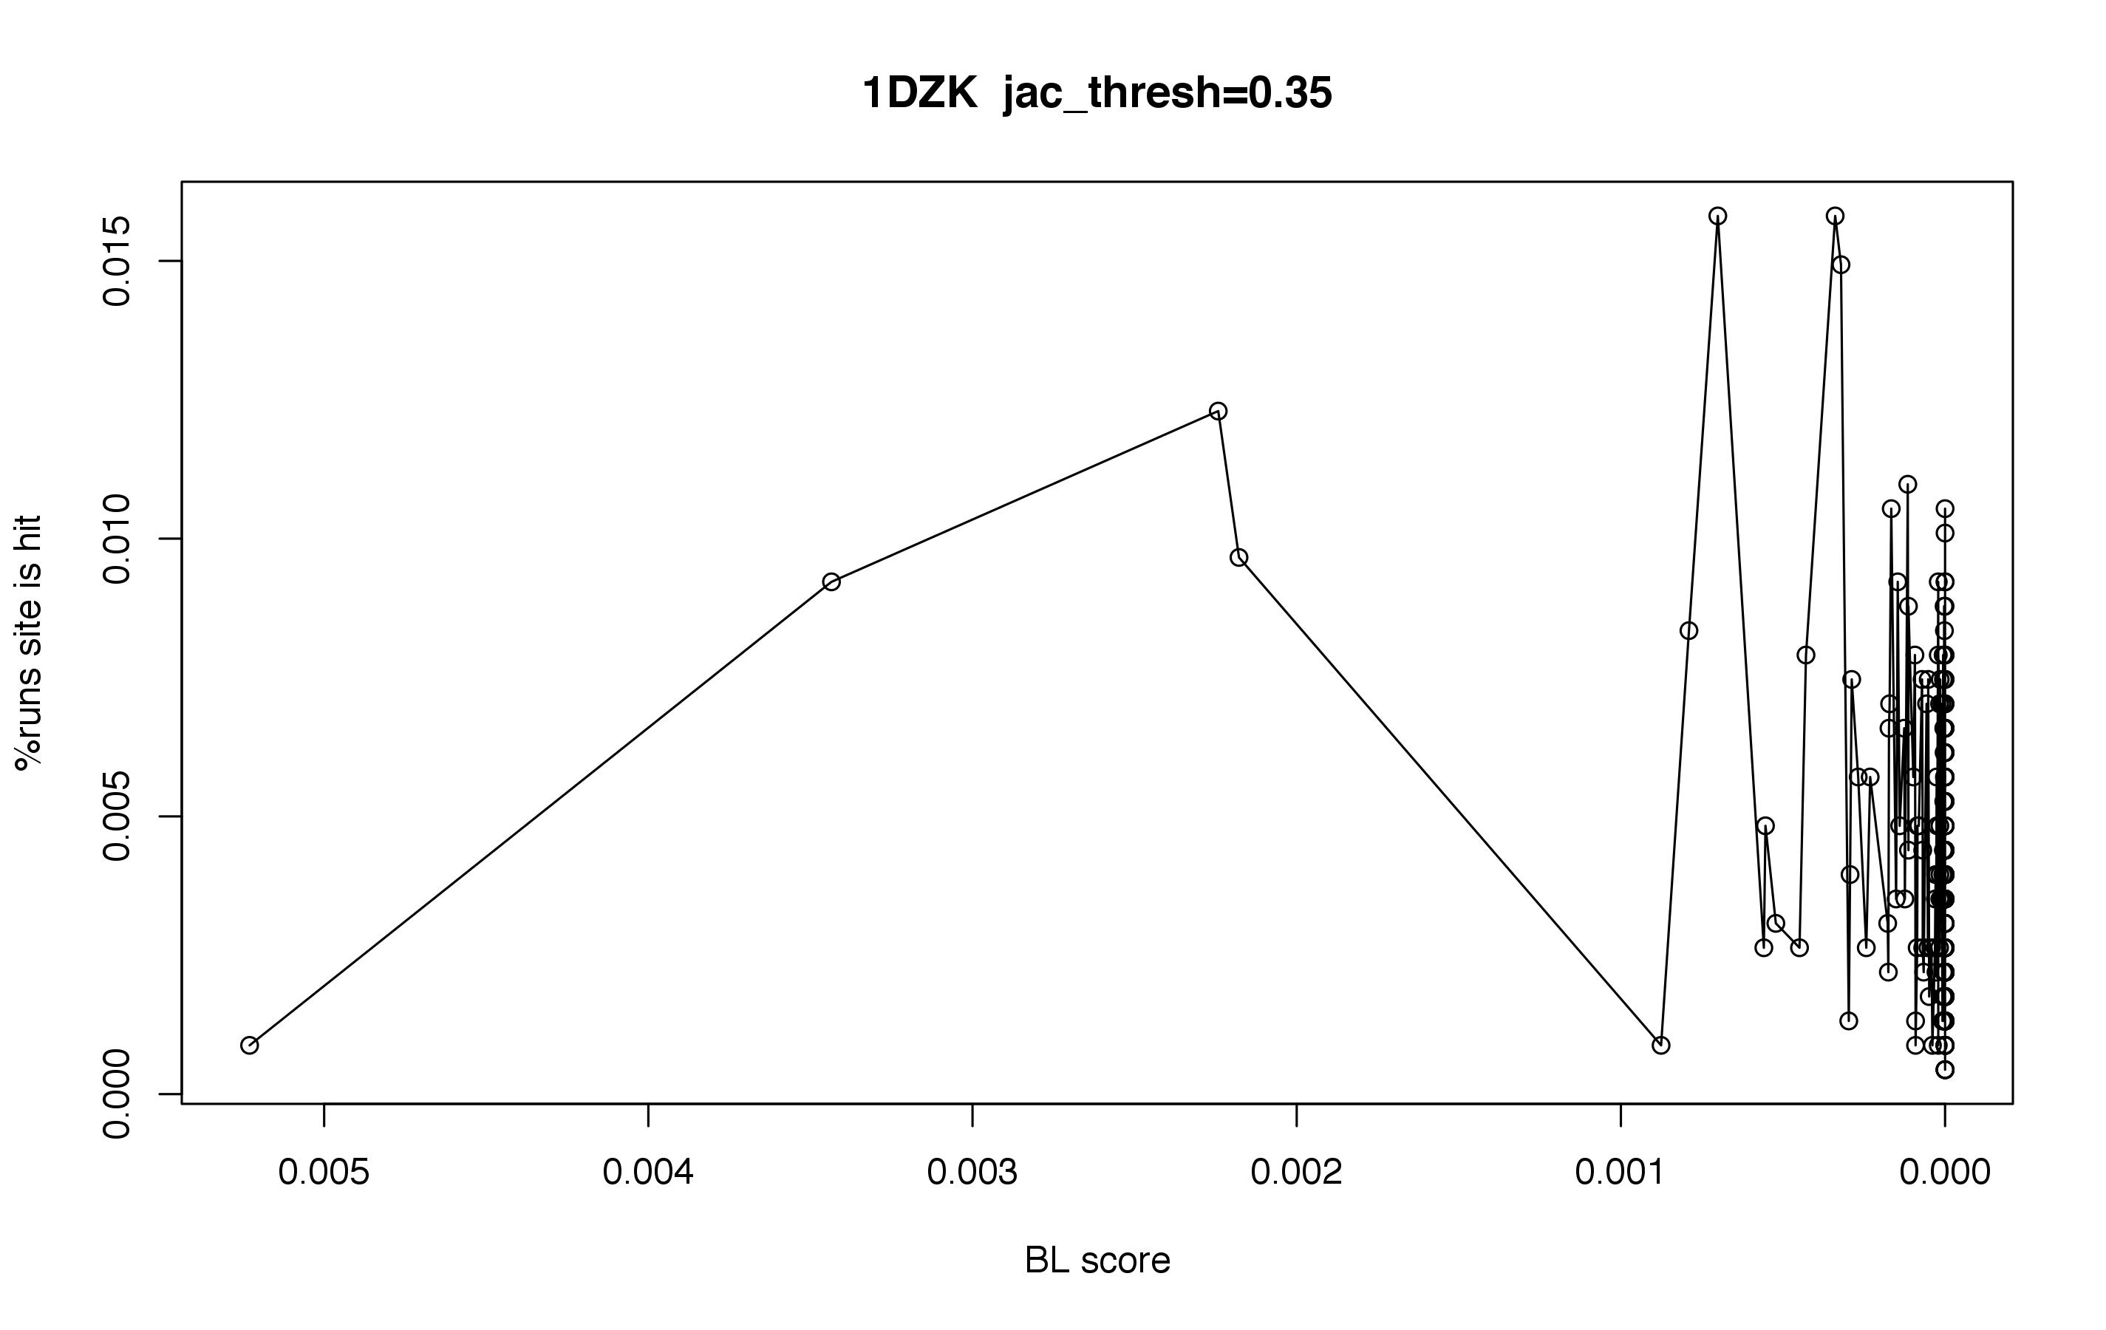
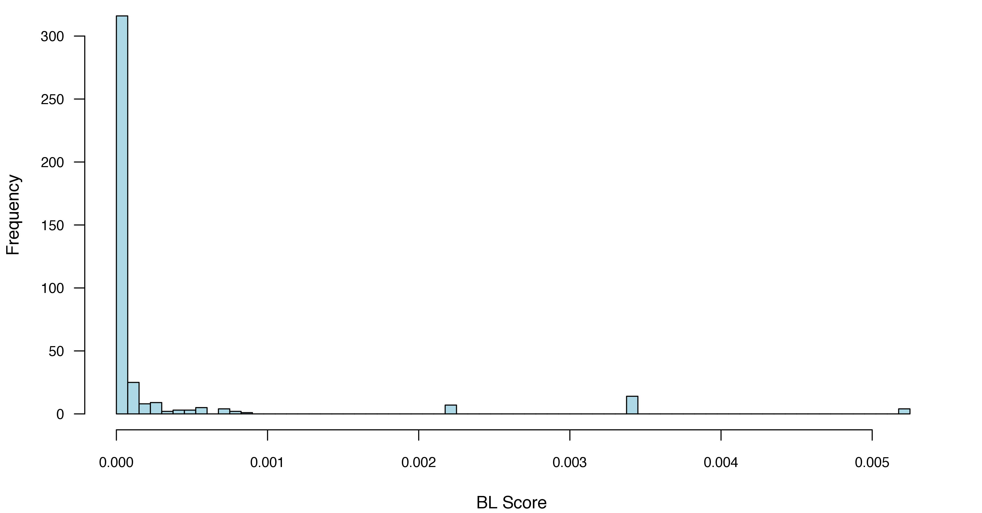

Slide 5
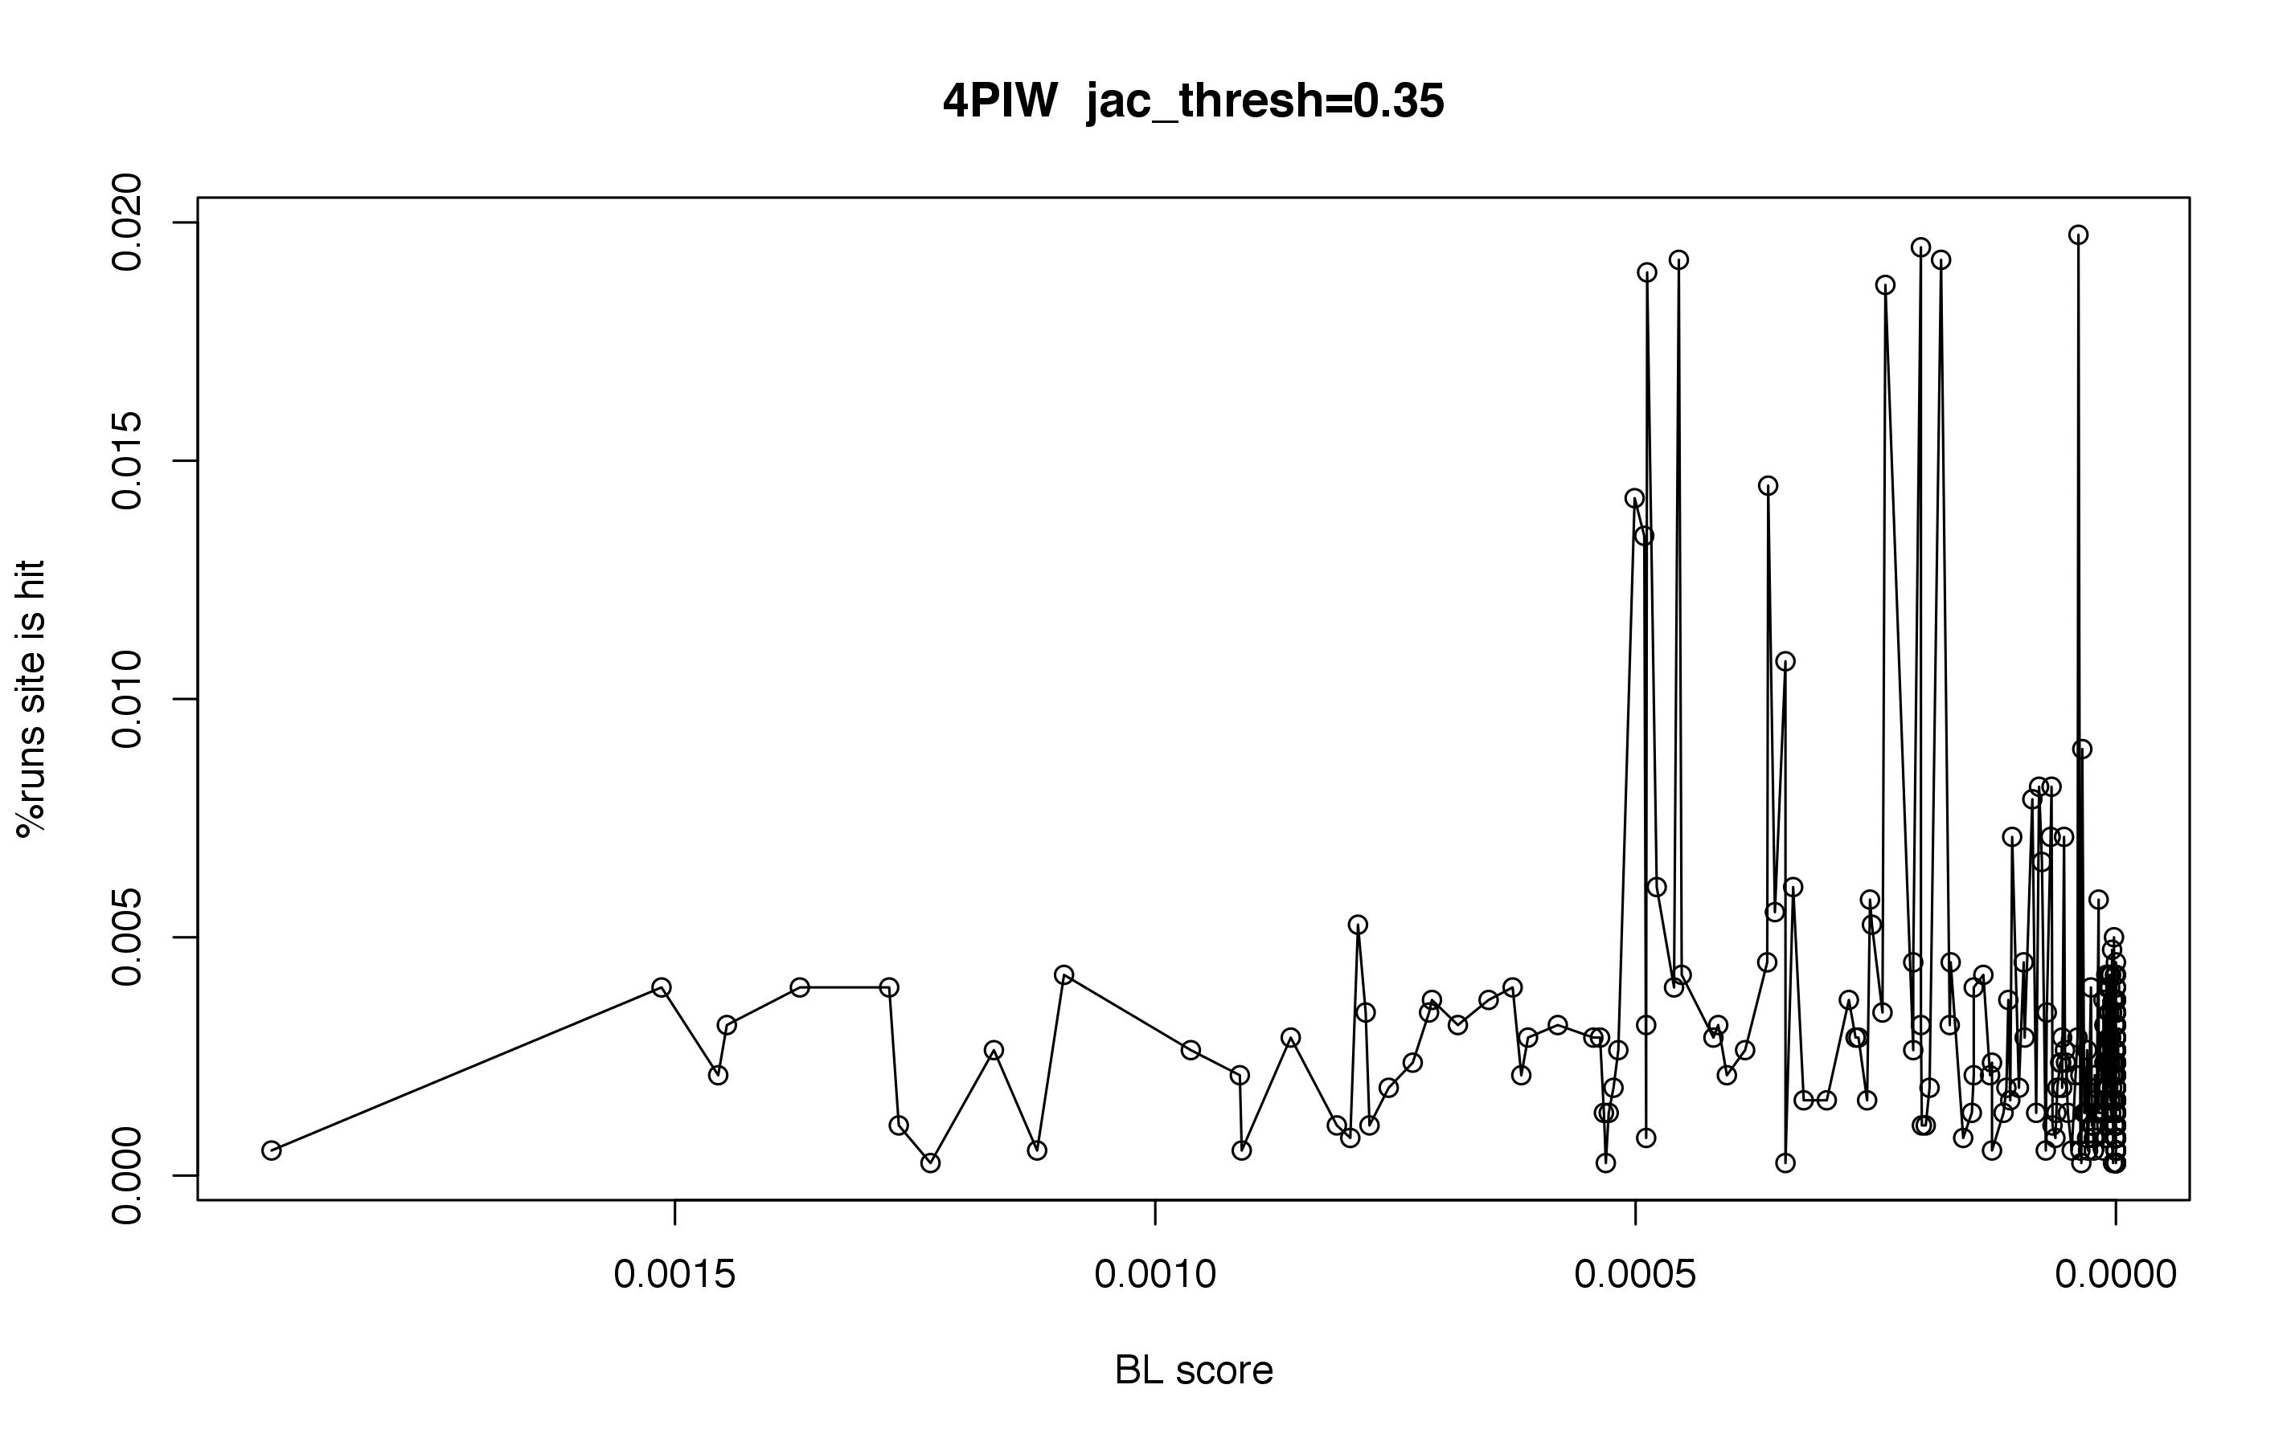
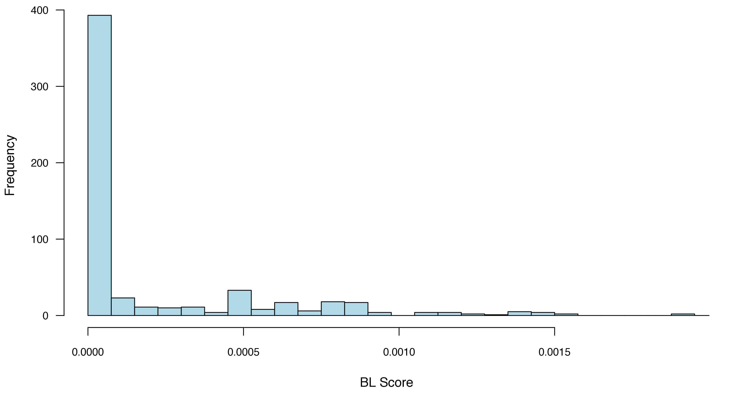

Slide 6
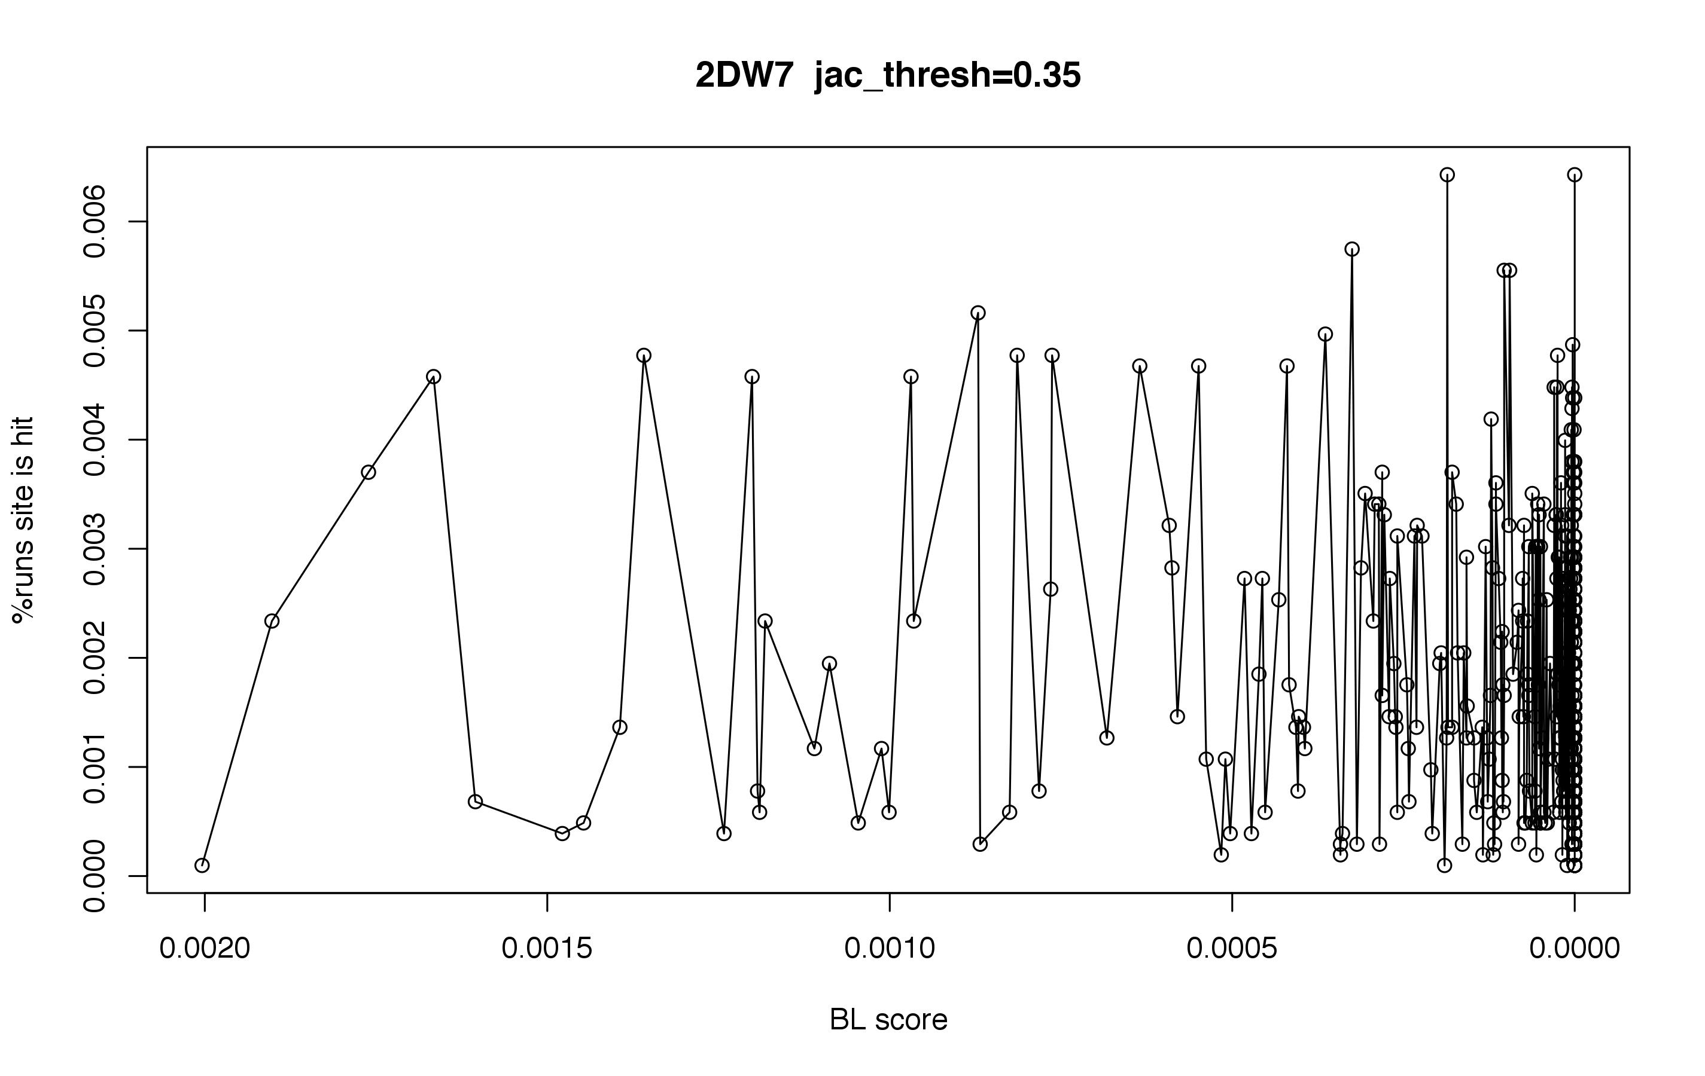
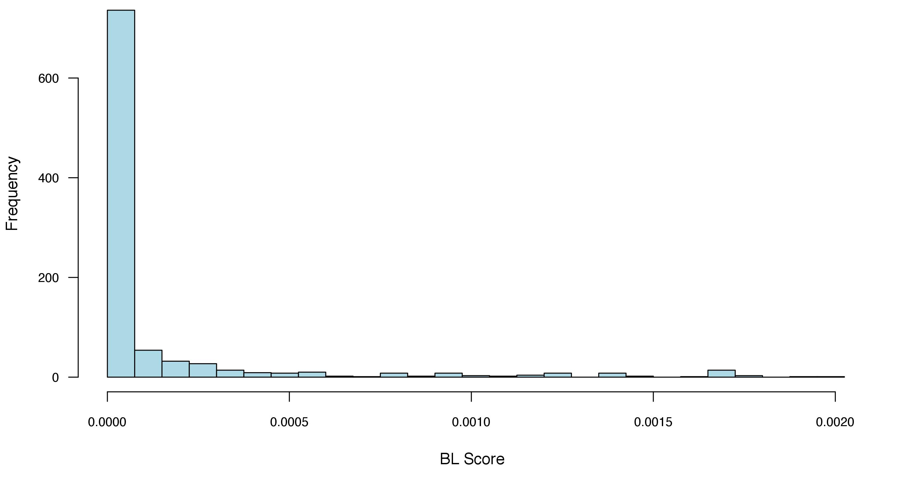

Slide 7
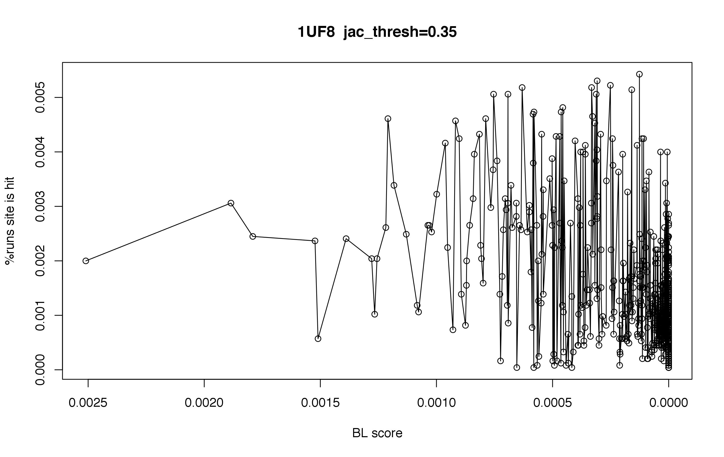
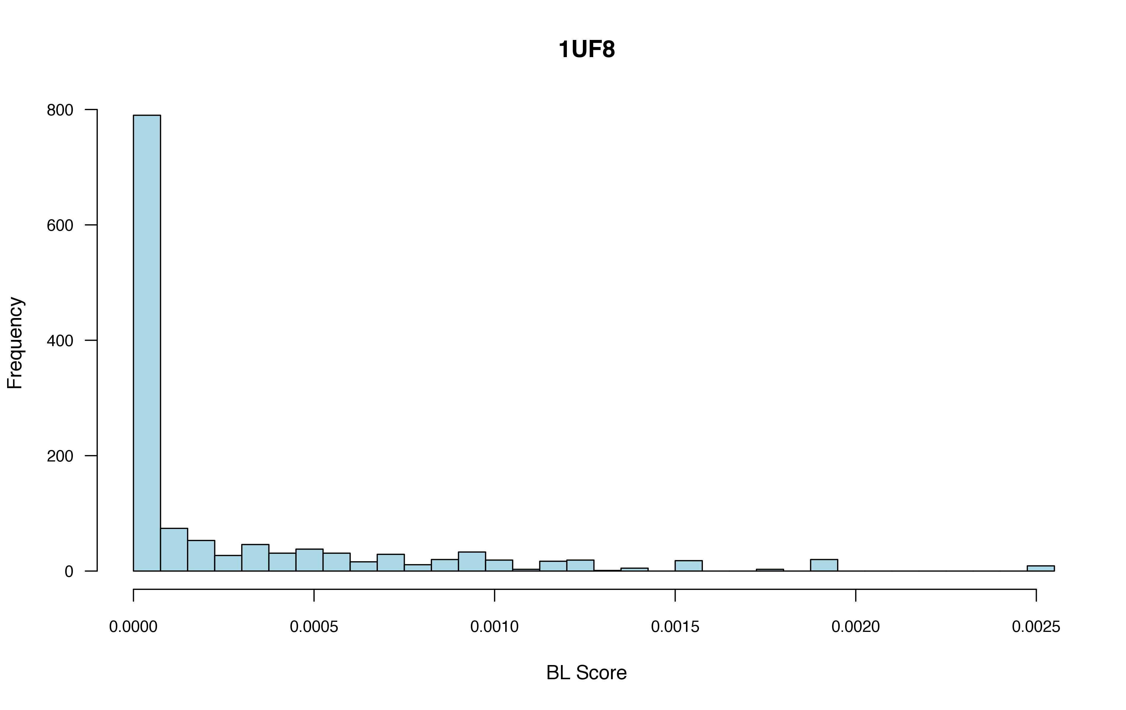

Slide 8
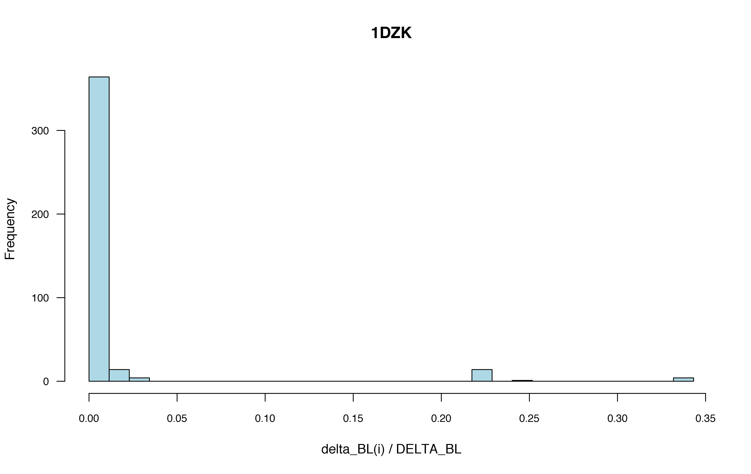

Slide 9
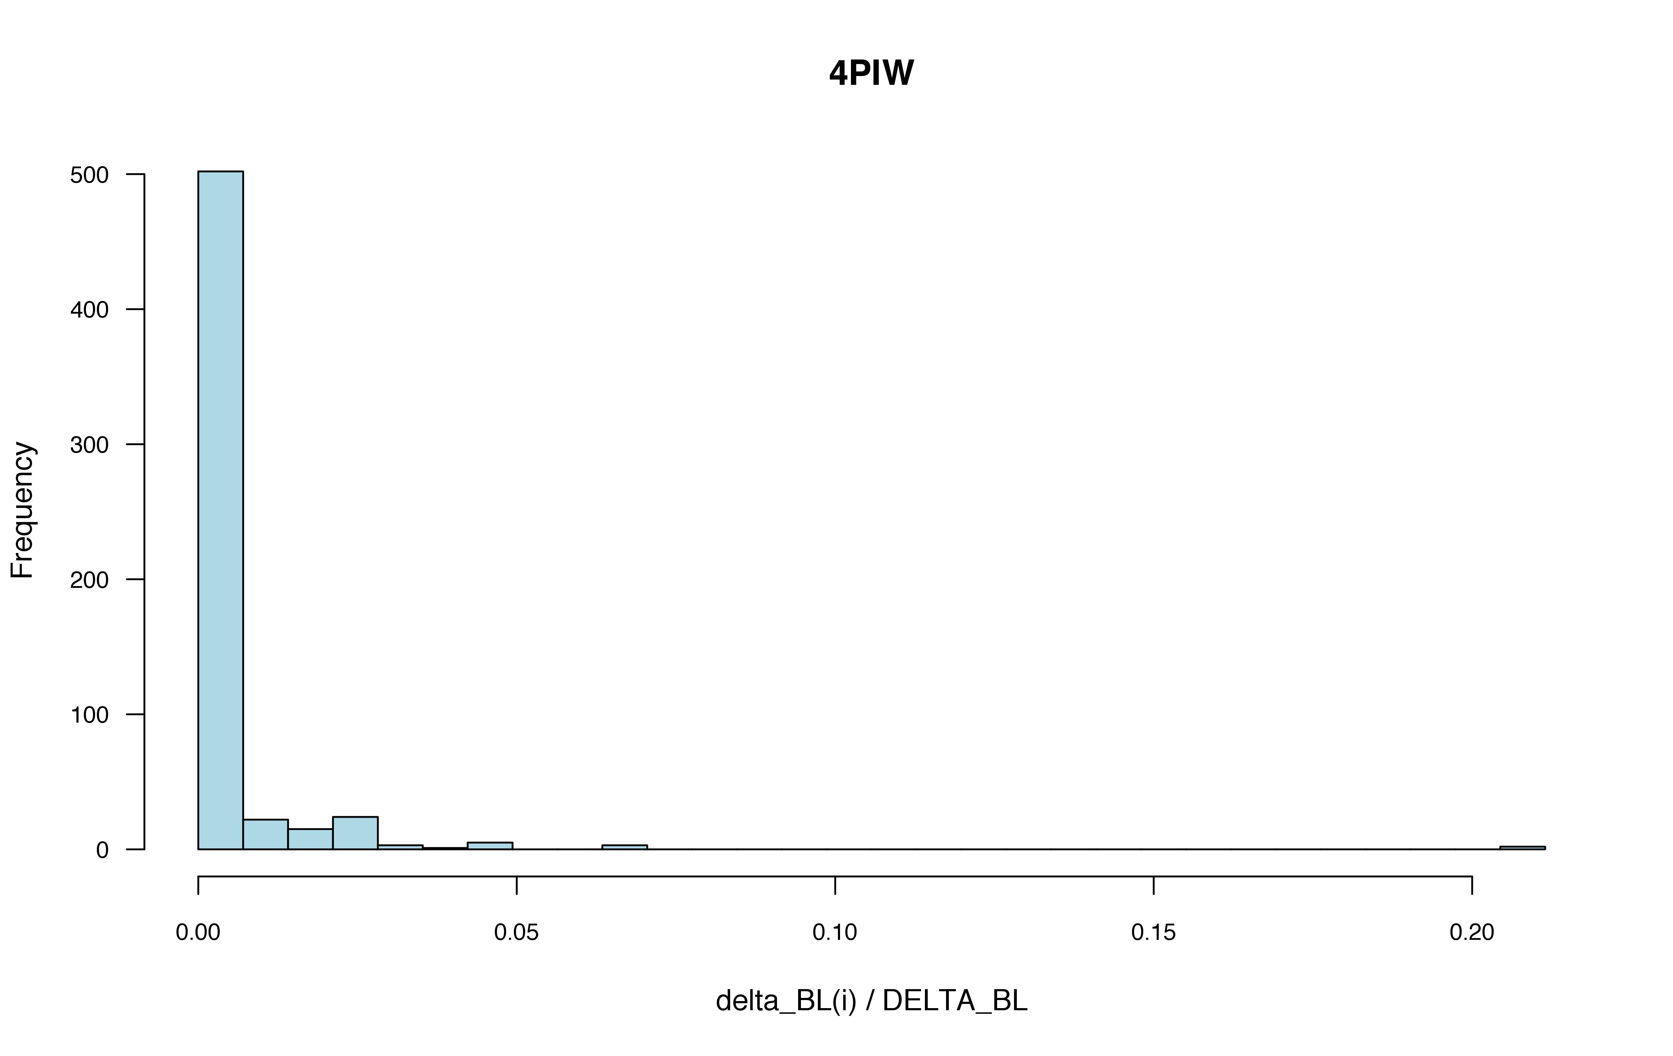

Slide 10
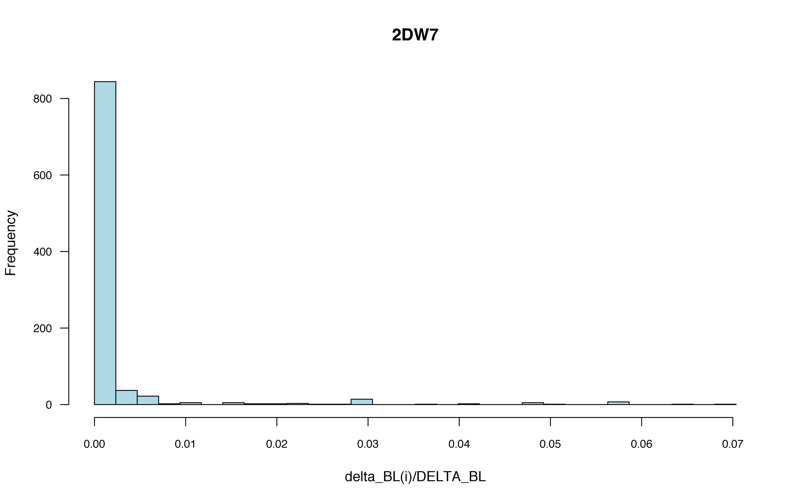

Slide 11
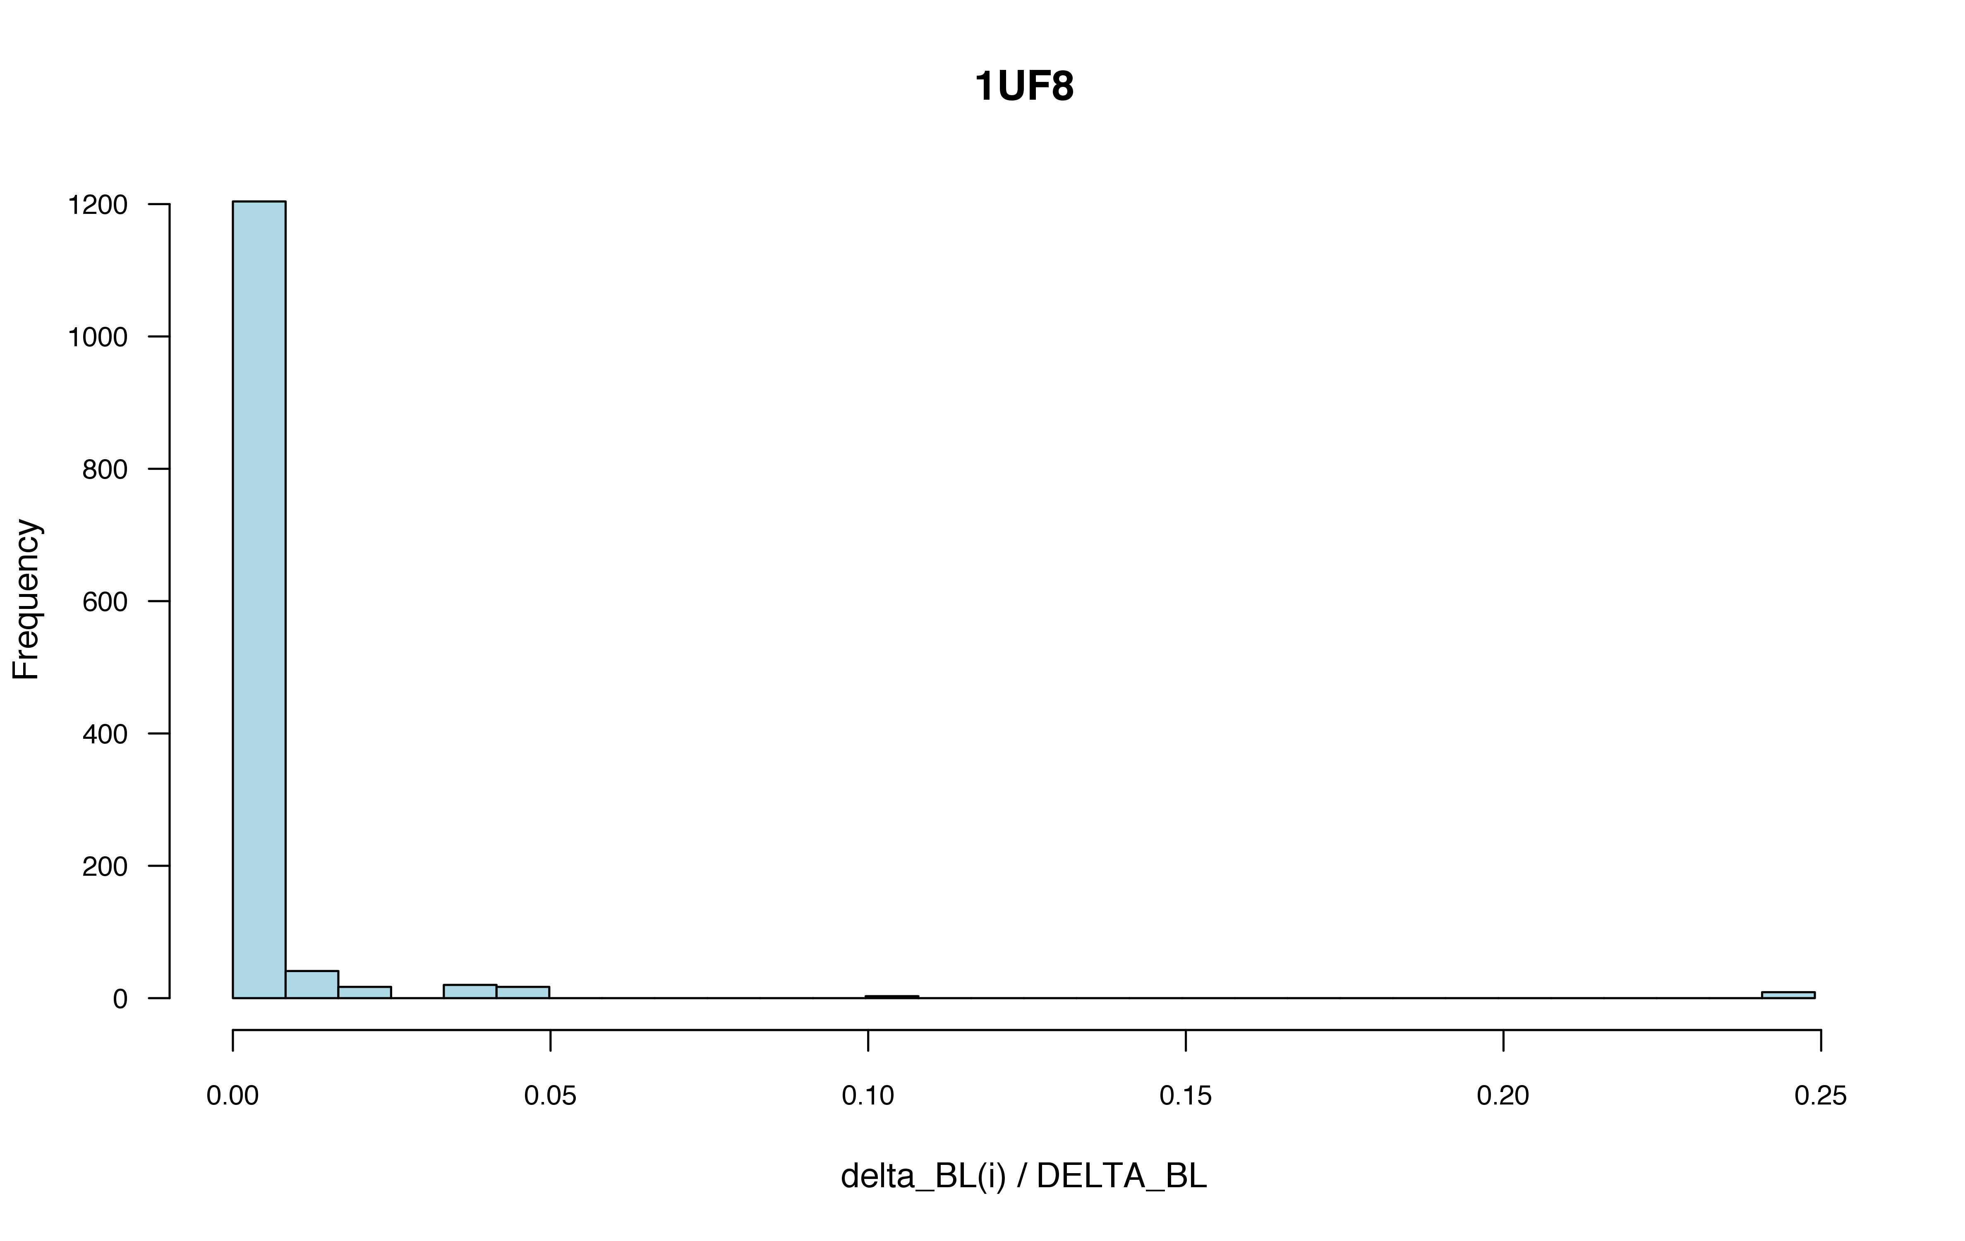

Slide 12
Binding Sites Summary from Gap Theory Calculations
Num Proteins w/1 binding site: 135
Num Proteins w/2 binding sites: 69
Num Proteins w/3 binding sites: 32
Num Proteins w/4 binding sites: 22
Num Proteins w/5 binding sites: 7
Num Proteins w/6 binding sites: 6
Num Proteins w/7 binding sites: 1
Num Proteins w/8 binding sites: 0
Num Proteins w/9 binding sites: 1

Slide 13
GO enrichment analyses
Term Back_frequency Sample_frequency P-value
single-organism metabolic process 4495 165 5.896e+01 + 9.514e-40
biological regulation 10349 242 1.357e+02 + 3.001e-36
organic substance metabolic process 8800 222 1.154e+02 + 8.228e-35
primary metabolic process 8544 214 1.121e+02 + 1.518e-31
pos reg. of bio. process 4686 156 6.147e+01 + 2.629e-31
regulation of immune system process 1142 73 1.498e+01 + 5.770e-27
regulation of metabolic process 6113 167 8.018e+01 + 6.334e-24
regulation of cell communication 2692 104 3.531e+01 + 1.628e-22
neg. regulation of bio. process 3932 128 5.158e+01 + 1.714e-22
response to chemical 3514 120 4.609e+01 + 2.370e-22
signal transduction 4427 136 5.807e+01 + 4.861e-22
regulation of cell death 1382 73 1.813e+01 + 5.579e-22
reg. of cellular metabolic process 5677 156 7.446e+01 + 1.224e-21
regulation of signal transduction 2398 96 3.145e+01 + 2.040e-21
reg. protein modification process 1255 68 1.646e+01 + 8.266e-21

