Slide 1
How to avoid plagiarism

Slide 2
Overview
What is plagiarism
Plagiarism for computer codes
Why avoiding plagiarism
Forms of plagiarism
Ways to avoid plagiarism
Quoting
Paraphrasing
How to avoid plagiarism

Slide 3
What is plagiarism?
Broadly defined, using another’s work without giving them clear credit.
One of the three cardinal sins of scientific misconduct
“The failure, whether intentional or not, to cite one's sources properly is referred to as plagiarism.“
From Yale Graduate School Website
http://tilt.library.skagit.edu/module4/plagiarism.htm

Slide 4
Plagiarism for computer codes
Before we discuss plagiarism we have to consider copyright and patent:
Copyright (the law that stands behind the open source license):
Doesn't prohibit all plagiarism
Allow for fair use of copyrighted stuff: excluding some things and some parts of software code from copyright protection.
For some computer codes it's not even legal to copy them with proper acknowledge:
I.e. you can't copy a routine of windows and just it -- it's illegal.
However, for licenses common academic settings it's ok to copy, i.e. open source
Information from Dr. Dov Greenbaum;

Slide 5
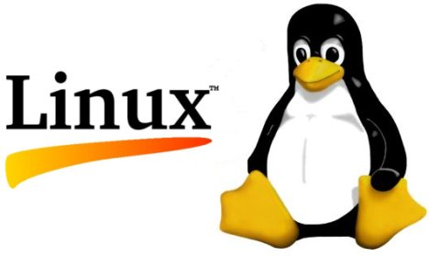
Plagiarism for computer codes: Open source
Open source:
Open Source copying:
It’s allowed, but sometimes:
If you want to commercialize
If it’s protected by patent law
philosophy or pragmatic methodology that promotes free redistribution and access to an end product's design and implementation details
Information from Dr. Dov Greenbaum;
More information: http://en.wikipedia.org/wiki/Open_source;

Slide 6
Open source
Open-source license:
Commonly free
Allowing for modification, redistribution, and commercial use without having to pay the original author.
Different restrictions: permit modification of the source code for personal use or only permit non-commercial redistribution
Examples:
GNU General Public License GPL
BSD
Mozilla Public License
…
Properly cite:
name of the authors
a copyright statement
Information from Dr. Dov Greenbaum;
More information:http://en.wikipedia.org/wiki/Open-source_license; http://www.opensource.org/licenses/alphabetical;
http://en.wikipedia.org/wiki/Comparison_of_free_software_licenses

Slide 7
Why we have to avoid plagiarism?
Moral and intellectual reasons:
No respect for others
need to know how to express things in your own voice
Penalties:
In Yale: two semesters of suspension, even up to expulsion from the University
Yale College Undergraduate Regulations: Cheating, Plagiarism, and Documentation. http://yalecollege.yale.edu/content/cheating-plagiarism-and-documentation

Slide 8
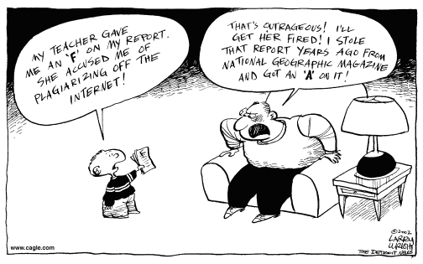
The internet has really changed the context things
http://www.eclectic-eccentric.com/2010/04/sunday-salon-plagiarism-or-creativity.html

Slide 9
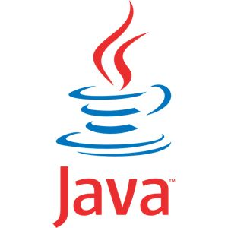
Forms of plagiarism
Using words from a source without citation
Copying and pasting text from online encyclopedias
Quoting a source without using quotation marks-even if it is cited. “...”
Transcribing text from any printed material, such as books, magazines or newspapers.
Copying source code from Internet
Yale Writing Center; Mirka, 2004, The Plagiarism Trap. Powerpoint Presentation

Slide 10
Using information from a source without attribution
Using photographs, video or audio without permission or acknowledgement
Quoting statistics without naming the source ­ unless you gathered the data yourself
Handing in course papers or other work that are purchased from commercial sources as your own
Using another student’s or your parents’ work and claiming it as your own even with permission
Yale Writing Center; Mirka, 2004, The Plagiarism Trap. Powerpoint Presentation
http://plagiarism.umf.maine.edu/quick-tips-for-avoiding-plagiarism/

Slide 11
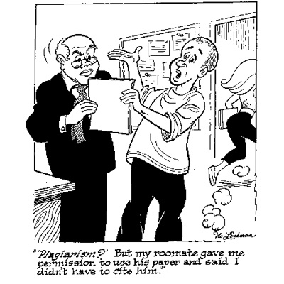
Plagiarism?
http://www.pyrczak.com/antiplagiarism/cartoons.htm

Slide 12
Paraphrasing a source in a form that stays too close to the original (even if it’s cited).
Source
Words
Your
Words

Slide 13
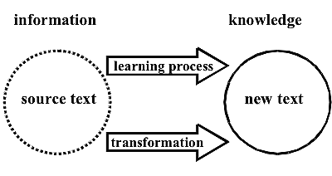
Ways to avoid plagiarism
Paraphrasing
Quoting
“ ”
Reference
[Writing from sources: Avoiding the P word, Jdawson et al
http://lsn.curtin.edu.au/tlf/tlf2008/refereed/dawson.html]

Slide 14
How to paraphrase
Restate a source’s idea in your own words
Distinguish your voice from the source’s
Wrong: blur the line between the writer’s voice and the source idea, alters the original without changing its form or content, retains long phrases verbatim from the original
Right: mark the boundaries between your own voice and the source’s voice, puts the source’s idea to work in service of your own argument.
Yale Writing Center, how to generate fair paraphrase: http://writing.yalecollege.yale.edu/fair-paraphrase.

Slide 15
Example of Paraphrasing I
Original Source Material:
Source:
“The protein-protein interaction network is susceptible to targeted attacks on the hubs of the network. Since hub proteins are pivotal for the robustness of the protein-protein network, it is conceivable that the S. cerevisiae genome may contain more genetically redundant duplicates of the hubs compared to other proteins. On the other hand, gene duplications may cause an imbalance in the concentration of the components of protein-protein complexes that might be deleterious. The first mechanism predicts that the hubs should have a higher fraction of paralogs than other proteins. In contrast, the latter mechanism, which is sometimes referred to as dosage sensitivity, predicts the opposite.”
Ekman D, Light S, Björklund AK, Elofsson A. (2006) What properties characterize the hub proteins of the protein-protein interaction network of Saccharomyces cerevisiae? Genome Biol. 2006;7(6):R45

Slide 16
Example of Paraphrasing I(Cont.)
Explanation:
This example has been plagiarized. The student has only moved the original author's words around, inserting and deleting small portions as needed. The student has not used quotation marks for the portions that are still identical to the original, and has not credited the original author.
Plagiarized Version
Hub proteins should have a higher fraction of paralogs than other proteins since hubs are crucial to the robustness of the protein-protein interaction network and S. cerevisiae genome may contain more genetically redundant duplicates. In contrast, dosage sensitivity refered to an imbalance in the concentration of the components of protein-protein complexes caused by gene duplications predicts the opposite.
Reference:
Ekman D, Light S, Björklund AK, Elofsson A. (2006) What properties characterize the hub proteins of the protein-protein interaction network of Saccharomyces cerevisiae? Genome Biol. 2006;7(6):R45
VS
Original source
“The protein-protein interaction network is susceptible to targeted attacks on the hubs of the network. Since hub proteins are pivotal for the robustness of the protein-protein network, it is conceivable that the S. cerevisiae genome may contain more genetically redundant duplicates of the hubs compared to other proteins. On the other hand, gene duplications may cause an imbalance in the concentration of the components of protein-protein complexes that might be deleterious. The first mechanism predicts that the hubs should have a higher fraction of paralogs than other proteins. In contrast, the latter mechanism, which is sometimes referred to as dosage sensitivity, predicts the opposite.”

Slide 17
Example of Paraphrasing I(Cont.)
Correct Version
According to Ekman D et al (2006), two mechanisms give opposite predictions on the amount of hub proteins’ paralogs. Given the importance of hubs in network robustness, a higher duplicability of hub proteins in the S. cerevisiae genome is expected while dosage sensitivity indicates the contrary conclusion since higher duplications of gene may break the balance of interaction complexes which is considered harmful.
Reference:
Ekman D, Light S, Björklund AK, Elofsson A. (2006) What properties characterize the hub proteins of the protein-protein interaction network of Saccharomyces cerevisiae? Genome Biol. 2006;7(6):R45
Explanation:
This example has been paraphrased and is not considered plagiarized. The student credits the original author at the beginning of the paraphrased passage and again at the end to indicate that the ideas continue to be drawn from this author's work.

Slide 18
Open source code
Now given we're focused on open source then
What is practical definition of plagiarism for computer codes ?
Currently, this is under discussion and there's no hard answer. However, you know when you see it .
Here‘s some practical guidelines : “The following guidelines are provided to help in determining if an incident of copying or plagiarism has occurred. · The lecturer may suspect a student of program plagiarism if the student submits a program that is so similar to the program submitted by a present or past student, in whole or in part, in the course that the solutions may be converted to one another by a simple mechanical transformation.”
from Policy on Copying and Plagiarism of Computer Program Submissions, University of Cape Town
http://www.cs.uct.ac.za/teaching/forms/Department%20Plagiarism%20Policy.pdf

Slide 19
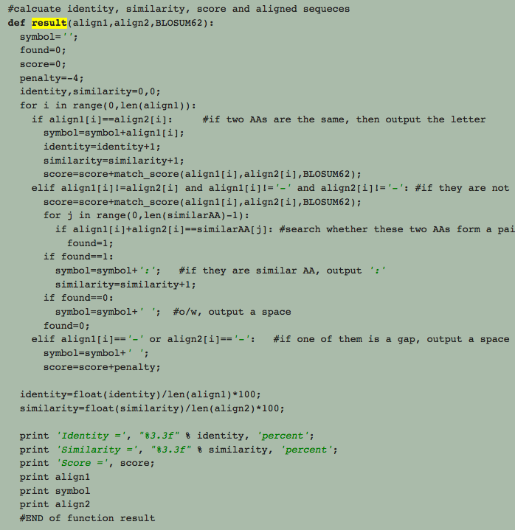
Example II—source code
Next, we'll give you some practical examples of know it when you see it.
Smith-Waterman Algorithm in Python , Source code from:
http://forrestbao.blogspot.com/2007/09/smith-waterman-algorithm-in-process.html

Slide 20
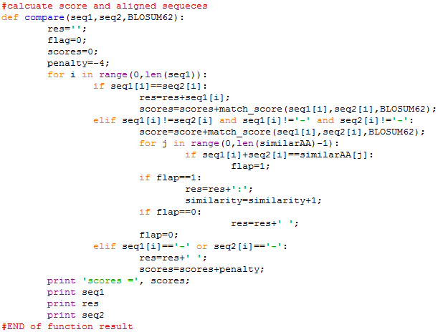
Example II—source code(Cont.)
Original Source
Plagiarism Version
Explanation:
This example has been plagiarized. The student has only changed variable names, function names and deleted comments and some lines.

Slide 21
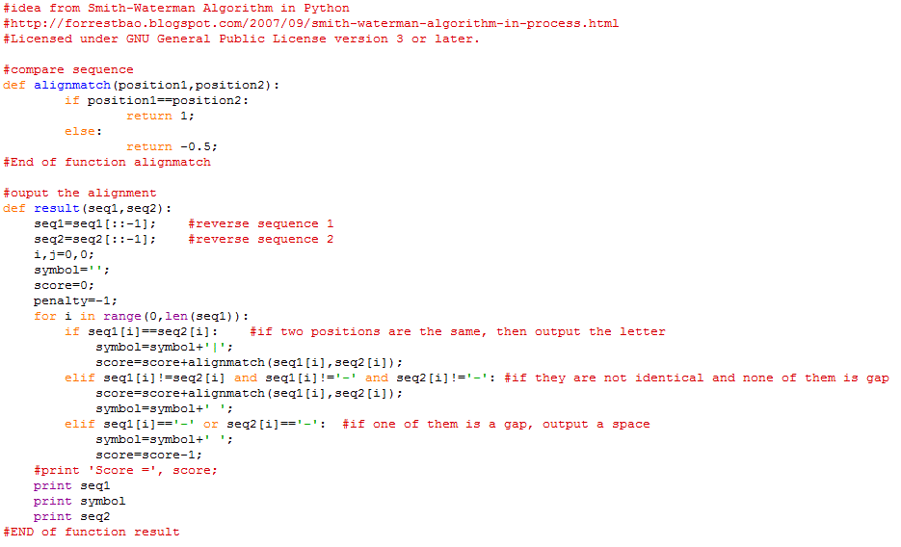
Example II—source code(Cont.)
Correct Version
Explanation:
This example has been paraphrased and is not considered plagiarized. The student has cited the original source code and paraphrased the code in his own way according to his purpose.

Slide 22
When you MUST cite
When you quote two or more words verbatim, or even one word if it is used in a way that is unique to the source.
No need to cite common words, eg:
“sequence alignment” or “network motif”
New Concept/ Applying to new topic,eg:
“kinesthetic self-concept”
When you introduce facts that you have found in a source.
Facts found in a particular or unusual context should be cited
When you paraphrase or summarize ideas, interpretations, or conclusions that you find in a source.
“ ”
Cite
Quote from Yale Writing Center: http://writing.yalecollege.yale.edu/warning-when-you-must-cite

Slide 23
When you MUST cite
When you introduce information that is not common knowledge or that may be considered common knowledge in your field, but the reader may not know it.
Common Knowledge
Quote from Yale Writing Center: http://writing.yalecollege.yale.edu/warning-when-you-must-cite

Slide 24
Trick about “common knowledge”
knowledge that most educated people know or can find out easily in an encyclopedia or dictionary. Therefore, it doesn’t need to be cited.
Common knowledge that is deep into one field might be not known by outsiders.
What has been said in the class or repeated in textbooks and other sources.
Check with a professor or TF
Quote from Yale Writing Center: http://writing.yalecollege.yale.edu/common-knowledge

Slide 25
When you MUST cite
When you borrow the plan or structure of a larger section of a source’s argument.
When you build on another’s method found either in a source or from collaborative work in a lab.
When you build on another’s program in writing computer code or on a not-commonly-known algorithm.
When you collaborate with others in producing knowledge.
Quote from Yale Writing Center: http://writing.yalecollege.yale.edu/warning-when-you-must-cite

Slide 26
How to avoid plagiarism
Advice from Prof. Carol Jacobs:
You need to cite all sources used for papers, including drafts of papers, and repeat the reference each time you use the source in your written work.
You need to place quotation marks around any cited or cut-and-pasted materials, IN ADDITION to footnoting or otherwise marking the source.
If you do not quote directly – that is, if you paraphrase – you still need to mark your source each time you use borrowed material. Otherwise you have plagiarized.
It is also advisable that you list all sources consulted for the draft or paper in the closing materials, such as a bibliography or roster of sources consulted.

Slide 27
How to avoid plagiarism
Tips:
Use your own words and ideas!
Take very good notes:
write down the source as you are taking notes. Do not wait until later to try and retrieve the original source
Consider using tools to help organize your research and keep your information in one place, like
Cite your sources while you write your rough draft.
Mirka, 2004, The Plagiarism Trap. Powerpoint Presentation; UCSD, How to avoid plagiarism brochure, 2009

Slide 28
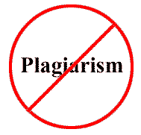
The most important thing:
Pay attention to it and take it seriously!

