Slide 1
Genetic Association Analysis
--- impact of NGS

Slide 2
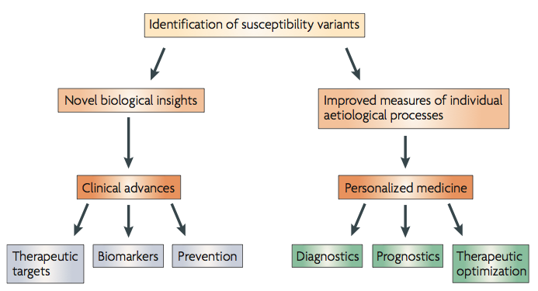
One fundamental goal of genetics studies is to identify genetic variants causing phenotypic variations
What does NGS have to offer?
Genome-wide association studies for complex traits: consensus, uncertainty and challenges.
M I McCarthy, G R Abecasis, et al. Nature Review Genetics, 2008
Notes:
More background of GWAS

Slide 3
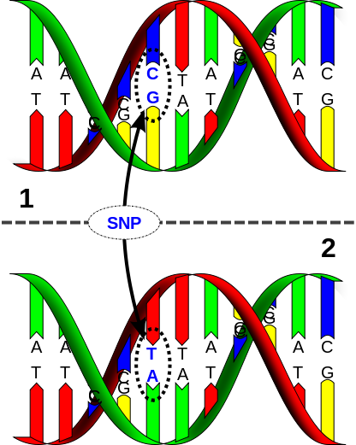
Before NGS, what do people do?
  Linkage analysis
  Genome-wide association studies
Genome-wide association studies (GWAS)
  SNP (single nucleotide polymorphism)
  Technology: Microarray
  Two major manufacturer:
  Illumina and Affymetrix
http://en.wikipedia.org/wiki/Single-nucleotide_polymorphism
Notes:
Define LD and common SNPs

Slide 4
Linkage Disequilibrium
Parent 1
Parent 2
A B
a b
A B
a b
X
A B
a b
A b
A b
A B
a b
OR
a B
A B
a b
A B
A b
a B
A b
A B
a b
A B
etc…
High LD -> No Recombination
(r² = 1) SNP1 “tags” SNP2
Low LD -> Recombination
Many possibilities
ASHG 2008 Hapmap Tutorial: http://hapmap.ncbi.nlm.nih.gov/tutorials.html.en

Slide 5

SNPs on microarrays are “tagging” SNPs (reduce cost!!!)
Selected based on linkage-disequilibrium structure
How do we know the LD structure?
The International HapMap Project
www.hapmap.org

Slide 6
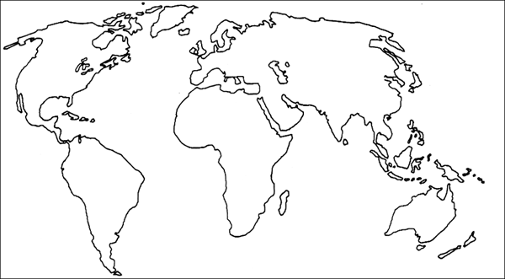
The International HapMap Project
Involved Illumina,
Affymetrix,
>20 institutions worldwide
HapMap1 (2003) and
Hapmap2 (2005)
- 4 populations (270 indiv):
CEU (NW European from Utah),
CHB (Han Chinese from Beijing),
JPT (Japanese from Tokyo),
YRI (Yoruban from Nigeria)
Hapmap3 (2010)
- 11 populations (4+7, 1301 indiv)

Slide 7
In GWAS, only common SNPs (generally, with minor allele frequency > 5%) are considered
  Only common SNPs can “tag” other common SNPs, and vice versa.
  The actual “causal” SNPs are usually not directly genotyped
With NGS, we can:
  Analyze rare variants
  Get much better (highest possible) resolution
But, are we there yet?
  What are the challenges of analyzing rare variants?
  What have we done?

Slide 8
Challenge #1: Very limited statistical power
A toy example:
Suppose we wish to test the association between a gene (with alleles A and B) and human height. We collected 100 individuals from the population
 | Scenario #1 |  | Scenario #2
 | Allele A | Allele B | Allele A | Allele B
# of indiv | 70 | 30 | 99 | 1
Avg height | 6’ | 6’1’’ | 6’ | 6’1’’
Equal effect size for the variants in the two scenarios
In which scenario, you are more inclined to believe the association?

Slide 9
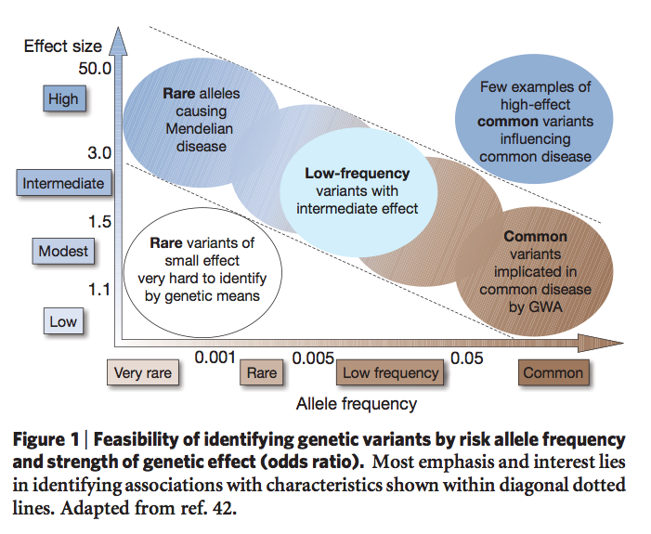
To maintain the same statistical power, a rare variant must have much larger effect size than a common variant.
Finding the missing heritability of complex diseases. T A Manolio, F S Collions, N J Cox, et al. Nature Reviews. 2009
Notes:
What is effect size?

Slide 10
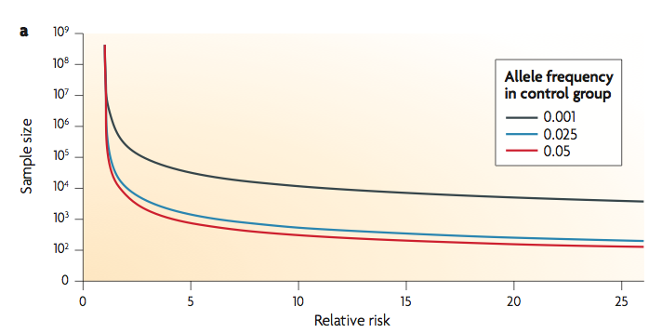
With the same effect size, rare variants need much larger sample size to be detected than common variants
Statistical analysis strategies for association studies involving rare variants. V Bansal, O Libiger, A Torkamani and N J Schork. Nature Reviews Genetics. 2010.

Slide 11
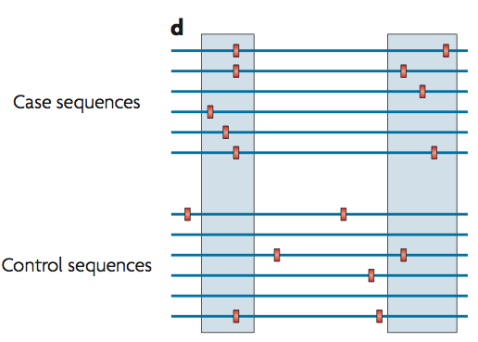
One strategy to deal with this problem is to create a “super-variant” by “collapsing” rare variants that belong to a functional unit (e.g. a gene)
Statistical analysis strategies for association studies involving rare variants. V Bansal, O Libiger, A Torkamani and N J Schork. Nature Reviews Genetics. 2010.

Slide 12
Collapsing methods:
  Burden tests
  Kernel-based tests

Slide 13
Sum tests
  CAST (cohort allelic sums test)
    Define a “super variant” X_{C} for each collapsing set C
    X_{C} = 1 if the individual carries any of the rare variants in the collapsing set
  CMC test (combined multivariate and collapsing test)
    Extension of CAST
    Including each common variant (without collapsing) and do multivariate test

Slide 14
In CAST and CMC tests, when a collapsing set is large enough, the “super-variant” for every individual will be 1
A modification: Sum test
  Define the super-variant X_{C} as the total number of rare variants within the collapsing set carried by an individual
  CAST v.s. Sum test: analogous to dominant v.s. additive genetic model on a single variant
Notes:
Define additive and dominant

Slide 15
A further extension
  weighted-sum test (w-Sum)
  allows one to include variants of all allele frequency in a collapsing set
  weight variants according to allele frequency so that rare variants are not overwhelmed by common variants
Pros and cons of pooled tests
  Pro: Degree of freedom is 1
  Con: won’t work when variants within a collapsing set affect the phenotype in different directions

Slide 16
aSum (adaptive sum) test
  Decide the sign of each variant by its marginal association with the trait
  Account for possible opposite association direction
  The cost is that degrees of freedom are consumed while estimating the signs from the data
Another class of tests that account for possible sign differences within a collapsing set are the kernel-based tests

Slide 17
Kernel-based test
  Two ways to understand it
  A. If a set of variants contain some causal variants, then phenotype similarities should be correlated with the “genotype similarities” defined on these variants
  B. Assuming the effects of a set of variants come from certain distribution with zero mean and some variance, it tests whether the variance is zero or not
  No assumptions about the direction of association

Slide 18
Kernel-based test
  Example: SKAT (Sequence Kernel Association Test)
  A very popular R package
  Use kernel methods to compute SNP-set level p-values efficiently
  Allows adjusting for covariates
  Flexible kernel choices (able to account for the interactions between variants)

Slide 19
Summary
  Due to the low allele frequency, direct testing rare variants has very limited power
  Assuming multiple causal variants fall in a pre-defined variant set, one can collapse the variants in the set and test on the set of variants
  Pooled tests work well when all variants in a collapsing set affect the phenotype in the same direction
  Kernel-based test can deal with opposite association directions

Slide 20
Family-based study design – enriching rare variants
  Rare variants may not longer be rare within a family
  Traditional association tests that assume independence between samples are no longer valid
  Relationships between family members need to be accounted for

Slide 21
Testing rare variants in family-based design
  Example: famSKAT (family-based SKAT)
  Extension of the original SKAT method
  Adding a variance component to the original SKAT model to account for familial relatedness between samples
  Only available for quantitative trait yet
Sequence Kernel Association Test for Quantitative Traits in Family Samples.
H Chen, J B Meigs, J Dupuis. Genetic Epidemiology, 2013

Slide 22
Challenge #2: Needles in haystack
  A few causal variants in a huge number of variants
  In statistical language: “multiple testing burden”
  Need to reduce the total number of variants to be tested (and try to avoid missing true causal variants)

Slide 23
Commonly used strategies
  Targeted sequencing (e.g. Exome-Seq)
  Filter variants by functional annotations (e.g. synonymous mutations)
  More generally speaking, filter variants based on predicted “deleteriousness”
  Rationale: a. reduce false positives; b. biologically unimportant variants usually have small effect sizes (hard to detect anyway)

Slide 24
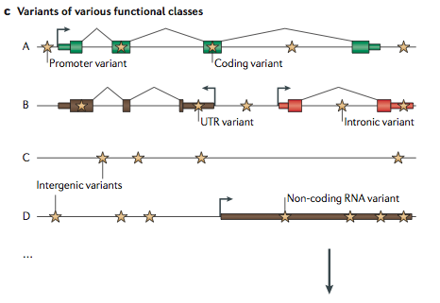
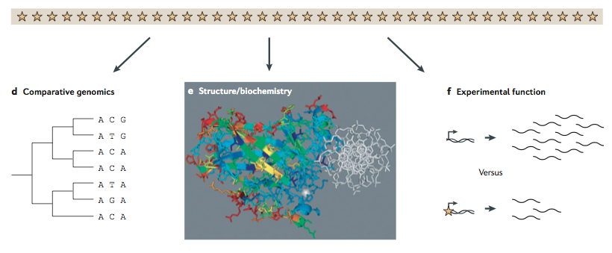
Needles in stack of needles: finding disease-causal variants in a wealth of genomic data. G M Cooper, J Shendure. Nature Reviews Genetics. 2011.

Slide 25
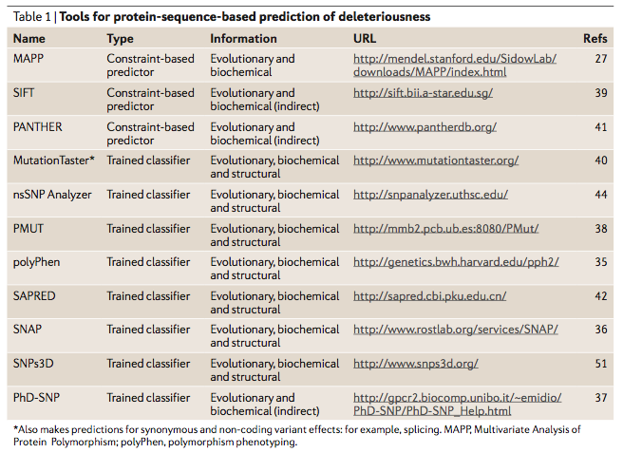

Slide 26
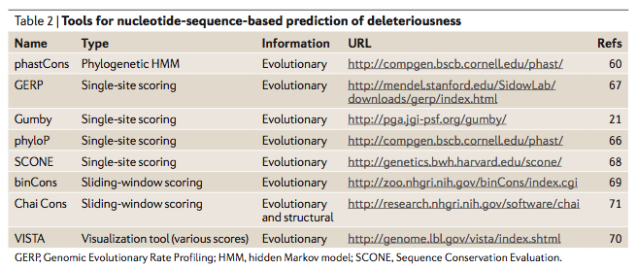

Slide 27
Despite so many efforts, not many rare variants were detected for common diseases
Rare variant detection is more successful for rare diseases
A possible explanation: even with all the above efforts, the power may be still not enough?
Or, rare variants may not contribute that much susceptibility for common disease?

Slide 28
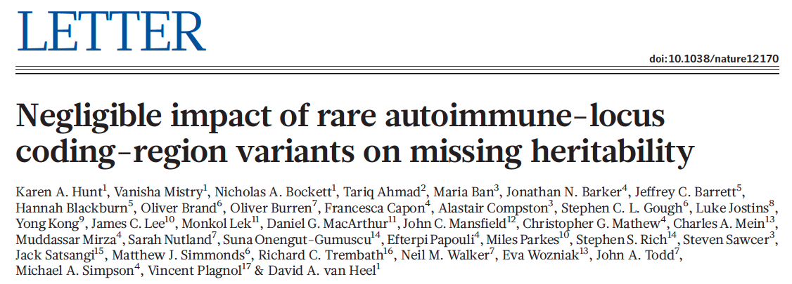
25 auto-immune risk genes’ coding regions were sequenced on 40,000 individuals
Rare variants in these genes have negligible contribution to auto-immune disease susceptibility

Slide 29
Summary
  NGS technology offers an opportunity to discover disease susceptibility rare variants
  Two major challenges in rare variant association studies:
    Limited power due to low allele frequency
    Too many rare variants
  Some strategies for rare variant association studies:
    Collapsing
    Family-based design
    Variant filtering based on predicted deleteriousness

Slide 30

Non-coding variant annotation, with the FunSeq Workflow
30 (c) Mark Gerstein, 2002, Yale, bioinfo.mbb.yale.edu
Mark Gerstein
Yale
Slides freely downloadable from
Lectures.GersteinLab.org.
See last slide
for references & more info.
Disclosure: MG on advisory board for DNAnexus & BINA
Notes:
30

Slide 31
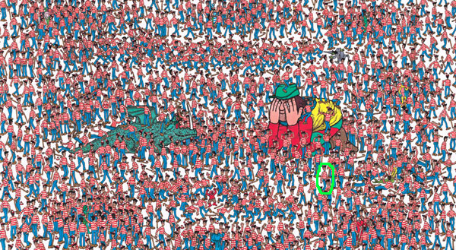
Where is Waldo?
(Using Annotation to Prioritize the ~3M Germline variants &
~5K Somatic Mutations in a Tumor Sample)

Slide 32
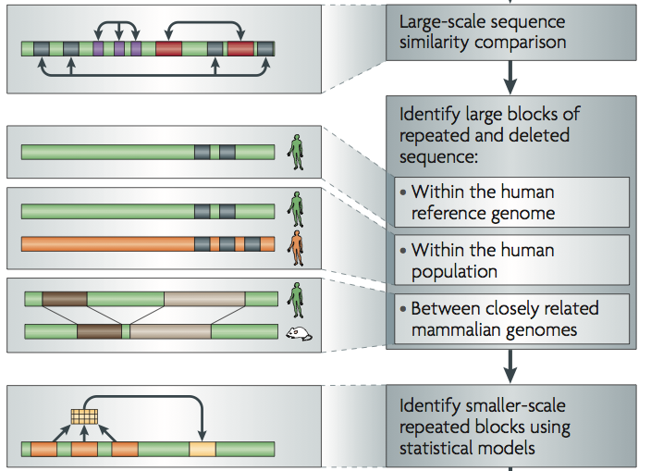
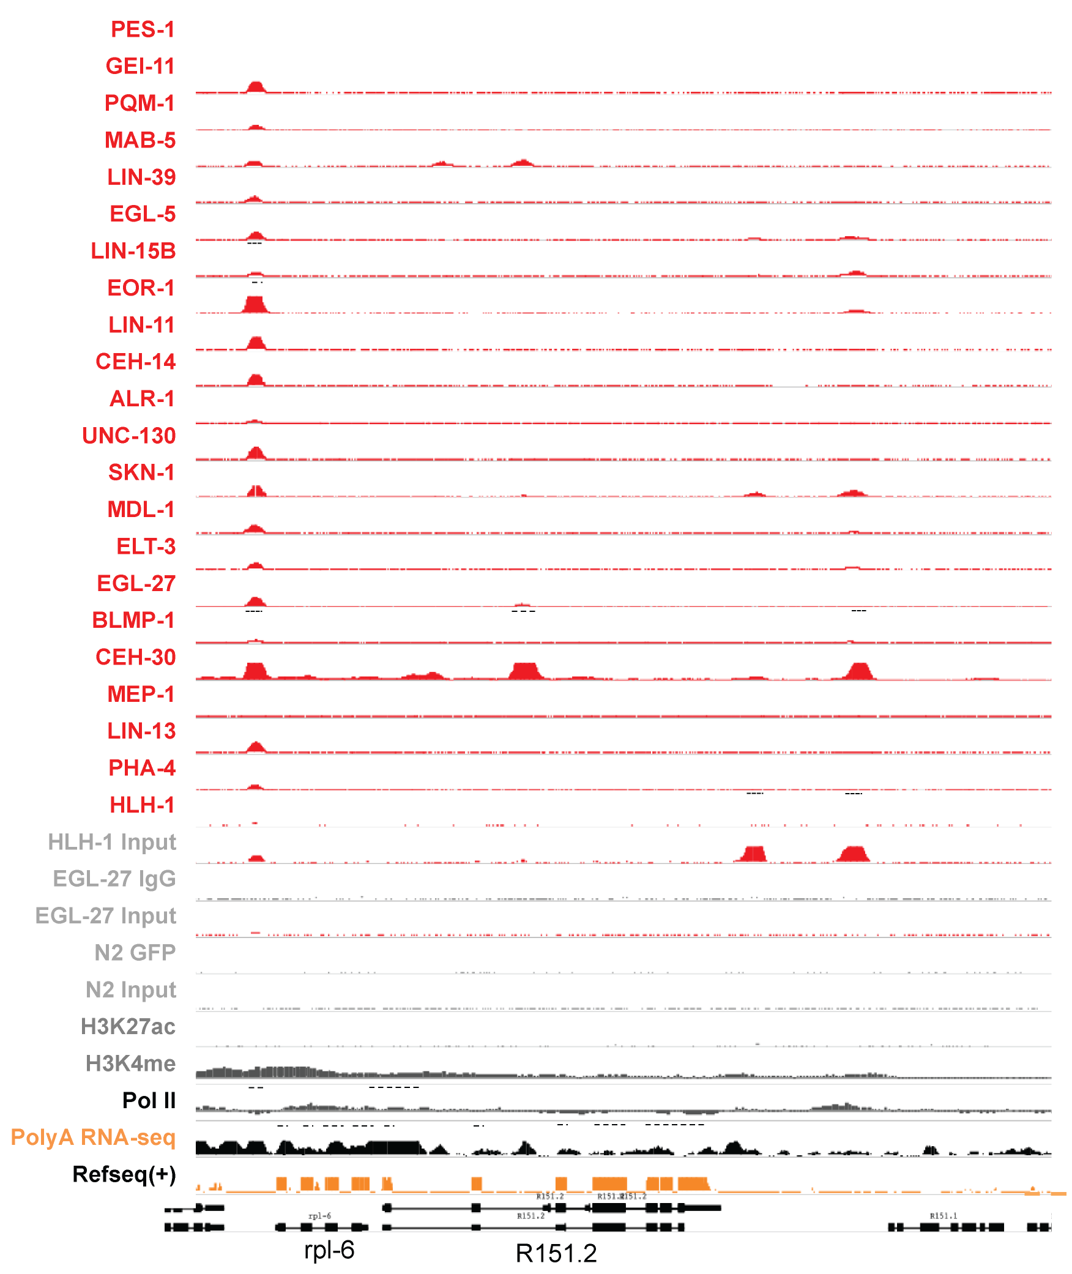
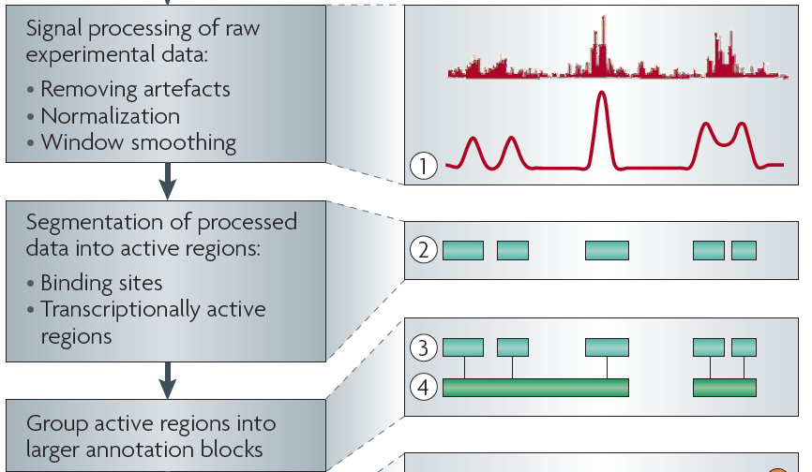
Sources of Annotation:
Comparative
&
Functional
[Nat. Rev. Genet. (2010) 11: 559]
[Science 330:6012]

Slide 33
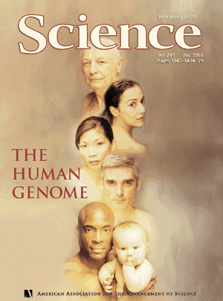
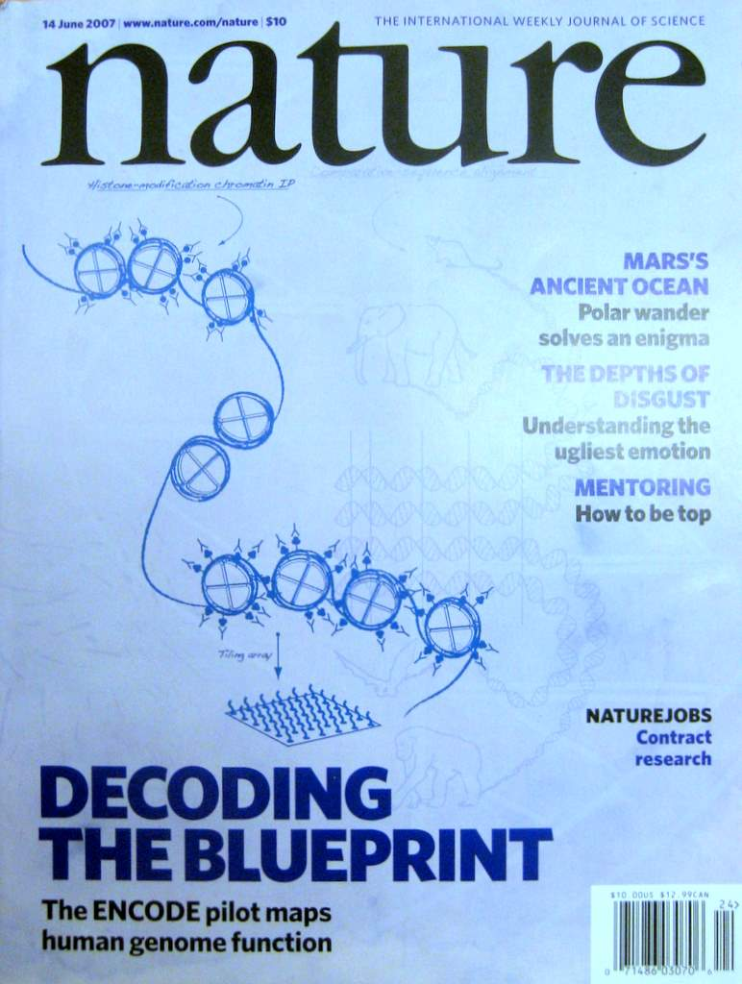


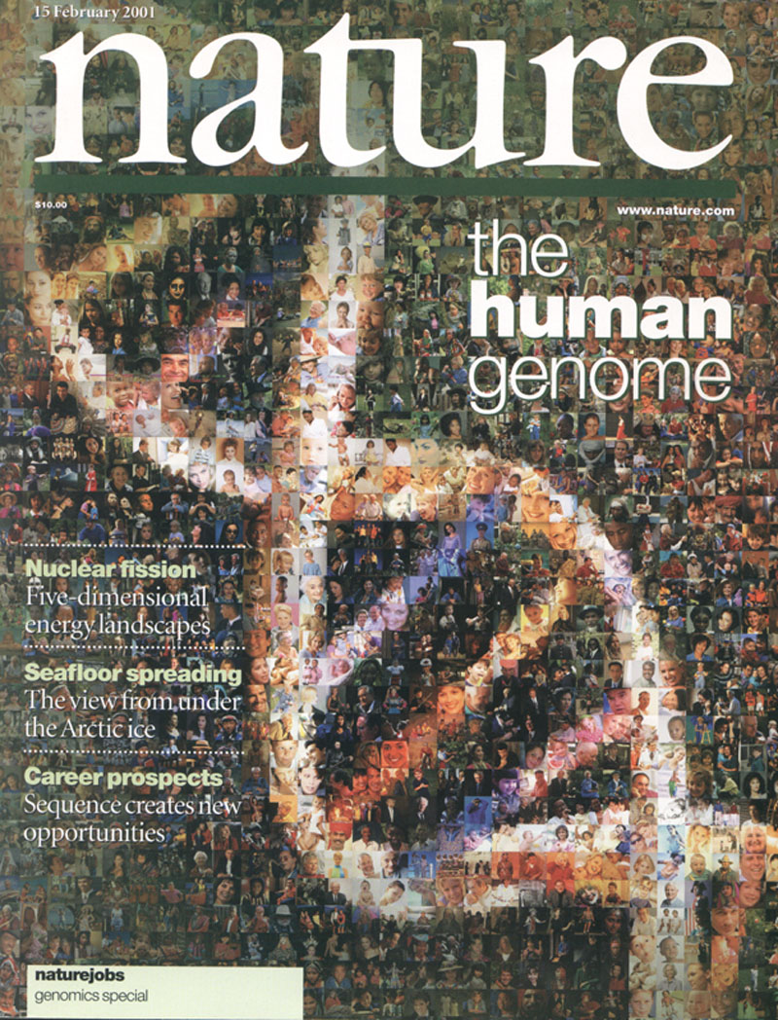

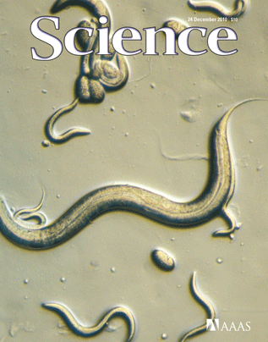
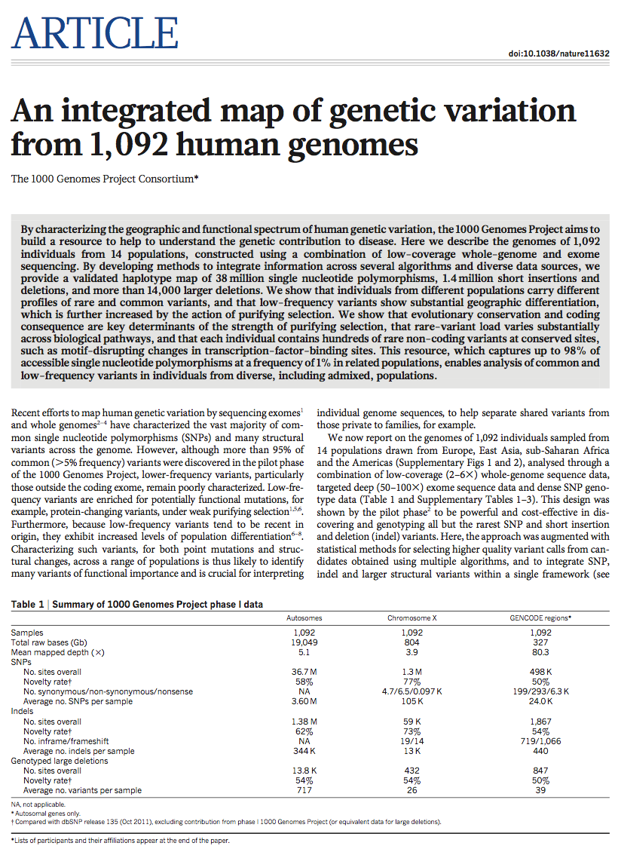
1998
1999
2000
2001
2002
2003
2004
2005
2006
2007
2008
2009
2010
2011
2012
1000G FIG
1) coding (LoF)
MacArthur et al. Science ('12)
2) Non-coding
Khurana et al. Science ('13)
1000 Genomes
Phase 1
Production
Project

Slide 34

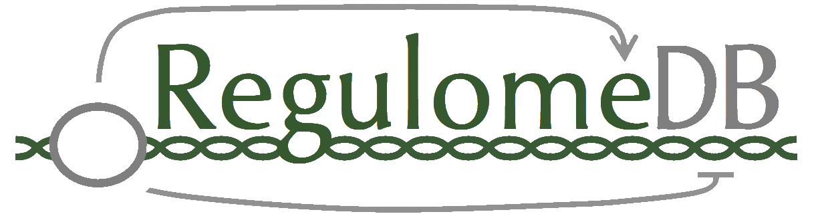
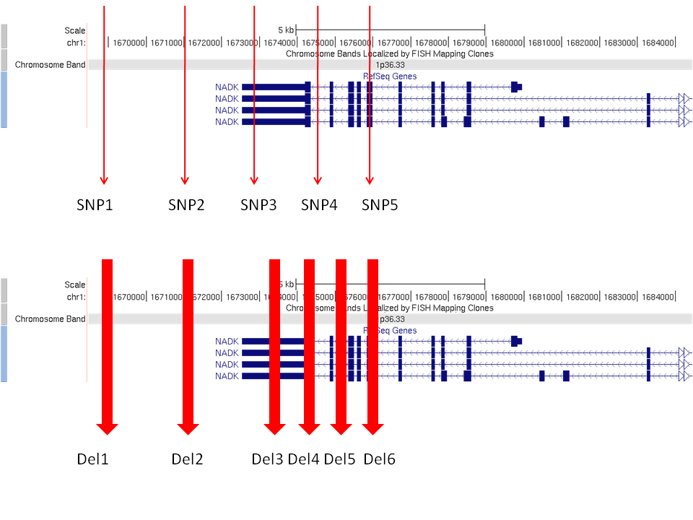
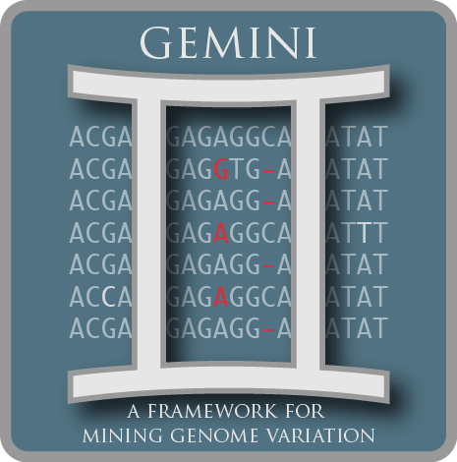


Noncoding Variant Annotation Tools
Growing out of ENCODE & 1000G
FunSeq
Other Efforts
ANNOVAR

Slide 35
Non-coding variant annotation, with FunSeq Workflow
Finding ultra-sensitive non-coding regions
& disruptive mutations (eg motif breakers)
  Using 1000G & ENCODE to characterize natural patterns of variation in regulatory elements
Also, annotation based on network connectivity
  Prioritize hubs
Building a practical workflow & software tool
for cancer genomes
  Identifying drivers
  as somatic variants breaking natural patterns

Slide 36
Gene categories with known phenotypic effects
Decreasing tolerance to mutation
LoF-tol
Neutral
GWAS
HGMD
Essential
(common
disease-assoc.
variants)
(rare
disease-causing
variants)
Homozygous inactivation in at least one healthy 1000 Genomes individual
Weak selection constraints
Homozygous inactivation leads to clinical features of death before puberty or infertility
Very strong selection constraints
From MacArthur et al, Science, 2012
From Liao et al, PNAS, 2008
Notes:
Introduce the pink & cyan
Goal is to predict disease
We’ll start training/testing on the extremes
Lof
Essen -
Hgmd – rarer mendelian variants
Gwas – “common” variants
Neutral

Slide 37
Enrichment of rare SNPs as a metric for Negative Selection
Initial Metrics for selection
  GERP
    Evolutionary conservation useful but human-specific regions (Ward & Kellis, Science, 2012)
  SNP density
    Confounded by mutation rate
Depletion of common polymorphisms
  For regions under selection
  Alternatively, negative selection restricts the allele frequency of deleterious mutations.
(rare=derived allele freq < 0.5%)
LOF-tol (Loss-of-function tolerant): least negative selection
Cancer: most selection
[Khurana et al., Science (‘13)]

Slide 38
Negative selection in non-coding elements
Broad categories of regulatory regions under negative selection
Consistent with previous studies
ENCODE, Nature, 2012
Mu et al, NAR, 2011
(Non-coding RNA)
(DNase I hypersensitive sites)
(TFSS: Sequence-specific TFs)
(Transcription factor binding sites)
[Khurana et al., Science (‘13)]

Slide 39
~700 specific sub-categories of broad non-coding categories; Possible to study now using 1000G Phase 1
Divide broad categoriees
  ncRNA: snRNA, snoRNA, miRNA, lincRNA
  Motifs & binding sites of different TF families
  TFBSs divide into proximal vs distal and cell-line–specific vs –non-specific
Large sample size:1,092 humans compared to pilot ~180
[Khurana et al., Science (‘13)]

Slide 40
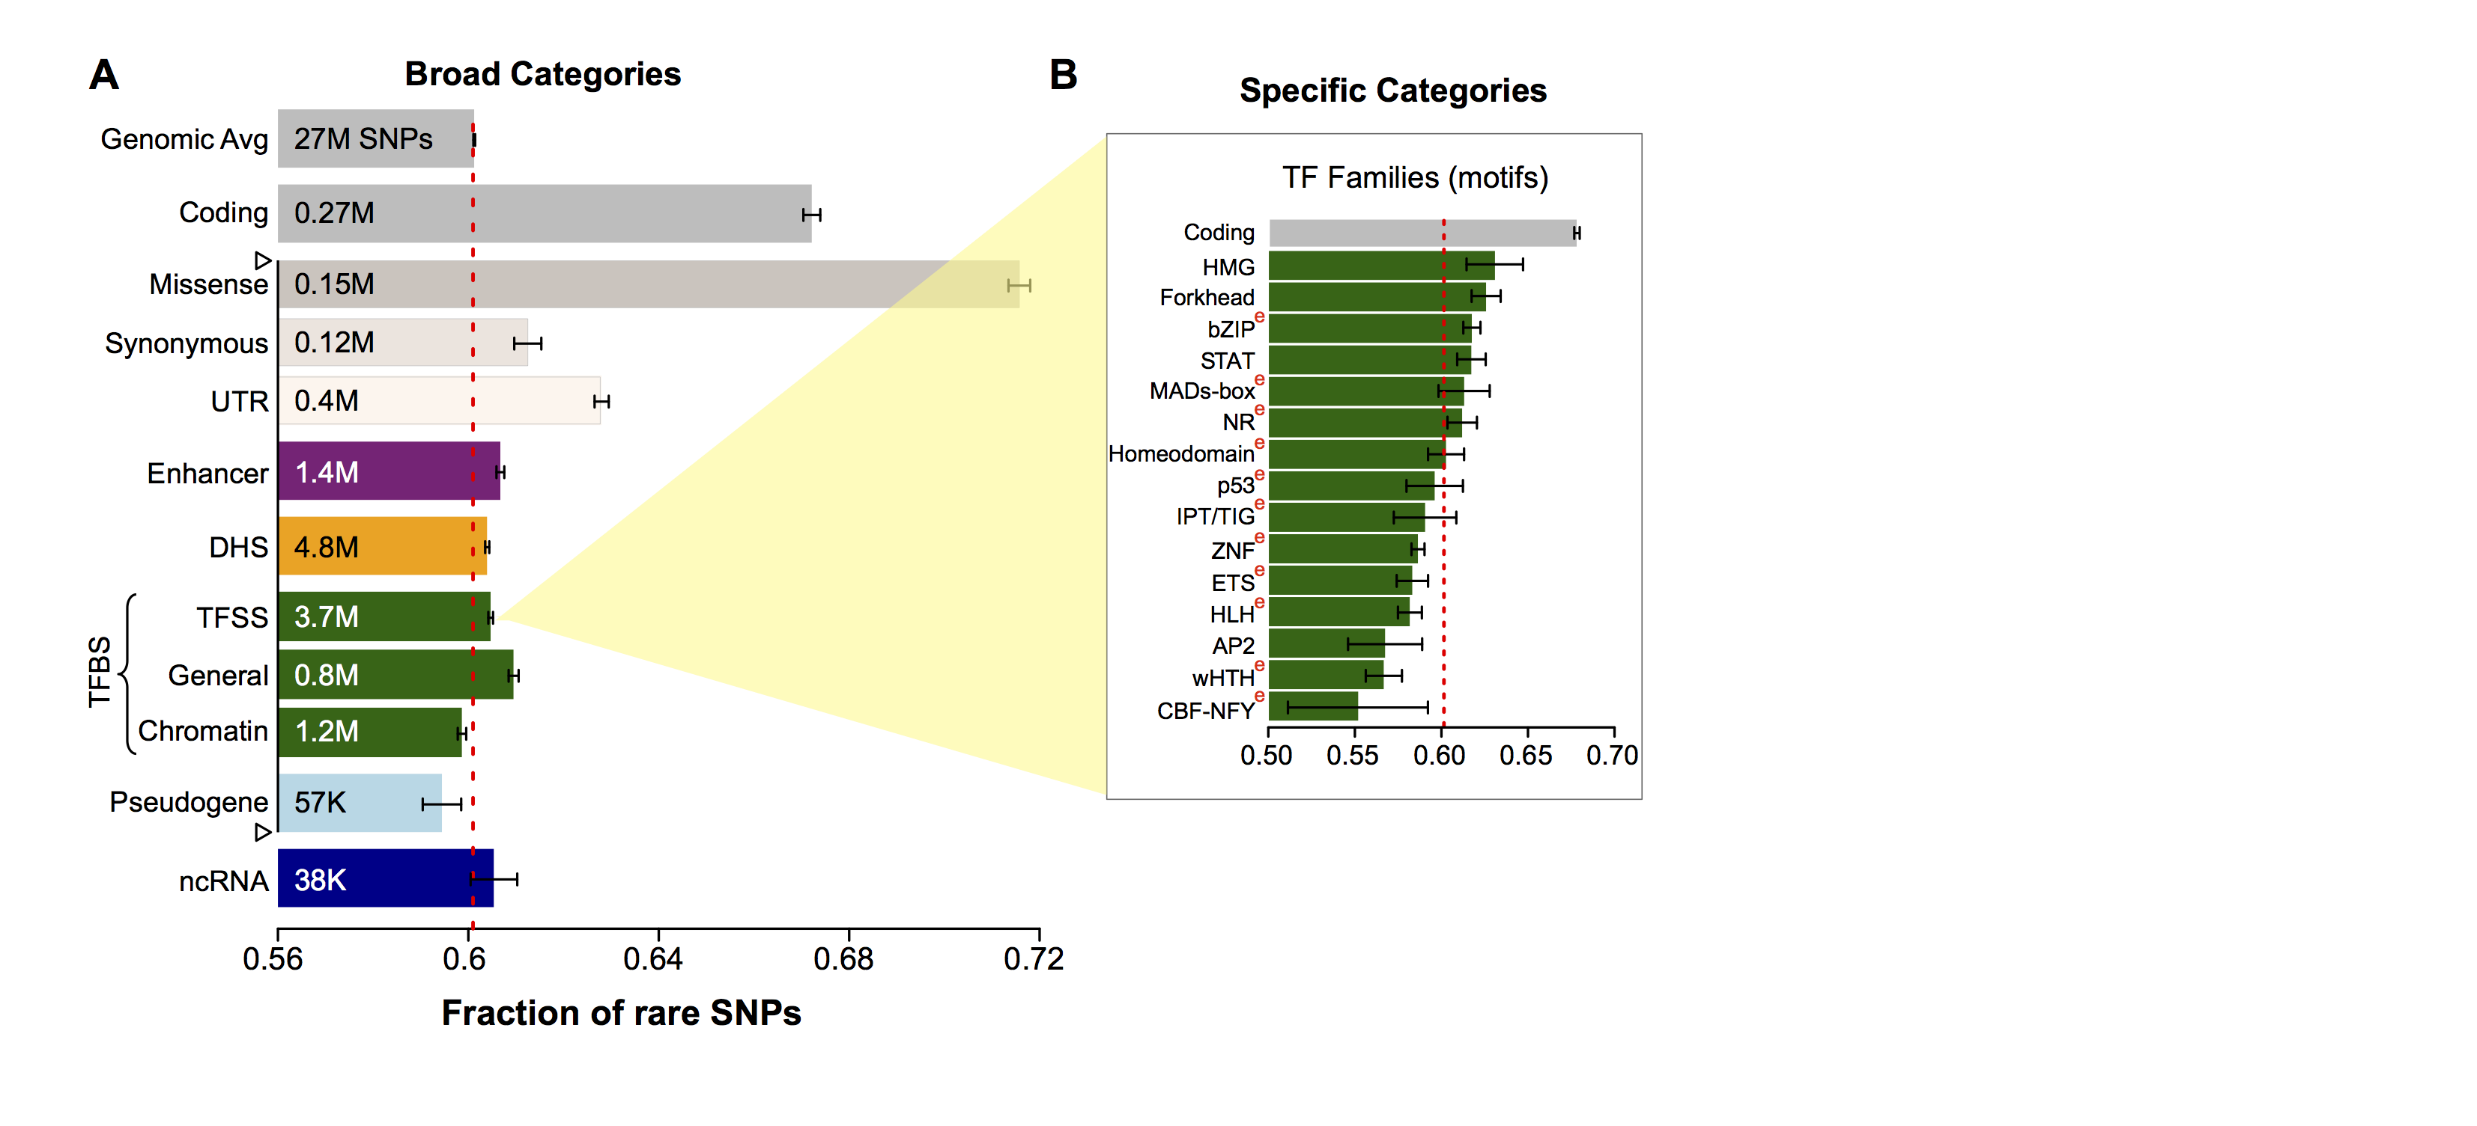
Differential selective constraints among sub-categories
[Khurana et al., Science (‘13)]

Slide 41
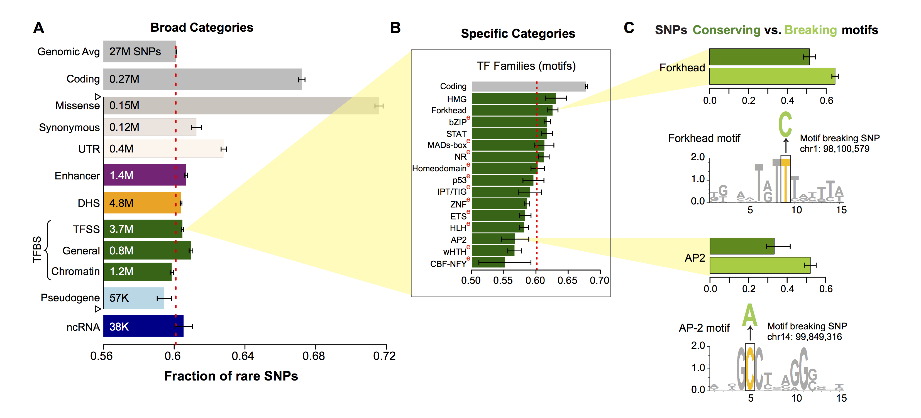
SNPs which break TF motifs are under stronger selection
[Khurana et al., Science (‘13)]

Slide 42
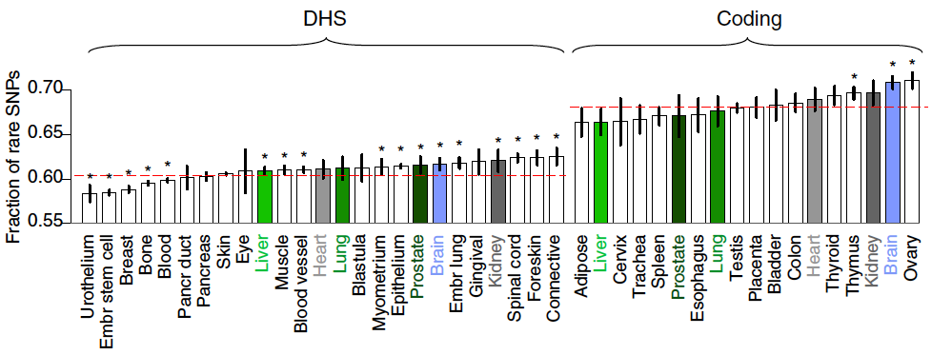
Negative selection and tissue-specificity of coding and non-coding regions
  Ubiquitously expressed genes and bound regions show stronger selection
  Differences in constraints amongst tissues
  Constraints in coding genes and regulatory genes are correlated across tissues
[Khurana et al., Science (‘13)]

Slide 43
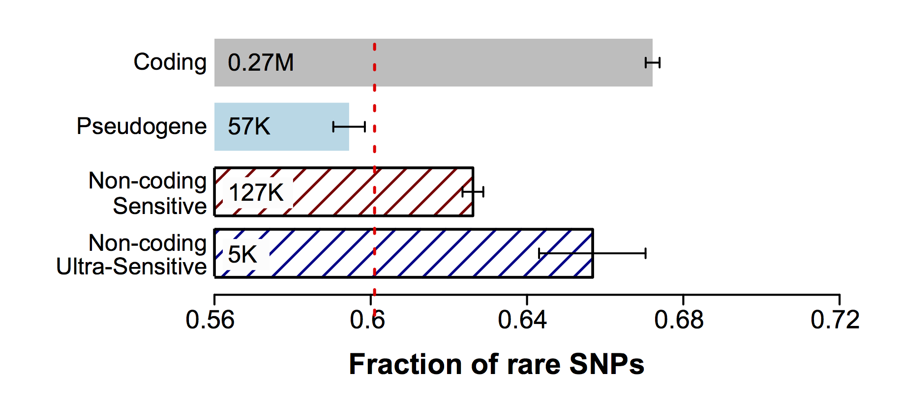
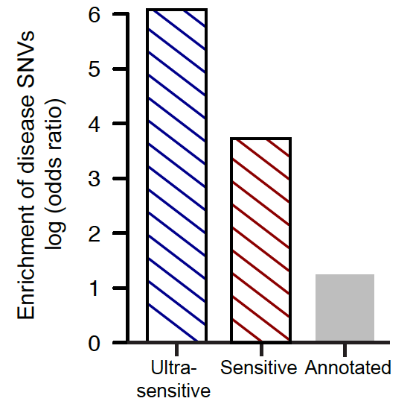
Can we identify which non-coding elements are under very strong “coding-like” selection ?
~0.4% genomic coverage (~ top 25)
~0.02% genomic coverage (top 5)
Start 677 high-resolution non-coding categories; Rank & find those under strongest selection
Binding peaks of some general TFs (eg FAM48A)
Core motifs of some TF families (eg JUN, GATA)
DHS sites in spinal cord and connective tissue
~400-fold
Enrichment of know disease-causing mutations from Human Gene Mutation database
~40-fold
[Khurana et al., Science (‘13)]

Slide 44
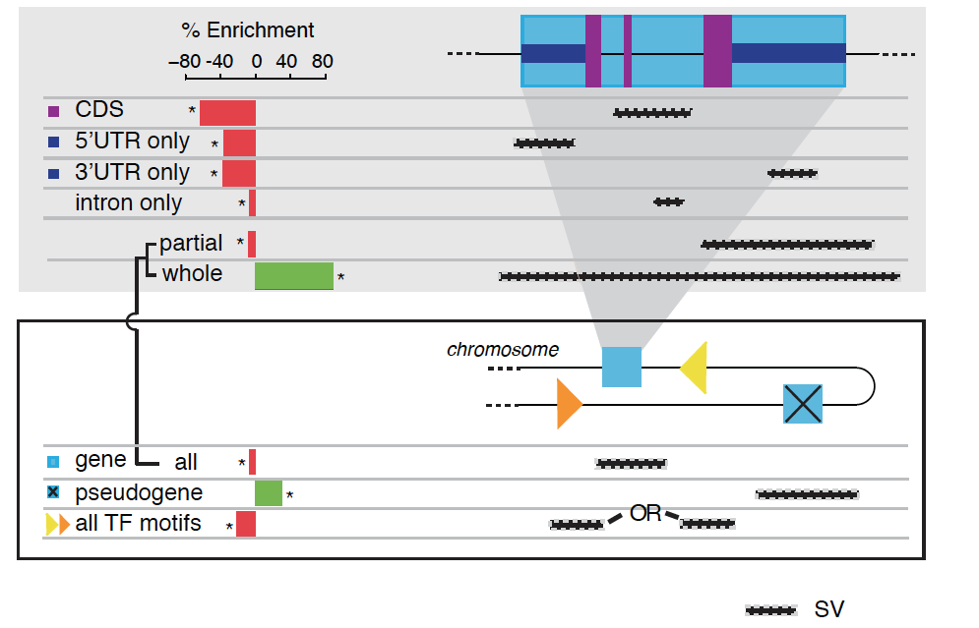
Indels and larger SVs show largely consistent patterns to SNPs
Indels
Structural variants are generally depleted for functional elements
[Khurana et al., Science (‘13)]

Slide 45
Non-coding variant annotation, with FunSeq Workflow
Finding ultra-sensitive non-coding regions
& disruptive mutations (eg motif breakers)
  Using 1000G & ENCODE to characterize natural patterns of variation in regulatory elements
Also, annotation based on network connectivity
  Prioritize hubs
Building a practical workflow & software tool
for cancer genomes
  Identifying drivers
  as somatic variants breaking natural patterns

Slide 46
Gene centralities in networks reflect their selection constraints
[Khurana et al., Science (‘13)]

Slide 47
Multinet – the ultimate hairball!
Genes participate in many networks and no single network captures the global picture of gene interactions
Combine regulatory interactions with other networks : physical protein-protein, signaling, metabolic, phosphorylation and genetic to create a unified network (Multinet)
Nodes: ~15,000 genes
Edges: ~110,000 interactions
Edges shown in gray
[Khurana et al., PLOS Comp. Bio. ’13]

Slide 48
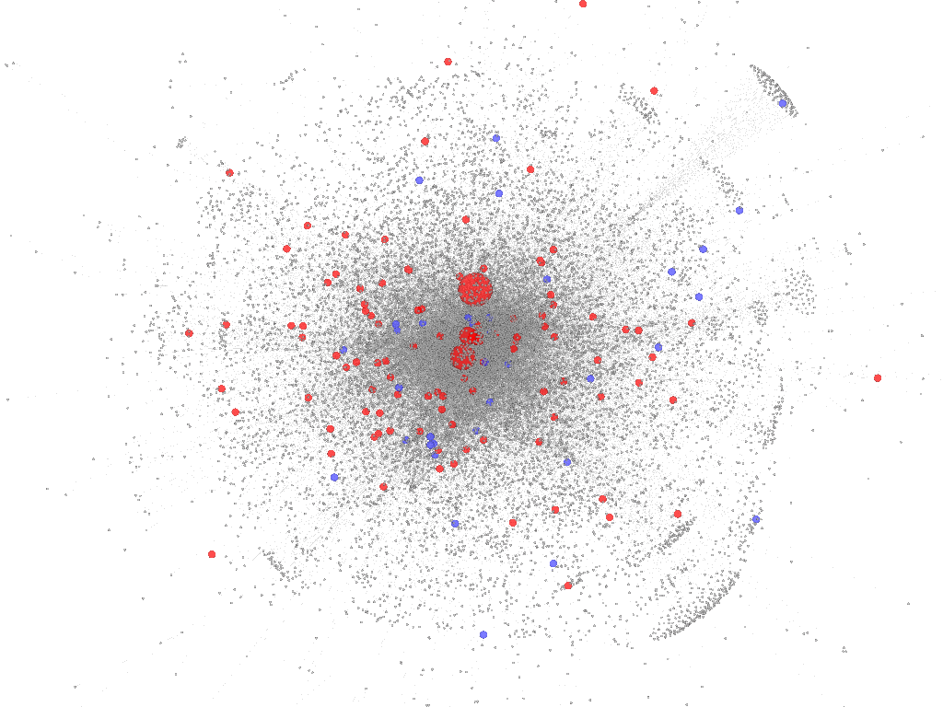
Gene properties in Multinet
Essential genes are
Unified network
degree (log scale)
Connected to more genes
Num of networks
Involved in more networks
LoF-tolerant genes
Essential genes
LoF-tolerant
Essential
Size of nodes scaled by total degree
[Khurana et al., PLOS Comp. Bio. ’13]

Slide 49
Non-coding variant annotation, with FunSeq Workflow
Finding ultra-sensitive non-coding regions
& disruptive mutations (eg motif breakers)
  Using 1000G & ENCODE to characterize natural patterns of variation in regulatory elements
Also, annotation based on network connectivity
  Prioritize hubs
Building a practical workflow & software tool
for cancer genomes
  Identifying drivers
  as somatic variants breaking natural patterns

Slide 50
Noncoding cancer variants from whole-genome sequencing
64 prostate cancer
(Berger et al, Nature, 2011; Baca et al, Cell, 2013)
  ~1500 to 18,000 per sample
21 breast cancer (Nik-Zainal et al, Cell, 2012)
  ~2000 to 80,000 per sample
3 medulloblastoma (Rausch et al., Cell 148, 2012).
  ~1600 to 2000 per sample
~99% of somatic SNVs occur in non-coding regions, including TFBSs, ncRNAs and pseudogenes
Cancer sequencing has been very exome focused
but TERT promotor mutation

Slide 51
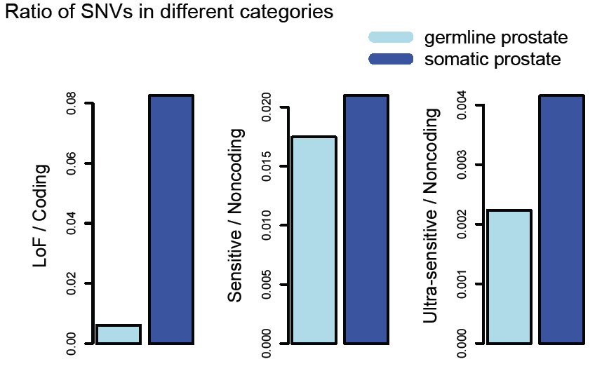
Germline vs somatic variants
Somatic mutations do not follow patterns of natural polymorphisms
Those deviating the most from these patterns are most likely to be cancer drivers providing selective advantage to the tumor cells (confirmed for protein-coding genes)
Look for mutations in elements under strong negative selection
[Khurana et al., Science (‘13)]

Slide 52
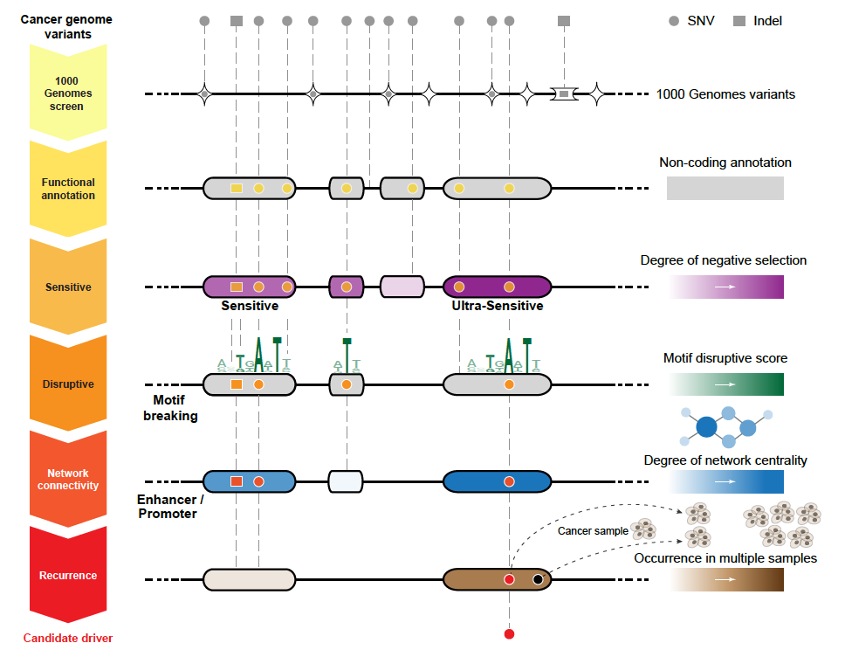
Identification of non-coding candidate drivers amongst somatic variants: Scheme
[Khurana et al., Science (‘13)]

Slide 53
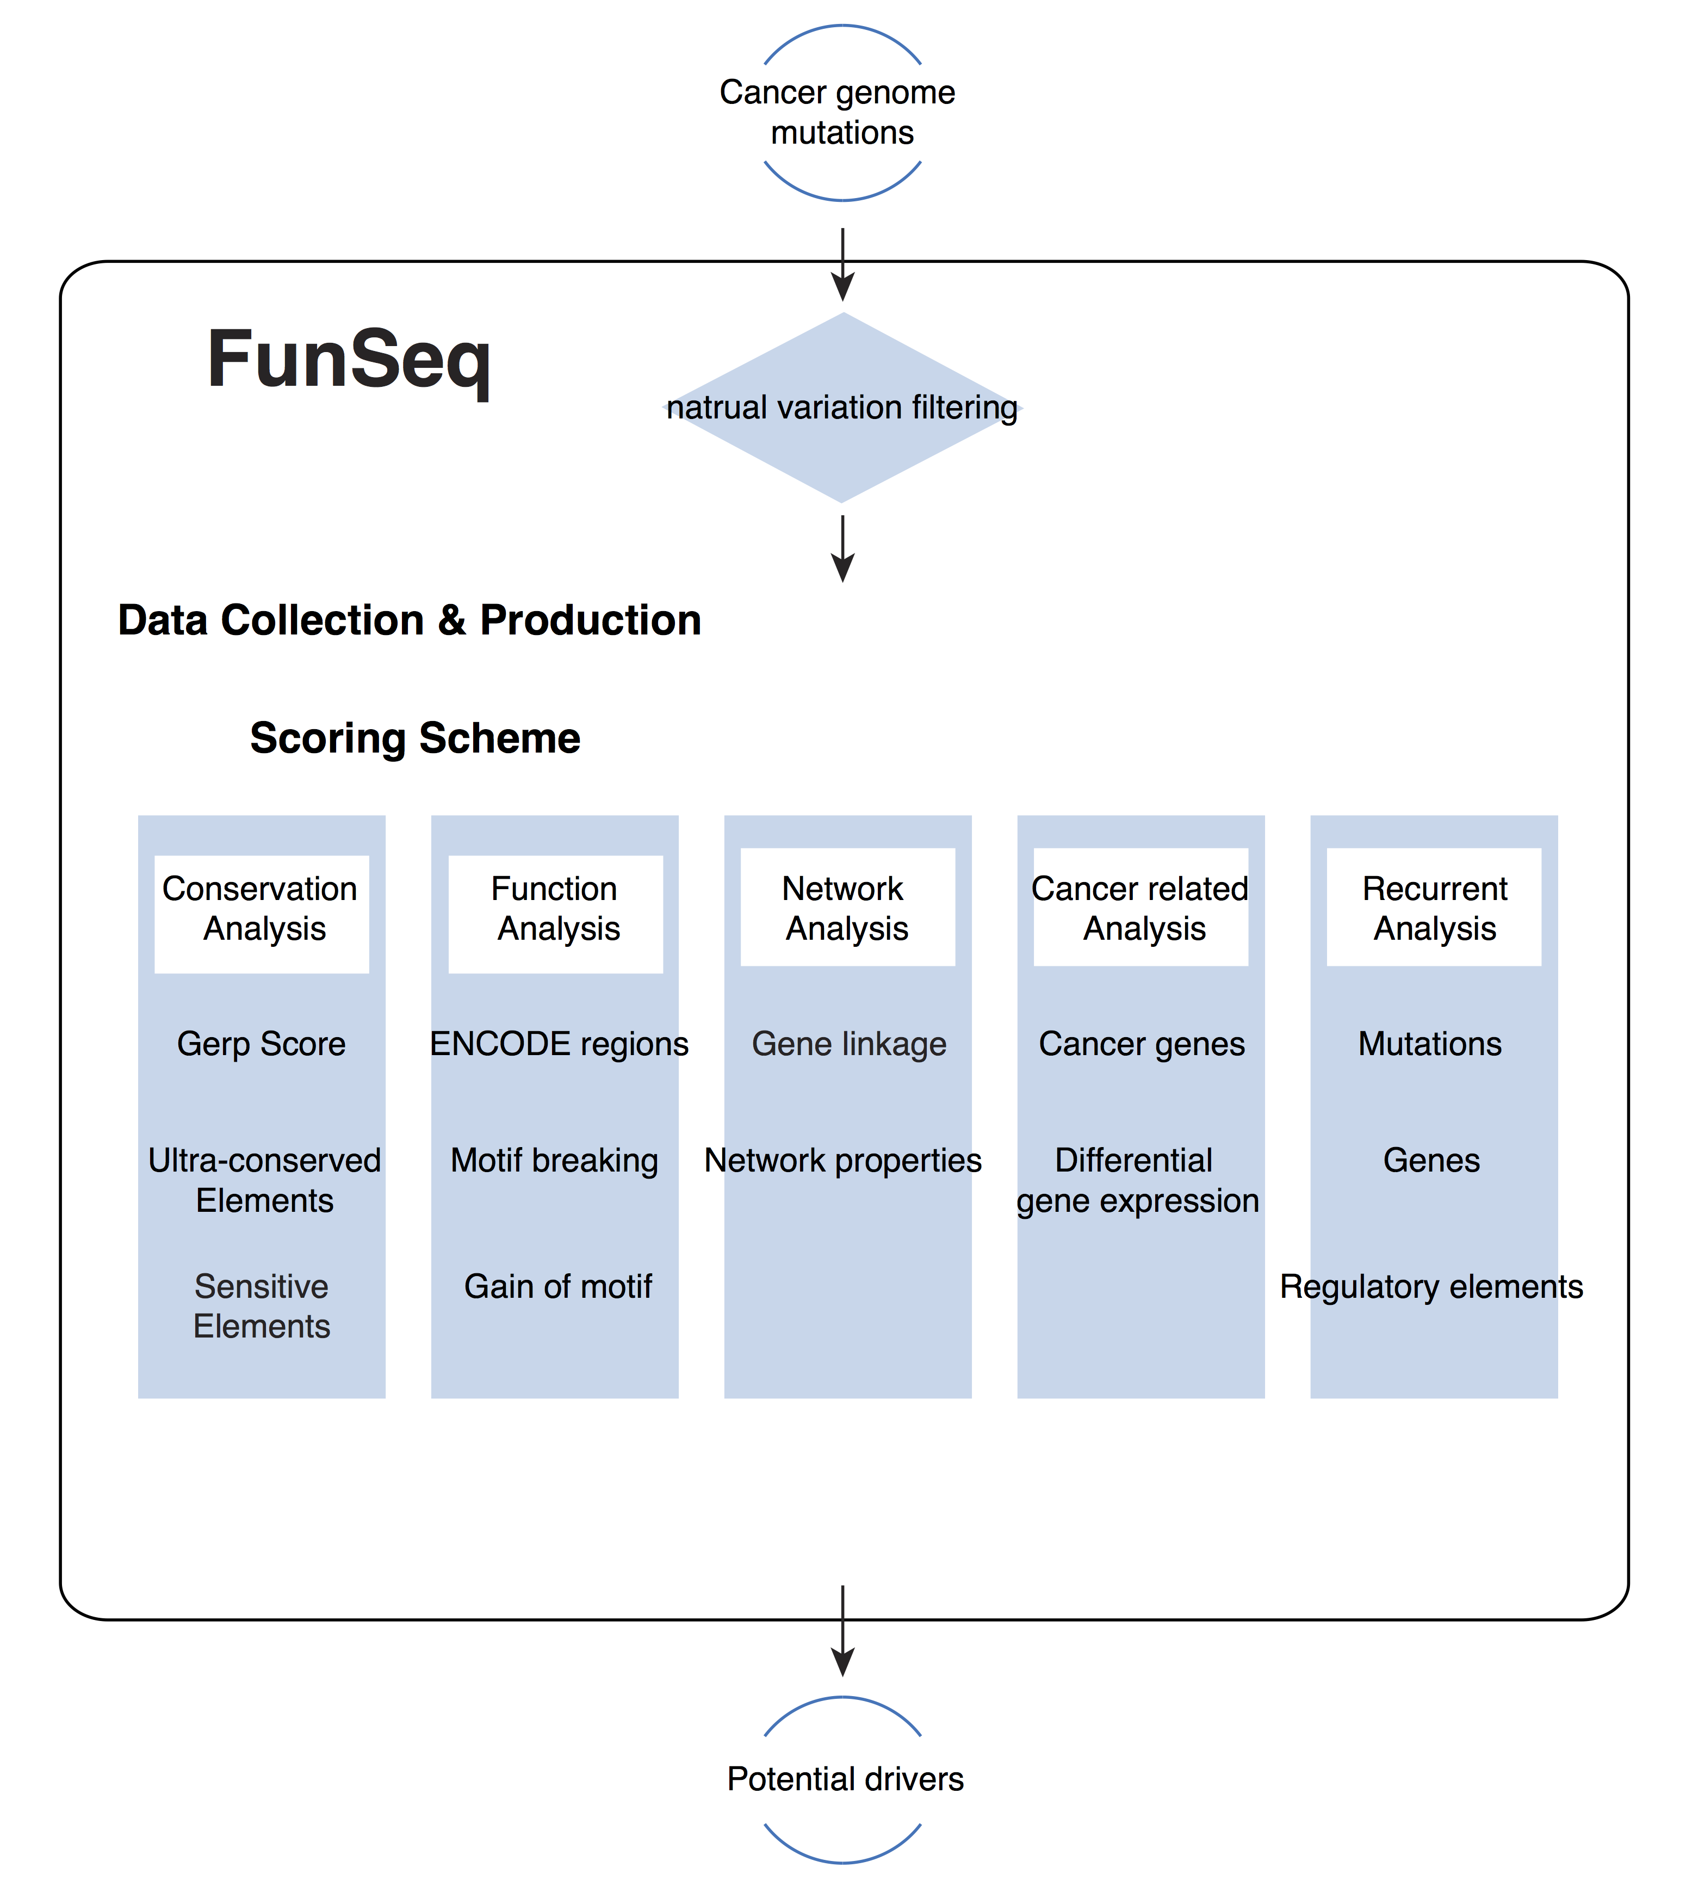
FunSeq.GersteinLab.org : webserver & code download

Slide 54
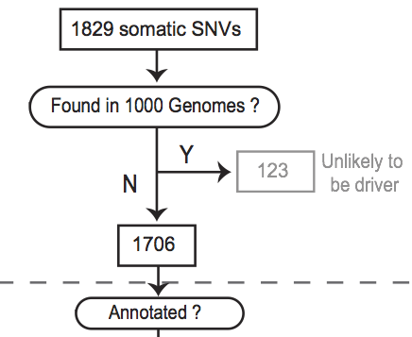
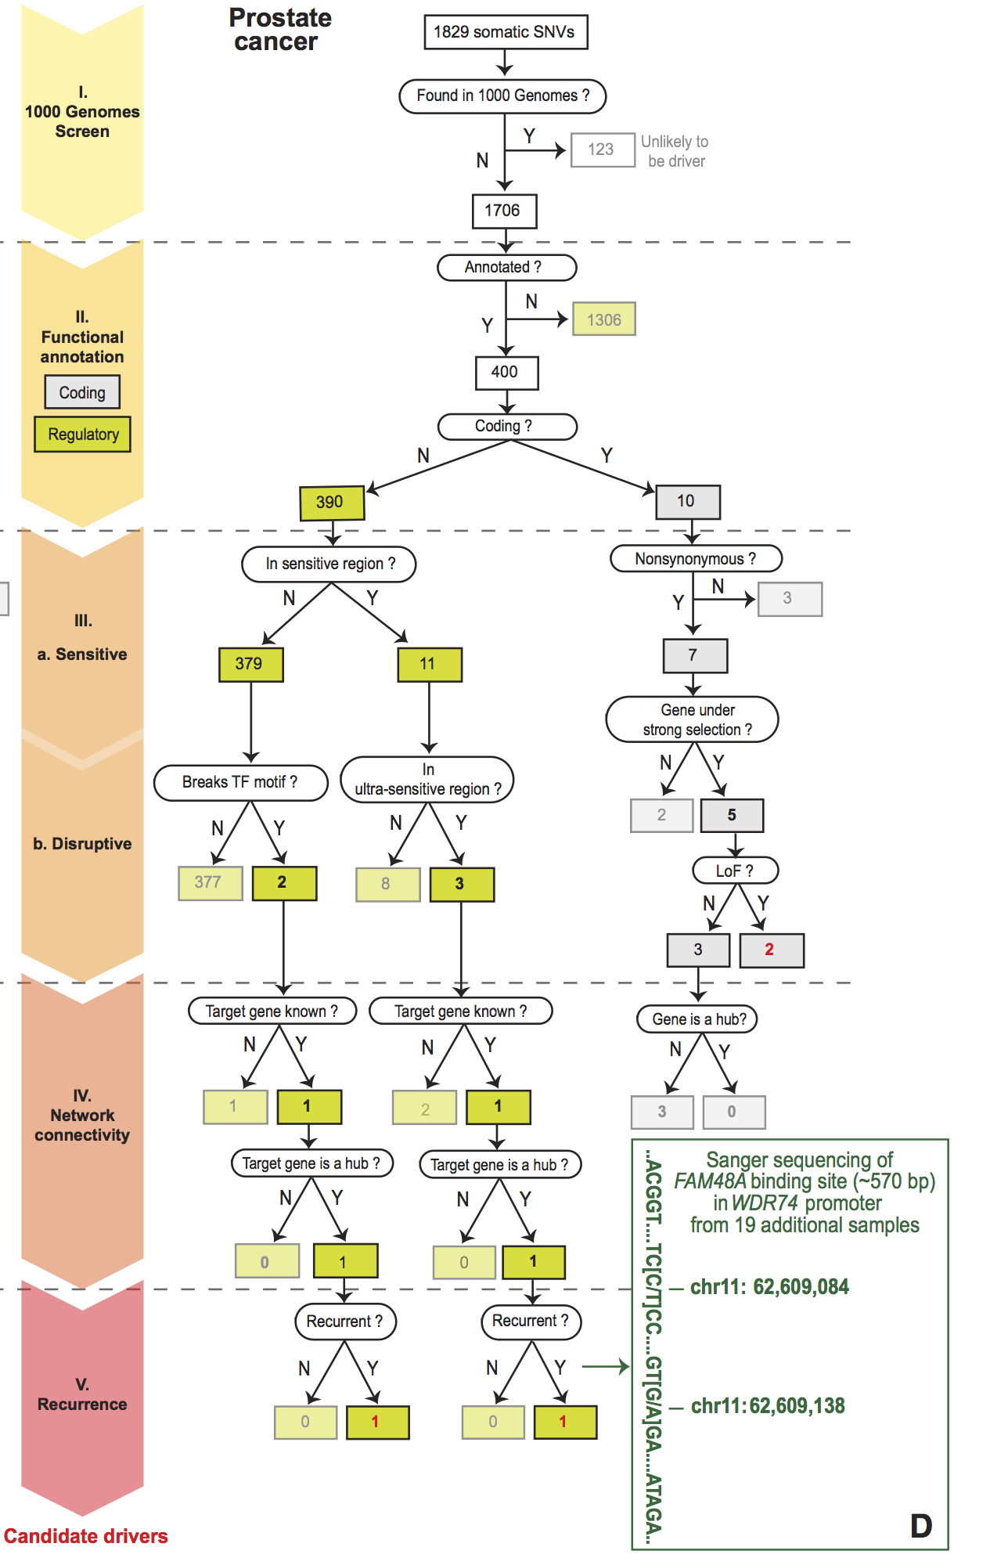
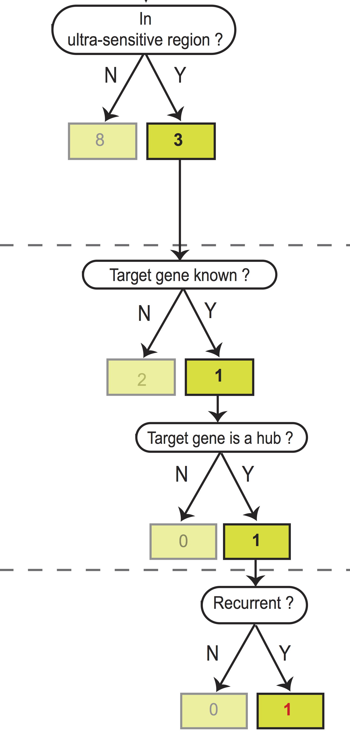
Flowchart for 1 Prostate Cancer Genome (from Berger et al. '11)
[Khurana et al., Science (‘13)]
Notes:
Just have one path

Slide 55
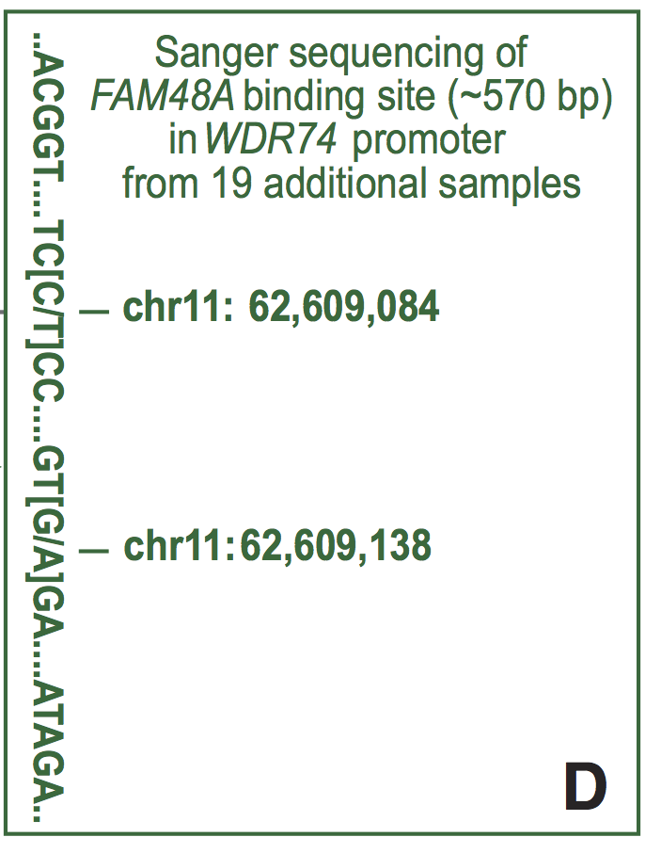
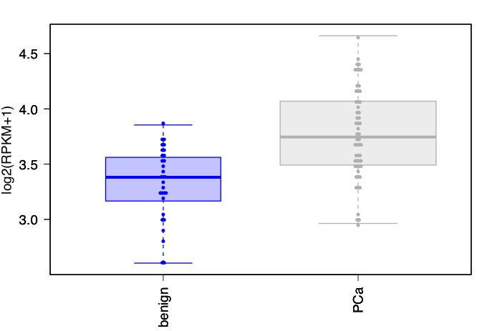
Identification of non-coding candidate drivers amongst somatic variants: Examples
Validation of a candidate driver identified in prostate cancer sample in WDR74 gene promoter
Sanger sequencing in 19 additional samples confirms the recurrence
WDR74 shows increased expression in tumor samples
benign
PCs
[Khurana et al., Science (‘13)]

Slide 56
Non-coding variant annotation, with FunSeq Workflow
Finding ultra-sensitive non-coding regions
& disruptive mutations (eg motif breakers)
  Using 1000G & ENCODE to characterize natural patterns of variation in regulatory elements
Also, annotation based on network connectivity
  Prioritize hubs
Building a practical workflow & software tool
for cancer genomes
  Identifying drivers
  as somatic variants breaking natural patterns

Slide 57

Cancer Prioritzation Acknowledgements
~50 people
~1000 “authors”
Functional Interpretation Subgroup
Yale
Ekta Khurana, Yao Fu, Jieming Chen,
Xinmeng Mu, Lucas Lochovsky,
Arif Harmanci, Alexej Abyzov, Suganthi Balasubramanian, Cristina Sisu,
Declan Clarke, Mike Wilson
Sanger
Vincenza Colonna,
Yali Xue, Chris Tyler-Smith
Cornell
Steven Lipkin, Jishnu Das, Robert Fragoza, Xiaomu Wei, Haiyuan Yu
Andrea Sboner, Dimple Chakravarty, Naoki Kitabayashi, Vaja Liluashvili,
Zeynep H. Gümüş, Mark A. Rubin
US, UK, Switzerland….
Hyun Min Kang, Tuuli Lappalainen, Kathryn Beal, Daniel Challis, Yuan Chen, Laura Clarke, Fiona Cunningham, Emmanouil T. Dermitzakis, Uday Evani, Paul Flicek, Erik Garrison, Javier Herrero, Yong Kong, Kasper Lage, Daniel G. MacArthur, Gabor Marth, Donna Muzny, Tune H. Pers, Graham R. S. Ritchie, Jeffrey A. Rosenfeld, Fuli Yu, Richard Gibbs
Hiring Postdocs. See gersteinlab.org/jobs !

Slide 58
Info about content in this slide pack
PERMISSIONS: This Presentation is copyright Mark Gerstein, Yale University, 2013. Please read permissions statement at
http://www.gersteinlab.org/misc/permissions.html .
Feel free to use images in the talk with PROPER acknowledgement
(via citation to relevant papers or link to gersteinlab.org).
Paper references in the talk were mostly from Papers.GersteinLab.org.
PHOTOS & IMAGES. For thoughts on the source and permissions of many of the photos and clipped images in this presentation see http://streams.gerstein.info . In particular, many of the images have particular EXIF tags, such as kwpotppt , that can be easily queried from flickr, viz: http://www.flickr.com/photos/mbgmbg/tags/kwpotppt

