Slide 1
Genetic Association Analysis --- impact of NGS

Slide 2
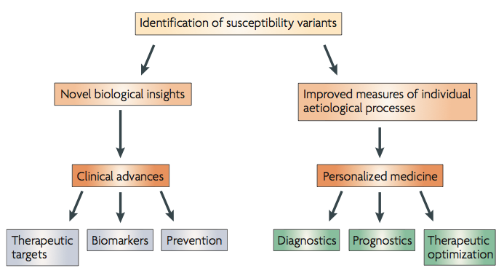
One fundamental goal of genetics studies is to identify genetic variants causing phenotypic variations
What does NGS have to offer?
Genome-wide association studies for complex traits: consensus, uncertainty and challenges.
M I McCarthy, G R Abecasis, et al. Nature Review Genetics, 2008
Notes:
More background of GWAS

Slide 3
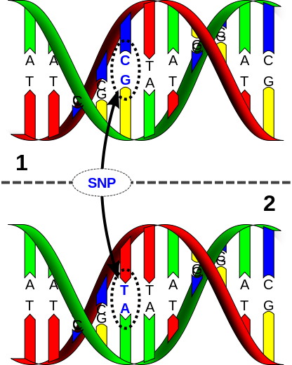
Before NGS, what do people do?
Linkage analysis
Genome-wide association studies
Genome-wide association studies (GWAS)
SNP (single nucleotide polymorphism)
Technology: Microarray
Two major manufacturers:
Illumina and Affymetrix
http://en.wikipedia.org/wiki/Single-nucleotide_polymorphism
Notes:
Define LD and common SNPs

Slide 4
Linkage Disequilibrium
Parent 1
Parent 2
A B
a b
A B
a b
X
A B
a b
A b
A b
A B
a b
OR
a B
A B
a b
A B
A b
a B
A b
A B
a b
A B
etc…
High LD -> No Recombination
(r² = 1) SNP1 “tags” SNP2
Low LD -> Recombination
Many possibilities
ASHG 2008 Hapmap Tutorial: http://hapmap.ncbi.nlm.nih.gov/tutorials.html.en

Slide 5
SNPs on microarrays are “tagging” SNPs (reduce cost!!!)
Selected based on linkage-disequilibrium structure
How do we know the LD structure?
The International HapMap Project
www.hapmap.org

Slide 6
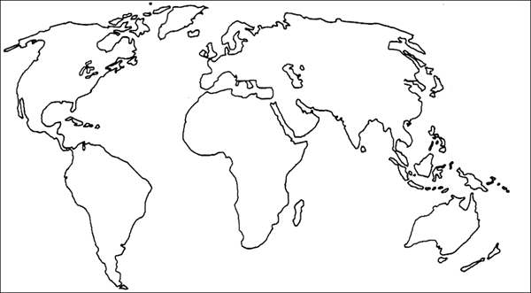
The International HapMap Project
Involved Illumina, Affymetrix, >20 institutions worldwide
HapMap1 (2003) and Hapmap2 (2005) - 4 populations (270 indiv): CEU (NW European from Utah), CHB (Han Chinese from Beijing), JPT (Japanese from Tokyo), YRI (Yoruban from Nigeria)
Hapmap3 (2010) - 11 populations (4+7, 1301 indiv)
www.hapmap.org

Slide 7
In GWAS, only common SNPs (generally, with minor allele frequency > 5%) are considered
Only common SNPs can “tag” other common SNPs
The actual “causal” SNPs are usually not directly genotyped
With NGS, we can:
Analyze rare variants
Get much better (highest possible) resolution
But, are we there yet?
What are the challenges of analyzing rare variants?
What have we done?

Slide 8
Challenge #1: Very limited statistical power
A toy example:
Suppose we wish to test the association between a gene (with alleles A and B) and human height. We collected 100 individuals from the population
 | Scenario #1 |  | Scenario #2
 | Allele A | Allele B | Allele A | Allele B
# of indiv | 70 | 30 | 99 | 1
Avg height | 6’ | 6’1’’ | 6’ | 6’1’’
Equal effect size for the variants in the two scenarios
Which scenario is more convincing about the association?

Slide 9
Challenge #1: Very limited statistical power
A toy example:
Suppose we wish to test the association between a gene (with alleles A and B) and human height. We collected 100 individuals from the population
 | Scenario #1 |  | Scenario #2
 | Allele A | Allele B | Allele A | Allele B
# of indiv | 70 | 30 | 99 | 1
Avg height | 6’ | 6’1’’ | 6’ | 6’1’’
Equal effect size for the variants in the two scenarios
Which scenario is more convincing about the association?

Slide 10
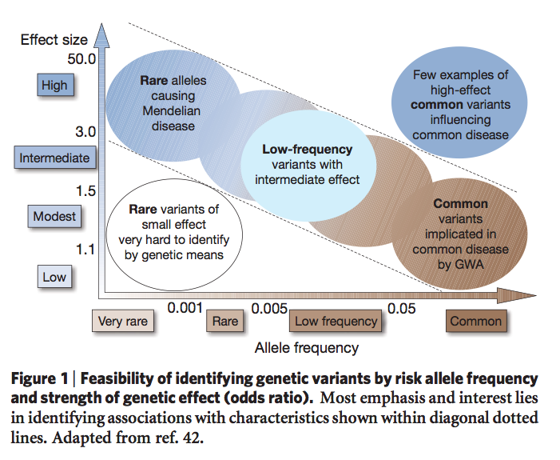
To maintain the same statistical power, a rare variant must have much larger effect size than a common variant.
Finding the missing heritability of complex diseases. T A Manolio, F S Collions, N J Cox, et al. Nature Reviews. 2009
Notes:
What is effect size?

Slide 11
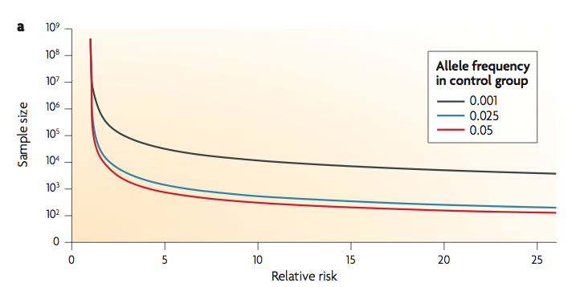
With the same effect size, rare variants need much larger sample size to be detected than common variants
Statistical analysis strategies for association studies involving rare variants. V Bansal, O Libiger, A Torkamani and N J Schork. Nature Reviews Genetics. 2010.

Slide 12
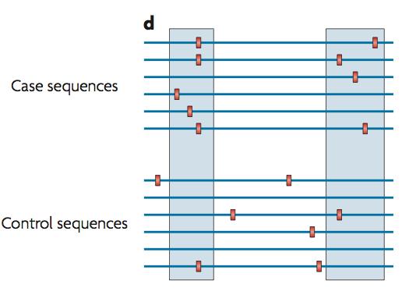
One strategy to deal with this problem is to create a “super-variant” by “collapsing” rare variants that belong to a functional unit (e.g. a gene)
Statistical analysis strategies for association studies involving rare variants. V Bansal, O Libiger, A Torkamani and N J Schork. Nature Reviews Genetics. 2010.

Slide 13
Collapsing methods:
Burden tests
Kernel-based tests

Slide 14
Sum tests
CAST (cohort allelic sums test)
Define a “super variant” X_{C} for each collapsing set C
X_{C} = 1 if the individual carries any of the rare variants in the collapsing set
CMC test (combined multivariate and collapsing test)
Extension of CAST
Including each common variant (without collapsing) and do multivariate test
A strategy to discover genes that carry multi-allelic or mono-allelic risk for common diseases: a cohort allelic sums test (CAST). Morgenthaler S, Thilly W G. Mut. Res. 2007
Methods for Detecting Associations with Rare Variants for Common Diseases: Application to Analysis of Sequence Data. Li B, Leal S M, 2008. Am J Hum Genet.

Slide 15
In CAST and CMC tests, when a collapsing set is large enough, the “super-variant” for every individual will be 1
A modification: Sum test
Define the super-variant X_{C} as the total number of rare variants within the collapsing set carried by an individual
Analysis of multiple SNPs in a candidate gene or region. Chapman J M, Whittaker. Genet Epidemiol. 2008.
Notes:
Define additive and dominant

Slide 16
A further extension
weighted-sum test (w-Sum)
allows one to include variants of all allele frequency in a collapsing set
weight variants according to allele frequency so that rare variants are not overwhelmed by common variants
A Groupwise Association Test for Rare Mutations Using a Weighted Sum Statistic. Madsen B E, Browning S R. PLoS Genet. 2009.
Pooled association tests for rare variants in exon-resequencing studies. Price A L et al. Am J Hum Genetic, 2010.
Pros and cons of burden tests
Pro: Degree of freedom is 1
Con: won’t work when variants within a collapsing set affect the phenotype in different directions

Slide 17
aSum (adaptive sum) test
Decide the sign of each variant by its marginal association with the trait
Account for possible opposite association direction
The cost is that degrees of freedom are consumed while estimating the signs from the data
A data-adaptive sum test for disease association with multiple common or rare variants. Han F, Pan W. Hum. Hered. 2010.
Another class of tests that account for possible sign differences within a collapsing set are the kernel-based tests

Slide 18
Kernel-based test
Two ways to understand it
A. If a set of variants contain some causal variants, then phenotype similarities should be correlated with the “genotype similarities” defined on these variants
B. Assuming the effects of a set of variants come from a distribution with zero mean and some variance, it tests whether the variance is zero or not
No assumptions about the direction of association

Slide 19
Kernel-based test
Example: SKAT (Sequence Kernel Association Test)
A very popular R package
Use kernel methods to compute SNP-set level p-values efficiently
Allows adjusting for covariates
Flexible kernel choices (able to account for the interactions between variants)
Rare-variant association testing for sequencing data with the sequence kernel association test. Wu MC, Lee S, Cai T, Li Y, Boehnke M, Lin X. Am J Hum Genet. 2011

Slide 20
Summary
Due to the low allele frequency, direct testing rare variants has very limited power
Assuming multiple causal variants fall in a pre-defined variant set, one can collapse the variants in the set and test on the set of variants
Burden tests work well when all variants in a collapsing set affect the phenotype in the same direction
Kernel-based test can deal with opposite association directions

Slide 21
Family-based study design – enriching rare variants
Rare variants may not longer be rare within a family
Traditional association tests that assume independence between samples are no longer valid
Relationships between family members need to be accounted for

Slide 22
Testing rare variants in family-based design
Example: famSKAT (family-based SKAT)
Extension of the original SKAT method
Adding a variance component to the original SKAT model to account for familial relatedness between samples
Only available for quantitative trait yet
Sequence Kernel Association Test for Quantitative Traits in Family Samples.
H Chen, J B Meigs, J Dupuis. Genetic Epidemiology, 2013

Slide 23
Challenge #2: Needles in haystack
A few causal variants in a huge number of variants
In statistical language: “multiple testing burden”
Need to reduce the total number of variants to be tested (and try to avoid missing true causal variants)

Slide 24
Commonly used strategies
Targeted sequencing (e.g. Exome-Seq)
Filter variants by functional annotations (e.g. synonymous mutations)
More generally speaking, filter variants based on predicted “biological importance”
Rationale: a. reduce false positives; b. biologically unimportant variants usually have small effect sizes (hard to detect anyway)

Slide 25
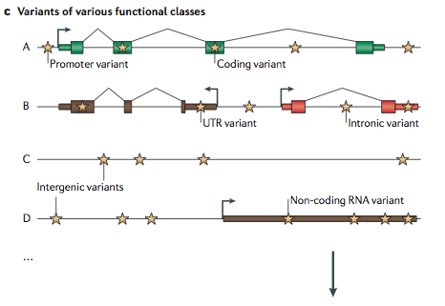
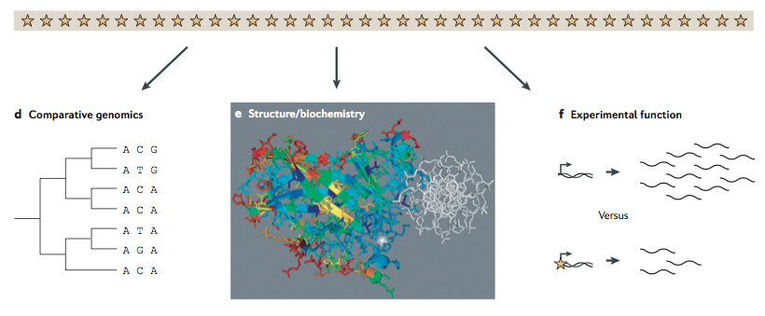
Needles in stack of needles: finding disease-causal variants in a wealth of genomic data. G M Cooper, J Shendure. Nature Reviews Genetics. 2011.

Slide 26
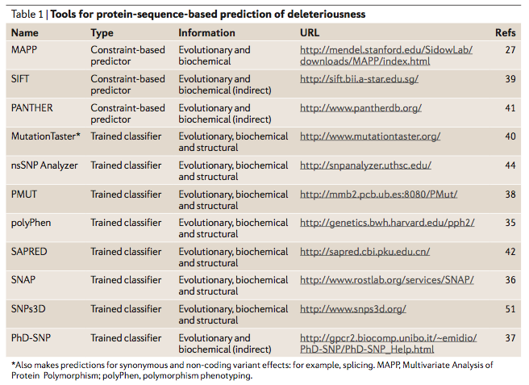
Needles in stack of needles: finding disease-causal variants in a wealth of genomic data. G M Cooper, J Shendure. Nature Reviews Genetics. 2011.

Slide 27
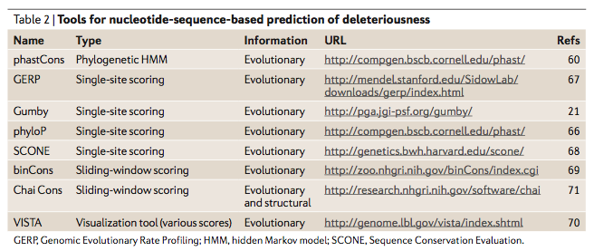
Needles in stack of needles: finding disease-causal variants in a wealth of genomic data. G M Cooper, J Shendure. Nature Reviews Genetics. 2011.

Slide 28
Despite so many efforts, not many rare variants were detected for common diseases
Rare variant detection is much more successful for rare diseases
A possible explanation: even with all the above efforts, the power may be still not enough?
Or, rare variants may not contribute that much susceptibility for common disease?

Slide 29
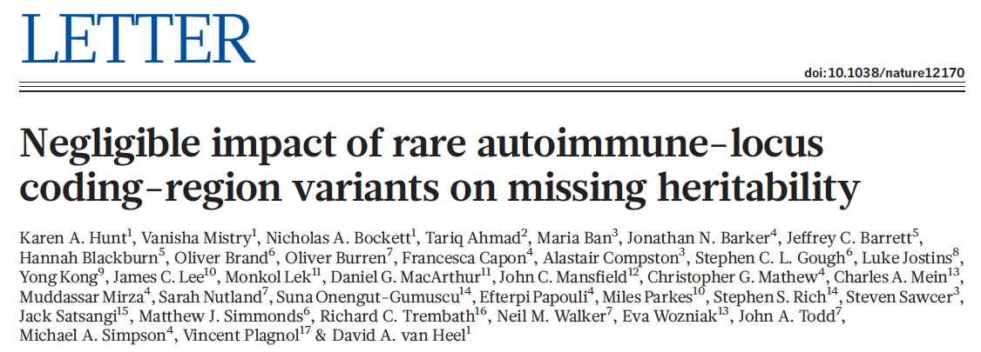
25 auto-immune risk genes’ coding regions were sequenced on 40,000 individuals
Rare variants in these genes have negligible contribution to auto-immune disease susceptibility
Negligible impact of rare autoimmune-locus coding-region variants on missing heritability. Hunt K A et al. Nature, 2013

Slide 30
Summary
NGS technology offers an opportunity to discover disease susceptibility rare variants
Two major challenges in rare variant association studies:
Limited power due to low allele frequency
Too many rare variants (most are irrelevant)
Some strategies for rare variant association studies:
Collapsing
Family-based design
Variant filtering based on predicted deleteriousness

