Slide 1
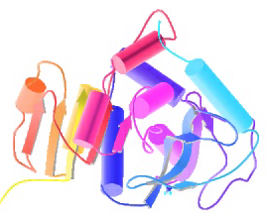
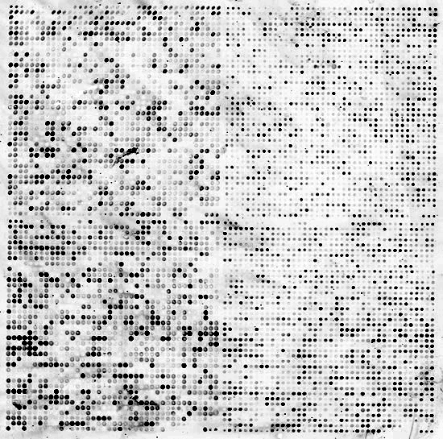


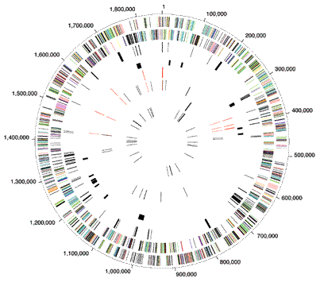
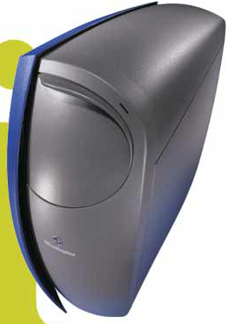

BIOINFORMATICS
Unsupervised Datamining
Mark Gerstein, Yale University
gersteinlab.org/courses/452
(last edit in fall '12)

Slide 2
Datamining
Building the data matrix
  Generic
  Gene centric
  Genomic region
  Network centric
Databases
Supervised Mining
Unsupervised mining
  Simple overlaps
  Clustering rows & columns (networks)
  PCA
  SVD (theory + appl.)
  Weighted Gene Co-Expression Network
  Biplot
  CCA

Slide 3
Spectral Methods Outline & Papers
Simple background on PCA (emphasizing lingo)
More abstract run through on SVD
Application to
  O Alter et al. (2000). "Singular value decomposition for genome-wide expression data processing and modeling." PNAS 97: 10101
  J Qian et al. (2001). "Beyond synexpression relationships: local clustering of time-shifted and inverted gene expression profiles identifies new, biologically relevant interactions." J Mol Biol. 314: 1053.
  Langfelder P, Horvath S (2007) Eigengene networks for studying the relationships between co-expression modules. BMC Systems Biology 2007, 1:54
  Z Zhang et al. (2007) "Statistical analysis of the genomic distribution and correlation of regulatory elements in the ENCODE regions." Genome Res 17: 787
  TA Gianoulis et al. (2009) "Quantifying environmental adaptation of metabolic pathways in metagenomics." PNAS 106: 1374.

Slide 4
Unsupervised Mining
Simple "Overlaps"

Slide 5
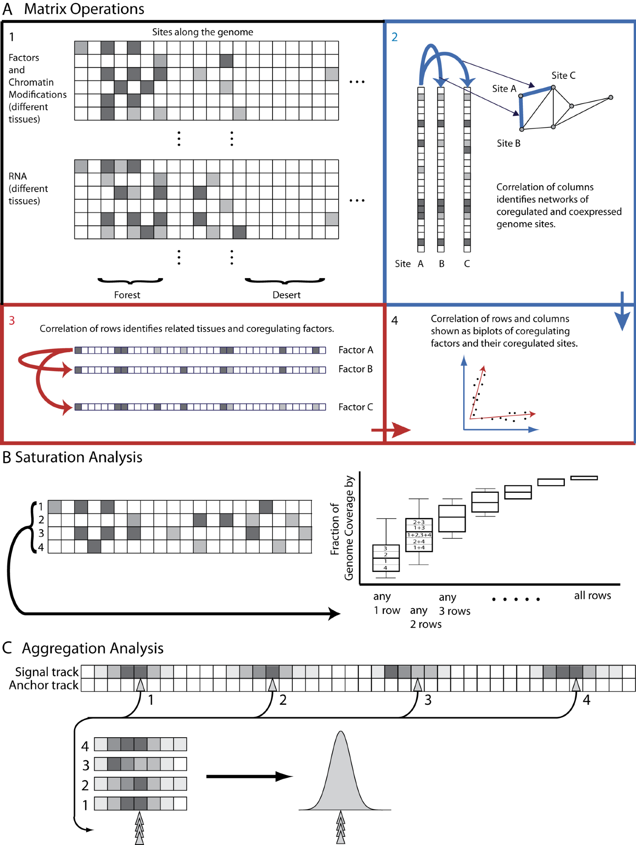
Structure of Genomic Features Matrix

Slide 6
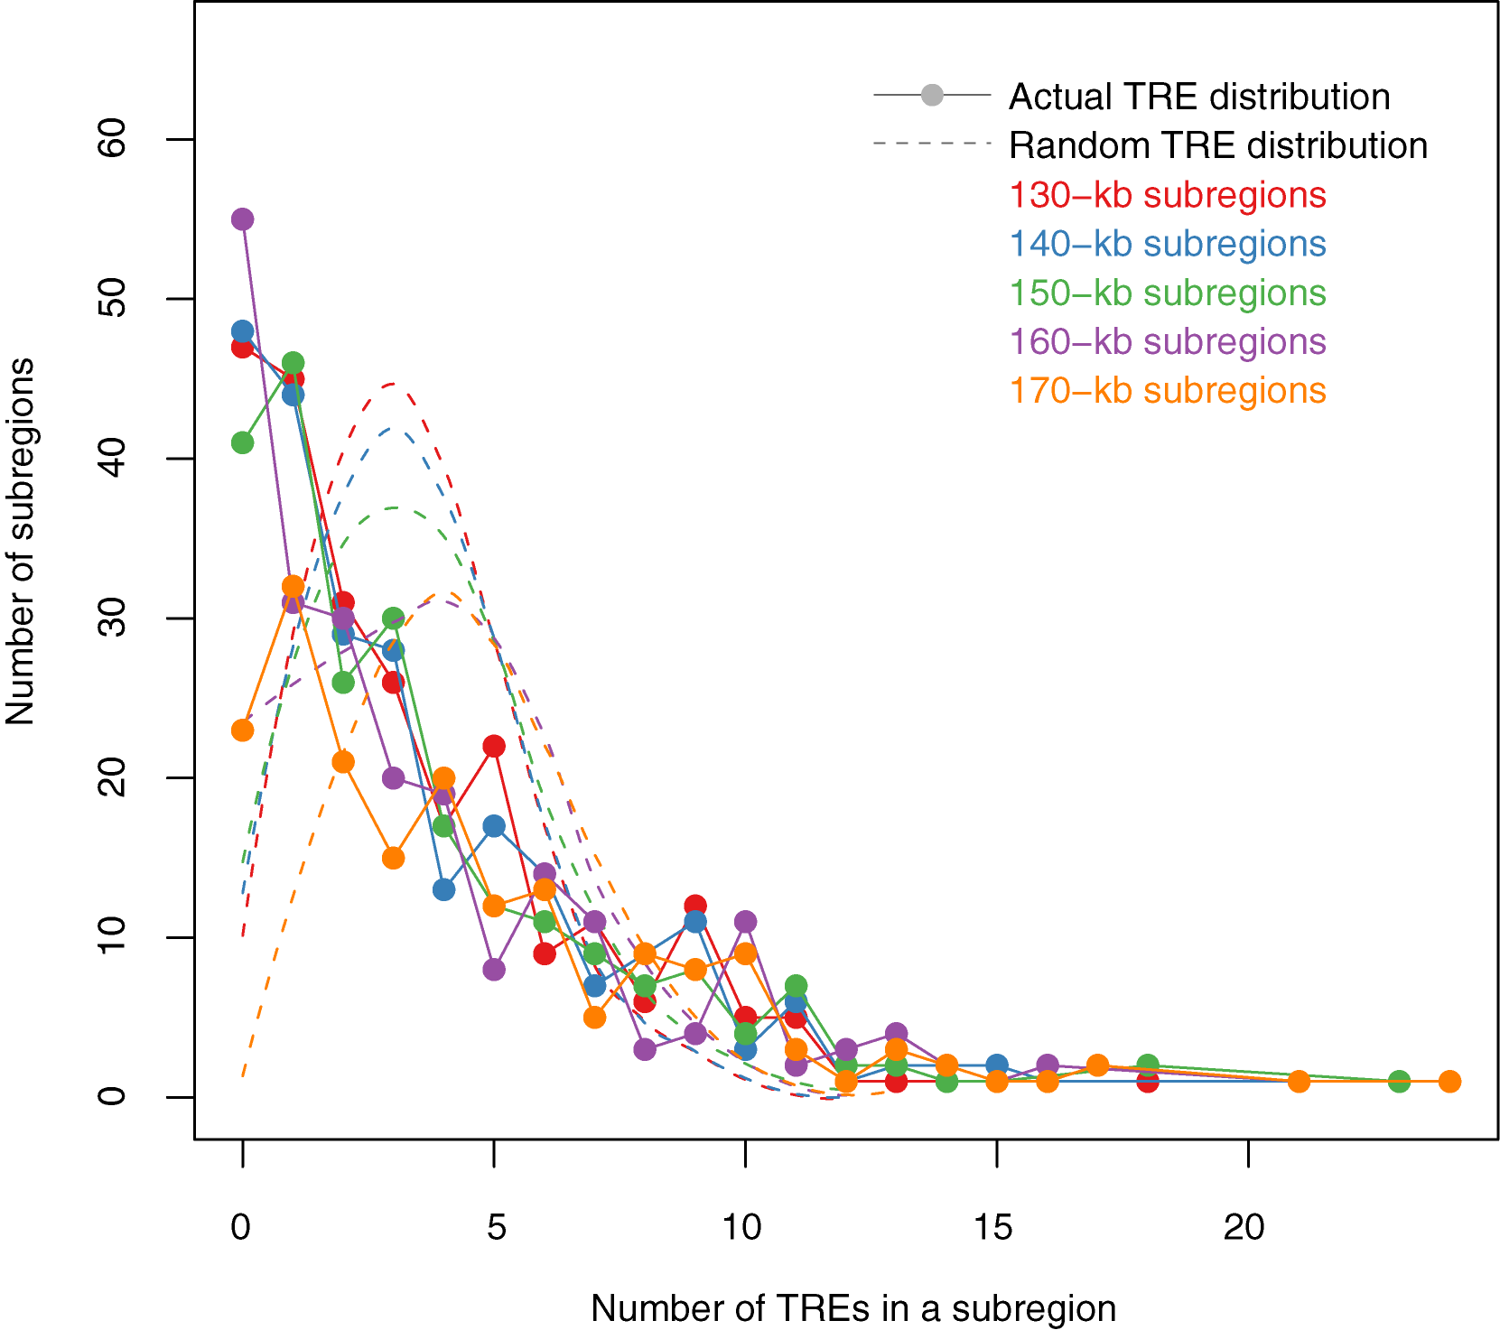
Non-random distribution of TREs
TREs are not evenly distributed throughout the encode regions
(P < 2.2×10⁻¹⁶ ).
The actual TRE distribution is power-law.
The null distribution is ‘Poissonesque.’
Many genomic subregions with extreme numbers of TREs.
Zhang et al. (2007) Gen. Res.

Slide 7
Aggregation & Saturation
[Nat. Rev. Genet. (2010) 11: 559]

Slide 8
Unsupervised Mining
Clustering Columns & Rows of the Data Matrix

Slide 9
Correlating Rows & Columns
[Nat. Rev. Genet. (2010) 11: 559]

Slide 10
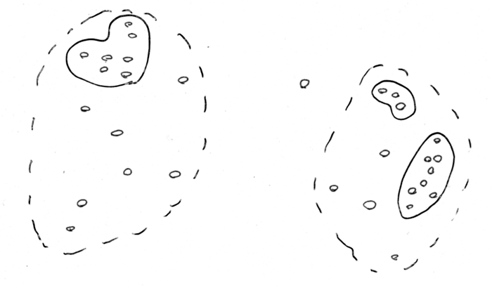
“cluster” predictors

Slide 11
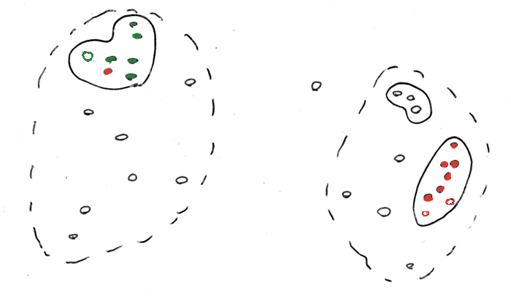
Use clusters to predict Response

Slide 12
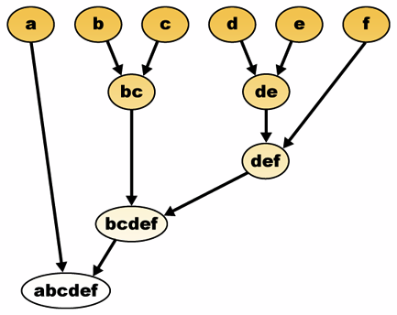
Agglomerative Clustering
Bottom up
v top down
(K-means, know how many centers)
Single or multi-link
  threshold for connection?
http://commons.wikimedia.org/wiki/File:Hierarchical_clustering_diagram.png

Slide 13
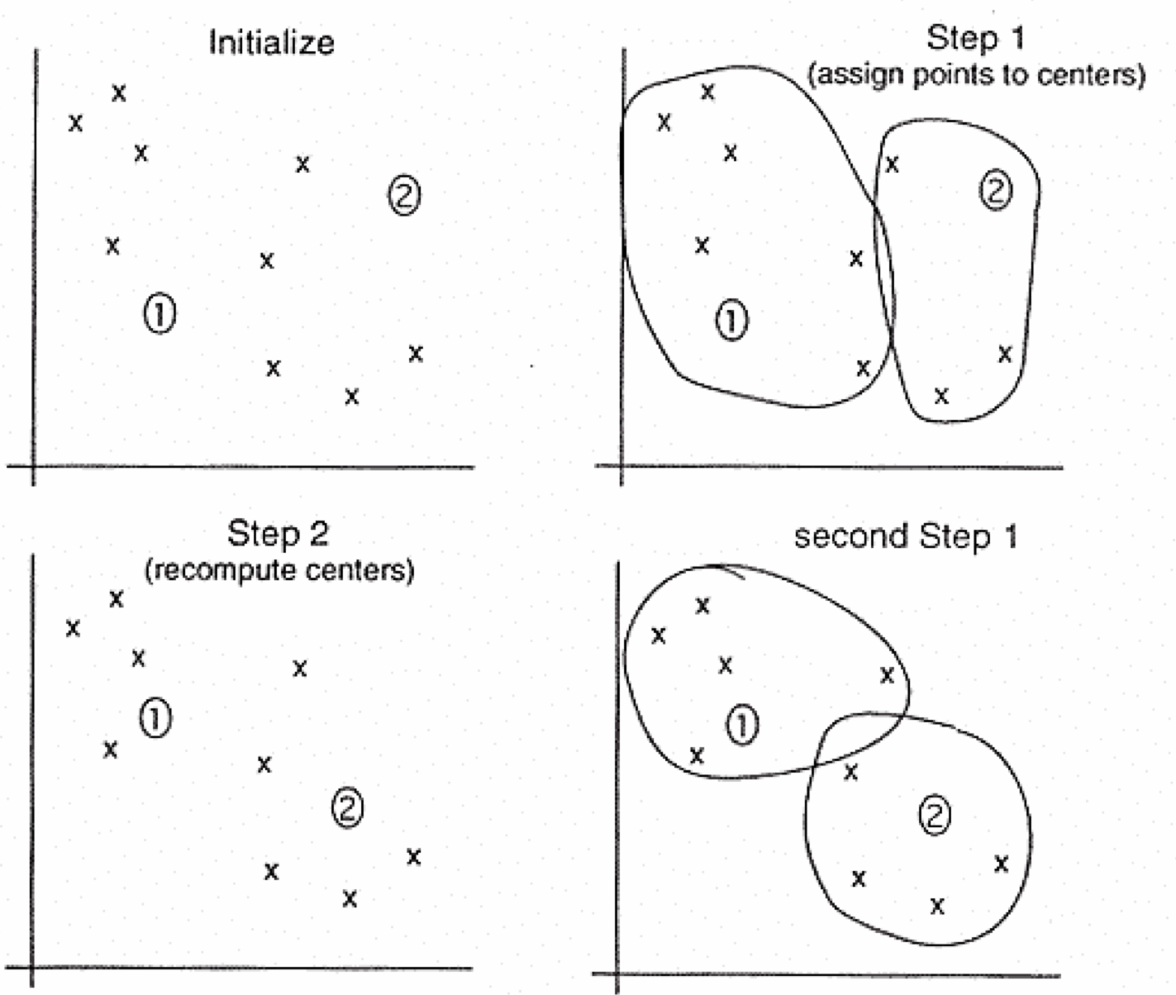
K-means
1) Pick ten (i.e. k?) random points as putative cluster centers.
2) Group the points to be clustered by the center to which they are
closest.
3) Then take the mean of each group and repeat, with the means now at
the cluster center.
4)Stop when the centers stop moving.

Slide 14
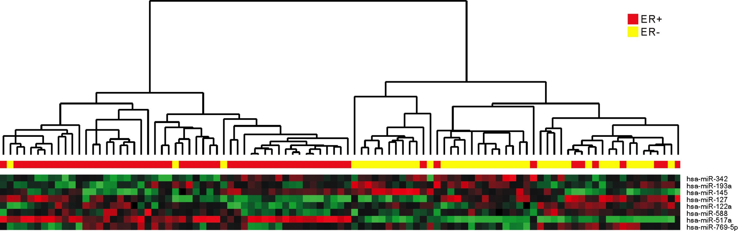
Using Genes to Cluster Cancer Samples
(3) Clustering based on RE score divides samples into 2 main types of cancer
(4) Clustering better than based on indiv. gene expression levels
(1) RE-score profile for diff. miRNA in 1 cancer sample.
(2) Tabulate over many different breast cancer samples
Cheng et al., Genome Biology, 2009

Slide 15
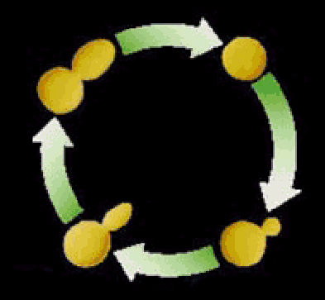

Clustering the yeast cell cycle to uncover interacting proteins
[Brown, Davis]
mRNA expression level (ratio)
Time->
Microarray timecourse of
1 ribosomal protein
Notes:
REM: Picking interesting relationships between genes pairs from ~18M possibilities

Slide 16
Clustering the yeast cell cycle to uncover interacting proteins
mRNA expression level (ratio)
Time->
Random relationship from ~18M
Notes:
REM: Picking interesting relationships between genes pairs from ~18M possibilities

Slide 17
Clustering the yeast cell cycle to uncover interacting proteins
[Botstein; Church, Vidal]
mRNA expression level (ratio)
Time->
Close relationship from 18M
(2 Interacting Ribosomal Proteins)
Notes:
REM: Picking interesting relationships between genes pairs from ~18M possibilities

Slide 18
Clustering the yeast cell cycle to uncover interacting proteins
mRNA expression level (ratio)
Time->
Predict Functional Interaction of
Unknown Member of Cluster
Notes:
REM: Picking interesting relationships between genes pairs from ~18M possibilities

Slide 19
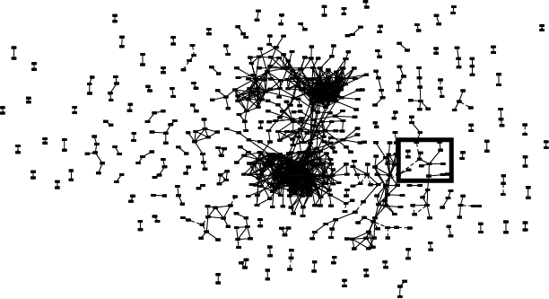
Global Network of Relationships
~470K significant
relationships
from ~18M possible

Slide 20
Network = Adjacency Matrix
Adjacency matrix A=[a_{ij}] encodes whether/how a pair of nodes is connected.
For unweighted networks: entries are 1 (connected) or 0 (disconnected)‏
For weighted networks: adjacency matrix reports connection strength between gene pairs
Adapted from : http://www.genetics.ucla.edu/labs/horvath/CoexpressionNetwork

Slide 21
Unsupervised Mining
Principal Component Analysis
(PCA)

Slide 22
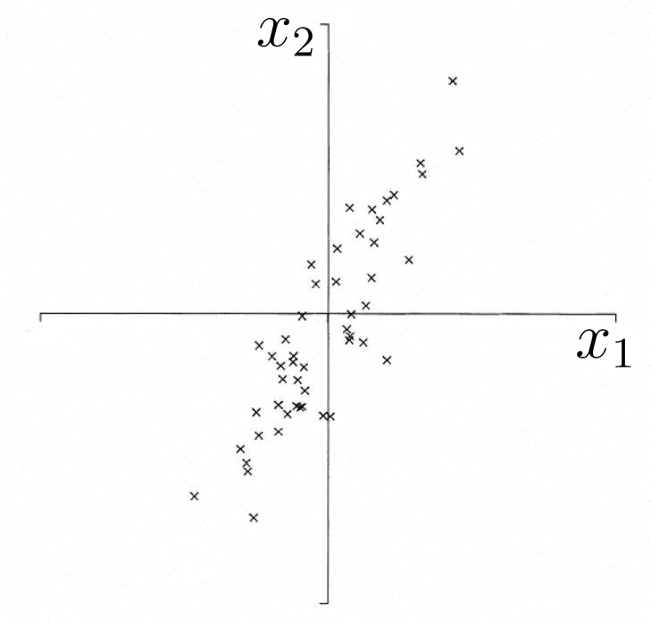
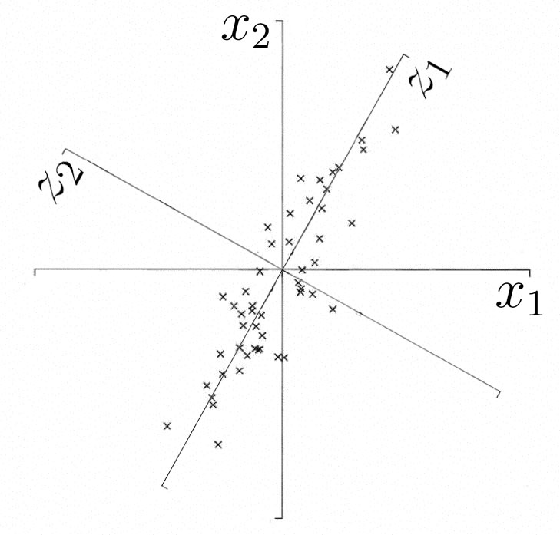
What is PCA?
A technique used to reduce the dimensionality of a data set by finding directions of maximum variability
Projection (typically a rotation) into new axes
But still retains the dataset’s variation
y₁
y₂
Adapted from http://www.astro.princeton.edu/~gk/A542/PCA.ppt

Slide 23
PCA Matrix
Start with dataset of k variables X = x₁, x₂ ... x_{k} and n observations.
Construct covariance or correlation matrix for variables.
The Eigenvalue Problem or Eigenanalysis: matrix diagonalization and solve for eigenvalues and eigenvectors
E.g. Start with a bunch of coordinates
Observations | X1 | X2
1 | 2 | 5
2 | 5 | 6
3 | 4 | 2
4 | 3 | 7
5 | 9 | -5
…
n | -5 | -8

Slide 24
Interpretation:
Eigenvalues & Eigenvectors
λ₂
λ₁
Adapted from http://myweb.dal.ca/~hwhitehe/BIOL4062/pca.ppt

Slide 25
Dimension Reduction
Since much of the variation can often be explained the first few PCs, the whole dataset can essentially be represented by those.
But how many components do we choose?
One convenient method: Scree diagram
Figure from http://myweb.dal.ca/~hwhitehe/BIOL4062/pca.ppt

Slide 26
PCA terminology
Principal component (PC) j is the jth eigenvector of correlation/covariance matrix.
PC scores are the new variables for each observation, produced as a linear combination of coefficients and original variables.
Eigenvalue, λ_{j}, is the amount of variance accounted for by the jth PC.
Proportion of variance accounted for by component is given by λ_{j} / Σ λ_{j}
Coefficients, a_{jk}, are elements of eigenvectors that relate original variables (standardized if using correlation matrix) to components.
Loading of kth original variable on jth component is given by a_{jk√}λ_{j} – this is the correlation between variable and component

Slide 27
Potential problems of PCA
If the dataset…
Lacks Independence
  NO PROBLEM
Lacks Normality
  Normality desirable but not essential
Lacks Precision
  Precision desirable but not essential
Lacks Linearity
    Problem: Use other non-linear (kernel) methods
Many Zeroes in Data Matrix (Sparse)
  Problem: Use Correspondence Analysis

Slide 28
Unsupervised Mining
SVD
Puts together slides prepared by Brandon Xia with images from
Alter et al. papers

Slide 29
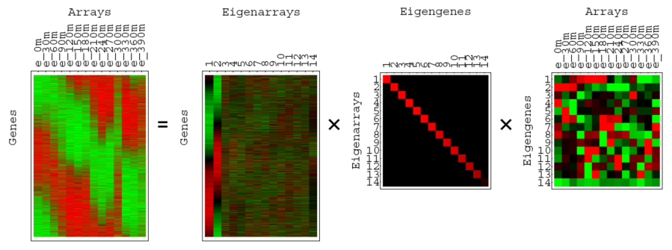
SVD for microarray data
(Alter et al, PNAS 2000)

Slide 30
A = USV^{T}
A is any rectangular matrix (m ≥ n)
Row space: vector subspace generated by the row vectors of A
Column space: vector subspace generated by the column vectors of A
  The dimension of the row & column space is the rank of the matrix A: r (≤ n)
A is a linear transformation that maps vector x in row space into vector Ax in column space

Slide 31
A = USV^{T}
U is an “orthogonal” matrix (m ≥ n)
Column vectors of U form an orthonormal basis for the column space of A: U^{T}U=I
u₁, …, u_{n} in U are eigenvectors of AA^{T}
  AA^{T} =USV^{T} VSU^{T} =US² U^{T}
  “Left singular vectors”

Slide 32
A = USV^{T}
V is an orthogonal matrix (n by n)
Column vectors of V form an orthonormal basis for the row space of A: V^{T}V=VV^{T}=I
v₁, …, v_{n} in V are eigenvectors of A^{T}A
  A^{T}A =VSU^{T} USV^{T} =VS² V^{T}
  “Right singular vectors”

Slide 33
A = USV^{T}
S is a diagonal matrix (n by n) of non-negative singular values
Typically sorted from largest to smallest
Singular values are the non-negative square root of corresponding eigenvalues of A^{T}A and AA^{T}

Slide 34
AV = US
Means each Av_{i} = s_{i}u_{i}
Remember A is a linear map from row space to column space
Here, A maps an orthonormal basis {v_{i}} in row space into an orthonormal basis {u_{i}} in column space
Each component of u_{i} is the projection of a row onto the vector v_{i}

Slide 35
SVD of A (m by n): recap
A = USV^{T} = (big-"orthogonal")(diagonal)(sq-orthogonal)
u₁, …, u_{m} in U are eigenvectors of AA^{T}
v₁, …, v_{n} in V are eigenvectors of A^{T}A
s₁, …, s_{n} in S are nonnegative singular values of A
AV = US means each Av_{i} = s_{i}u_{i}
“Every A is diagonalized by 2 orthogonal matrices”

Slide 36
SVD as sum of rank-1 matrices
A = USV^{T}
A = s₁u₁v₁^{T} + s₂u₂v₂^{T} +… + s_{n}u_{n}v_{n}^{T}
s₁ ≥ s₂ ≥ … ≥ s_{n} ≥ 0
What is the rank-r matrix A that best approximates A ?
  Minimize
A = s₁u₁v₁^{T} + s₂u₂v₂^{T} +… + s_{r}u_{r}v_{r}^{T}
Very useful for matrix approximation

Slide 37
Examples of (almost) rank-1 matrices
Steady states with fluctuations
Array artifacts?
Signals?

Slide 38
Geometry of SVD in row space
A as a collection of m row vectors (points) in the row space of A
s₁u₁v₁^{T} is the best rank-1 matrix approximation for A
Geometrically: v₁ is the direction of the best approximating rank-1 subspace that goes through origin
s₁u₁ gives coordinates for row vectors in rank-1 subspace
v₁ Gives coordinates for row space basis vectors in rank-1 subspace
y
v₁
x

Slide 39
Geometry of SVD in row space
y
v₁
A
x
y
y
s₁u₁v₁^{T}
x
x
This line segment that goes through origin approximates the original data set
The projected data set approximates the original data set

Slide 40
Geometry of SVD in row space
A as a collection of m row vectors (points) in the row space of A
s₁u₁v₁^{T} + s₂u₂v₂^{T} is the best rank-2 matrix approximation for A
Geometrically: v₁ and v₂ are the directions of the best approximating rank-2 subspace that goes through origin
s₁u₁ and s₂u₂ gives coordinates for row vectors in rank-2 subspace
v₁ and v₂ gives coordinates for row space basis vectors in rank-2 subspace
y’
y
x’
x

Slide 41
What about geometry of SVD in column space?
A = USV^{T}
A^{T} = VSU^{T}
The column space of A becomes the row space of A^{T}
The same as before, except that U and V are switched

Slide 42
Geometry of SVD in row and column spaces
Row space
  s_{i}u_{i} gives coordinates for row vectors along unit vector v_{i}
  v_{i} gives coordinates for row space basis vectors along unit vector v_{i}
Column space
  s_{i}v_{i} gives coordinates for column vectors along unit vector u_{i}
  u_{i} gives coordinates for column space basis vectors along unit vector u_{i}
Along the directions v_{i} and u_{i}, these two spaces look pretty much the same!
  Up to scale factors s_{i}
  Switch row/column vectors and row/column space basis vectors
  Biplot....

Slide 43
Additional Points
Time Complexity (Cubic)
Application to text mining
  Latent semantic indexing
  sparse
A

Slide 44
Conclusion
SVD is the “absolute high point of linear algebra”
SVD is difficult to compute; but once we have it, we have many things
SVD finds the best approximating subspace, using linear transformation
Simple SVD cannot handle translation, non-linear transformation, separation of labeled data, etc.
Good for exploratory analysis; but once we know what we look for, use appropriate tools and model the structure of data explicitly!

Slide 45
Unsupervised Mining
Intuition on interpretation of SVD in terms of genes and conditions

Slide 46
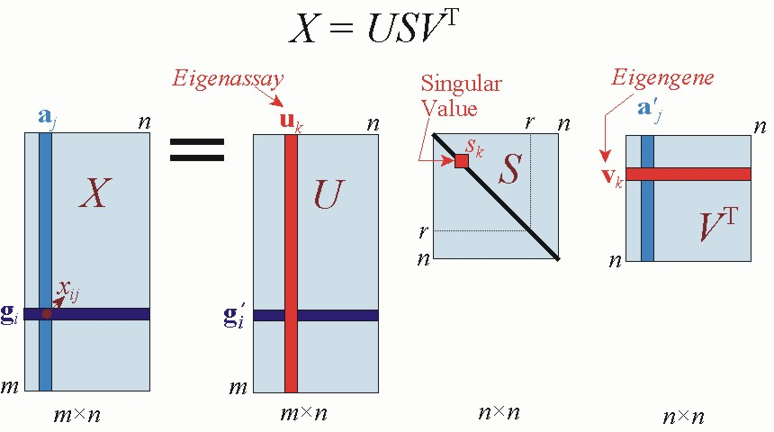
SVD for microarray data
(Alter et al, PNAS 2000)

Slide 47
Notation
m=1000 genes
  row-vectors
  10 eigengene (v_{i}) of dimension 10 conditions
n=10 conditions (assays)
  column vectors
  10 eigenconditions (u_{i}) of dimension 1000 genes

Slide 48
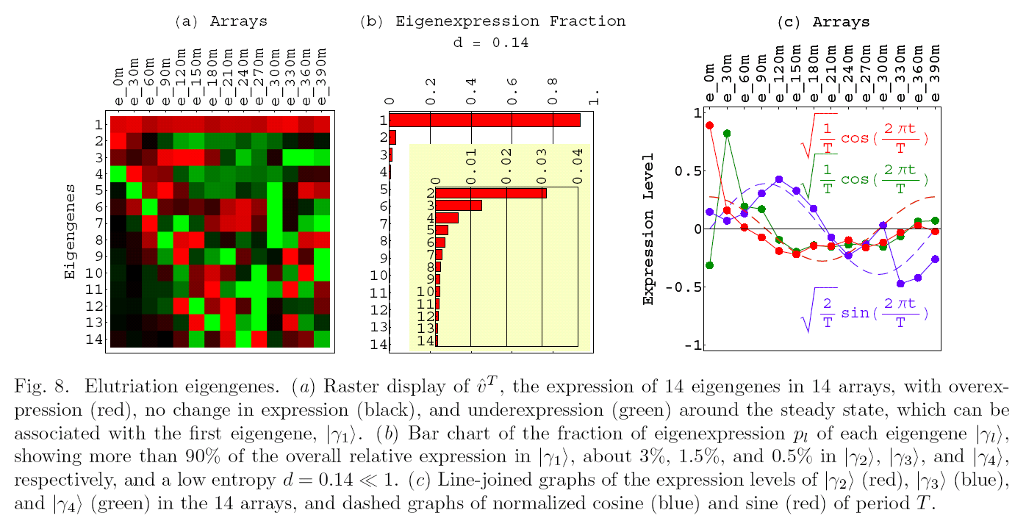
Close up on Eigengenes

Slide 49
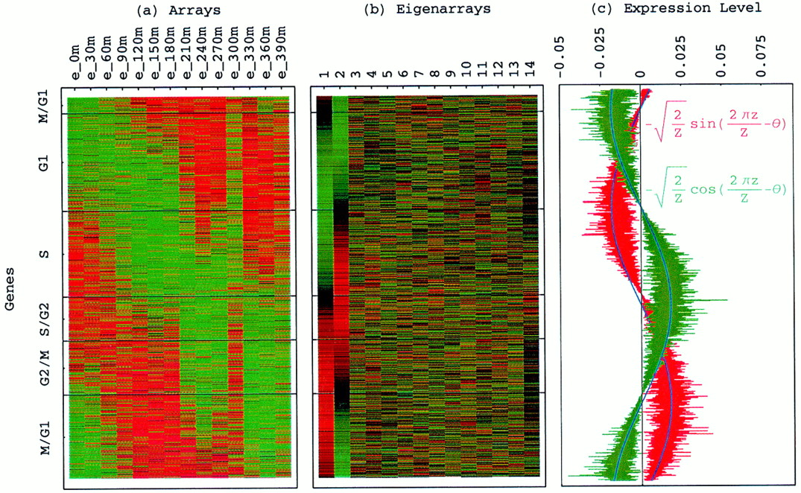
Genes sorted by correlation with top 2 eigengenes
Alter, Orly et al. (2000) Proc. Natl. Acad. Sci. USA 97, 10101-10106
Copyright ©2000 by the National Academy of Sciences

Slide 50
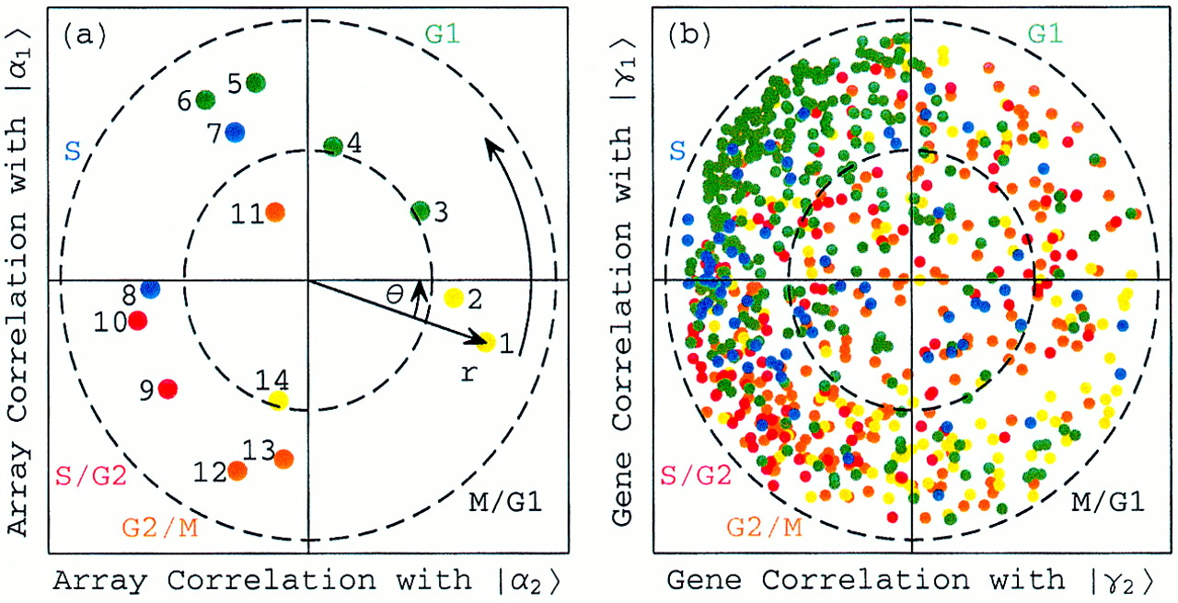
Normalized elutriation expression in the subspace associated with the cell cycle
Alter, Orly et al. (2000) Proc. Natl. Acad. Sci. USA 97, 10101-10106
Copyright ©2000 by the National Academy of Sciences

Slide 51
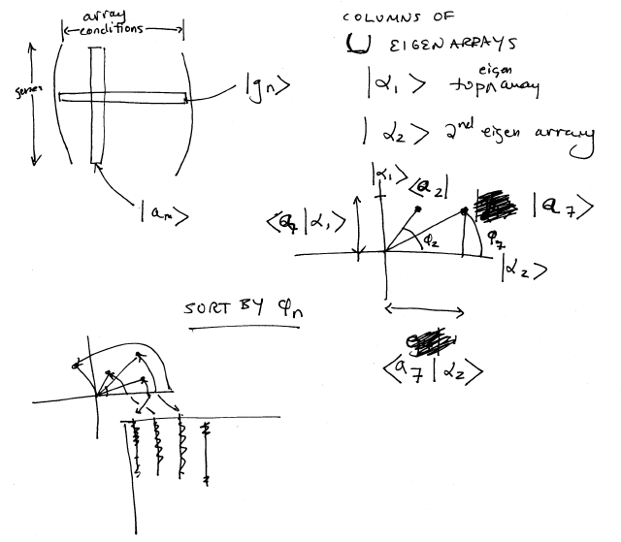
Plotting Experiments in Low Dimension Subspace

Slide 52
Unsupervised Mining
Weighted Gene Co-Expression Network

Slide 53
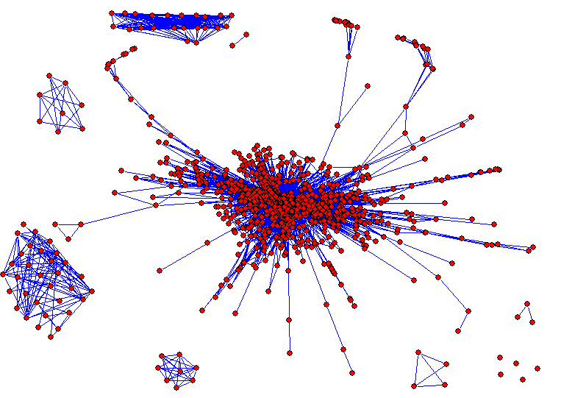
Weighted Gene Co-Expression Network Analysis
Bin Zhang and Steve Horvath (2005)
"A General Framework for Weighted Gene Co-Expression Network Analysis",
Statistical Applications in Genetics and Molecular Biology: Vol. 4: No. 1, Art. 17.
Adapted from : http://www.genetics.ucla.edu/labs/horvath/CoexpressionNetwork

Slide 54
Central concept in network methodology:
Network Modules
Modules: groups of densely interconnected genes (not the same as closely related genes)‏
  a class of over-represented patterns
Empirical fact: gene co-expression networks exhibit modular structure
Adapted from : http://www.genetics.ucla.edu/labs/horvath/CoexpressionNetwork

Slide 55
Module Detection
Numerous methods exist
Many methods define a suitable gene-gene dissimilarity measure and use clustering.
In our case: dissimilarity based on topological overlap
Clustering method: Average linkage hierarchical clustering
  branches of the dendrogram are modules
Adapted from : http://www.genetics.ucla.edu/labs/horvath/CoexpressionNetwork

Slide 56
Topological overlap measure,
TOM
Pairwise measure by Ravasz et al, 2002
TOM[i,j] measures the overlap of the set of nearest neighbors of nodes i,j
Closely related to twinness
Easily generalized to weighted networks
Adapted from : http://www.genetics.ucla.edu/labs/horvath/CoexpressionNetwork

Slide 57
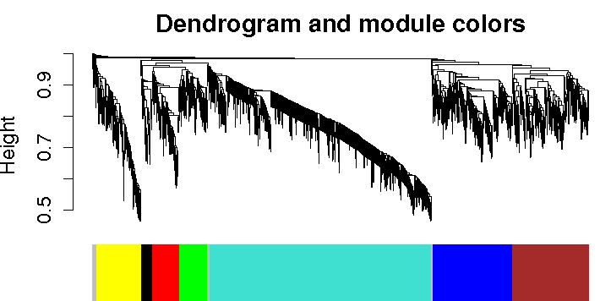
Example of module detection via hierarchical clustering
Example of module detection via
hierarchical clustering
Expression data from human brains, 18 samples.
Adapted from : http://www.genetics.ucla.edu/labs/horvath/CoexpressionNetwork

Slide 58
Module eigengenes
Often: Would like to treat modules as single units
  Biologically motivated data reduction
Construct a representative
Our choice: module eigengene = 1st principal component of the module expression matrix
Intuitively: a kind of average expression profile
Genes of each module must be highly correlated for a representative to really represent
Langfelder P, Horvath S (2007) Eigengene networks for studying the relationships between co-expression modules. BMC Systems Biology 2007, 1:54
Adapted from : http://www.genetics.ucla.edu/labs/horvath/CoexpressionNetwork

Slide 59
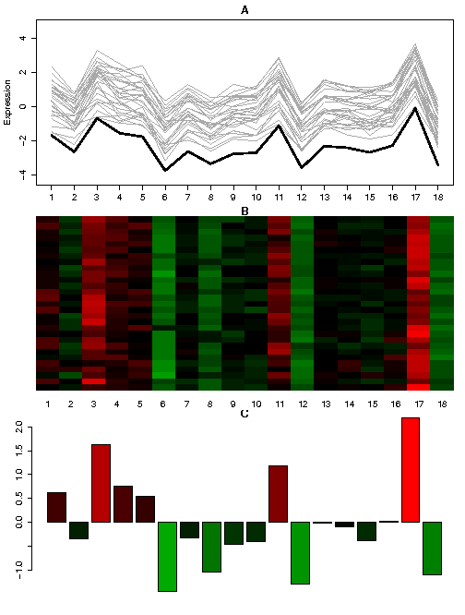
Example
Human brain expression data, 18 samples
Module consisting of 50 genes
Adapted from : http://www.genetics.ucla.edu/labs/horvath/CoexpressionNetwork
Langfelder P, Horvath S (2007) Eigengene networks for studying the relationships between co-expression modules. BMC Systems Biology 2007, 1:54

Slide 60
Module eigengenes are very useful!
Summarize each module in one synthetic expression profile
Suitable representation in situations where modules are considered the basic building blocks of a system
  Allow to relate modules to external information (phenotypes, genotypes such as SNP, clinical traits) via simple measures (correlation, mutual information etc)‏
  Can quantify co-expression relationships of various modules by standard measures
Langfelder P, Horvath S (2007) Eigengene networks for studying the relationships between co-expression modules. BMC Systems Biology 2007, 1:54
Adapted from : http://www.genetics.ucla.edu/labs/horvath/CoexpressionNetwork

Slide 61
Human and chimpanzee brain expression data
Construct gene expression networks in both sets, find modules
Construct consensus modules
Characterize each module by brain region where it is most differentially expressed
Represent each module by its eigengene
Characterize relationships among modules by correlation of respective eigengenes (heatmap or dendrogram)
Adapted from : http://www.genetics.ucla.edu/labs/horvath/CoexpressionNetwork

Slide 62
For more information
Weighted Gene Co-expression Networks website:
http://www.genetics.ucla.edu/labs/horvath/CoexpressionNetwork/

Slide 63
A short methodological summary of the publications.
How to construct a gene co-expression network using the scale free topology criterion? Robustness of network results. Relating a gene significance measure and the clustering coefficient to intramodular connectivity:
  Zhang B, Horvath S (2005) "A General Framework for Weighted Gene Co-Expression Network Analysis", Statistical Applications in Genetics and Molecular Biology: Vol. 4: No. 1, Article 17
Theory of module networks (both co-expression and protein-protein interaction modules):
  Dong J, Horvath S (2007) Understanding Network Concepts in Modules, BMC Systems Biology 2007, 1:24
What is the topological overlap measure? Empirical studies of the robustness of the topological overlap measure:
  Yip A, Horvath S (2007) Gene network interconnectedness and the generalized topological overlap measure. BMC Bioinformatics 2007, 8:22
Software for carrying out neighborhood analysis based on topological overlap. The paper shows that an initial seed neighborhood comprised of 2 or more highly interconnected genes (high TOM, high connectivity) yields superior results. It also shows that topological overlap is superior to correlation when dealing with expression data.
  Li A, Horvath S (2006) Network Neighborhood Analysis with the multi-node topological overlap measure. Bioinformatics. doi:10.1093/bioinformatics/btl581
Gene screening based on intramodular connectivity identifies brain cancer genes that validate. This paper shows that WGCNA greatly alleviates the multiple comparison problem and leads to reproducible findings.
  Horvath S, Zhang B, Carlson M, Lu KV, Zhu S, Felciano RM, Laurance MF, Zhao W, Shu, Q, Lee Y, Scheck AC, Liau LM, Wu H, Geschwind DH, Febbo PG, Kornblum HI, Cloughesy TF, Nelson SF, Mischel PS (2006) "Analysis of Oncogenic Signaling Networks in Glioblastoma Identifies ASPM as a Novel Molecular Target", PNAS | November 14, 2006 | vol. 103 | no. 46 | 17402-17407
The relationship between connectivity and knock-out essentiality is dependent on the module under consideration. Hub genes in some modules may be non-essential. This study shows that intramodular connectivity is much more meaningful than whole network connectivity:
  "Gene Connectivity, Function, and Sequence Conservation: Predictions from Modular Yeast Co-Expression Networks" (2006) by Carlson MRJ, Zhang B, Fang Z, Mischel PS, Horvath S, and Nelson SF, BMC Genomics 2006, 7:40
How to integrate SNP markers into weighted gene co-expression network analysis? The following 2 papers outline how SNP markers and co-expression networks can be used to screen for gene expressions underlying a complex trait. They also illustrate the use of the module eigengene based connectivity measure kME.
  Single network analysis: Ghazalpour A, Doss S, Zhang B, Wang S, Plaisier C, Castellanos R, Brozell A, Schadt EE, Drake TA, Lusis AJ, Horvath S (2006) "Integrating Genetic and Network Analysis to Characterize Genes Related to Mouse Weight". PLoS Genetics. Volume 2 | Issue 8 | AUGUST 2006
  Differential network analysis: Fuller TF, Ghazalpour A, Aten JE, Drake TA, Lusis AJ, Horvath S (2007) "Weighted Gene Co-expression Network Analysis Strategies Applied to Mouse Weight", Mammalian Genome. In Press
The following application presents a `supervised’ gene co-expression network analysis. In general, we prefer to construct a co-expression network and associated modules without regard to an external microarray sample trait (unsupervised WGCNA). But if thousands of genes are differentially expressed, one can construct a network on the basis of differentially expressed genes (supervised WGCNA):
  Gargalovic PS, Imura M, Zhang B, Gharavi NM, Clark MJ, Pagnon J, Yang W, He A, Truong A, Patel S, Nelson SF, Horvath S, Berliner J, Kirchgessner T, Lusis AJ (2006) Identification of Inflammatory Gene Modules based on Variations of Human Endothelial Cell Responses to Oxidized Lipids. PNAS 22;103(34):12741-6
The following paper presents a differential co-expression network analysis. It studies module preservation between two networks. By screening for genes with differential topological overlap, we identify biologically interesting genes. The paper also shows the value of summarizing a module by its module eigengene.
  Oldham M, Horvath S, Geschwind D (2006) Conservation and Evolution of Gene Co-expression Networks in Human and Chimpanzee Brains. 2006 Nov 21;103(47):17973-8
Adapted from : http://www.genetics.ucla.edu/labs/horvath/CoexpressionNetwork

Slide 64
Unsupervised Mining
Biplot

Slide 65
Biplot
A biplot is a two-dimensional representation of a data matrix showing a point for each of the n observation vectors (rows of the data matrix) along with a point for each of the p variables (columns of the data matrix).
  The prefix ‘bi’ refers to the two kinds of points; not to the dimensionality of the plot. The method presented here could, in fact, be generalized to a threedimensional (or higher-order) biplot. Biplots were introduced by Gabriel (1971) and have been discussed at length by Gower and Hand (1996). We applied the biplot procedure to the following toy data matrix to illustrate how a biplot can be generated and interpreted. See the figure on the next page.
Here we have three variables (transcription factors) and ten observations (genomic bins). We can obtain a two-dimensional plot of the observations by plotting the first two principal components of the TF-TF correlation matrix R1.
  We can then add a representation of the three variables to the plot of principal components to obtain a biplot. This shows each of the genomic bins as points and the axes as linear combination of the factors.
The great advantage of a biplot is that its components can be interpreted very easily. First, correlations among the variables are related to the angles between the lines, or more specifically, to the cosines of these angles. An acute angle between two lines (representing two TFs) indicates a positive correlation between the two corresponding variables, while obtuse angles indicate negative correlation.
  Angle of 0 or 180 degrees indicates perfect positive or negative correlation, respectively. A pair of orthogonal lines represents a correlation of zero. The distances between the points (representing genomic bins) correspond to the similarities between the observation profiles. Two observations that are relatively similar across all the variables will fall relatively close to each other within the two-dimensional space used for the biplot. The value or score for any observation on any variable is related to the perpendicular projection form the point to the line.
Refs
  Gabriel, K. R. (1971), “The Biplot Graphical Display of Matrices with Application to Principal Component Analysis,” Biometrika, 58, 453–467.
  Gower, J. C., and Hand, D. J. (1996), Biplots, London: Chapman & Hall.

Slide 66
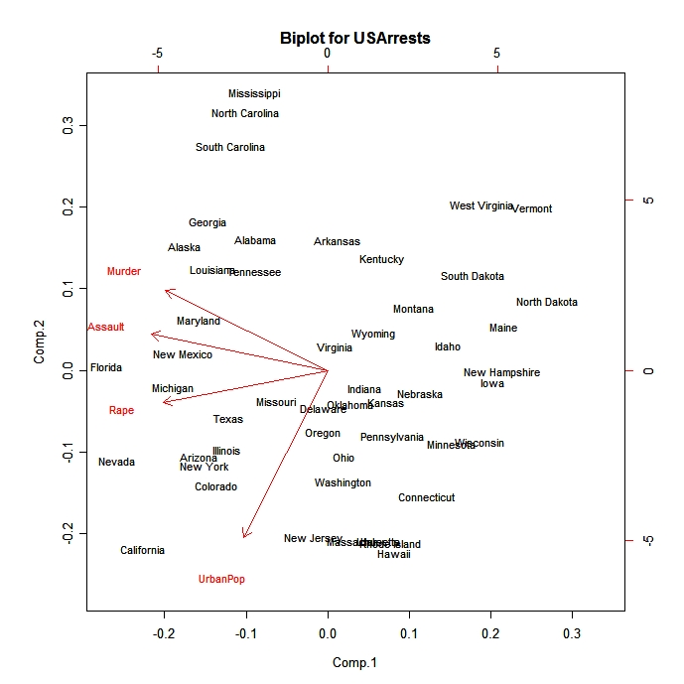
Introduction
A biplot is a low-dimensional (usually 2D) representation of a data matrix A.
  A point for each of the m observation vectors (rows of A)
  A line (or arrow) for each of the n variables (columns of A)
Notes:
A biplot can be obtained through either PCA or SVD.
A biplot is a direct visual representation of three types of relationships.
Observation to observation (point to point): are two observations like each other?
Variable to variable (line to line): are two variables correlated?
Observation to variable (point to line): How significant is a variable to an observation?

Slide 67
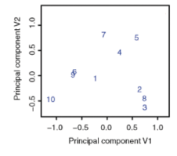
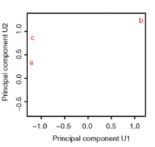
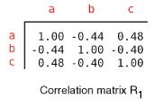
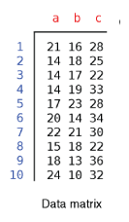
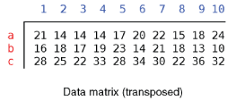
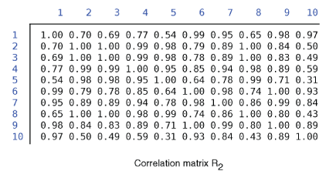
PCA
TFs: a, b, c...
Genomic
Sites: 1,2,3...
A
A^{T}A (TF-TF corr.)
A^{T}
AA^{T} (site-site correlation)
Notes:
67

Slide 68
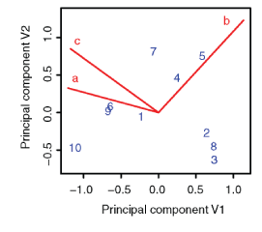
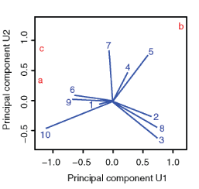
Biplot to Show Overall Relationship of TFs & Sites
TFs: a, b, c...
Genomic
Sites: 1,2,3...
A=USV^{T}
A^{T}A (TF-TF corr.)
A^{T}
AA^{T} (site-site correlation)
Notes:
68

Slide 69
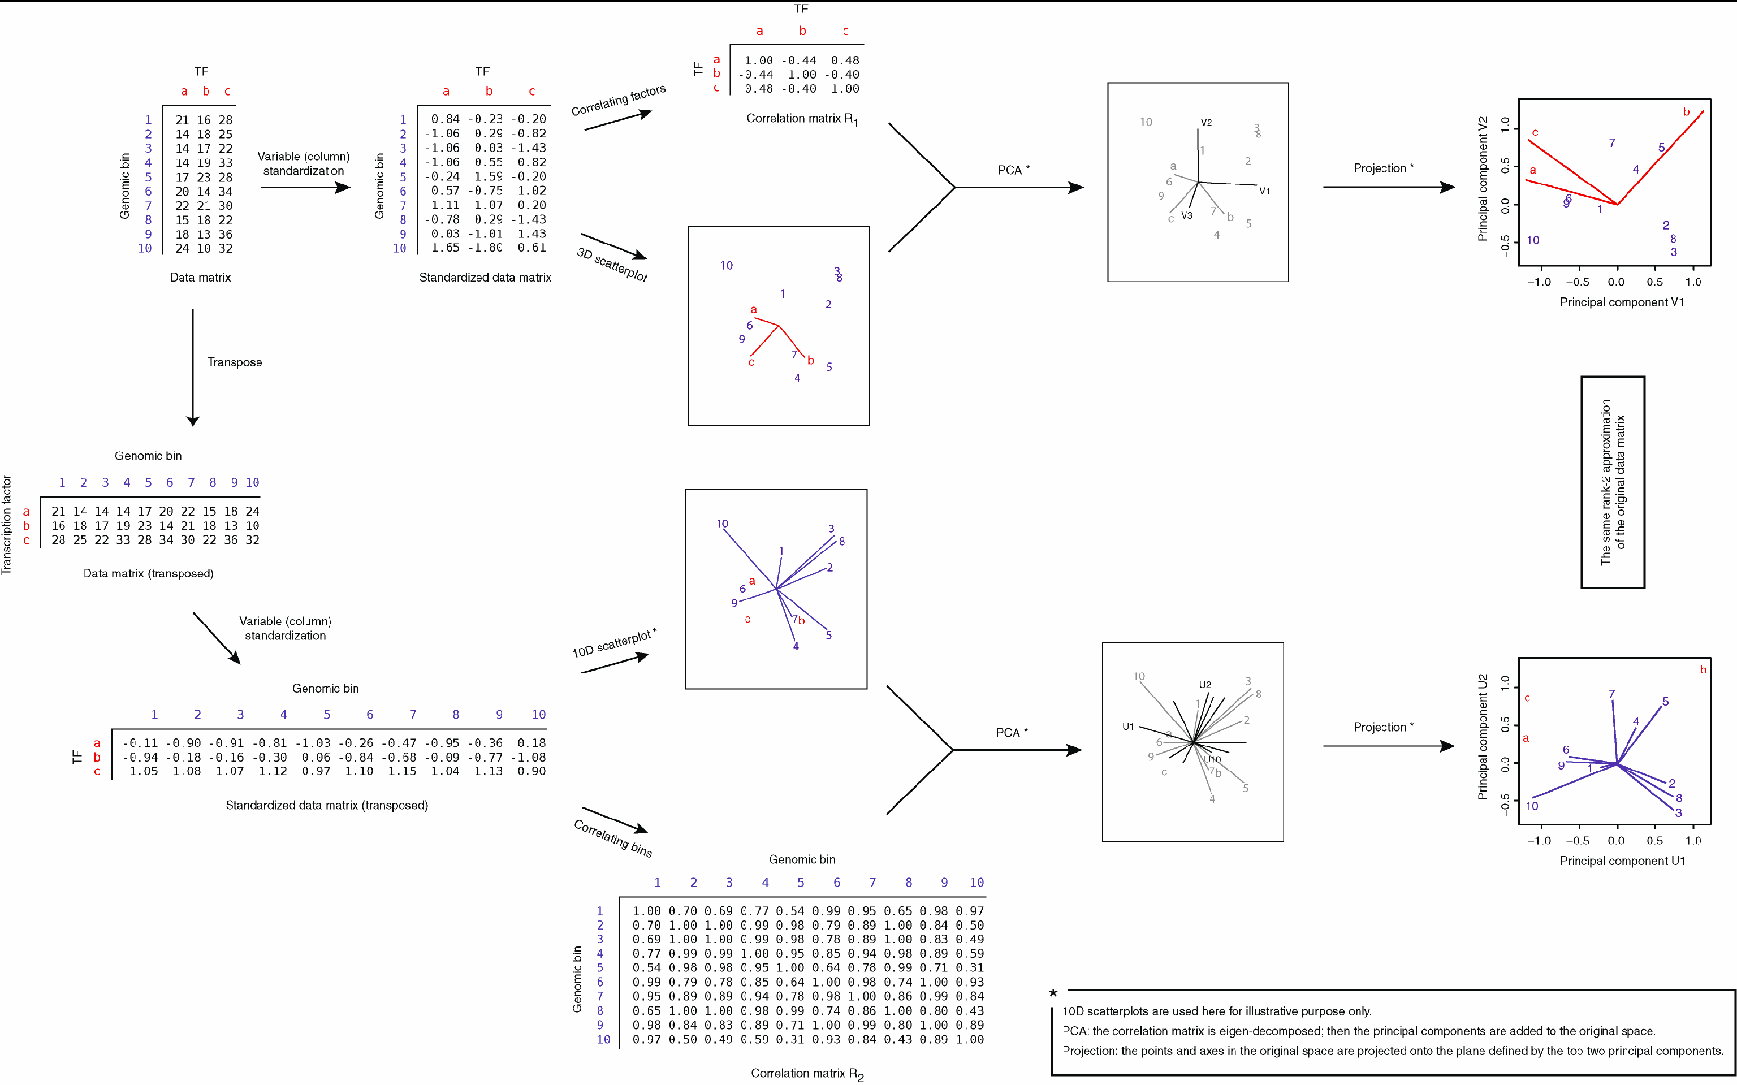
Biplot Ex
A’A
A

Slide 70
Biplot Ex #2
A^{T} A = V S² V^{T}
A v_{j} = u_{j} s_{j} & A^{T} u_{j} = v_{j} s_{j}
A = (U S^{r}) (V S^{1−r}) ^{T}
A A^{T} = U S² U^{T}

Slide 71
Biplot Ex #3
Assuming s=1,
Av = u
A^{T}u = v

Slide 72
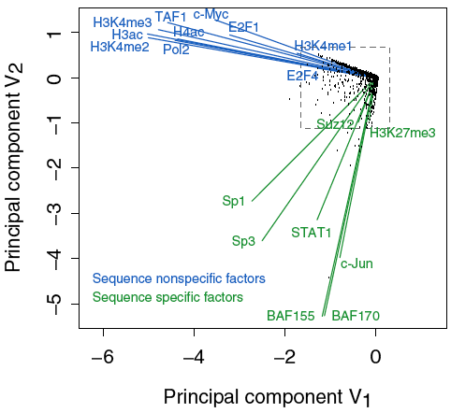
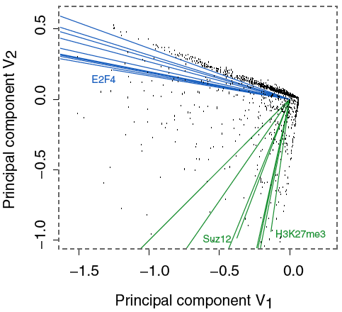
Results of Biplot
Pilot ENCODE (1% genome): 5996 10 kb genomic bins (adding all hits) + 105 TF experiments → biplot
Angle between TF vectors shows relation b/w factors
Closeness of points gives clustering of "sites"
Projection of site onto vector gives degree to which site is assoc. with a particular factor
Zhang et al. (2007) Gen. Res.
Notes:
72

Slide 73
Results of Biplot
Biplot groups TFs into sequence-specific and sequence-nonspecific clusters.
  c-Myc may behave more like a sequence-nonspecific TF.
  H3K27me3 functions in a transcriptional regulatory process in a rather sequence-specific manner.
Genomic Bins are associated with different TFs and in this fashion each bin is "annotated" by closest TF cluster
Zhang et al. (2007) Gen. Res.
Notes:
73

Slide 74
Unsupervised Mining
CCA

Slide 75

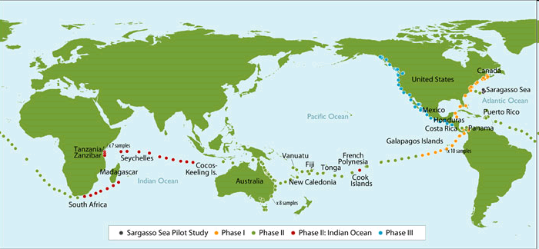
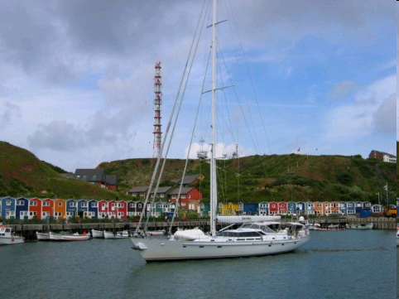
Sorcerer II Global Ocean Survey
Sorcerer II journey August 2003- January 2006
Sample approximately every 200 miles
Rusch, et al., PLOS Biology 2007
Notes:
Add viral dataaverage trimmed sequence read length 822 bp (1-2 genes)

Slide 76
Sorcerer II Global Ocean Survey
Additional Metadata via GPS coordinates
Metadata
GPS coordinates, Sample Depth, Water Depth, Salinity, Temperature, Chlorophyll Content
Metagenomic Sequence: 6.25 GB of data
0.1–0.8 μm size fraction (bacteria)
6.3 billion base pairs (7.7 million reads)
Reads were assembled and genes annotated
1 million CPU hours to process
Metabolic Pathways
Membrane Protein Families
Rusch, et al., PLOS Biology 2007
Notes:
trimmed sequence read length 822 bp (1-2 genes)
Rusch et. al., (2007) PLOS Biology
starting in Halifax, Canada and samples were collected at sites along the U.S. east coast, Gulf of Mexico, Galapagos Islands, central and south Pacific Oceans, Australia, Indian Ocean, South Africa, across the Atlantic back to the U.S.,

Slide 77
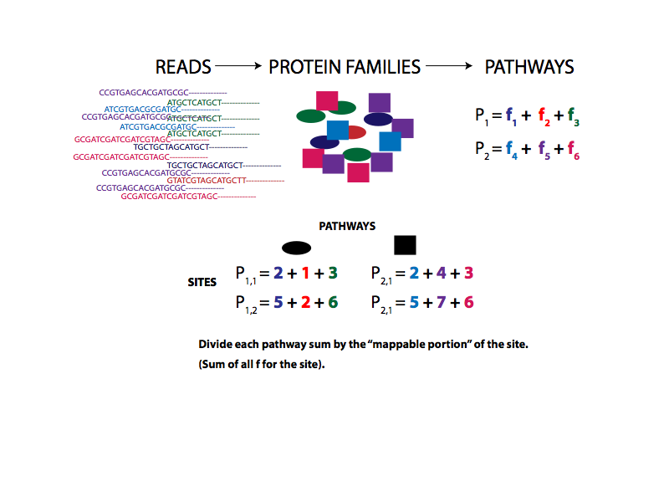
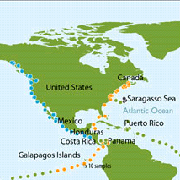
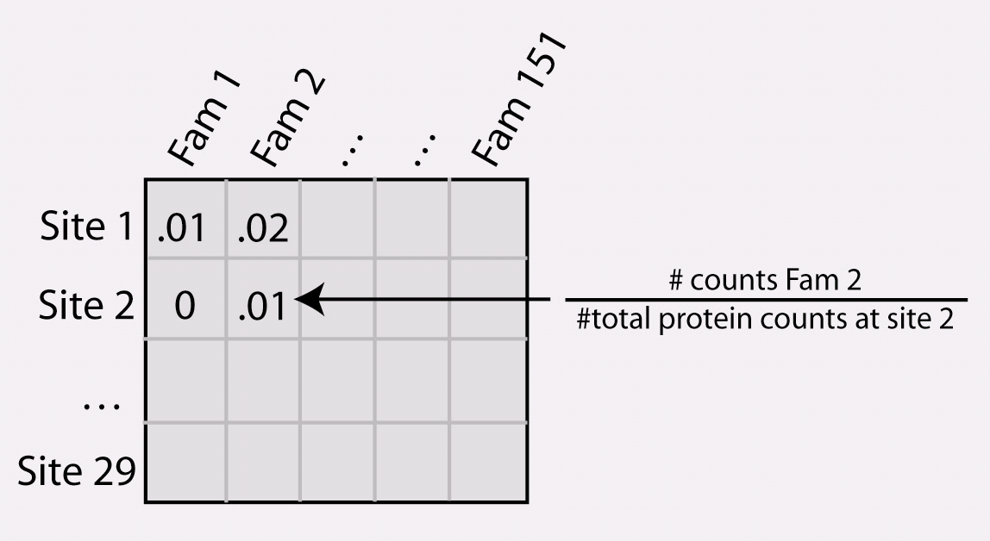
Mapping Raw Metagenomic Reads to a Matrix of Familes or Pathways for each Site
Families Matrix
Patel et. al., Genome Research 2010
Notes:
77

Slide 78
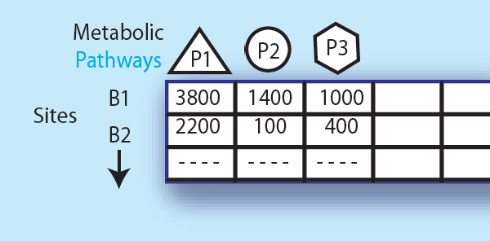
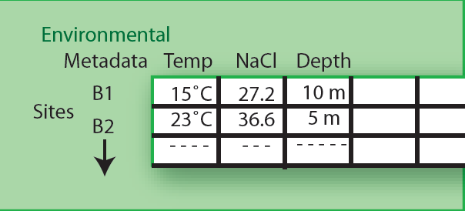
Expressing data as matrices indexed by site, env. var., and pathway usage
Pathway Sequences
(Community Function)
Environmental
Features
[Rusch et. al., (2007) PLOS Biology;
Gianoulis et al., PNAS (in press, 2009]
Notes:
78
What is GOS
In this study, water was filtered and sequenced. In addition, environmental features such as temperature, salinity, etc were also collected
WE USED THIS DATASET to investigate our initial hypothesis that
QUANTITATIVE DESCRIPTION OF how our environments are changing
There would be co-variation between particular pathways and environmental features
To do this, we first needed to map sequences to pathways
Further, we wanted to use the measurements from the environment explicitly and in the remainder of this section of the talk
I will discuss the development of these methodologies and provide a few examples

Slide 79
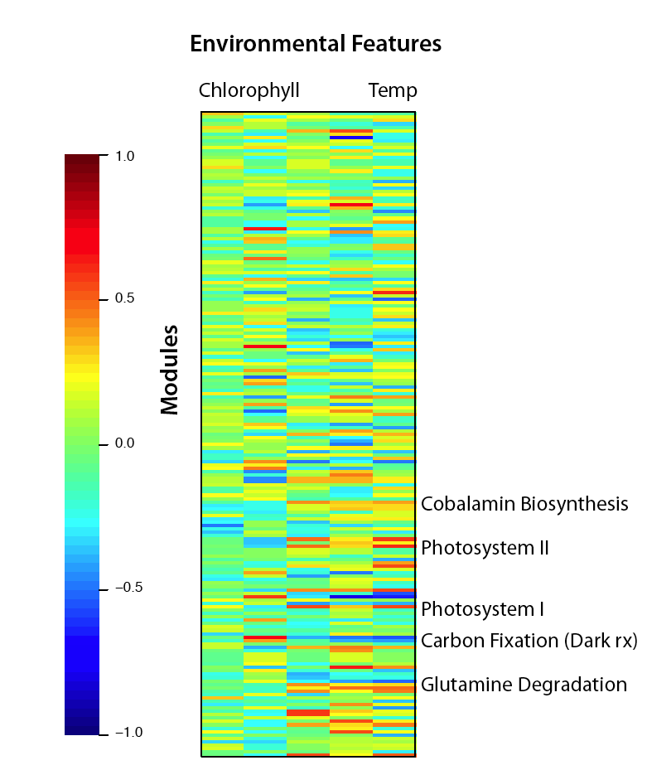
Simple Relationships: Pairwise Correlations
Pathways
[ Gianoulis et al., PNAS (in press, 2009) ]
Notes:
79
Step-wise (backwards elimination) linear regression to select features
Metabolic repertoire of microbial community modulated by a number of different environmental features
This treats each feature in isolation
We want a way to look at the environment as a whole

Slide 80






Canonical Correlation Analysis:
Simultaneous weighting
# km run/week
Weight
Lifestyle Index
Fit Index
Lifestyle Index = a +b + c
Fit Index = a + b +c
Notes:
80
Blood pressure, cholesterol levels, body weight

Slide 81
Canonical Correlation Analysis:
Simultaneous weighting
# km run/week
Weight
Lifestyle Index
Fit Index
Environmental
Features
Metabolic Pathways/
Protein Families
Lifestyle Index = a +b + c
etc
Photosynthesis
etc
Temp
Fit Index = a + b +c
Chlorophyll
Lipid Metabolism
Notes:
81
Blood pressure, cholesterol levels, body weight

Slide 82
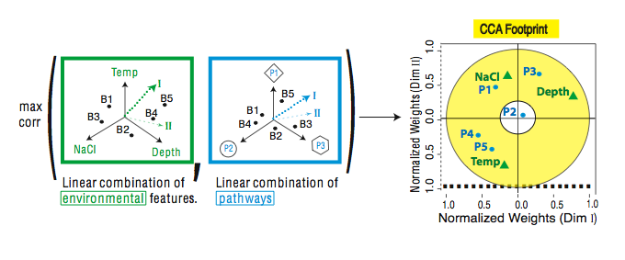
CCA: Finding Variables with Large Projections in "Correlation Circle"
The goal of this technique is to interpret cross-variance matrices
We do this by defining a change of basis.
Gianoulis et al., PNAS 2009
Notes:
82
I am first going to give a high-level overview of how we can use this technique to investigate the co-variation between the environment and metabolic pathways
Next, since George mentioned a few statisticians will be in the audience, I want to briefly provide a little bit of the technical details to give some intiution (you can ignore this).
Maximize the objective function, can be formulated as an eigen problem
Plotting degrees in the same coordinate system with carbohydrate metabolism or methionine biosynthesis would not make any sense.
First dimension then we take the orthogonal direction
The goal of this technique is to interpret cross-variance matrices.
More formally, we are defining a change of basis.
We compute the covariance
The units are completely different!!
However, the power of CCA is that defines a new coordinate system as shown by the heavy dotted line and thin dashed line in the plot
The normalized weights essentially give pathways and environment the same units
The circle around 0.3 represents the accepted cut-off for features that do “fit the model” or are co-varying and those that don’t
In the next few slides, I will show these results plotted in a couple of different ways to provide some intuition on what they mean
Further, I will use “footprints” derived from all three levels of the analysis: linear models, DPM, and CCA to illustrate more general trends in linking environment and metabolism

Slide 83
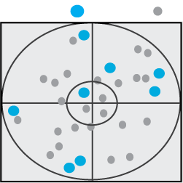
CCA results
We are defining a change of basis of the cross co-variance matrix
We want the correlations between the projections of the variables, X and Y, onto the basis vectors to be mutually maximized.
Eigenvalues→ squared canonical correlations
Eigenvectors→ normalized canonical correlation basis vectors
Environment
Family
Correlation= 1
This plot shows the correlations in the first and second dimensions
Correlation Circle: The closer the point is to the outer circle, the higher the correlation
Variables projected in the same direction are correlated
Correlation = .3

Slide 84
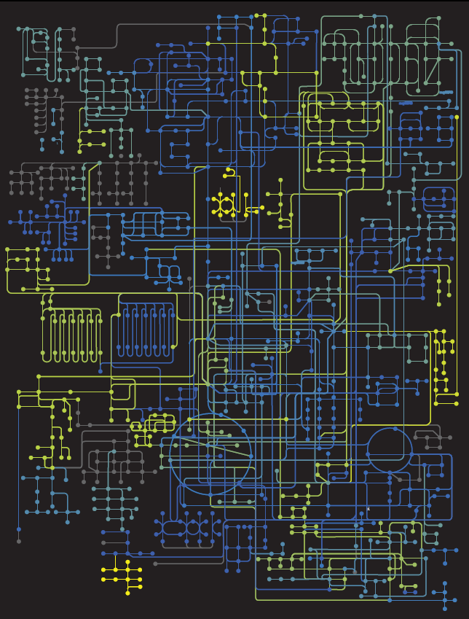

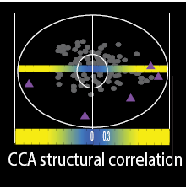
Circuit Map
Strength of Pathway co-variation with environment
Environmentally
invariant
Environmentally
variant
Gianoulis et al., PNAS 2009
Notes:
84
Because if we showed this bullseye it would just be a cloud dense mess of points; I am going to display the results in a slightly different way
Here I am showing a representation of the metabolic map
The strength of the pathways’ environmental co-variation is color-coded (yellow strongest to blue weakest) as measured by the absolute value of their structural correlations (normalized weights) derived from CCA.
Nodes (balls) symbolize compound, whereas connecting lines are enzymes.
Balls and lines are color-coded according to their KEGG-level co-variation score, which is calculated as an aggregate over all enzymes (lines) in a given map; all enzymes (lines) corresponding to a single KEGG map will have the same color.

Slide 85
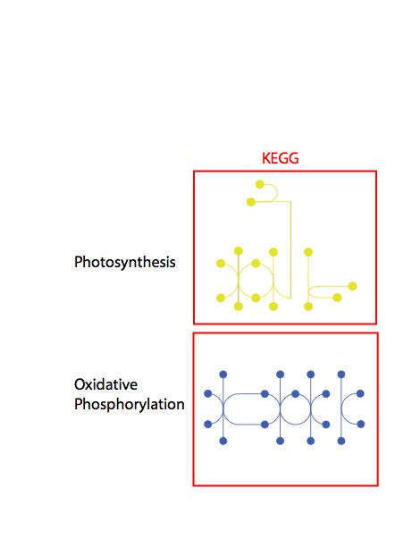
Conclusion #1: energy conversion strategy, temp and depth
Gianoulis et al., PNAS 2009
Notes:
85

Slide 86
Supervised Learning
Given: training data
  The input objects (usually represented as vectors) – x, y values
  The labels – colors
Define: a function that determines the labels given the input objects
Use the function to predict the labels of new objects
Criminisi, Shotton, and Konukoglu Microsoft Technical Report 2011

Slide 87
Supervised Learning
Regression vs Classification
  Regression: labels are quantitative
  Classification: labels are categorical
Regularized vs Un-regularized
  Regularized: penalize model complexity to avoid over-fitting
  Un-regularized: no penalty on model complexity
Parametric vs Non-parametric
  Parametric: an explicit parametric model is assumed
  Non-parametric: otherwise
Ensemble vs Non-ensemble
  Ensemble: combines multiple models
  Non-ensemble: a single model

Slide 88
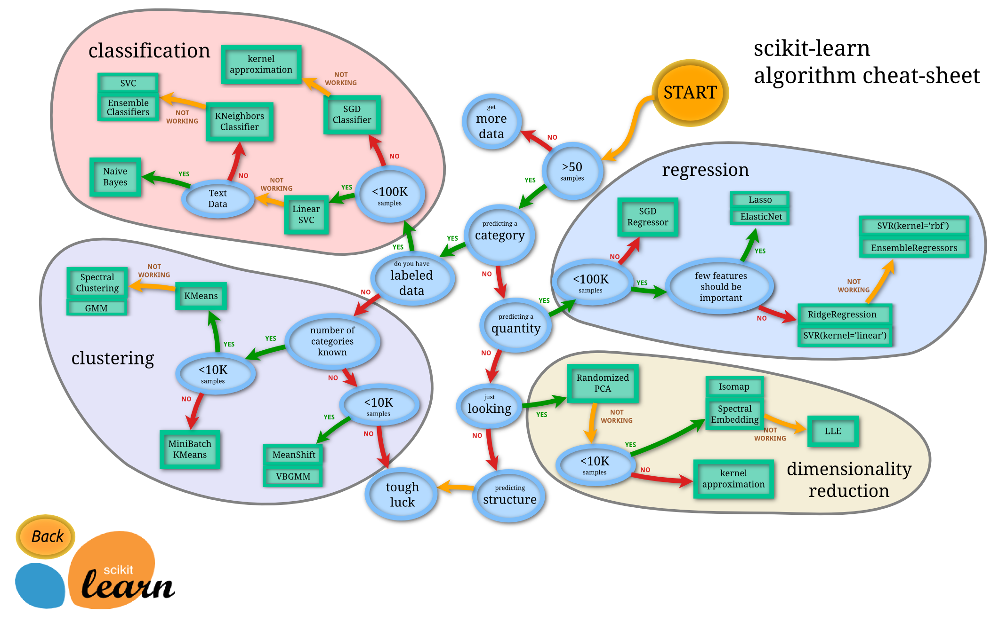
The World of Supervised (and Unsupervised) Learning
SciKit learn: http://scikit-learn.org/stable/tutorial/machine_learning_map/

Slide 89
Decision Trees
Classify data by asking questions that divide data in subgroups
Keep asking questions until subgroups become homogenous
Use tree of questions to make predictions
Example: Is a picture taken inside or outside?
Criminisi, Shotton, and Konukoglu Microsoft Technical Report 2011

Slide 90

What makes a good rule?
Want resulting groups to be as homogenous as possible
Rule 1
Rule 2
All groups still 50/50
→ Unhelpful rule
2/3 Groups homogenous
→Good rule
Nando de Freitas 2012 University of British Columbia CPSC 340
Notes:
Emphasize that classification is based on underlying characteristics

Slide 91
Quantifying the value of rules
Decrease in inhomogeneity
  Most popular metric: Information theoretic entropy
  Use frequency of classifier characteristic within group as probability
  Minimize entropy to achieve homogenous group
S =

Slide 92
Algorithm
For each characteristic:
  Split into subgroups based on each possible value of characteristic
Choose rule from characteristic that maximizes decrease in inhomogeneity
For each subgroup:
  if (inhomogeneity < threshold):
    Stop
  else:
    Restart rule search (recursion)

Slide 93
Application to protein-protein interactions
To be classified/predicted
Use for prediction
Kingsford and Salzberg Nat. Biotechnol 2008

Slide 94
Decision Tree for Protein-Protein Interaction Prediction
Red: Doesn’t interact
Green: Real interaction
Kingsford and Salzberg Nat. Biotechnol 2008
Notes:
Emphasize that this is a toy example. Would be good to show how this actually performs

Slide 95
Extensions of Decision Trees
Decision Trees method is very sensitive to noise in data
Random forests is an ensemble of decision trees, and is much more effective.

Slide 96
Support Vector Machines
A very powerful tool for classifications
Example Applications:
  Text categorization
  Image classification
  Spam email recognition, etc
It has also been successfully applied in many biological problems:
  Disease diagnosis
  Automatic genome functional annotation
  Prediction of protein-protein interactions
  and more…

Slide 97

Example: Leukemia patient classification
ALL: acute lymphoblastic leukemia
AML: acute myeloid leukemia
William S Nobel. What is a support vector machine? Nature Biotechnology. 2006

Slide 98

A simple line suffices to separate the expression profiles of ALL and AML
William S Nobel. What is a support vector machine? Nature Biotechnology. 2006

Slide 99

In the case of more than two genes, a line generalizes to a plane or “hyperplane”.
For generality, we refer to them all as “hyperplane”
William S Nobel. What is a support vector machine? Nature Biotechnology. 2006

Slide 100

Is there a “best” line?
William S Nobel. What is a support vector machine? Nature Biotechnology. 2006

Slide 101

The maximum margin hyperplane
William S Nobel. What is a support vector machine? Nature Biotechnology. 2006

Slide 102

Denote each data point as (x_{i}, y_{i})
x_{i} is a vector of the expression profiles
y_{i} = -1 or 1, which labels the class
A hyperplane can be represented as: w*x + b = 0
The margin-width equals to:
http://en.wikipedia.org/wiki/Support_vector_machine

Slide 103
Find a hyperplane such that:
  No data points fall between the lines and
  The margin 2/||w|| is maximized
Mathematically,
  Minimize_{w,b} 1/2 ||w||², subject to:
  for y_{i} = 1,
  for y_{i} = -1,
  Combining them, for any i,
So far, we have been assuming that the data points from two classes are always linearly separable. But that’s not always the case

Slide 104

What if…
William S Nobel. What is a support vector machine? Nature Biotechnology. 2006

Slide 105

Allow a few anomalous data points

Slide 106
The soft-margin SVM
  subject to, for any i,
  S_{i} are the slack variables
  C controls the number of tolerated misclassifications.
  A small C would allow more misclassifications
  A large C would discourage misclassifications
  Note that even when the data points are linearly separable, one can still introduce the slack variables to pursue a larger separation margin

Slide 107

Linear separating hyperplanes always enough?
William S Nobel. What is a support vector machine? Nature Biotechnology. 2006

Slide 108

Transform (x_{i}) into (x_{i}, x_{i}²)
William S Nobel. What is a support vector machine? Nature Biotechnology. 2006

Slide 109
Non-linear SVM
  In some cases (e.g. the above example), even soft-margin cannot solve the non-separable problem
  Generally speaking, we can apply some function to the original data points so that different classes become linearly separable (maybe with the help of soft-margin)
  In the above example, the function is f(x) = (x, x²)
  The most import trick in SVM: to allow for the transformation, we only need to define the “kernel function”,
  The above example essentially uses a polynomial kernel

Slide 110
The “kernel trick”
  In optimization theory, a constrained optimization problem can be formulated into its dual problem (the original problem is called primal problem)
  The dual formulation of SVM can be expressed as:
  , subject to
  The “Kernel”: , can be replaced by more sophisticated kernels:

Slide 111

“Support vector machine”, where does the name come from?
  The x_{i} for which α_{i} > 0 are called support vectors
  They fall between or right on the separating margins

Slide 112
Two commonly used kernels (and there are more)
Polynomial kernel:
  a = 1 (inhomogeneous) or 0 (homogenous)
  d controls the degree of polynomial and henceforth the flexibility of the classifier
  degenerates to linear kernel when a = 0 and d = 1
Gaussian kernel:
  σ controls the width of the Gaussian and plays a similar role as d in the polynomial kernels

Slide 113
Questions for practitioners: Which kernel to use? How to choose parameters?
  Trial and error
  Cross-validation
High-degree kernels always fit the training data well, but at increased risks of over-fitting, i.e. the classifier will not generalize to new data points
  One needs to find a balance between classification accuracy on the training data and regularity of the kernel (not allowing the kernel to be too flexible)

Slide 114

A low-degree kernel (left) and an over-fitting high-degree kernel (right)
William S Nobel. What is a support vector machine? Nature Biotechnology. 2006

Slide 115
The parameter C has a similar role
  Large C will make few classification errors on the training data
  But this may not generalize to the testing data
  Small C pursues a large separating margin at the expenses of some classification errors on the training data.
  The accuracy more likely to generalize to testing data

Slide 116


Large C
Small C
Intermediate C
http://cbio.ensmp.fr/~jvert/talks/110401mines/mines.pdf

Slide 117
More about kernels
  With kernels, non-vector data can be easily handled – we only need to define the kernel function between two objects
  Examples of non-vector biological data include: DNA and protein sequences (“string kernels”), nodes in metabolic or protein-protein interaction networks, microscopy images, etc
  Allows for combining different types of data naturally – define kernels on different data types and combine them with simple algebra
Notes:
references

