Slide 1
SIGNAL PROCESSING FOR
NEXT-GEN SEQUENCING DATA
Peaks
DNAse I-seq
CHIP-seq
Gene models
RNA-seq
RIP/CLIP-seq
Binding sites
FAIRE-seq
Transcripts

Slide 2
The Power of Next-Gen Sequencing
Chromosome Conformation Capture
+ More Experiments
DNA
Genome Sequencing
Exome Sequencing
DNAse I hypersensitivity
CHIP
CHART, CHirP, RAP
CLIP, RIP
CRAC
PAR-CLIP
iCLIP
Protein
RNA
RNA-seq
For more Seq technologies, see: http://liorpachter.wordpress.com/seq/

Slide 3
Next-Gen Sequencing as Signal Data
Map reads (red) to the genome. Whole pieces of DNA are black.
Count # of reads mapping to each DNA base → signal
Rozowsky et al. 2009 Nature Biotech
Notes:
Need better picture

Slide 4
Outline
Read mapping: Creating signal map
Finding enriched regions
  CHIP-seq: peaks of protein binding
RNA-seq: from enrichment to transcript quantification
Application: Predicting gene expression from transcription factor and histone modification binding
Isoform 1
Isoform 2

Slide 5
Read mapping
Problem: match up to a billion short sequence reads to the genome
Need sequence alignment algorithm faster than BLAST
Rozowsky et al. 2009 Nature Biotech

Slide 6
Read mapping (sequence alignment)
Dynamic programming
  Optimal, but SLOW
BLAST
  Searches primarily for close matches, still too slow for high throughput sequence read mapping
Read mapping
  Only want very close matches, must be super fast

Slide 7
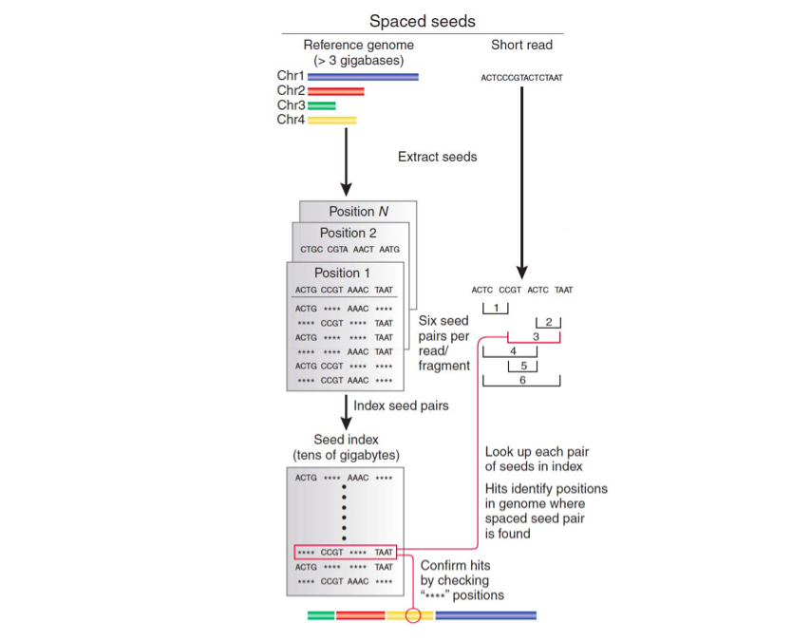
Index-based short read mappers
Similar to BLAST
Map all genomic locations of all possible short sequences in a hash table
Check if read subsequences map to adjacent locations in the genome, allowing for up to 1 or 2 mismatches.
Very memory intensive!
Trapnell and Salzberg 2009, Slide adapted from Ray Auerbach
Notes:
So memory intensive that you have to use regions of the genome as queries and index strings in groups of reads.

Slide 8
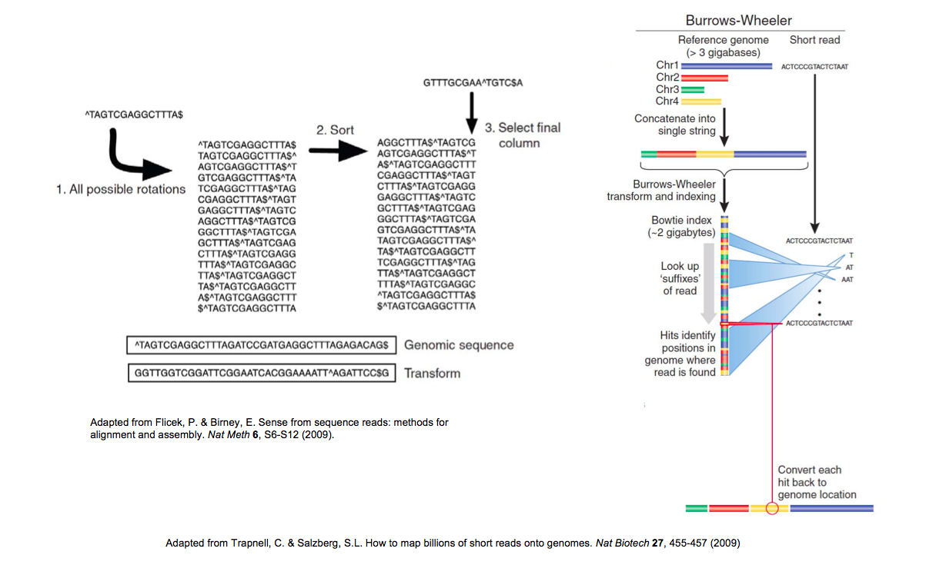
Read Alignment using Burrows-Wheeler Transform
Used in Bowtie, the current most widely used read aligner
Described in Coursera course: Bioinformatics Algorithms (part 1, week 10)
Trapnell and Salzberg 2009, Slide adapted from Ray Auerbach

Slide 9
Read mapping issues
Multiple mapping
Unmapped reads due to sequencing errors
VERY computationally expensive
  Remapping data from The Cancer Genome Atlas consortium would take 6 CPU years¹
Current methods use heuristics, and are not 100% accurate
These are open problems
¹https://twitter.com/markgerstein/status/396658032169742336

Slide 10
FINDing enriched regions: CHIP-seq data analysis
transcription factor
histone modification
Park 2009 Nature Reviews Genetics

Slide 11
CHIP-seq Intro
Determine locations of transcription factors and histone modifications.
The binding of these factors is what regulates whether genes get transcribed.
Park 2009 Nature Reviews Genetics

Slide 12
CHIP-seq protocol
DNA bound by histones and transcription factors
Target protein of interest with Antibody
Sequence DNA bound by protein of interest
Park 2009 Nature Reviews Genetics

Slide 13
CHIP-seq Data
# of sequence reads
Chromosomal region
Basic interpretation: Signal map to represents binding profile of protein to DNA
How do we identify binding sites from CHIP-seq signal “peaks”?
Park 2009 Nature Reviews Genetics
Notes:
Highlight that there are many different methods being used for CHIP-seq data analysis

Slide 14
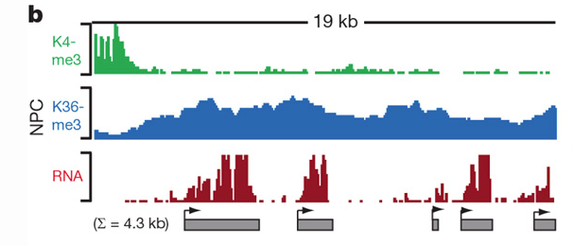
CHIP-seq Data
Peaks can be
Narrow
Broad
Sequence-specific transcription factors
Some histone modifications
Park 2009 Nature Reviews Genetics, Khalil et al 2009 PNAS
Notes:
Highlight that there are many different methods being used for CHIP-seq data analysis

Slide 15
CHIP-seq Data
Peaks can be
Narrow
Broad
Sequence-specific transcription factors
Some histone modifications
Park 2009 Nature Reviews Genetics, Khalil et al 2009 PNAS
Notes:
Highlight that there are many different methods being used for CHIP-seq data analysis

Slide 16

“Naïve” CHIP-seq analysis
Background assumption: all sequence reads map to random locations within the genome
Given N total reads, M bins, what is the probability of observing K reads mapping to a bin?
Probability that a read maps to a specific bin: p = 1/N
Binomial distribution:
  Each read is a trial
  Reads mapped to bin are successes
M bins
K reads in bin
N total reads
Fix equation
Rozowsky et al. 2009 Nature Biotech, Park 2009 Nature Reviews Genetics
Notes:
Would be nice to have a histogram of the reads/bin for a CHIP-seq data set, compared to the Poisson distribution

Slide 17


“Naïve” CHIP-seq analysis
M bins
K reads in bin
N total reads
Binomial distribution is computationally expensive to calculate for large N
Poisson distribution is equal to binomial distribution when probability of success (read mapping) is low
Reminder:
Fix equations
Rozowsky et al. 2009 Nature Biotech, Park 2009 Nature Reviews Genetics

Slide 18
“Naïve” CHIP-seq analysis
Background assumption: all sequence reads map to random locations within the genome
Given N total reads, M bins, what is the probability of observing K reads mapping to a bin?
M bins
K reads in bin
N total reads
Poisson distribution:
Fix equation
Rozowsky et al. 2009 Nature Biotech, Park 2009 Nature Reviews Genetics
Notes:
Would be nice to have a histogram of the reads/bin for a CHIP-seq data set, compared to the Poisson distribution

Slide 19
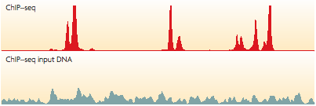
Is a Poisson background reasonable for CHIP-seq data?
“Input” experiment: Sequence DNA from starting material prior to antibody purification
There are also “peaks” in the input!
Park 2009 Nature Reviews Genetics

Slide 20
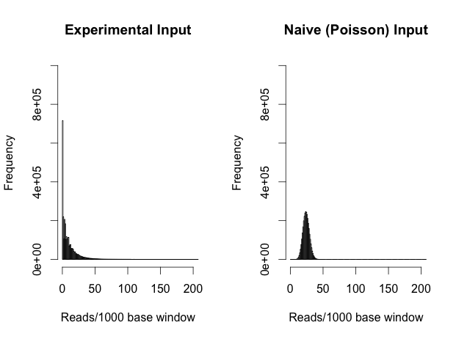
Is a Poisson background reasonable for CHIP-seq data?
Input experiment has many “peaks” with large numbers of reads, and many more regions with 0 reads than expected

Slide 21
Another problem with Poisson background for CHIP-Seq
“Input” experiment: Sequence DNA from starting material prior to antibody purification
Signal in adjacent bins is correlated!
Different approach needed for “broad” peaks
Park 2009 Nature Reviews Genetics

Slide 22
Determining protein binding sites by comparing CHIP-seq data with input
Candidate binding site
identification
Input normalization/
bias correction
Comparison of sample vs. input
Notes:
Broad marks, TAR calling, EM

Slide 23
Peakseq
Rozowsky et al. 2009 Nature Biotech
Gerstein Lab

Slide 24
Candidate binding site identification
Use Poisson distribution as background, as in the “naïve” analysis discussed earlier
Normalize read counts for mappability (uniqueness) of genomic regions
Use large bin size, finer resolution analysis later
Rozowsky et al. 2009 Nature Biotech

Slide 25
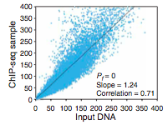
Input normalization
Normalize based on slope of least squares regression line.
Normalized reads = CHIP-seq reads/(slope*input reads)
Rozowsky et al. 2009 Nature Biotech
Notes:
Low quality image

Slide 26
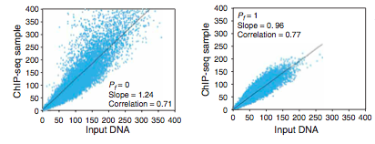
Input normalization
All data points
Candidate peaks removed
Using regression based on all data points (including candidate peaks) is overly conservative.
Rozowsky et al. 2009 Nature Biotech

Slide 27
Calling peaks vs. input
Binomial distribution
  Each genomic region is like a coin
  The combined number of reads is the # of times that the coin is flipped
  Look for regions that are “weighted” toward sample, not input
ENCODE NF-Kb CHIP-seq data
Notes:
Maybe expand this into two slides

Slide 28
Multiple Hypothesis Correction
Millions of genomic bins → expect many bins with p-value < 0.05!
How do we correct for this?

Slide 29
Multiple Hypothesis Correction
Bonferroni Correction
  Multiply p-value by number of observations
  Adjusts p-values → expect up to 1 false positive
  Very conservative
Notes:
Bonferroni – family wise error rare
Benjamini Hochberg – False discovery rate
Maybe add familywise error rate
Add broad peak calling, TAR calling

Slide 30
Multiple Hypothesis Correction
Benjamini-Hochberg Correction
  q-value = p-value*# of tests/rank
False discovery rate (FDR)
  Expected number of false positives as a percentage of the total rejected null hypotheses
  Expectation[false positives/(false positives+true postives)]
q-value: maximum FDR at which null hypothesis is rejected.

Slide 31
Is PeakSeq an optimal algorithm?

Slide 32
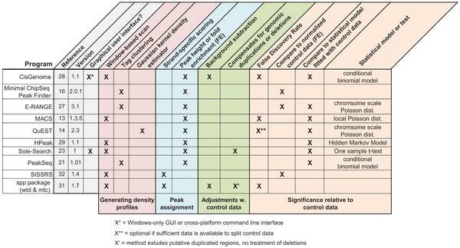

Many other CHIP-seq “peak”-callers
Wilbanks EG, Facciotti MT (2010) Evaluation of Algorithm Performance in ChIP-Seq Peak Detection. PLoS ONE 5(7): e11471. doi:10.1371/journal.pone.0011471
http://www.plosone.org/article/info:doi/10.1371/journal.pone.0011471
Notes:
Even more now!

Slide 33
CHIP-seq Data
Peaks can be
Narrow
Broad
Sequence-specific transcription factors
Some histone modifications
Park 2009 Nature Reviews Genetics, Khalil et al 2009 PNAS
Notes:
Highlight that there are many different methods being used for CHIP-seq data analysis

Slide 35
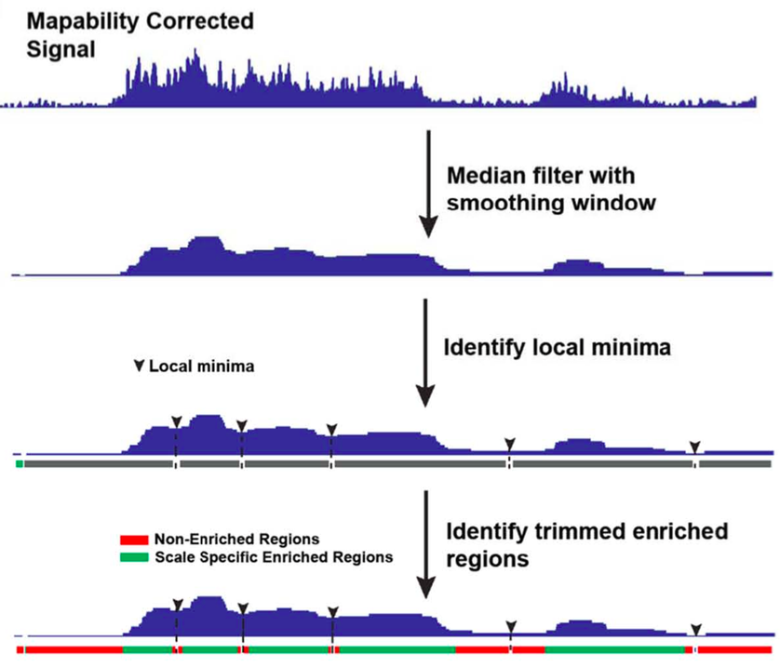
Harmanci et al. Genome Biology 2014

Slide 36
CHIP-seq summary
Method to determine DNA binding sites of transcription factors or locations of histone modifications
Must normalize sequence reads to experimental input
Search for signal enrichment to find peaks
  Peakseq: binomial test + Benjamini-Hochberg correction
  Many other methods

Slide 37
RNA-SEQ: GOING BEYond enrichment

Slide 38
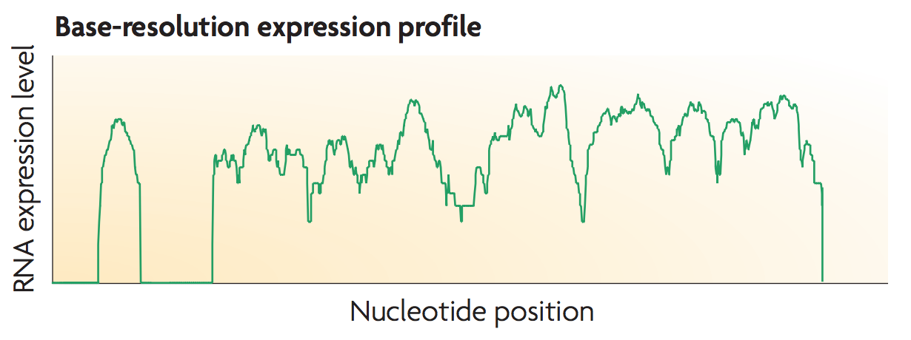
RNA-seq
Searching for “peaks” not enough:
Are these “peaks” part of the same RNA molecule?
How much of the RNA is really there?
Wang et al Nature Reviews Genetics 2009

Slide 39
Background: RNA splicing
intron
exon
pre-mRNA must have introns spliced out before being translated into protein.
The final components of an mRNA are called exons

Slide 40
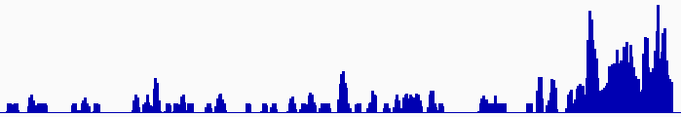
Are these “peaks” part of the same RNA molecule?
Cluster reads setting minimum-run and maximum gap parameters for newly identified transcriptionally active regions (TARs)
Assess exon discovery rates for known genes and noncoding RNAs
min run
max gap
Known exon
Known exon
TAR
TAR
TAR
novel TAR
correct identification
possible exon extension
ENCODE RNA-Seq Data
Notes:
Analogous to broad peak calling

Slide 41
Are these “peaks” part of the same RNA molecule?
Different values of minimum run and maximum gap lead to different predicted transcriptionally active regions
min run max gap
Known exon
Known exon
TAR
TAR
TAR
TAR
TAR
novel TAR
correct identification
possible exon extension
ENCODE RNA-Seq Data
Notes:
Analogous to broad peak calling

Slide 42
Background: RNA splicing
intron
exon
pre-mRNA must have introns spliced out before being translated into protein.
The final components of an mRNA are called exons

Slide 43
Background: alternative splicing
intron
exon
Alternative splicing leads to creation of multiple RNA isoforms, with different component exons.
Sometimes, exons can be retained, or introns can be skipped.
Isoform 1
Isoform 2

Slide 44
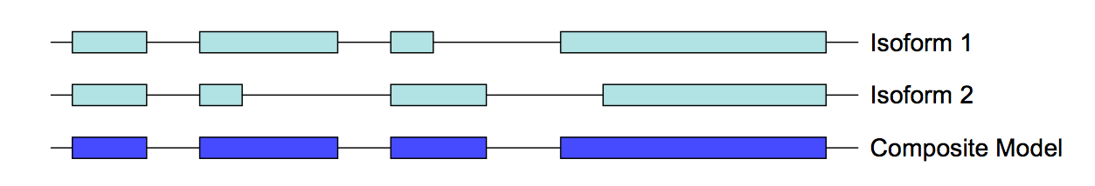
Simple quantification
Count reads overlapping annotations of known genes
Simplest method: Make composite model of all isoforms of gene
Quantification: Reads per kilobase per million reads (RPKM)

Slide 45
Isoform Quantification
Map reads to genome
How do we assign reads to overlapping transcripts?

Slide 46
Isoform Quantification
Simple method: only consider unique reads

Slide 47
Isoform Quantification
Simple method: only consider unique reads
Problem: what about the rest of the data?

Slide 49
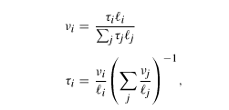

What is the normalization issue with RPKM vs. TPM?
V – isoform’s fraction of nucleotides in the transcriptome (NPM = v*10^6)
T – isoform’s fraction of total transcriptome transcripts (TPM = v*10^6)
L – length of isoform

Slide 50

Generative model
G – isoform
S – start position
O – orientation (this is only used in non-strand-specific RNA-Seq)
R – read sequences
Theta – transcript levels

Slide 52
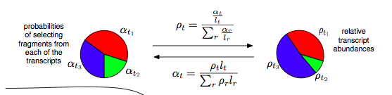
Expectation Maximization Algorithm
Assign reads to isoforms to maximize likelihood of generating pattern of observed reads.
0. Initialize (expectation): Assign reads randomly to isoforms based on naïve (length normalized) probability of the read coming from that isoform (as opposed to other overlapping isoforms)
Lior Pachter 2011 ArXiv

Slide 53
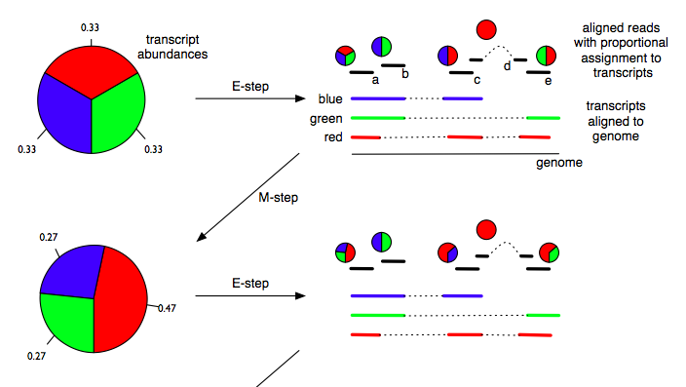
Expectation Maximization Algorithm
1. Maximization: Choose transcript abundances that maximize likelihood of the read distribution (Maximization).
Lior Pachter 2011 ArXiv

Slide 54
Expectation Maximization Algorithm
2. Expectation: Reassign reads based on the new values for the relative quantities of the isoforms.
Lior Pachter 2011 ArXiv
Notes:
Where is the read expected to map, based on the .
Find isoform abundance that maximizes the probability of observing the reads.

Slide 55
Expectation Maximization Algorithm
3. Continue expectation and maximization steps until isoform quantifications converge (it is a mathematical fact that this will happen).
Lior Pachter 2011 ArXiv

Slide 56
Detecting new transcripts
Search for “peaks”:
Reads that overlap splice junctions→peaks part of same transcript
Special sequencing techniques to find ends of transcripts
Still a major open area of research
Wang et al Nature Reviews Genetics 2009
Notes:
min-run max-gap, TAR calling, similar to peak calling

Slide 57
RNA-Seq conclusions
Quantification harder than CHIP-seq because of RNA splicing

Slide 58
Comparing Genome-wide signals

Slide 59
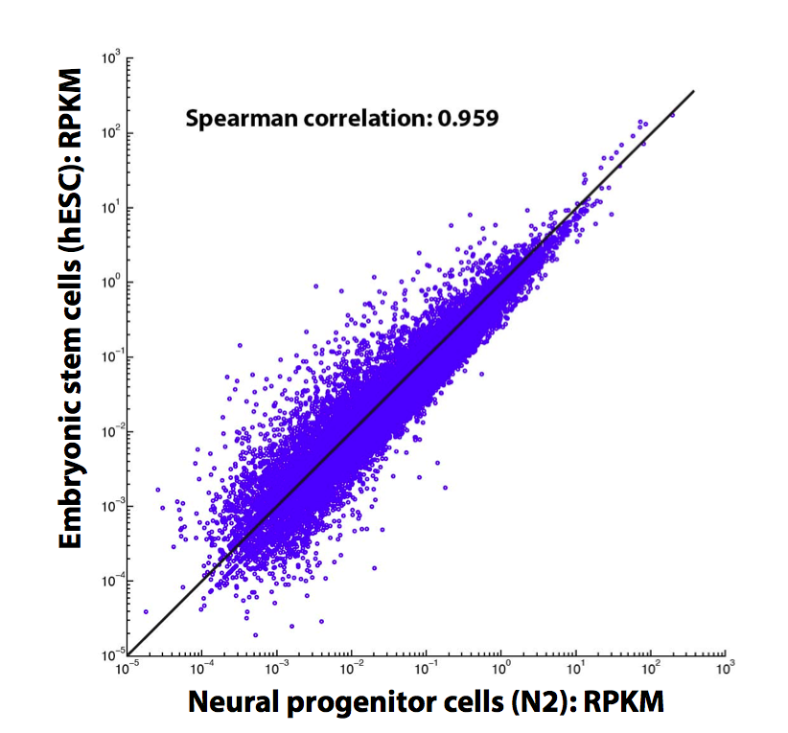
RNA-seq Expression Correlation
Correlate expression between tissues
Slide adapted from L Habegger

Slide 60
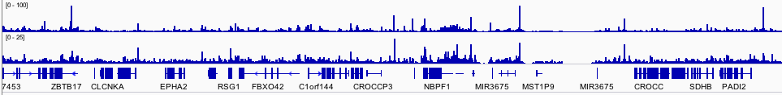
CHIP-seq signals of interacting proteins
Fos and Jun, which interact physically, have similar binding profiles at many genomic loci.
Fos
Jun
Data from ENCODE Consortium, figure by me

Slide 61
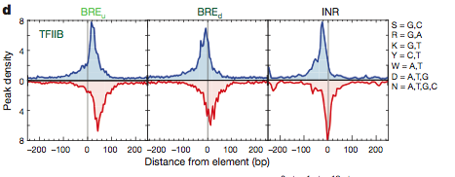
Signal aggregation
Sum signals from all genomic locations of a certain type
  Here: CHIP seq signal at fixed distances from protein binding motif
Venters and Pugh Nature 2013
Notes:
Use different example

Slide 62
Predicting gene expression with chip-seq data

Slide 63

Relating gene expression with histone modification and TF binding signals
“Input”
To what extent the gene expression levels are determined by TF binding/ HM modification?
Histone modification
TF Binding signal
Predictive models
Gene expression levels
“Output”
Slide by Chao Cheng

Slide 64
Setting up the model
1. Divide area around gene into bins according to distance to trascription start and end sites
TSS (transcription start site)
TTS (transcription terminal site)
Gene k
40
1
80
120
81
4 …
41 ….44
121
160
Bin 40-1
(TSS-4kb to TSS)
Bin 41-80
(TSS to TSS+4kb)
Bin 120-81
(TTS-4kb to TTS)
Bin 121-160
(TTS to TTS+4kb)
Slide by Chao Cheng

Slide 65
Setting up the model
2. Collect histone modification data for each bin, and for each gene
TSS (transcription start site)
TTS (transcription terminal site)
Gene k
40
1
80
120
81
4 …
41 ….44
121
160
Bin 40-1
(TSS-4kb to TSS)
Bin 41-80
(TSS to TSS+4kb)
Bin 120-81
(TTS-4kb to TTS)
Bin 121-160
(TTS to TTS+4kb)
Chromatin features:
Histone modifications
Predictors
~10000 refseq genes
HM1, 2, 3, ……
Bin 1
Bin 2
……
Bin160
Slide by Chao Cheng

Slide 66
Setting up the model
3. Train model to “learn” relationship between CHIP-seq and RNA-seq data.
TSS (transcription start site)
TTS (transcription terminal site)
Gene k
40
1
80
120
81
4 …
41 ….44
121
160
RNA-Seq data
Bin 40-1
(TSS-4kb to TSS)
Bin 41-80
(TSS to TSS+4kb)
Bin 120-81
(TTS-4kb to TTS)
Bin 121-160
(TTS to TTS+4kb)
Prediction target:
Gene expression level
Chromatin features:
Histone modifications
Predictors
~10000 refseq genes
HM1, 2, 3, ……
Bin 1
Bin 2
……
Bin160
Slide by Chao Cheng

Slide 67
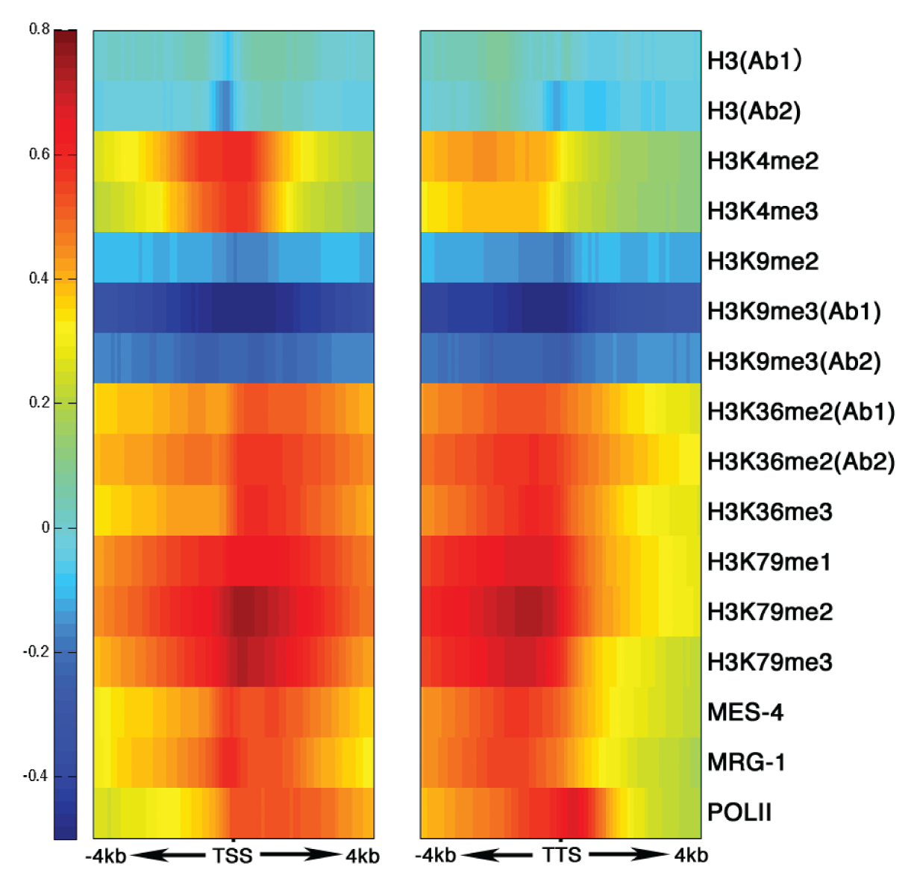
His. mods around TSS & TTS are clearly related to level of gene expression, in a position-dependent fashion
START
STOP
TTS
Slide by Chao Cheng
Gerstein*,…, Cheng* et al. 2010, Science
Correlation between Signal and expression

Slide 68
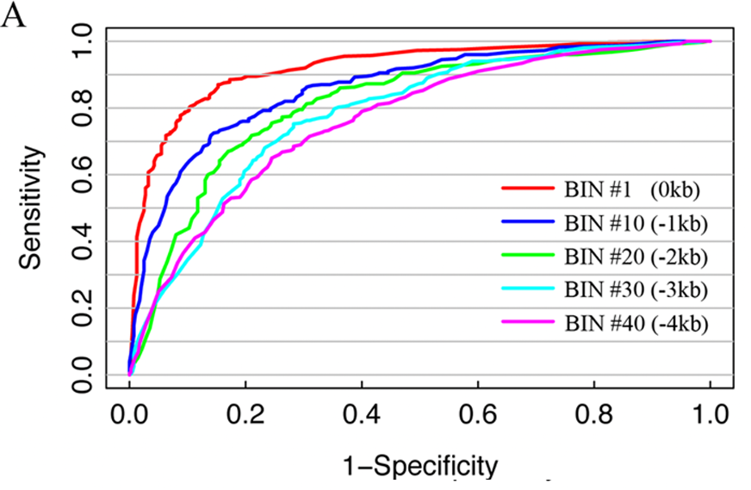
Support vector machine to classify genes with high, medium and low expression
Areas close to gene predict expression better
Slide by Chao Cheng

Slide 69
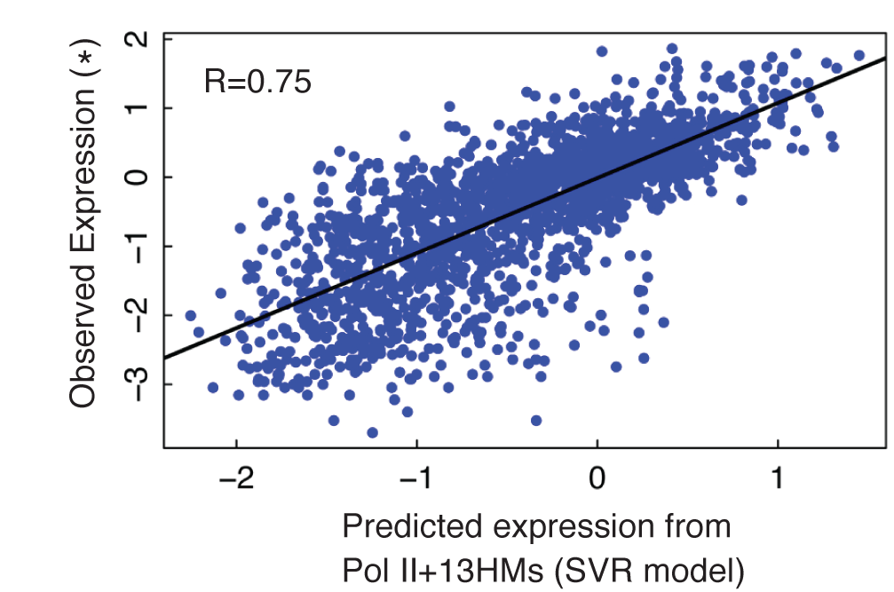
Support vector regression to predict gene expression levels
Slide by Chao Cheng
Notes:
Cite Cheng et al. Genome Research 2013

Slide 70
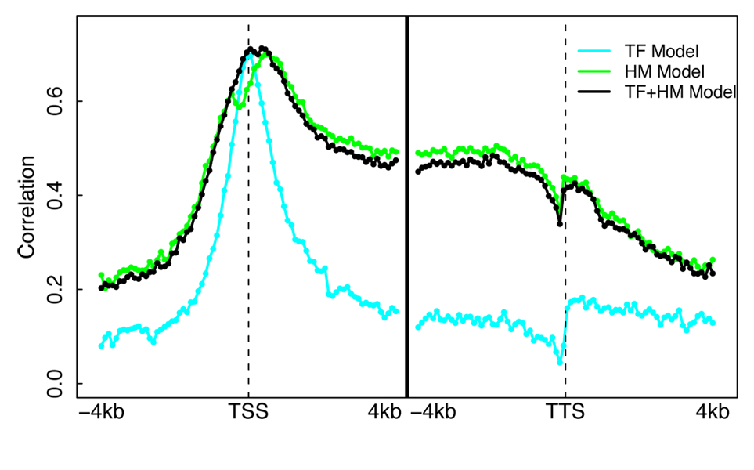
Mouse ESC Models Illuminates Different Regions of Influence for TFs vs HMs
Datasets
  ChIP-Seq for 12 TFs
  (Chen et al. 2008)
  ChIP-Seq for 7 HMs
  (Meissner et al.’08; Mikkelsen et al. ’07)
  RNA-Seq (Cloonan et al. 2008)
A TF+HM model that combine TF and HM features does NOT improve accuracy!
Cheng et al. 2011, Nucleic Acids Res.
Slide by Chao Cheng

Slide 71
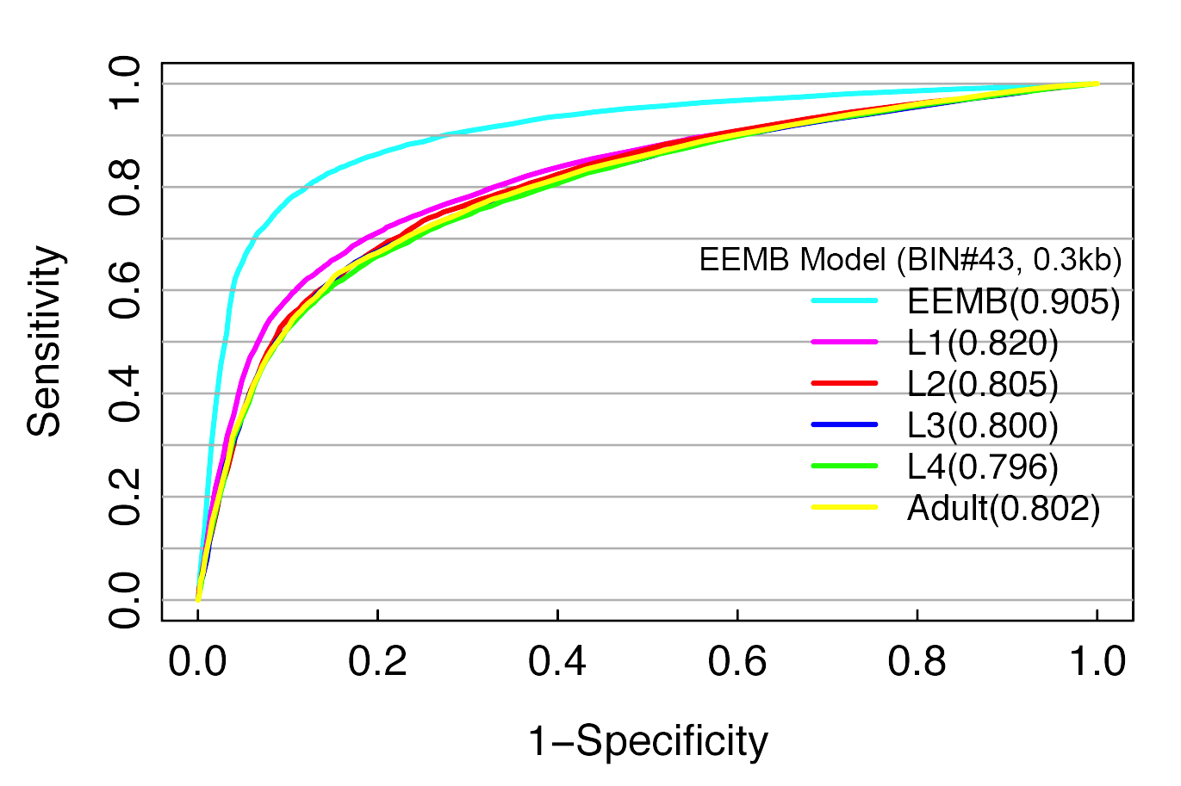
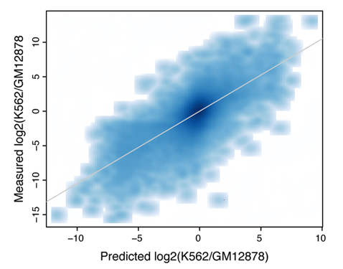
TF and HM models are tissue specific
PCC=0.73
HM model-- Best prediction is achieved by using histone modification and expression data from the same developmental stage
TF model– differential TF binding signals are predictive of differential expression levels between two human cell lines
Slide by Chao Cheng
Cheng et al. 2011, Genome Biology (a)

Slide 72
Summary: relate TF/HM signals with expression
TF/HM signals are highly predictive to gene expression
TF and HM signals are redundant for ‘predict’ gene expression
TF and HM models are tissue/cell line specific
microRNA expression can also be predicted
Slide by Chao Cheng
Gerstein et al. 2010, Science
Cheng et al. 2011, Nucleic Acids Res.
Cheng et al. 2011, Genome Biology (a)

Slide 73
Conclusions
Diverse sequencing experiments have common analysis elements, based on signal processing.
Proper statistics key to making claims about NGS data.
Integrating many genome-wide experiments through machine learning can yield useful inferences about biology.

Slide 74
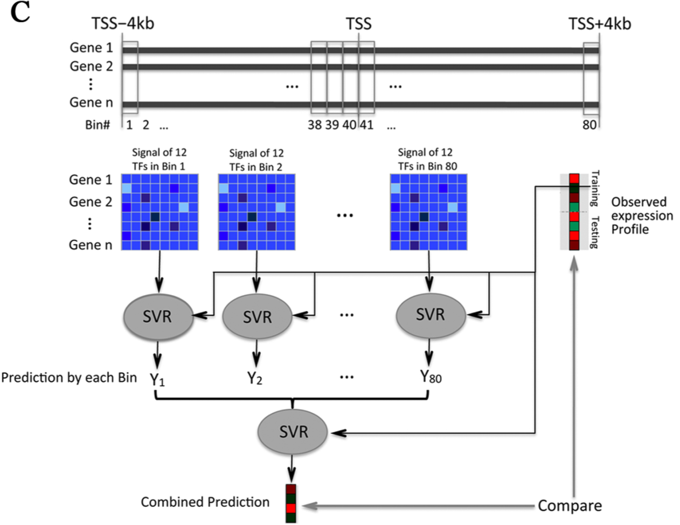
Predictor v2:
2-levels, now with TFs
Slide by Chao Cheng
[Cheng et al. NAR ('11)]

Slide 75
Ensemble machine learning
Integrate multiple machine learning models to learn patterns in the data
These methods generally perform better than single ensemble learning methods

