Slide 1
funRNA functional interpretation of variants in noncoding RNA
Michael Rutenberg-Schoenberg
gpmtg
Gerstein Lab
5 December 2014

Slide 2
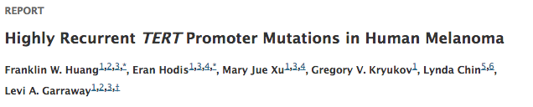
Background
Genetic variants in noncoding DNA → disease
  IF they affect important genes
Genetic variants in ncRNA and UTRs less studied
  Could affect import genes
  Could affect ncRNA function
Huang et al. Science 2013

Slide 3
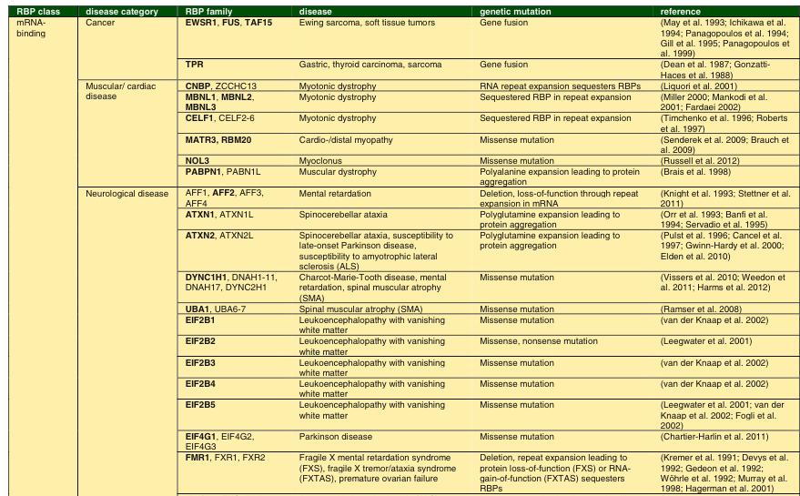
RBPs: A laundry list of disease associations
Yeo Springer 2014

Slide 4
Disease Impact of RNA Binding Proteins
Neurological diesease
  FMR1 – Autism
    targets enriched for germline mutations in Autism
  TDP43 – ALS
Cancer
  EWSR1, FUS
TFs were long known to cause diseases, same for RBPs
  ncRNA mutations in RBP footprints next step?

Slide 5
Levels of Information about RNA
CDS
AAAAAAAA
Whole Gene/Transcript Level
  Expression level/breadth (RNA-Seq)
  RNA degradation rate
  Biotype – mRNA, rRNA, lncRNA

Slide 6
Levels of Information about RNA
Structured
region
AAAAAAAA
Whole Gene/Transcript Level
Subregions within RNA
Protein-binding site
(CLIP-Seq)

Slide 7
Levels of Information about RNA
Protein-binding
motif
m6A*
AAAAAAAA
Single base
chemical modification
Whole Gene/Transcript Level
Subregions within RNA
Motif/Single base level
miRNA
binding site
Polyadenylation
signal

Slide 8
Levels of Information about RNA
Structured
region
CDS
Protein-binding
motif
m6A*
AAAAAAAA
Single base
chemical modification
Whole Gene/Transcript Level
Subregions within RNA
Motif/Single base level
Integration/Network
Protein-binding site
(CLIP-Seq)
miRNA
binding site
Polyadenylation
signal
HUB?

Slide 9
Levels of Information about RNA
AAAAAAAA
Whole Gene/Transcript Level
Subregions within RNA
Motif/Single base level
Focus on RNA binding proteins
Protein-binding site
(CLIP-Seq)

Slide 10
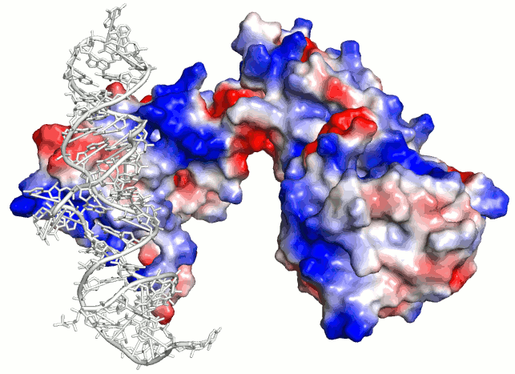
Why are RNA-protein interactions important?
Translation Regulation
RNA Splicing/Biogenesis
Protein
RNA
Noncoding Function
RNA Degradation
http://biochemlabsolutions.com/FASTAandPDB.html, PDB IQZW

Slide 11
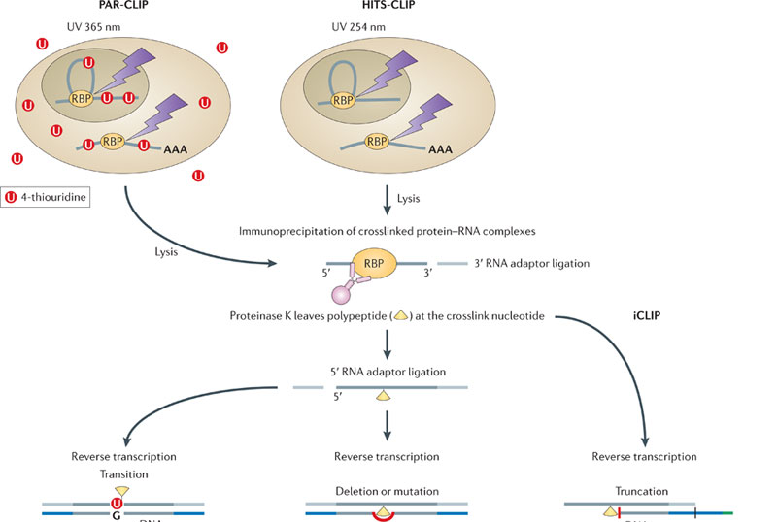
CLIP-Seq
3 major technologies, all similar:
HITS-CLIP, PAR-CLIP, iCLIP
Konig et al. Nature Reviews Genetics 2012

Slide 12
Summary of CLIP-Seq Compendium
Data Sources:
  Starbase2, doRiNA databases
45 distinct RNA binding proteins, >100 datasets
Peaks merged for RBPs with multiple CLIP-Seq datasets
Blin et al Nucl Acids Res 2014, Li et al Nucl Acids Res 2014

Slide 13
Sensitivity to mutation
Rare variants are more likely to be deleterious, as they affect fewer individuals
Rare DAF proportion =
Rare defined as < 1 per 200 samples

Slide 14
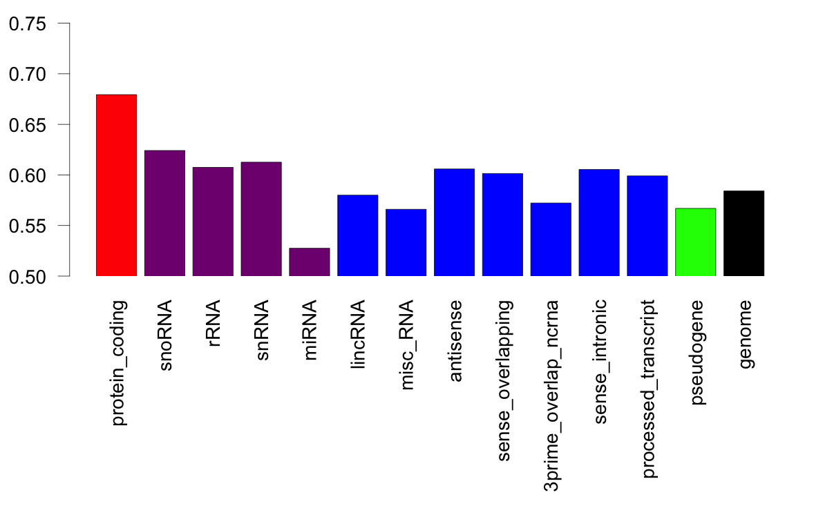
Rare Variant proportion across Gencode annotations
1000 genomes variants (release 3), GENCODE v19
All calculations done on composite gene models (like original RSEQtools)
Notes:
Variants are missing Y chromosome – why?
----- Meeting Notes (12/5/14 10:03) -----
How to deal with uneven coverage?

Slide 15
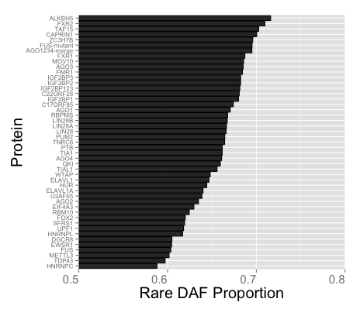
Rare DAF Proportion in CLIP-Seq regions
Each bar is the binding sites for 1 RBP
Protein binding sites on RNA are highly sensitive to mutation, even relative to protein-coding regions
Notes:
Difference between my old numbers and new numbers. Old file had 37.9 M SNPs. New file from JZ/YF has 36.4 M SNPs. In some cases, a lot of rare SNPs are missing for particular factors. WHY??? Which is correct?
----- Meeting Notes (12/5/14 10:03) -----
Look at subsampling of nucleotides

Slide 16
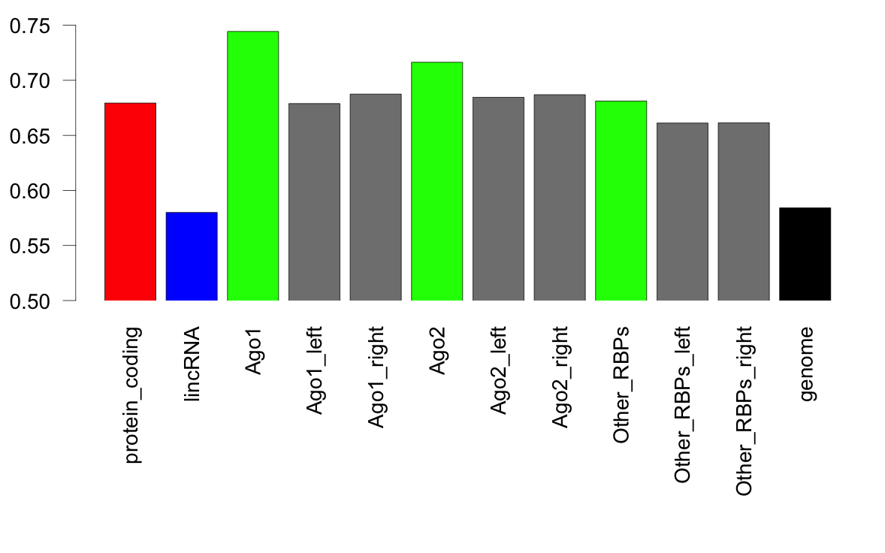
Comparison to adjacent regions
16
Left Matching Region
CLIP-Seq Footprint
Right Matching Region

Slide 17
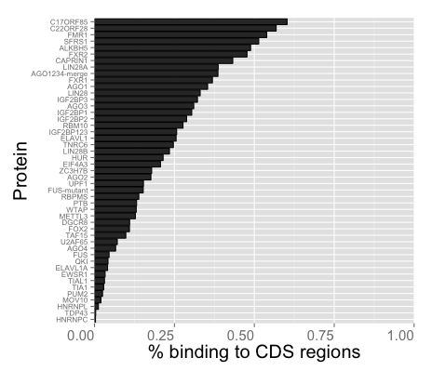
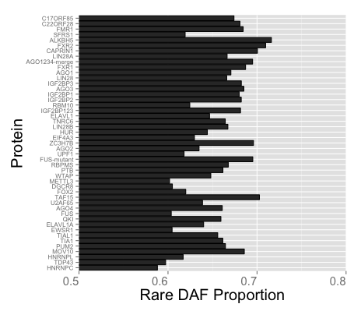
Coding vs. Noncoding Regions
Genome average
CDS average
The vast majority of RNA binding occurs outside of CDS regions

Slide 18
Coding vs. Noncoding Regions
Genome average
CDS average
The vast majority of RNA binding occurs outside of CDS regions

Slide 19
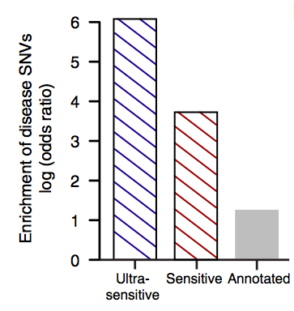
HGMD variants
RBP footprints > 100-fold enriched for HGMD SNPs

Slide 20
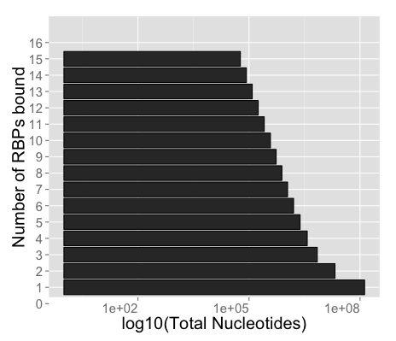
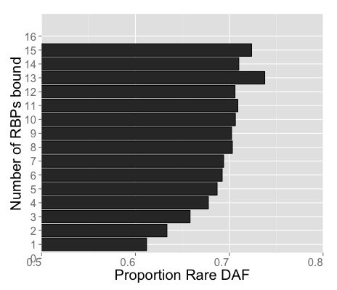
Highly Occupied Regions
RNA regions bound by many RBPs are more sensitive to mutation
Analogous to enhancers

Slide 21
Future Plans
Investigate effects of other RNA annotations on sensitivity to mutation
  miRNA binding sites
  Global protein footprinting
  Experimental RNA structure probing
Build scoring framework
Networks of RBPs
  like ENCODE-nets → how do RBPs regulate each other?

Slide 22
RNA turnover
Vignette from Simon lab

Slide 23
Why are RNA-protein interactions important?
Translation Regulation
RNA Splicing/Biogenesis
Protein
RNA
Noncoding Function
RNA Degradation
http://biochemlabsolutions.com/FASTAandPDB.html, PDB IQZW

Slide 24
Future Plans
Determine transcript specific half lives
Look for RBPs that afffect half life

Slide 25
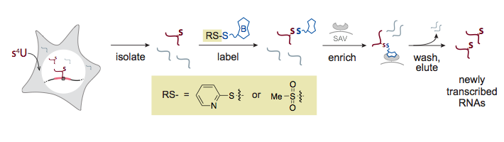
Experimental Scheme (nitty gritty)
Steps to purify 4SU-containing RNA
  Connect biotin to 4SU
  Precipitate with streptavidin beads
Problem: HPDP-biotin only biotinylates 1% of 4SUs
Experimental finding: MTS-biotin biotinylates ~50% of 4SUs

Slide 26
MTS (new) has much less length bias than HPDP (old)
Dominant transcript isoforms (>90% of total expression for gene)

Slide 27
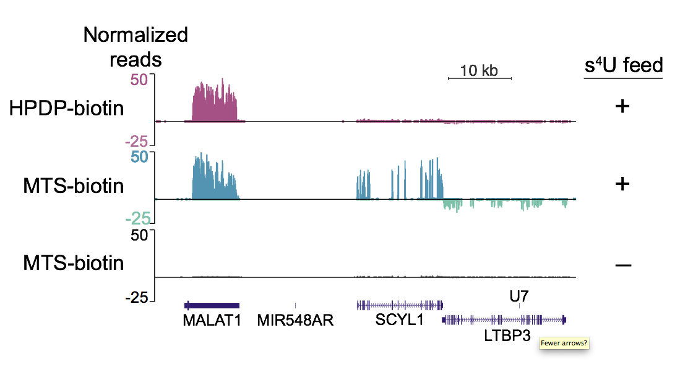
Example of Length Bias

Slide 28
Acknowledgements
Jing
Arif
Yao
Xiaotong
Cristina
Jason
Joel
P2-Var
Jasmine Mu
Mark
Erin Duffy
Rui Fang
Matt Simon

