Slide 1
Simulation at Extreme Scale
William Gropp
www.cs.illinois.edu/~wgropp

Slide 2
Why Talk About Simulation?
Big Data requires Big Computing
Simulation both a consumer and producer of data
Individual data objects may be huge
  Really huge, as in Petabytes
HPC systems are uniquely capable of processing huge data viewed as a single object
  Compared even with large cluster systems
  Key feature of HPC systems is very fast interconnect, making HPC system one big machine in a way that clouds are not.

Slide 3
HPC in 2011
2012
Sustained PF systems
  K Computer (Fujitsu) at RIKEN, Kobe, Japan (2011)
  “Sequoia” Blue Gene/Q at LLNL
  NSF Track 1 “Blue Waters” at Illinois
  Undoubtedly others (China, … )
Focus remains on FLOPS, even though systems are uniquely capable of handling big data
  There has been a long history of ranking systems by FLOPS
  Esp TOP500 but also HPCC, others, even Graph500
NSF asked in 2006 for a sustained PetaFLOP system
  Includes entire application, not just “the fast part”
  Includes realistic I/O in time
  Illinois won the award with “Blue Waters”
Notes:
Still can’t compile single-threaded code to reliably get good performance – see the work in autotuners. Lesson – there’s a limit to what can be automated. Pretending that there’s an automatic solution will stand in the way of a real solution

Slide 4
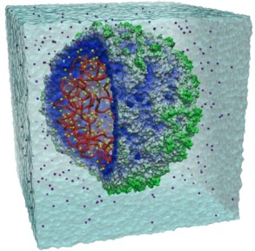
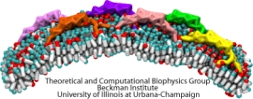
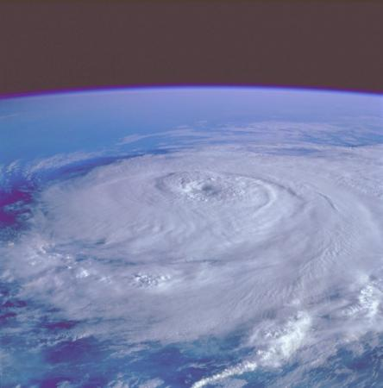
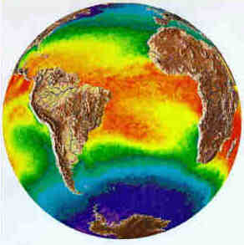
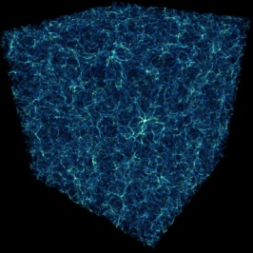
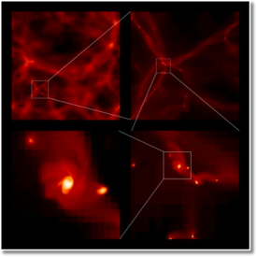
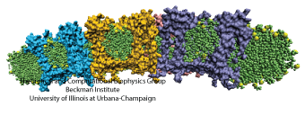
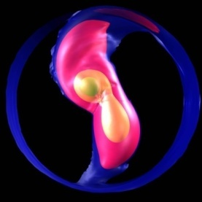
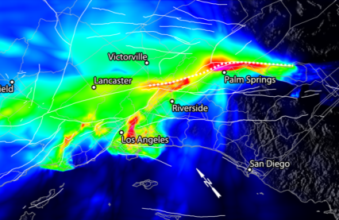
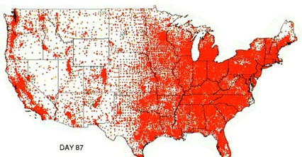
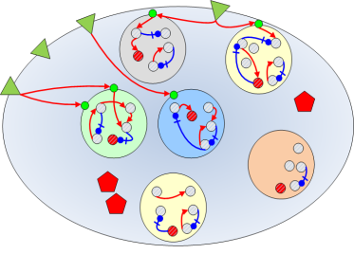
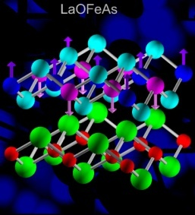
Sustained Petascale computing will enable advances in a broad range of science and engineering disciplines
Molecular Science
Weather & Climate Forecasting
Astrophysics
Astronomy
Earth Science
Health
Life Science
Materials
Missing are true data-centric applications
Have one? - http://www.nsf.gov/pubs/2008/nsf08529/nsf08529.htm
or search for NSF PRAC (#1 with duckduckgo)

Slide 5
Blue Waters Science Team Characteristics
Science Area | Number of Teams | Codes | Structured Grids | Unstructured Grids | Dense Matrix | Sparse Matrix | N-Body | Monte Carlo | FFT | Significant I/O
Climate and Weather | 3 | CESM, GCRM, CM1, HOMME | X | X |  | X |  | X
Plasmas/Magnetosphere | 2 | H3D(M), OSIRIS, Magtail/UPIC | X |  |  |  | X |  | X | X
Stellar Atmospheres and Supernovae | 2 | PPM, MAESTRO, CASTRO, SEDONA | X |  |  | X |  | X |  | X
Cosmology | 2 | Enzo, pGADGET | X |  |  | X | X
Combustion/Turbulence | 1 | PSDNS | X |  |  |  |  |  | X
General Relativity | 2 | Cactus, Harm3D, LazEV | X |  |  | X
Molecular Dynamics | 4 | AMBER, Gromacs, NAMD, LAMMPS |  |  | X |  | X |  | X
Quantum Chemistry | 2 | SIAL, GAMESS, NWChem |  |  | X | X | X | X |  | X
Material Science | 3 | NEMOS, OMEN, GW, QMCPACK |  |  | X | X | X | X
Earthquakes/Seismology | 2 | AWP-ODC, HERCULES, PLSQR, SPECFEM3D | X | X |  |  | X |  |  | X
Quantum Chromo Dynamics | 1 | Chroma, MILC, USQCD | X |  | X | X | X |  | X
Social Networks | 1 | EPISIMDEMICS
Evolution | 1 | Eve
Computer Science | 1 |  |  | X | X | X |  |  | X | X
Notes:
Notes: First, rows: variety of application areas Second, columns: variety of needs by applications. Third, note that many areas (all but one) checked multiple columns – a “domain specific” machine (one that did just one data structure) would be inadequate. Need for flexibility

Slide 6
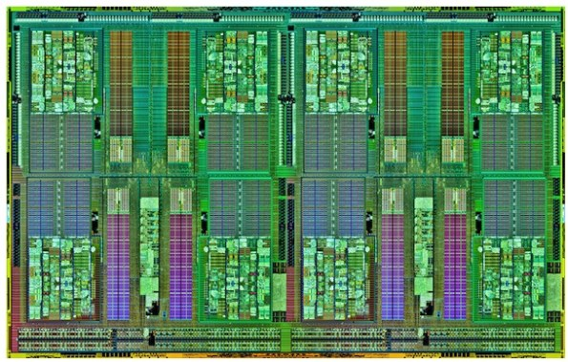
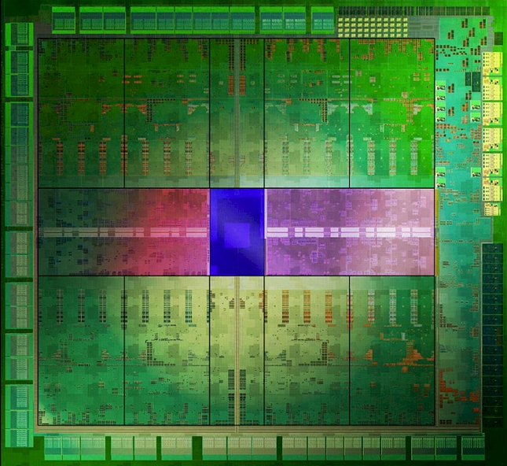
Heart of Blue Waters: Two New Chips
AMD Interlagos
157 GF peak performance
Features:
2.3-2.6 GHz
8 core modules, 16 threads
On-chip Caches
L1 (I:8x64KB; D:16x16KB)
L2 (8x2MB)
Memory Subsystem
Four memory channels
51.2 GB/s bandwidth
NVIDIA Kepler
1,400 GF peak performance
Features:
15 Streaming multiprocessors (SMX)
SMX: 192 sp CUDA cores, 64 dp units, 32 special function units
L1 caches/shared mem (64KB, 48KB)
L2 cache (1536KB)
Memory subsystem
Six memory channels
180 GB/s bandwidth

Slide 7









Cray XE6 Nodes
Dual-socket Node
  Two AMD Interlagos chips
    16 core modules, 64 threads
    313 GFs peak performance
    64 GBs memory
      102 GB/sec memory bandwidth
  Gemini Interconnect
    Router chip & network interface
    Injection Bandwidth (peak)
      9.6 GB/sec per direction
HT3
HT3
Blue Waters contains 22,640 Cray XE6 compute nodes.

Slide 8


Cray XK7 Nodes
Dual-socket Node
  One AMD Interlagos chip
    32 GBs memory
      51.2 GB/s bandwidth
  One NVIDIA Kepler chip
    1.4 TFs peak performance
    6 GBs GDDR5 memory
      180 GB/sec bandwidth
  Gemini Interconnect
    Same as XE6 nodes
PCIe Gen2
HT3
HT3
Blue Waters contains 3,072 Cray XK7 compute nodes.

Slide 9
Gemini Interconnect Network
Blue Waters
3D Torus Size
23 x 24 x 24
InfiniBand
Login
Servers
Network(s)
GigE
SMW
Y
Fibre Channel
X
Boot Raid
Z
Infiniband
Interconnect
Network
Lustre
Compute Nodes
Service Nodes
Cray XE6 Compute
Operating System
Login/Network
Service Nodes spread
throughout the torus
Cray XK7 Accelerator
Boot
Login Gateways
System Database
Network
Lustre File System
LNET Routers
Notes:
Note mixed elements in Torus; note complexity in assigning blocks of processes to Torus.

Slide 10
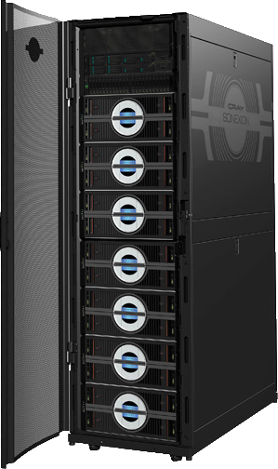
Blue Waters Disk Subsystem
Cray Sonexion 1600
  Lustre file system
  Reliable, Modular, Scalable
  Fully integrated
    Servers
    Disk drives (Scalable Storage Units)
    QDR Infiniband switches
  Hierarchical monitoring
Blue Waters Disk Subsystem
  Capacity: 34.6 PBs (raw), 25.9 PBs (usable)
  Bandwidth: >1 TB/s (sustained)

Slide 11
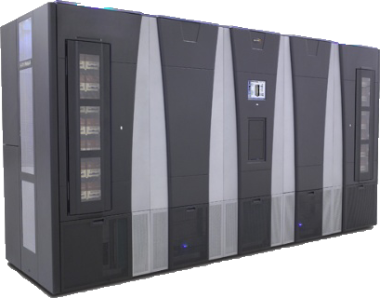
Blue Waters Archive System
Spectra Logic T-Finity
  Dual-arm robotic tape libraries
  High availability and reliability, with built-in redundancy
Blue Waters Archive
  Capacity: 380 PBs (raw), 300 PBs (usable)
  Bandwidth: 100 GB/sec (sustained)
  RAIT for increased reliability

Slide 12
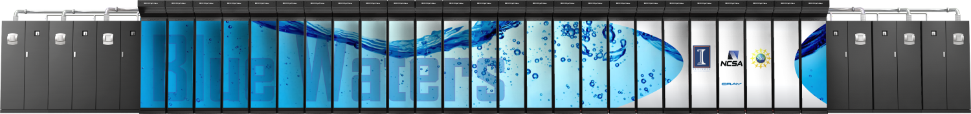
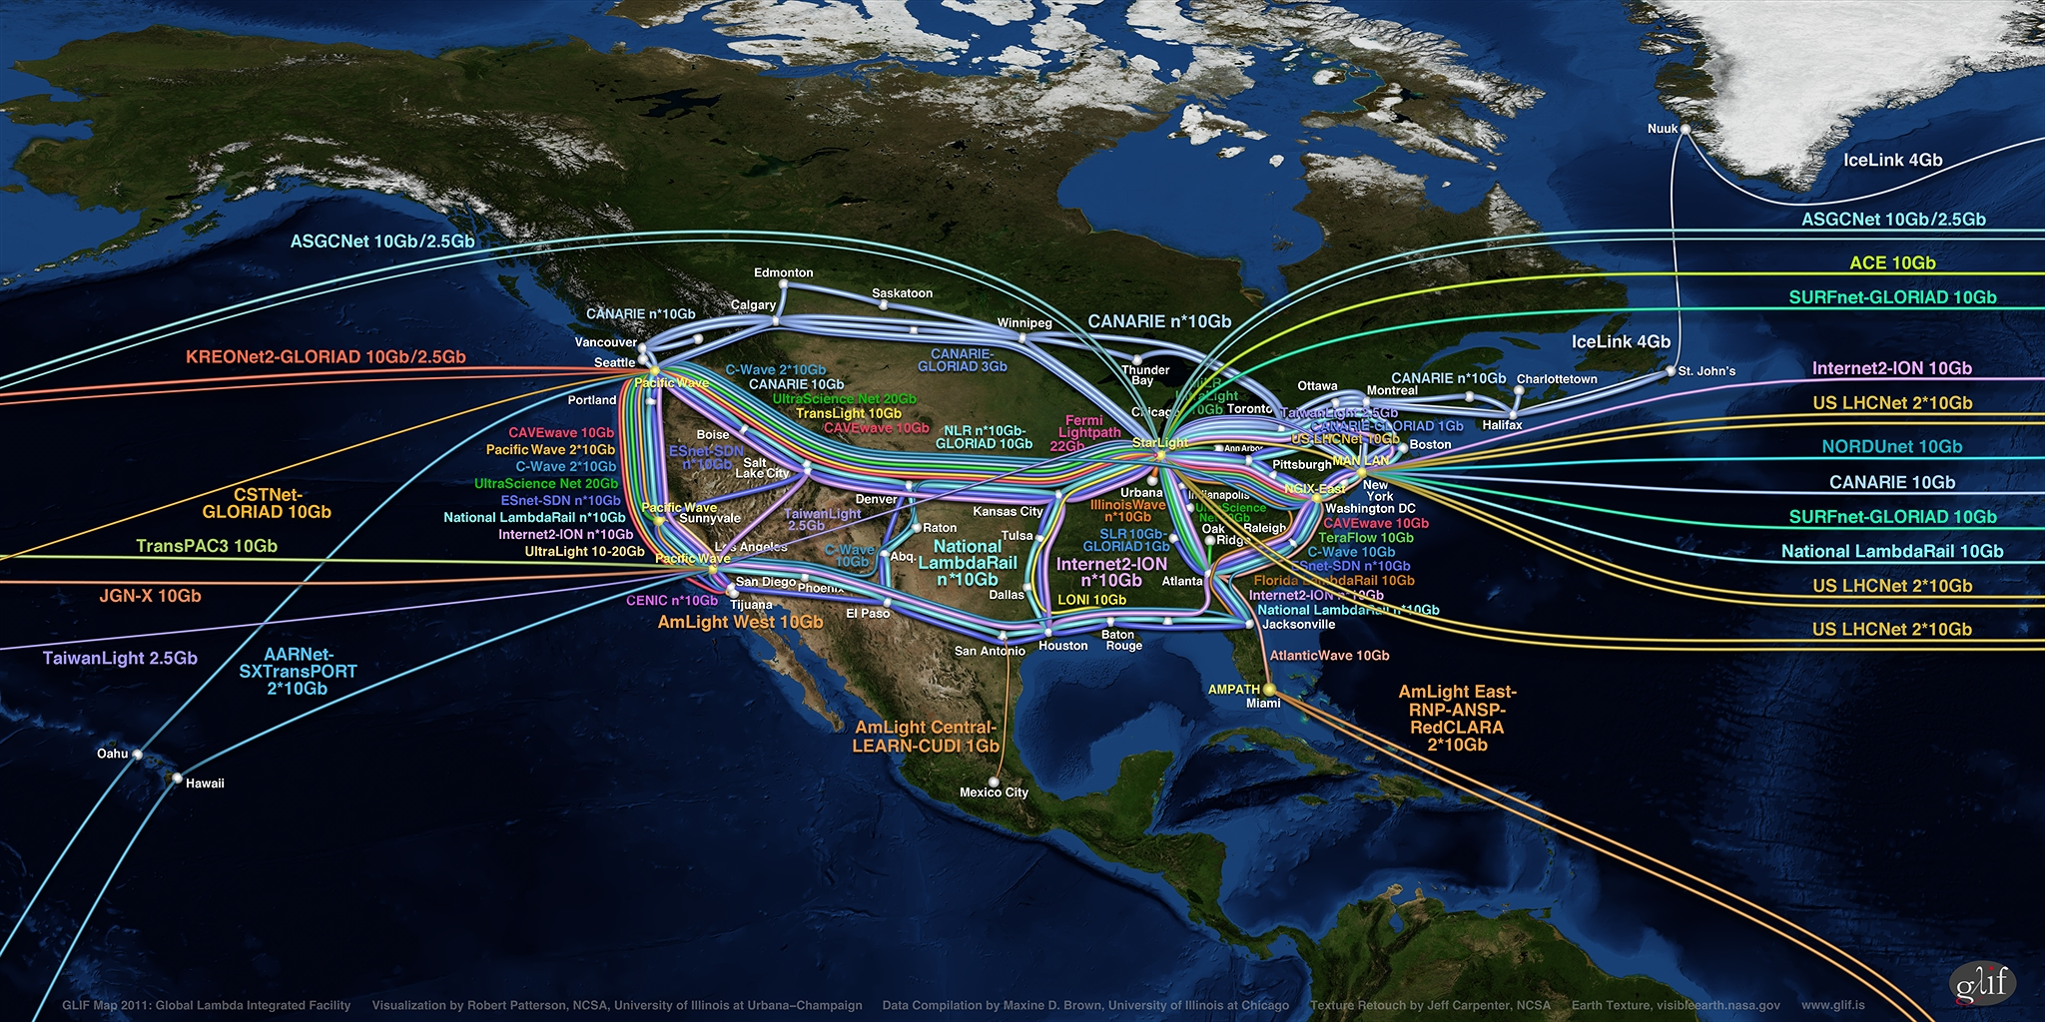
Blue Waters Computing System
IB Switch
>1 TB/sec
10/40/100 Gb
Ethernet Switch
100 GB/sec
120+ Gb/sec
WAN
Spectra Logic: 300 PBs
Sonexion: 26 PBs
Notes:
Note just compute – main memory (1.6PB); Disk (26PB); near line (300PB)

Slide 13
How Do We Make Effective Use of These Systems?
Better use of our existing systems
  Blue Waters will provide a sustained PF, but that typically requires ~10PF peak (BW over 11PF peak)
Improve node performance
  Make the compiler better
  Give better code to the compiler
  Match algorithms/data structures to real hardware
Improve parallel performance/scalability
Improve productivity of applications
  Better tools and interoperable languages, not a (single) new programming language
Improve algorithms wrt real hardware
  Optimize for the real issues – data movement, power, resilience, …
Notes:
Could say something here about convergence – wireless etc. also concerned about power, reliability, engineering for performance

Slide 14
Common Themes
Multiple operations must be pending at any time
  Asynchronous I/O, communication, even computation
  “split” computations and communication
Complex systems require adaptive approaches
  “Autotuning” for likely choices, runtime optimization
Operations must be on aggregates
  CPU: “vectors” (GPU gangs/workers/vectors)
  I/O: Collective, parallel I/O
Example: Parallel collective I/O for a distributed data structure
  mesh distributed across all nodes

Slide 15
Four Levels of Collective I/O
File Space
Level 0
Level 1
Level 2
Level 3
0
1
2
3
Processes
15

Slide 16
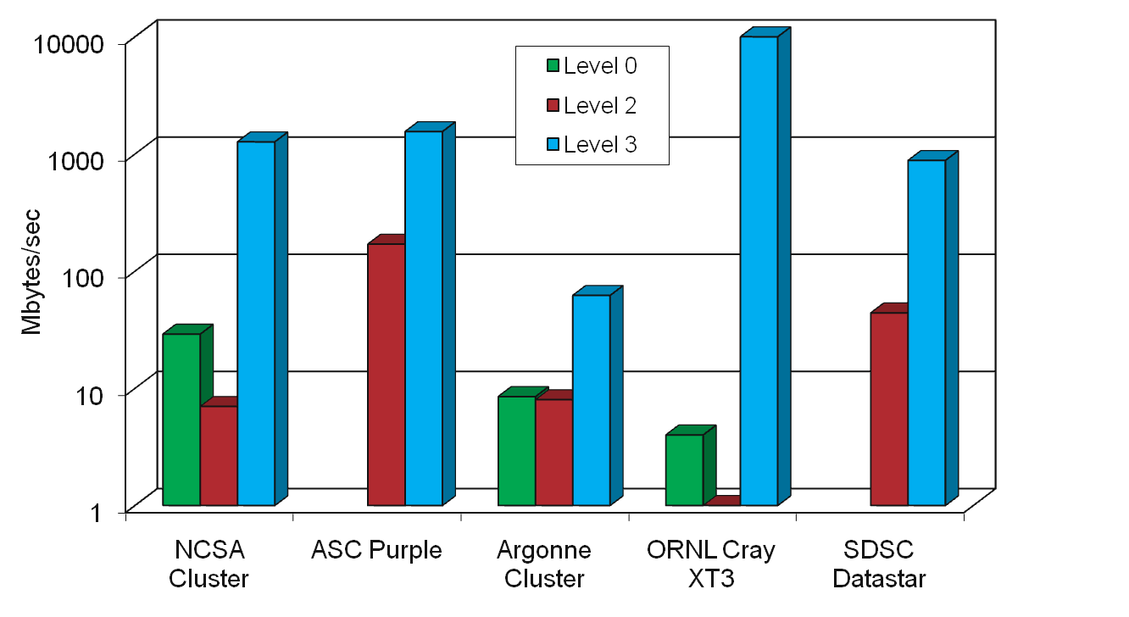
Distributed Array Access: Write Bandwidth
Array size: 512 x 512 x 512
1GB data
Note:Log Scale!
128 procs
256 procs
32 procs
256procs
128 procs
Thanks to Weikuan Yu, Wei-keng Liao, Bill Loewe, and Anthony Chan for these results.
16

Slide 17
Better Algorithms and
Data Structures
Relying on compilers or other optimization tools (including autotuning) only offers the best performance with the given data structure and algorithm
  That’s a big constraint
Processors include hardware to address performance challenges
  “Vector” function units
  Memory latency hiding/prefetch
  Atomic update features for shared memory
  Etc.

Slide 18
Sparse Matrix-Vector Multiply
Barriers to faster code
“Standard” formats such as CSR do not meet requirements for prefetch or vectorization
Modest changes to data structure enable both vectorization, prefetch, for 20-80% improvement on P7
Prefetch results in Optimizing Sparse Data Structures for Matrix Vector Multiply
http://hpc.sagepub.com/content/25/1/115

Slide 19
What Does This Mean For You?
It is time to rethink data structures and algorithms to match the realities of memory architecture at all levels
  Better match of algorithms to prefetch hardware is necessary to overcome memory performance barriers
Similar issues come up with heterogeneous processing elements (someone needs to design for memory motion and concurrent and nonblocking data motion) and for file/data operations

Slide 20
Processes and SMP nodes
HPC users typically believe that their code “owns” all of the cores all of the time
  The reality is that was never true, but they did have all of the cores the same fraction of time when there was one core /node
We can use a simple performance model to check the assertion and then use measurements to identify the problem and suggest fixes.
Based on this, we can tune a state-of-the-art LU factorization….

Slide 21
Happy Medium Scheduling
Performance irregularities introduce load-imbalance.
Pure dynamic has significant overhead; pure static too much imbalance.
Solution: combined static and dynamic scheduling
Communication Avoiding LU factorization (CALU) algorithm, S. Donfack, L .Grigori, V. Kale, WG, IPDPS ‘12
Scary Consequence: Static data decompositions will not work at scale.
Corollary: programming models with static task models will not work at scale
Notes:
Note that MPI does *not* have a completely static task model – works with threads

Slide 22
Needs for Big Data and
Extreme Scale Simulation
Better use of existing resources
  Performance-oriented programming
  Dynamic management of resources at all levels
  Embrace hybrid programming models (you have already if you use SSE/VSX/OpenMP/OpenAcc/…)
Focus on results (end-to-end)
  Adapt to available network bandwidth and latency
  Exploit I/O capability (available space grew faster than processor performance!)
Prepare for the future
  Latency tolerant algorithms
  Data-driven systems
  Hybrid processor architectures
  Fault tolerance

Slide 23
Thanks
Torsten Hoefler
  Performance modeling lead, Blue Waters; MPI datatype
David Padua, Maria Garzaran, Saeed Maleki
  Compiler vectorization
Dahai Guo
  Streamed format exploiting prefetch, vectorization, GPU
Vivek Kale
  SMP work partitioning
Hormozd Gahvari
  AMG application modeling
Marc Snir and William Kramer
  Performance model advocates
Abhinav Bhatele
  Process/node mapping
Van Bui
  Performance model-based evaluation of programming models
Funding provided by:
  Blue Waters project (State of Illinois and the University of Illinois)
  Department of Energy, Office of Science
  Sandia National Laboratories
  National Science Foundation

Slide 24




