Slide 1
ICGC Pan-Cancer Analysis of Whole Genomes (PCAWG) Update
Josh Stuart (UCSC), Gad Getz (Broad)
TCGA Meeting Oct 28, 2014

Slide 2
Pan-Can Analysis of Whole Genomes
Activities
5 computing centres with synchronized mutation calls for 2,000 whole cancer genomes (+ UCSC/NCI cluster)
Establishment of a governance structure:
  Steering Committee & Technical Working Group
More than 150 abstracts submitted
16 Thematic Groups formed
Establishment of timelines of overall project
Timeline of Data Freezes and Availability
Tom Hudson

Slide 3
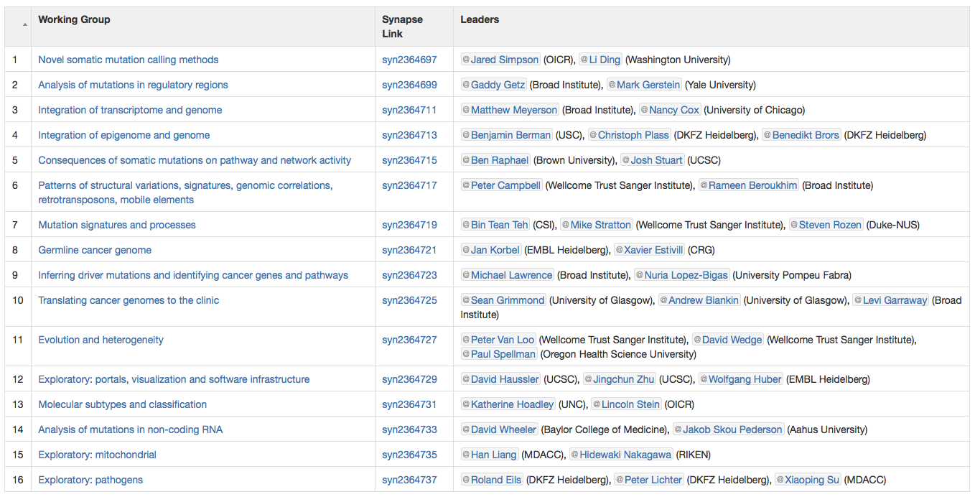
Steering committee and 16 working groups
SC: Peter Campbell, Lincoln Stein, Jan Korbel, Gad Getz, Josh Stuart

Slide 4
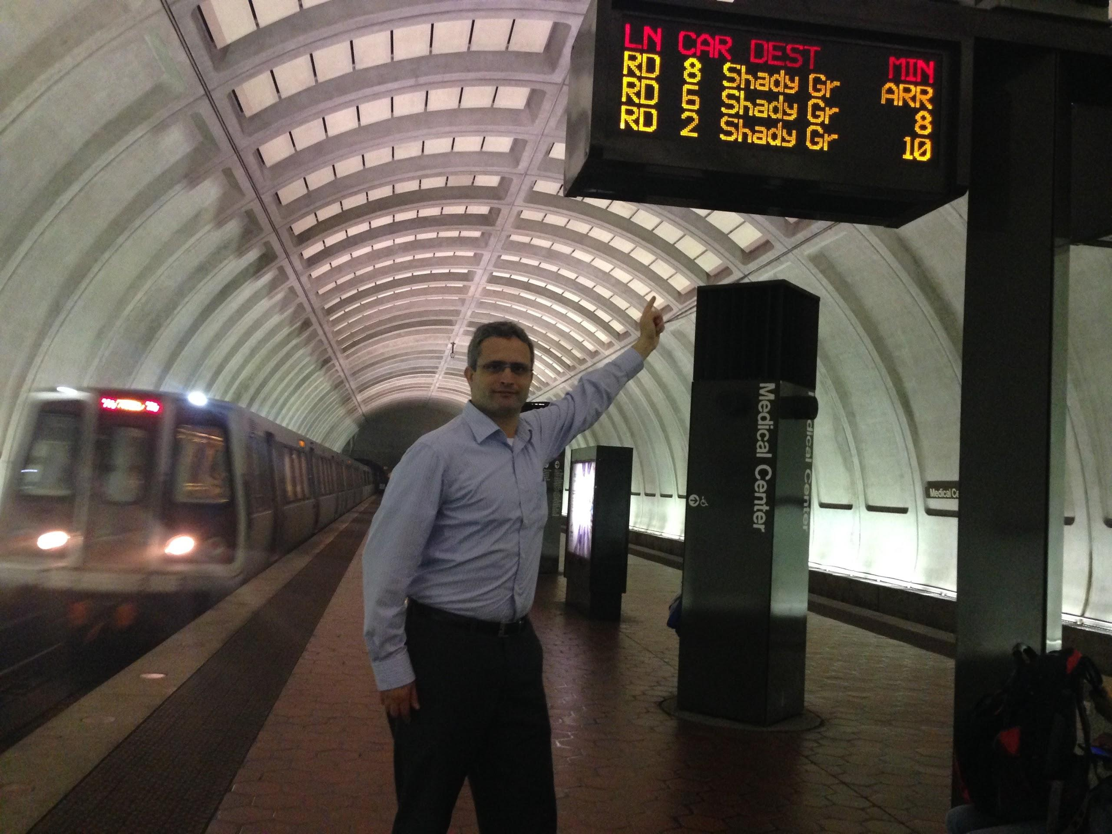
Analysis Trains
Our “Train” concept for analysis runs now adopted by the project
Now we have clear decoupling between SOP development and deployment.
First results now emerging.
Establish a timeline for two initial trains.

Slide 5
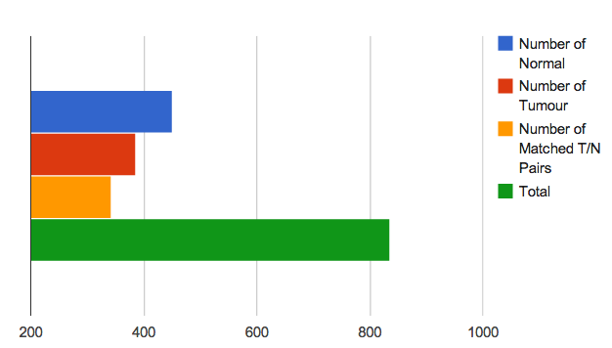
Train 1.0 Re-Alignment Summary
450
386
342
836
(Link to Tracking Table)

Slide 6
Train 2.0 Re-Alignment Summary
450
386
342
836
(Link to Tracking Table)

Slide 7
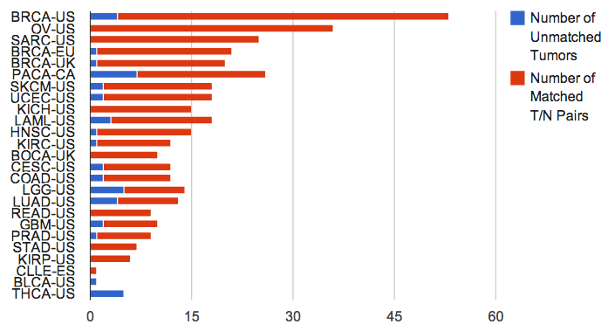
WGS Alignments (v 2.0)
Samples Pairs
US 688 273
UK 60 29
EU 41 20
CA 45 19
ES 2 1
Total 836 342
(Link to Tracking Table)
75% of genomes aligned
  All of TCGA.
  50% of ICGC.
Notes:
Update w/ Train 2.0 numbers

Slide 8
State of Train 2.0 Re-alignments
75% of Train 2.0 pairs are aligned (X/Y)
100% of TCGA Genomes completed

Slide 9
NCI cluster completed all TCGA re-alignments
NCI Cluster @ UCSC (SDSC Data Center)
1728 cores, expanding to 2240
13TB total RAM
Installed April 25th
680 Alignments by May 12
45 WGS per day average
Uploaded to CGHub @ average of 5TB/day (max 10TB in one day)

Slide 10
Status of Core Analyses
WGS Alignments for Train 2 to completed in 2 weeks (by Nov 14).
Variant Calling Now Launching
mRNA-Seq alignments will start Dec 2.
Delay of overall project by 2-3 months (now looking at June-July completion).

Slide 11
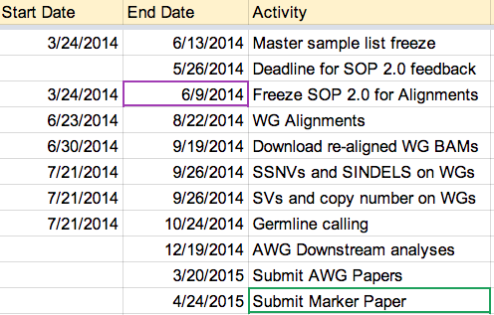
Train 2.0
Train 2.0
(Link to Train Schedule)
Overall project behind 2-3 months at this point.

Slide 12
Core Analyses: WGS Alignments
All TCGA WGS alignments available from CGHub
~80% ICGC WGS alignments available from other servers.
Amazon clouds stepping in to help w/ ICGC alignments from genomes at EBI and Bionimbus
Completed by Dec 14.

Slide 13
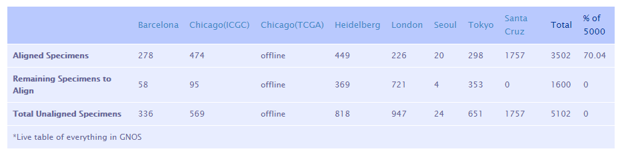
Challenge: The two cloud data centres that hold the largest number of genomes are underperforming due to stability issues. Expected alignment throughput was 20-50 alignments/day. We are getting <20 alignments/week.
Shared responsibility for this situation: OICR staff deployed a workflow system that worked on Amazon at scale and at small scale in the academic centres. We didn’t have the opportunity to perform full scalability testing on the academic centres.

Slide 14
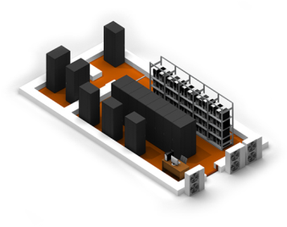

Amazon Compute Helping ICGC Alignments
Offload jobs into Amazon Web Services, and to other data centres
ICGC genomes
Virginia
Chicago
Ireland
ICGC genomes
London
Barcelona
Bandwidth is main limitation: transfers limited to 5-6 genomes/day. London alignments will be finished in mid-December in best realistic case.
Slide Provided by Lincoln Stein

Slide 15
Core Analyses: Variant Calling
3 ICGC pipelines proposed originally
  Broad, Sanger, DKFZ
Additional proposed from TCGA groups
  WashU, Baylor
  Broad, WashU, Baylor in 3-way tie on DREAM-SMC
Limited compute available from centers
Slow transfer of aligned BAMs from everywhere but CGHub (see O’Connor transfer graph)
NCI-Cluster installing callers.
VCFs of TCGA exchanged on NCI SFTP
  Synapse frontend will help organize.

Slide 16
Running Variant Callers Locally leverage compute, data movement is a mess
WGS Data
Variant Callers
Variant Calls
CGHub
GNOS Server
(TCGA)
Fast
Broad
NCI SFTP Site
London
GNOS Server
(ICGC)
WashU
Baylor
OR
Chicago
GNOS Server
(ICGC)
GNOS Server of Origin
Sanger
etc
DKFZ
…and 4 others
(ICGC)
Bandwidth
constraints
Complain about
Compute availability
Adapted from slide provided by Lincoln Stein

Slide 17
Running the Core Pipelines Locally
CGHub
GNOS Server
(TCGA)
Broad
NCI SFTP Site
WashU
London
GNOS Server
(ICGC)
Baylor
VCF Files
Sanger
OR
Chicago
GNOS Server
(ICGC)
GNOS Server of Origin
etc
DKFZ
…and 4 others
(ICGC)
Adapted from slide provided by Lincoln Stein

Slide 18
Plan for Variant Calling
Broad, WashU, Baylor
  Run pipeline on NCI-Cluster.
    ICGC WGS alignments available locally on Hitachi store
    Upload VCFs into NCI SFTP site.
DKFZ & Sanger
  Start running native pipeline on CGHub (TCGA) and London (ICGC) alignments now.
    Investigate whether their HPCs can support VMs.
    Upload VCFs back into GNOS server of origin.
  As cloud data centres finish their alignments (including AWS), start running the two virtual pipelines on cloud holdings.
Defer work on virtualization of pipeline to 2015.
Adapted from slide provided by Lincoln Stein

Slide 19
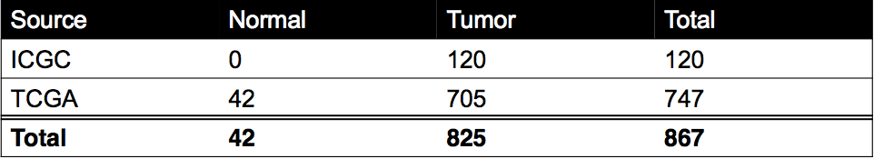
Core Analyses: RNA-Seq Alignments
RNA-Seq availability in Release 17 (see table)
Data provided by Marc Perry and Francis Ouellette, OICR

Slide 20
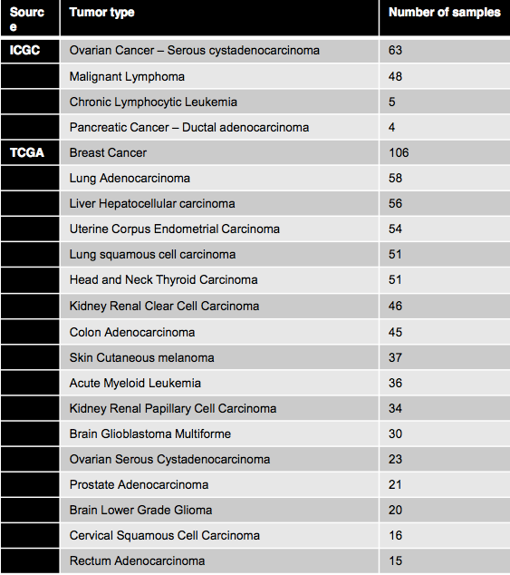
Core Analyses: RNA-Seq Alignments
RNA-Seq availability in Release 17 (see table)
Data provided by Marc Perry and Francis Ouellette, OICR

Slide 21
Next Steps
Face-to-Face in Boston next week 11/4-11/5
  WG presentations
Working group pilot analyses
Re-organization of some groups to maximize harmonization of datasets (e.g. gene annotations) and outputs (e.g. consensus calling)

Slide 22
SV analysis: participant labs
Chairs: Peter Campbell (Sanger), Rameen Beroukhim (Broad)
Dmitry Gordenin (NIH)
Peter Park (Harvard)
Li Ding (Wash U)
Gaddy Getz (Broad)
Mark Gerstein (Yale)
Lynda Chin (MDACC)
Rosalind Eeles (ICR)
Rebecca Fitzgerald (MRC CU)
Jongsun Jung (Syntekabio)
Satoru Miyano (Tokyo)
Suzanne Sindi (UC Merced)
Alfonso Valencia (CNIO)
Kevin White (Chicago)
Ken Chen (MDACC)
Jan Korbel (EMBL)
Shamil Sunyaev (BWH)
Matthew Meyerson (Broad)
Lars Feuerbach (DKFZ)
Andy Lynch (Cambridge)
Ben Rafael (Brown)
David Haussler (UCSC)
David Bowtell (Peter Mac)
Benedikt Brors (DKFZ)
Robert Grossman (Chicago)
Karsten Rippe (DKFZ)
David Torrents (ICREA)
Sungsoo Yoon (Seoul National)
Sean Grimmond (Glasgow)
>80 participants total
Slide provided by Peter Campbell and Rameen Beroukhim

Slide 23
SV working group goals
Detect fusions, copy-number alterations, and the events that contributed to them
Detect mechanistic signatures
Detect signatures of selection
Determine networks of associated events

Slide 24
Technical issues
Integrating rearrangement and copy-number calls from different callers
Integrating rearrangements and copy-number changes into a unified profile
Distinguishing positively selected recurrent events

Slide 25
Disparate fusion calls from different tools
← Fusion callers →
← Fusion callers →
← Fusion callers →
Young Seok Ju

Slide 26
PCAWG 7 – Mutation Signatures and Processes
Leaders: Mike Stratton, Bin Tean Teh, Steve Rozen
Objective: Analyze the somatic mutations from the ICGC Pan-Cancer genomes for physical mutation signatures reflecting endogenous mutagenic processes and exogenous mutagenic exposures
Current efforts: Improving the previously developed mutational signatures framework to identify low burden mutational signatures and curating previously published data for mutational signatures analysis
PAN-CAN Analysis: Will commence after somatic mutation calling by ICGC Pan-Cancer pipelines
Slide provided by Mike Stratton Bin Tean Teh, Steve Rozen

Slide 27
Integration of Epigenome and Genome (PCAWG-4)
Pan-Cancer Analysis of Whole Genomes (PCAWG)
Working Group leaders:
Benedikt Brors, DKFZ
Christoph Plass, DKFZ
Hui Shen, Van Andel Research Institute
Ben Berman, Cedars-Sinai Medical Center
Slide provided by Benedikt Brors, Christoph Plass, Hui Shen, Ben Berman

Slide 28
Integration of Epigenome and Genome (PCAWG-4)
  DKFZ group: Benedikt Brors, Lars FeuerbachYassen Assenov, Olga Bogatyrova, Christoph Plass, Ting Wang (Wash U), Joseph Costello (UCSF)
  Cedars-Sinai/Van Andel group: Hui Shen, Huy Dinh, Peter Laird, Ben Berman
  Broad group: Gaddy Getz, Matthew Meyerson, Marcin Imielinski, Cheng-Zhong Zhang
  CNAG/Barcelona group: Ivo Gut, José Ignacio Martín-Subero
Slide provided by Mike Stratton Bin Tean Teh, Steve Rozen

Slide 29
PCAWG-4: Themes
Investigating the trans effects of mutations in chromatin regulators on the epigenome
  Mutations in regulators of the epigenome and their effects on the DNA methylome (DKFZ)
  Functional Mutations (CNAG/Barcelona)
Investigating the cis effects of non-coding regulatory mutations (single-nucleotide and structural) on local epigenetic and transcriptional state
  The interplay between non-coding regulatory mutations and the cancer epigenome (CS/VARI)
  Mining the epigenomic consequences of non-coding structural genomic alterations (Broad)
Slide provided by Mike Stratton Bin Tean Teh, Steve Rozen

Slide 30
PCAWG-4: Work phases
Phase I: Collect methylation datasets
  Platforms: HM450k (thousands of cases), WGBS (100-200 cases)
  Status: Using TCGA and DKFZ train 2.0 samples, requesting submission from others
Phase II: Harmonization
  HM450k: Compare and combine TCGA and DKFZ normalization pipelines (in progress)
  WGBS: Use TCGA Bis-SNP pipeline (realignment required, not started yet)
Phase III: Identify methlyation changes
  Benchmark “Differentially Methylated Region” (DMR) methods: minfi, DMRcate
  Define unsupervised clusters
  Identify epigenetic drivers (Requires transcriptome calls from PCAWG-2)
  Functional annotation of non-coding DMRs (Use annotations from PCAWG-3)
Phase IV: Associate methylation changes with genetic mutations
  Trans effect mutations in chromatin modifier genes (DKFZ group, CNAG/Barcelona group)
  Cis-regulatory mutations (CS/VARI group, Broad Institute group)
Slide provided by Mike Stratton Bin Tean Teh, Steve Rozen

Slide 31
Phase I: Collect Methylation Datasets
  Two platforms supported: HM450k, WGBS
  Status: Currently harmonizing TCGA and DKFZ train 2.0 datasets, and requesting submissions for all other projects
  Instructions for submission on wiki: “PCAWG Methylation Submission SOP - v1.0”
  Train 2.0 HM450k datasets included so far:
    All TCGA samples (935 cases)
    DKFZ PBCA (238 cases), MALY (97 cases), and EOPC (71 cases)
  Train 2.0 WGBS datasets included so far:
    All TCGA WGBS samples (xx cases)
    DKFZ PBCA (xx cases), EOPC (xx cases), MALY (xx cases)
    CNAG CLLE (xx cases)
Slide provided by Mike Stratton Bin Tean Teh, Steve Rozen

Slide 32
Phase II: Harmonization
HM450k harmonization in progress
  Compare TCGA and DKFZ pipelines, which are slightly different
  Both use methylumi “noob” (Normal exponential using out-of-band probes) background correction
  DKFZ pipeline uses SWAN quantile normalization in minfi package, while TCGA uses BMIQ beta-mixture quantile method
  Use RNBeads and/or TCGA “EGCtools” for Q/C plotting, SNP removal, etc.
Publications:
  Triche, T. J., Weisenberger, D. J., Van Den Berg, D., Laird, P. W., & Siegmund, K. D. (2013). Low-level processing of Illumina Infinium DNA Methylation BeadArrays. Nucleic Acids Research, 41(7), 1–11
  Assenov, Y., Müller, F., Lutsik, P., Walter, J., Lengauer, T., & Bock, C. (2014). Comprehensive analysis of DNA methylation data with RnBeads. Nature methods.
WGBS does not need harmonization, we will re-process everything using TCGA Bis-SNP pipeline
Slide provided by Mike Stratton Bin Tean Teh, Steve Rozen

Slide 33
Germline PCAWG working group leaders & members
WG leaders:
Xavier Estivill
Jan Korbel
WG membership:
Sebastian Waszak, EMBL Heidelberg
Stephan Ossowski, CRG Barcelona
Oliver Drechsel, CRG Barcelona
Georgia Escaramis, CRG Barcelona
Erik Garrison, Boston College
Ken Chen, MD Anderson
Reyka Jayasinghe, Washington University in St. Louis
Bo Peng, MD Anderson Cancer Center
Ji Wan Park, Hallym University
SG Luke Heo, Hallym University
Eun Pyo Hong, Hallym University
Youngil Koh, Seoul National University Hospital
Sungsoo Yoon,Seoul National University Hospital
Mi Kyeong Lee, Seoul National University Hospital
Yeun-Jun Chung, Catholic Medical Center
Youngwook Kim, Samsung Medical Center
Keunchil Park, Samsung Medical Center
Ayellet Segre, Broad Institute
Ying Wu, Annai Systems
Francisco De La Vega, Annai Systems
Suyash Shringarpure, Stanford University
Carlos Bustamante, Stanford University
Slide provided by Xavier Estivill and Jan Korbel

Slide 34
Challenges facing the germline WG
Generating high-quality germline variant calls from raw (unfiltered) calls generated by PCAWG variant calling pipelines (10 SNV/INDEL/SV callers)
Defining suitable filters based on site validation data, using support vector machine
Re-genotyping all variant sites across all samples (required for harmonization of calls)
Constructing a high-quality haplotyped germline variant set that can be used for imputation in GWAS
Slide provided by Xavier Estivill and Jan Korbel

Slide 35
Pan-cancer germline cancer genome analysis workflow
Raw germline variant discovery (PCAWG pipelines)
VCF
VCF
VCF
VCF
VCF
VCF
VCF
VCF
VCF
VCF
Variant integration & normalisation
Single-sample allele annotation
VCF
VCF
VCF
VCF
VCF
VCF
VCF
VCF
VCF
VCF
Machine learning-based variant filtering
VCF
VCF
VCF
VCF
VCF
VCF
VCF
VCF
VCF
VCF
Variant genotyping and phasing
Final VCF
Slide provided by Xavier Estivill and Jan Korbel

Slide 36
Germline variant and haplotype validation strategies
Mendelian concordance based on sequenced parent-offspring trios from the 1000 Genomes Project (on which same pipeline will be run)
Germline SNP genotyping arrays available for subset of TCGA/ICGG samples
Newly generated validation data for ~3000 germline variation sites (focus on sites difficult to discover)
Slide provided by Xavier Estivill and Jan Korbel

Slide 37
PAWG-15: Mitochondria and HLA
Leader
  Han Liang
  Hidewaki Nakagawa
Members
  Japan
    Akihiro Fujimoto, Seiya Imoto, Satoru Miyano, Shinichi Mizuno, Tatsuhiko Tsunoda, Rui Yamaguchi
  South Korea
    Kwang-Sung Ahn, Hyun Sub Cheong, Jung Kyoon Choi, Yeun-Jun Chung, Jongsun Jung, Hyung-Lae Kim, Youngil Koh, Ji Wan Park, Keunchil Park, Sungsoo Yoon, Youngwook Kim
  USA
    Chad Creighton, Leng Han, Jun Li, Yuan Yuan, Li Zhang, Mike McLellan, Matt Bailey, John Weinstein
Slide provided by Han Liang and Hidewaki Nakagawa

Slide 38
Mitochondria and Cancer
Motivation
  Cells’ powerhouse and suicidal weapon store
  Dysregulated in cancer cells: Warburg effect
Goals and planned analyses
  Somatic mutations in mitochondrial DNA (mtDNA)
  Copy number variations of mtDNAs
  Expression change in mitochondrial respiration chain complex genes
  Pancancer analysis of mtDNA-related energy metabolism
Slide provided by Han Liang and Hidewaki Nakagawa

Slide 39
mtDNA somatic mutation calling using pilot-50
In 45 valid normal-tumor pairs, using three popular mutation callers (heteroplasmy cutoff = 5%)
  GATK unified genotype (SNV and indel)
  MuTects (SNV)
  VarScan (SNV and indel)
35 samples with 81 somatic events (17 indels, 64 SNVs) called by at least one caller
47 events (below) were called by at least two callers
Slide provided by Han Liang and Hidewaki Nakagawa

Slide 40
Issues
Some BCM bam files show “@RG error” message: has to remove empty “PI:” field
Immediate next steps
Double check the best-performing mutation caller using Train 2 benchmark dataset
Other planned analyses
Slide provided by Han Liang and Hidewaki Nakagawa

Slide 41
HLA and Immunogenomics
They are located at Chr 6p21 and most polymorphic regions
Their variants are related with immune response and immune diseases
The IMGT/HLA Database is a central repository for sequences of HLA
Genomic approach to cancer immuno-editing in human through pan-cancer analysis (Satoru Miyano, University of Tokyo)
Defining genomic alterations underlying “immunologic tumor” using whole genome sequencing data of various tumor types (Sung-Soo Yoon, Seoul National University)
Characterization of DNA copy number variation in HLA region in the human genome (Li Zhang, MDACC)
HLA alignment /genotype in 2000~ WGS and mutation data
>> Immunogenomics
Slide provided by Han Liang and Hidewaki Nakagawa

Slide 42
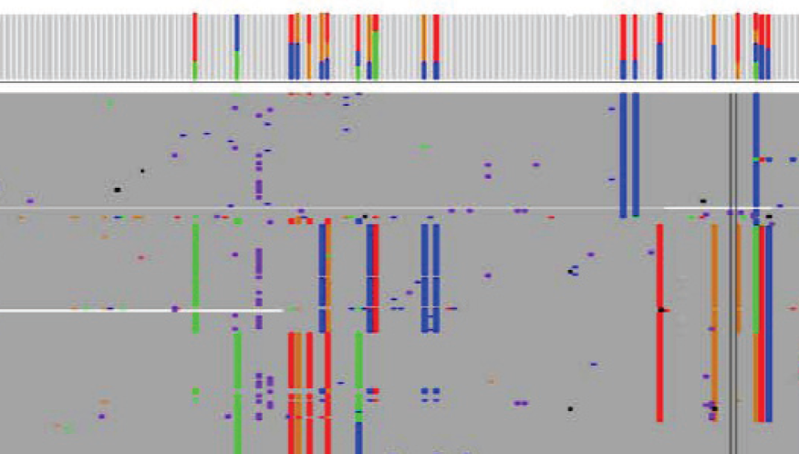
HLA Pilot: 10 WGS data (x30) of RIKEN liver cancers
Plan A
Plan B
Plan C
BWAmem alignment to hg19
BWAmem alignment to hg19 + IMGT/HLA Database
BWAmem
alignment to
IMGT/HLA
Database
Unaligned reads
Aligned to HLA regions
RE-alignment to IMGT/HLA Database
BAM file for HLA regions
HLA genotype by SBT
Variant call by
ATHLATES
HLAminer
GATK UnifiedGenotype
Slide provided by Han Liang and Hidewaki Nakagawa

Slide 43
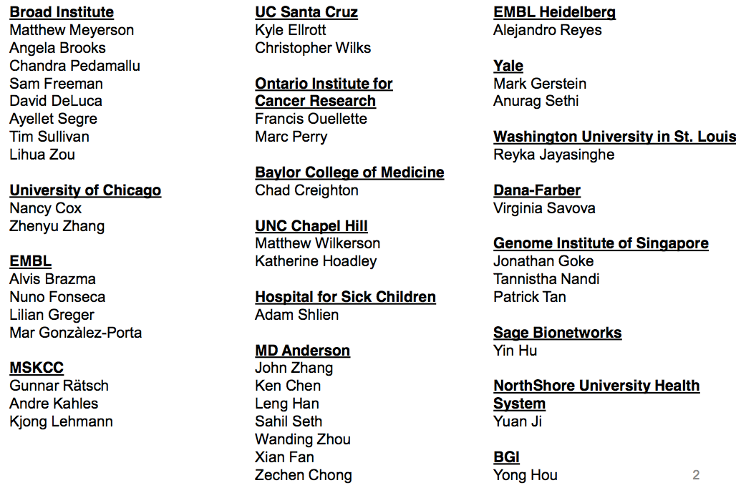
PCAWG3 - Transcriptomes
Slide provided by Angela Brooks

Slide 44
Transcriptome group deliverables
RNA-Seq alignment of TCGA/ICGC
Exon expression
Splice junction expression
Transcript expression
Gene expression
Splicing event quantification
RNA-Seq variant calls
RNA fusion
Slide provided by Angela Brooks

Slide 45
Challenges in building the RNA-Seq alignment SOP
TCGA RNA-Seq BAMs are incompatible with SAM 1.4. E.g., Unable to reconstruct original read data (FASTQ).
TCGA/ICGC RNA-Seq may have mixed sequencing platforms
No clear consensus of “best” aligner tool
Slide provided by Angela Brooks

Slide 46
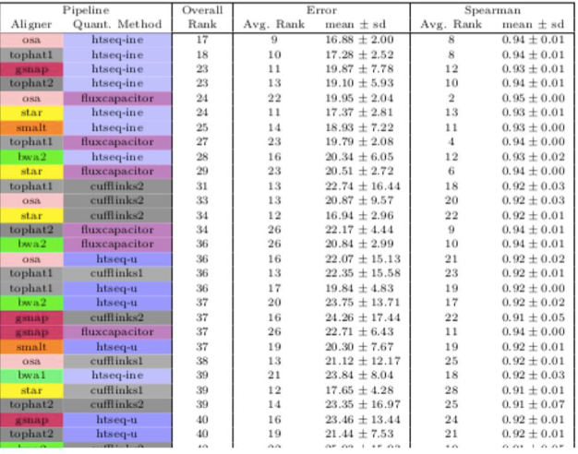
RNA-Seq Analysis Assessment
Accuracy based on simulated transcript levels
EMBL group (Fonseca, Marioni, Brazma)
Determine aligners and quant combinations
Slide provided by Angela Brooks

Slide 47
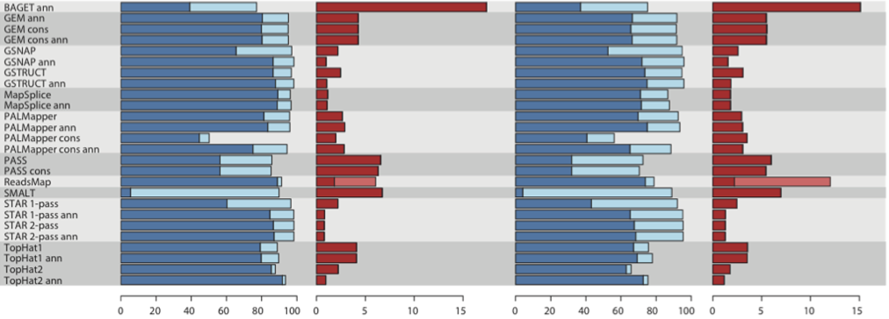
RNA-Seq Analysis Assessment
Accuracy based on simulated spliced reads
MSKCC group (Kahles, Lehmann, Rätsch)
Determine aligners and quant combinations
Slide provided by Angela Brooks

Slide 48
Conclusion from RNA-Seq assessments
No aligner gives the best results for all metrics
Choice of aligner and downstream analysis tools depend on what is most important deliverable
  Prioritized deliverables
    Exon level quantification
    Gene expression
    Splice junction detection
Slide provided by Angela Brooks

Slide 49
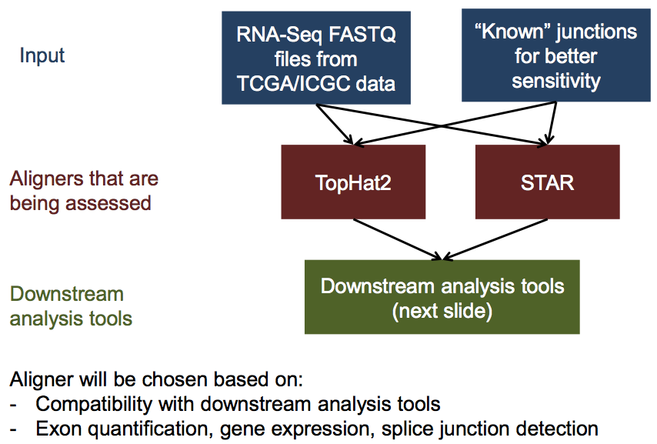
Current plan for RNA-Seq SOP:
(test on pilot-50)
Slide provided by Angela Brooks

Slide 50
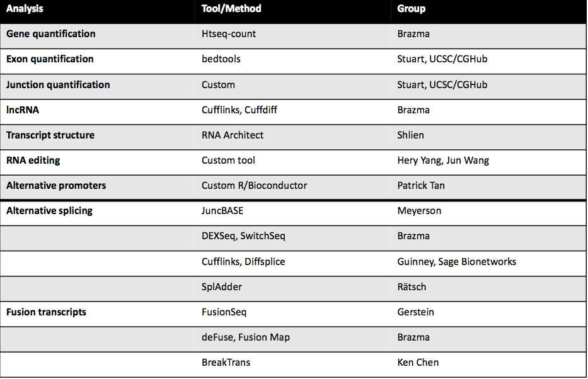
RNA-Seq-related analyses
Slide provided by Angela Brooks

Slide 51
Timeline for deliverables
PCAWG 50 data: Nov. 3rd F2F meeting
  BAMs from two different aligners and downstream analysis
Finalize analysis evaluation: Early or mid- December
Implement final RNA-Seq analysis SOP on PCAWG data: Early 2015
Slide provided by Angela Brooks

Slide 52
PCAWG-13: Molecular Subtypes and Classification
Lincoln Stein (co-lead)
  A Classifier for Pan-cancer tumor types
Katherine Hoadley (co-lead)
  Pan-cancer RNA sequencing analysis
Larsson Omberg and Adam Margolin
  Mutation and integrative subtyping based on kernalized tensor methods
Adam Margolin (Dual with PCAWG-3)
  Identify genetic patterns of mutations and fusion transcripts through integrative analysis of large-scale cros-cancer genome and transcriptome sequencing data
Andrew Cherniack and Gad Getz
  Utilizing Broad Firehose to Create Molecular Subtypes based on Copy Number and Gene Expression Profiles
Zhibo Gao and Lin Li (Dual with PCAWG-9)
  Pan-Cancer analysis of digestive system and urinary system cancers
Adapted From Slide provided by Katherine Hoadley and Lincoln Stein

Slide 53
Next Steps
This group is dependent on a number of other groups
Once RNAseq realignments/quantification and final mutation calls are made, this group will ramp up progress
Slide provided by Katherine Hoadley and Lincoln Stein

Slide 54
Steering committee and 16 working groups
SC: Peter Campbell, Lincoln Stein, Jan Korbel, Gad Getz, Josh Stuart

Slide 55
PCAWG-2-5-9-14
Merged group:
  2: Mutations in regulatory regions (Getz & Gerstein)
  14: Non-coding RNA mutations (Wheeler & Pederson)
  9: Inferring driver mutations (Lopez-Bigas & Lawrence)
  5: Network and Pathway Analysis (Raphael & Stuart)

Slide 56
PCAWG-12: Exploratory: portals, visualization and software infrastructure
Jingchun Zhu, D. Haussler et al.: UCSC Cancer Genomics Browser
Wolfgang Huber (EMBL, Heidelberg): position specific error modelling
Nuria Lopez-Bigas et al. (Barcelona): IntOGen, gitools – interactive exploration of variant calls and integrative analysis
Victor de la Torre / A. Valencia (Madrid): integrative analysis
Brian O’Connor: cloud and workflow tech, visualization portal based on the ICGC DCC portal
Slide provided by Jing Zhu and Wolfgang Huber

Slide 57
Technical and logistical issues
Diversity of aims and methods
Groups focused on downstream / tertiary analysis (e.g. Lopez-Bigas, Valencia) have not yet had an urgent need to access train data
Group focused on technical data quality (Huber) is now (Oct 2014) positioned to download train 2 BAM files to EBI.
Adapted From Slide provided by Jing Zhu and Wolfgang Huber

Slide 58
Position specific error model from 1000s normal genomes
W. Huber
Use 1000s of normal genome datasets to learn for each mappable nucleotide in the genome the probability of each error type (both from wet & dry processes) to ~10⁻³ precision
Aim: be useful for variant calling (esp. subclonal, intergenic) and method development
Distinguish ‘universal’ vs study-specific effects
Methodology: computations facilitated by HDF5 (Bioconductor package h5vc)
Preliminary result: some variant call sets from published studies overlap problematic high-error rate sites
Slide provided by Jing Zhu and Wolfgang Huber

Slide 59
Slide provided by Jing Zhu and Wolfgang Huber

Slide 60
Slide provided by Jing Zhu and Wolfgang Huber

Slide 61
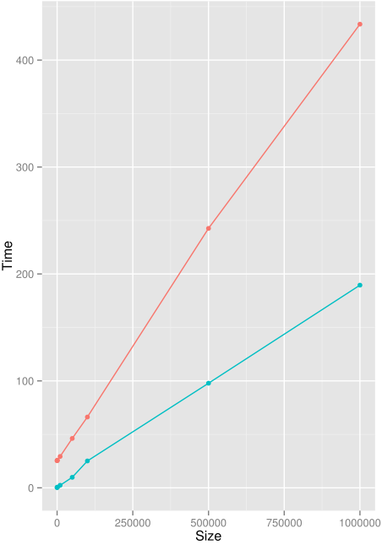
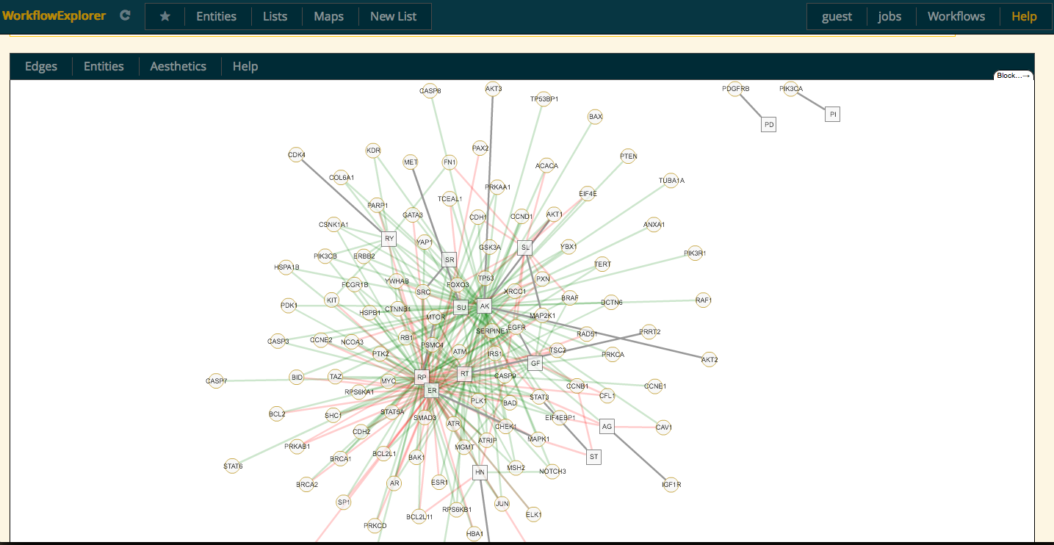
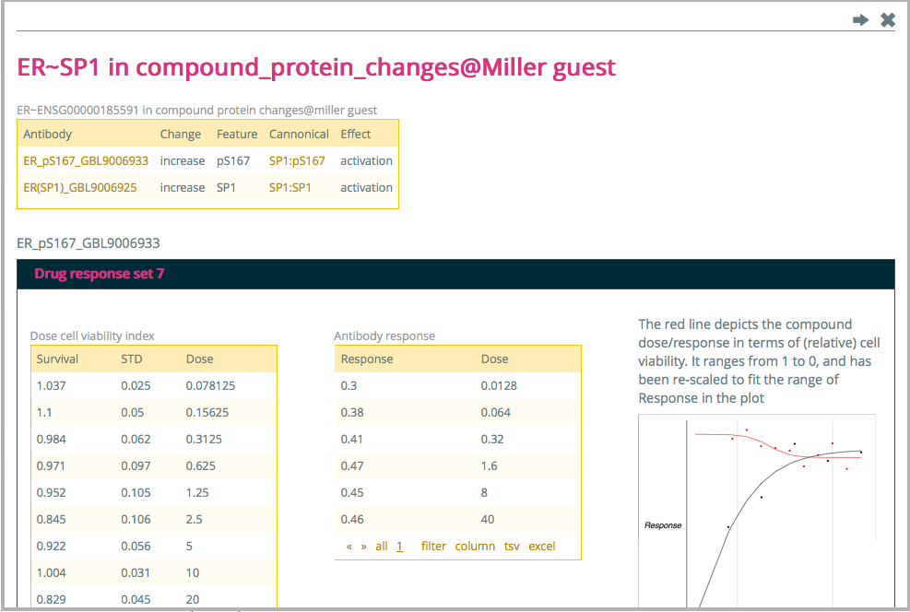
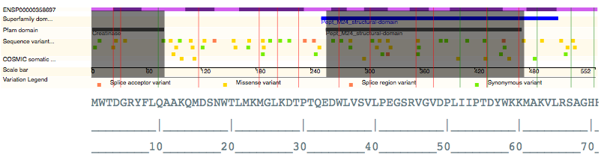
CNIO PANCANCER INFRASTRUCTURE -- se.bioinfo.cnio.es
Tertiary analysis Across different molecular types
SNV, CNV, Expression, methylation and RPPA
Basic analysis tools
Integrative tools
Variant annotation using databases and our own methods; more than 80 different annotation fields:
DbNSFP damage predictions, KinMut, 1000 Genomes, GERP, CADD, EVS, COSMIC, UniProt, InterPro, Appris, Interaction surfaces and functional residues in close proximity (using experimental PDBs and models)
Enactment infrastructure
Provenance
Reproducibility/Reusability
Flexible deployment
Efficiency
Efficient workflows. Sequence (mutation consequence) workflow against ANNOVAR: no loading time, 100% to 500% faster depending on coding variant density, 30% memory consumption.
Exploration environment
  ICGC/TCGA example and some workflows at se.bioinfo.cnio.es
HTML/JS/CSS templates and widgets
General purpose cytoscape-web visualization, Jmol, d3js, nvd3
R/SVG/JS plotting infrastructure
Slide provided by Jing Zhu and Wolfgang Huber

Slide 62
Summary
Variant Calling Now Beginning in Earnest
Working groups identifying “pilot” datasets

Slide 63
Acknowledgements

