Slide 1
Update on ICGC/TCGA
Pan-cancer Analysis of Whole Genomes (PCAWG)
Josh Stuart (UCSC), Gaddy Getz (Broad / MGH)
on behalf of PCAWG SC
Slides Contributed by Working Group Leaders: Link to Google Presentation

Slide 2
Pan-Can Analysis of Whole Genomes
Set Up
7 computing centres with synchronized mutation calls for 2,000 whole cancer genomes (including UCSC/NCI cluster)
Establishment of a governance structure:
Steering Committee & Technical Working Group
More than 150 abstracts submitted
16 Thematic Groups formed
Establishment of timelines of overall project
Timeline of Data Freezes and Availability

Slide 3
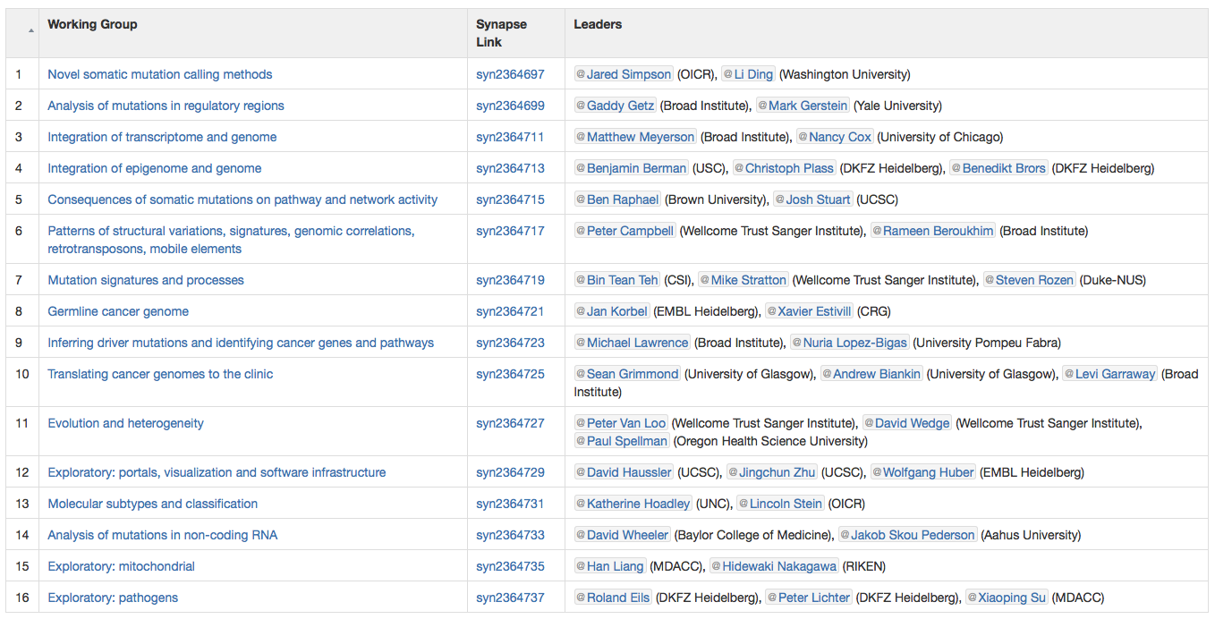
Steering committee and 16 working groups
SC: Peter Campbell, Lincoln Stein, Jan Korbel, Gad Getz, Josh Stuart

Slide 4
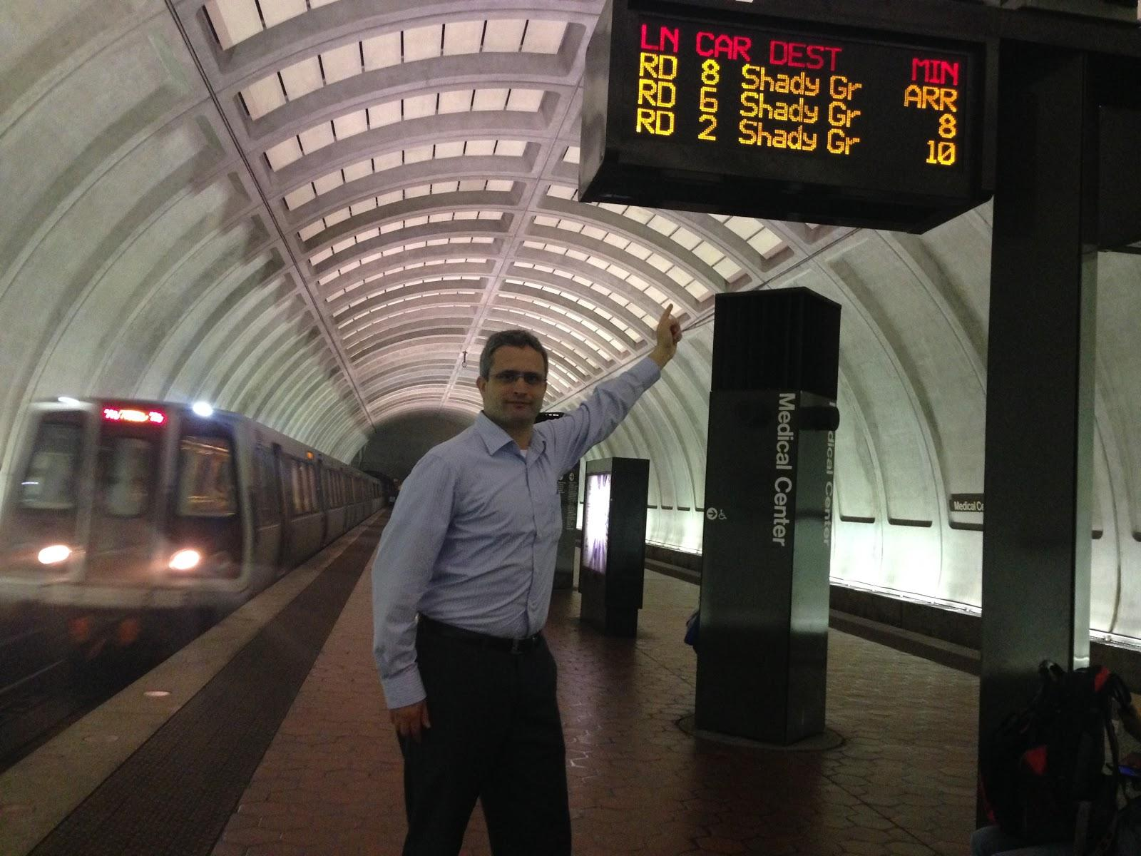
Analysis Trains
“Train” concept for analysis adopted
clear decoupling between SOP development and deployment.
Train 1 variant calling and annotation underway
Train 2 re-alignments nearly complete.

Slide 5
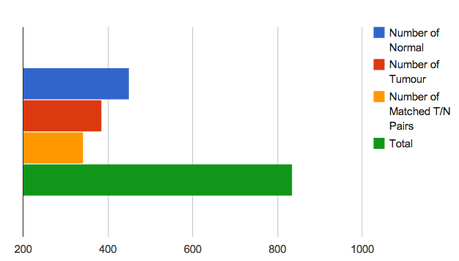
Train 1.0: Re-Alignment Summary
450
386
342
836
Train 1 had 342 total aligned donors (genome pairs)
(Link to Tracking Table)

Slide 6
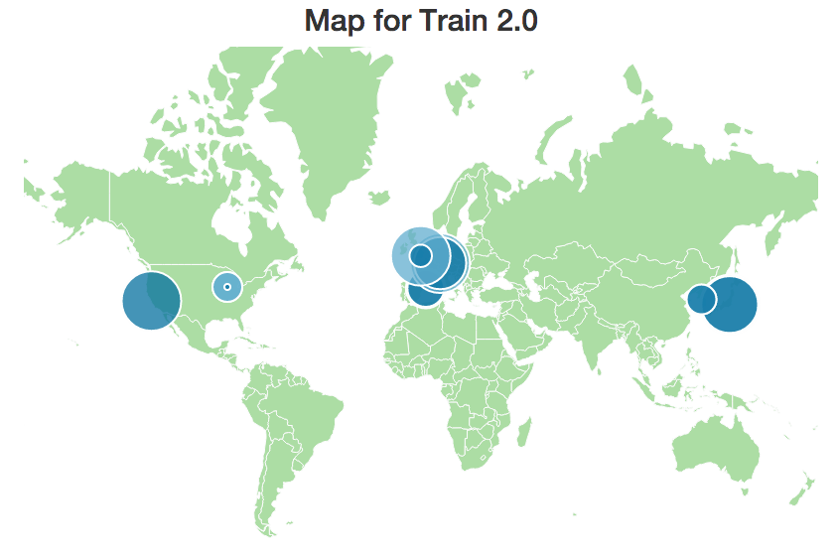
Train 2.0: Worldwide contribution
exceeded milestone of 2000 pairs
pancancer.info
As of 4:48pm 10/22/2014

Slide 7
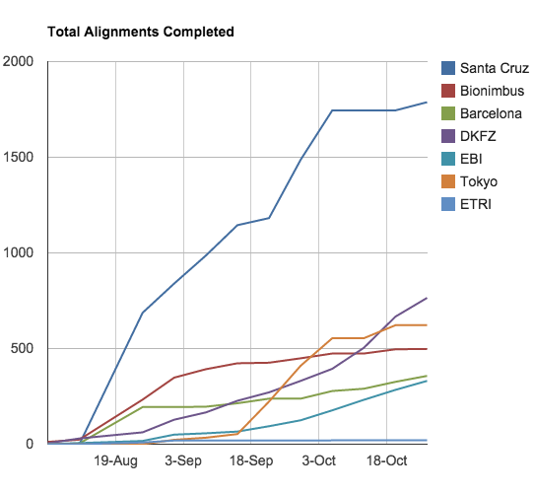
4190 Train 2.0 Alignments (All Centers)
(2022 pairs; as of Oct 27)
NCI-Cluster
UCSC*: 1788
Bionimbus: 496
Barcelona: 326
DKFZ: 668
EBI: 284
Tokyo: 652
ETRI: 20
Finishing: 65 “problem donors” (130 samples) being rerun
* NCI Cluster @ UCSC (SDSC)
1728 cores, expanding to 2240, 13TB total RAM
Uploads to CGHub @ 5TB/day (ave)

Slide 8
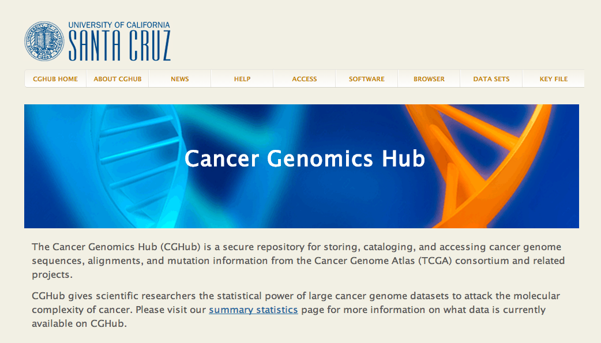
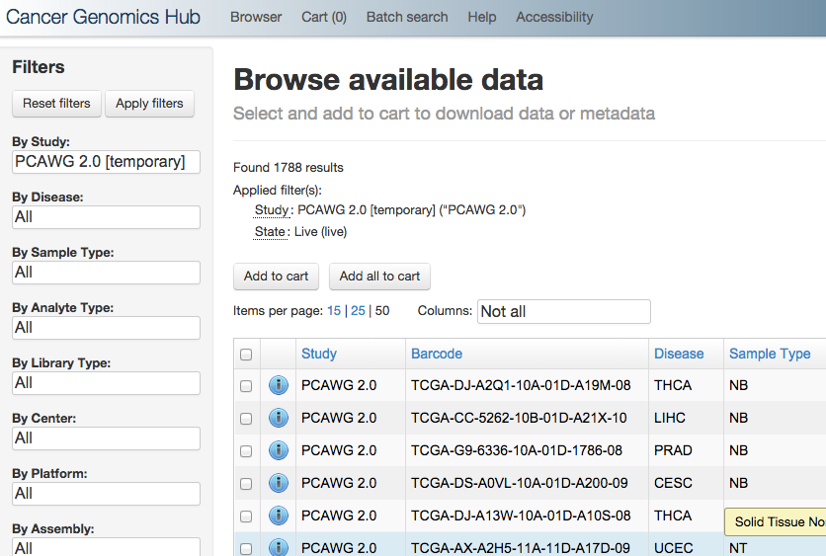
Getting Train 2.0 BAMs from CGHub
(“PCAWG 2.0” Study Group)

Slide 9
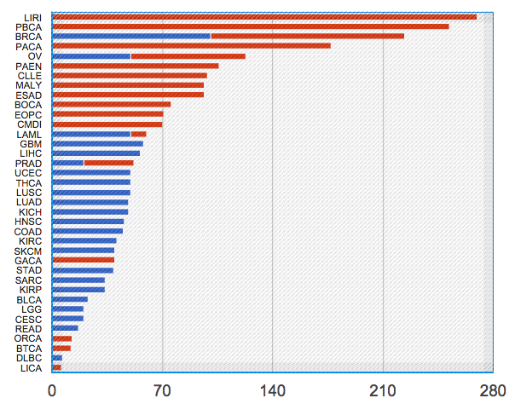
Overview of Current PCAWG Dataset (Train 2)
TCGA
ICGC
2022 Pairs
Donors (Sample Pairs)
TCGA and ICGC data complementary

Slide 10
Finishing Core Re-Alignments
QC Checks put in place.
Read groups: Number and name match between original and re-aligned BAM
Checks on samtools stats
Re-aligning some samples that failed (~5% of samples)
Identifying if problems in data vs method vs infrastructure
Samples that fail again will be flagged for possible removal

Slide 11
Next Steps: Core Analyses
WGS Alignments for Train 2 to completed next week (by Nov 3).
Straggling samples will go on Train 3
Variant Calling Launching
mRNA-Seq alignments will start Dec 15.
Estimated completion date: June-July.

Slide 12
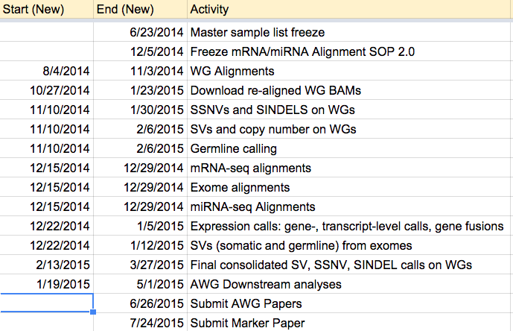
Train 2.0 Timeline
Papers Submitted before August
(Link to Train Schedule)

Slide 13
Core Analyses: Variant Calling
3 ICGC pipelines proposed originally
Broad, Sanger, DKFZ
Additional proposed from TCGA groups
WashU, Baylor
Broad, WashU, Baylor in 3-way tie on DREAM-SMC
Limited compute available from centers
Slow transfer of aligned BAMs from some sites
NCI-Cluster installing callers.
VCFs of TCGA exchanged on NCI SFTP
Synapse frontend will help organize.

Slide 14
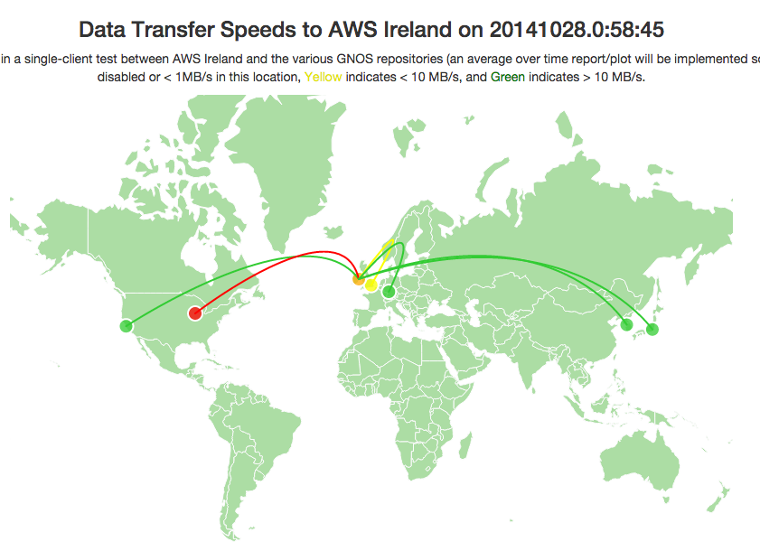
Problem: Distributing BAMs to Callers Limited by Slowest

Slide 15
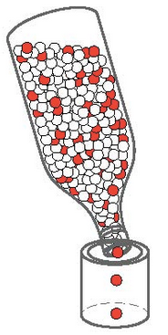
Problem: Distributing BAMs to Callers Limited by Slowest
Current bottlenecks
(U Chicago, EBI)

Slide 16
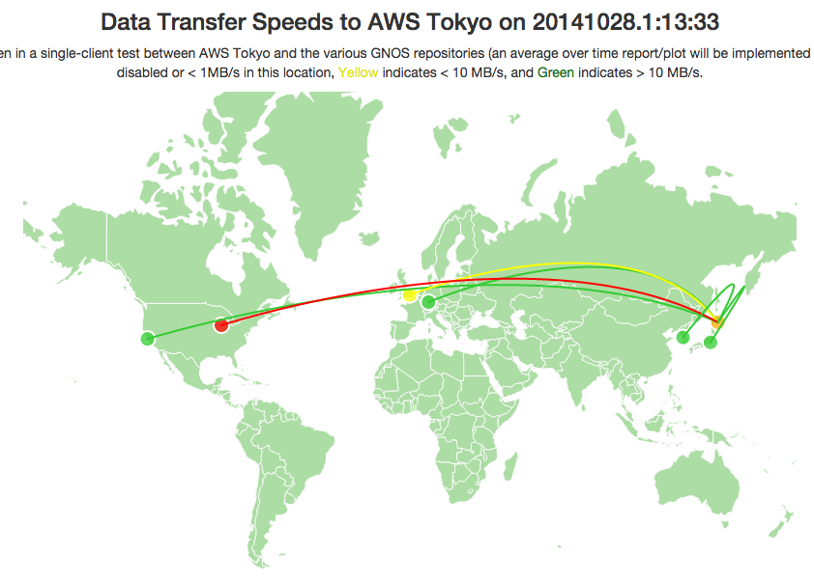
Problem: Distributing BAMs to Callers Limited by Slowest
Current bottlenecks
(U Chicago, EBI)

Slide 17
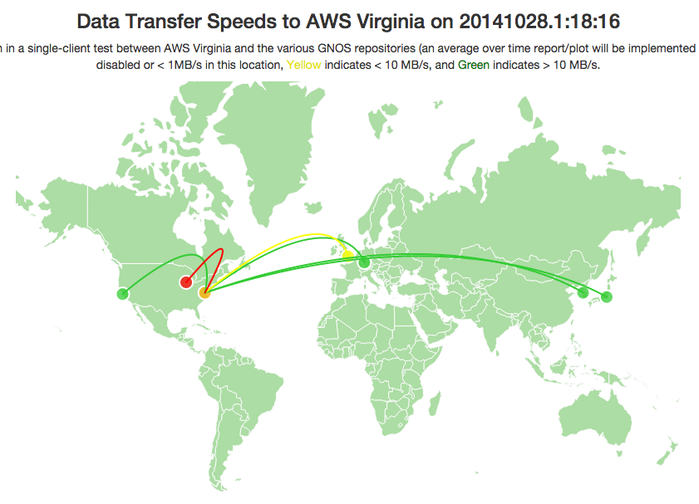
Problem: Distributing BAMs to Callers Limited by Slowest
Current bottlenecks
(U Chicago, EBI)

Slide 18
Solution 1: Run Variant Callers Locally leverage compute, data movement is a mess
WGS Data
(GNOS Servers)
Variant Callers
Variant Calls
Fast
CGHub
(TCGA)
Broad
NCI SFTP Site
London
(ICGC)
WashU
Baylor
OR
Chicago
(ICGC)
GNOS Server of Origin
Sanger
…and 4 others
(ICGC)
etc
DKFZ
Bandwidth
constraints
Complain about
Compute availability
Adapted from slide provided by Lincoln Stein

Slide 19
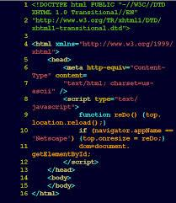
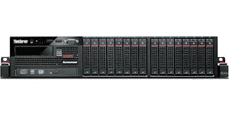
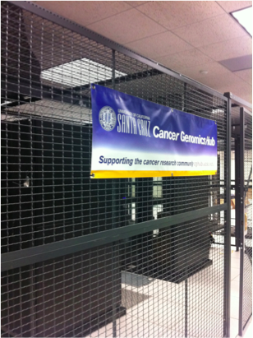
Solution 2: Run Variant Callers on Clusters
Any Linux Development Environment
Docker container
NCI-Cluster
CGHub
WashU
WGS Data
Sage
(Larsson Omberg)
Firewall
NCI-SFTP Jamboree
(Todd Pihl)

Slide 20
Plan for Variant Calling
Broad, WashU, Baylor
Run pipeline on NCI-Cluster.
ICGC WGS alignments available locally on Hitachi store
Upload VCFs into NCI SFTP site.
DKFZ & Sanger
Start running native pipeline on CGHub (TCGA) and London (ICGC) alignments now.
Investigate whether their HPCs can support VMs.
Upload VCFs back into GNOS server of origin.
As cloud data centres finish their alignments (including AWS), start running the two virtual pipelines on cloud holdings.
Defer work on virtualization of pipeline to 2015.
Adapted from slide provided by Lincoln Stein

Slide 21
Validating Variant Calling
Plan designed by NHGRI and Broad/WashU/Baylor
Validating mutation calls (SNVs, small indels and structural validation) for 39 pilot + 10 other TCCA cases.
Validation of ~5,000-10,000 predicted events per case.
WashU will do capture and validation for 26 cases and Baylor for 13.
Sequencing Data to be released to community.
500-1000X coverage per site.
Discussion on balancing SV vs SNV calls
Start Validation Nov 13
Assumes 3 months to finish
To use results for final SNV/SV consolidation (starting Feb 13)
Steering Committee Advised Dates

Slide 22
Core Analyses: RNA-Seq Alignments
RNA-Seq availability in Release 17 (see table)
Additional samples with RNA-seq are expected from ICGC and TCGA (TCGA numbers from OICR mirror)
Data provided by Marc Perry and Francis Ouellette, OICR

Slide 23
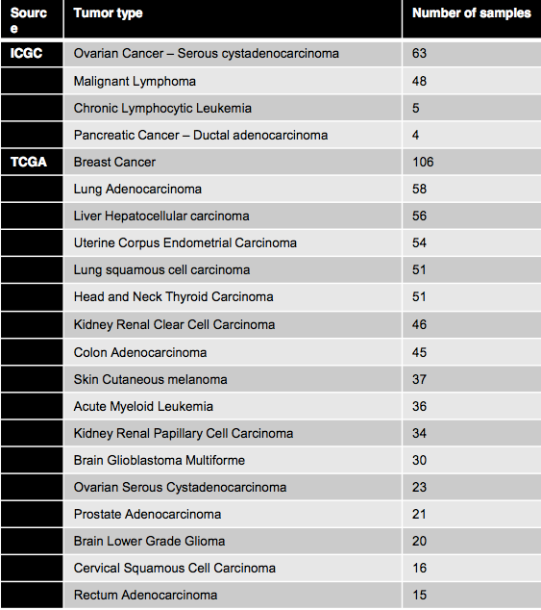
Core Analyses: RNA-Seq Alignments
RNA-Seq availability in Release 17 (see table)
Data provided by Marc Perry and Francis Ouellette, OICR

Slide 24
Challenges in building the RNA-Seq alignment SOP
TCGA RNA-Seq BAMs are incompatible with SAM 1.4. E.g., Unable to reconstruct original read data (FASTQ).
TCGA/ICGC RNA-Seq may have mixed sequencing platforms
No clear consensus of “best” aligner tool
Slide provided by Angela Brooks

Slide 25
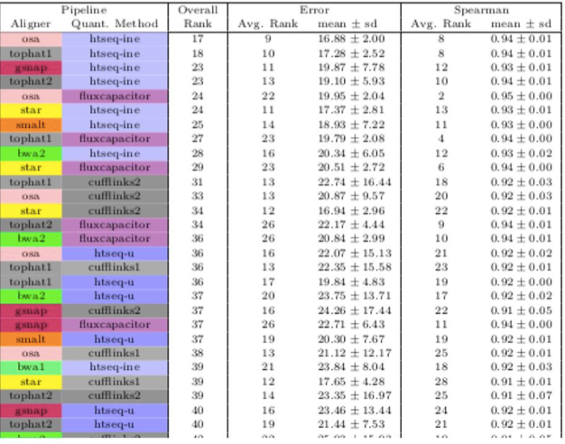
RNA-Seq Analysis Assessment
Accuracy based on simulated transcript levels
EMBL group (Fonseca, Marioni, Brazma)
Determine aligners and quant combinations
Slide provided by Angela Brooks

Slide 26
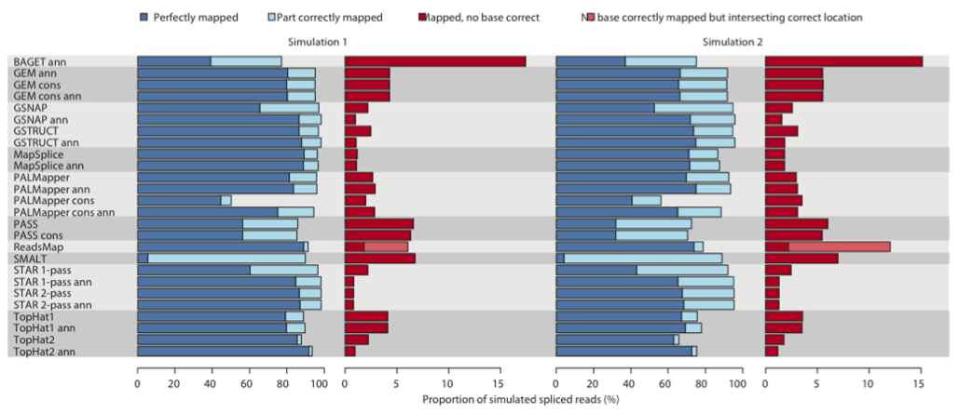
RNA-Seq Analysis Assessment
Test based on simulated spliced reads and transcript mapping
Accuracy based on simulated spliced reads
MSKCC group (Kahles, Lehmann, Rätsch)
Determine aligners and quant combinations
Slide provided by Angela Brooks

Slide 27
Conclusion from RNA-Seq assessments
No aligner gives the best results for all metrics
Choice of aligner and downstream analysis tools depend on what is most important deliverable
Prioritized deliverables
Exon level quantification
Gene expression
Splice junction detection
Slide provided by Angela Brooks

Slide 28
Current plan for RNA-Seq SOP: (test on pilot-50)
Slide provided by Angela Brooks

Slide 29
Timeline for RNA-Seq Alignments
PCAWG 50 data: Nov. 3rd F2F meeting
BAMs from two different aligners and downstream analysis
Finalize analysis evaluation: Early or Mid-December (Early Dec)
Implement final RNA-Seq analysis SOP on PCAWG data: Early 2015 (Start alignment 12/15)
Steering Committee Advised Dates
Slide provided by Angela Brooks

Slide 30
Next Steps: Downstream Analyses

Slide 31
Next Steps: Downstream Analyses
WG-6: SV Group
Detect fusions, copy-number alterations, and the events that contributed to them
Detect mechanistic signatures
Detect signatures of selection
Determine networks of associated events
Leads: Peter Campbell, Rameen Beroukhim

Slide 32
Next Steps: Downstream Analyses
WG-7: Mutation Signatures Group
ID physical mutation signatures
endogenous mutagenic processes
exogenous mutagenic exposures
Improve ability to ID low burden mutational signatures
Leads: Mike Stratton, Bing Teh, Steve Rosen

Slide 33
Next Steps: Downstream Analyses
WG-3: Transcriptomes
RNA-Seq alignment of TCGA/ICGC
Exon expression
Splice junction expression
Transcript expression
Gene expression
Splicing event quantification
RNA-Seq variant calls
RNA fusion
Leads: Angela Brooks, Matthew Meyerson, Nancy Cox

Slide 34
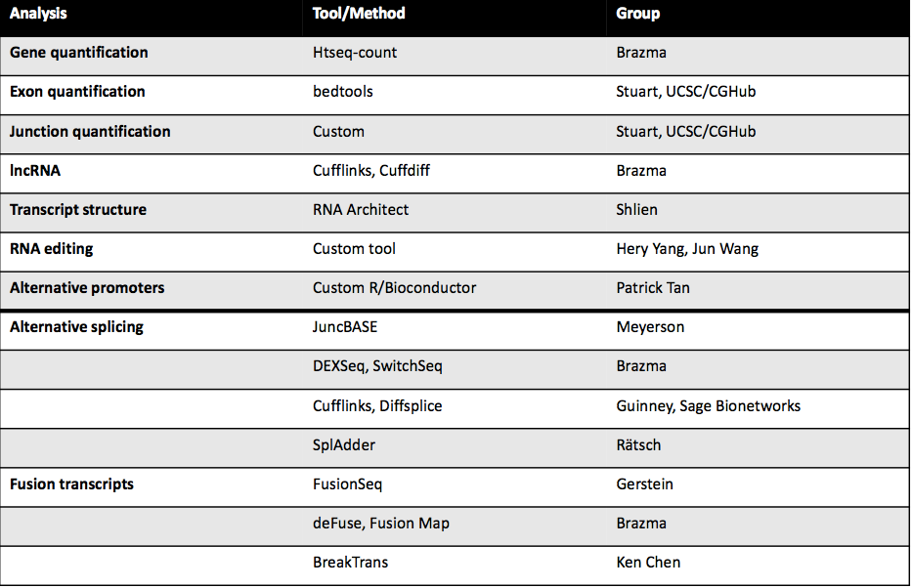
Divide-and-conquer RNA-Seq downstream analyses
Stuart, UCSC / NCI-Cluster
Stuart, UCSC / NCI-Cluster
Slide provided by Angela Brooks

Slide 35
Next Steps: Downstream Analyses
WG-4: Epigenomics Group
trans effects of muts in chromatin regulators
Muts in epi regulators → DNA methylome (DKFZ)
Functional Mutations (CNAG/Barcelona)
cis effects of non-coding regulatory mutations (SNV & SV) on local epigenetic and transcriptional state
non-coding regulatory muts and cancer epigenome (CS/VARI)
epigenomic consequences of non-coding structural genomic alterations (Broad)
Leads: Benedikt Brors, Christoph Plass, Hui Shen, Ben Berman

Slide 36
Next Steps: Downstream Analyses
WG-8: Germline Group
High-quality germline variant calls from raw (unfiltered) calls generated by PCAWG variant calling pipelines (10 SNV/INDEL/SV callers)
Suitable filters based on site validation data w/ SVMs
Re-genotyping all variant sites across all samples (required for harmonization of calls)
High-quality haplotyped germline variant set for imputation in GWAS
Leads: Xavier Estivill and Jan Korbel

Slide 37
Next Steps: Downstream Analyses
WG-15: Mitochondrial Group
Motivation:
Cells’ powerhouse / suicidal weapon store
Dysregulated in cancer cells (Warburg effect)
Goals and planned analyses:
Somatic mutations in mitochondrial DNA (mtDNA)
Copy number variations of mtDNAs
Expression change in mitochondrial respiration chain complex genes
Pancancer analysis of mtDNA-related energy metabolism
Leads: Han Liang and Hidewaki Nakagawa

Slide 38
Next Steps: Downstream Analyses
WG-2-5-9-14 Merged Group - Drivers
Identify coding and non-coding consequences of mutations
Reveal signatures of positive selection: driver vs passenger
Connect mutations of regulators to their targets’ regulation
Integration and pathway analysis
“Pilot 607” - Using public set to exersize analyses.
Leads: Nuria Lopez-Bigas, Mike Lawrence, Mark Gerstein, Gad Getz,
David Wheeler, Jakob Pederson, Josh Stuart, Ben Raphael

Slide 39
Summary
Face-to-Face in Boston next week 11/4-11/5
WG presentations
Working group pilot analyses
Re-organization of some groups to maximize harmonization of datasets (e.g. gene annotations) and outputs (e.g. consensus calling)
Variant Calling Now Beginning in Earnest
Working groups identifying “pilot” datasets
Validation of findings?
WashU/BCM to will validate some initial variants in subset of cases
What about validation of significant results?
What about functional validation?

Slide 40
Acknowledgements
UCSC
Kyle Ellrott
PCAWG Tech
Brian O’connor, Sergei Iakhnin, Keiran Raine
PCAWG WG Leaders and members
CGHub
Chris Wilks, Linda Rosewood
NCI / NHGRI
Todd Pihl, Carolyn Hutter
Sage
Larsson Omberg
PCAWG SC
Lincoln Stein, Jan Korbel, Peter Campbell

