Slide 1
Breakpoint analysis
Yale/Mayo
May 2014
Yale/Mayo

Slide 2
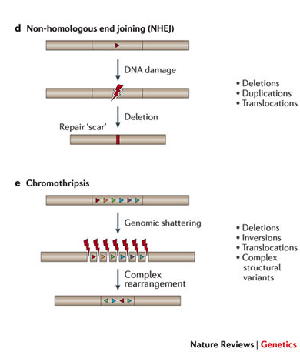
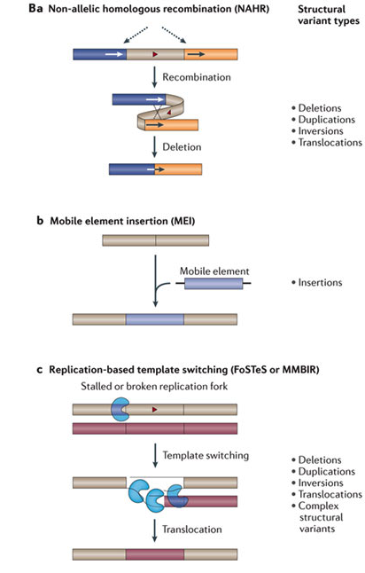
SV formation mechanism
Non-Allelic Homologous Recombination (NAHR)
Non-homologous Recombination(NHR)
Non-homologous end joining (NHEJ)
Fork Stalling and Template Switching (FoSTeS)
Transposable Element Insertion (TEI)
Variable Number of Tandem Repeats (VNTR)
Weischenfeldt et al., 2013

Slide 3
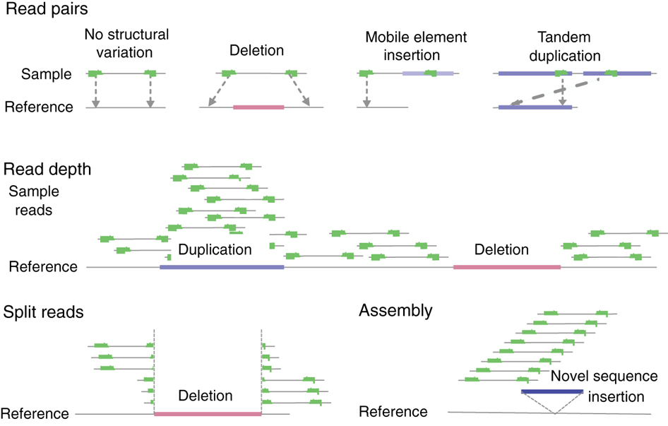
Structural Variation Discovery
Jan Korbel, European Molecular Biology Laboratory

Slide 4
Mechanism Classification
NAHR
Deletion
Highly similar with minor offset
Deletion
Single RETRO
Repeat Element
Multiple RETRO
RE1
RE2
[Lam et al. Nat. Biotech. ('10)]

Slide 5
SV Mechanism Classification
[Lam et al. Nat. Biotech. ('10)]

Slide 6
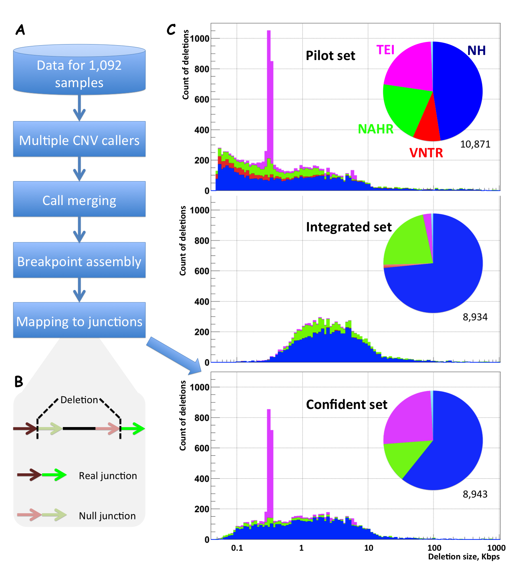
Yale/Mayo

Slide 7
Breakpoint validation with high coverage PCR-free trio data
Yale/Mayo

Slide 8
HiSeq 2500 insert length distribution
For >50% of pairs, reads significantly overlap (read lengths are 250 bp)
Yale/Mayo

Slide 9
Merging overlapping reads
Assume mismatches are binomially distributed (p=0.75)
Pick overlap length with lowest p-val
In overlap, pick bases with higher quality score
*Only use read pairs with low ratio of # mismatches to overlap length (< 0.2)
Read #1
ATCGTCGGTAA
CGCTATATCGGA
CGCTATATCGGA
…
Read #2
CGCTATATCGGA
New fragment
ATCGTCGCTAAATCGGA
Yale/Mayo

Slide 10
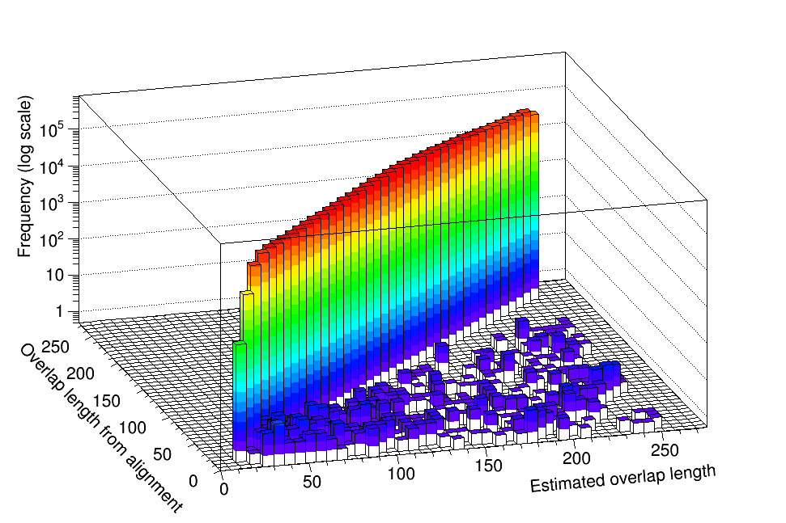
Overlap consistency in NA12878
Overlap estimates are consistent with overlaps in alignment for 99.95% of read pairs
Yale/Mayo

Slide 11
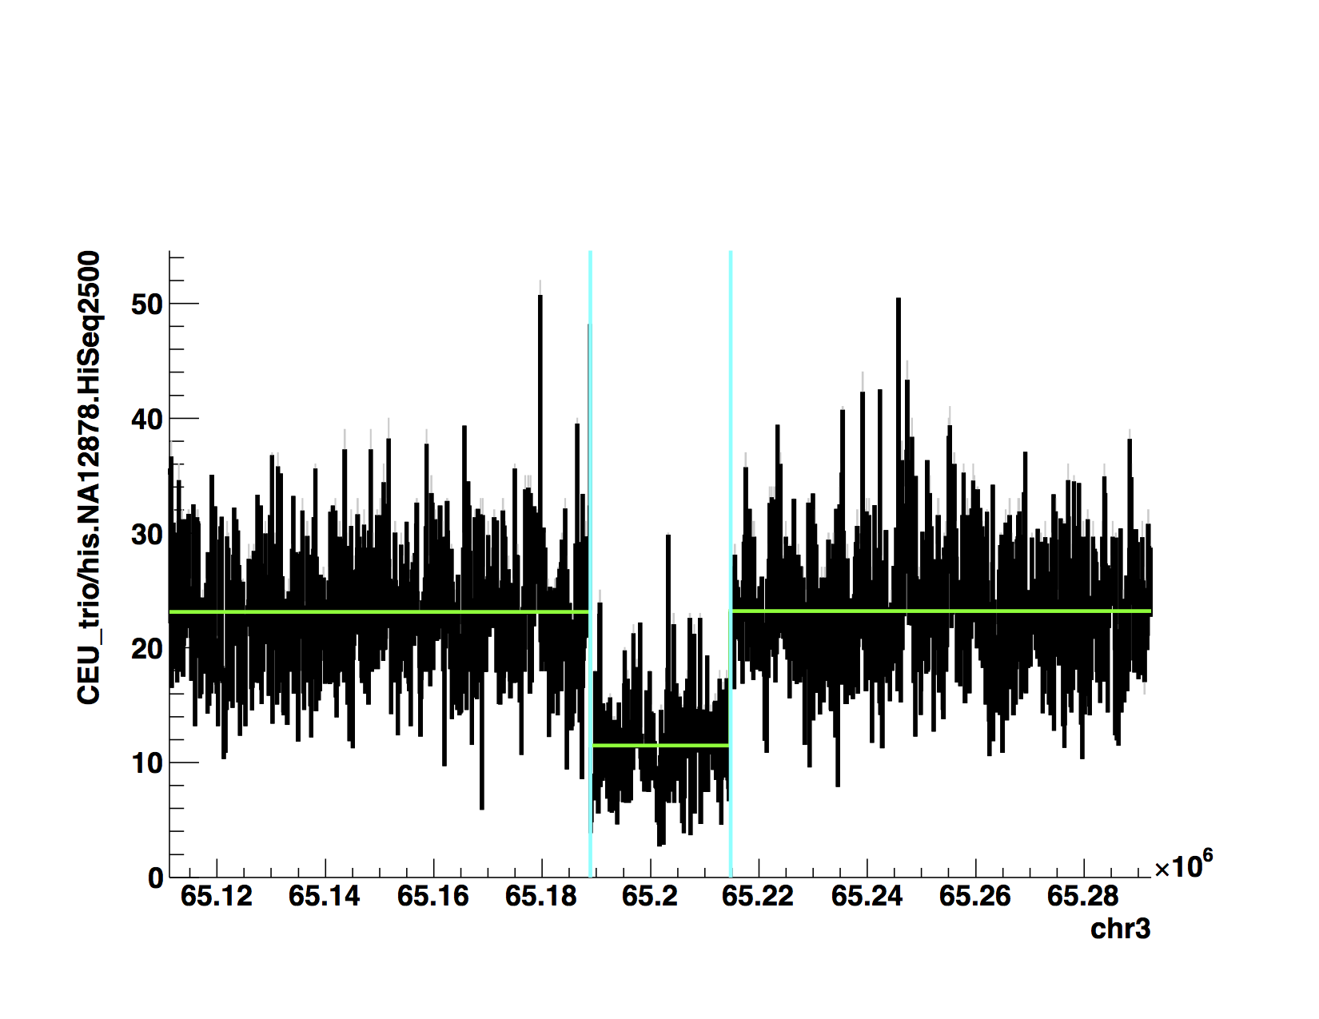
Validation pipeline
1. Genotype events (CNVnator)
2. Extract reads near events (+/- 1kb)
Nearby read pairs
Reference genome
Deletion call
4. Find supported events using strict criteria
3. Make fragments (as per prev. slide) and realign with AGE
Yale/Mayo
Most likely overlap
Constructed fragment
Studied genome
Reference genome
AGE alignment

Slide 12
Results in YRI + CEU trios
Phase 1 confident set by Alex
8,943 breakpoints in 1,092 individuals
34% breakpoints confirmed exactly just in trios
Additional 5% confirmed with slight differences
NOTE: Events “not supported” include misgenotyped events
Yale/Mayo

Slide 13
Dataset summary
8,943 breakpoints
5,433 (60.8%) NH
2,262 (25.3%) TEI
1,167 (13.0%) NAHR
Validation
6.4% site FDR by IRS
6.8% site FDR by PCR
13.7% site + breakpoint FDR sequence by PCR
34% have exact support in high coverage trios
5% have inexact support in high coverage trios
Yale/Mayo

Slide 14
Analysis
Aggregation with SNPs and indels
Testing association with
chromatin state
histones
methylation
Analysis of micro-insertions
Yale/Mayo

Slide 15
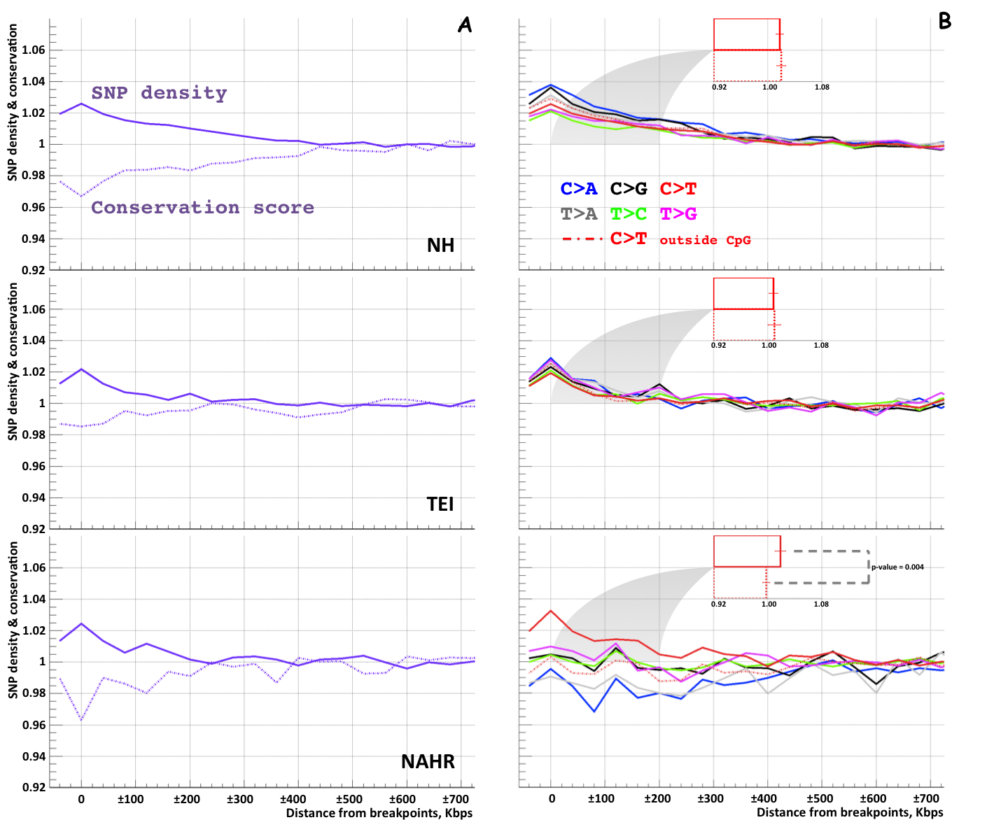
Aggregation with SNPs
Yale/Mayo

Slide 16
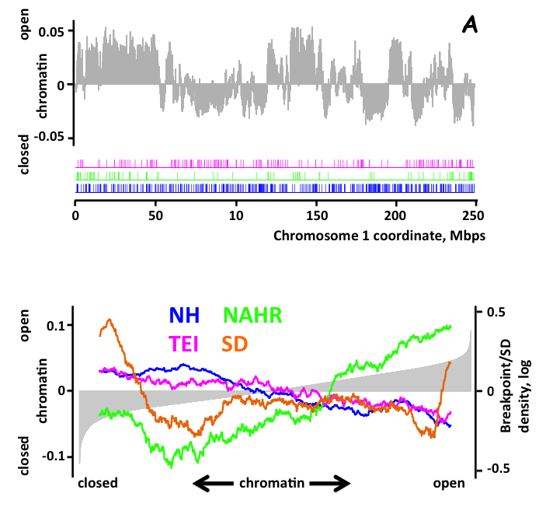
Chromatin State
Yale/Mayo

Slide 17
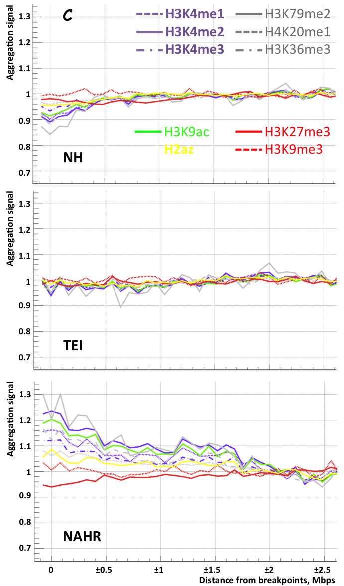
Histone marks
Active
H3K4me1
H3K4me2
H3K4me3
H3K79me2
H3K20me1
H3K9ac
H2az
Repressive
H3K27me3
H3K9me3

Slide 18
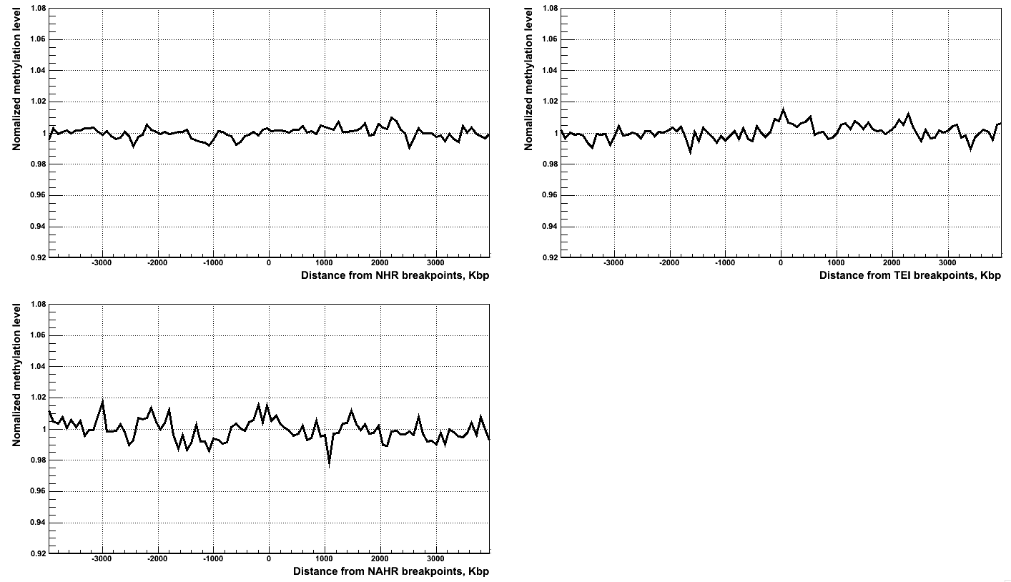
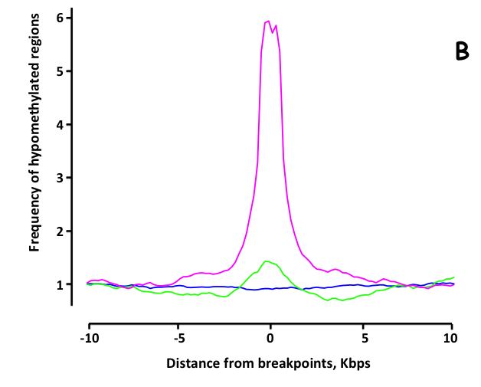
Methylation
NH
TEI
Hypomethylated
(de-methylated)
regions in sperm
NH
TEI
NAHR
NAHR
Methylation levels
in H1ESC
NH NAHR
TEI SD

Slide 19
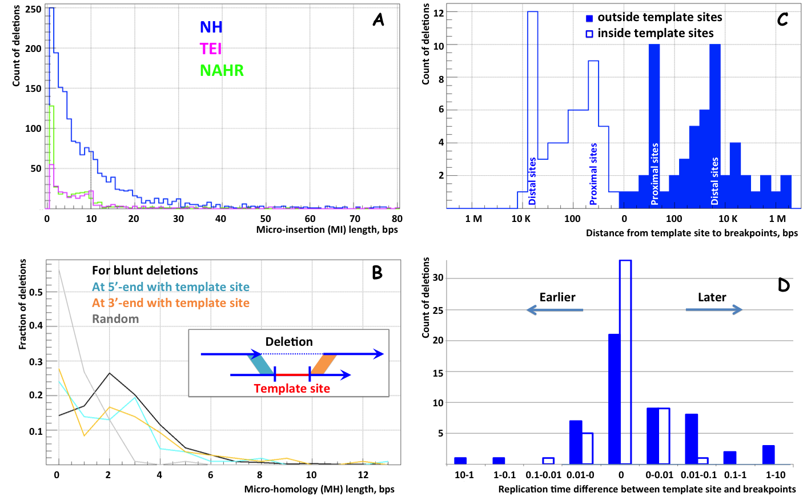
Micro-insertions
Yale/Mayo

Slide 20
Acknowledgements
Yale University
Mayo Clinic
Shantao Li
Daniel Ree Kim
Wyatt Clark
Arif Harmanci
Mark Gerstein
Alexej Abyzov
Other
Xinmeng Jasmine Mu
Adrian Stuetz
Ken Chen
Matthew Hurles
Jan Korbel
Charles Lee
Yale/Mayo

