Slide 1
Impact of non-synonymous SNPs on localized frustration of proteins
Variation Meeting
09/18/2014

Slide 2
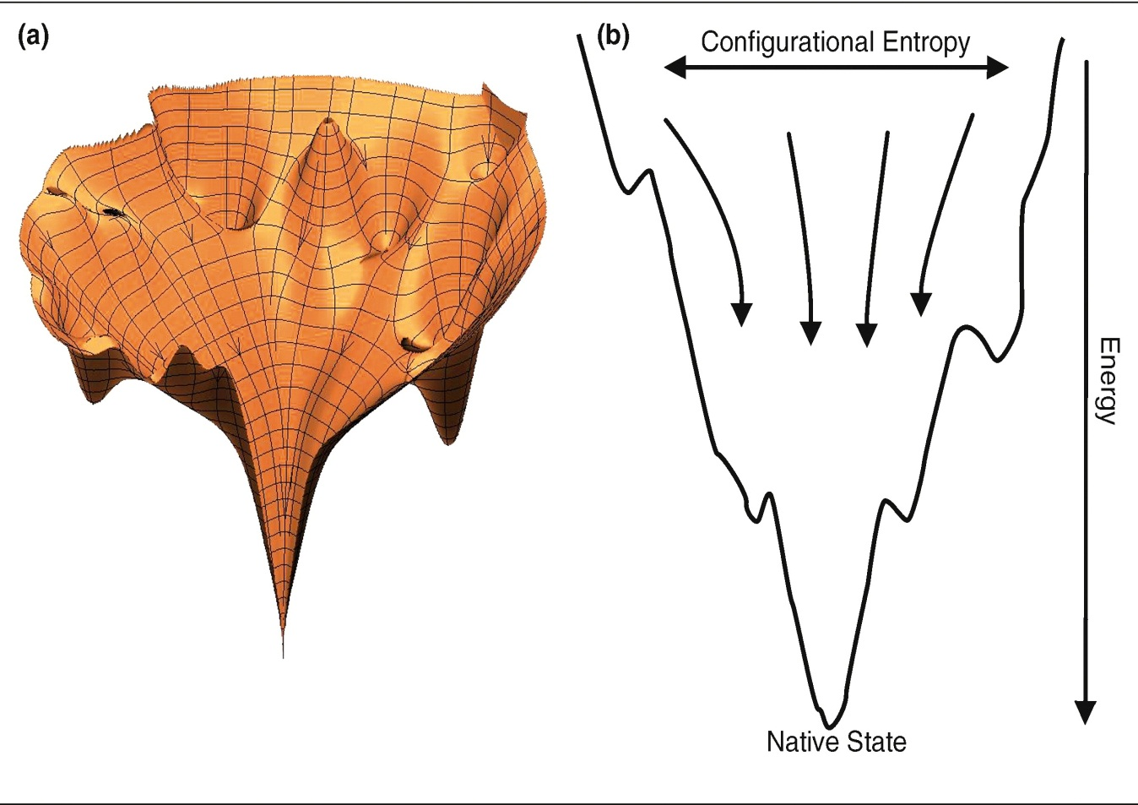
Principle of minimal frustration
Not unique pathway for folding but an ensemble of converging pathways.
Energy landscape smoothened to prevent entrapment in local minima .
Local roughness on the surface due to the limited 20 amino acid code and competing evolutionary constraints.
Schug et. al., Current opinion in Pharmacology 2010
1
Notes:
2

Slide 3
Objective of the proposed work
Investigate the impact of non-synonymous single nucleotide polymorphism on the localized frustration profile of protein structures.
Comparison of the localized frustration profile of SNPs mapping to protein structure from the 1000 Genome and HGMD datasets.
2

Slide 4
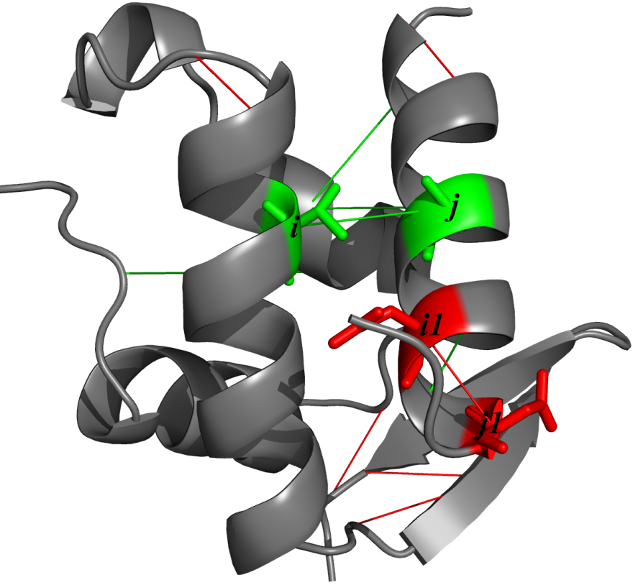
Frustration categories
Residue level : Randomize the identity of the interacting amino acid i, keeping all other identities and interaction parameters at their native value.
Additionally stabilized residues considered minimally frustrated (F_{ij} > 0.78).
Destabilized residues considered maximally frustrated (F_{ij} < -1).
Ferreiro PNAS 2011
Notes:
4
4
4
4

Slide 5
Frustration categories
Pairwise Mutational frustration : How favorable are native residues relative to other residues in that location?
Randomize the identities of the interacting amino acids (R_{i} and R_{j}) keeping all other interaction parameters at their native value.
4
Notes:
5

Slide 6
Frustration categories
Configurational frustration : How favorable are the native interactions between two residues relative to other interactions that two residues can form in other compact structures?
Randomize the identities as well as the distances and densities of the interacting amino acids R_{i}, R_{j}.
5
Notes:
6

Slide 7
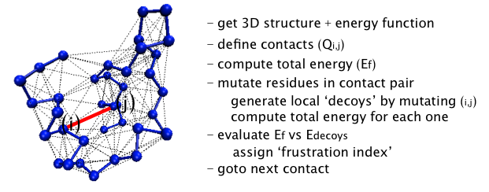
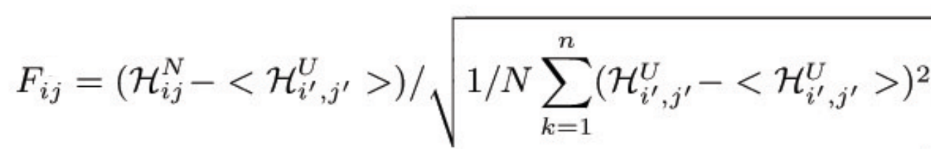
Frustration Algorithm
Jenik et. al., Nucleic Acids Research 2012
6
Notes:
7

Slide 8
Localized Frustration Pipeline
Run VAT to annotate variant list
(1KG phase 1 & HGMD variants)
Map nsSNPs onto high resolution
protein structures
Apply homology modeling to generate
mutated structure
Calculate the localized frustration profile of
the native and mutated structure
7

Slide 9
1KG residue level frustration profile
1KG SNPs increases the residue frustration to a certain extent in some protein structures.
8

Slide 10
1KG configuration frustration profile
Configurational frustration also observe increase in maximally frustrated residues.
9

Slide 11
1KG residue frustration and GERP score
Unconstrained nsSNPs impact the frustration profile to a higher extent than constrained SNPs.
10

Slide 12
HGMD residue level frustration profile
Native residues of HGMD are minimally frustrated to a lower extent than 1KG native residues.
nsSNPs in HGMD increases the amount of minimally frustrated residues.
11

Slide 13
HGMD residue frustration and GERP score
constrained nsSNPs increases the amount of maximally and minimally frustrated residues.
12

Slide 14
Future directions
Exhaustive analysis of the 1000 genome phase 3 and HGMD SNPs with gencode 19 annotations.
Explore the localized frustration profile of pan cancer data to identify key mutations.
Map SNPs onto structural interaction network to identify and characterize key sub-networks.
14

