Slide 1

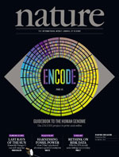

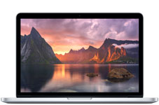
How BIG are Genomics Data?
20 days of Twitter (text only)
=
½ a day of Facebook (2012)
> 200 Terabytes
400 Macbook Pro HDs
http://nature.com/encode, http://www.internetlivestats.com/twitter-statistics/; http://www.businessweek.com/articles/2012-08-23/facebooks-is-bigger-than-yours; http://apple.com

Slide 2
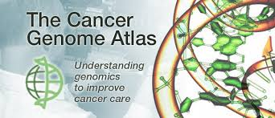
How BIG are Genomics Data?
100 days of Twitter (text only)
=
2 days of Facebook (2012)
> 1 Petabyte
2000 Macbook Pro HDs
http://nature.com/encode, http://www.internetlivestats.com/twitter-statistics/; http://www.businessweek.com/articles/2012-08-23/facebooks-is-bigger-than-yours; http://apple.com

Slide 3
How BIG are Genomics Data?
100 days of Twitter (text only)
=
2 days of Facebook (2012)
2000 Macbook Pro HDs
> 1 Petabyte
5x ENCODE
(2012 Release)
https://ocg.cancer.gov/programs/tcga; http://www.internetlivestats.com/twitter-statistics/; http://www.businessweek.com/articles/2012-08-23/facebooks-is-bigger-than-yours; http://apple.com

Slide 4
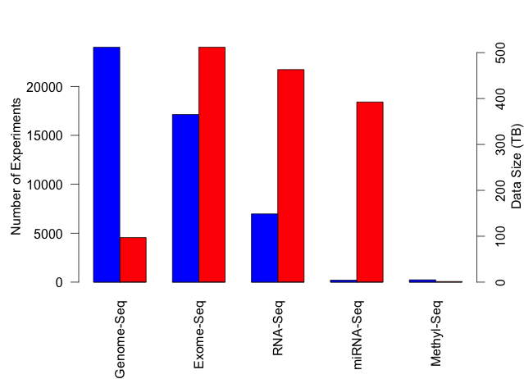
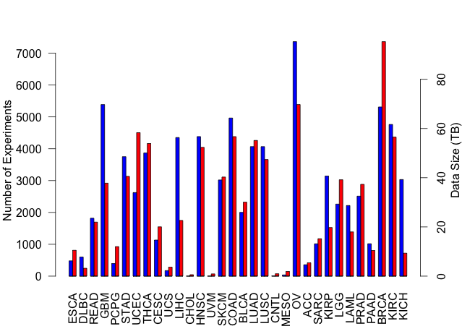
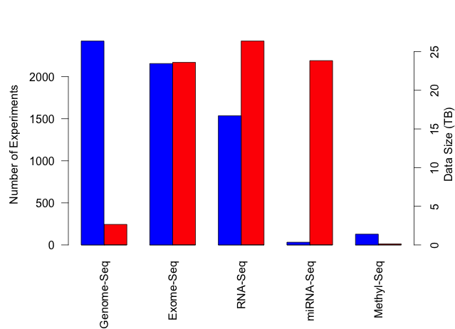
TCGA: What’s in a petabyte?
Experiment Types
>73,000 Experiments
34 Cancer Types
~5,000 Patients
Breast Cancer Experiment Types
Experiments
Data Size (TB)
TCGA Cancer Types
Breast Cancer Expt. Types
https://cghub.ucsc.edu/summary_stats.html
Notes:
----- Meeting Notes (9/23/14 17:02) -----
Make labels diagonal and bigger. Remove top panel. Arrow from BRCA to Breast Cancer expt. types.

