Slide 1
AlleleDB Figure Pack
- Uniform Survey of Allele-specific binding and expression across 383 individuals -
Jieming
Allele
5th May 2014

Slide 2
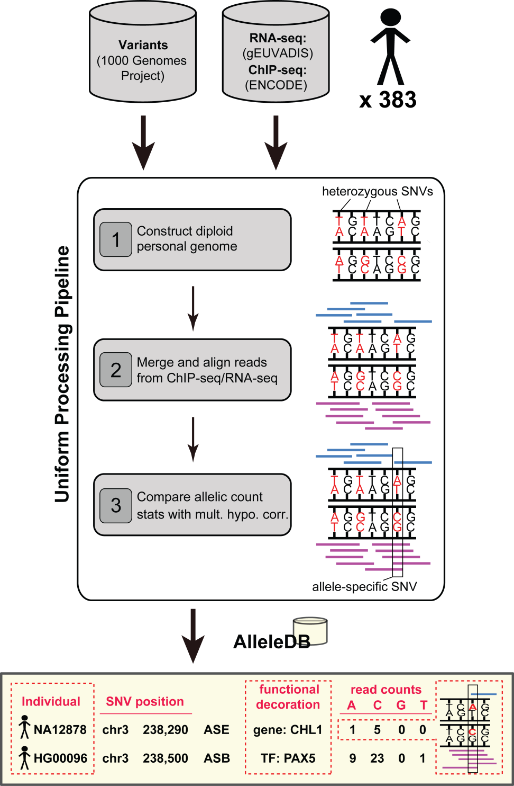
Figure 1. Uniform processing of data from 383 individuals and construction of AlleleDB.

Slide 3
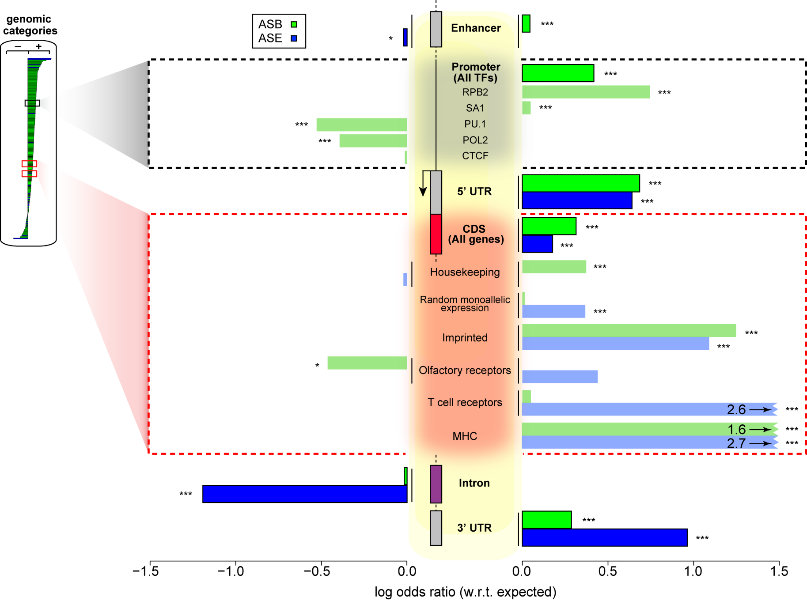
Figure 2. Some genomic regions are more susceptible to allele-specific regulation.

Slide 4
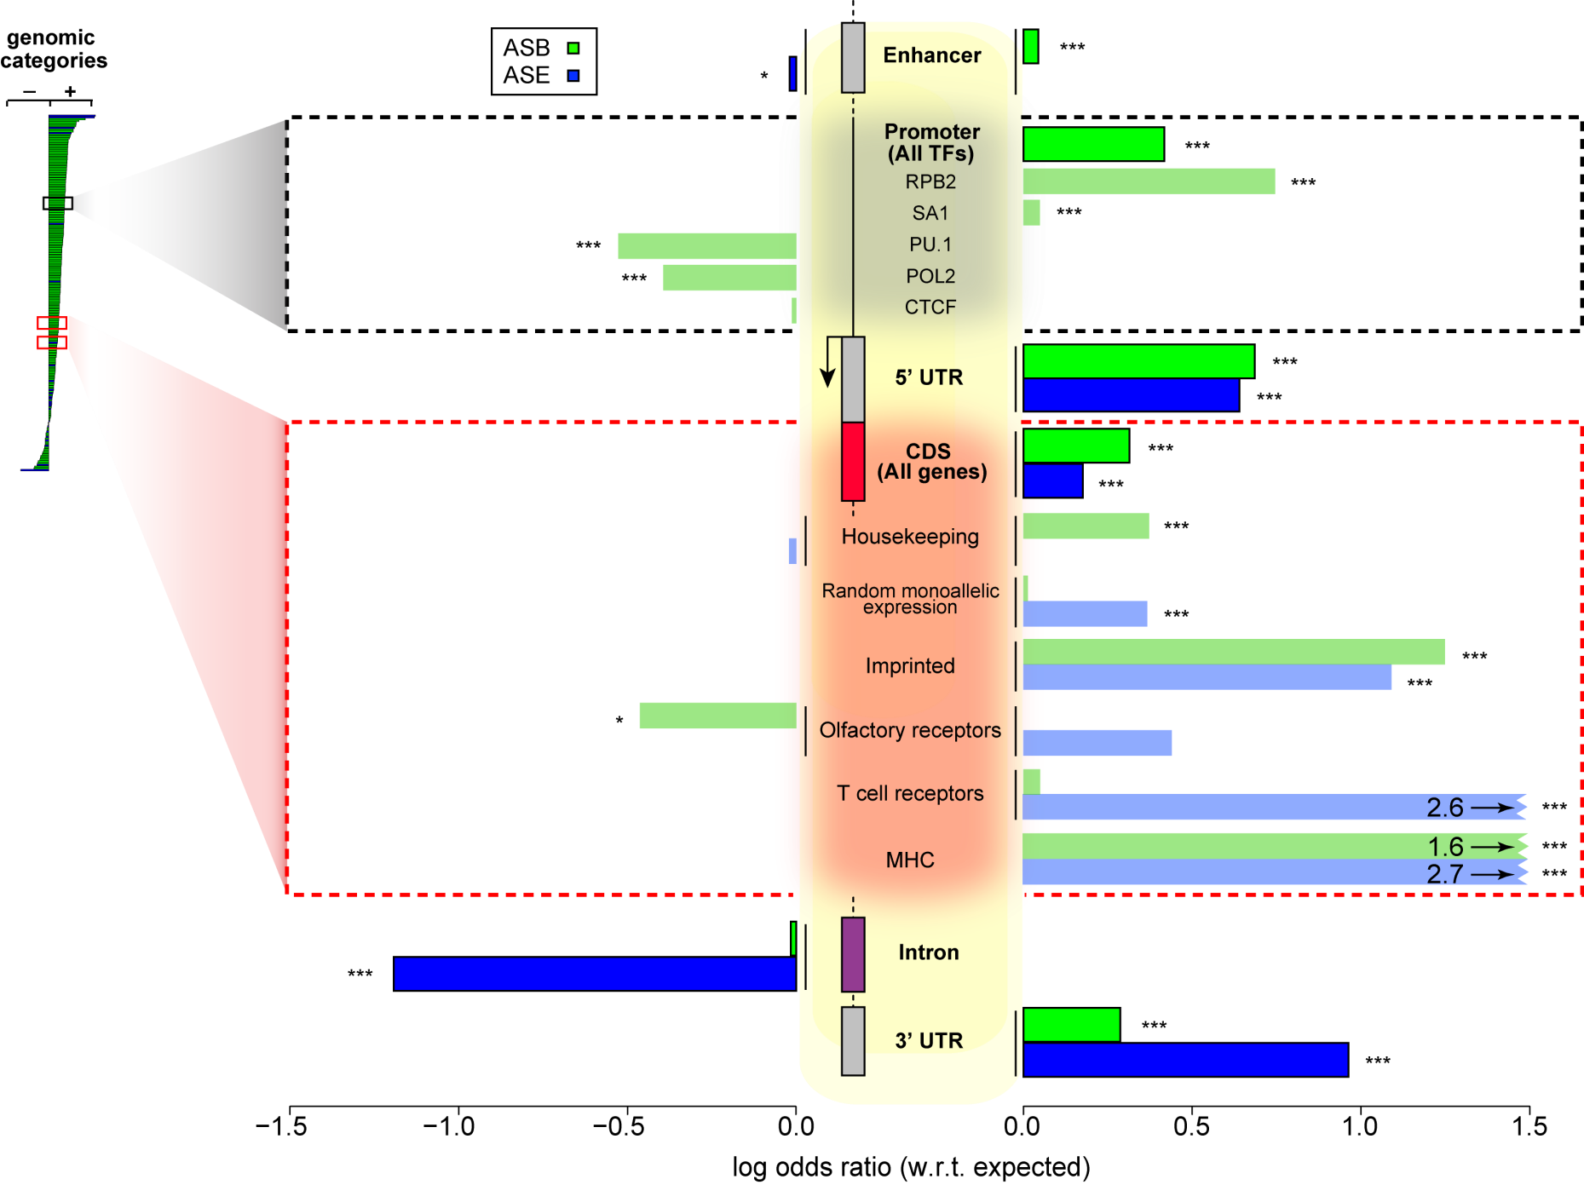
Figure 2. Some genomic regions are more susceptible to allele-specific regulation.

Slide 5
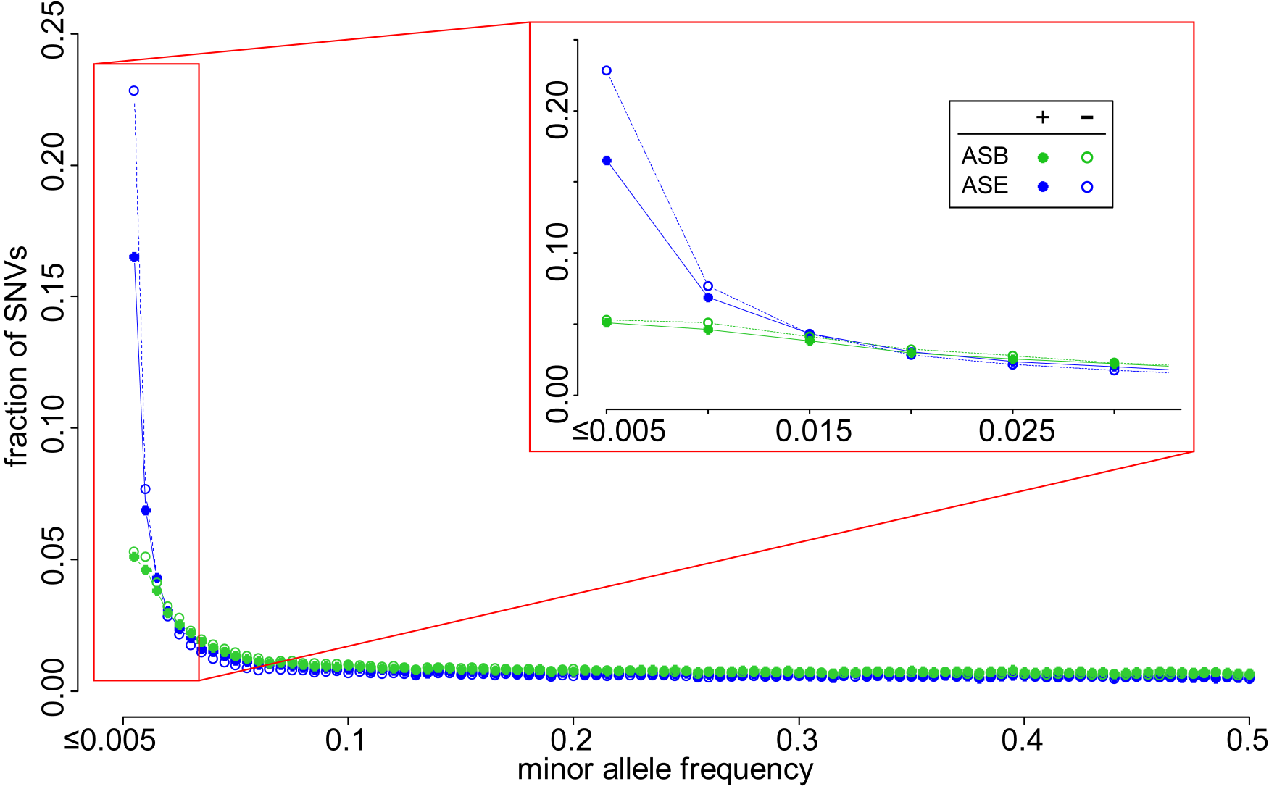
Figure 3. A considerable fraction of AS variants are rare but do not form the majority. Lesser proportion of AS SNVs than non-AS SNVs are rare, suggesting less selective constraints in AS SNVs.

Slide 6
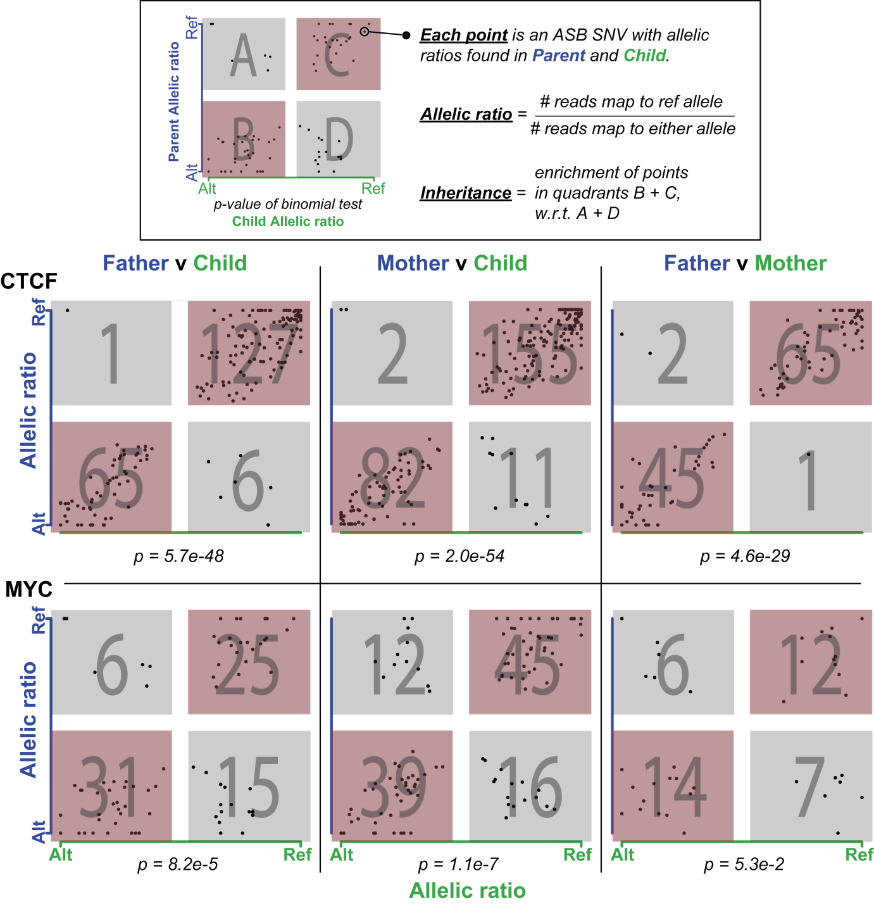
Figure 4. Inheritance of allele-specific binding events is evident in some TFs but not so apparent in others.

Slide 7
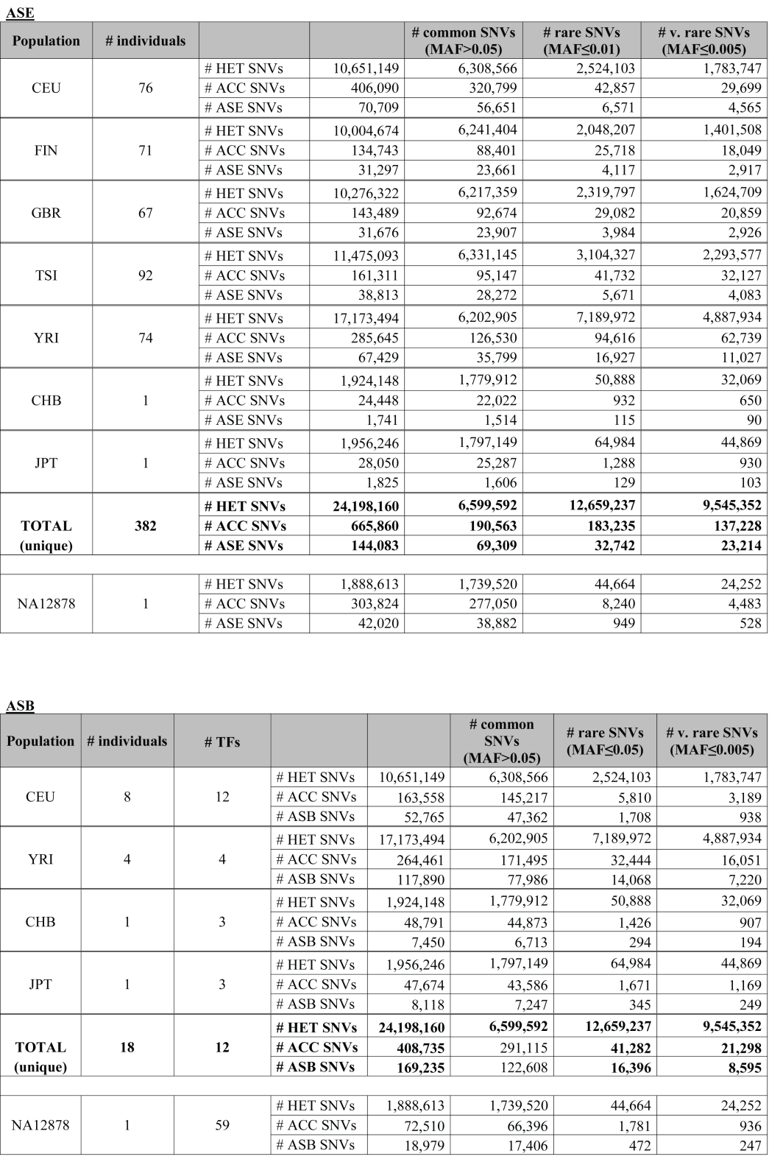
Table 1.
Notes:
# SNVs
Total SNVs/all SNVs
Total over individuals
# - remove
ACC – accessible
Annotate no NA12878 in CEU
Combine CHB and JPT

