Slide 1
Consider the geneset: Why the transcripts used for variant annotation matter
Mark Gerstein on behalf of
Adam Frankish
Computation Genomics, Wellcome Trust Sanger Institute
(both on behalf of the Gencode consortium)

Slide 2



GENCODE gene annotation
HAVANA
Manual annotation
Ensembl
Computational annotation
GENCODE geneset
Notes:
The GENCODE geneset is created by a merge of manual annotation produced by the HAVANA group at Sanger and automated annotation from the Ensembl group at EBI..
The asymmetry in the thickness of the arrow reflects the fact that for protein-coding, lncRNA and pseudogene loci more than 95% of the transcripts are manually annotated.

Slide 3






The GENCODE consortium
HAVANA
Manual annotation
Ensembl
Computational annotation
Annotation hints, experimental and computational validation
GENCODE geneset
Notes:
The manual annotation is supported by computational and wet lab groups who, through their predictions, highlight regions of interest in the genome to be followed up by manual annotation during first pass annotation, then during post-annotation QC identify potential features missing from the annotation and finally to experimentally validate the annotated transcripts. Annotators also feed back their experiences to computational groups to help improve pipelines.
I need to check this slide vs the logo rules.

Slide 4
GENCODE and RefSeq are different
SLC25A17 on GRCh38
Notes:
One purpose of this presentation is to discus how two widely used geneset, GENCODE and RefSeq differ and how this affects variant annotation. Taking this locus SLC25A17 as an example one can immediately see….

Slide 5
GENCODE has more alternative splicing
RefSeq NM/XM: 7
GENCODE comprehensive: 17
CCDS: 2
Notes:
….that GENCODE captures more alternative splicing. The RefSeq set, which includes manually annotated NM transcripts and computationally predicted XMs, has 7 AS transcripts, while the GENCODE comprehensive set, which includes all the transcripts we annotate has 17. The CCDS set, which is primarily a collaboration between RefSeq, Ensembl and HAVANA has only 2.

Slide 6
GENCODE has more alternative splicing
RefSeq NM/XM: 7
GENCODE comprehensive: 17
CCDS: 2
For each multi-exon protein-coding locus:
- GENCODE comprehensive – 7.6 transcripts, 4.3 unique translations
- RefSeq NM/XM – 3.4 transcripts, 2.7 unique translations
- RefSeq NM – 1.9 transcripts, 1.7 unique translations
Notes:
Looking at alternative splicing across all protein-coding loci reveals this pattern is consistent with GENCODE having more than twice as many transcripts as RefSeq manual plus computational set and 4 times as many transcripts as the RefSeq manually annotated set at multi-exon protein-coding genes.

Slide 7
GENCODE has more unique exonic features
Novel cassette exon
Novel alternative splice site
Novel putative TSS, 5’ UTR
Notes:
The reason for this is that GENCODE annotates more exonic features than RefSeq. So using this same example locus there are 3 cassette exons, three exons with novel splice sites and and two exons which share a putative novel TSS that are present in the GENCODE geneset but not RefSeq.
Alternative splice sites at this locus – two alt acceptors and one alt donor
Novel putative TSS supported by EST, cDNA evidence and Fantom CAGE cluster (permissive set) – if balance of evidence change to suggest this is not a TSS would still annotated retained-intron transcripts here

Slide 8
GENCODE has more unique exonic features
Novel cassette exon
Genomic coverage of exons at protein-coding loci:
- GENCODE ~1.3%
- RefSeq NM/XM ~1%
Novel alternative splice site
Novel putative TSS, 5’ UTR
Notes:
As a result of the annotation of alternatively spliced transcripts containing features like these, plus transcripts that retain intronic sequence and those that have longer 3’ UTR sequences, the genomic coverage of GENCODE transcripts at protein-coding genes is approximately 1/3 greater than that of the RefSeq transcripts.
Genomic coverage calculated for both strands ie 6GB sequence

Slide 9
Expression of unique exons and introns is similar for GENCODE and RefSeq
maximum read count
Notes:
To investigate whether GENCODE is simply identifying transcriptional or splicing noise we looked at the level of transcription of features unique to either GENCODE or RefSeq or common to both sets. These cumulative frequency plots represent the maximum read coverage across 21 ENCODE phase 2 cells lines of internal exons (we have exlcuded novel terminal exons for this analysis on the left) and introns (on the right). Exons present in both GENCODE and RefSeq set are more highly expressed than those unique to either set BUT exons unique to GENCODE have an almost identical profile as those unique to RefSeq – SO even though GENCODE annotate many more unique features than RefSeq – there is no suggestion these GENCODE-only features are any less reliable than RefSeq only features. For introns the message is the same but more so – GENCODE and RefSeq common exons show a very similar expression profile to GENCODE- and RefSeq-unique introns.
Analysis by Dmitri Pervouchine in Roderic Guigo’s group
Mapped reads from ENCODE cell lines to genome
Count reads mapping to exons and introns - this analysis looks at internal exons and introns only i.e. novel terminal exons were excluded
X Axis = maximum read count – the read count from the cell-line with the highest read count for that feature
Y axis = Cumulative frequency
Message:
1 – exons present in GENCODE and RefSeq set are more highly expressed than those unique either set BUT exons unique to GENCODE have an almost identical profile as those unique to RefSeq – SO even though GENCODE annotate many more unique features than RefSeq – there is no suggestion these GENCODE-only features are any less reliable than RefSeq only features
2 – for introns the message is the same but more so – GENCODE and RefSeq common exons show a very similar expression profile to GENCODE- and RefSeq-unique introns

Slide 10
Gencode & Variants

Slide 11
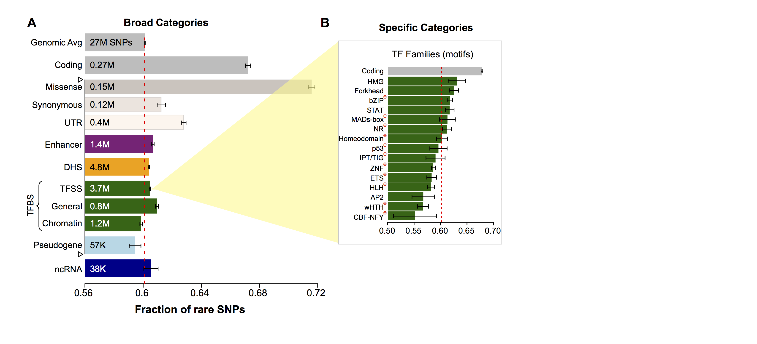
Gencode consistently annotates CDSes in the context of UTRs, Pseudogenes & ncRNAs, so can uniformly look at the effect of variants on these
[Khurana et al., Science (‘13)]

Slide 12
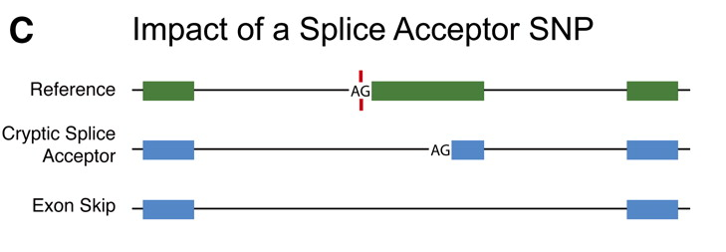
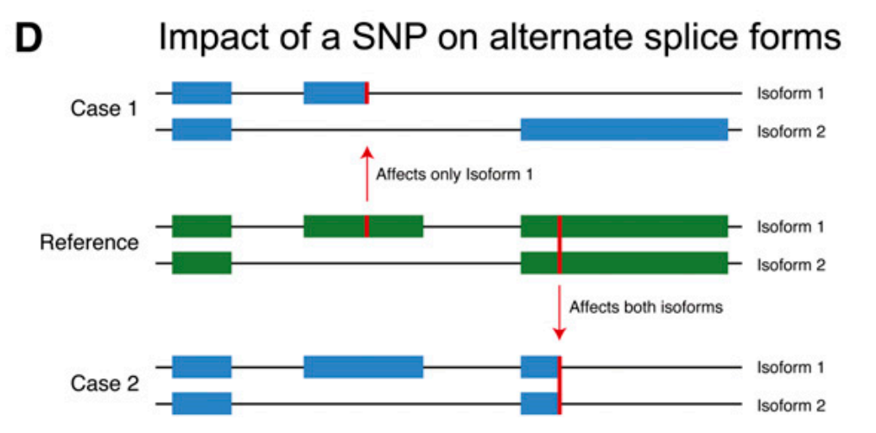
One has to consider transcript structure to assay impact of variants on genes
[Balasubramanian et al., Genes Dev., ’11]

Slide 13
Reference transcript set affects consequence calling
Notes:
So this paper published earlier in the year by Davis McCarthy demonstrated that using the same variant annotation pipeline but different reference transcripts (GENCODE and RefSeq) gives significantly different results – eg only a 44% agreement in annotations for putative loss-of-function variants. This spurred us to look at the same problem from a more transcript-centric point of view.

Slide 14
More variants intersect with GENCODE transcripts
exonic variants 1KG
GENCODE comp
RefSeq NM + XM
378498
866215
53906
Notes:
To assess how the greater genomic coverage of GENCODE transcripts affected variation calling, we looked at a set of variants identified from both low coverage whole-genome sequencing and high coverage exome sequencing of 379 europeans from phase 1 of the 1000 genomes project. Clearly, although the majority of variants are shared between the two genesets, GENCODE has 7 fold more unique variants compared to the most comprehensive RefSeq set which includes manual and automated annotation.
Analysis by Graham Ritchie
EUR super-population (379 individuals) from the phase 1 release of the 1000 genomes project. This includes data from both low coverage whole-genome sequencing and high coverage exome sequencing.
Only considered VEP calls of exonic and splice junction variants
While the greatest number of variants are common to both sets GENCODE has 7 fold more unique variants compared to RefSeq

Slide 15
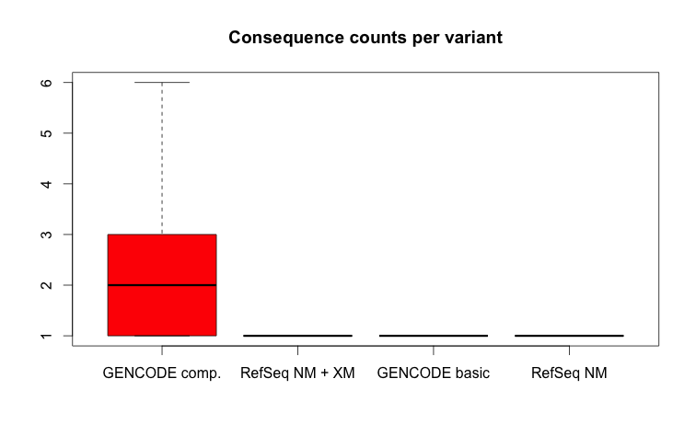
Transcript complexity makes calling variant consequence more difficult
Consequence counts per variant
Notes:
The downside to the transcript complexity captured by GENCODE is that it can make consequence calling more difficult by increasing the number of consequences called by VEP for each variant in set. GENCODE has mean of ~2 consequences per variant and a maximum of 6 while even the most complex RefSeq geneset calls a single consequence per variant pretty much all the time.

Slide 16
Simplifying Gencode

Slide 17
GENCODE Basic set reduces transcript complexity
GENCODE Basic: 3
At protein-coding locus GENCODE basic transcript set contains:
- only protein-coding transcripts
- only transcripts with a full-length CDS (ATG to stop)
Notes:
So in the light of this problem we wanted to investigate ways to make the GENCODE geneset less complex. One of the ways we looked to do this was via the creation of the GENCODE basic geneset. GENCODE basic is a subset of the comprehensive set which has at least one representative full-length transcript for each locus.
For protein coding genes this means that only full-length protein-coding transcripts are included and transcripts such as those with incomplete CDSs and retained_intron and NMD biotypes are excluded.
For example, at the SLC25A17 locus the GENCODE basic set contains three transcripts.

Slide 18
GENCODE Basic shares characteristics with RefSeq genesets
Notes:
The GENCODE basic set resembles the RefSeq genesets more closely than the GENCODE comprehensive set, and has a mean number of transcripts and unique translations per locus intermediate between the RefSeq manually annotated set and the RefSeq manual plus automated set. So already we can see it is providing a more tractable number of transcripts.
– having 2.7 transcripts and 2.4 unique translations per multi-exon protein-coding locus

Slide 19
GENCODE basic reduces complexity in variant consequence calling
Notes:
Similarly the GENCODE basic set shares the simplicity of the two RefSeq sets by calling only one consequence per variant.

Slide 20
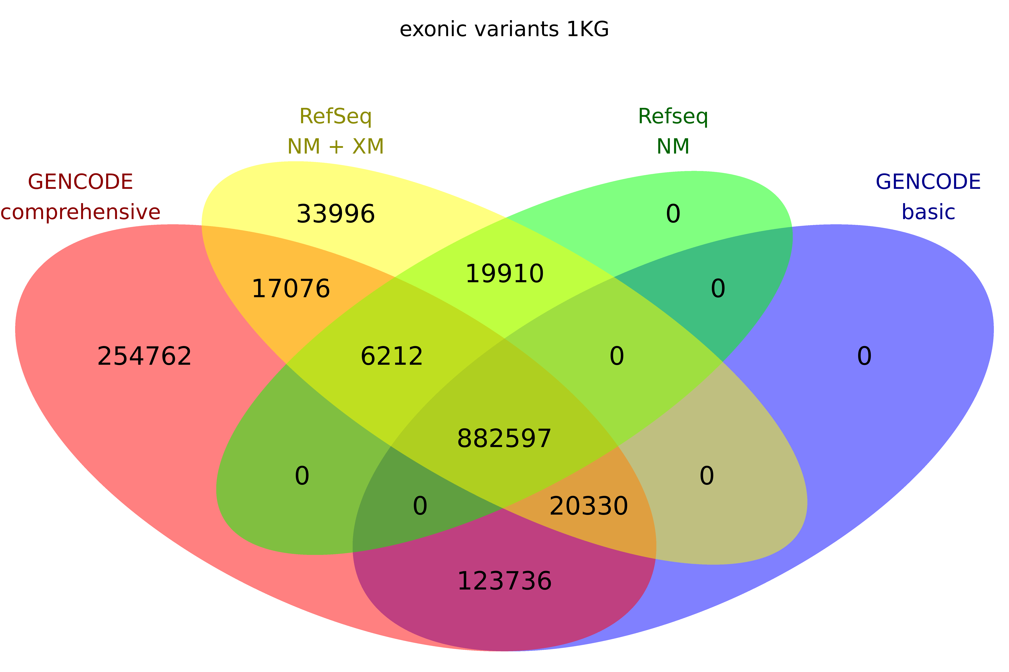
GENCODE basic still gives greater coverage of variation than RefSeq
Notes:
Despite the reduction in complexity the GENCODE basic set offers, it still intersects uniquely with ~2.5 times more variants in the 357 European individuals from the 1000 genomes pilot 1 compared to the largest RefSeq set. So while we have reduced the complexity of the annotation this has not been at the expense of completely losing the greater coverage offered by the GENCODE comprehensive set.
Analysis by Graham Ritchie
Despite the reduction in complexity GENCODE basic provides it still intersects uniquely with ~2.5 times more variants in the 357 European individuals from the 1000 genomes pilot 1

Slide 21
Transcript level quantification unreliable
Notes:
We have for some time wanted to use RNAseq data to allow us to provide tissue-specific sets of transcripts that would be useful both to browser users and as a filter in the Ensembl VEP, but all evidence we have seen suggests that transcript level quantification is not currently sufficiently robust to permit this.

Slide 22
But can we identify most highly expressed transcripts?
Notes:
So we looked at the possibility that even though we might not be able to accurately determine the level of an individual transcript, we might be able to identify the most highly expressed or dominant transcript in a tissue or cell-line.

Slide 23
Identifying dominant transcripts to reduce transcript complexity
Flux Capacitor dominant
Cufflinks2 dominant
Transcript quantification with Flux Capacitor and Cufflinks2
- both find a dominant transcript (DT) for only 50-60% of all genes
- where both declare a DT agree ~85% of cases (5x dominance)
- where agree DT, 75%-90% are in GENCODE basic
- where disagree on DT, up to 50% are in GENCODE basic (>0x dominance)
Notes:
To investigate this we ran two parallel pipelines – following mapping with Tophat2 we ran FluxCapacitor and Cufflinks for transcript quantification and used the outputto identify dominant transcripts. The pipelines don’t always call a dominant transcript which is not surprising as not all genes are expressed in a given tissue.
Where they do both call a dominant transcript there is good agreement especially higher levels of dominance - 5x dominance means that the expression of the dominant transcript is at least 5 fold higher than the next most highly expressed transcript. Where dominant transcript is agreed it is very likely to be included in the GENCODE basic set and even where there is no agreement individual predictions are also likely to be present in the GENCODE basic set, suggesting the basic set captures a high proportion of the most highly expressed transcripts.

Slide 24
Summary
GENCODE aims to capture as much biological complexity as possible
This facilitates consistent discovery of genic variants but complicates their interpretation
GENCODE basic transcripts are intended to bridge this
Notes:
So in summary, biology is complex and we try to capture this, which is great to identifying novel variants in genes but makes predicting their consequences very hard. The GENCODE basic set attempts to reconcile this problem by simplifying the transcript set without sacrificing too much coverage and while it seems to contain a large number of highly expressed (and presumably functional) transcripts we are making use of RNAseq data to filter transcripts and exons in a biologically meaningful manner

Slide 25
Acknowledgements
WTSI
Adam Frankish
Jen Harrow et al.
Anacode team
Annotools team
EBI
Graham Ritchie
Robert Petryszak
Bronwen Aken et al.
CNIO, Madrid
Alfonso Valencia
Michael Tress
CRG, Barcelona
Roderic Guigo
Dimitri Pervouchine
Barbara Uszczynska
University of Lausanne
Alex Reymond et al.
UCSC
Mark Diekhans
Rachel Harte
MIT
Manolis Kelis et al.
Yale
Mark Gerstein et al.
CSHL
Tom Gingeras et al.
Accessing GENCODE
Gencodegenes.org: http://www.gencodegenes.org/data.html
UCSC Browser: http://genome.ucsc.edu/cgi-bin/hgGateway
ENSEMBL Browser: http://www.ensembl.org/Homo_sapiens/Info/Index
Vega Browser: http://vega.sanger.ac.uk/Homo_sapiens/Info/Index

