Slide 1
Overdispersion
141023
Allele

Slide 2
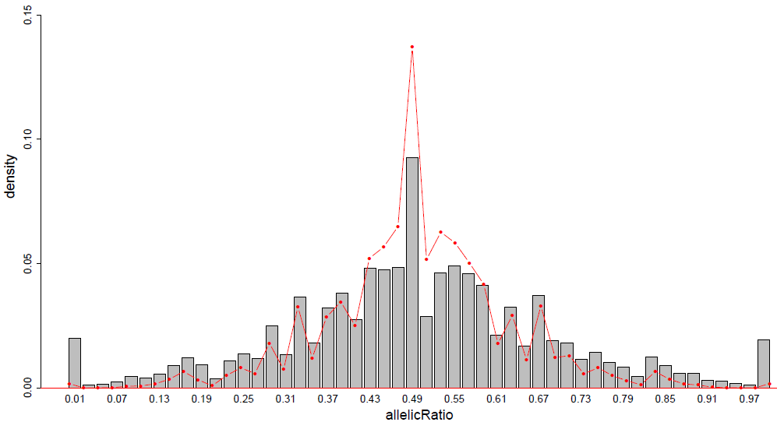
NA12878, combined-RNAseq
N=6-499759, bins=40
Binomial
Empirical

Slide 3
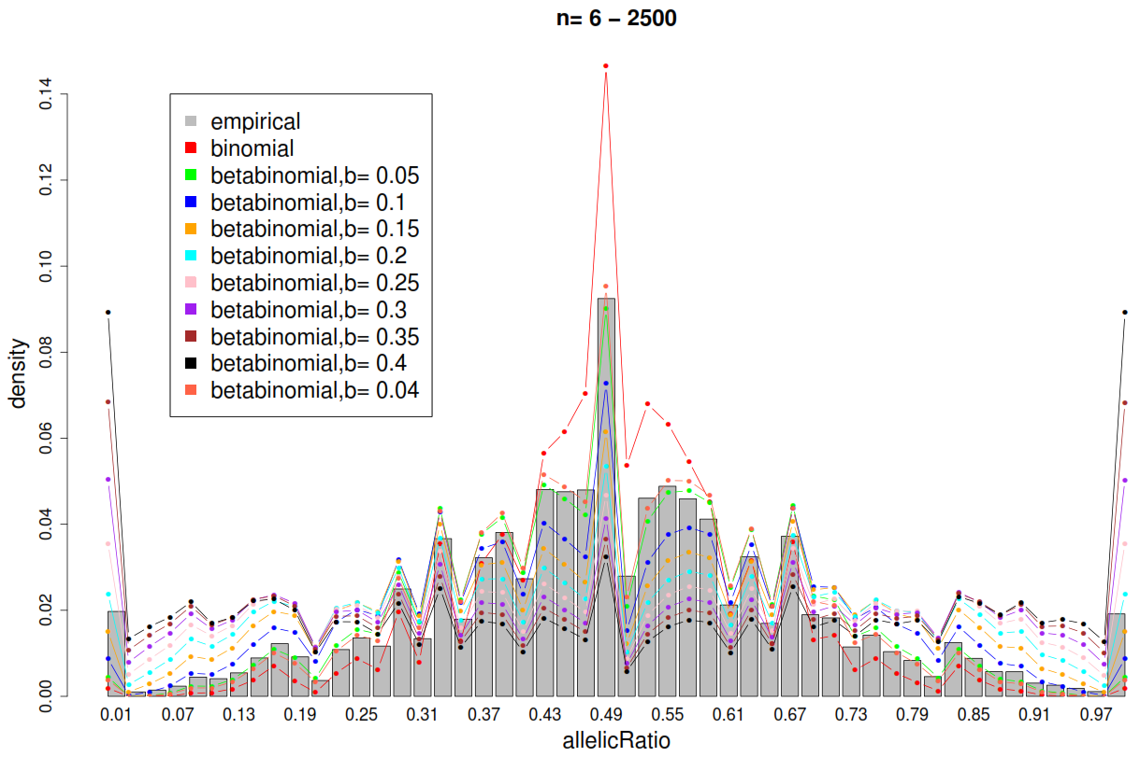
Range of overdispersion parameter for Betabinomial compared to binomial

Slide 4
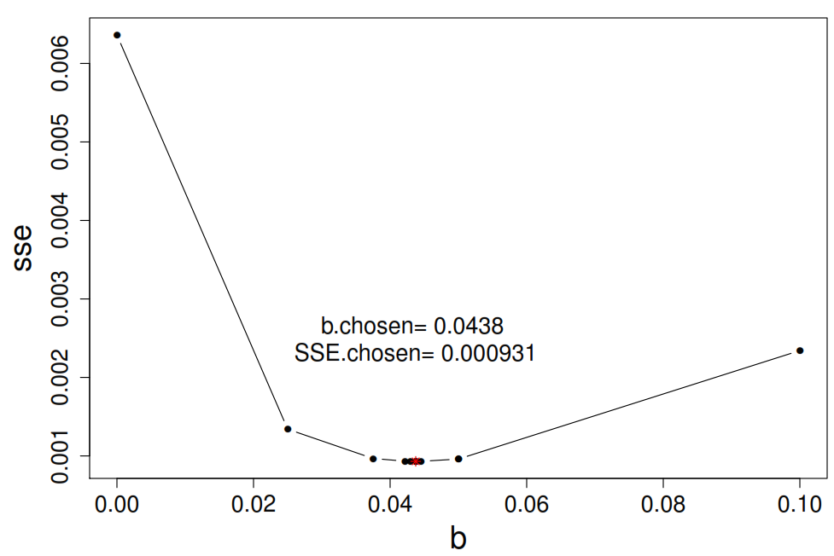
Using sum of squared errors (SSE) and Newton-Raphson-like process to hone in on an “optimal” b estimate
Start from b=0.05 to b=1, by=0.05; move on once SSE increases --> b.choice
Restart scan. Start from b.choice-previous.by/2, to b.choice+ previous.by/2, by=previous.by/4
Stop when SSE “converges”: prev SSE = current SSE at 3 significant figures
 | b | sse
1 | 0 (binomial) | 0.0063628632
2 | 0.05000000 | 0.0003891566
3 | 0.10000000 | 0.0017363458

Slide 5
Method1: Using sum of squared errors (SSE) and Newton-Raphson-like process to hone in on an “optimal” b estimate
Start from b=0.05 to b=1, by=0.05; move on once SSE increases --> b.choice
Restart scan. Start from b.choice-previous.by/2, to b.choice+ previous.by/2, by=previous.by/4
Stop when SSE “converges”: prev SSE = current SSE at 3 significant figures
 | b | sse
1 | 0 (binomial) | 0.0063628632
2 | 0.05000000 | 0.0003891566
3 | 0.10000000 | 0.0017363458
4 | 0.02500000 | 0.0013406707
5 | 0.03750000 | 0.0009675685
6 | 0.05000000 | 0.0009598836
7 | 0.04375000 | 0.0009309229
8 | 0.04218750 | 0.0009331956
9 | 0.04296875 | 0.0009315328
10 | 0.04375000 | 0.0009309229
11 | 0.04453125 | 0.0009313293
Notes:
0.05
0.025
0.0125
0.00625
0.003125
0.0015625

Slide 6
Method2: same as before but now weight the SSE for each bin in a “pyramid” manner
Weight = 0.04, 0.08 …………………………………..1,1,0.96,0.92,0.88………………..............0.04

Slide 7
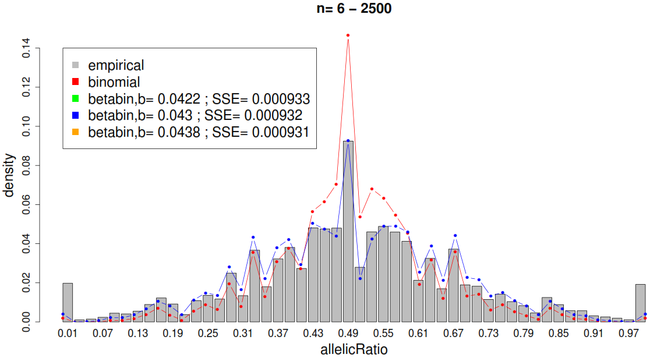
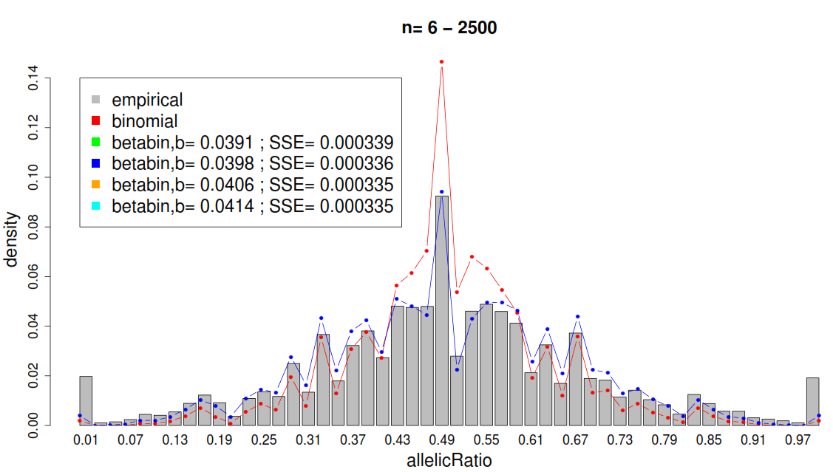
Method1: No weights
Method2: Weighted

Slide 8
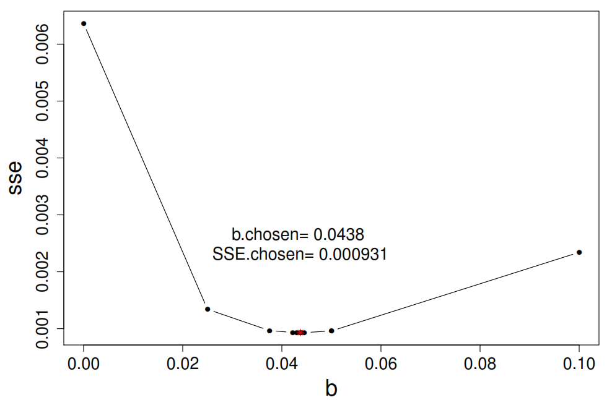
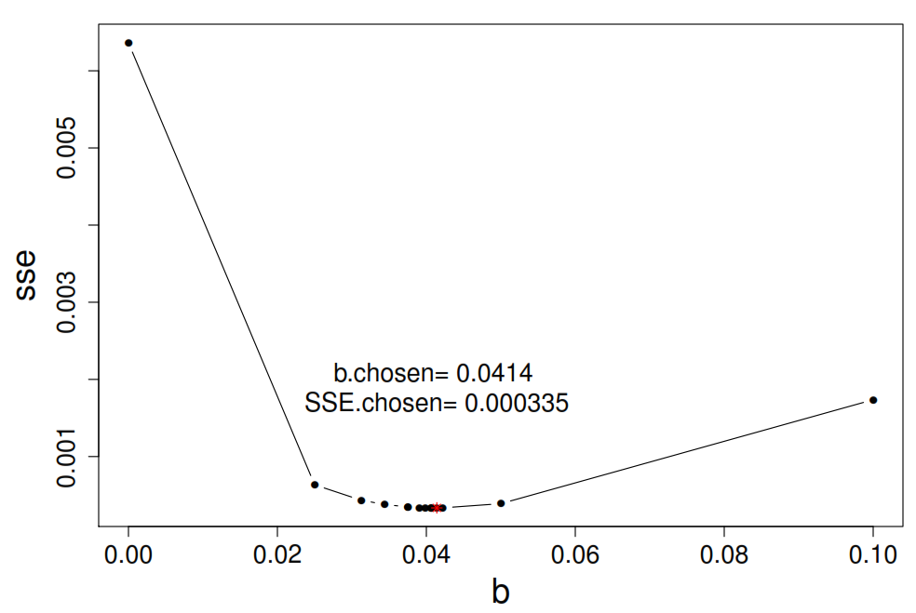
Method1: No weights
Method2: Weighted

Slide 9
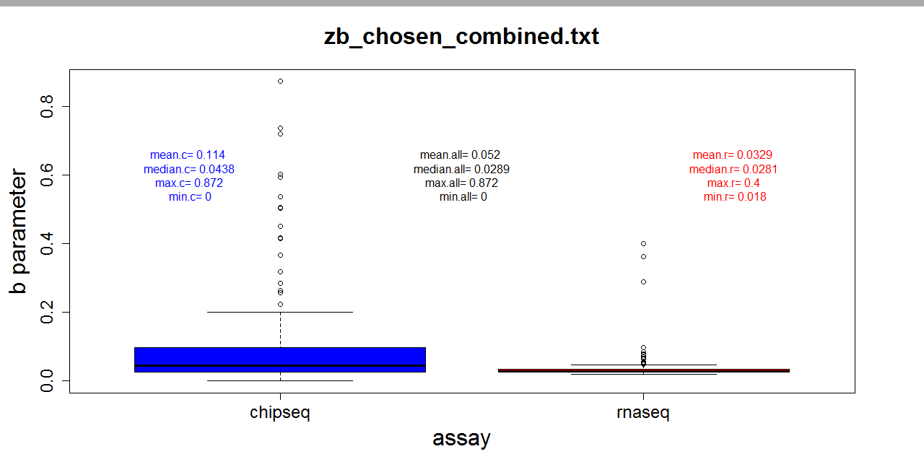
Repeat that for 501 datasets
(118 ChIP-seq and 383 RNA-seq)

Slide 10
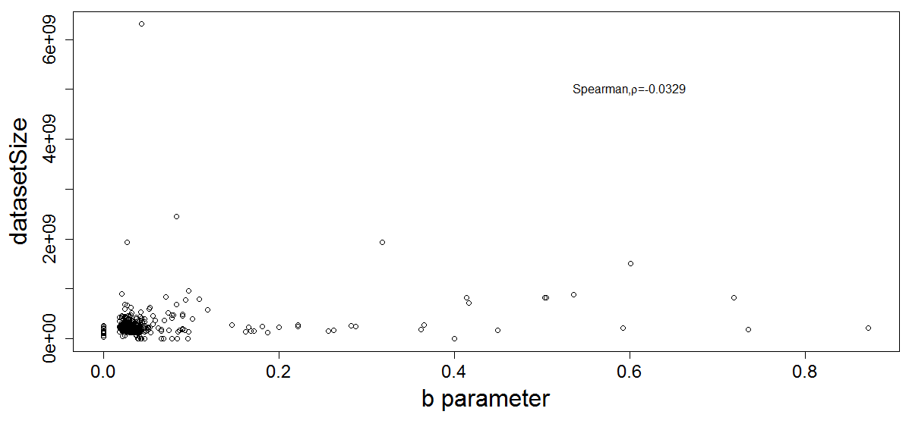
Correlation between b and #reads in dataset (pooled)

Slide 11
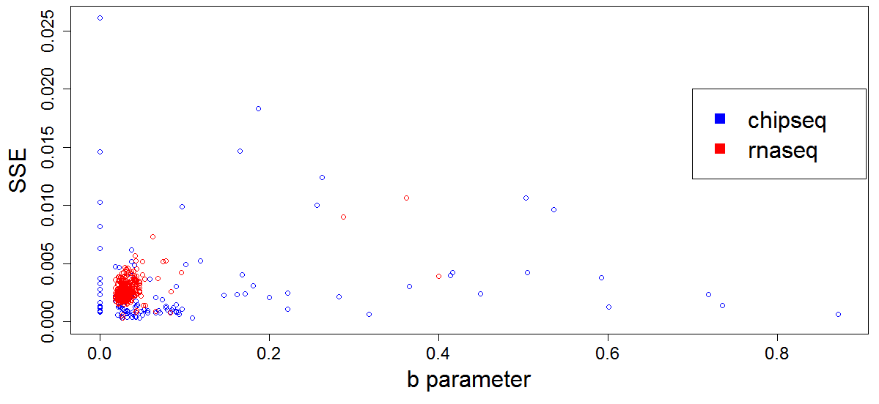
Repeat that for 501 datasets
(118 ChIP-seq and 383 RNA-seq)

Slide 12
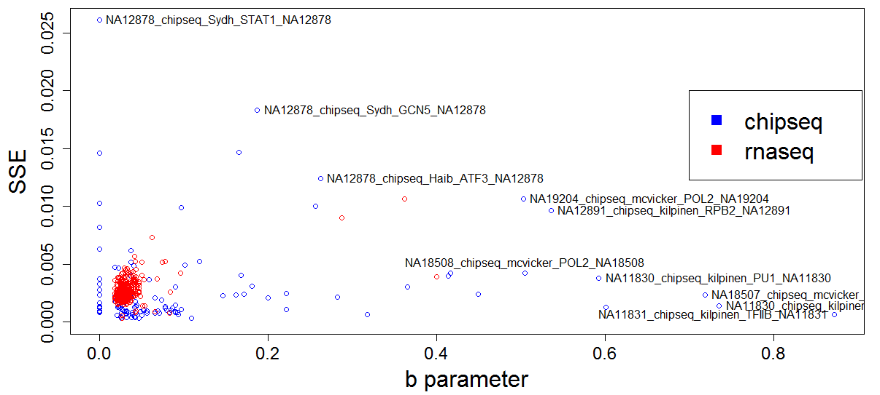
Repeat that for 501 datasets
(118 ChIP-seq and 383 RNA-seq)

Slide 13
In progress
TopHat2 vs Bowtie1 – difference in aligned reads
Boxplots for weights vs no-weights for all 501
B parameter values between biological and technical replicates
More things:
How to use the betabinomial to obtain a final set of intHets
Obtain an improved set of control SNVs

