Slide 1
Phase 3 SV Functional Analysis
Yan Zhang & Jing Zhang
Gerstein Lab
10/2014

Slide 2
Overview
Personal genome
SNP freq. vs. SV freq.
Overlap of SVs vs. functional elements

Slide 3
Overlap of SVs vs. Functional Elements

Slide 4
Different SV types
DEL Deletion
DUP Duplication
INV Inversion
CNV Copy number polymorphism
INS.MT Nuclear Mitochondrial Insertion
SVA Insertion of SVA element
LINE1 Insertion of LINE1 element
ALU Insertion of ALU element
3014
12786
Total: 69380
838
42518
3060
858
.MT
170
6136
Merged SV set used for this analysis:
ALL.wgs.mergedSV.v2.20130502
Notes:
CNV – multi-allelic
DEL, DUP – bi-allelic

Slide 5
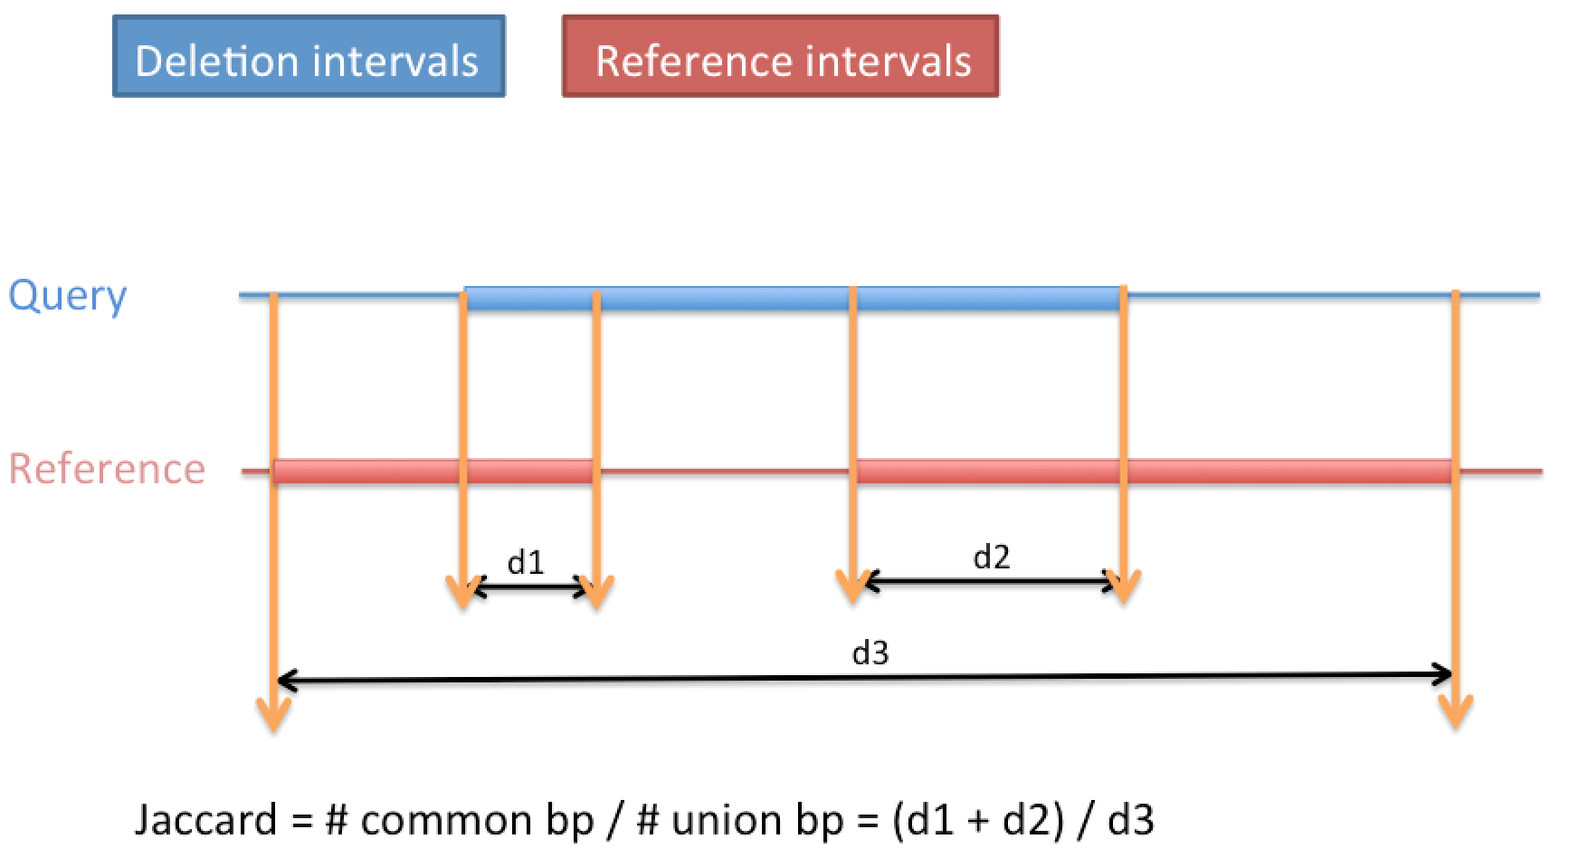
Our previous analysis scheme
Overlap measure:
  Jaccard measure
Randomization procedure:
  We used the piece-wise subsampling method (Peter Bickel, et al. Ann Appl Stat, 2010) after removing gap regions in the genome.

Slide 6
Our current analysis scheme
Investigate SVs in different allele frequency bins:
Overlap measure:
  Use ‘partial overlap count’ and ‘engulfing overlap count’ as overlap measures for Non INS SVs
  Log2 fold change & empirical p-value
Randomization procedure:
  SV allele freq. bins:
    (0, 0.001], (0.001, 0.01], (0.01, 0.1], (0.1, 1]
  Randomly shuffle SV locations
    Same number of SVs, same length distribution
    Homogeneity requirement:
      Shuffled SVs still locate on the same chromosome
      Hg19 gap removed (also taken into account in our previous scheme)

Slide 7
Some thoughts about tied interval features

Slide 8
Count measurement
(take ‘partial overlap count’ for example)
SVs
Genomic elements
Query
Q1
Q2
Reference
R1
R2
R3
For null distribution: Query is shuffled, Reference is fixed.
For each genomic element (R), a binary indicator represents whether it is influenced by SV or not:
I₁ = 0, I₂ = 1, I₃ = 1.
Count the number of genomic elements that have at least 1 bp overlap with some SV:
Count = I₁ + I₂ + I₃ = 2.

Slide 9
What if there exists dependency between the location of R’s (eg. R2-R6 are tied)
Shuffled
query
Query
Reference
R1
R2
R3
R4
R5
R6
Count the number of genomic elements that have at least 1 bp overlap with some SV:
Count = I₁ + I₂ + I₃ + I₄ + I₅ + I₆= 5

Slide 10
Tied vs. non-tied examples of interval reference features (R1-R6)
Reference
(non-tied)
R1
R2
R3
R4
R5
R6
Reference
(tied)
R1
R2
R3
R4
R5
R6

Slide 11
Tied vs. non-tied examples of interval reference features (R1-R6)
Shuffling the Q’s (query features) does not break the dependency structure among R’s (reference features). Therefore, the permutation test is still valid.
Fold change = real count / avg. null counts
In which, avg. null counts = E(I₁)+E(I₂)+…+E(I₆), which is not related to the dependency between R1,…,R6.
Thus, the formula of fold change is also not related to the dependency between R1,…,R6.
Different choices of measures might have different power.

Slide 12
Overlap of SVs vs. Functional Elements:
Our previous results

Slide 13
DEL overlap with genomic elements
*
*
*
*
*
*
*
*
* pvalue < 0.01
*
Pseudogene CDS UTR Exon Intron lincRNA ENCODE.tf Sensitive.nc Conserved

Slide 14
*
*
*
*
*
*
*
* pvalue < 0.01
Pseudogene CDS UTR Exon Intron lincRNA ENCODE.tf Sensitive.nc Conserved

Slide 15
* pvalue < 0.01
Pseudogene CDS UTR Exon Intron lincRNA ENCODE.tf Sensitive.nc Conserved

Slide 16
* pvalue < 0.01
Pseudogene CDS UTR Exon Intron lincRNA ENCODE.tf Sensitive.nc Conserved

Slide 17
INS_ALU insertion position overlap with genomic elements
*
*
*
*
*
* pvalue < 0.01
Pseudogene CDS UTR Exon Intron lincRNA ENCODE.tf Sensitive.nc Conserved

Slide 18
INS_LINE1 insertion position overlap with genomic elements
*
*
*
*
*
* pvalue < 0.01
Pseudogene CDS UTR Exon Intron lincRNA ENCODE.tf Sensitive.nc Conserved

Slide 19
INS_MT insertion position overlap with genomic elements
* pvalue < 0.01
*
Pseudogene CDS UTR Exon Intron lincRNA ENCODE.tf Sensitive.nc Conserved

Slide 20
INS_SVA insertion position overlap with genomic elements
*
*
*
*
*
*
* pvalue < 0.01
Pseudogene CDS UTR Exon Intron lincRNA ENCODE.tf Sensitive.nc Conserved

Slide 21
* pvalue < 0.01
*
*

Slide 22
Overlap of SVs vs. Functional Elements:
Our current results, 4 SV freq. bins

Slide 23
Distribution of SV allele freq. in the merged SV file
Histogram of SV freq. (all SV types)

Slide 24
AF quantiles in different SV types
Quantile | CNV | DEL | DUP | INV | ALU | LINE1 | SVA | INS.MT
0% | 0.000394 | 0.000197 | 0.0001970 | 0.000197 | 0.000197 | 0.000197 | 0.000197 | 0.00019700
25% | 0.000592 | 0.000197 | 0.0001970 | 0.000197 | 0.000592 | 0.000197 | 0.000394 | 0.00019700
50% | 0.001183 | 0.000394 | 0.0001970 | 0.000394 | 0.003748 | 0.000789 | 0.003156 | 0.00059200
75% | 0.006312 | 0.003156 | 0.0005920 | 0.002367 | 0.023274 | 0.005720 | 0.018935 | 0.00305725
100% | 1.000000 | 0.991716 | 0.9998028 | 0.858777 | 0.877120 | 0.786588 | 0.767061 | 0.47495100

Slide 25
Number of SVs (all types) in each bin
Currently we use the 4 bins of fixed AF bounds, not AF quantiles.
(Discussion needed to finalize bin settings.)
AF (0, 0.001]: 40854
AF (0.1, 1]: 5594
AF (0.001, 0.01]: 14943
AF (0.01, 0.1]: 7989

Slide 26
Number of SVs in each SV type in each bin
Currently we use the 4 bins of fixed AF bounds, not AF quantiles.
(Discussion needed to finalize bin settings.)
AF Bin | CNV | DEL | DUP | INV | LINE1 | ALU | SVA | INS.MT
(0, 0.001] | 1367 | 27197 | 5424 | 557 | 1695 | 4212 | 296 | 106
(0.001, 0.01] | 1005 | 8009 | 623 | 166 | 770 | 4060 | 273 | 37
(0.01, 0.1] | 372 | 3862 | 78 | 87 | 375 | 3004 | 191 | 20
(0.1, 1] | 270 | 3450 | 11 | 48 | 220 | 1510 | 78 | 7

Slide 27
Results of using ‘partial overlap count’
Currently we use 1 bp overlap as the lowest overlap requirement. We can also change the overlap requirement.

Slide 28
Will add error bars, or label p-value levels
And give the number of SVs in each bin.

Slide 29
DEL overlap with genomic elements (partial overlap)
An alternative format:
Clustered bar plot.
Will add error bars, or label p-value levels
And give the number of SVs in each bin.
Only non-significant fold changes are indicated by arrows.
Significance level:
P-value < 0.01
Log2 fold change

Slide 30
DEL overlap with genomic elements (partial overlap)
An alternative format:
Clustered bar plot.
Ordered by the purple bars
Log2 fold change

Slide 31
An alternative format: 4 mini plots for a SV type (such as DEL)

Slide 35
Results of using ‘engulfing overlap count’

Slide 40
Points for discussion
Z-score or fold change?
ENCODE.TF set currently used is the small motif set, not peak set.
Overlapped (tied) annotation
Different randomization schemes:
  GSC piece-wise subsampling excluding gap region (used in previous )
  Shuffle SVs and relocate them on the same chromosome, excluding gap region (currently used)
  Shift annotation or SVs along the ‘circle’ of chromosomes
  Local sampling: Sample each SV in a range (e.g. 10 Mb window) around the given real SV location.
Threshold of overlap (number of bases, or fraction)
Frequency bins
Binning of data by: CAT, AF, MECH, TYPE, CDS, RVIS, LEN SV
Adding other categories? E.g. Funseq explicit enhancers, explicit promoters, DHS, tissue specific DHS, tissue-specific vs. non-specific binding site, TF binding site family

Slide 41
To do
Look at SV freq. bins of equal size (3-4 bins)
Add ‘whole gene’ as a genomic element category
Add pseudo count for elements where there is no hit for genomic elements
Look at deletions at least 1kb in size
Break CDS into 3 categories based on Residual Variation Intolerance Score (RVIS)
Break pseudogenes into two categories: DUP & PSSD
Look at SVs overlap with gene categories (based on the number of paralogs/pseudogenes. Baikang Pei is helping extracting this information.)
Separate DELs by mechanisms (Hugo Lam and Jasmine Mu are working on the mechanism classification for a filtered DEL set.)
Update all results of INS SVs as well

Slide 42
Common deletions from 1kg are in regions under less selection pressure
Rare DAF percentage
Rare DAF percentage =(# SNPs with DAF < 0.5%)/(# SNPs)
Stronger selection pressure
Integrative annotation of variants from 1092 humans: Application to cancer genomics, Science, 2013

Slide 43
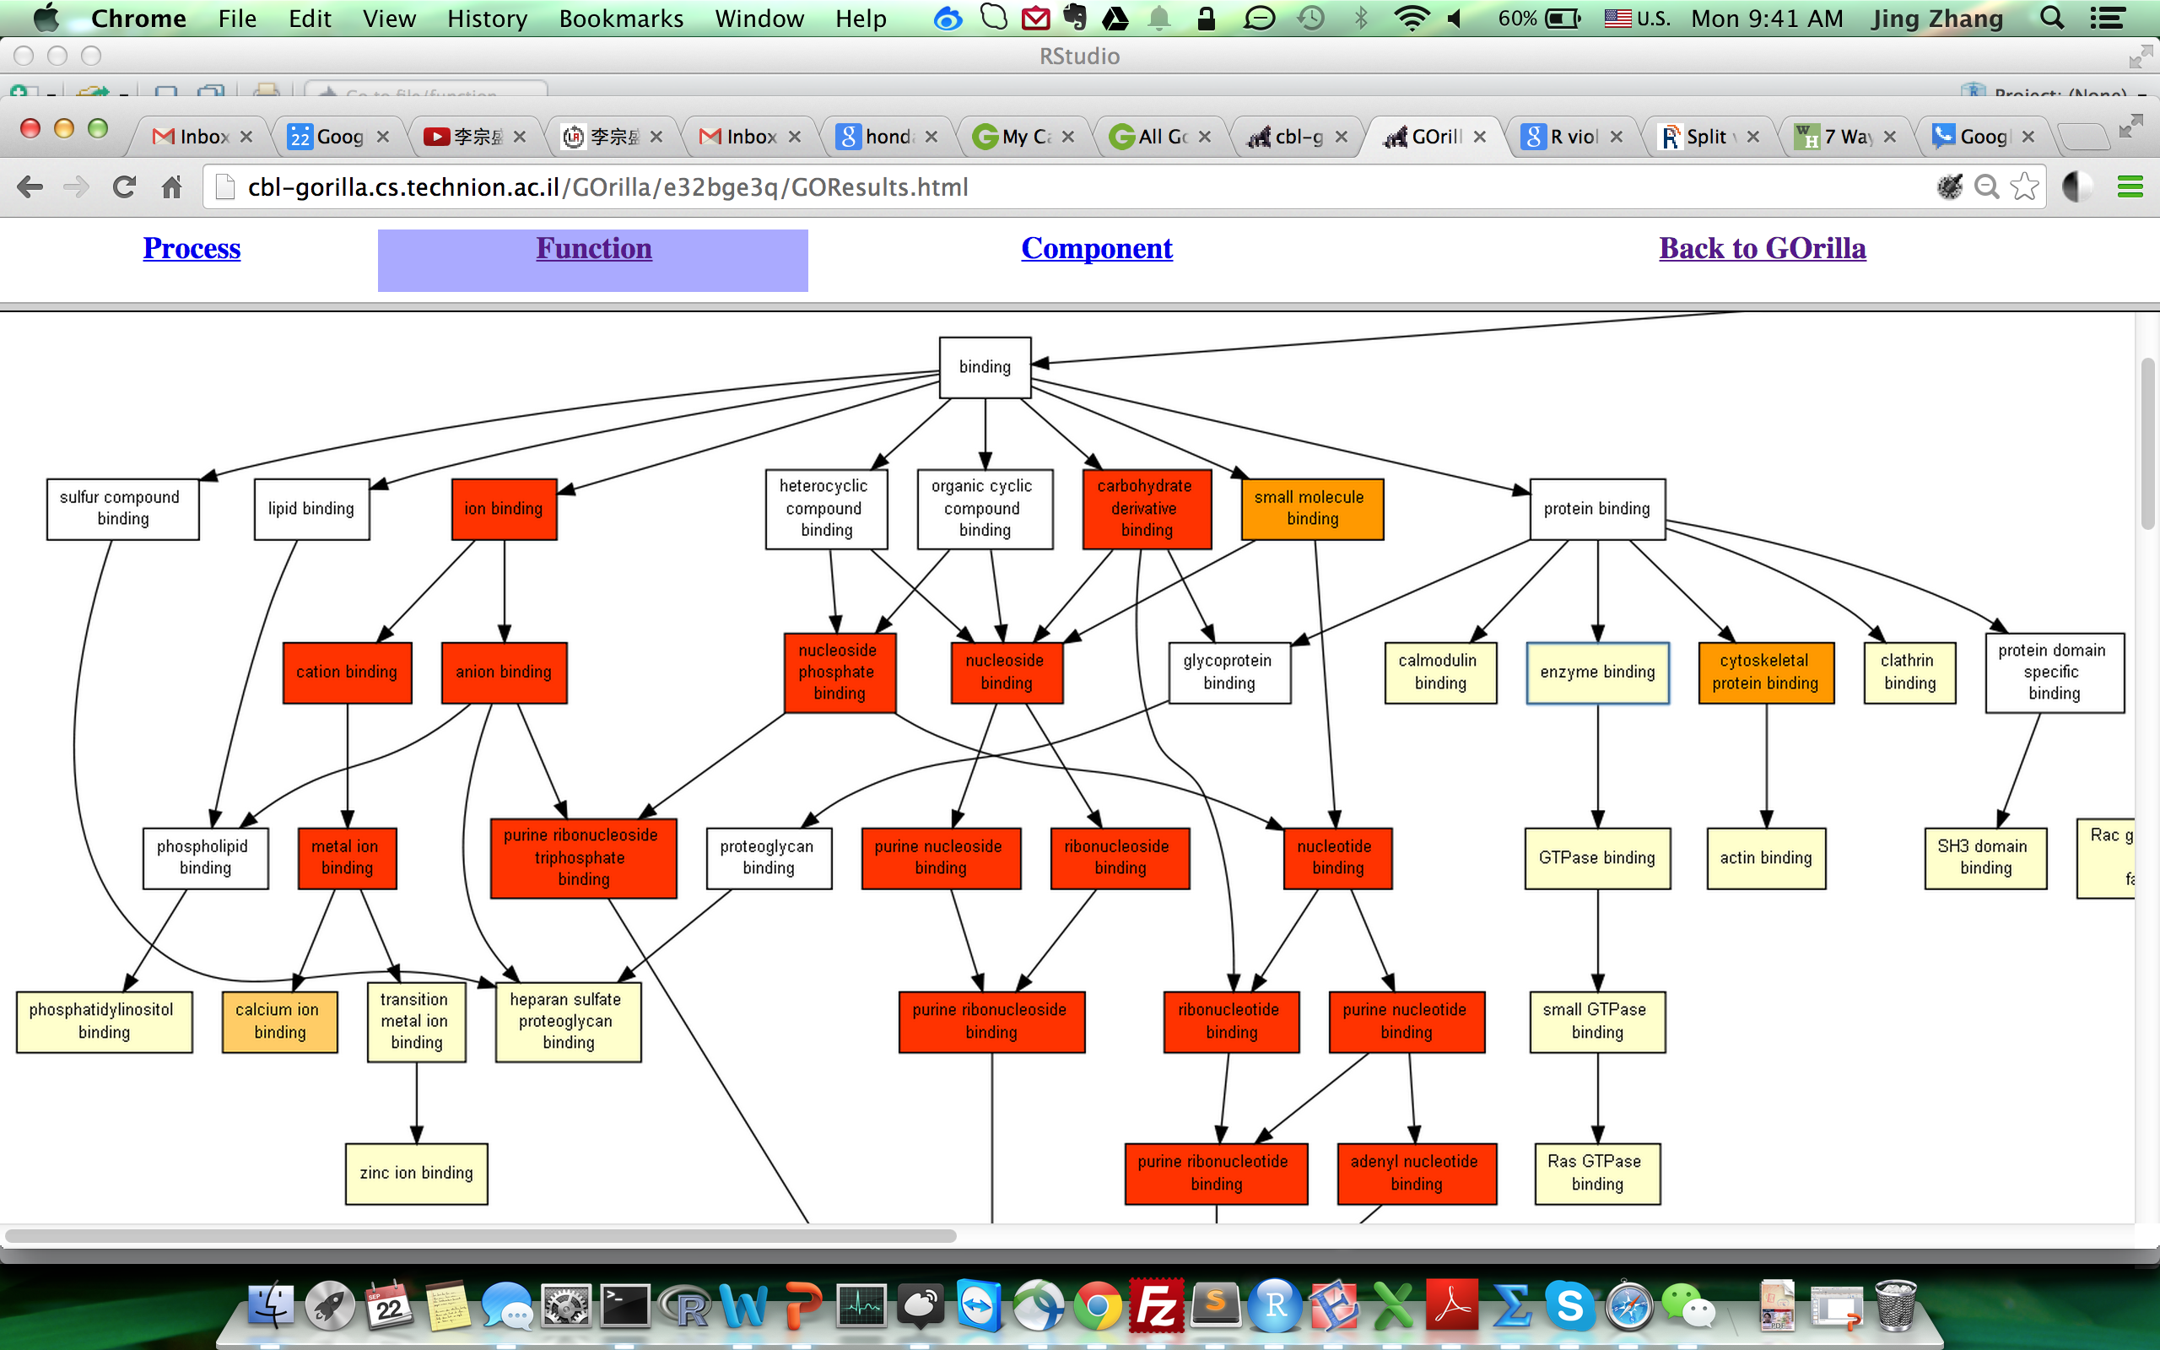
GO analysis of genes overlapped with SVs VS. genes without SV overlapping
Genes overlapped with SVs are enriched in a list of binding events

Slide 44
