Slide 1
Overview of ENCODE Elements
Mark Gerstein for the "ENCODE TEAM"

Slide 2
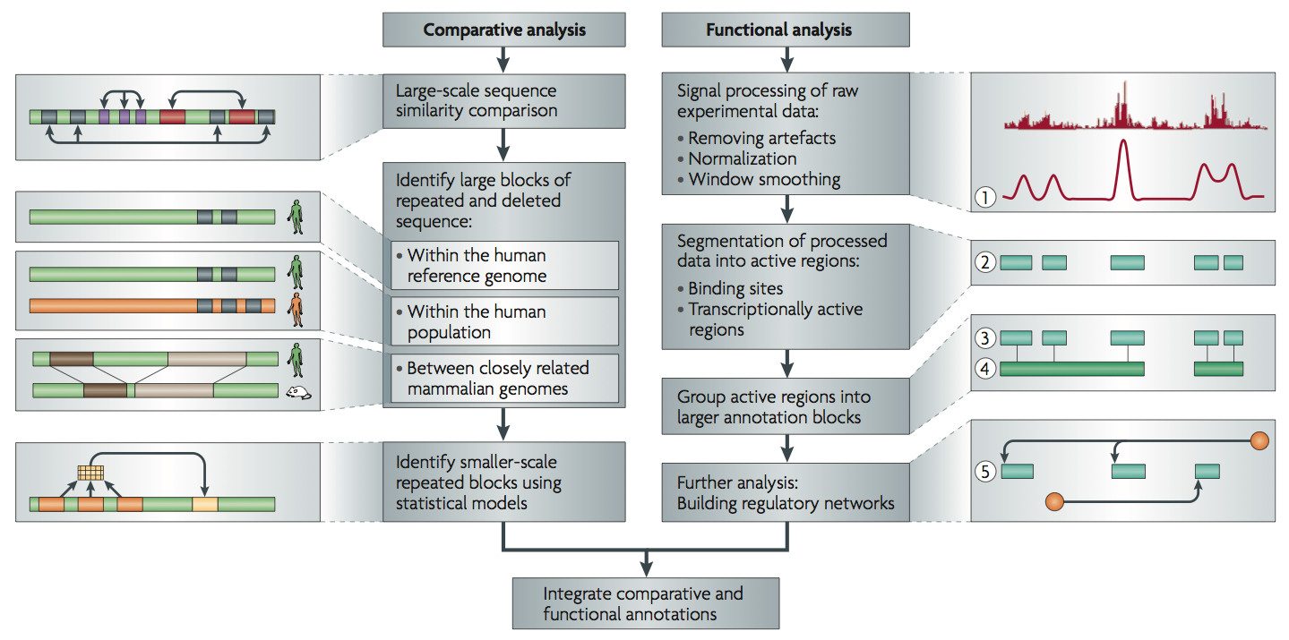
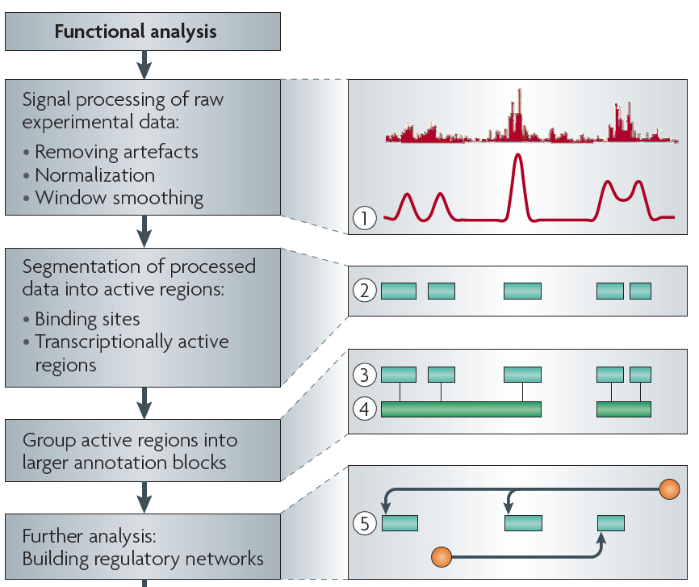
Non-coding Annotations: Overview
There are several collections of information "tracks" related to non-coding features
Sequence features, incl. Conservation
Functional Genomics
ChIP-seq (Epigenome & seq. specific TF) and ncRNA & un-annotated transcription
[Nat. Rev. Genet. (2010) 11: 559]

Slide 3
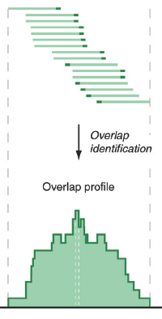
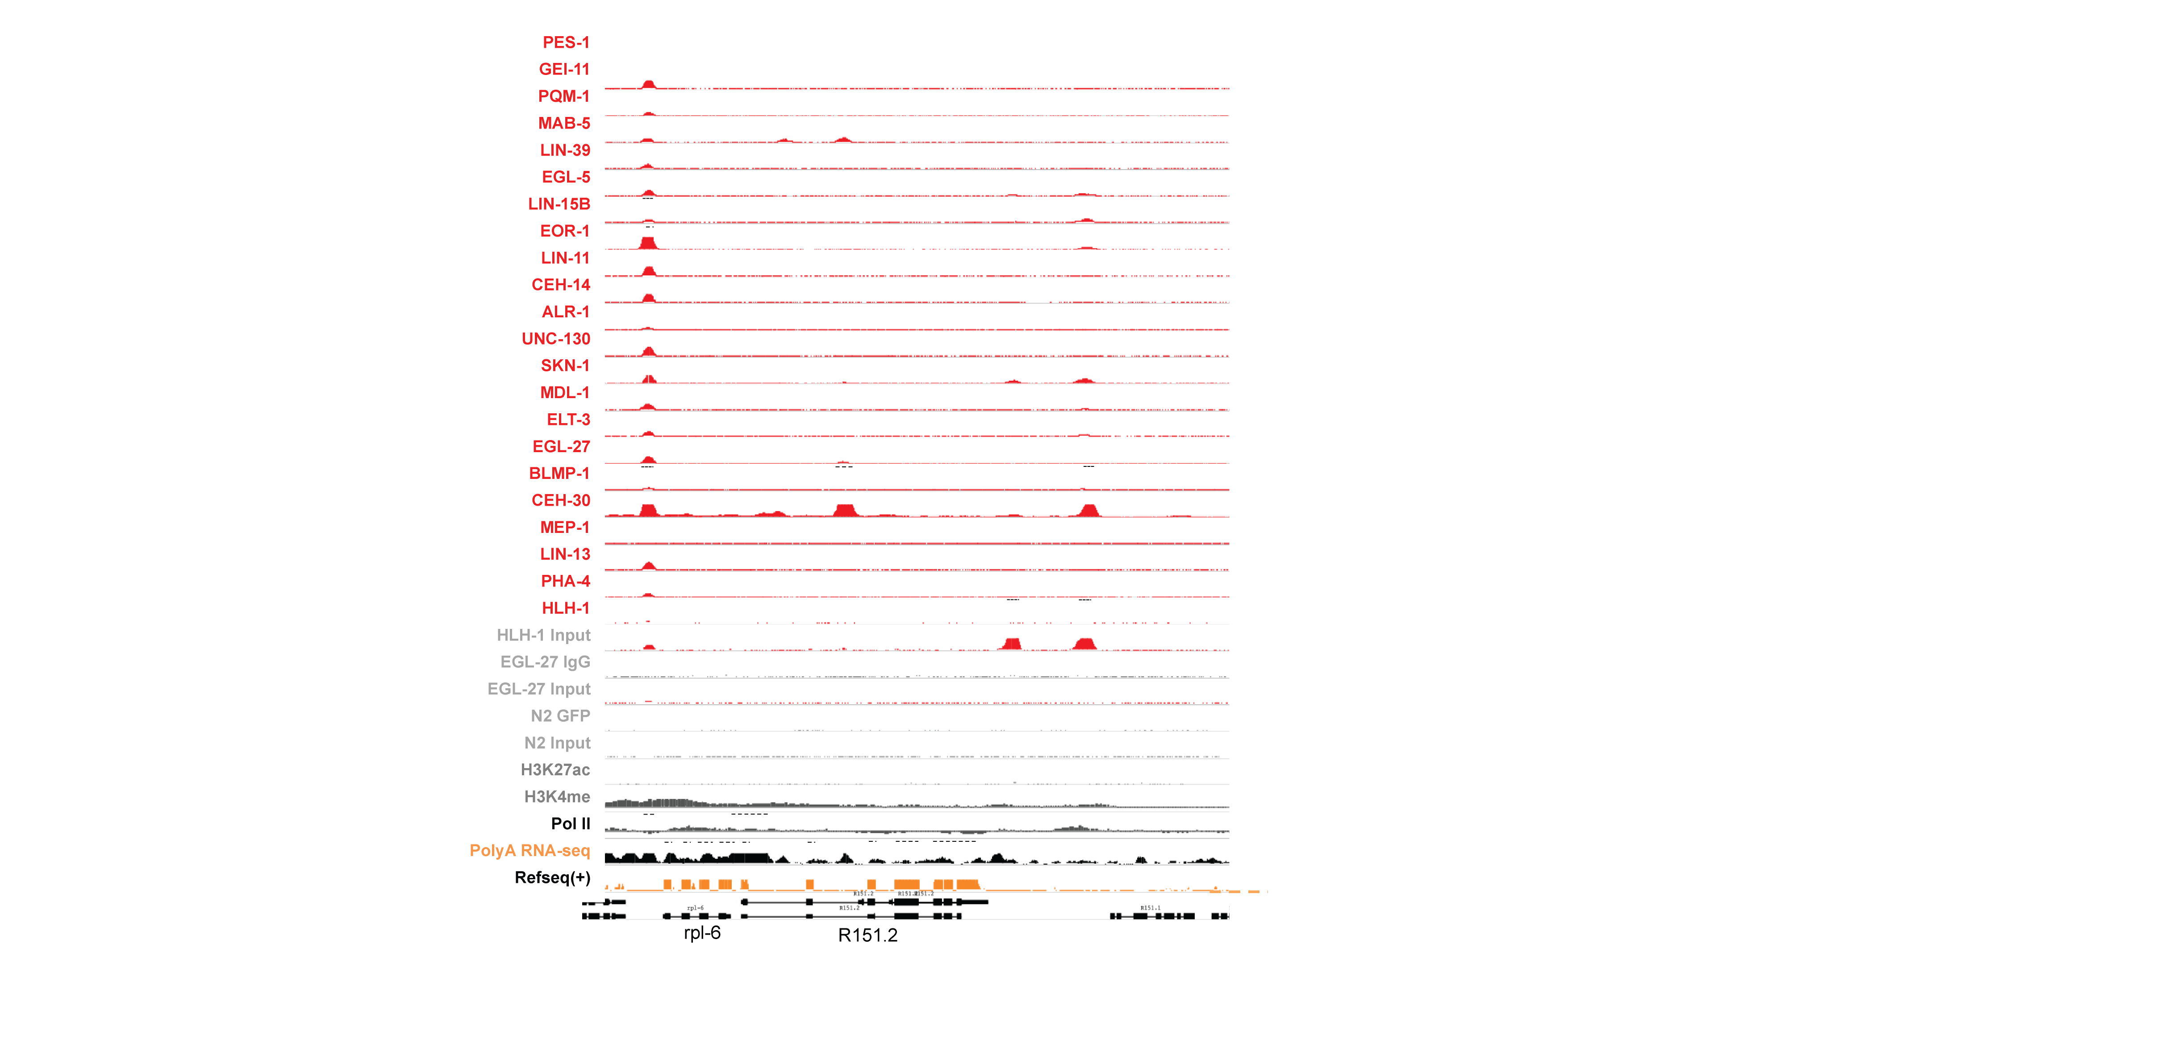
Signal Track for RNA-seq & ChIP-seq
stronger track
[PLOS CB 4:e1000158]

Slide 4
Functional Genomics Annotations
A) PEAKS
1. DNase peaks at the UCSC genome browser {on many cell lines}
2. The regulation track at the UCSC genome browser, with compilation of TF ChIP-seq peaks from uniform processing (individual peaks are annotated with TF and cell line)
3. Blacklist Regions
C) PROMOTERS
Annotated GENCODE TSSes (also, TSSes with FANTOM CAGE support)
D) ENHANCERS (Supervised)
- Yip et al., Ren et al. &c
E) UNSUPERVISED SEGMENTATIONS,
INCLUDING ENHANCERS
- ChromHMM, SegWay, HiHMM....
F) HOT/LOT REGIONS
G) CONNECTIVITY
7. Enhancer-target gene connection
8. TF-target network connectivity
9. TADs: Topologically Associated Domain
s.
H) Motifs for TF binding
B) RNA BASICS
4. A matrix of expression data of known genes (or exons) for protein-coding genes & known ncRNAs {on many cell lines}
5. Novel RNA contigs track, i.e., possible novel transcripts. "Transcriptionally Active Regions (TARs)”
6. Novel junctions
I) OTHER
10. List of Allelic SNPs & Regions
11. Models
new order

Slide 5
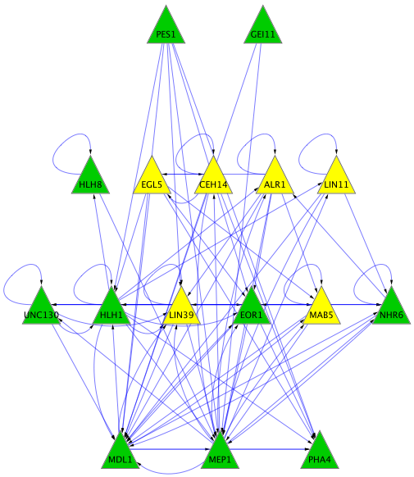
Higher level Information from ChIP-seq
TFs with Peaks
Control
His. Marks
(broad)
rapid comment del?
Networks
Aggregations
[Science 330: 1775
+ ENCODE Data Sources
TFs & Control: Yale
HMs: UW & Broad ]

Slide 6
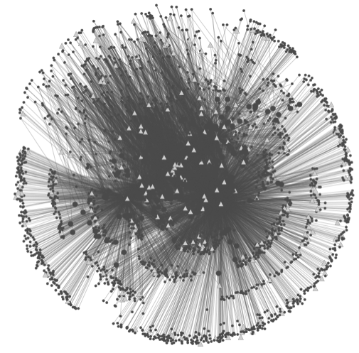
Data Flow: peaks to proximal & distal networks
Peak Calling
Assigning TF binding sites to targets
Filtering high confidence edges & distal regulation
[Cheng et al., Bioinfo. ('11);
Nature 489:91 ('12), doi:10.1038/nature11245;
Yip et al., GenomeBiology ('12)]
~500K Edges
Based on stat. model combining
signal strength & location relative to typical binding
TF
TF
Potential
Distal
Edge
Strong
Proximal
Edge

Slide 7
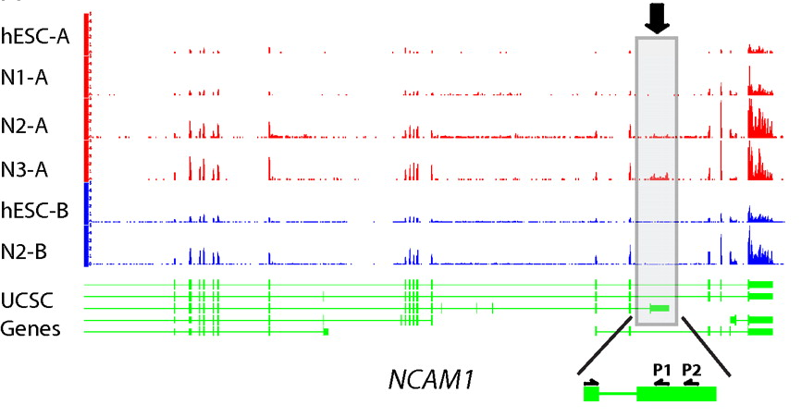
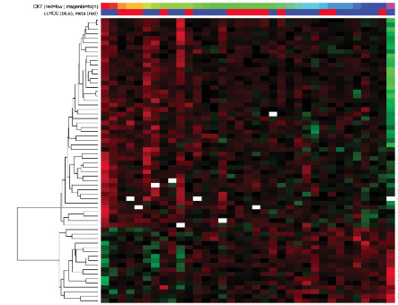
Higher level Information from
RNA-seq:
Avg. signal at exons & "TARs" (RPKMs)
[PNAS 4:107: 5254 ; IJC 123:569]
Signal tracks for two genes are shown. Figure made using UCSC genome browser.
RNA-Seq experiments one would keep: the expression levels (i.e. RPKMs) of ~20,000 genes, ~70,000 transcripts, ~200,000 exons, and ~2 million splices. Also, we would store information on ~15,000 novel Transcriptionally Active Regions (TARs), ~2,000 allele-specific expressed genes, ~50 chimeric transcripts as well as lists of differentially expressed elements between conditions.
Mertz, Kirsten D., Francesca Demichelis, Andrea Sboner, Michelle S. Hirsch, Paola Dal Cin, Kirsten Struckmann, Martina Storz, et al. “Association of cytokeratin 7 and 19 expression with genomic stability and favorable prognosis in clear cell renal cell cancer.” International Journal of Cancer 123, no. 3 (2008): 569-576.
Mapped reads show isoform composition in two different stages.
Du et al (in revision).

Slide 8
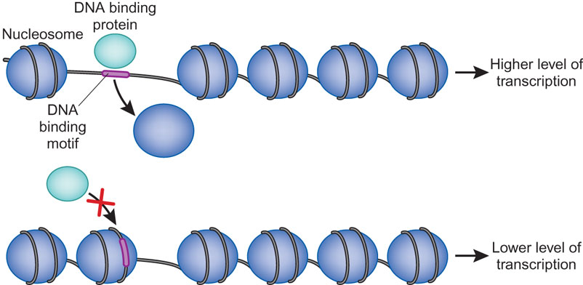
DNase Peak
Dnase Reads
ANS: combine w next? cut away reads
Groop L. Open chromatin and diabetes risk[J]. Nature genetics, 2010, 42(3): 190-192.

Slide 9

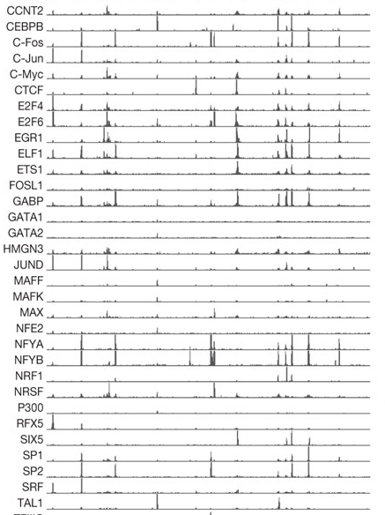
DNase hypersensitivity as a mark of functionality
Transcription Factor (ChIP-Seq)
Thurman et al Nature 2012

Slide 10
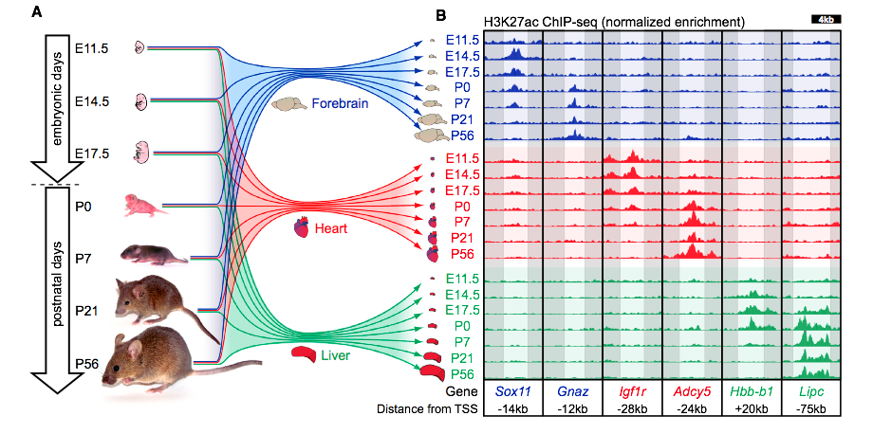
H3K27ac is an important mechanism to regulate the activity of enhancers in different developmental stages
Epigenetically, H3K27ac marks are present near active enhancers.
Nord, et al., Cell, 2013

Slide 11
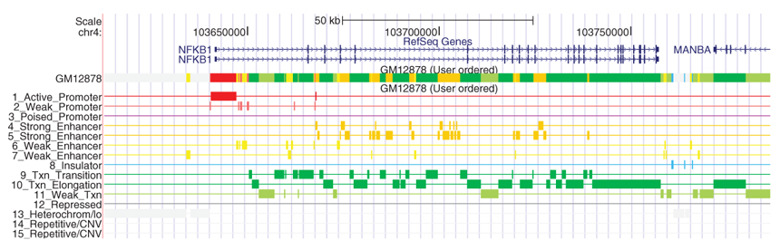
Genome Segmentations
how to connect
Ernst and Kellis, Nature Methods, 2012.

Slide 12
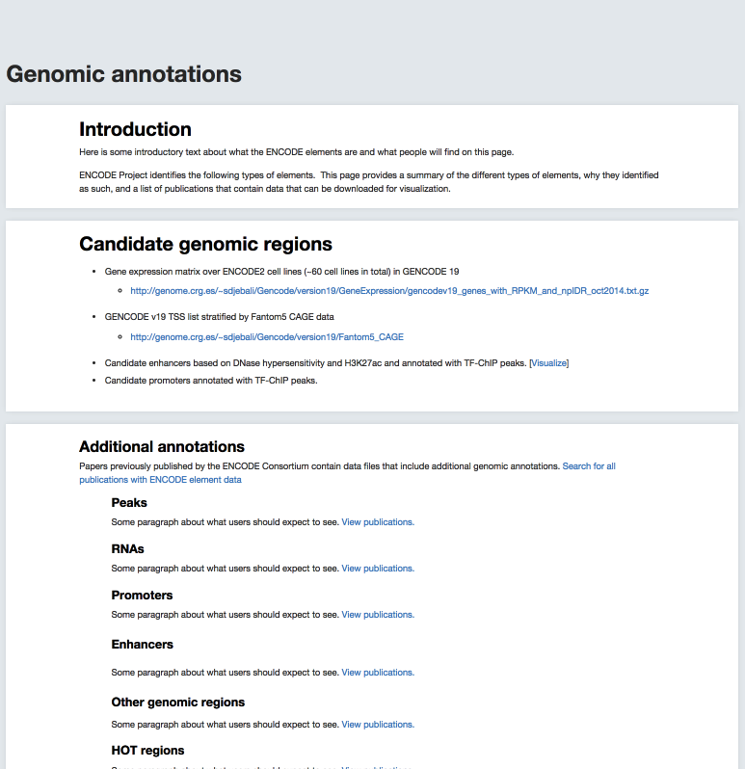
Simplified
+
Comprehensive
(based on published work from '12 & '14 rollouts)
eurie's new stuff

Slide 13
"Simplified" Annotation
"Slice" through the ENCODE, providing close-to-data subset of the annotations
Gene expression matrix
  over ENCODE2 cell lines (~60 cell lines in total) in GENCODE 19
TSS list
  GENCODE v19
“Tissue type” facet for the cell lines (DCC)

Slide 14
Simplified annotation
show more TFs? line up annotation, more cell lines, cut redund.
Candidate enhancers: The master list of TSS-distal DHS peaks annotated with
    H3K27ac enrichment (percentile over background) in a cell-type-specific manner.
    TF ChIP-seq peaks across cell-types
Candidate promoters: The master list of TSS-proximal DHS peaks annotated with TF ChIP-seq peaks across cell types.

Slide 16
Default Theme
Default Outline Level 1
  Level 2

Slide 17

Details of DNase peaks, H3K27ac annotation and TF ChIP-seq annotations
DNase peak detail
H3K27ac annotation
TF annotation

Slide 18
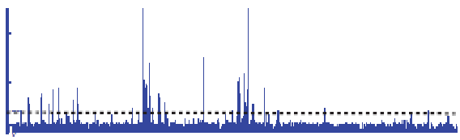

Peak Calling
ChIP
Generate and threshold the signal profile and identify candidate target regions
  Simulation (PeakSeq),
  Local window based Poisson (MACS),
  Fold change statistics (SPP)
Threshold
Potential Targets
Normalized Control
Score against the control
Significantly Enriched targets

Slide 19
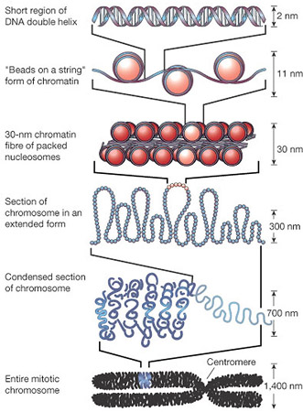
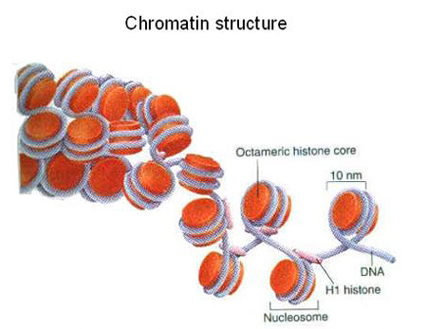
* Bremner Lab website
Chromatin is the combination or complex of DNA and proteins that make up the contents of the nucleus of a cell. The basic repeat element of chromatin is the nucleosome, interconnected by sections of linker DNA.
http://www.integratedhealthcare.eu/1/en/histones_and_chromatin/

Slide 20
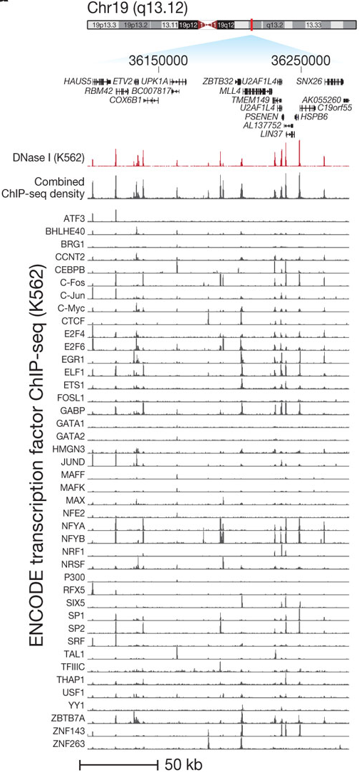
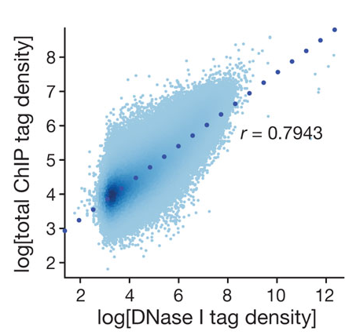
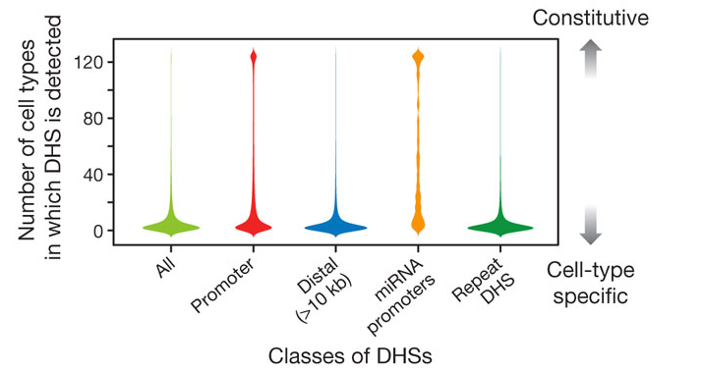
DNase hypersensitivity as a mark of functionality
Characteristic of all classes of cis-regulatory elements
Crucial indicator of cell-type-specific TSS-distal regulatory activity
Thurman et al Nature 2012

Slide 21
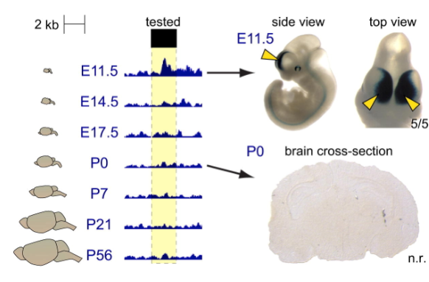
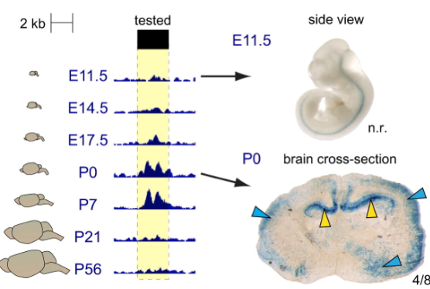
H3K27ac enrichment is predictive of cell-type-specific enhancer activity across developmental stages
Nord, et al., Cell, 2013
Notes:
For each figure: Left = H3K27ac in tested region, right = results of LacZ staining in in vivo transgenic assay
Top figure: Positive enhancer prediction at e11.5 days, (Negative control at P0)
Bottom figure: reverse of top. High H3K27ac, positive for enhancer activity at P0, negative at e11.5 days. (n.r = non-reproducible)

