Slide 1
Consortium Assessment of RNA-Seq Quality
Michael Rutenberg Schoenberg
Gerstein lab Journal Club
10/07/2014

Slide 2
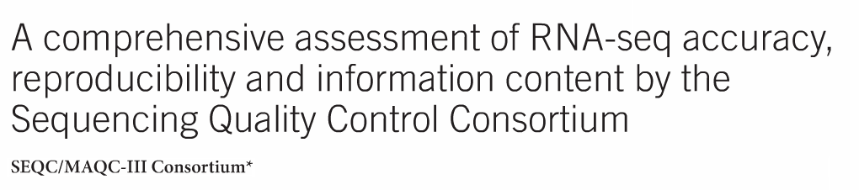
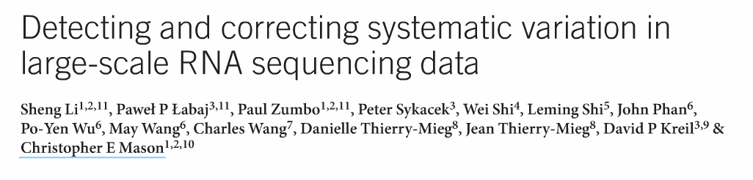
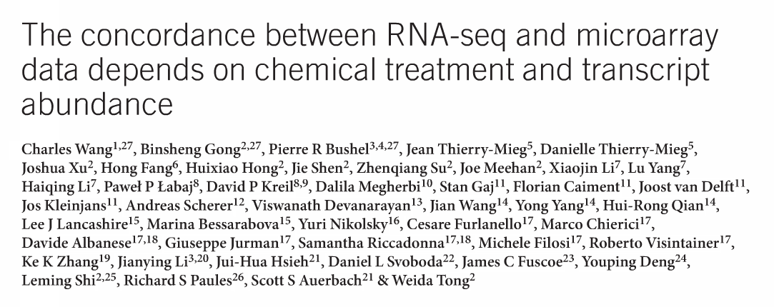
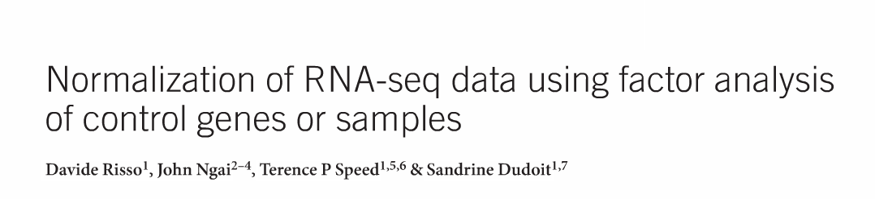
Sequence Quality Consrtium (SEQC)
Nature Biotech September 2014 Issue

Slide 3
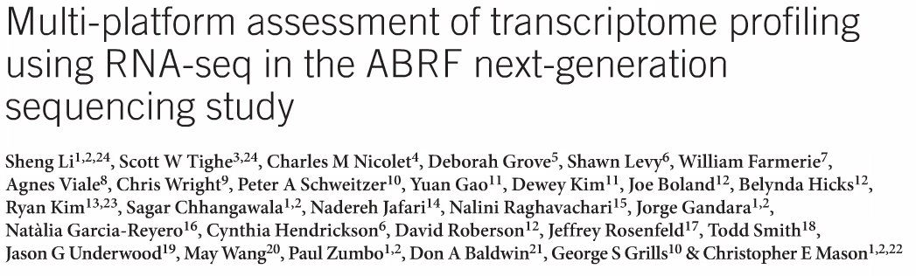
Association of Biomolecular Research Facilities
Nature Biotech September 2014 Issue

Slide 4
3 Consortia
Sequencing Quality Consortium/Microarray Quality Consortium (SEQC/MAQC)
  Third stage of an FDA study that originally focused on microarray quality
  Focus on Illumina and
Association of Biomolecular Research Facilities
  Illumina, Pac Bio, 454, and Ion Torrent
Led by Chris Mason

Slide 5
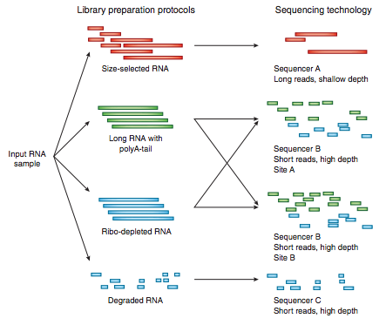
Standardized RNA Samples
(common to SEQC and ABRF)
A: Universal Human Reference RNA
B: Human Brain Reference RNA
C: 75% A, 25% B
D: 75% B, 25% A
All Samples had synthetic spike-ins (External RNA Controls Consortium)
Sequenced in replicates
Assumption: Differentially expressed genes are false positives
  Focus on finding methods that minimize variation between samples
Notes:
Stratagene's Universal Human Reference (UHR) RNA (sample A) and Ambion's Human Brain Reference RNA (sample B).

Slide 6
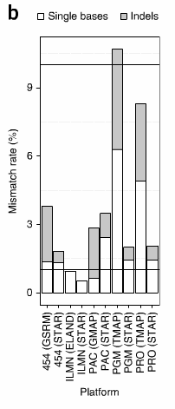
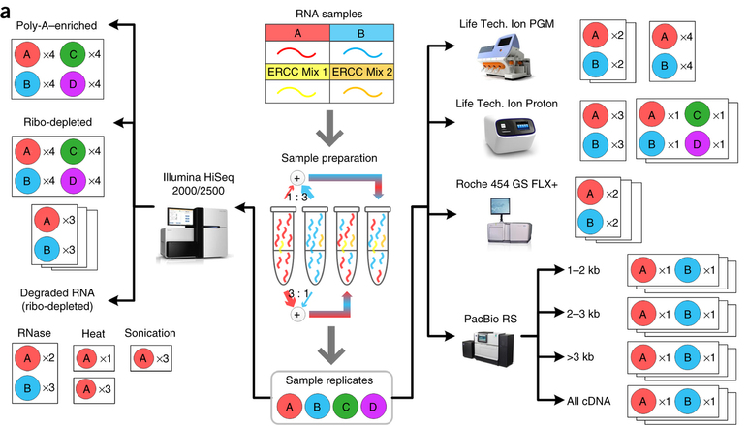
Overall study design
SOLiD Sequencing (SEQC, not ABRF)
Li et al. Nature Biotech 2014

Slide 7
Synthetic Spike-in Controls
Idea: Add synthetic RNA of known concentration to different samples with RNAs of unknown relative quantity
Normalize based on reads mapping to synthetic RNAs

Slide 8
Applications of synthetic RNA spike-ins
Global changes in gene expression
  Myc induces increase in total RNA production in tumor cells (Lin et al. Cell 2012)
Correcting noise in RNA-Seq
Single cell RNA-Seq
RNA subpopulations
  CLIP-Seq/RIP-Seq
  Subcellular RNA fractions
  Etc.

Slide 10
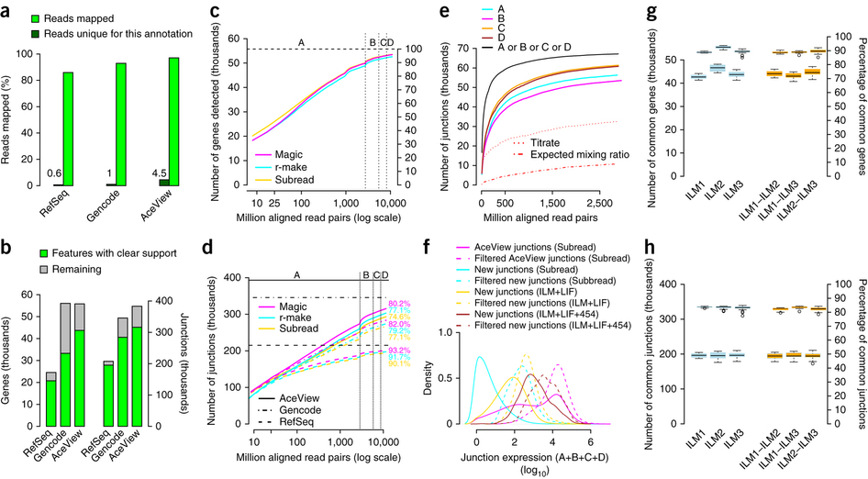
Annotations
GENCODE (v15)
  Annotation based on RNA-Seq, qPCR validation of splice junctions, and manual annotation
Aceview
  Catalog of cDNA sequences
Refseq
  Manually curated high confidence nucleotide sequences
SEQC/MAQC Consortium III Nat Biotech 2014

Slide 11
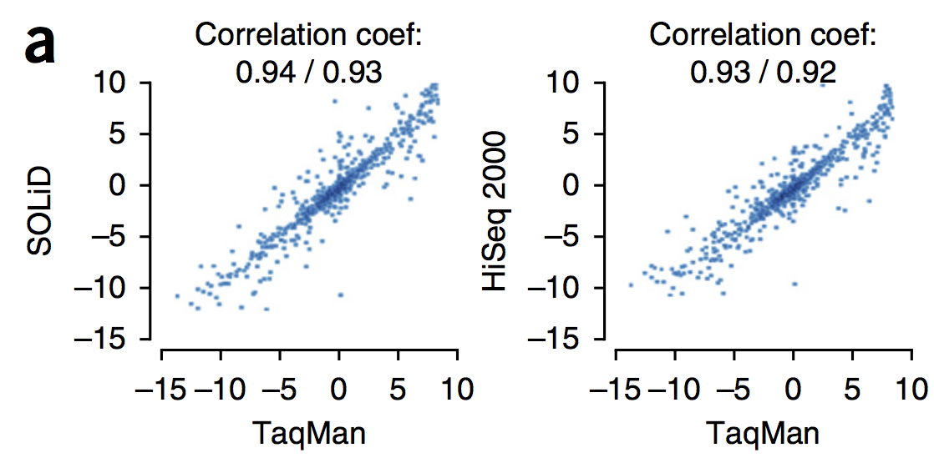
RNA-Seq matches qPCR
843 Genes, log2 ratio of expression in sample A and B

Slide 13
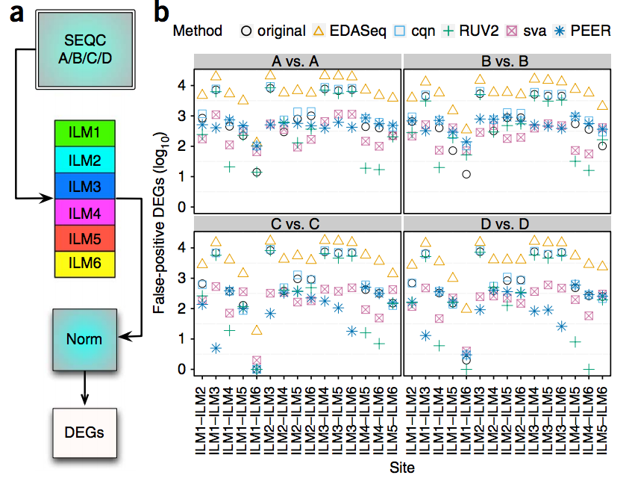
Many false positive differentially expressed genes in RNA-Seq

Slide 14
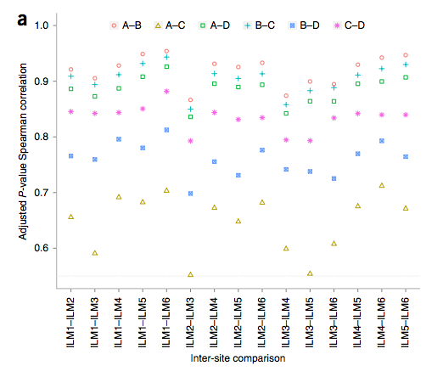
Variation between sites
Site 3 always has the worst inter-site correlation

Slide 15
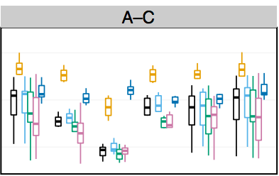
Correlations of differentially expressed genes between different samples
PEER and EDA-Seq have the highest correlations
PEER also did well for false positives and benefits
  uses information about which site samples came from

Slide 16
Association of Biomolecular Research Facilities
Focus: Comparing different sequencing platforms
Nature Biotech September 2014 Issue

Slide 17
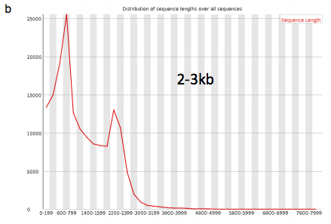
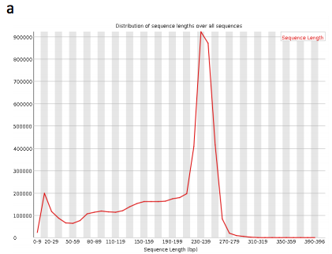
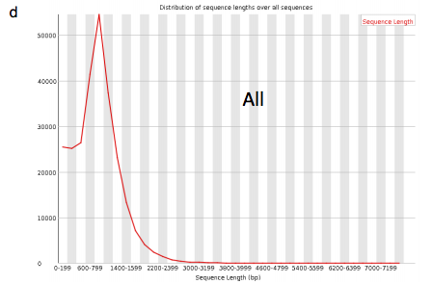
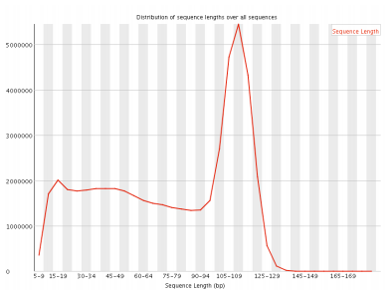
Read lengths
Illumina
  50 bp paired end
Pac Bio
  800 bp - 3kb (highly variable)
454
  mean ~550 bp, Gaussian distribution
Personal Genome Machine
  Mean: 176 bp
Ion Proton
  Mean: 81 bp

Slide 18
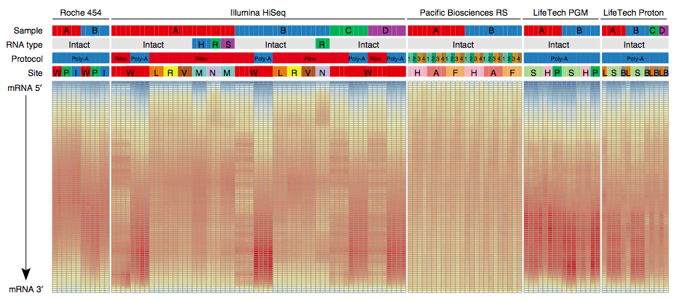
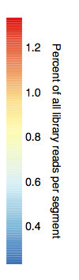
Base qualities
Notes:
Reverse transcriptase works less well at the first ~16 bases. Bias seen in all platforms, though not as much in Pac Bio.

Slide 19
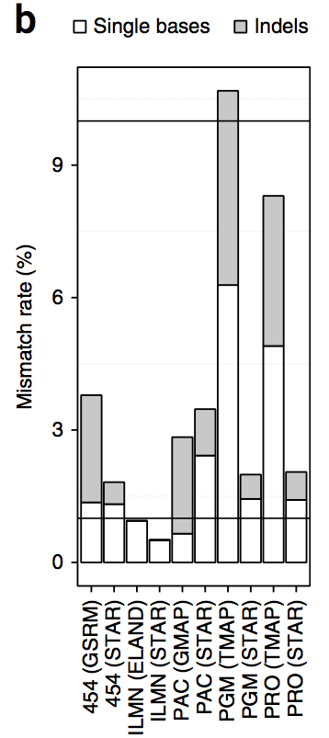
Error rates depend on aligner
90% accuracy
Aligners
  STAR – used for all platforms
  Eland – Illumina HiSeq
  TMAP – Ion Proton/Ion Personal Genome Machine
  GSRM – 454
  GMAP – Pacific Biosciences
Better performance for platform-specific aligners
99% accuracy

Slide 20
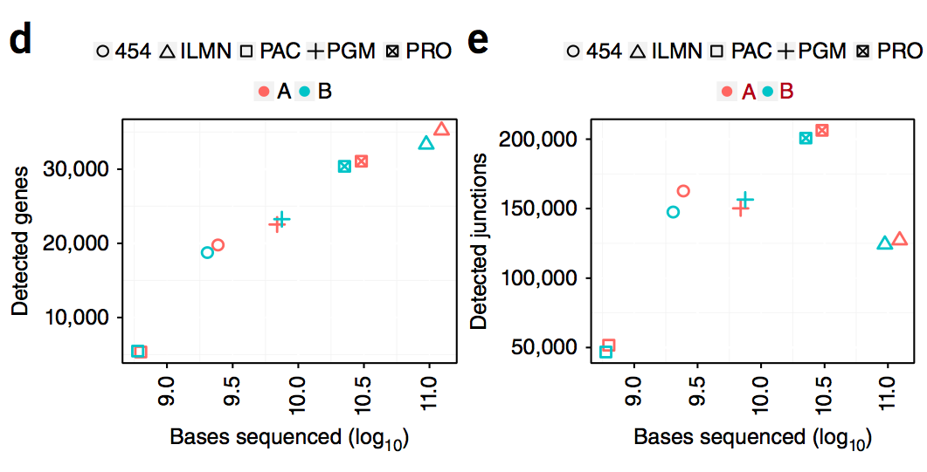
Gene/splice junction detection vs. Bases sequenced

Slide 21
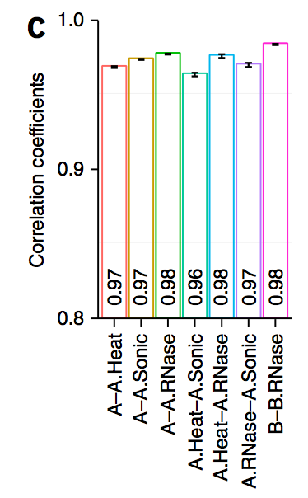
Sequencing of lower quality RNA
RNA treated by heat/sonication might be more similar to low quality RNA that has been stored for a long time, or chemically treated

Slide 22
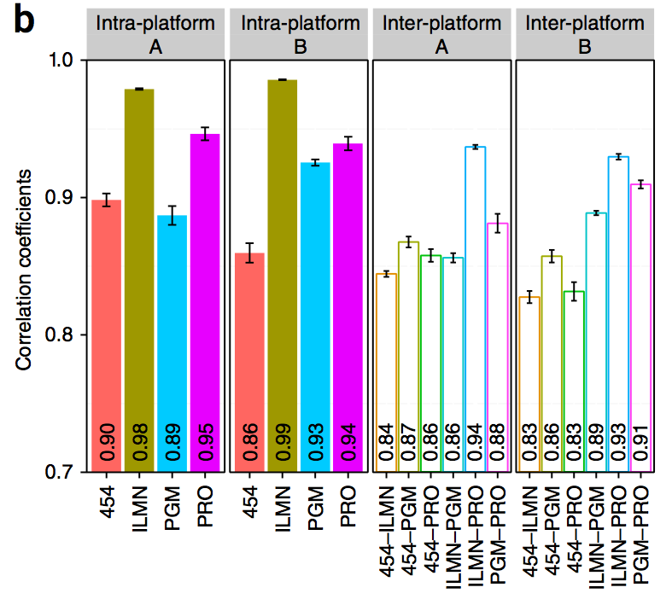
Correlation between samples by platform
Illumina better, but maybe just because of read depth
PacBio omitted because of low data

Slide 23
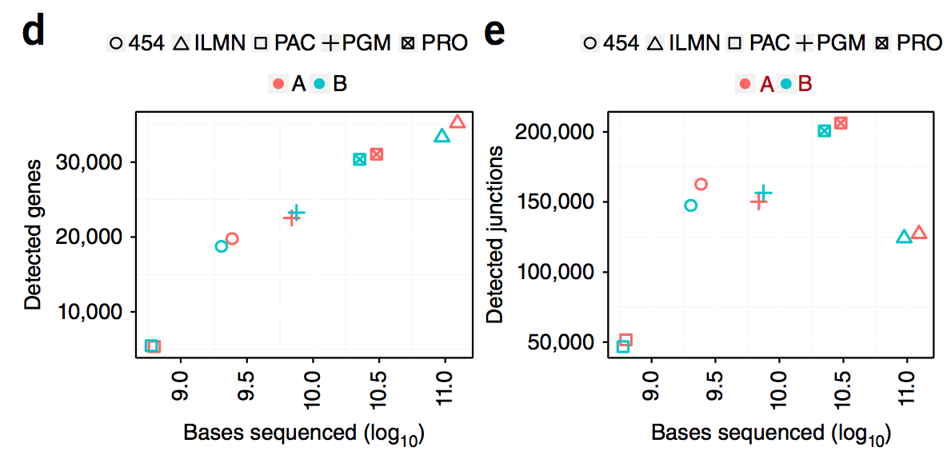
Read Depth vs. Gene/Splicing Detection

Slide 24
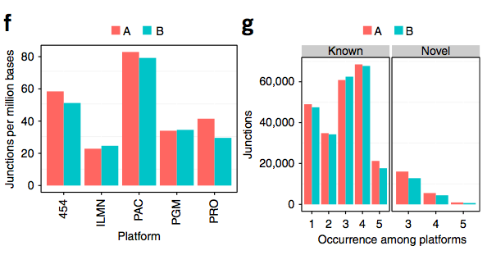
Cross-platform detection of splice junctions
Differences in junctions per million basses are due to read length

Slide 25
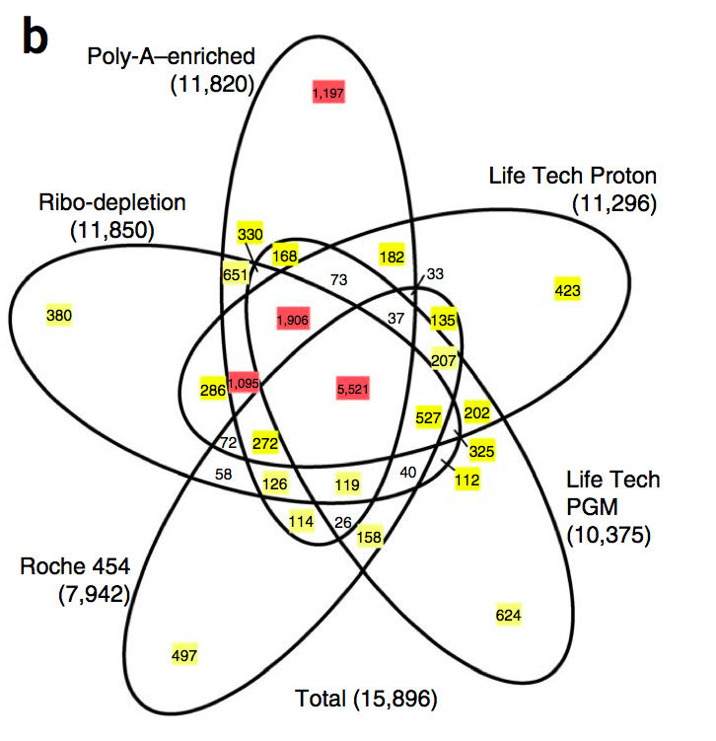
Overlap of differentially expressed genes (A vs. B) between sequencing platforms
Differential expression by limma voom

Slide 27
Synthetic Spike-in Controls
Idea: Add synthetic RNA of known concentration to different samples with RNAs of unknown relative quantity
Normalize based on reads mapping to synthetic RNAs
Pombe Genes
S_{norm} = 9.6
HPDP (old) Pulldown
Input (Total RNA-Seq)

Slide 28
Applications of synthetic RNA spike-ins
Global changes in gene expression
  Myc induces increase in total RNA production in tumor cells (Lin et al. Cell 2012)
Correcting noise in RNA-Seq
Single cell RNA-Seq
RNA subpopulations
  CLIP-Seq/RIP-Seq
  Subcellular RNA fractions
  Etc.

Slide 29
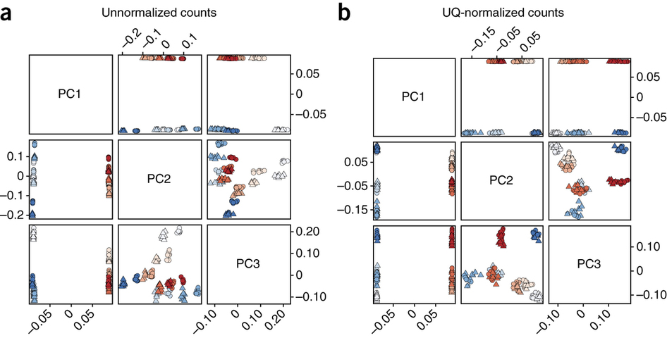
PCA: 16 replicates of two human RNA samples (red/blue)
PC 2/3 do not distinguish biological samples!

Slide 30
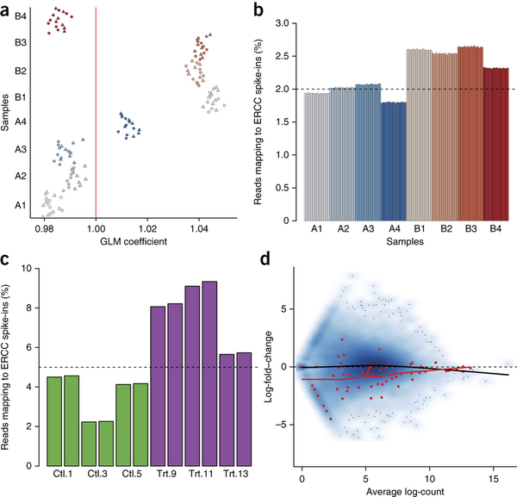
Do spike-in controls behave independently of their associated biological samples?

Slide 31
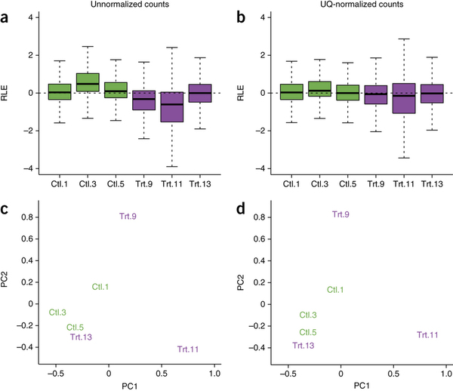

Slide 32
Outlook
SEQC is an excellent data set for RNA-Seq tool development
Spike-ins may be helpful in correcting for library preparation biases in RNA-Seq

Slide 33
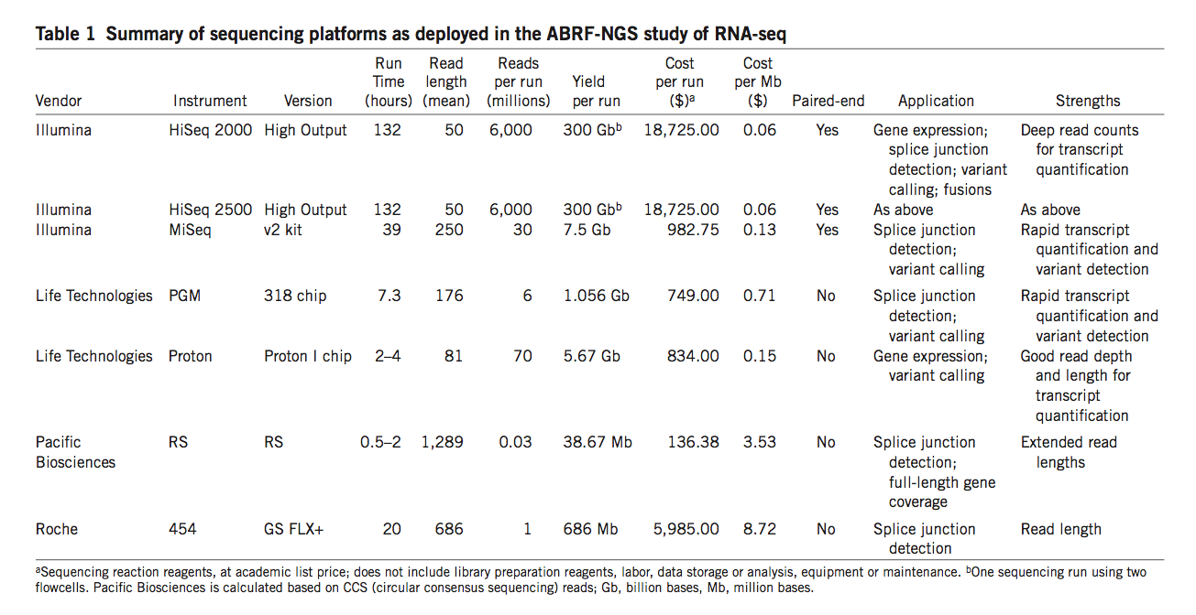
Cost of Sequencing

