Slide 1
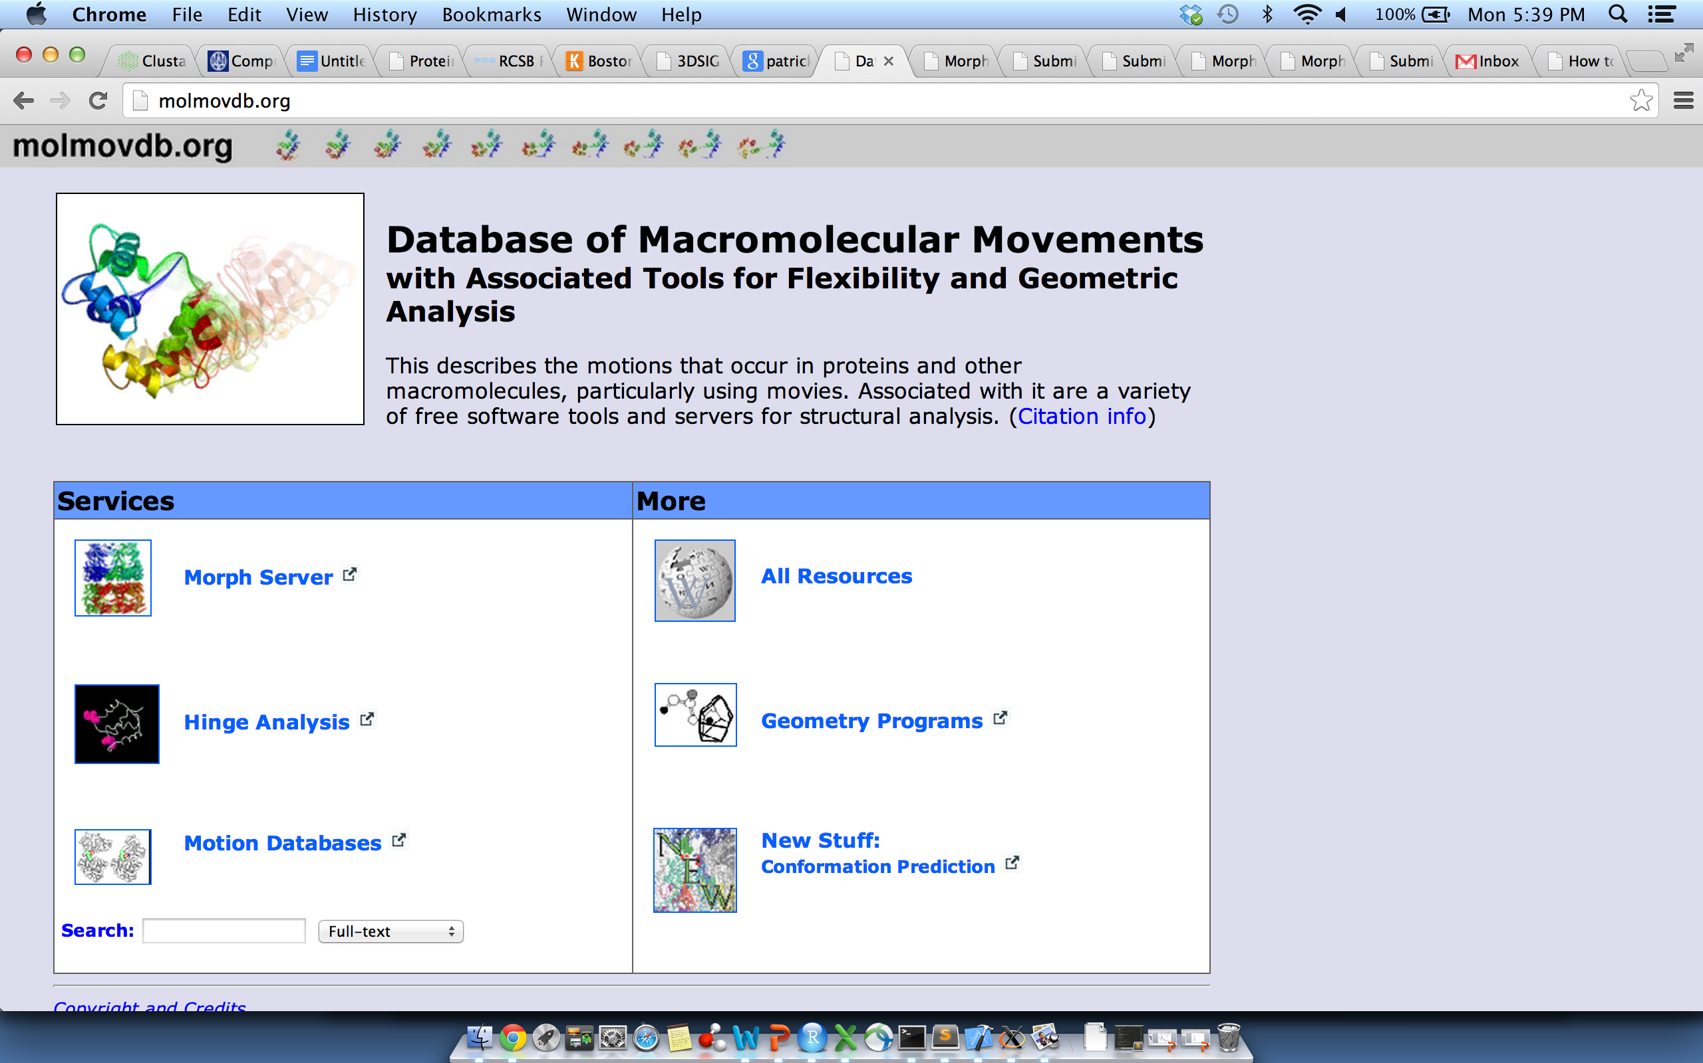
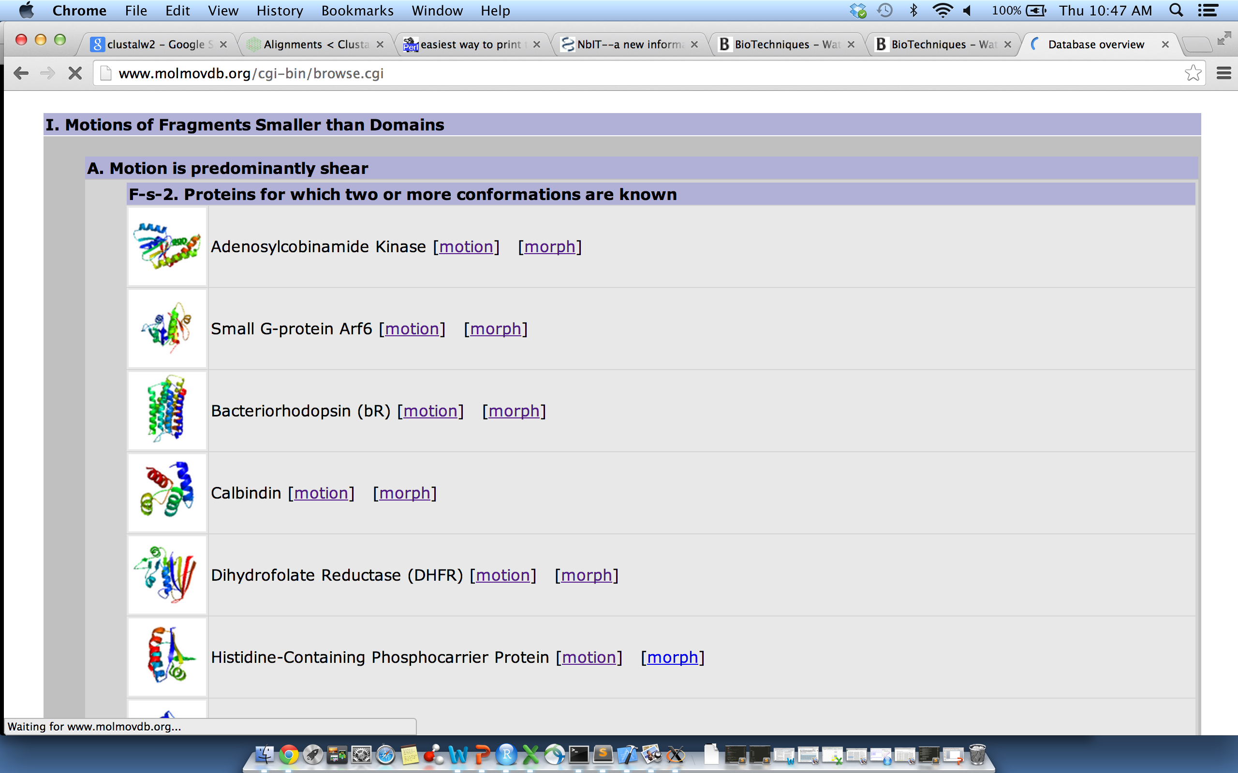
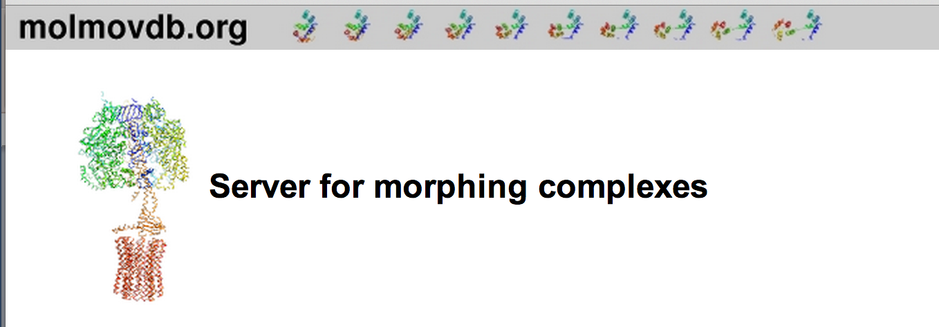
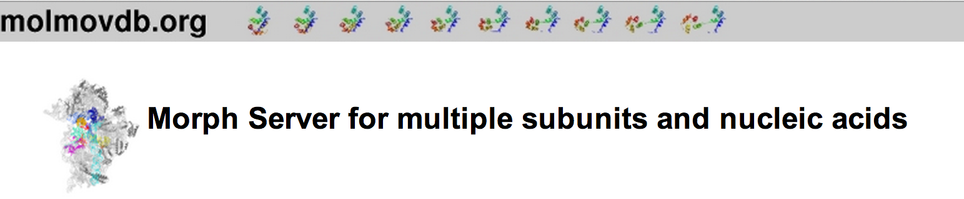

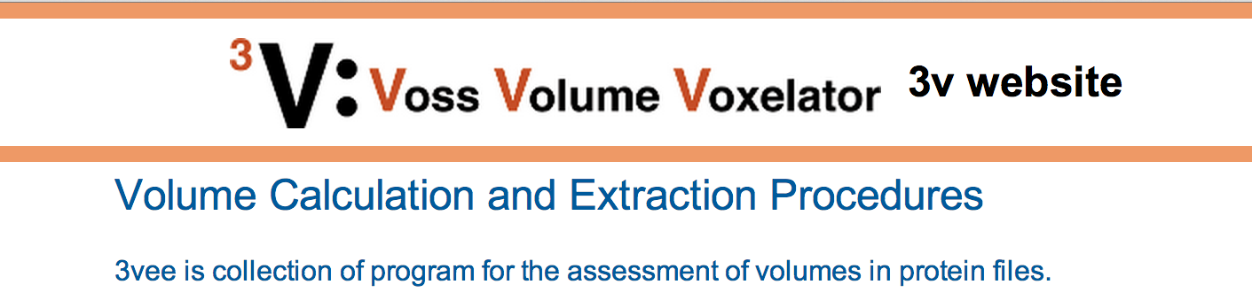
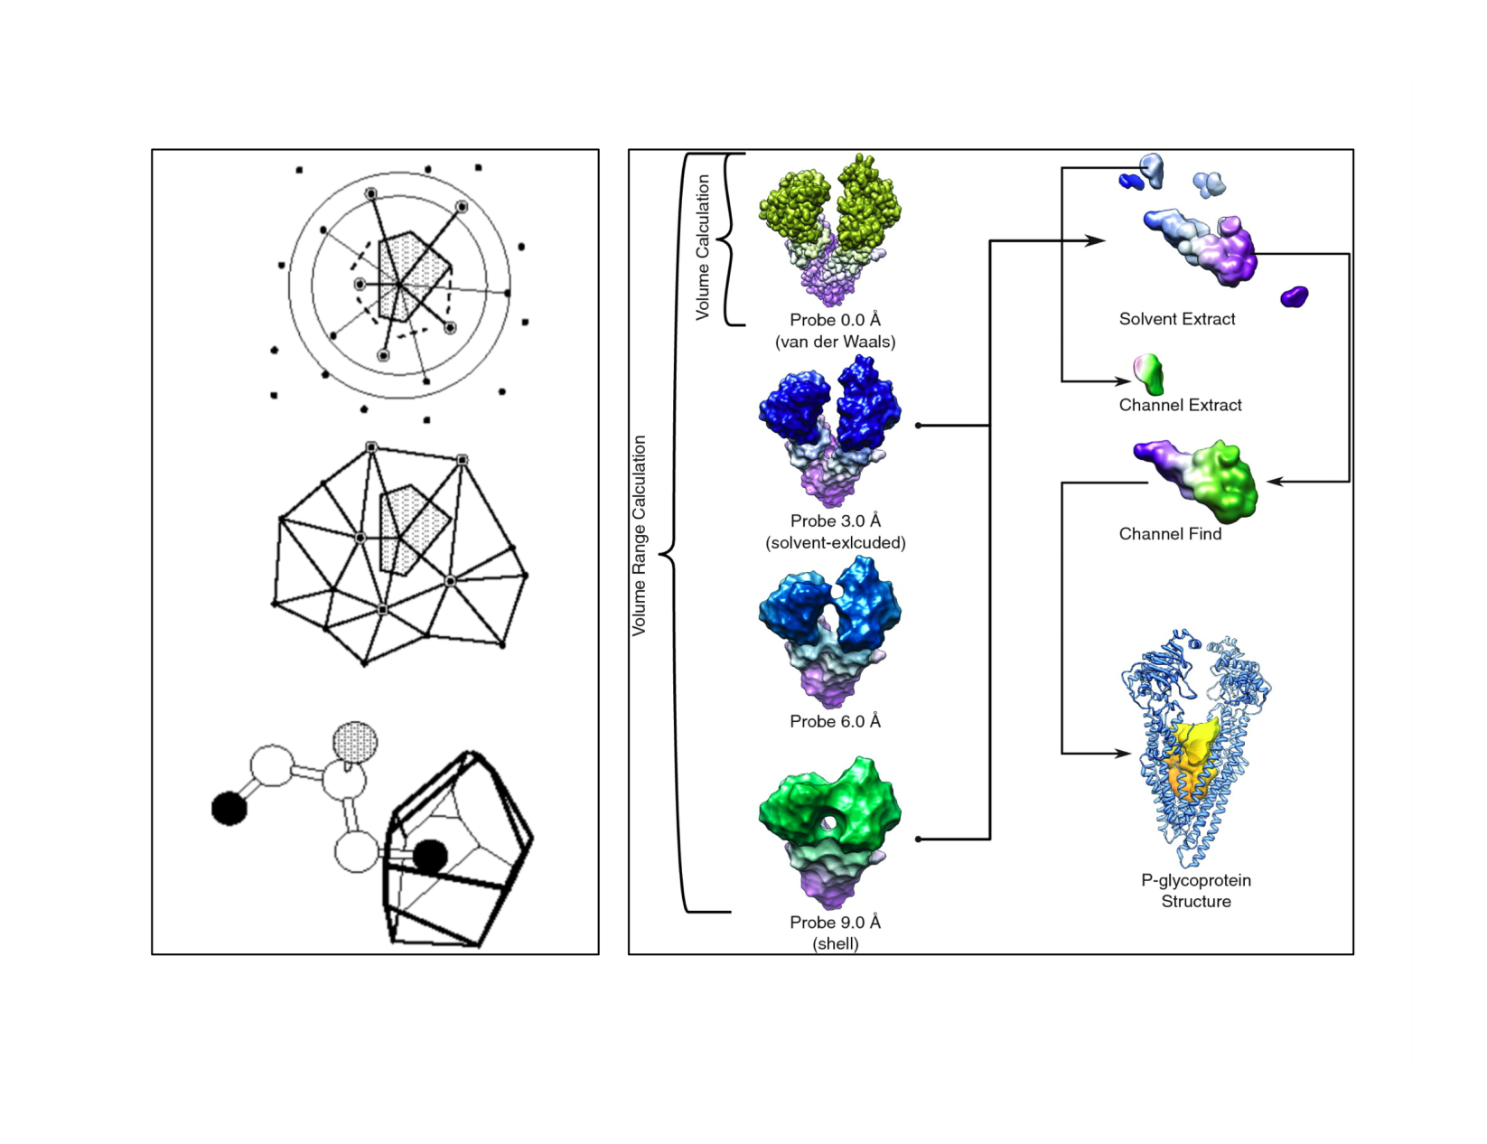
Movies of Conformational Changes
Database of Alternative Conformations
Quantifying Internal Packing of Residues
Identification of Protein Cavities

Slide 2
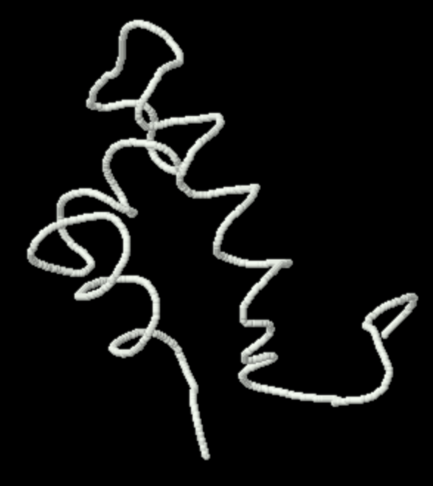

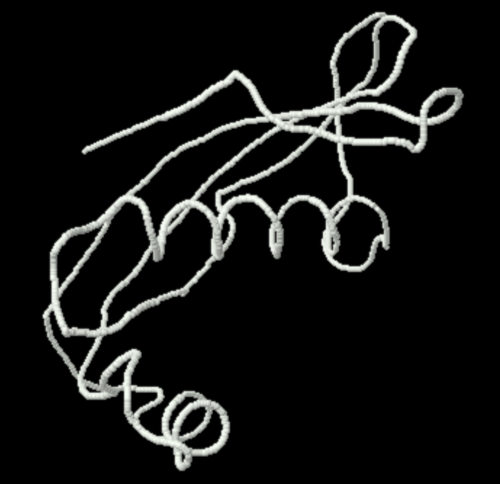
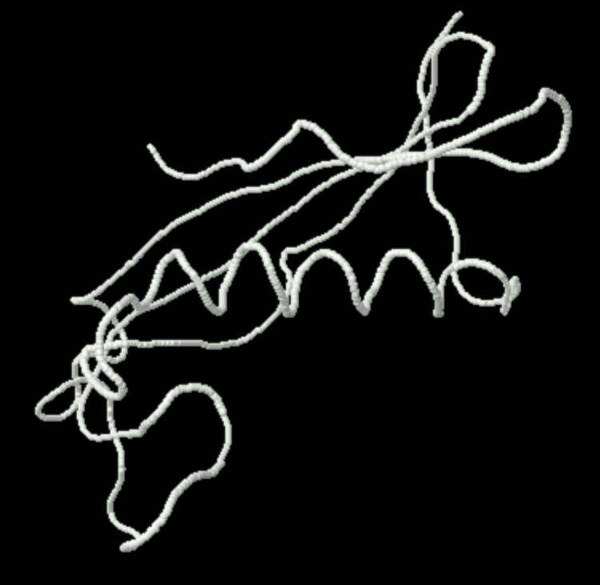
Alternative Energetic Wells or the Same Basin?
Purine repressor
(1PRV, 1PRU)
Cystatin
(1CEW, 1A67)
Notes:
Purine repressor: 1prv, 1pru
Cystatin: 1cew –> 1a67

Slide 3
Renewed interest in allostery
  Relevance in the context of human disease
  Growing volume of available data on allosteric systems
  Allostery as a basic framework for understanding proteins in general
Motlagh, Hesam N., et al. Nature (2014)
Smock, Robert G., and Lila M. Gierasch. "Sending signals dynamically." Science 324.5924 (2009): 198-203.
3

Slide 4
The growth rate of novel fold discovery has not kept pace with the growth rate of novel structure discovery

Slide 5
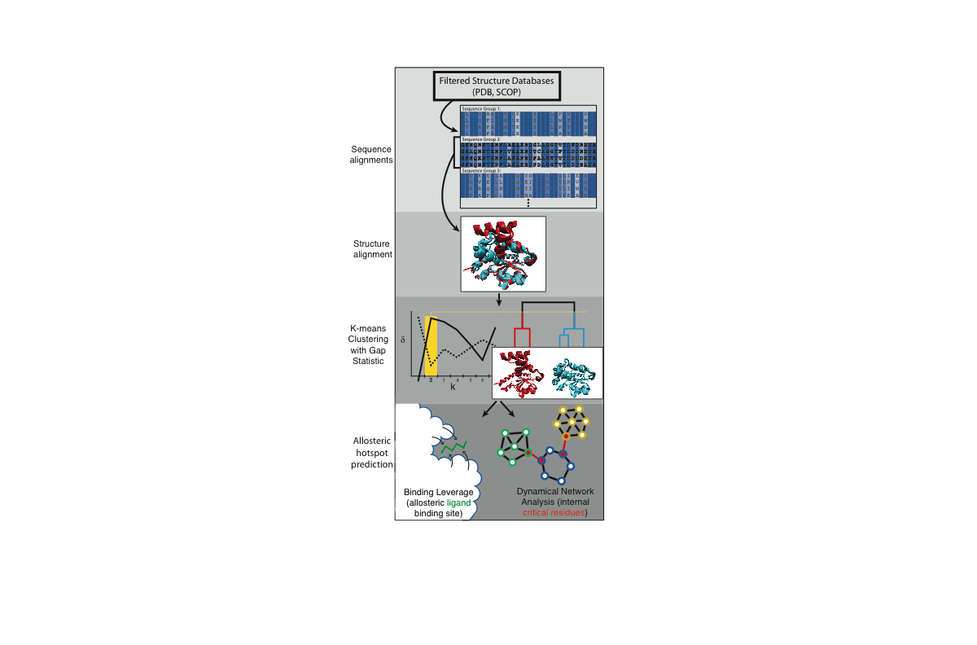

Slide 6
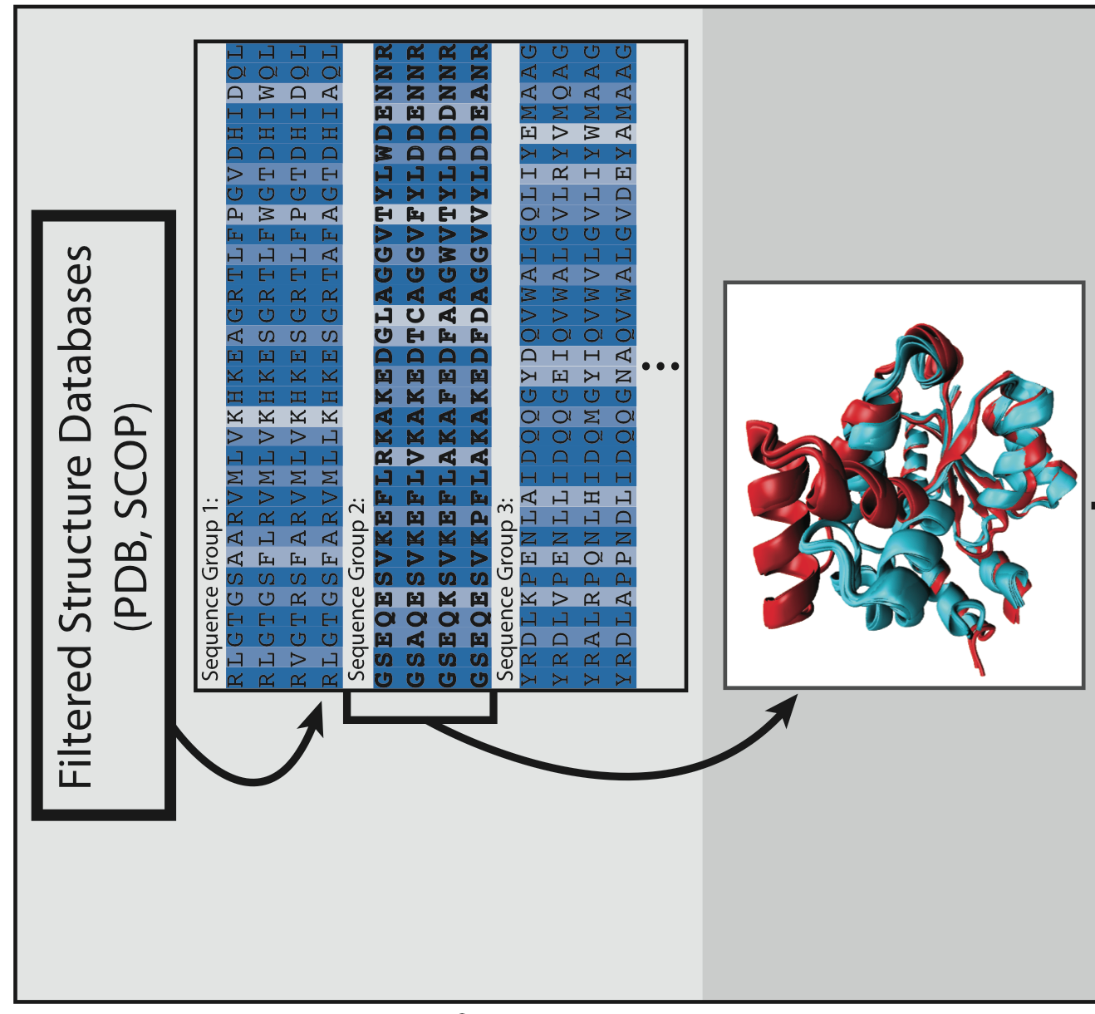
Processing Raw Data: Sequence & Structure Alignments

Slide 7
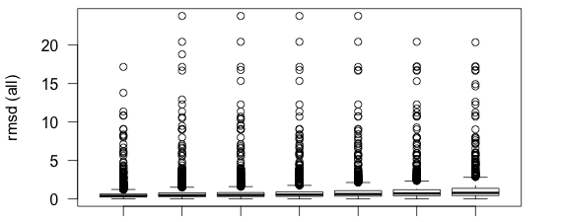
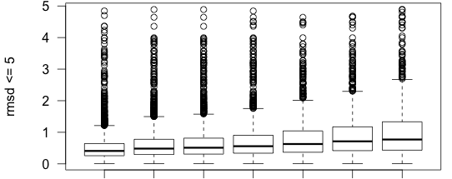
RMSD vs. Sequence Identity
Av: 0.60 0.75 0.78 0.86 0.98 1.10 1.24
Av: 0.53 0.64 0.67 0.73 0.81 0.90 1.00
Seq. ID 100 95 90 70 50 40 30
100 95 90 70 50 40 30
Notes:
RMSD distributions for the set of all available protein domains (criteria: resolution <= 3.0 A, R-Free <= 0.28, at least 3 crystal structures available)

Slide 8
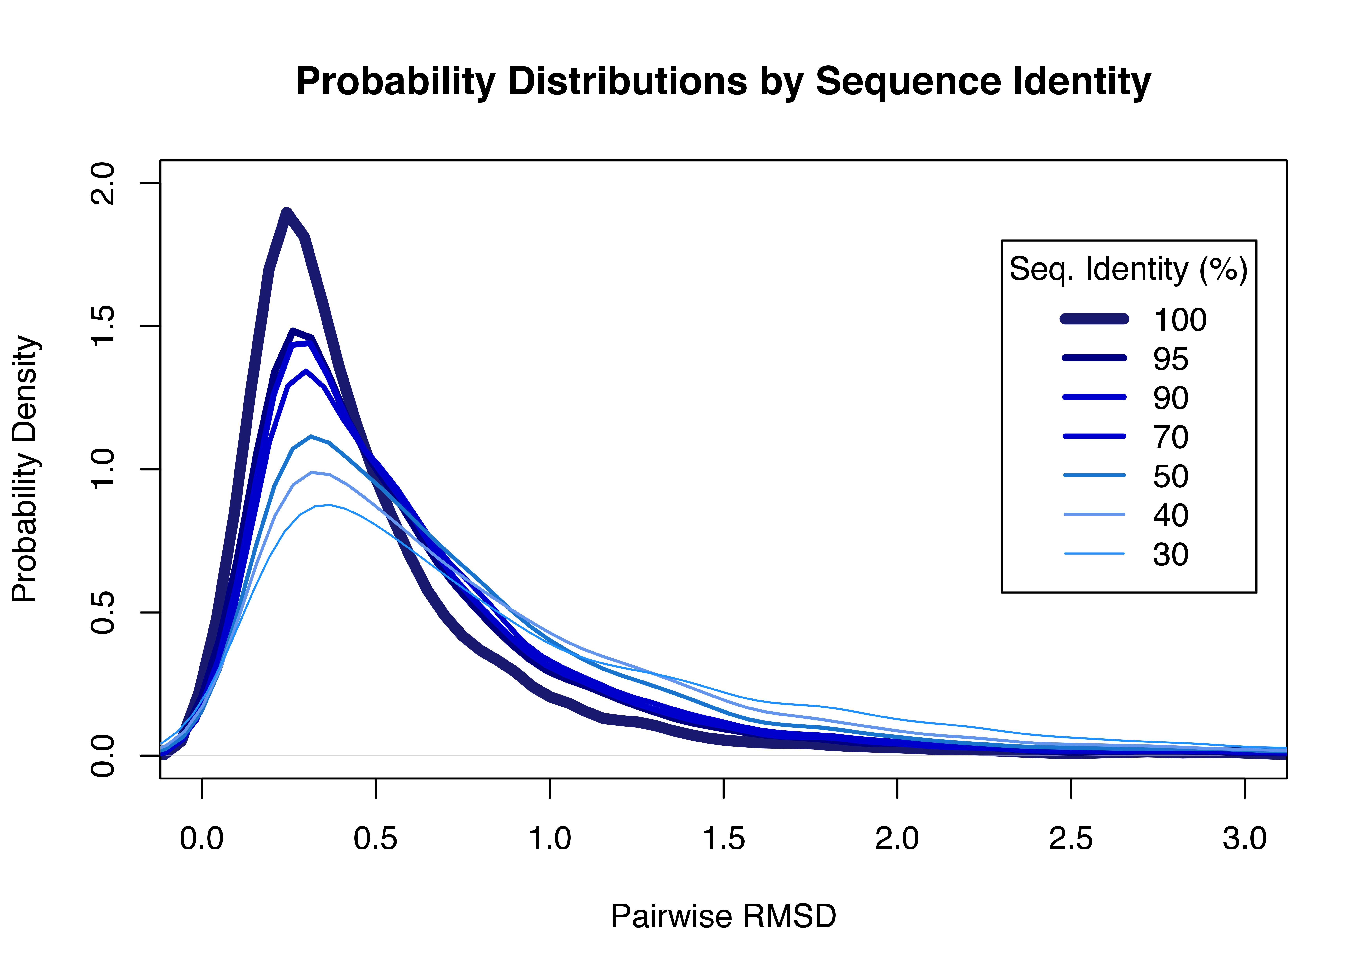

Slide 9
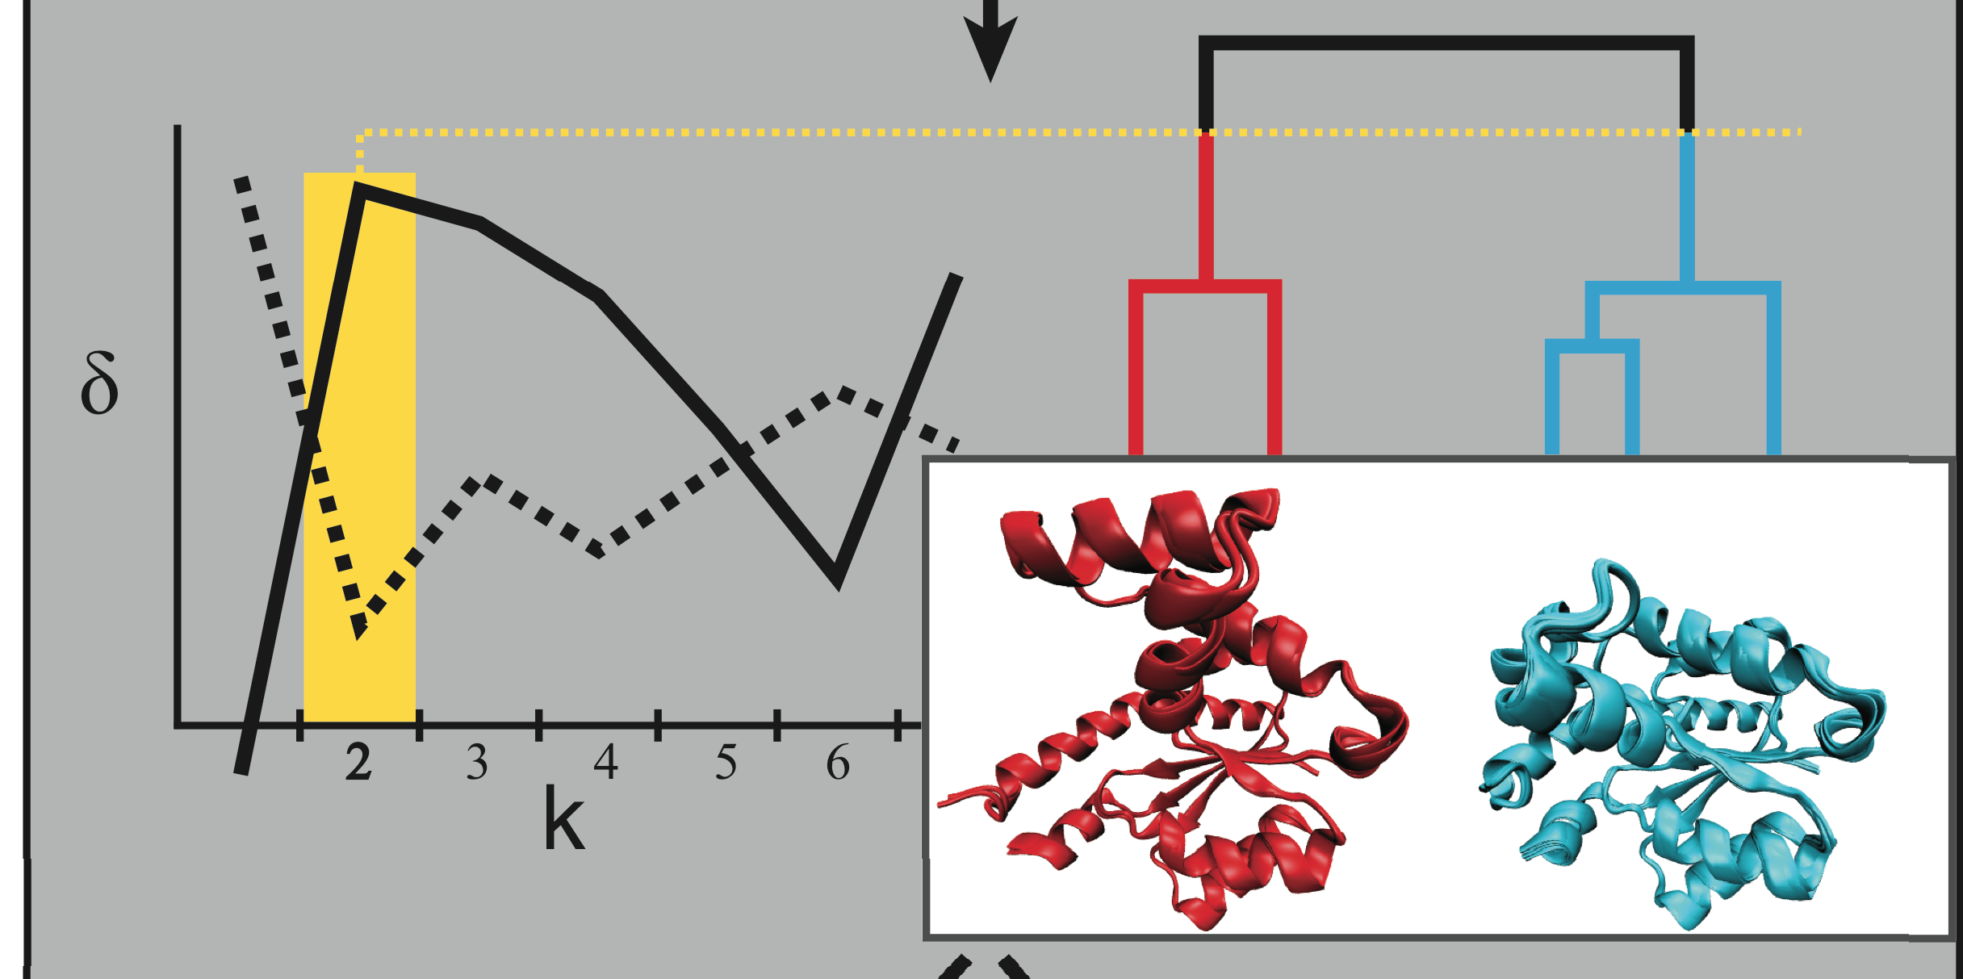
Automated Identification of Alternative Biological States

Slide 10
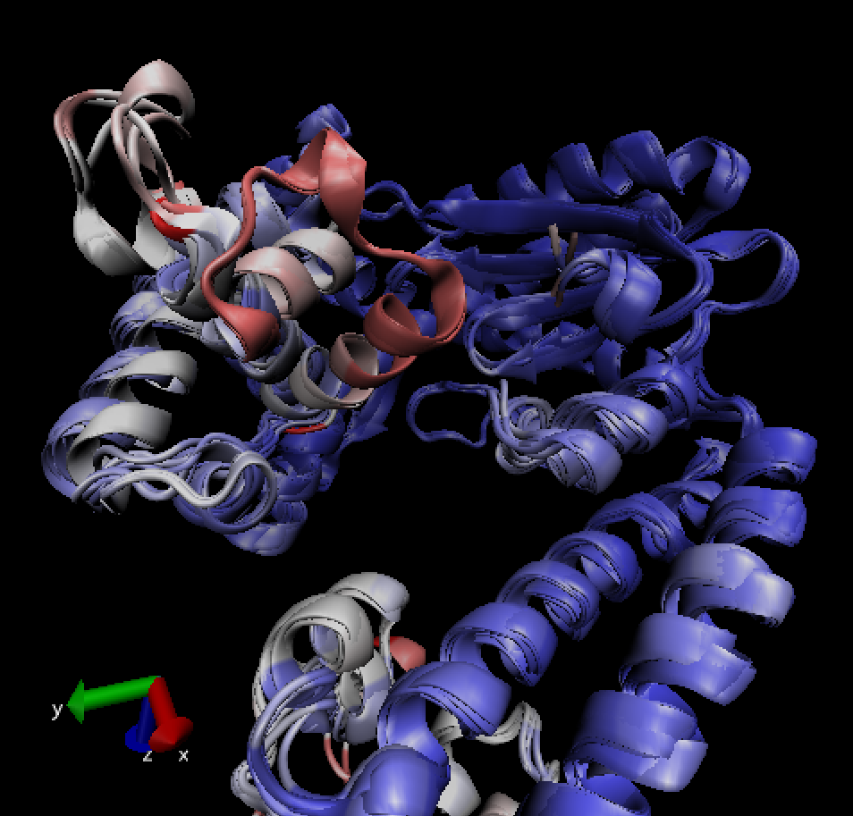
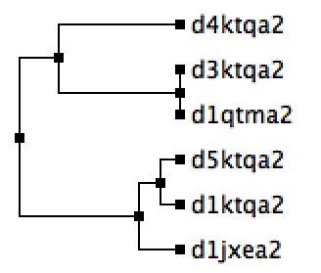
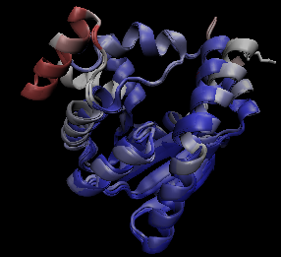
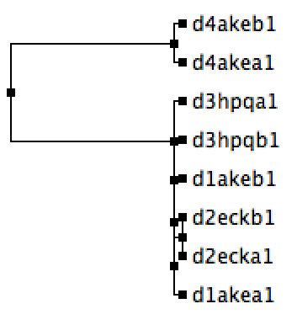
Bound to DNA
DNA Pol I
Apo
Apo
Adenylate
Kinase
Holo
Notes:
Eliminate this slide? – put as sub-fig in pipeline slide?

Slide 11
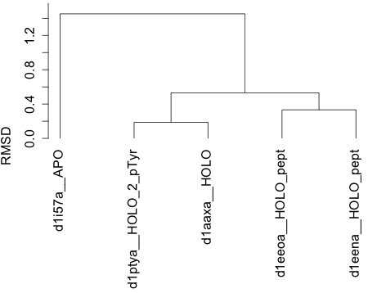
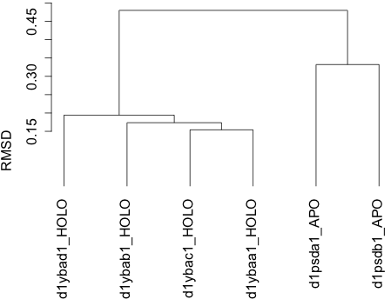
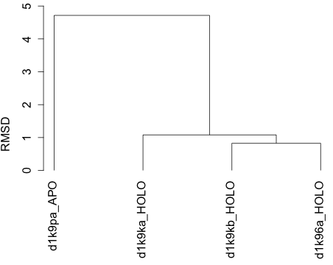
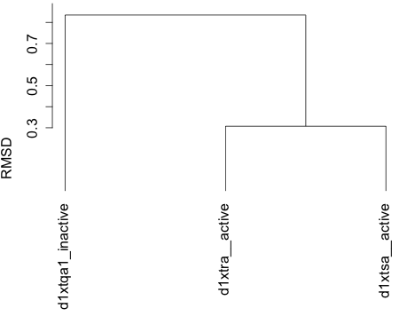
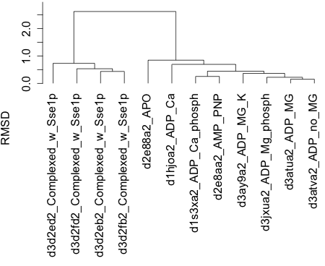
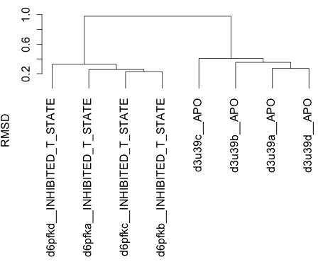
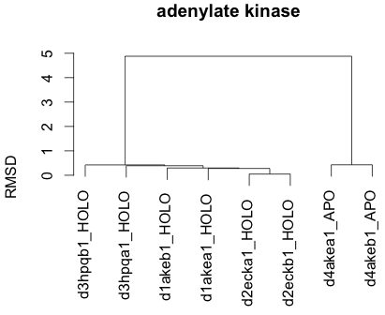
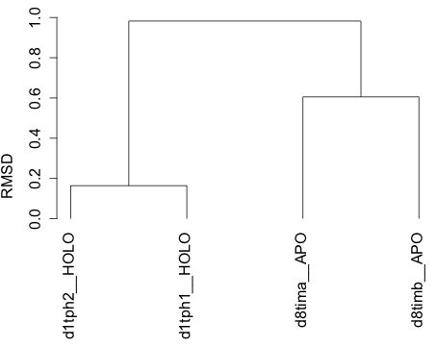
Alternative Bio States in Canonical Systems
Notes:
Little difference btwn qh & rmsd

Slide 12
Results for Annotated Allosteric Database
Criteria: All ASD proteins such that:
> at least 2 different PDBs
> at least 4 different SCOP domains (ie, min size for cluster is 4)
> these SCOP domains satisfy the criteria:
+ x-ray structures only, resolution < 2.8, R-Free < 0.28
> includes at least two cases for ligand status [“Yes” and “No”]
> allostery type (defined by ASD) is one of the following:
Allosteric activation by substrate
Allosteric competitive model
Allosteric switch
Harmonic oscillator model
Hinge
Induced allostery
Induced fit mechanism
Induced-fit model
Induced-fit model; Open-Close
Koshland-Nemethy-Filmer model (KNF model)
Ligand-induced conformational change
Morpheein model
Open-Close
Open-Close; Nested subunit-subunit interactions
R-T transition
R-T transition; Nested subunit-subunit interactions; Oligomerization
Symmetry model (MWC model)
Two sequential conformational changes
ASD: 56% (K=1)
SCOP: 59% (K=1)

Slide 13
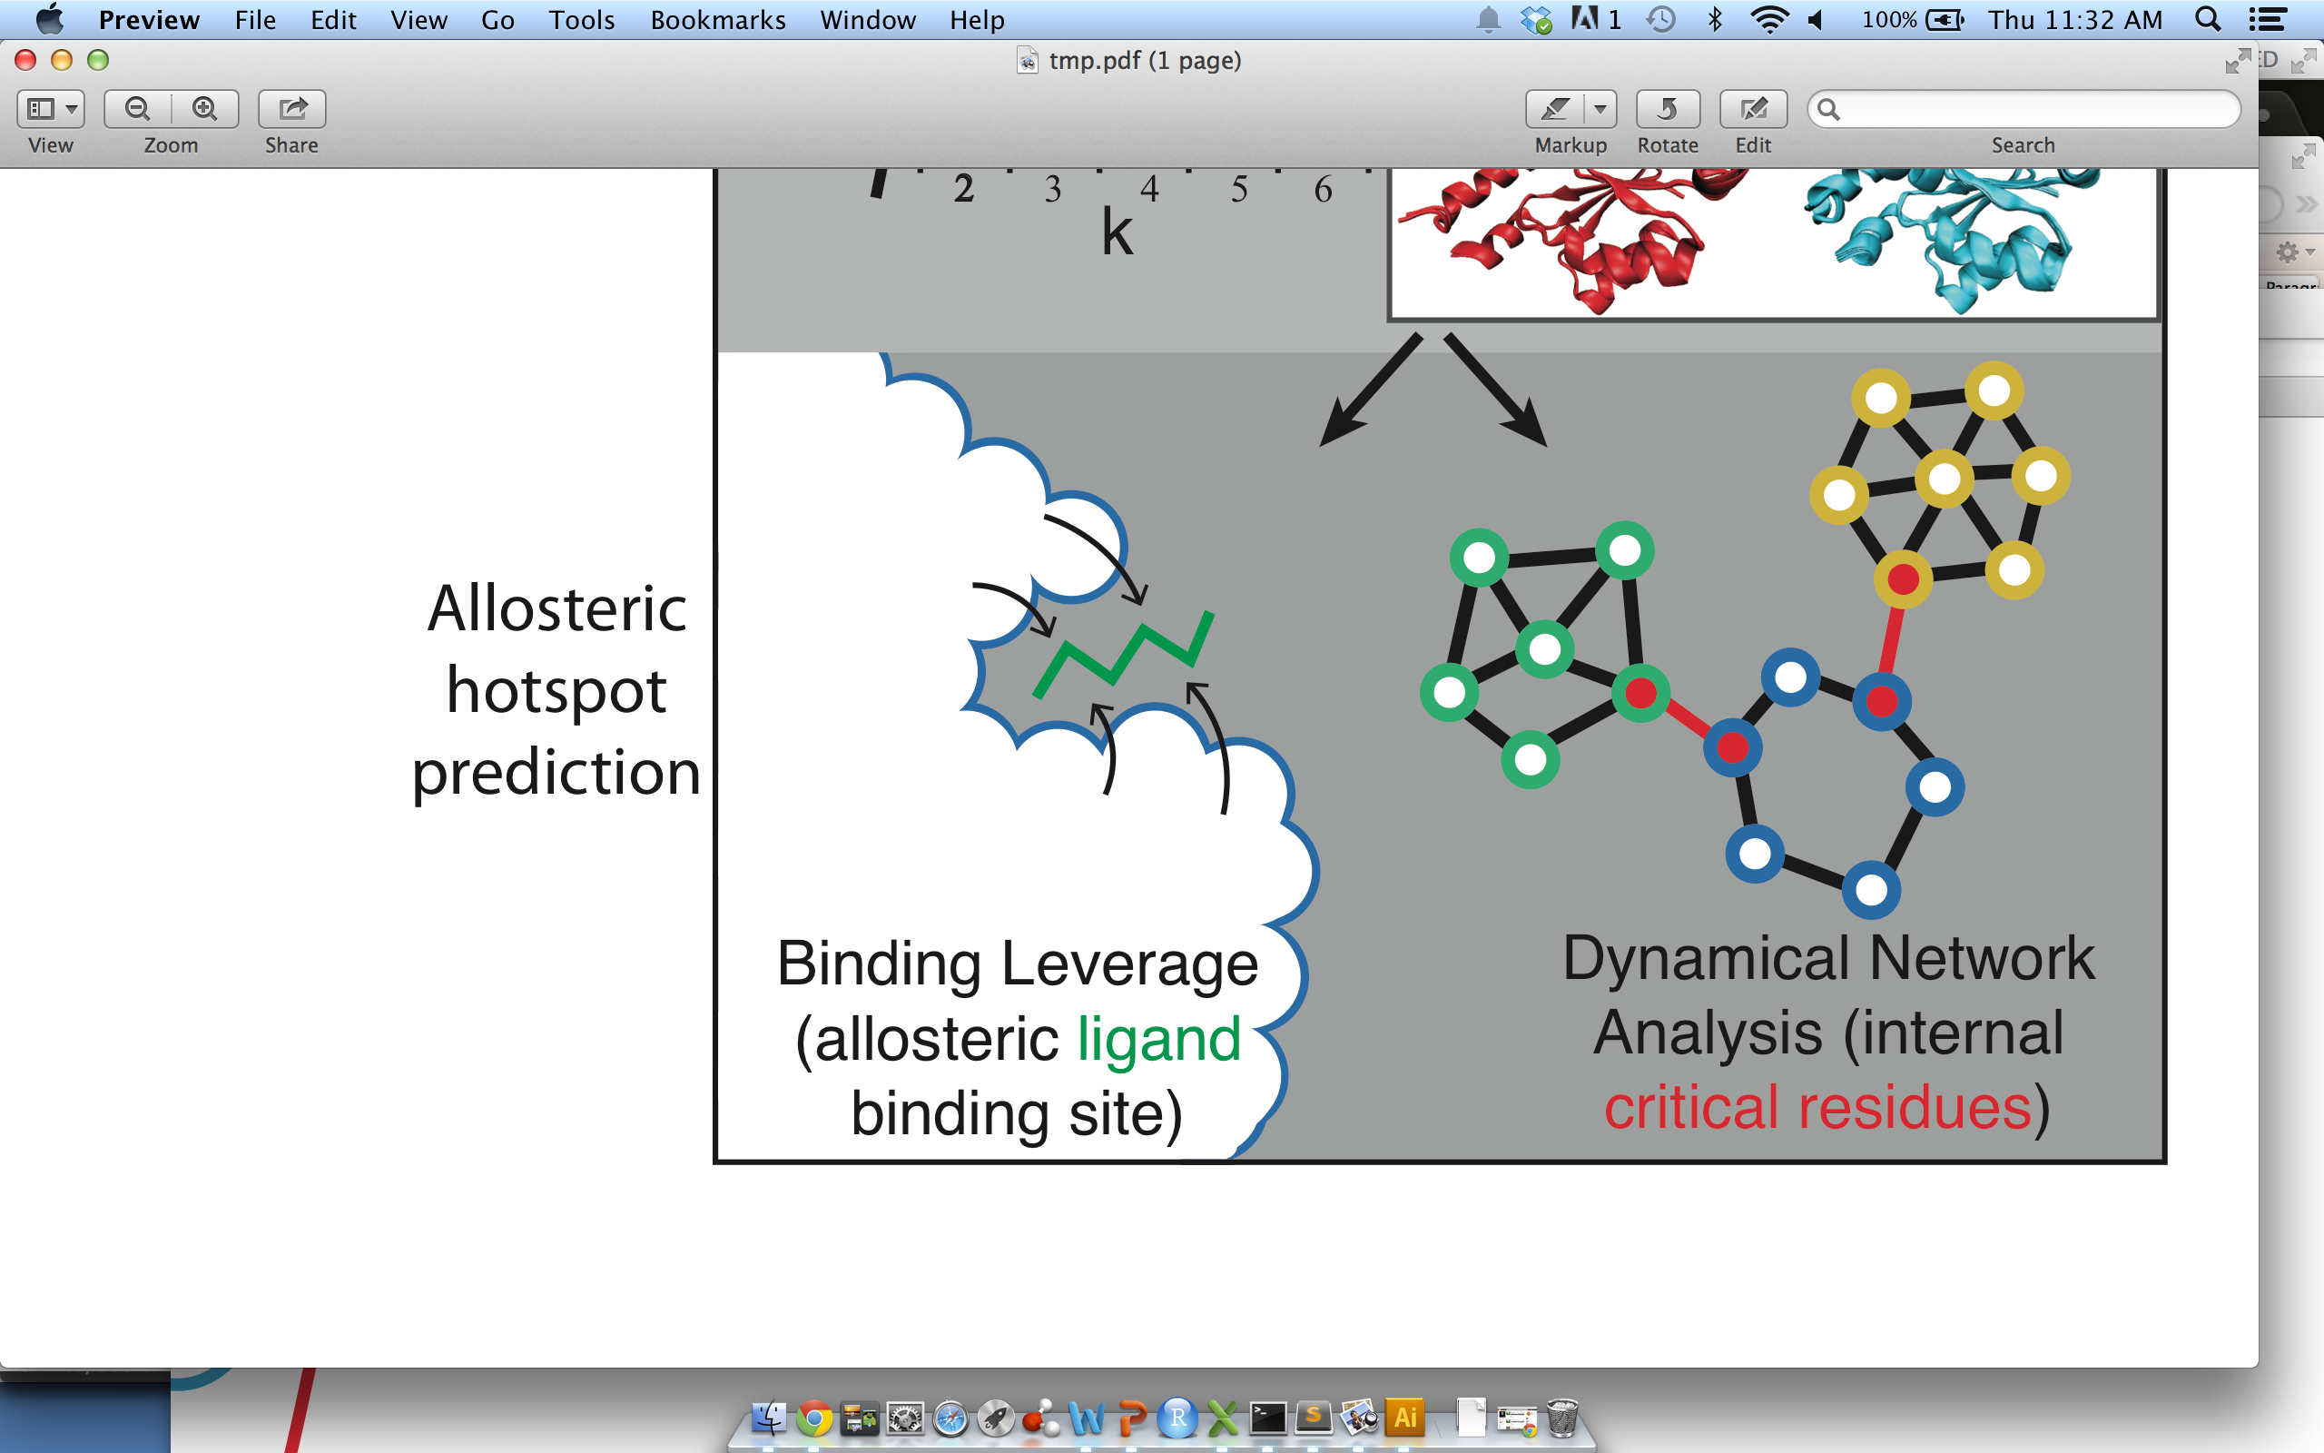
Identification of Allosteric Hotspots: Binding Leverage

Slide 14
Binding Leverage as a means of predicting allosteric sites
  Can be applied to alternative crystal structures or ANMs
  May identify known biological or latent allosteric sites
  Improvement with heavy-atom model over alpha-carbon atom model
Mitternacht S, et al. PLoS Comp Biol (2011)
Chennubhotla C. et al. Phys. Biol. (2005)
Mitternacht S, et al. PLoS Comp Biol (2011)

Slide 15
Basic Steps for Performing Binding Leverage Calculations
  Docking simulations to generate probe locations
  Change protein’s atomic coordinates (ex: ANMs)
  Calculate and rank probe locations by binding leverage -- use a model with all heavy atoms.
  Compare resultant ranked sites to known ligand binding sites
  Visualize predictions on protein surface
Chennubhotla C. et al. Phys. Biol. (2005)
Mitternacht S, et al. PLoS Comp Biol (2011)

Slide 16
  Docking simulations to generate candidate probe locations
  Use anisotropic network models to change protein’s atomic coordinates
Chennubhotla C. et
al. Phys. Biol. (2005)
  Calculate and rank probe locations by their ability to perturb large-scale conformational changes.
  Compare resultant ranked sites to known ligand binding sites
Mitternacht S, et al. PLoS Comp Biol (2011)
Notes:
Use as flowchart style

Slide 17
  Docking simulations to generate candidate probe locations
          Employ a model in which all heavy atoms are used in Monte Carlo docking simulations, and optimize parameters in interaction scoring function
  Use anisotropic network models to change protein’s atomic coordinates
Chennubhotla C. et
al. Phys. Biol. (2005)
  Calculate and rank probe locations by their ability to perturb large-scale conformational changes.
  Compare resultant ranked sites to known ligand binding sites
Mitternacht S, et al. PLoS Comp Biol (2011)
Notes:
Use as flowchart style

Slide 18
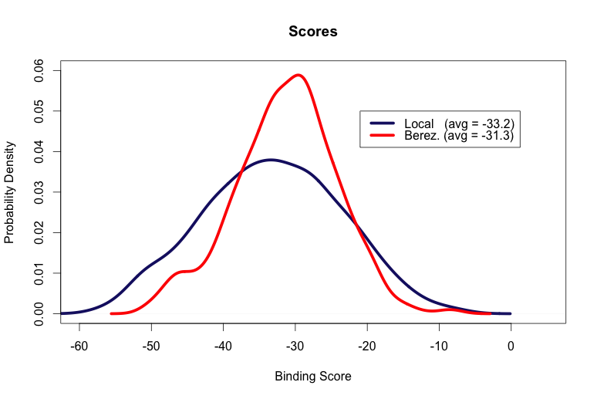
Notes:
Distributions of average pairwise QH values for sequence clusters at varying levels of sequence identity. Average values for each sequence identity level are provided at the top.

Slide 19
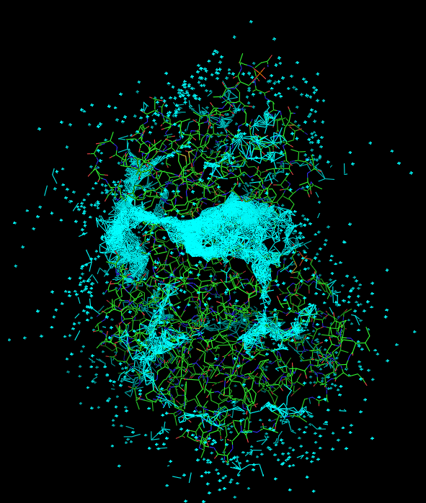
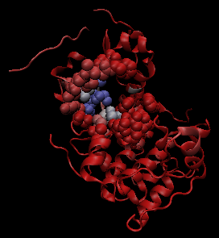
Protein Kinase A (pdb 1J3H)
Notes:
Pka (1j3h)

Slide 20
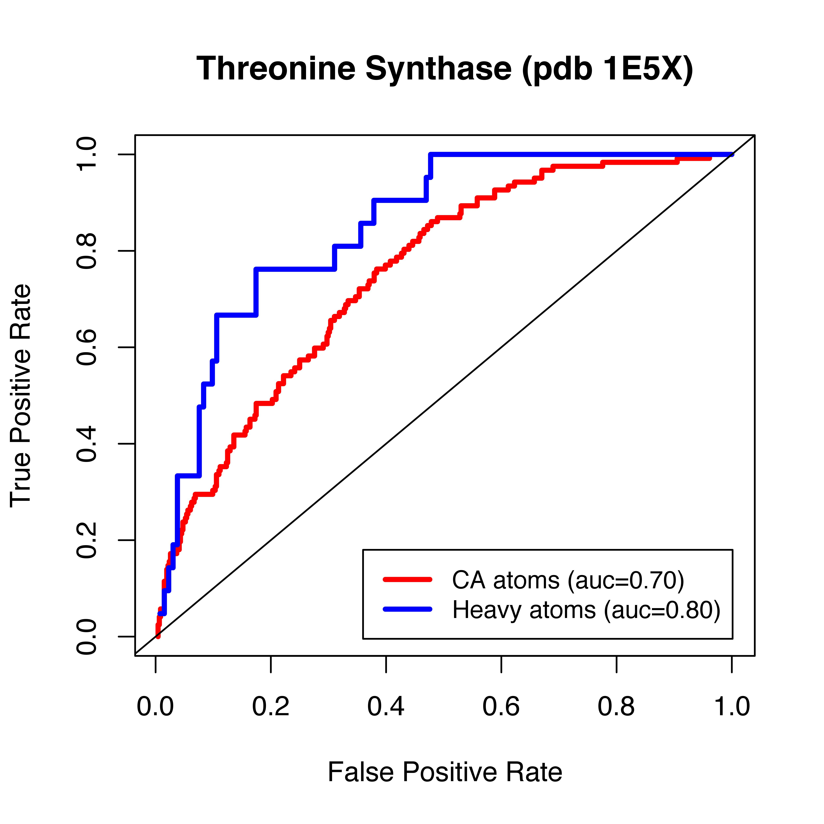
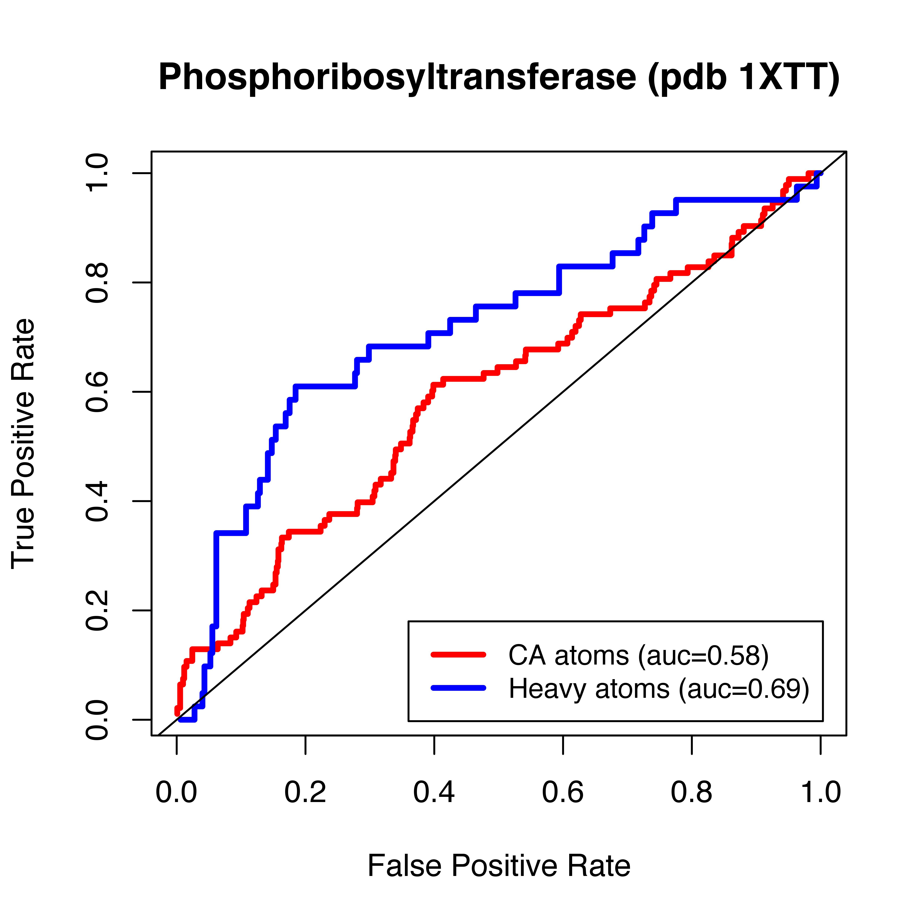

Slide 21
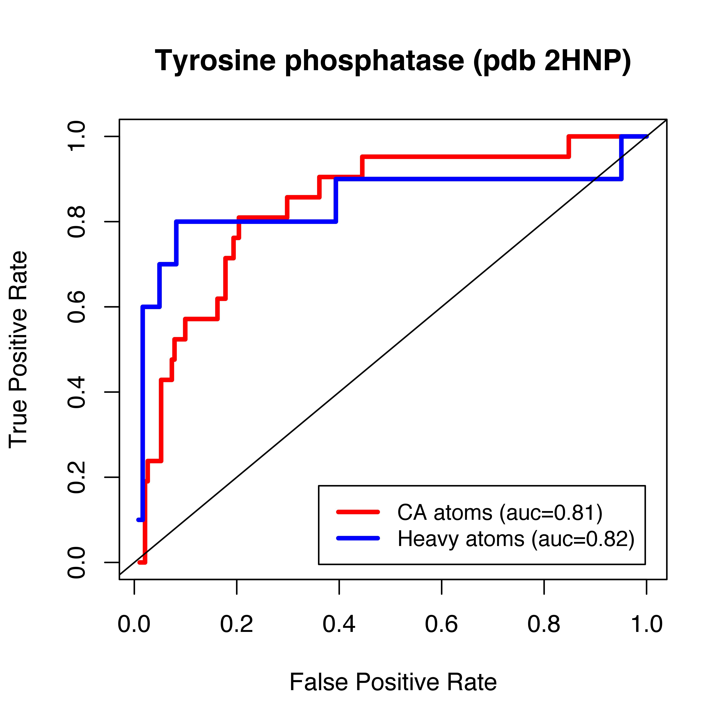
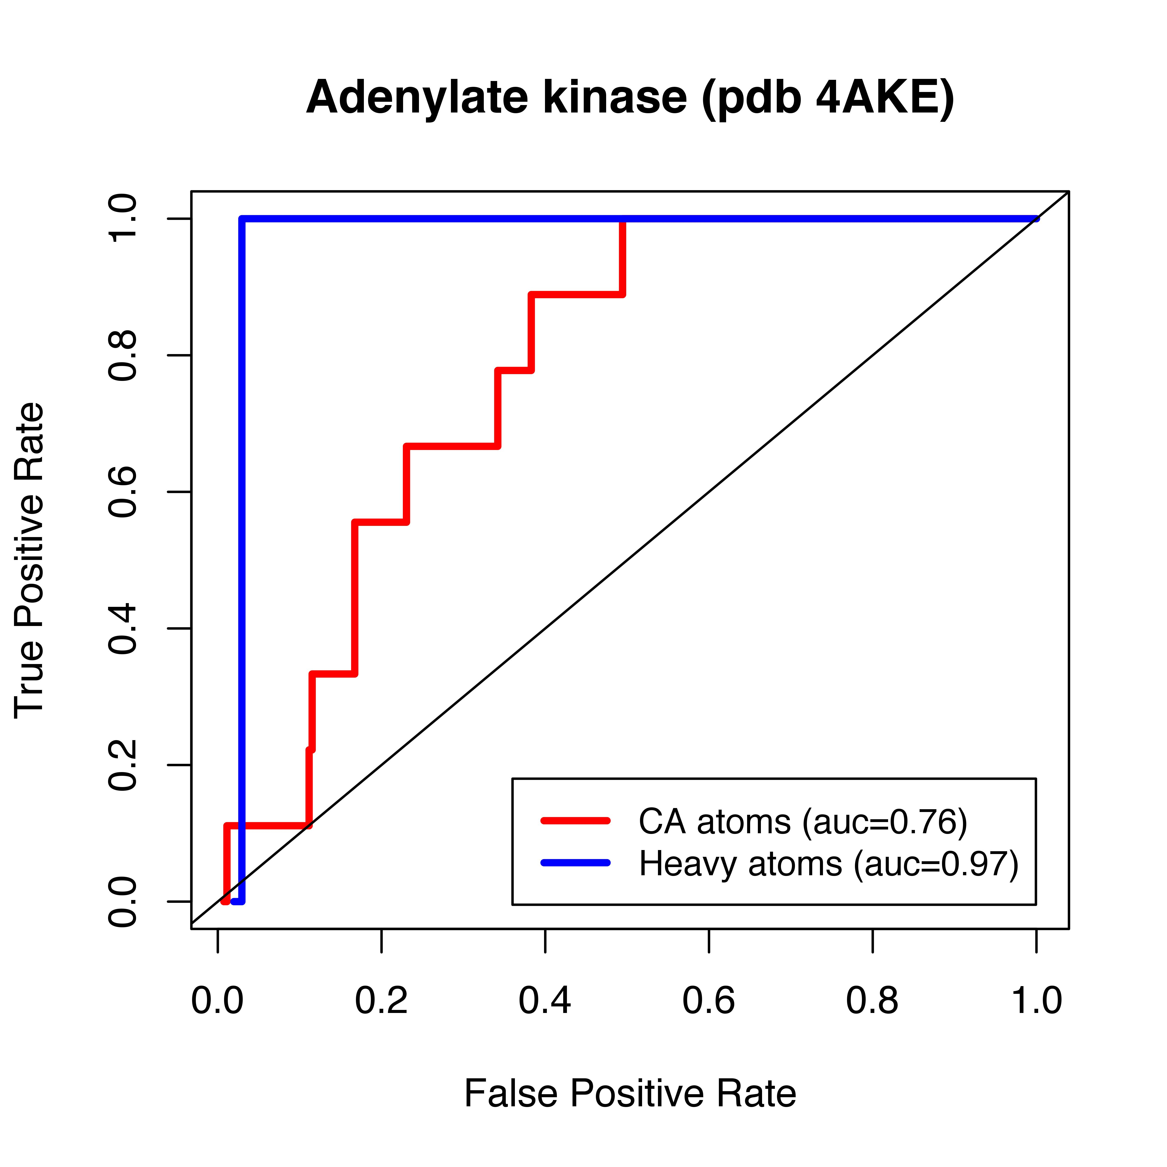
Notes:
Decompose into 2 results --- 1) Another model = heavy atoms 2) Paramaterization from docking.
Intro summary slide

Slide 22
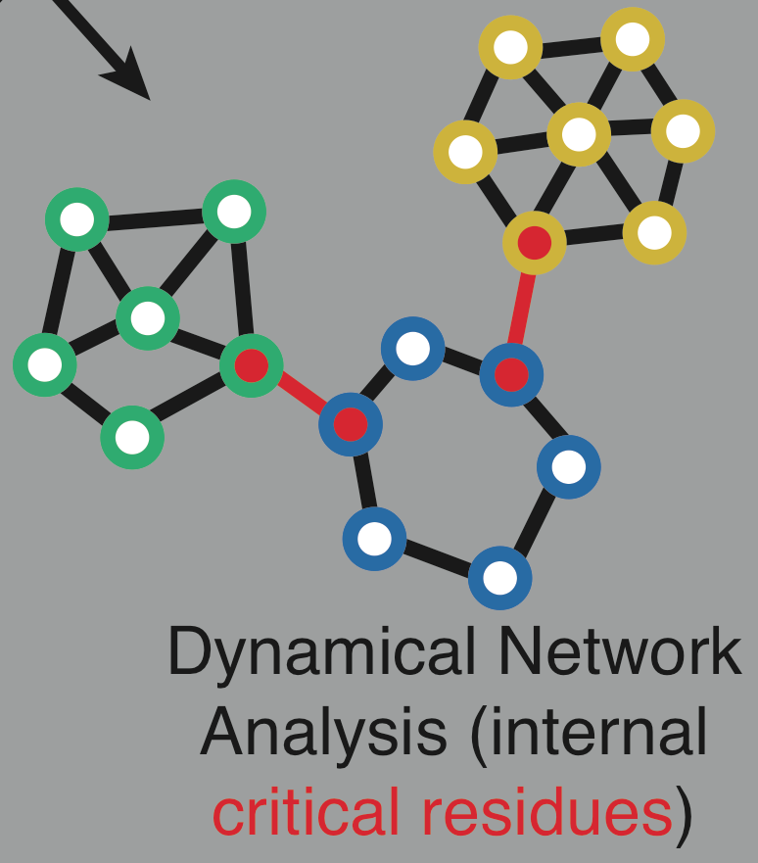
Identification of Allosteric Hotspots: Networks

Slide 23
Major focus in literature on protein dynamics has shifted to allostery over the last ~3 years
2 Complementary Approaches for Predicting and Identifying Allosteric Residues
  Binding Leverage to Binding Site Residues (use binding leverage)
  Internal Residues essential for intra-protein communication (use network decomposition)
Mitternacht S, et al. PLoS Comp Biol (2011)
Girvan, and Newman, PNAS, 2002

Slide 24
Identifying Essential Allosteric Residues & Pathways of Communication
First Entails Identifying Coherent Network Communities
Manley G, Rivalta I, and Loria JP. J. Phys. Chem. B (2013)

Slide 25
2 Network Community Algorithms
Girvan–Newman: Optimizes modularity when edges are successively removed from the network, with edges being removed in decreasing order of edge betweenness.
Advantages: Intuitive, simple, well-established & widely used
Infomap: A random walker explores the network graph, and the group of nodes through which the information flows very efficiently constitutes a module. Links between these defined modules capture busy avenues of communication (ie, high-betweenness edges between communities).
Advantages: Intrinsically interesting, consistently performed better in a battery of benchmark tests*, and anecdotally better than other methods
Rosvall M, PNAS 2008
* Lancichinetti A et al. Phys Rev. E. 2009

Slide 26
Given a Network Partition, How do we Define “Critical Residues”?

Slide 27
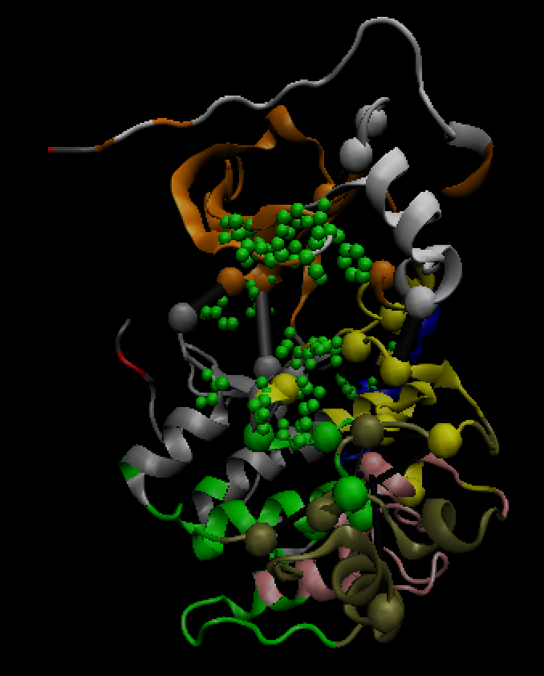
1J3H (G-Newman)
Num Communities: 10
Modularity: 0.66

Slide 28
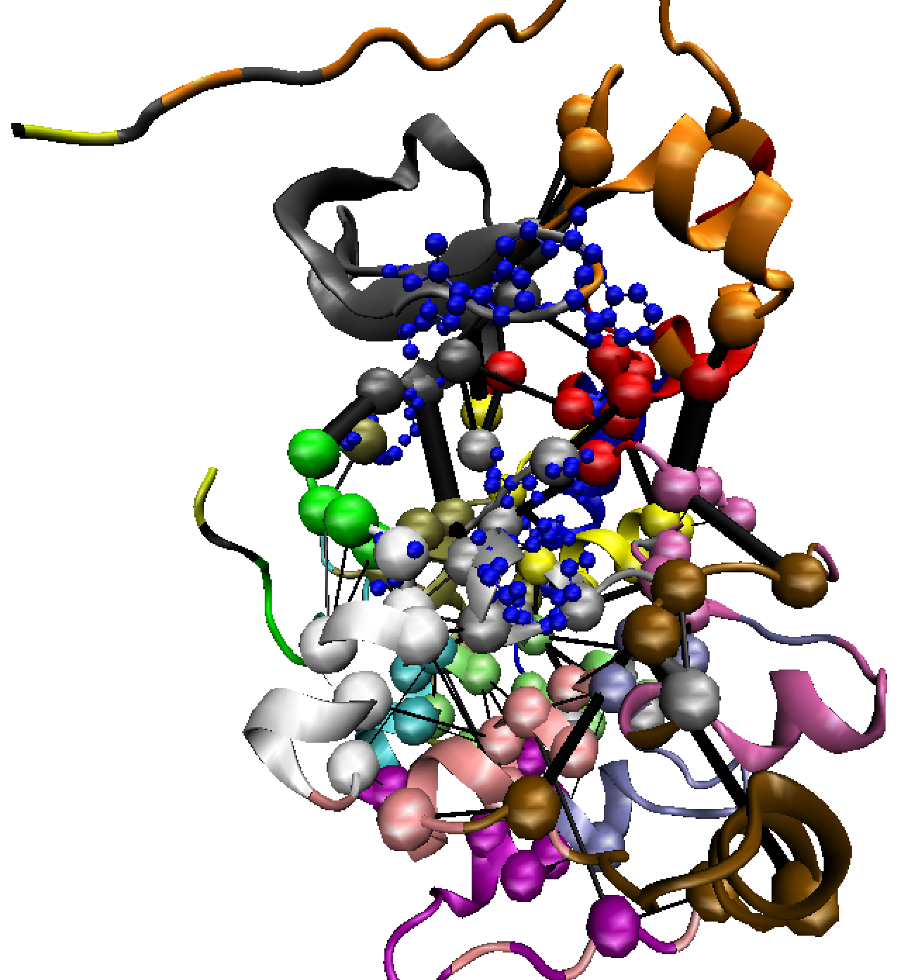
1J3H (infomap)
Modularity: 0.64
Num Communities: 18

Slide 29
1J3H (cAMP-dependent protein kinase) - num nodes: 329
 | GN | Infomap
Tot Num Communities | 10 | 18
Modularity | 0.66 | 0.64
Num Critical Residues | 27 | 73
% of GN critical residues which match those in Infomap:
[GN critical] ∧ [INFOMAP critical] / [GN critical] = 8/27 = 0.29 (expected val = 0.22)
GN:
Num critical nodes that match known binding site residues: 3
% critical nodes that match known binding site residues: 11
Rosvall:
Num critical nodes that match known binding site residues: 3
% critical nodes that match known binding site residues: 4
[GN critical] ∧ [INFOMAP critical]:
Num concordant residues that match known binding sites residues: 1
% = 1/8: 12.5

Slide 30
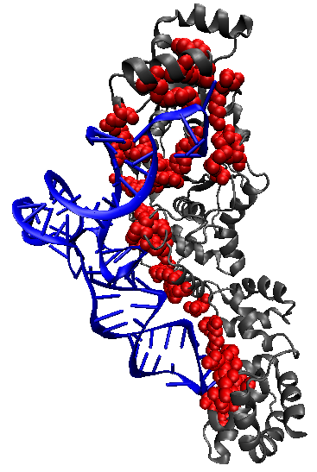
1N78: Define known critical residues as those which are within 3.0 A of the nucleic acid

Slide 31
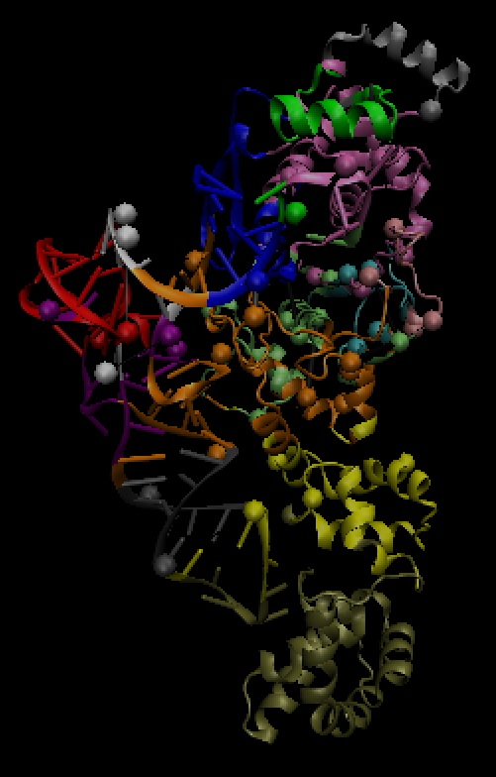
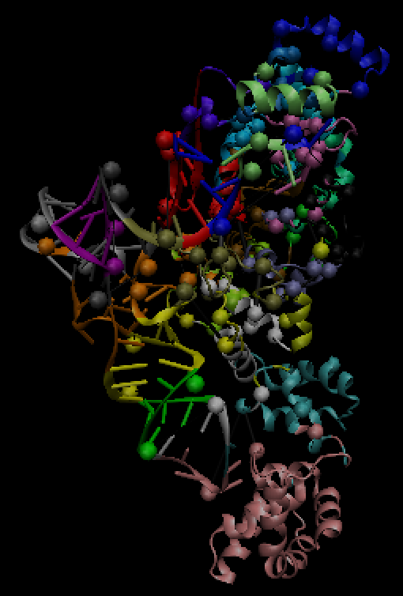
GN
Infomap

Slide 32
1N78 (tRNA synthetase) - num nodes: 542
 | GN | Infomap
Tot Num Communities | 14 | 25
Modularity | 0.71 | 0.68
Num Critical Residues | 47 | 109
% of GN critical residues which match those in Infomap:
[GN critical] ∧ [INFOMAP critical] / [GN critical] = 13/47 = 0.28 (expected val = 0.20)
GN:
Num critical residues matching known binding site residues: 4
Rosvall:
Num critical residues matching known binding site residues: 10
[GN critical] ∧ [INFOMAP critical]:
Num concordant residues that match known binding residues: 1 (exp = 13*[22/542] = 0.53)
Fraction of known binding site residues hit by critical residues:
GN: 4/43 = 9.3% (exp = 47/542 = 8.67%)
Infomap: 10/43 = 23.3% (exp = 109/542 = 20.1%)
Concordant: 1/43 = 2.3% (exp = 2.4%)

Slide 33
Degree of Concordance Between Community Detection Methods: GN vs. Infomap
Protein (PDB, # residues) | Community Detection Method: GN | InfoMap
 | Modularity | # Comm. | # Critical Residues | % of GN critical residues which match those in Infomap (expected)
tRNA synthetase (1N78, 542) | 0.71 | 0.68 | 14 | 25 | 47 | 109 | 0.28 (0.20)
Adenylate kinase (4AKE, 428) | 0.73 | 0.70 | 11 | 20 | 39 | 82 | 0.90 (0.19)
Arginine Kinase (3JU5, 728) | 0.72 | 0.69 | 12 | 28 | 41 | 142 | 0.22 (0.19)
Tyrosine Phosphatase (2HNP, 278) | 0.59 | 0.59 | 7 | 15 | 27 | 70 | 0.26 (0.25)
Phosphoribosyltransferase (1XTT, 846) | 0.72 | 0.68 | 9 | 32 | 36 | 174 | 0.22 (0.21)
cAMP-dep. PK (1J3H, 332) | 0.66 | 0.64 | 11 | 19 | 36 | 78 | 0.33 (0.23)
Anthranilate synthase (1I7Q, 1418) | 0.75 | 0.69 | 12 | 46 | 51 | 288 | 0.31 (0.20)
Malic enzyme (1EFK, 2212) | 0.81 | 0.72 | 17 | 70 | 74 | 425 | 0.18 (0.19)
Threonine synthase (1E5X, 884) | 0.73 | 0.69 | 13 | 36 | 43 | 192 | 0.28 (0.22)
G-6-P Deaminase (1CD5, 1596) | 0.79 | 0.72 | 18 | 54 | 58 | 266 | 0.16 (0.17)
Phosphofructokinase (3PFK, 1276) | 0.76 | 0.68 | 10 | 51 | 45 | 307 | 0.24 (0.24)
Tryptophan synthase (1BKS, 1294) | 0.77 | 0.69 | 10 | 46 | 41 | 284 | 0.24 (0.22)
Means | 0.73 | 0.68 | 12.0 | 36.8 | 44.8 | 201.4 | 0.3

Slide 34
Binding Site Identification: GN vs. Infomap
Protein (PDB, # residues) | Community Detection Method: GN | InfoMap
 | Modularity | # Comm. | # Critical Residues | % Binding Sites Captured (expected)
tRNA synthetase (1N78, 542) | 0.71 | 0.68 | 14 | 25 | 47 | 109 | 9.3* (8.7) | 23.3 (20.1)
Adenylate kinase (4AKE, 428) | 0.73 | 0.70 | 11 | 20 | 39 | 82 | 100 (99) | 100 (100)
Arginine Kinase (3JU5, 728) | 0.72 | 0.69 | 12 | 28 | 41 | 142 | 75 (41) | 100 (86)
Tyrosine Phosphatase (2HNP, 278) | 0.59 | 0.59 | 7 | 15 | 27 | 70 | 100 (43) | 100 (78)
Phosphoribosyltransferase (1XTT, 846) | 0.72 | 0.68 | 9 | 32 | 36 | 174 | 50 (36) | 100 (90)
cAMP-dep. PK (1J3H, 332) | 0.66 | 0.64 | 11 | 19 | 36 | 78 | 50 (54) | 50 (70)
Anthranilate synthase (1I7Q, 1418) | 0.75 | 0.69 | 12 | 46 | 51 | 288 | 25 (23) | 50 (76)
Malic enzyme (1EFK, 2212) | 0.81 | 0.72 | 17 | 70 | 74 | 425 | 25 (43) | 100 (96)
Threonine synthase (1E5X, 884) | 0.73 | 0.69 | 13 | 36 | 43 | 192 | 50 (31) | 75 (69)
G-6-P Deaminase (1CD5, 1596) | 0.79 | 0.72 | 18 | 54 | 58 | 266 | 8.3 (29) | 100 (76)
Phosphofructokinase (3PFK, 1276) | 0.76 | 0.68 | 10 | 51 | 45 | 307 | 37.5 (29) | 87.5 (92)
Tryptophan synthase (1BKS, 1294) | 0.77 | 0.69 | 10 | 46 | 41 | 284 | -
Means | 0.73 | 0.68 | 12.0 | 36.8 | 44.8 | 201.4 | 48.2 (39.7) | 80.5 (77.6)
* used only residues for 1N78

Slide 38
Conservation of Critical Residues: GN vs. Infomap
Protein (PDB, # residues) | Community Detection Method: GN | InfoMap
 | # Communities | # Critical Residues | Conservation of CR (p-val)
tRNA synthetase (1N78, 542) | 14 | 25 | 47 | 109 | -0.57 (2.0e-05) | -0.47 (1.3e-09)
Adenylate kinase (4AKE, 428) | 11 | 20 | 39 | 82 | -0.70 (3.2e-10) | -0.43 (8.9e-08)
Arginine Kinase (3JU5, 728) | 12 | 28 | 41 | 142 | -0.21 (9.0e-02) | -0.28 (4.4e-06)
Tyrosine Phosphatase (2HNP, 278) | 7 | 15 | 27 | 70 | -0.49 (4.2e-03) | -0.60 (3.1e-09)
Phosphoribosyltransferase (1XTT, 846) | 9 | 32 | 36 | 174 | -0.54 (2.1e-07) | -0.43 (5.9e-16)
cAMP-dep. PK (1J3H, 332) | 11 | 19 | 36 | 78 | -0.63 (5.1e-07) | -0.43 (4.0e-06)
Anthranilate synthase (1I7Q, 1418) | 12 | 46 | 51 | 288 | -0.44 (4.8e-07) | -0.45 (2.2e-16)
Malic enzyme (1EFK, 2212) | 17 | 70 | 74 | 425 | 0.22 (8.5e-01) | -0.19 (5.6e-06)
Threonine synthase (1E5X, 884) | 13 | 36 | 43 | 192 | -0.53 (8.5e-07) | -0.32 (2.5e-08)
G-6-P Deaminase (1CD5, 1596) | 18 | 54 | 58 | 266 | -0.36 (4.1e-04) | -0.08 (6.0e-02)
Phosphofructokinase (3PFK, 1276) | 10 | 51 | 45 | 307 | -0.43 (1.7e-06) | -0.16 (4.2e-04)
Tryptophan synthase (1BKS, 1294) | 10 | 46 | 41 | 284 | -0.48 (3.0e-09) | -0.40 (2.0e-15)
Means | 12.0 | 36.8 | 44.8 | 201.4

Slide 39
Concluding Remarks
The PDB increasingly provides raw data on proteins that occupy alternative energetic wells, and may thus be used to probe allostery
The gap statistic may be used to confidently identify the likely number of these wells when applied to multiple structure alignments
We describe a framework to leverage this approach across the entire PDB
In addition to alternative solved conformations, an approach in which heavy atoms are used with ANMs may be used to more confidently identify known ligand binding sites than an approach in which only alpha carbons are employed

Slide 40
Concluding Remarks
Infomap produces > 2x the number produced by GN (too many critical residues produced in Infomap)
Critical residues from GN generally do not appear as critical under Infomap
Both GN & Infomap give very similar modularity (avg: 0.73 vs 0.68)
Critical residues identified by both methods are more conserved than expected (signal somewhat stronger in GN relative to Infomap
Similar results obtainable when applied across the PDB?

Slide 41

Acknowledgments
Mark Gerstein
Anurag Sethi
Sushant Kumar
Koon-Kiu Yan
Committee Members
Gary Brudvig
Pat Loria
Gerstein Lab

Slide 42
Supplementary Slides

Slide 43


The following measure represents the sum of intra-cluster distances between points in a given cluster C_k containing n_k points:
Degree of compactness for a given cluster:
Difference between compactness in network partition relative to randomized partition:
Evaluation for optimal K
Tibshirani R. et al. Journal of the Royal Statistical Society: Series B (2001)

Slide 44
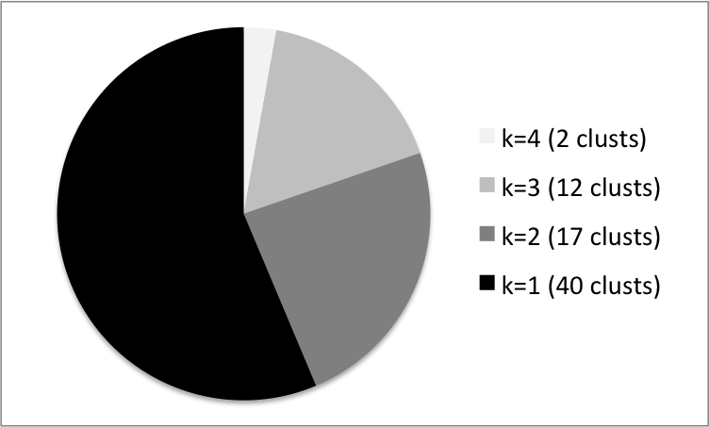
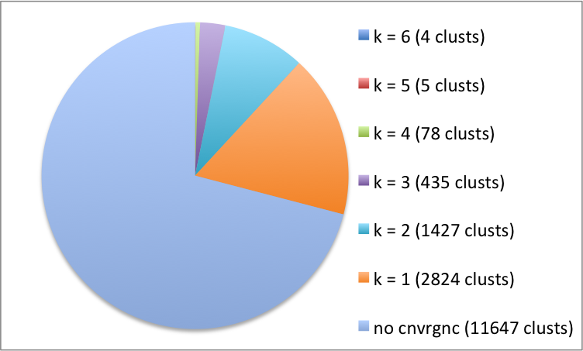
Results for Annotated Allosteric Database
ASD
56%
58%
* Note: For 66 of the proteins, the number of clusters was too small to run k means

Slide 45
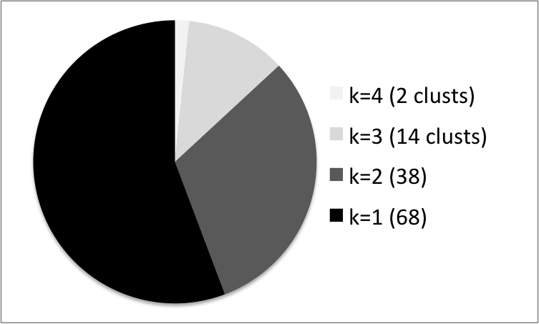
Results for Annotated Allosteric Database
58%
* Note: For 66 of the proteins, the number of clusters was too small to run k means

Slide 46
Add Criterion:
> includes at least two cases for ligand status [“Yes” and “No”]
56%
* Note: For 50 of the proteins, the number of clusters was too small to run k means
Notes:
Look @ k=1 prots. Do same alg, but w/whole prots, not just domains
See k>1 (@ domain or prot level)
Run on whole protein level.

Slide 47
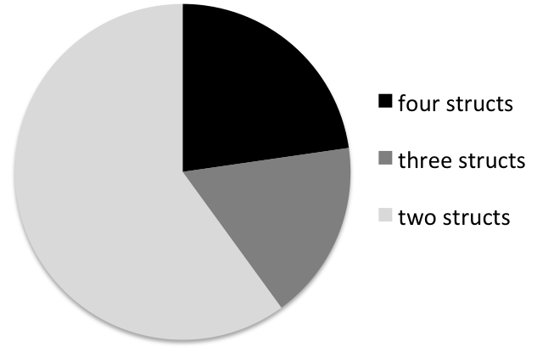

Slide 48
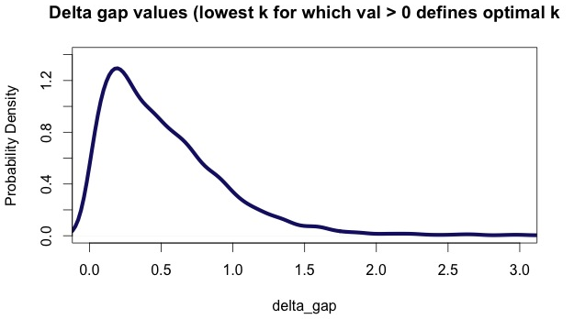

Slide 49
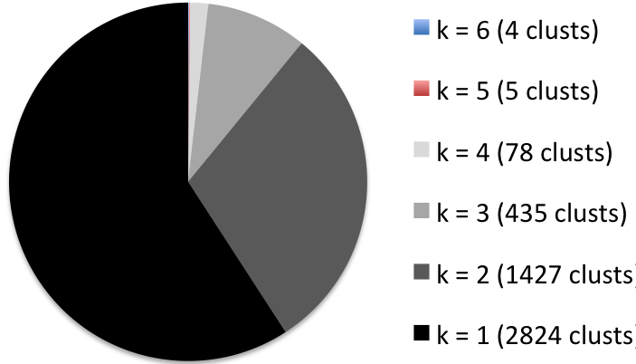
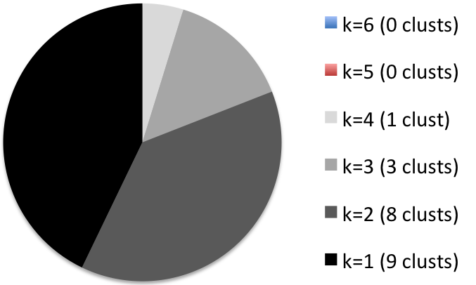
Distrib (entire db)
59%
Domains mapped to allo-db pathways set (tot = 21)
43%

