Slide 1
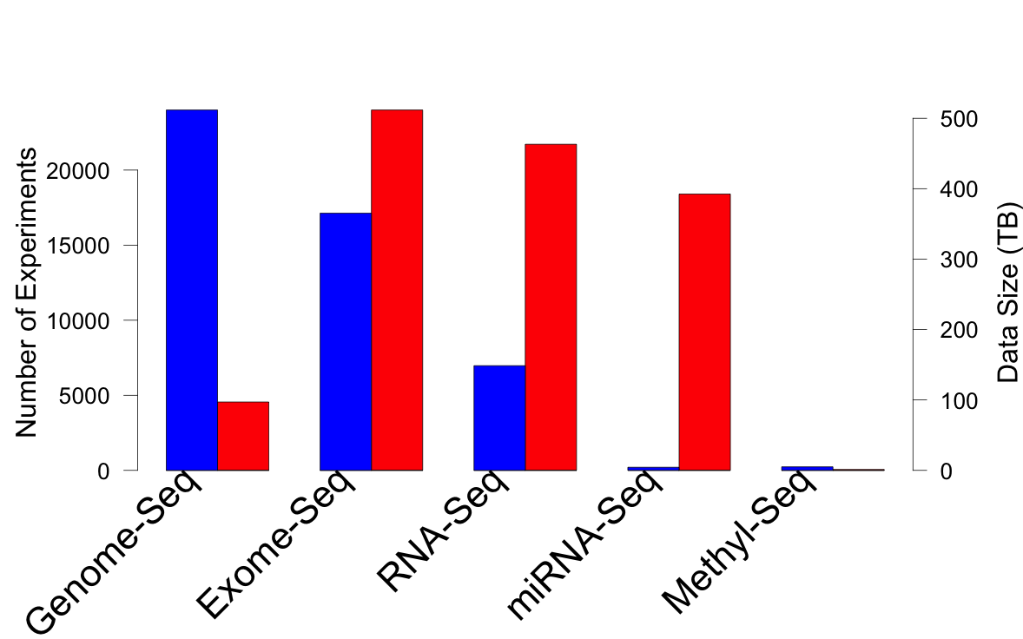
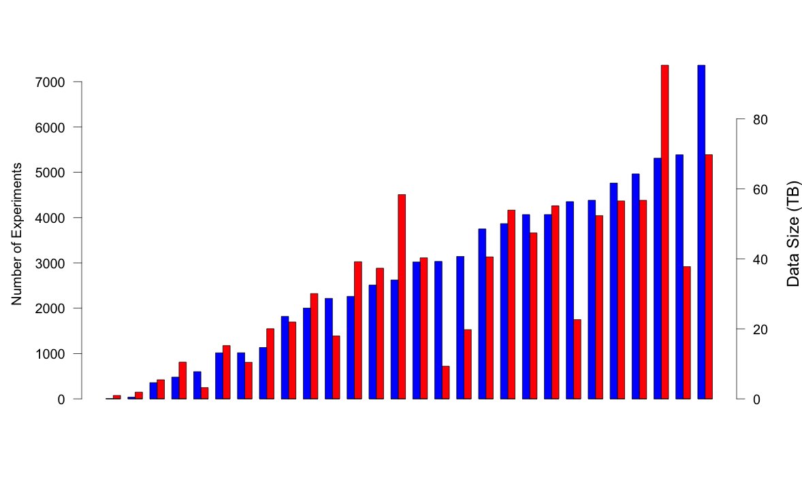
TCGA: What’s in a petabyte?
Breast Cancer
>30 TCGA Cancer Types
>73K Experiments
>11K Patients
https://cghub.ucsc.edu/

