Slide 1
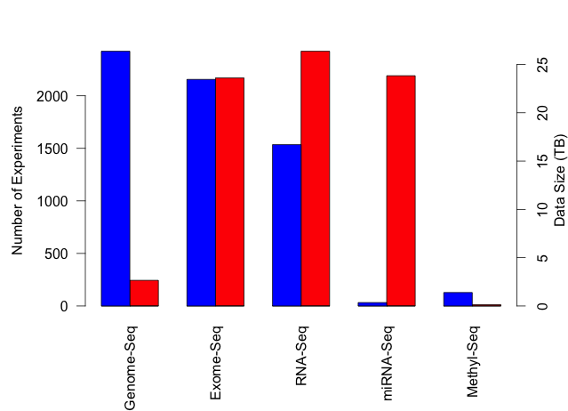
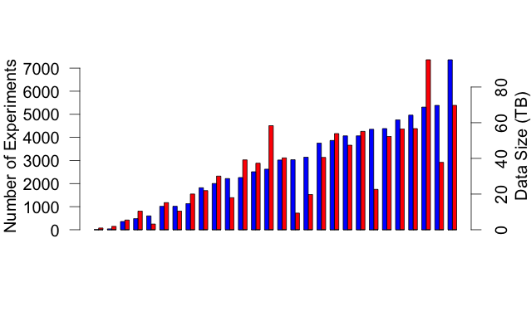
TCGA: What’s in a petabyte?
>73,000 Expt
34 Cancer Types
11,315 Patients
Breast Cancer Experiment Types
Experiments
Data Size (TB)
Breast Cancer
TCGA Cancer Types
CONTROLS
MESOTHELIOMA
ADENOID
ESOPHAGEAL
B-CELL
SARCOMA
PANCREAS
CERVIX
RECTUM
BLADDER
LEUKEMIA
BRAIN
GLIOMA
PROSTATE
UTERINE
MELANOMA
KIDNEY CHR
KIDNEY PAP
STOMACH
THYROID
LUNG
SQUAMOUS
LUNG ADENO
LIVER
HEAD AND NECK
KIDNEY CC
COLON
BREAST
GLIOBLASTOMA
OVARY
https://cghub.ucsc.edu/summary_stats.html
Notes:
----- Meeting Notes (9/23/14 17:02) -----
Make labels diagonal and bigger. Remove top panel. Arrow from BRCA to Breast Cancer expt. types.

